Slide 1
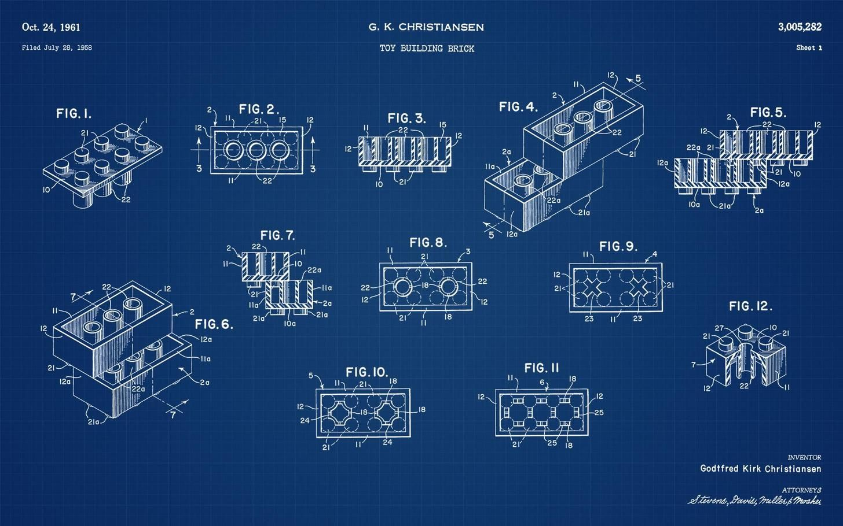
Every Theme is Awesome! Predicting the Lego Theme
Mark Kipper
Data Science Capstone Project, August 2, 2021 Cohort

Slide 2

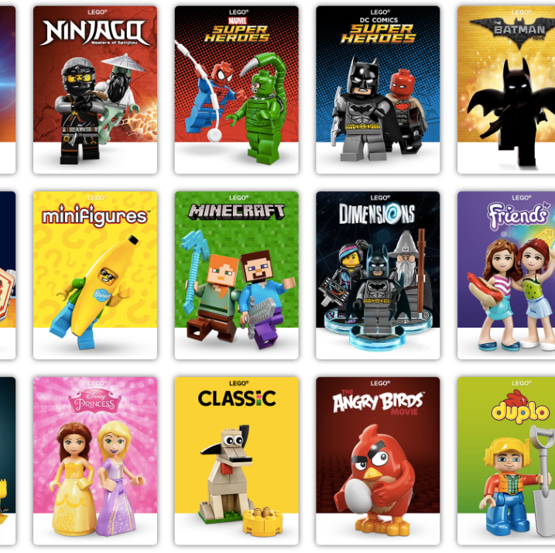
The question
Can a Lego theme be identified given other features of a Lego set like part name, part number, color id, etc.?

Slide 3
But…why?
Paired with sales data, the Lego Group can use this tool as a recommendation engine for developing and designing new sets based on more profitable, or more popular themes.
The Brickit company has a 3rd party app that scans loose Lego bricks and suggests new building ideas with the scanned bricks. Incorporating my tool can generate theme-specific building ideas spanning the history of Lego bringing new life to old bricks.

Slide 4
Data
csv files were obtained from the Rebrickable database.
themes.csv
colors.csv
parts.csv
sets.csv
inventories.csv
inventory_sets.csv
These tables were merged into 1 table that lists all sets and references a theme id.
Final shape: 919,288 rows x 17 columns

Slide 5
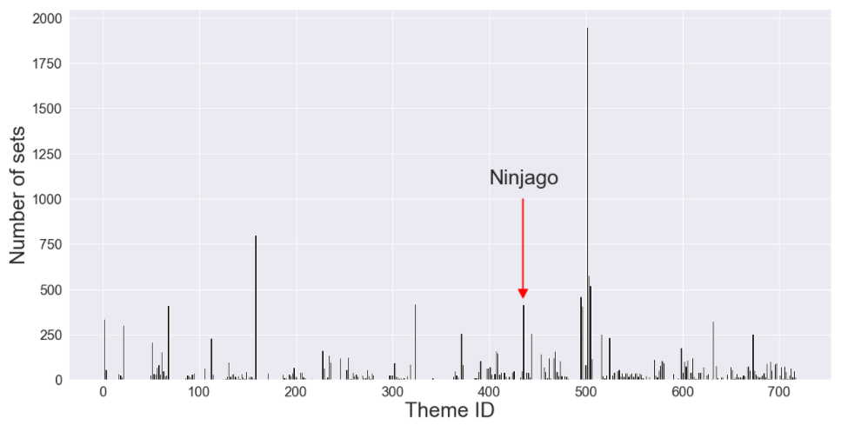
Features
I chose the Ninjago theme as the target variable for the model.
is_ninjago column compares the theme id of every row with the Ninjago theme id and records 1 for Ninjago (theme_id == 435) and 0 for non-Ninjago.
Some columns were not usable by any machine learning model due to non-numeric data.
I created new columns with the numeric length of the non-numeric data.
Ex. set_name becomes set_name_len

Slide 6
EDA
The features I used for the model are
year
num_parts
color_id
quantity
is_trans
part_num_len
color_name_len
part_name_len

Slide 7
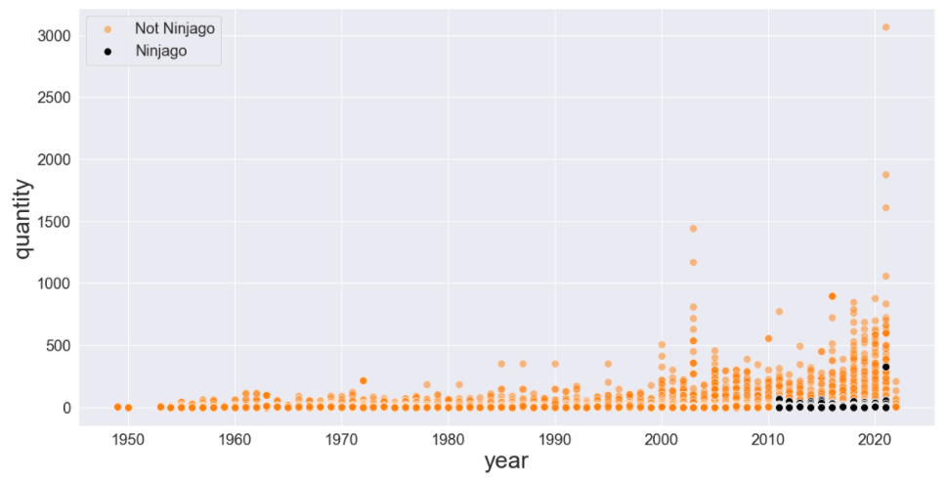
EDA
I used seaborn’s pairplot to visualize feature relationships
There are positive correlations between quantity and year

Slide 8
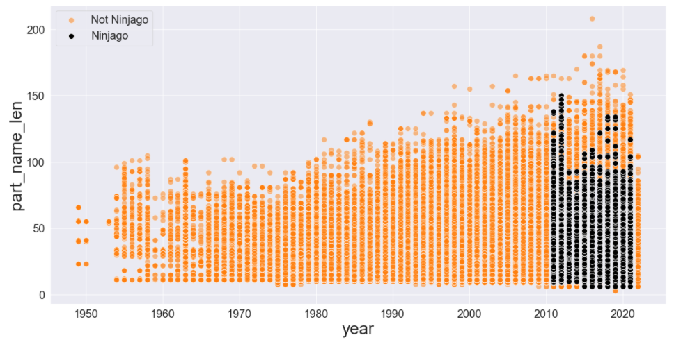
EDA
And between part_name_len and year

Slide 9
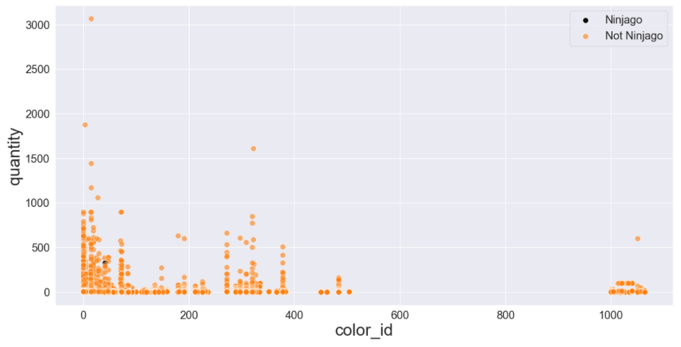
EDA
And a slightly negative correlation between quantity and color_id

Slide 10

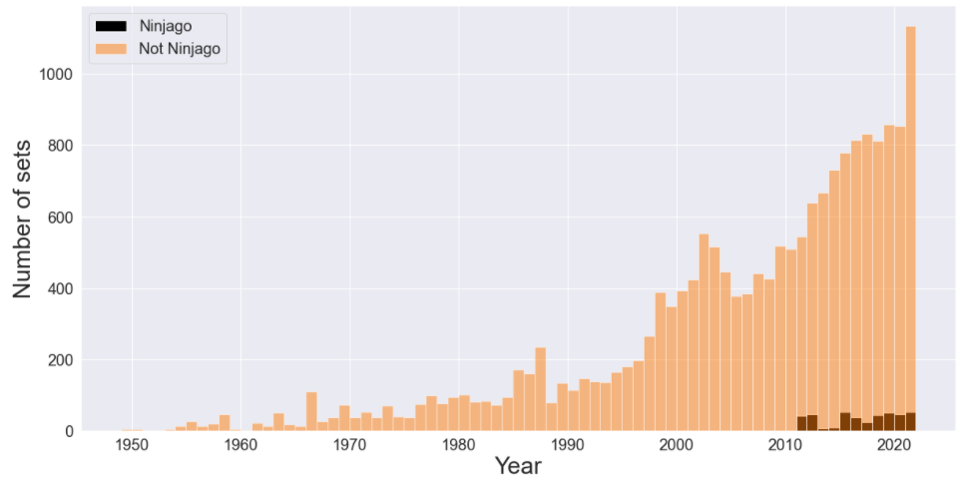
Imbalanced Data
There are over 400 themes in the Lego catalog
Ninjago as a theme debuted in 2011
Ninjago accounts for ~3% of all Lego sets produced

Slide 11
Model Selection
3 models used:
Logistic Regression
Random Forest
XG Boost
Each model run 3 times:
weight=‘balanced’
oversampling the majority class
undersampling the minority class
All models used 90% training split and 10% testing split

Slide 12
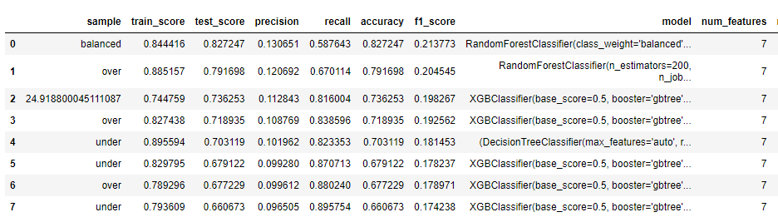
Model Comparisons

Slide 13
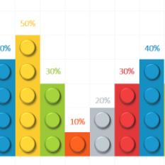
Results
Upon review of all models run on this dataset, the Random Forest model on the ‘weighted’ dataset performed the best with an accuracy of 82.7247%

Slide 14
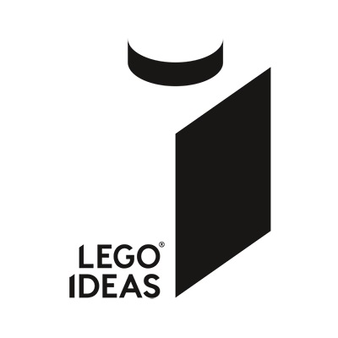
Future Work
A multiclass classifier can be trained to identify any theme, not just Ninjago
This model identifies if a single piece may belong to a certain theme but ideally the model should identify several pieces to determine what theme they may belong to
CountVectorizer could be used to record a vector of part identifiers, and then this vector would be ‘fed’ into the model to predict the theme.

