Slide 1
Grid Systems
A series of intersecting horizontal and vertical lines used to structure content.

Slide 2
Grid Systems
Originated in print, with moveable type
Post WWII, graphic designers devised a more flexible system

Slide 3
Why should you care?
Grids on the web are super helpful
We can define percentage based columns (fluid)
Helps align all of the content
Creates cohesive experience for users
Helps rearrange the screen on devices
DONT SHOW TO CAMERA; but as notes

Slide 4
How to use a grid
Define number of columns
Define max-width of screen content
Define column widths
Define left and right padding of column (gutter space)
Keep content within columns, or spread across multiple columns

Slide 5
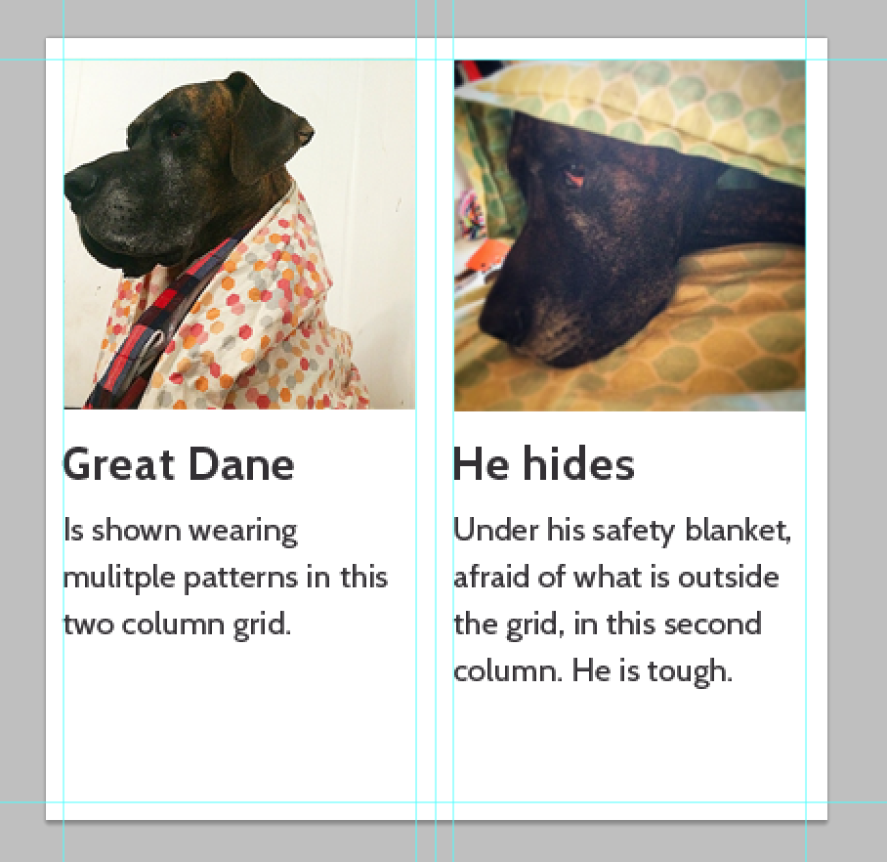
2 column grid

Slide 6
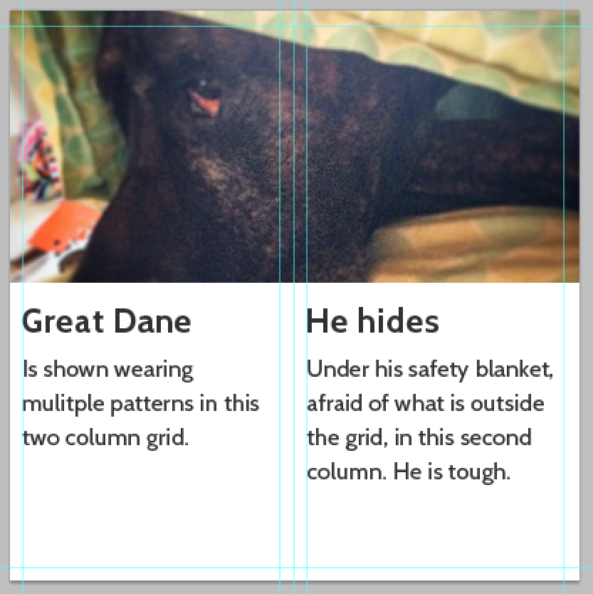
Still a 2 column grid

Slide 7
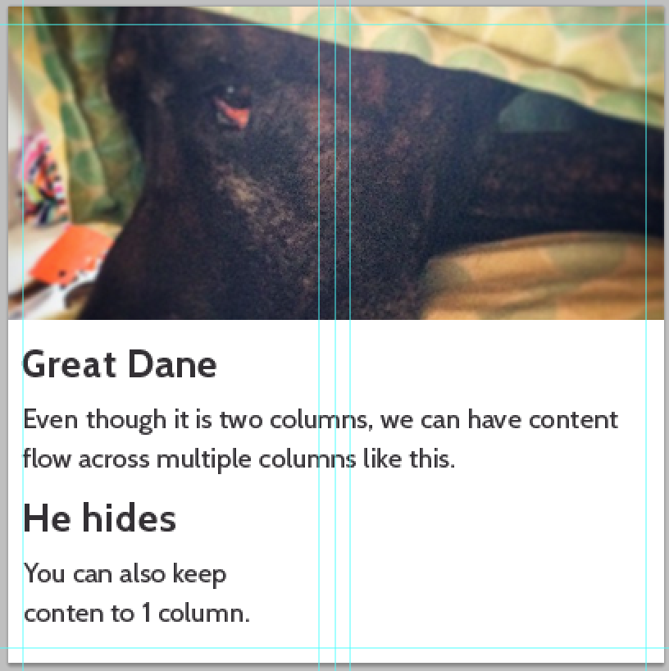
Yup, it's still 2 columns :)

Slide 8
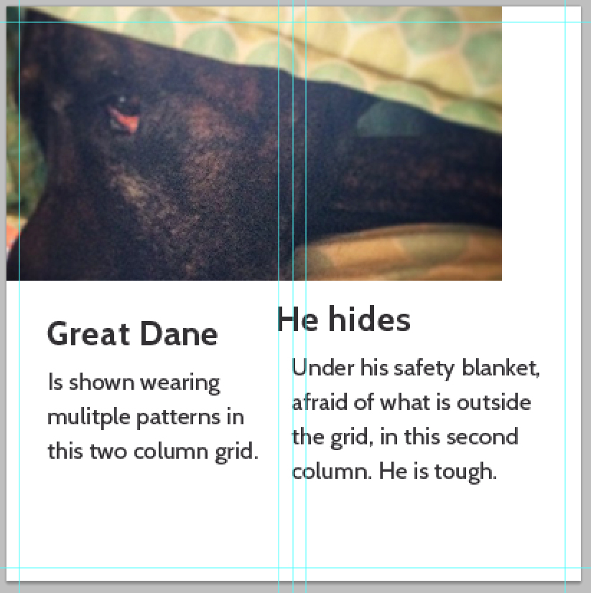
Don't do this.

Slide 9
How many columns?
As many or little as your design needs.
2-16 columns tends to be the range
3 or 12 tend to be the best numbers

Slide 10
Conclusion
Intersecting lines make up a grid
Grids are your friend!
Stay within the columns
Or span across the gutter into multiple columns

