Slide 1

Objective
Setup/Requirements
Jupyter Notebook Screenshots
Explanation of Stats
Key Insights & Conclusion
Mohammad Kamran Jilani
CS634
Fall 2024

Slide 2
FINAL project – Objective
Analyze data using 3 algorithm
Analyzed Heart Failure Clinical records using Random Forrest, Naive Bayes, GRU models for heart deaths
Data source: Heart Failure Clinical Records - UCI Machine Learning Repository

Slide 3

FINAL project – SETUP/Requirements
To run the provided program in a Jupyter notebook, you need to install the following libraries using pip. These are required to ensure all functionalities of your program work as expected:
Required Libraries:
NumPy: For numerical operations (e.g., arrays, matrices).
Pandas: For data manipulation and analysis (e.g., reading and processing the dataset).
scikit-learn: For machine learning models, cross-validation, and metrics (e.g., Random Forest, Naive Bayes, confusion matrix).
Keras: For building deep learning models (GRU, Dense, Dropout).
TensorFlow: For Keras support (Keras is part of TensorFlow).
Seaborn: For data visualization (e.g., count plot, heatmap).
Matplotlib: For plotting (e.g., visualizing the target variable and correlation matrix).
Command to run
pip install numpy pandas scikit-learn tensorflow keras seaborn matplotlib
GIT Repositor
https://github.com/mkjilani/jilani_mohammad_finaltermproj.git

Slide 4
FINAL project – SETUP/Requirements
Explanation of Key Libraries:
NumPy: Provides support for large, multi-dimensional arrays and matrices, along with a collection of mathematical functions to operate on these arrays.
Pandas: Offers data structures and operations for manipulating numerical tables and time series.
scikit-learn: A machine learning library that provides simple tools for data analysis and modeling.
TensorFlow: An open-source library for machine learning and deep learning. Keras is a high-level API in TensorFlow for building neural networks.
Seaborn: Built on top of Matplotlib, it simplifies the creation of visually appealing statistical graphics.
Matplotlib: A plotting library that helps create static, animated, and interactive visualizations in Python.

Slide 5
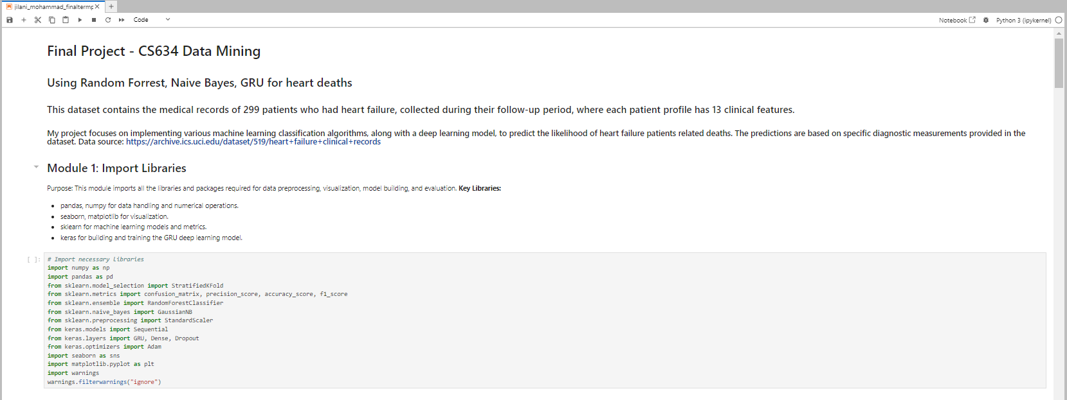
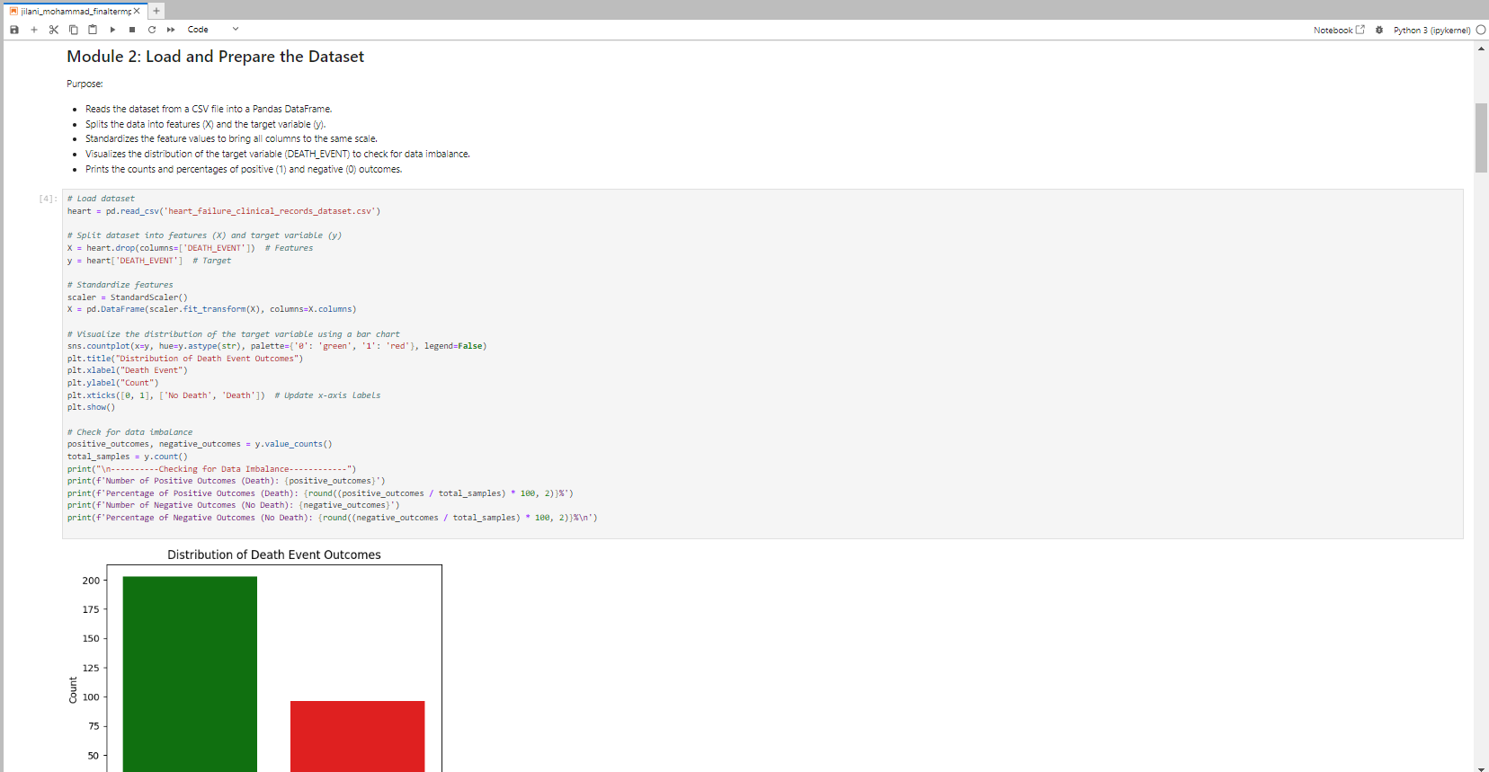
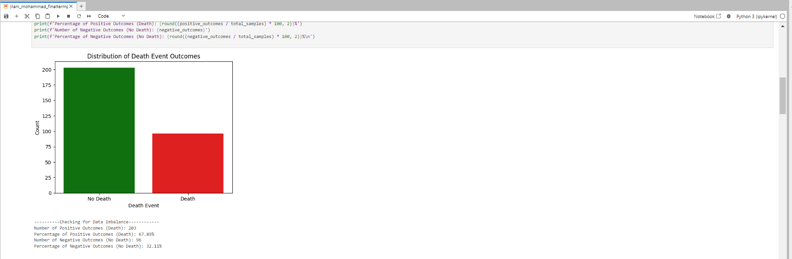
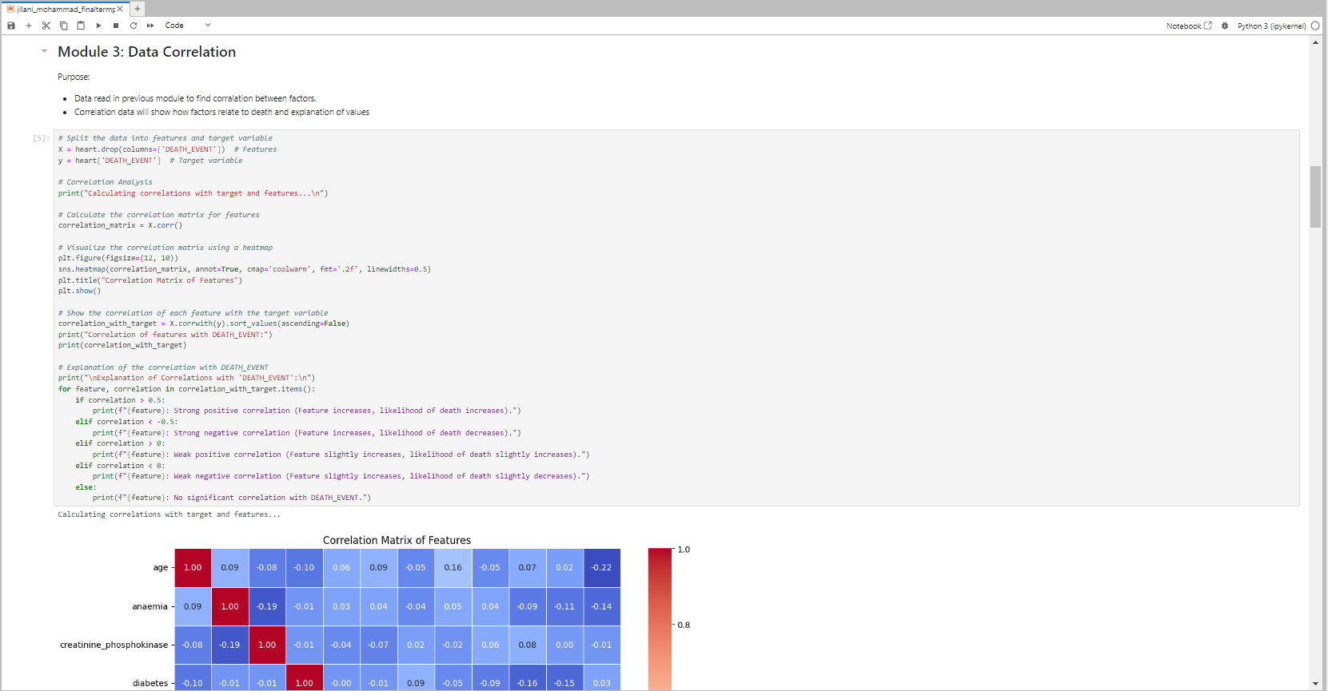
FINAL project – JUPYTER NOTEBOOK SCREENSHOTS

Slide 6
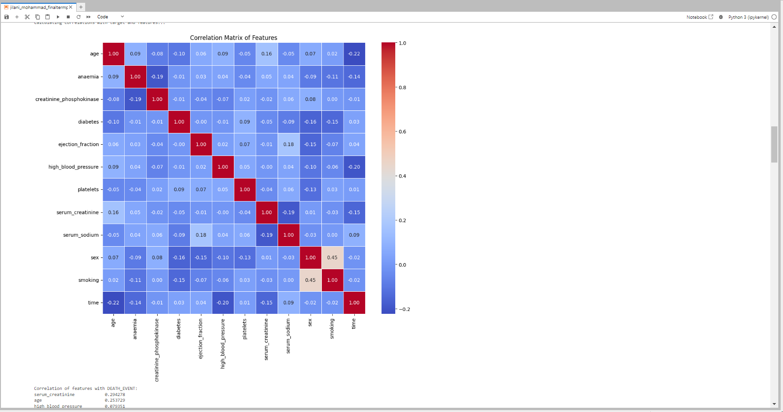
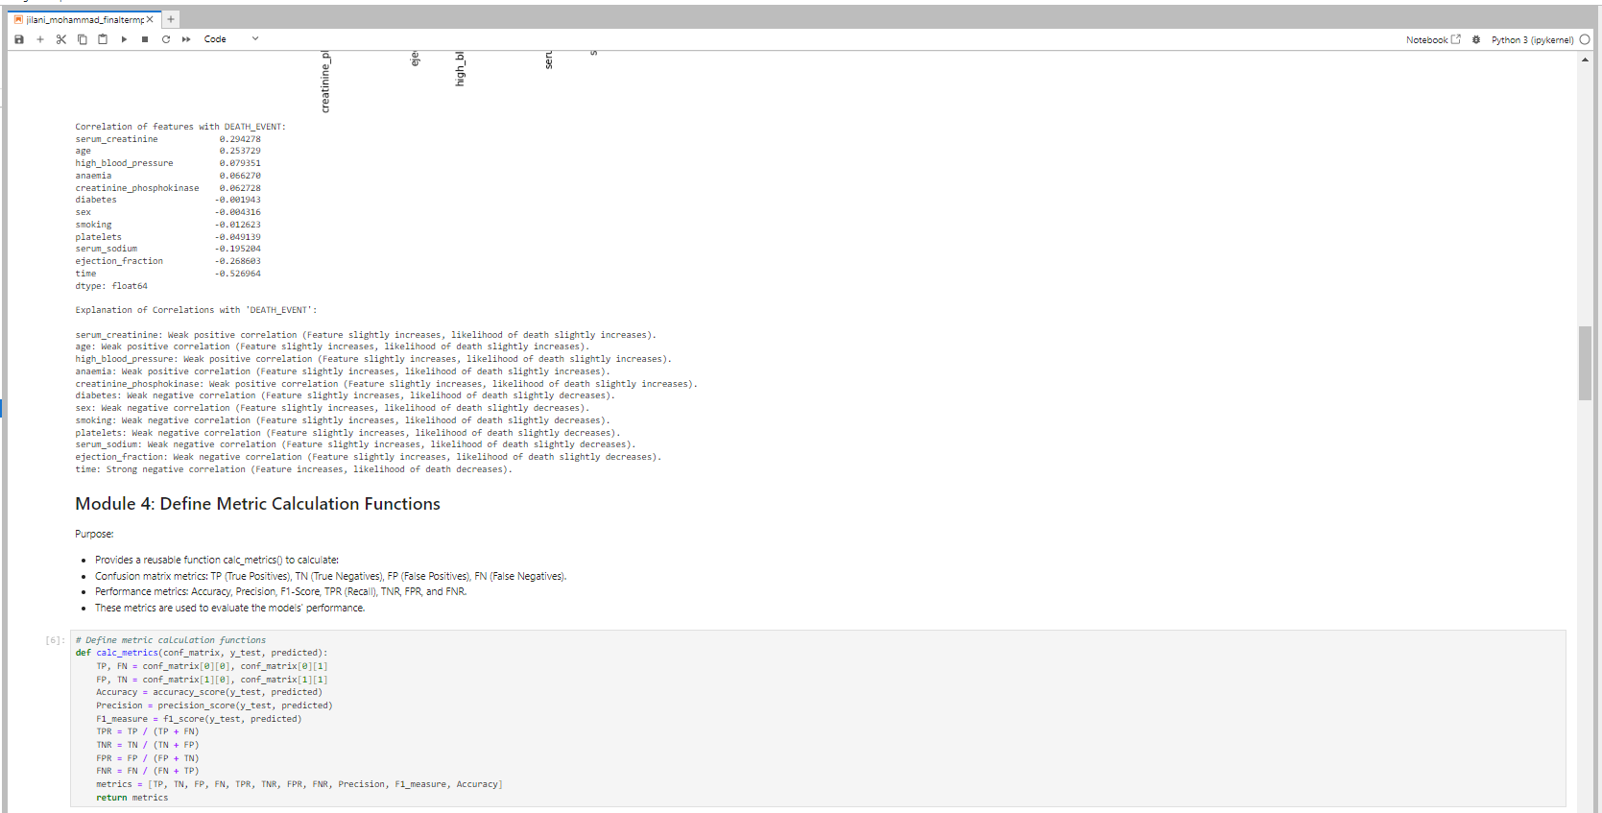
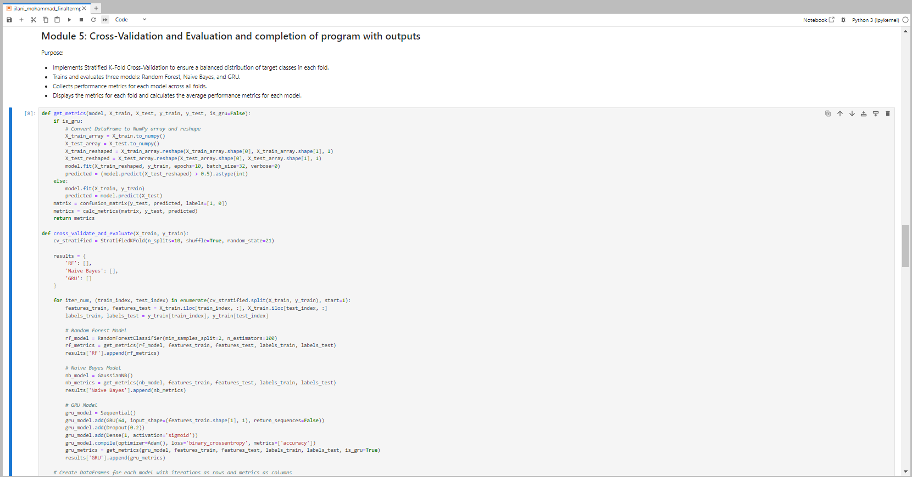
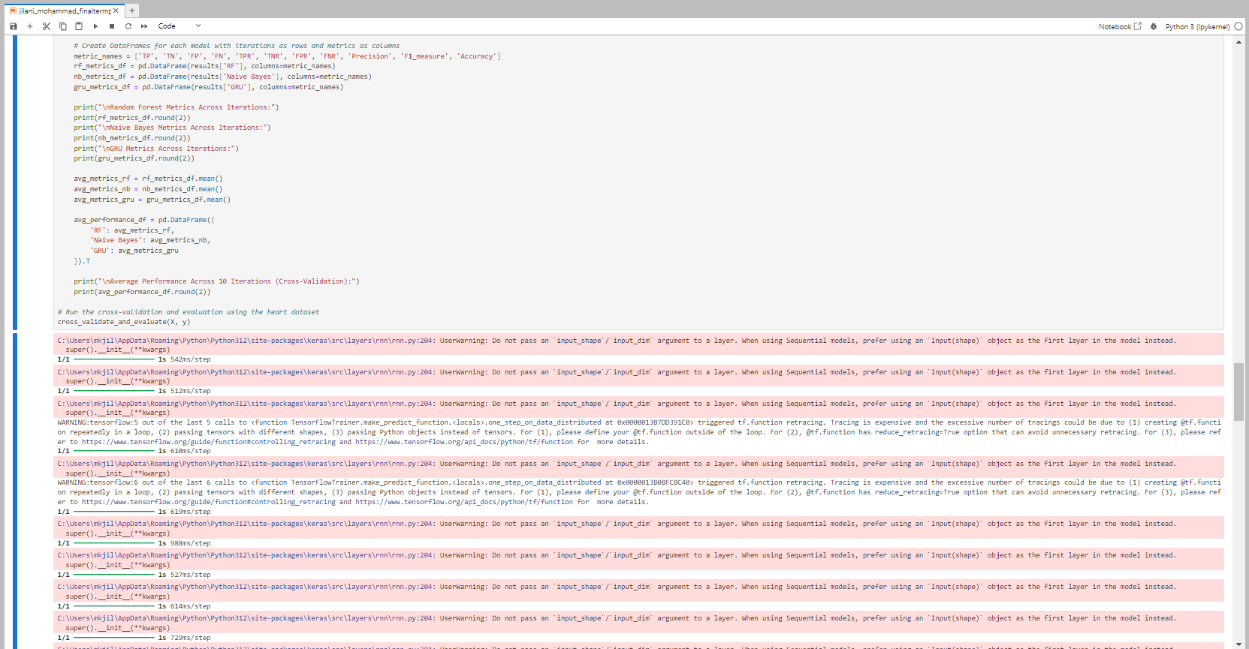

Slide 7
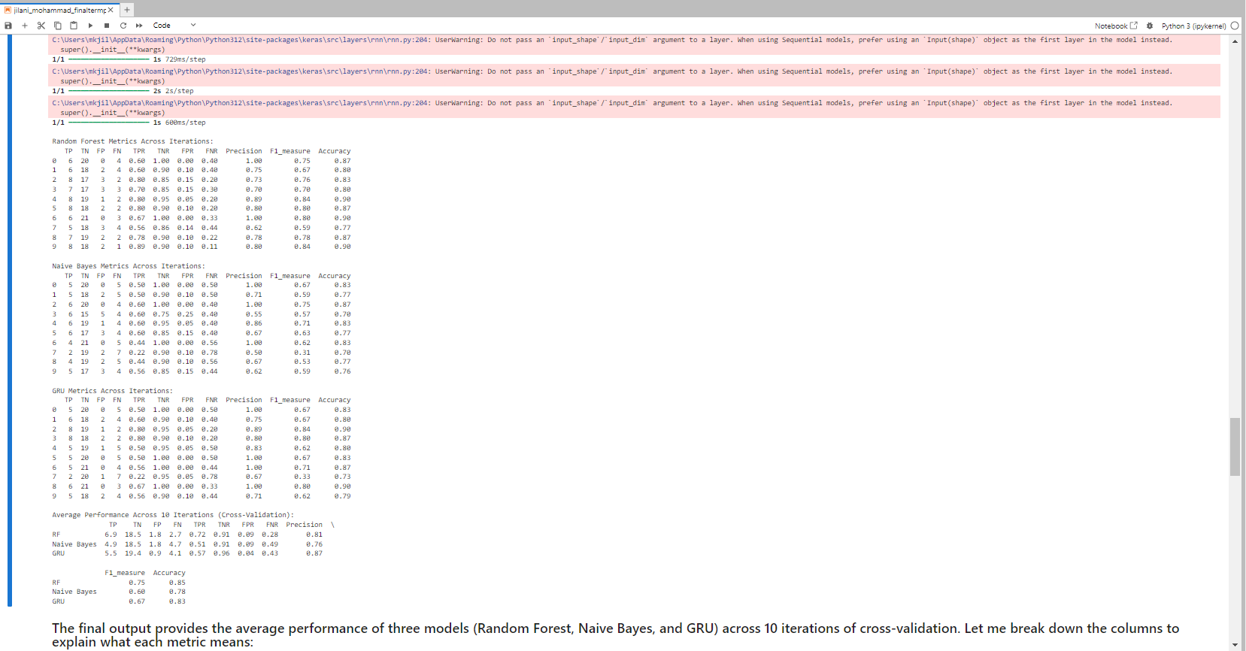
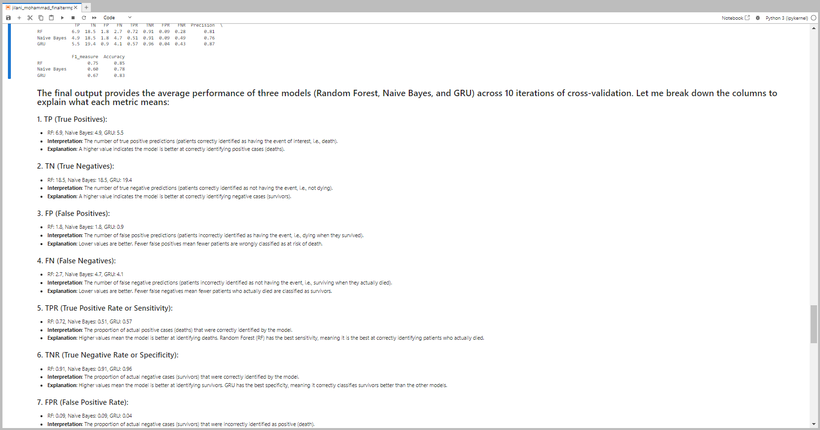
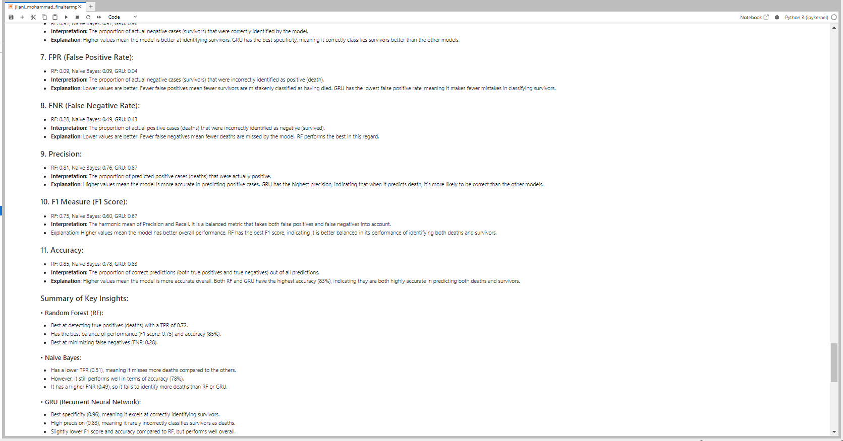
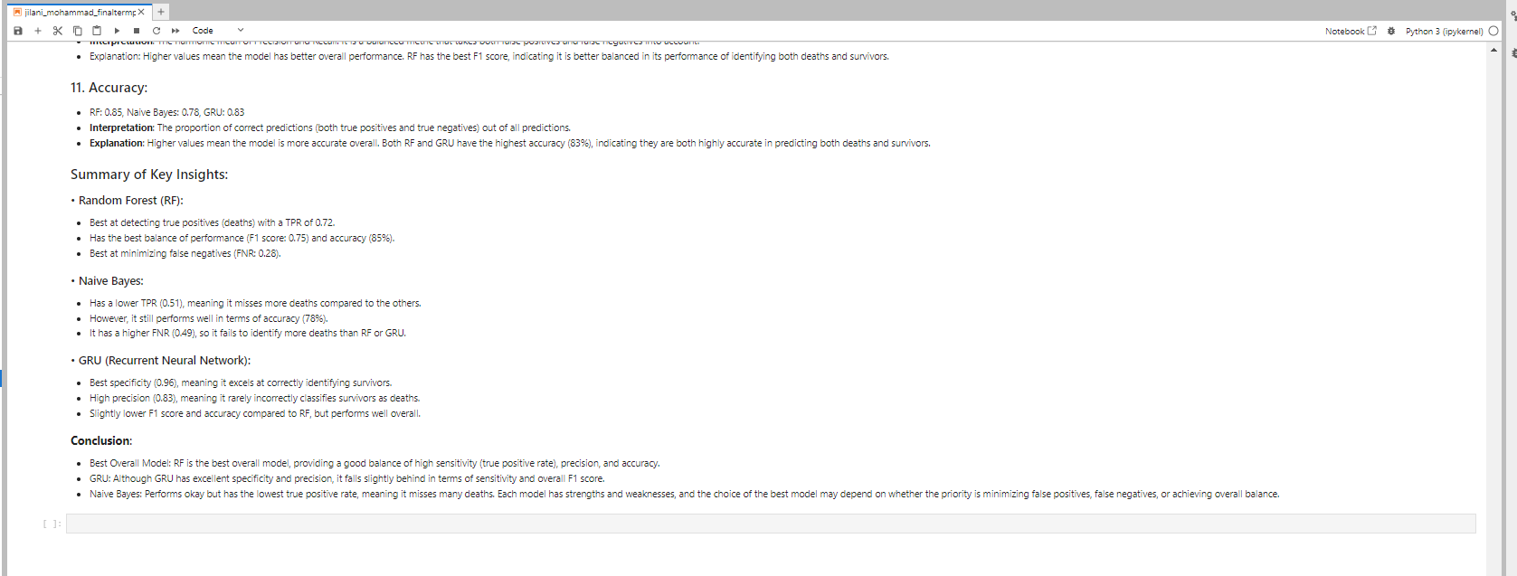

Slide 8
FINAL project – Explanation of stats
The final output provides the average performance of three models (Random Forest, Naive Bayes, and GRU) across 10 iterations of cross-validation. Let me break down the columns to explain what each metric means:
1. TP (True Positives):
RF: 6.9, Naive Bayes: 4.9, GRU: 5.5
Interpretation: The number of true positive predictions (patients correctly identified as having the event of interest, i.e., death).
Explanation: A higher value indicates the model is better at correctly identifying positive cases (deaths).
2. TN (True Negatives):
RF: 18.5, Naive Bayes: 18.5, GRU: 19.4
Interpretation: The number of true negative predictions (patients correctly identified as not having the event, i.e., not dying).
Explanation: A higher value indicates the model is better at correctly identifying negative cases (survivors).
3. FP (False Positives):
RF: 1.8, Naive Bayes: 1.8, GRU: 0.9
Interpretation: The number of false positive predictions (patients incorrectly identified as having the event, i.e., dying when they survived).
Explanation: Lower values are better. Fewer false positives mean fewer patients are wrongly classified as at risk of death.
4. FN (False Negatives):
RF: 2.7, Naive Bayes: 4.7, GRU: 4.1
Interpretation: The number of false negative predictions (patients incorrectly identified as not having the event, i.e., surviving when they actually died).
Explanation: Lower values are better. Fewer false negatives mean fewer patients who actually died are classified as survivors.
5. TPR (True Positive Rate or Sensitivity):
RF: 0.72, Naive Bayes: 0.51, GRU: 0.57
Interpretation: The proportion of actual positive cases (deaths) that were correctly identified by the model.
Explanation: Higher values mean the model is better at identifying deaths. Random Forest (RF) has the best sensitivity, meaning it is the best at correctly identifying patients who actually died.
6. TNR (True Negative Rate or Specificity):
RF: 0.91, Naive Bayes: 0.91, GRU: 0.96
Interpretation: The proportion of actual negative cases (survivors) that were correctly identified by the model.
Explanation: Higher values mean the model is better at identifying survivors. GRU has the best specificity, meaning it correctly classifies survivors better than the other models.
7. FPR (False Positive Rate):
RF: 0.09, Naive Bayes: 0.09, GRU: 0.04
Interpretation: The proportion of actual negative cases (survivors) that were incorrectly identified as positive (death).
Explanation: Lower values are better. Fewer false positives mean fewer survivors are mistakenly classified as having died. GRU has the lowest false positive rate, meaning it makes fewer mistakes in classifying survivors.
8. FNR (False Negative Rate):
RF: 0.28, Naive Bayes: 0.49, GRU: 0.43
Interpretation: The proportion of actual positive cases (deaths) that were incorrectly identified as negative (survived).
Explanation: Lower values are better. Fewer false negatives mean fewer deaths are missed by the model. RF performs the best in this regard.
9. Precision:
RF: 0.81, Naive Bayes: 0.76, GRU: 0.87
Interpretation: The proportion of predicted positive cases (deaths) that were actually positive.
Explanation: Higher values mean the model is more accurate in predicting positive cases. GRU has the highest precision, indicating that when it predicts death, it’s more likely to be correct than the other models.
10. F1 Measure (F1 Score):
RF: 0.75, Naive Bayes: 0.60, GRU: 0.67
Interpretation: The harmonic mean of Precision and Recall. It is a balanced metric that takes both false positives and false negatives into account.
Explanation: Higher values mean the model has better overall performance. RF has the best F1 score, indicating it is better balanced in its performance of identifying both deaths and survivors.
11. Accuracy:
RF: 0.85, Naive Bayes: 0.78, GRU: 0.83
Interpretation: The proportion of correct predictions (both true positives and true negatives) out of all predictions.
Explanation: Higher values mean the model is more accurate overall. Both RF and GRU have the highest accuracy (83%), indicating they are both highly accurate in predicting both deaths and survivors.

Slide 9
FINAL project – KEY INSIGHTS & CONCLUSION
Summary of Key Insights:
Random Forest (RF):
Best at detecting true positives (deaths) with a TPR of 0.72.
Has the best balance of performance (F1 score: 0.75) and accuracy (85%).
Best at minimizing false negatives (FNR: 0.28).
Naive Bayes:
Has a lower TPR (0.51), meaning it misses more deaths compared to the others.
However, it still performs well in terms of accuracy (78%).
It has a higher FNR (0.49), so it fails to identify more deaths than RF or GRU.
GRU (Recurrent Neural Network):
Best specificity (0.96), meaning it excels at correctly identifying survivors.
High precision (0.83), meaning it rarely incorrectly classifies survivors as deaths.
Slightly lower F1 score and accuracy compared to RF, but performs well overall.
Conclusion:
Best Overall Model:
GRU: Although GRU has excellent specificity and precision, it falls slightly behind in terms of sensitivity and overall F1 score.
Naive Bayes: Performs okay but has the lowest true positive rate, meaning it misses many deaths.
Each model has strengths and weaknesses, and the choice of the best model may depend on whether the priority is minimizing false positives, false negatives, or achieving overall balance.
RF is the best overall model, providing a good balance of high sensitivity (true positive rate), precision, and accuracy.

