Slide 1
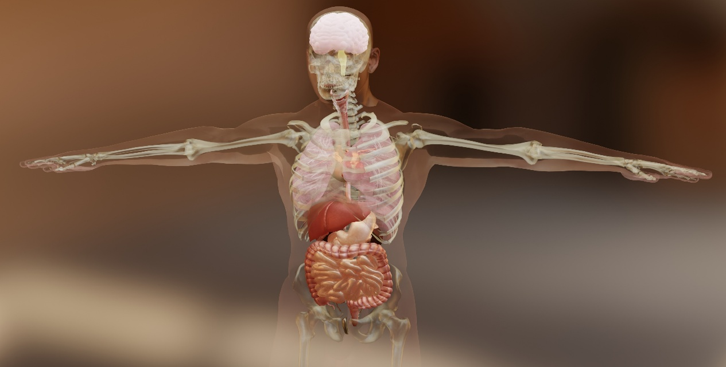
Unit 7
Anatomy and Physiology for Health and Social Care
A103000424337

Slide 2
Anatomy and Physiology for Health and Social Care
In this unit you will learn about how the human body is built up from its component parts.
You will investigate how these components work together to keep us healthy.
You will learn about what happens when some of these components stop working properly, and how to monitor people in your care to check their health on a regular basis.
A103000424337

Slide 3
Learning aims
A Know the organisation of the human body
B Understand the structure, function and interrelationship of major body systems
C Be able to carry out routine measurements and observations of body systems
D Know body system malfunctions and appropriate routine care
A103000424337

Slide 4
LEARNING AIM A
Know the organisation of the human body
A1 Organisation
A2 Structure of the main body organs
A3 Location of main body organs
A103000424337

Slide 5
LEARNING AIM B
Understand the structure, function and interrelationship of major body systems
B1 Body systems
B2 Body functions
B3 Interrelationships
A103000424337

Slide 6
LEARNING AIM C
Be able to carry out routine measurements and observations of body systems
C1 Observations of own body and/or of those of consenting peers
C2 Routine physiological measurements
C3 Health, safety and accuracy considerations
A103000424337

Slide 7
LEARNING AIM D
Know body system malfunctions and appropriate routine care
D1 Malfunctions
D2 Potential risk
D3 Routine care
A103000424337

Slide 8
Learning aims A and B
A1 Organisation
A2 Structure of the main body organs
A3 Location of main body organs
B1 Body systems
B2 Body functions
B3 Interrelationships
A103000424337

Slide 9
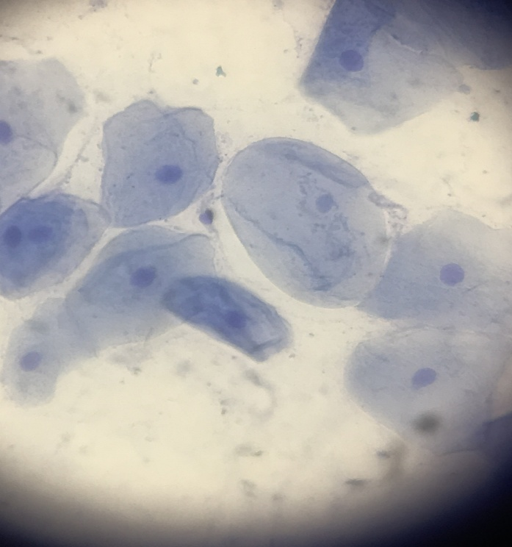
A1 Organisation
Cell membrane
Cytoplasm
Nucleus
Real human cheek cells seen under a microscope The main parts of a cell
A103000424337

Slide 10
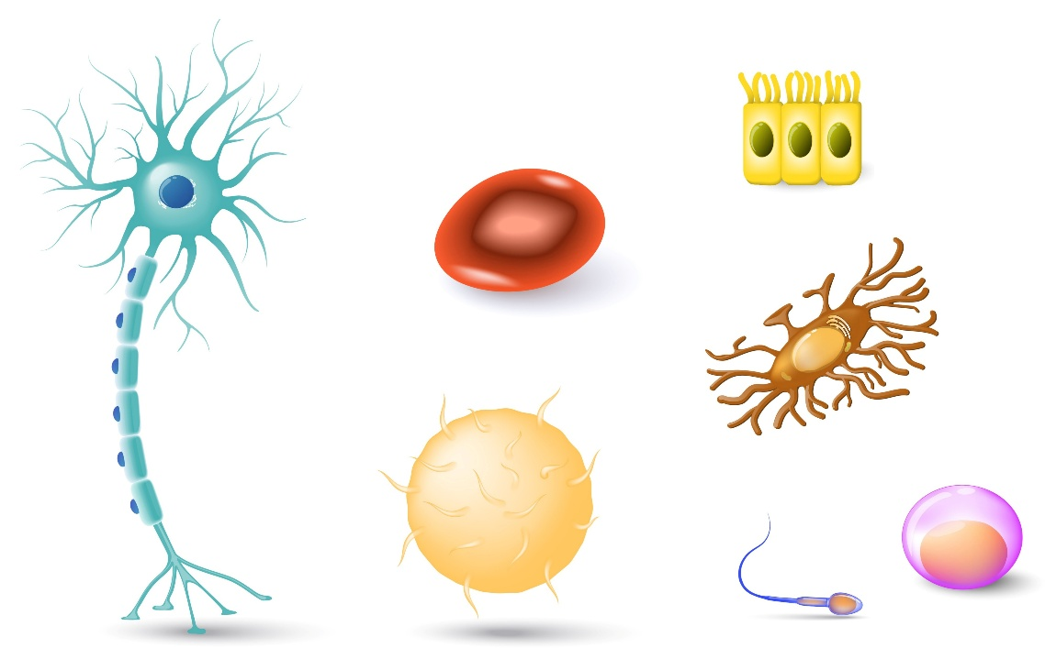
Match the cell to the description.
Nerve cell: transmits signals like a wire
Red blood cell: full of red haemoglobin
Intestinal cells: tiny projections on upper surface
Egg cell: large nucleus
Sperm cell: long tail to help it swim
White blood cell: large cell which moves and eats bacteria
Bone cell: lots of hard projections to join to other cells
A103000424337

Slide 11
Match the cell to the description.
Nerve cell: transmits signals like a wire
Red blood cell: full of red haemoglobin
Intestinal cells: tiny projections on upper surface
Egg cell: large nucleus
Sperm cell: long tail to help it swim
White blood cell: large cell which moves and eats bacteria
Bone cell: lots of hard projections to join to other cells
A103000424337

Slide 12
Cells, tissues, organs, organ systems and organisms
cells
individual building blocks
examples include muscle cells, nerve cells (neurones), connective tissue cells
tissues
a group of cells of all the same type
like a wall made of bricks
organs
made up from more than one type of tissue
like the walls, ceilings and floors making up a room in a house
organ systems
organisms
more than one organ combined
the living individual made up from all the organ systems combined
like bricks in a house wall
examples include muscle tissue, fat (adipose) tissue
examples include the heart made from muscle, connective and nervous tissues
many rooms in a house combined to make a whole floor
examples include the heart and lungs being combined to make the cardiorespiratory system
like all the floors combining to make a house
examples include humans, falcons and elephants
A103000424337

Slide 13
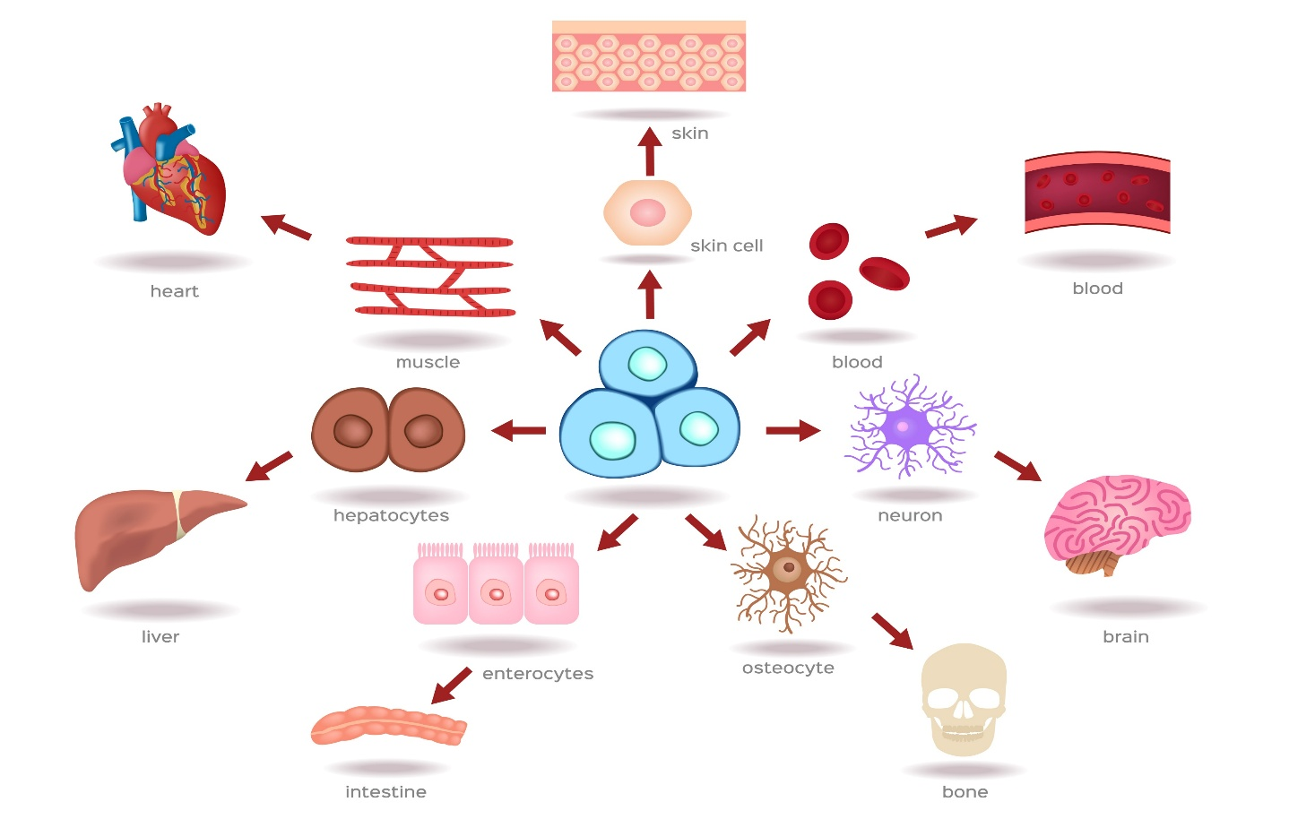
Cells, tissues, organs, organ systems and organisms
The arrows show how cells of the same type make tissues, then how mixing tissues makes organs
A103000424337

Slide 14
We are now going to learn about the structure and location of the main organs of the body including:
A2 and A3 Structure and location of main body organs
skin
heart
lungs
brain
eyes
ears
stomach
uterus
pancreas
intestines
liver
kidneys
bladder
ovaries/testes
A103000424337

Slide 15
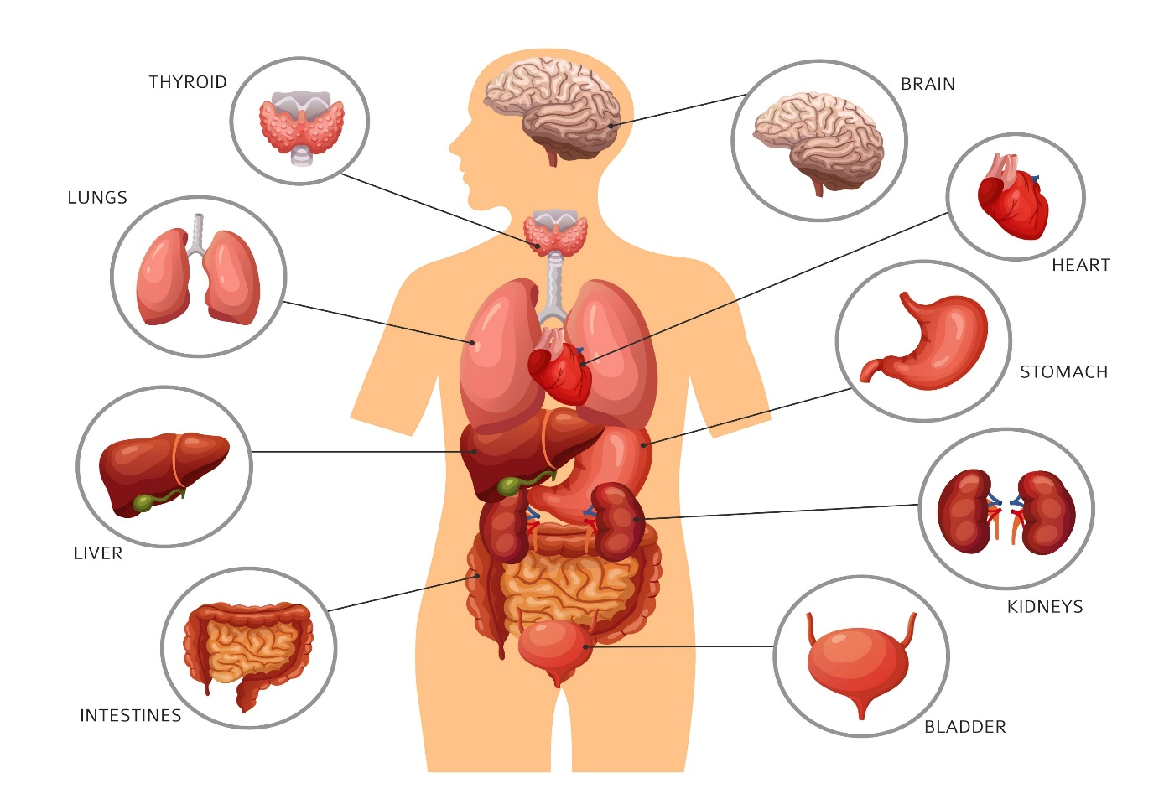
Human organs
A103000424337

Slide 16
B1 and B2 Body systems and functions
These are the major body systems:
Cardiovascular: heart, blood, blood vessels.
Respiratory: upper and lower respiratory tracts.
Nervous: brain, nerves, autonomic nervous system, the senses.
Endocrine: glands, hormones.
Digestive: mouth, oesophagus, stomach, small and large intestine, rectum.
Excretory: kidneys, ureters, bladder, urethra.
Reproductive: structure of male and female reproductive systems.
Musculoskeletal: bones, joints, ligaments, muscles.
A103000424337

Slide 17
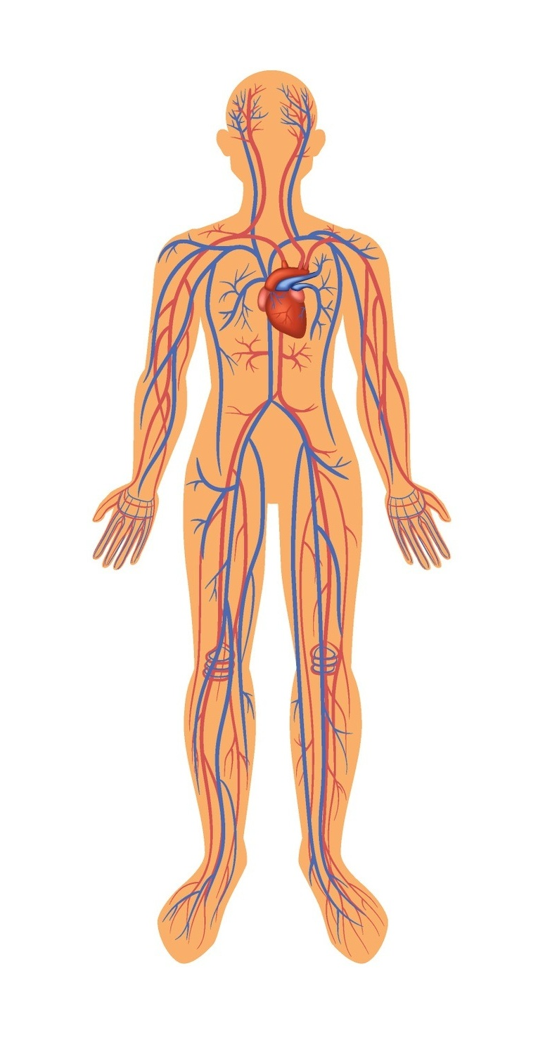
Cardiovascular (circulatory) system
Functions include:
supplying oxygen to body tissues
removal of waste products (such as urea)
electrical conduction of the heart.
A103000424337

Slide 18
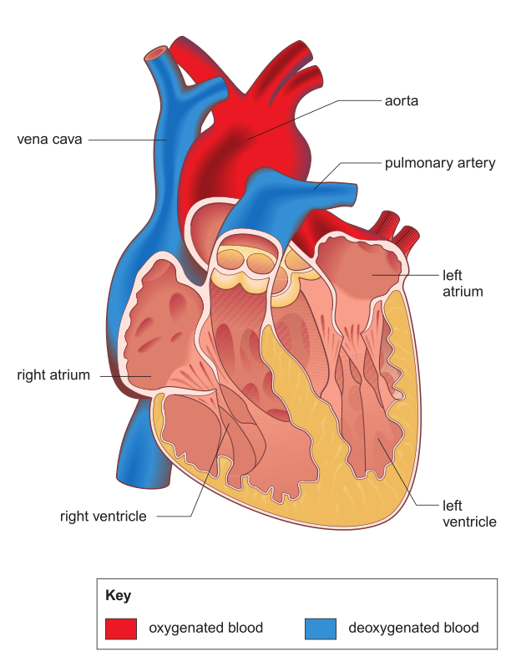
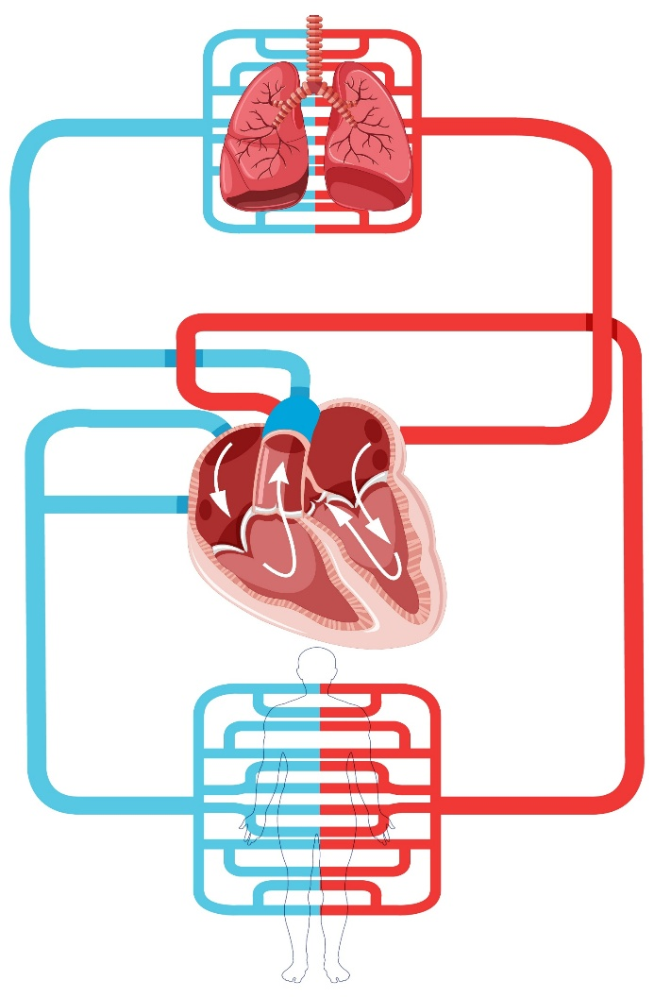
The heart pumps blood through the circulatory system
A103000424337

Slide 19
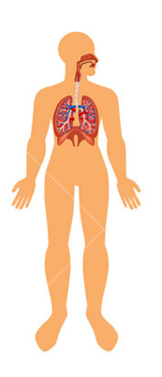
Respiratory system
Functions include:
maintenance of oxygen supply
excretion of carbon dioxide and water vapour.
A103000424337

Slide 20
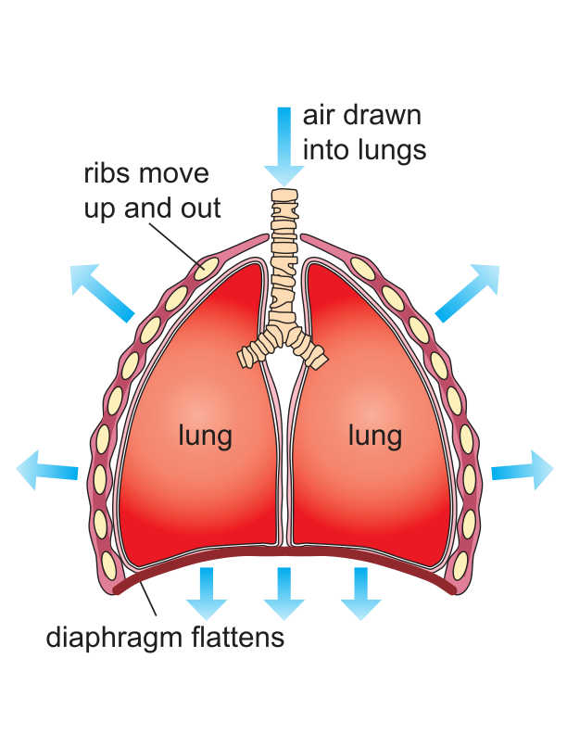
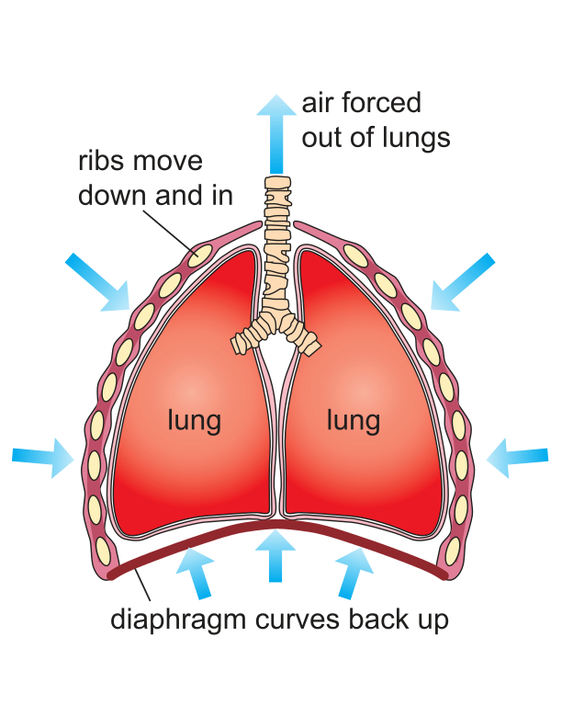
The diaphragm functions in breathing
inhaling
exhaling
A103000424337

Slide 21
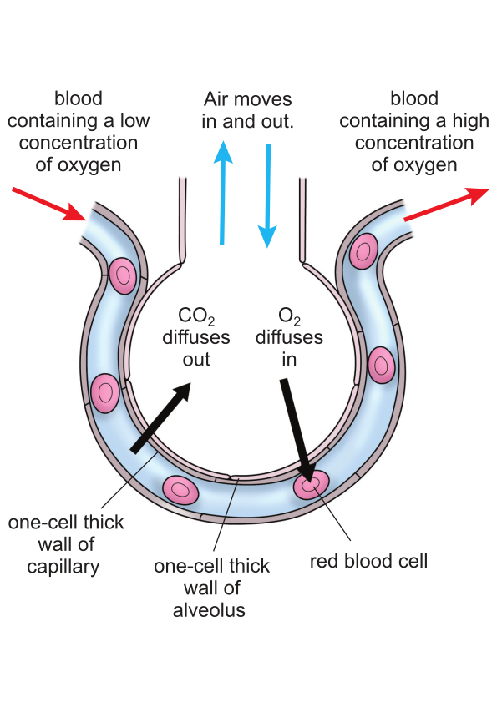
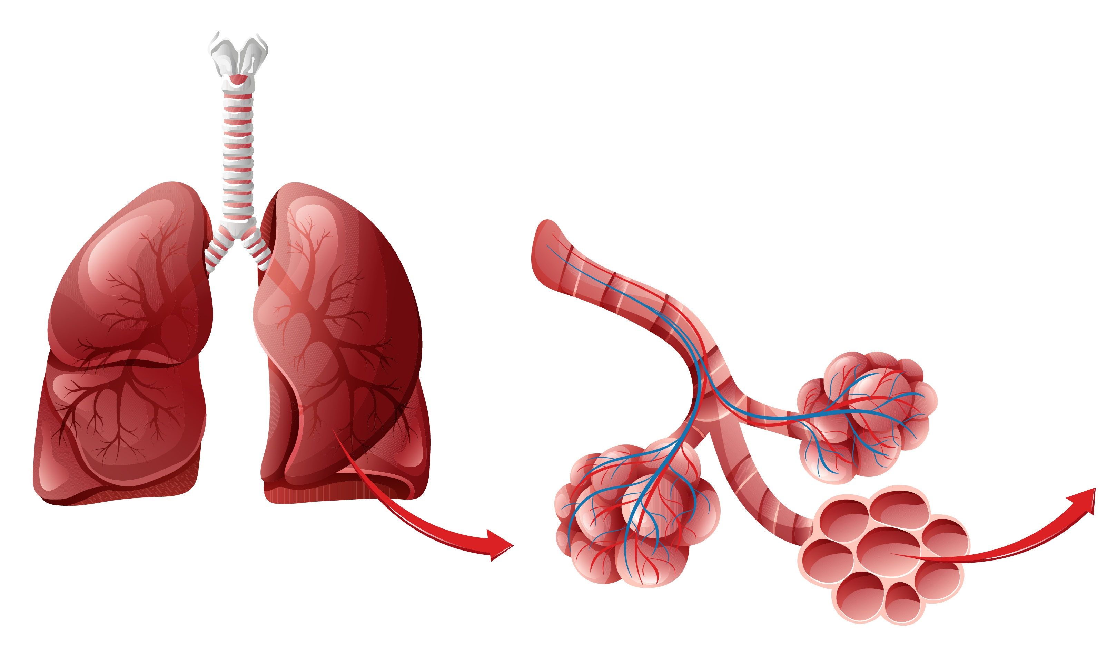
Alveoli structure and function
A103000424337

Slide 22
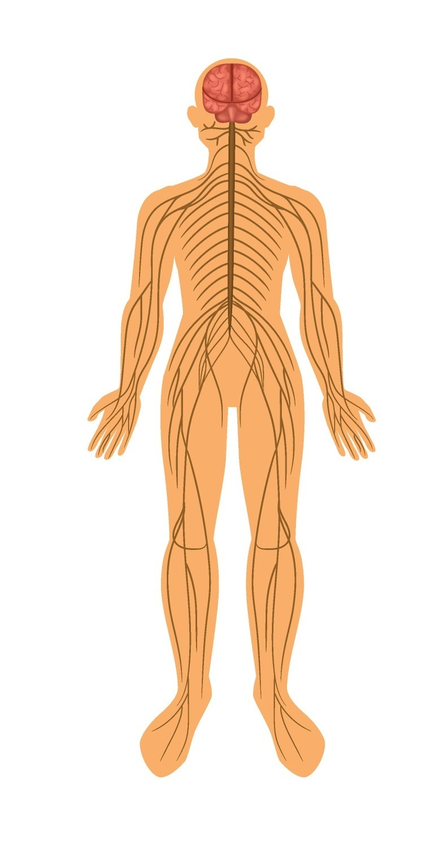
Nervous system
Functions include:
processing of and response to information about changes in the body
aiding perception through the five senses.
A103000424337

Slide 23
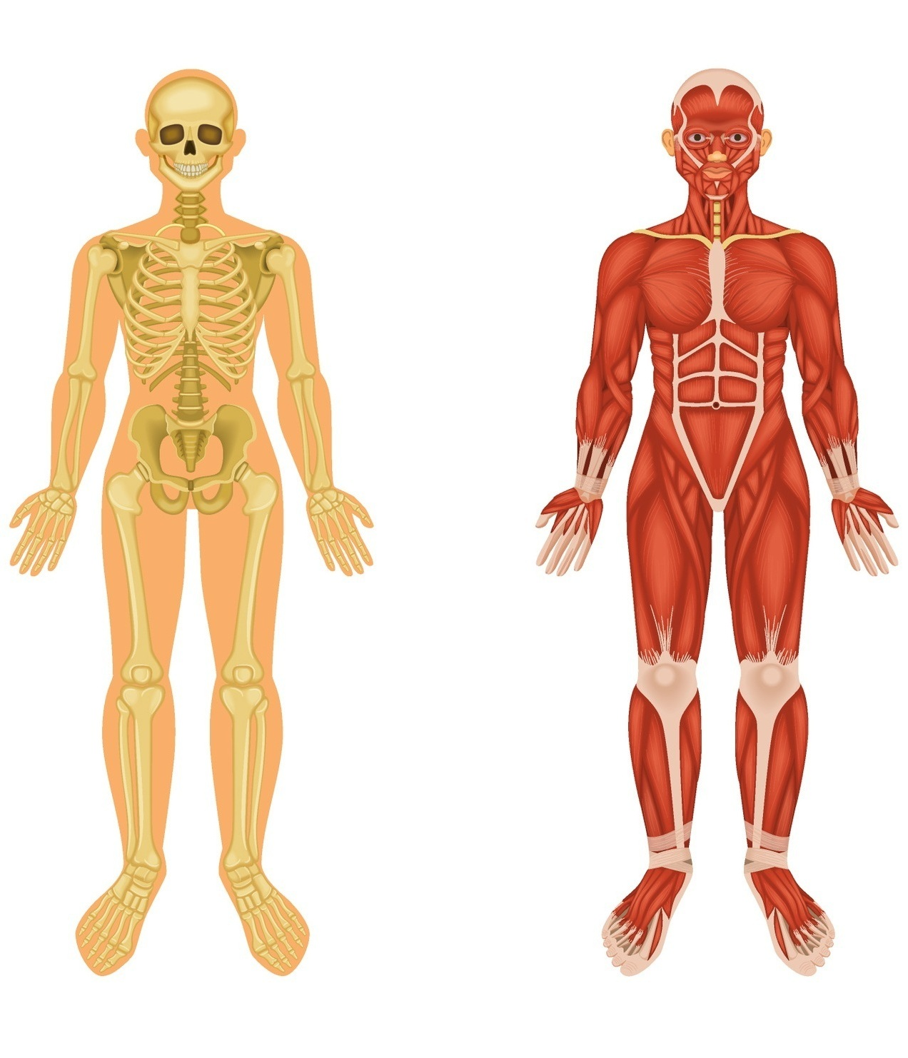
Musculoskeletal system
Functions include:
control of movement
coordination.
A103000424337

Slide 24
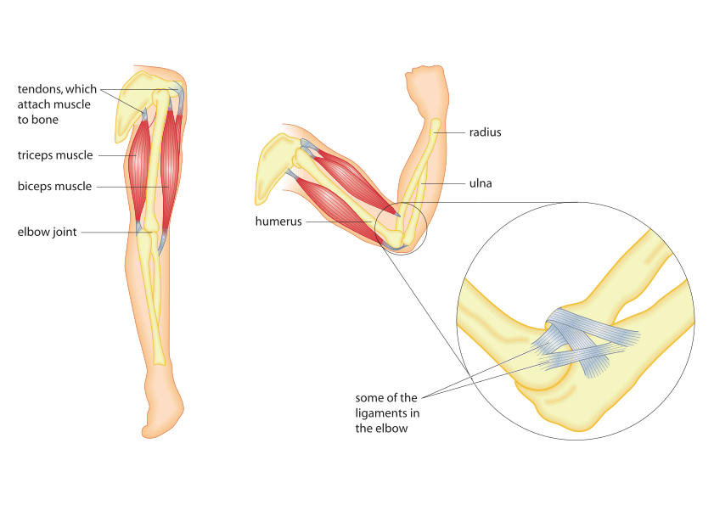
Movement
Muscles contract and pull on tendons
Tendons connect muscles to bones
Joints are where bones meet
Bones move at joints
Ligaments hold joints together
A103000424337

Slide 25
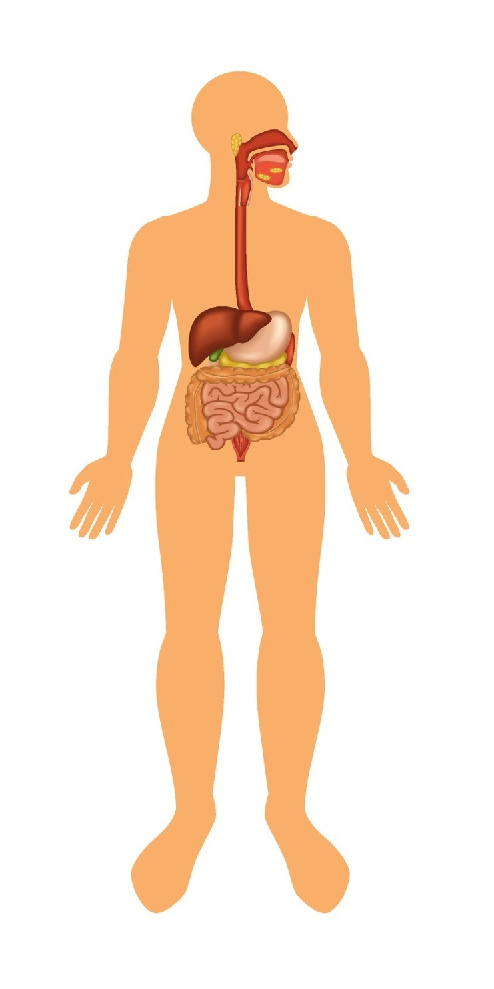
Digestive system
Functions include:
mechanical and chemical digestion
absorption and elimination of food materials.
A103000424337

Slide 26
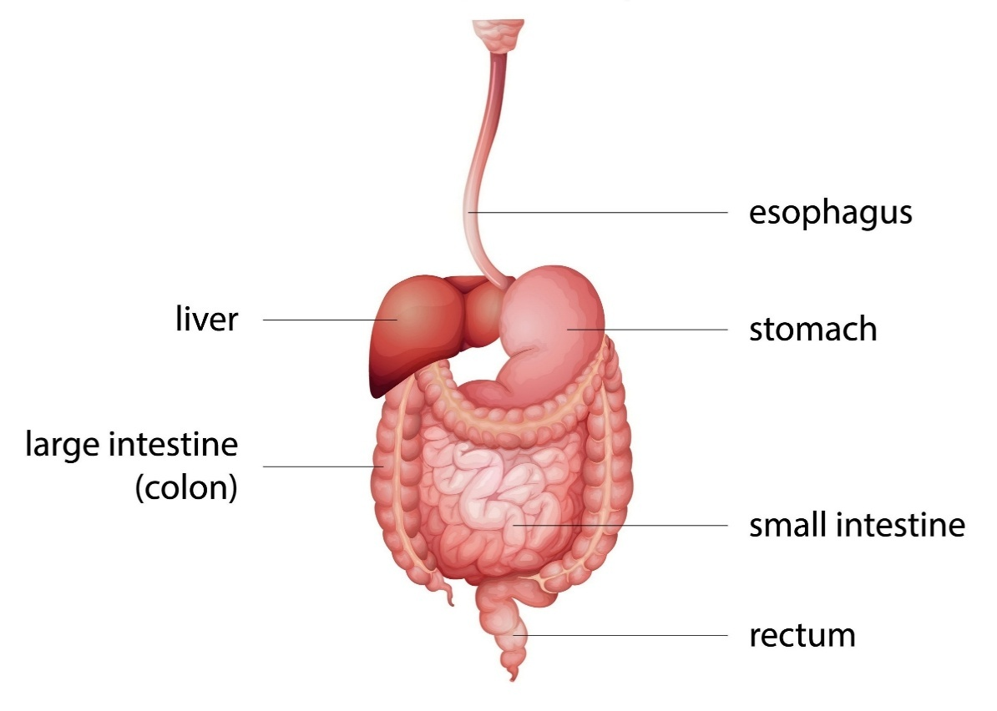
Human Digestive System
A103000424337

Slide 27
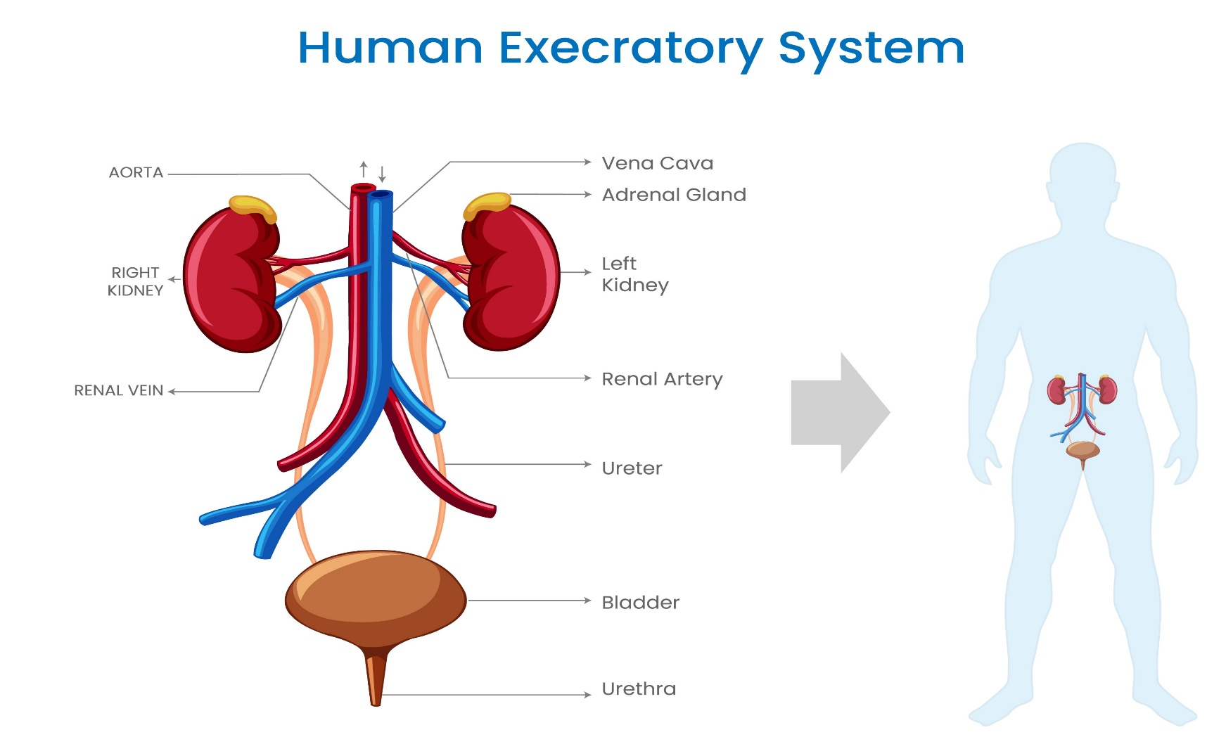
Excretory system
Functions include:
filtering of blood
salt balance
pH balance
fluid balance.
A103000424337

Slide 28
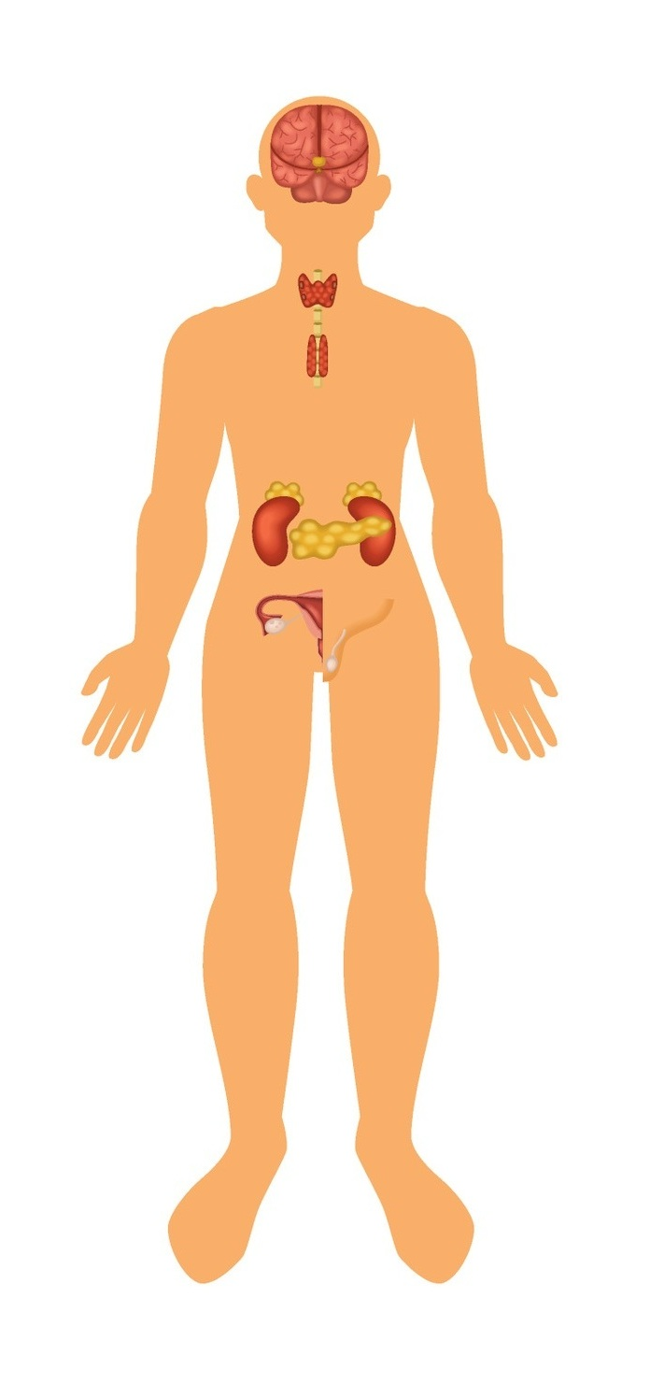
Endocrine system
Secretion of hormones to maintain balance in the body
A103000424337

Slide 29
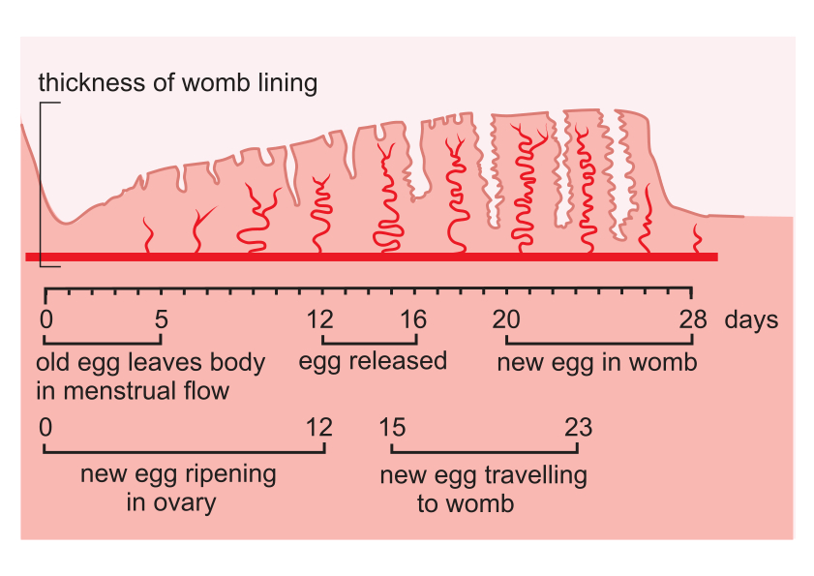
The menstrual cycle 1
A103000424337

Slide 30
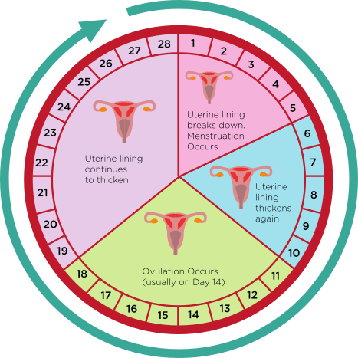
The menstrual cycle 2
A103000424337

Slide 31
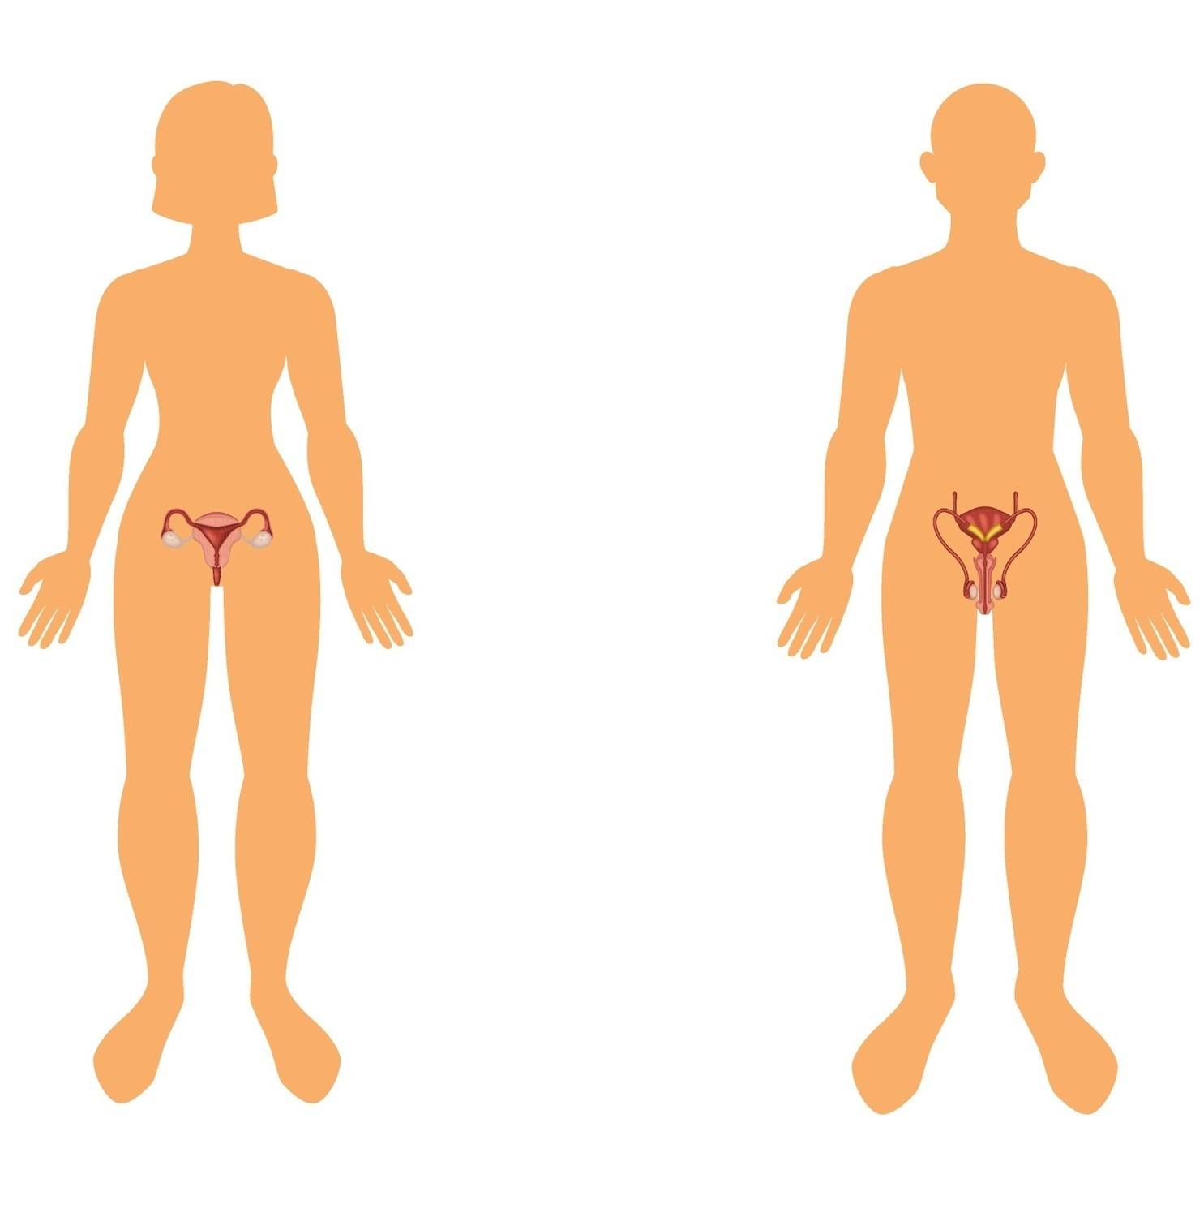
Reproductive system
Functions include:
manufacture of specialised sex cells
fertilisation
development of embryo
foetus
birth of a baby.
A103000424337

Slide 32
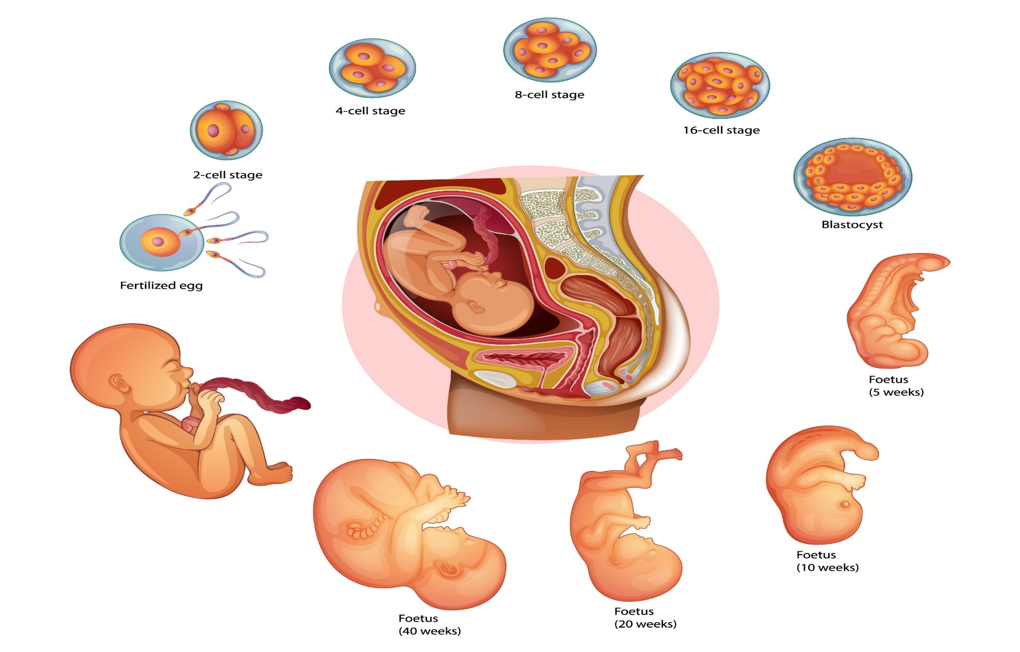
Foetal development
A103000424337

Slide 33
Research task
Select one of these body systems then prepare a presentation to include:
annotated diagram showing structure and relative organ sizes
function of the system in the body
individual role of each organ
relationship of structure to function in each case.
cardiovascular
respiratory
nervous
endocrine
digestive
excretory
reproductive
musculoskeletal
A103000424337

Slide 34
B3 Interrelationships
What happens when we get:
too hot:
sweat
go red in the face (flush)
take off some clothes
too cold:
shiver
lips turn blue
put on more clothes
A103000424337

Slide 35

Homeostasis
(keeping conditions in the body constant)
Research which systems work together to maintain the following and how they do this:
Oxygen supply and remove carbon dioxide
Blood glucose levels
Physical movement
Menstrual cycle
A103000424337

Slide 36
Assessment: Learning aims A and B
Complete assessment tasks for Learning aims A and B
A103000424337

Slide 37
Learning aims C and D
C1 Observations of own body and/or of those of consenting peers
C2 Routine physiological measurements
C3 Health, safety and accuracy considerations
D1 Malfunctions
D2 Potential risk
D3 Routine care
A103000424337

Slide 38
C1 Observations
Match up each body system to a malfunction that can affect it:
cardiovascular
respiratory
nervous
endocrine
digestive
excretory
reproductive
musculoskeletal
stiff joints
stomach ulcer
sterility
poor coordination
heart attack
growth disorders
asthma
over urination
A103000424337

Slide 39
C1 Observations
Match up each body system to a malfunction that can affect it:
cardiovascular
respiratory
nervous
endocrine
digestive
excretory
reproductive
musculoskeletal
stiff joints
stomach ulcer
sterility
poor coordination
heart attack
growth disorders
asthma
over urination
A103000424337

Slide 40

Reliability vs Accuracy
match the labels to the images
inaccurate and unreliable
inaccurate and reliable
accurate and unreliable
accurate and reliable
A103000424337

Slide 41
Reliability vs Accuracy
match the labels to the images
inaccurate and unreliable
inaccurate and reliable
accurate and unreliable
accurate and reliable
A103000424337

Slide 42
Risk factors
Can you match the boxes on the right with this list of risk factor types?
Lifestyle
Environment
Inherited
Age-related
passed down from parents
fatty foods
high BMI
arthritis
poor working conditions
dementia
smoking
lack of exercise
poor accommodation
A103000424337

Slide 43
Circulatory disorders
Select one of these health issues associated with the circulatory system and research it:
hypertension
coronary heart disease
deep vein thrombosis
A103000424337

Slide 44
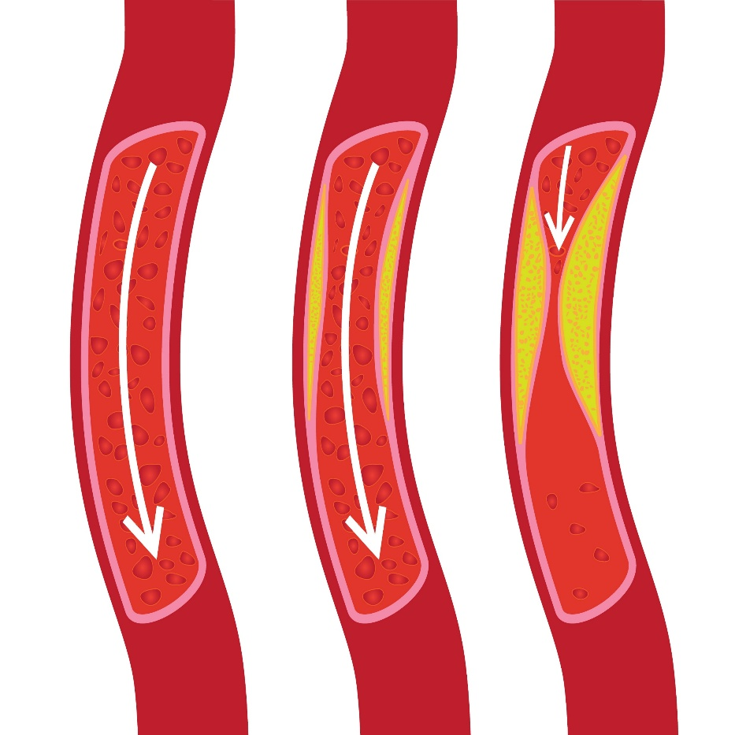
Blocked blood vessels
Can you describe how a build-up on the inside of a blood vessel could lead to coronary heart disease, or even a stroke?
A103000424337

Slide 45
Respiratory disorders
Select one of these health issues associated with the respiratory system and research it:
bronchitis
asthma
emphysema
lung cancer
tuberculosis
A103000424337

Slide 46
Nervous system disorders
Select one of these health issues associated with the nervous system and research it:
stroke
Parkinson’s disease
multiple sclerosis
sensory impairment
A103000424337

Slide 47
Digestive and excretory/renal system disorders
Select one of these health issues associated with the digestive system and research it:
bowel cancer
cholecystitis
irritable bowel syndrome (IBS)
collitis
Select one of these health issues associated with the excretory/renal system and research it:
urinary tract infections (UTIs)
renal failure
dialysis
A103000424337

Slide 48
Endocrine and other body system disorders
Select one of these health issues associated with the endocrine system and research it:
Type 1 diabetes
Type 2 diabetes
underactive/overactive thyroid gland
Select one of these health issues associated with some other body systems and research it:
reproductive:
  cervical cancer
  testicular cancer
  infertility
musculoskeletal:
  osteoarthritis
  osteoporosis
  gout
A103000424337

Slide 49
Command words - Pass
List | Write a list of the main items (not sentences).
State | Point out or list the main features.
Define | To state the meaning of something using the correct terms.
Identify | Give all the basic facts which relate to a topic.
Outline | Write a clear description but without going into too much detail.
Demonstrate | Show that you can do a particular activity or skill.
Explain | Make your point clear by providing sufficient detail.
Describe | Give a clear, straightforward description which includes all of the main points.
Summarise | Write down or articulate briefly the main points or essential features.
A103000424337

Slide 50
Command words - Merit
Discuss | To present an argument for and against.
Explain | Give logical reasons to support your view.
Describe | Give a full description including details of all the relevant features.
Demonstrate | Prove you can carry out a more complex activity.
Analyse | Identify the factors that apply, and state how these are linked and how each of them relates to the topic.
Justify | Give reasons for the points you are marking so that the marker knows how you arrived at that conclusion.
Suggest | Give your own ideas and thoughts.
A103000424337

Slide 51
Command words - Distinction
Assess | Evaluate in terms of advantages and disadvantages.
Analyse | Identify several relevant factors, show how they are linked, and explain the importance of each.
Evaluate | Bring together all of your information and make a judgement on the importance or success of something.
Recommend | Suggest changes or improvements.
Make recommendations | Make relevant and appropriate suggestions; usually for improvement.
Select and demonstrate | Select several relevant examples or pieces of related evidence which clearly support the arguments you are making. This may include showing particular practical skills.
Review | Consider each factor in turn, providing a description and explanation of their uses, strengths and weaknesses, making recommendations.
A103000424337

Slide 52
Assessment: Learning aims C and D
Complete assessment tasks for learning aims C and D
A103000424337

Slide 53
Acknowledgement
Images:
(Keys: l-left, r-Right, c-Centre, t-Top, b-Bottom)
123RF: Aamine29000 (Slide 1), Microone (Slide 15), Blueringmedia (Slide 20r), Crystaleyemedia (Slide 30)
Pearson Education Ltd.: Pearson Education Ltd (Slide20l, 29), HL Studios (Slide 18l), Mark Turner, Beehive Illustration (Slide 21r), Oxford Designers & Illustrators Ltd (Slide 24)
Shutterstock: Esmiles (Slide 9), Ali DM (Slide 21r)
stock.adobe.com: Designua (Slide 10, 11), Gritsalak (Slide 13), Macrovector (Slide 17, 19, 22, 23, 25, 28, 31), GraphicsRF (Slide 18r), Tamatus_art (Slide 21l), Blueringmedia (Slide 26, 32), Nandalal (Slide 27), Olenka758 (Slide 44).
A103000424337

