Slide 1
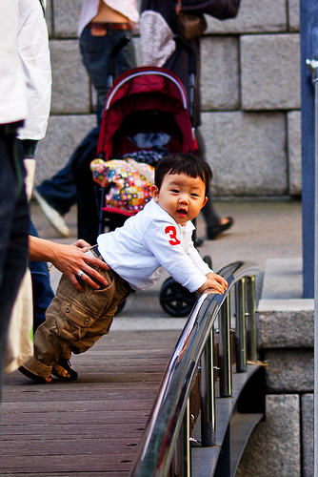
Ground Truth
“small asian boy leans over bridge railing while being held”
Resnet-50
“a young asian boy is climbing a wooden bridge over a wooden bridge”
Swin Transformer
“a young boy wearing a gray shirt and shorts is sitting on a bridge”

Slide 2
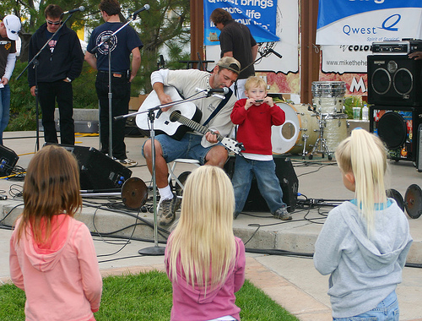
Ground Truth
“three little girls look on as a boy plays the harmonica with an adult guiutarist sitting
beside him”
Resnet-50
“a group of children playing instruments”
Swin Transformer
“a group of children play music in a parade”

Slide 3
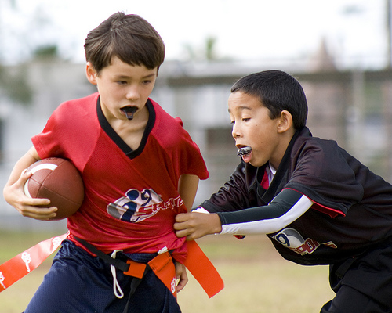
Ground Truth
“young football players with mouthguards”
Resnet-50
“a boy in a red shirt is holding a football and a boy in a red shirt and a white shirt”
Swin Transformer
“two boys are playing football”

