Slide 1
Mapping Migrancies
Forum Data Analysis

Slide 2
Interview Data Themes
Arrival
included processes at the airport (border processes - forms, surveillance, applications for SIN numbers, PR cards, other questions that are asked) processes of finding accommodation, jobs, getting organised (transportation, google maps, navigating home and work), and building initial networks (FB groups, meetups, other social media).
Aspiration
Aspirations of moving to Australia/Canada, and for onward migration as well. Career goals and ambitions, learning to be independent, self-development, and self-growth. Some were more strategic, in that, they saw these destinations as a step towards a future destination – i.e. Canadian PR provides easy access and entry to US, Australian PR to NZ, Singapore etc. Future aspirations were mostly discussed and represented as a series of options – geographies, careers, personal projects.
Cost
Most participants shared how much money they had spent in these processes. They often searched for receipts in their emails if they couldn’t remember, and a lot of the times they were themselves surprised when they realised how much they spent. People also talked about other costs especially temp-visa holders such as medical, school fees, housing. But some also included costs of family responsibilities, visits to home, bringing family over etc.
Decision
Decisions around selecting (or not selecting) destinations (including cities and suburbs), services (agents, lawyers, universities), opportunities (for work, socialising) other considerations (inequality, income, arts & culture). This also includes other decisions on switching or selecting particular types of visas, and visa opportunities. Also, important interventions, or influences in making decisions – for e.g. role of family, partner, romantic relationships, professional and social networks.

Slide 3
Affect
Feelings and emotions related to different processes, policies and pathways that migrants navigate (how people felt going through these processes). Feelings of being supported as well as discouraged. This also includes feelings and expectations around being in Australia and Canada, particular cities, suburbs, and professional spaces – what was expected and what these spaces feel like. Also, feelings attached to home and home countries, politics, loss, doubt, and digital connections to places, things and people left behind.
Planning
Plans often involved considering multiple destinations, various types of applications, planning timelines and time required to collect documents. This also involves a lot of planning for mobility opportunities that might arise indicating the ongoing or continuing nature of migration (i.e keeping documents up to date, checking, updating, tracking records etc.) Also – plans that fail or don’t materialise due to policy or other frameworks and how plans change through policy and regulatory infrastructures, or serendipitous encounters, luck and chance, and how new plans emerge.
Skills
Participants not only discussed their professional skills (and skills assessment processes) but also life skills – risk taking, agility, adaptation, language skills, cultural skills etc. They also talked about skills they acquired in the process of moving through new types of jobs they did, new career directions, new income strategies etc, and how they use their experiences to support others.
Space
This includes digital and physical spaces and infrastructures migrants inhabit, pass through, and navigate. Spaces of departure, transit and arrival (intersects with ‘arrival’). Digital spaces of forums, online support groups, family connections. Visual representation of spaces through maps – linear, flat and sometimes mostly messy. Elements of distance and time. Spaces and opportunity (‘downtown’ or CBD as spaces of opportunity, progress, social life). Spaces as transient (how spaces impact decisions).

Slide 4
Mind Maps
Timeline: Maps that are more linear with clear timelines and stepwise processes.
Life course: Maps that went beyond aspects of migration and covered other elements of life – places travelled, feelings, relationships, challenges, thoughts.
Process based: Maps that were organised as a series of processes people went through, where each process is represented separately.
Dynamic: These are the more “messy” maps – lots of back and forth, lots of entanglements, no clear indication of where the journey starts or ends.
Lists: some maps were just written down as lists of actions, plans, things people went through in their migration process.

Slide 5
Overview of Forums
Data from 01-01-2016 has been collected from both forums.
Cforum: 94212 Conversations (randomised)
Aforum: 106457 Conversations (total)
Data from Cforum was extracted using a randomised approach, as it is a much bigger data set. This also made it comparable to total data extracted from Aforum.
This Data was then categorized based on the interview themes by sorting conversations that contained synonymous words.

Slide 6
Thematic categorization (using synonymous words)
Themes | Synonymous words
Arrival | "arrival" or "entry" or "enter" or "airport" or "landing" or "departure"
Aspiration | "hope" or "aspire" or "ambition" or "wish" or "goal" or "aim" or "desire"
Cost | "cost" or "money" or "expense" or "price" or "fee" or "amount" or "value"
Decision | "decision" or "contemplate" or "think" or "advice" or "option" or "recommendation" or "suggestion" or "choice" or "selection" or "decide" or "determine"
Affect | “affect” or “effect” or "feeling" or "emotion" or "love" or "loss" or "sentiment" or "instinct" or "intuition" or "stress" or "worry" or "happy" or "reaction
Planning | "plan" or "idea" or "strategy" or "schedule" or "scheme" or "organize" or "arrange" or "target" or "change" or "update" or "track" or "record"
Skills | "skill" or "expertise" or "experience" or "career" or "profession" or "occupation" or "knowledge" or “language”
Space | "space" or "place" or "city" or "suburb" or "province" or "region" or "forum" or "street" or "road" or "transport" or "distance" or "location" or "map" or "time" or "infrastructure"

Slide 7
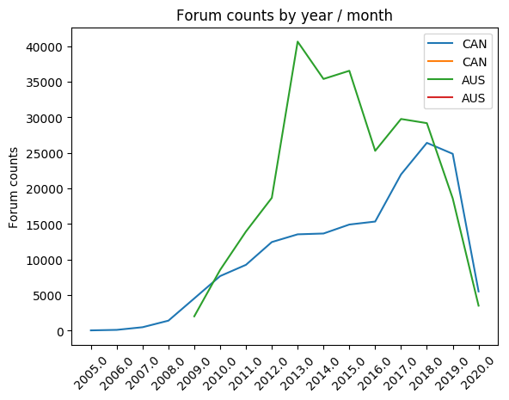
Forum counts by year/month

Slide 8
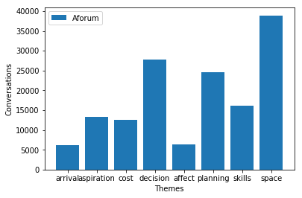
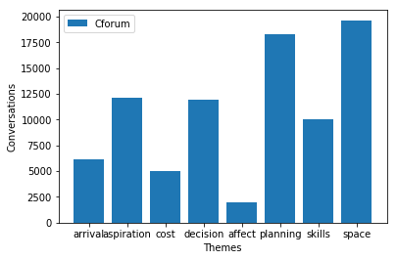
Total conversations by theme (from 2016) Aforum Cforum

Slide 9
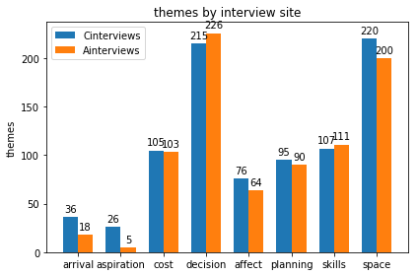
Interview comparison by themes

Slide 10
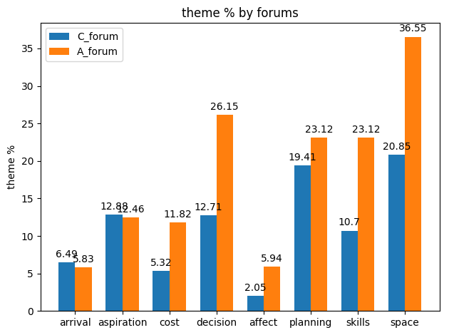
Forum theme % comparison (from 2016)

Slide 11
Top 100 words with highest TF-IDF (Term frequency/Inverse document frequency)
Cforum (after removing stopwords)
['2017', '2018', '2019', 'also', 'alt', 'anyone', 'applicant', 'application', 'applied', 'apply', 'back', 'base64', 'br', 'ca', 'canada', 'canadian', 'case', 'check', 'cic', 'citizenship', 'class', 'com', 'country', 'data', 'date', 'day', 'document', 'email', 'even', 'family', 'form', 'get', 'gif', 'go', 'good', 'got', 'help', 'hi', 'href', 'https', 'image', 'img', 'immigration', 'information', 'it', 'job', 'know', 'letter', 'li', 'like', 'link', 'list', 'may', 'medical', 'month', 'need', 'new', 'one', 'passport', 'people', 'permit', 'please', 'pr', 'process', 'processing', 'question', 'r0lgodlhaqabaiaaaaaaap', 'received', 'send', 'sent', 'shortname', 'since', 'smilie', 'span', 'sprite', 'src', 'status', 'still', 'take', 'target', 'test', 'thank', 'thanks', 'that', 'think', 'time', 'title', 'type', 'update', 'visa', 'waiting', 'want', 'work', 'would', 'www', 'xf', 'year', 'yes', 'yh5baeaaaaalaaaaaabaaeaaaibraa7', 'you’]
Aforum (after removing stopwords)
['12', '2017', '2018', '801', '820', 'advice', 'agent', 'also', 'anyone', 'applicant', 'application', 'applied', 'apply', 'applying', 'australia', 'australian', 'back', 'bridging', 'case', 'check', 'could', 'country', 'date', 'days', 'documents', 'done', 'dont', 'email', 'even', 'everyone', 'evidence', 'family', 'first', 'form', 'get', 'go', 'good', 'got', 'grant', 'granted', 'help', 'hi', 'im', 'immigration', 'information', 'know', 'last', 'like', 'long', 'make', 'married', 'may', 'migration', 'month', 'months', 'much', 'need', 'new', 'one', 'online', 'originally', 'partner', 'people', 'please', 'pmv', 'police', 'posted', 'pr', 'process', 'processing', 'question', 'quote', 'really', 'received', 'relationship', 'see', 'since', 'sponsor', 'stay', 'still', 'submitted', 'sure', 'take', 'thank', 'thanks', 'think', 'time', 'together', 'tourist', 'us', 'visa', 'wait', 'waiting', 'want', 'well', 'work', 'would', 'year', 'years', 'yes']

Slide 12
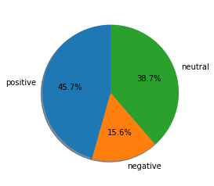
Sentiment Analysis (still working on this)
Cforum
45% conversations are assessed as positive, 15.6% negative, 38% neutral.

Slide 13
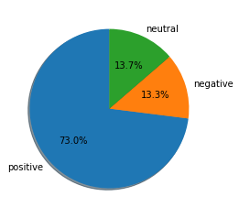
Aforum
Different to Cforum with 73% conversations were assessed as positive. Aforum discussions also captured recent changes from COVID-19.
While these charts provide a broad overview of the data, there are limitations of this method. Different sentiment analysis libraries can produce different results. The library used here is from textblob.
Computational methods also do not accurately capture emotive/linguistic nuances around sarcasm, or exaggeration which are common aspects of these discussions.
Can also be the parameters. Right now it appears that anything >0 is positive and anything <0 is negative.

Slide 14
Some examples
Negative sentiments
“hi [edt] I tried numerous times but was advised my application is in process its frustrating isnt it”
“looks like a moron is handling your case”
Positive sentiments
“application approved yesterday so happy best of luck to everyone else”
“visa grant great news guys: 457 dependent visa granted for my infant son visa application lodgement day 29jan. Priority requested twice in May, no response, grant 13 June all the best everyone”
Neutral sentiments
“I submitted my Indonesian police clearance with everything else when applied for 820 and yes the application can only be made in Jakarta. I'm Indonesian so I managed to get it without agents it might be a different case for others.”
“They didn't say about giving my seat to someone else. Also in their policy states that if the class has already started and i want to withdraw i have to pay for withdrawal fee.”

