Slide 1
FinCo
Referência PowerBI

Slide 2
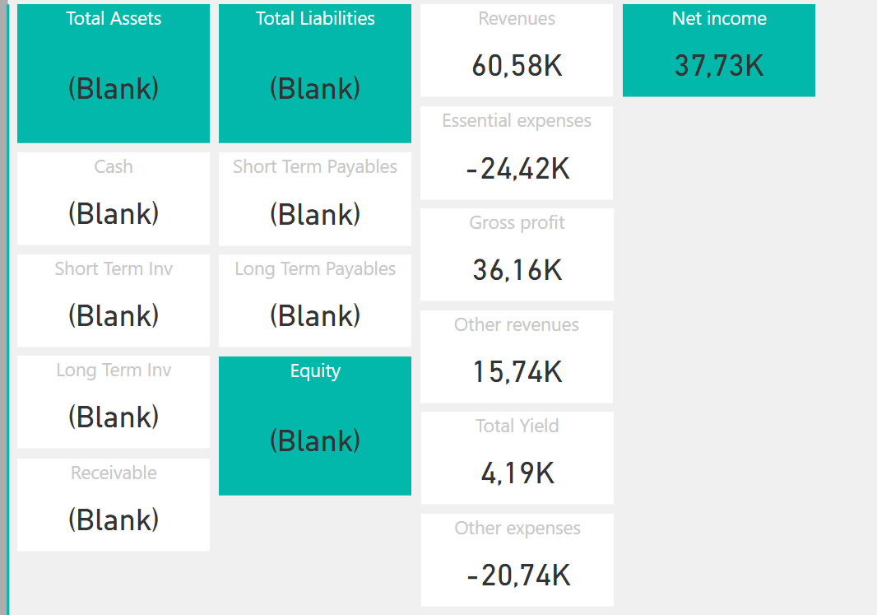
Indicadores

Slide 3
Indicadores
Total Asset
Cash
Short Term Investments
Long Term Investments
Short Term Receivables
Long Term Receivables
Total Liabilities
Short Term Payables
Long Term Payables
Equity
Income
Essential expenses
Gross profit
Other incomes
Total Yield
Other expenses
Net profit

Slide 4
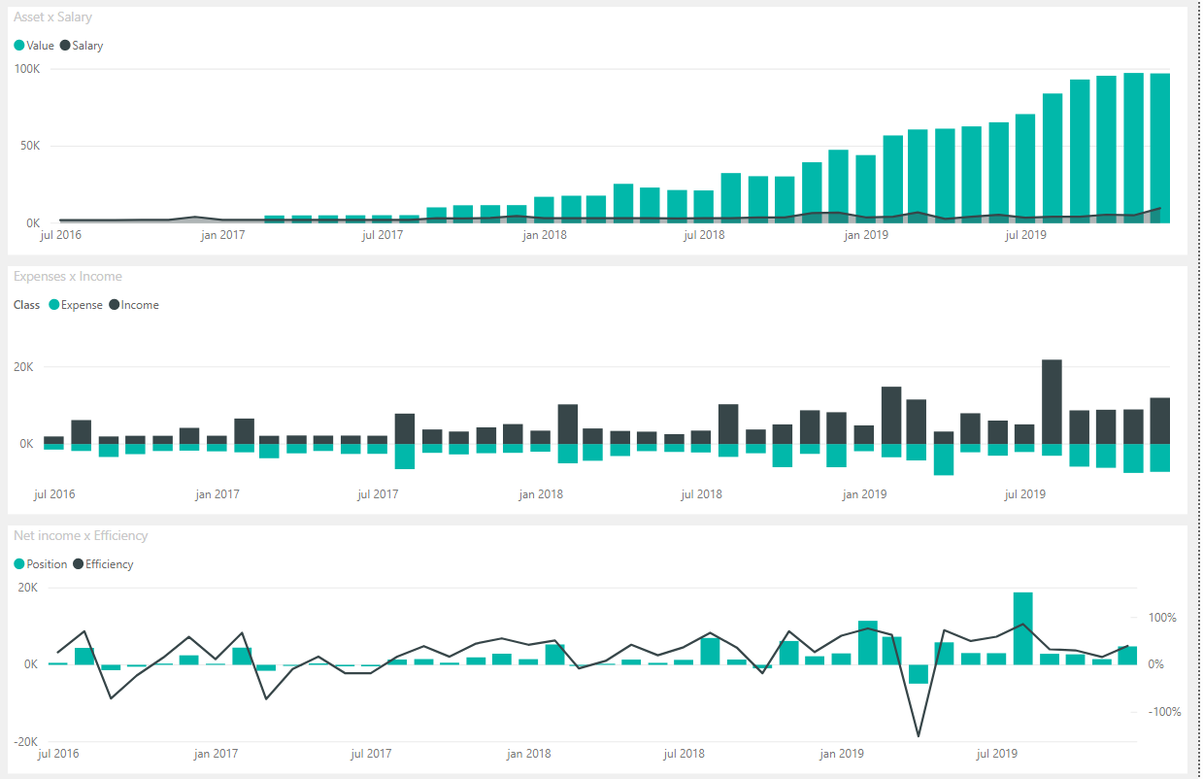
Flow

Slide 5
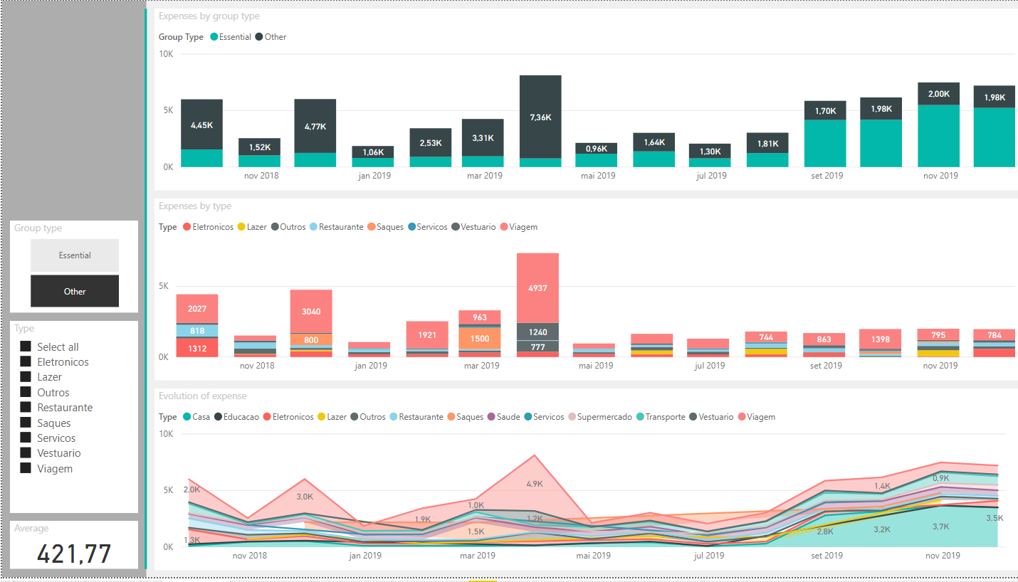
Expenses

Slide 6
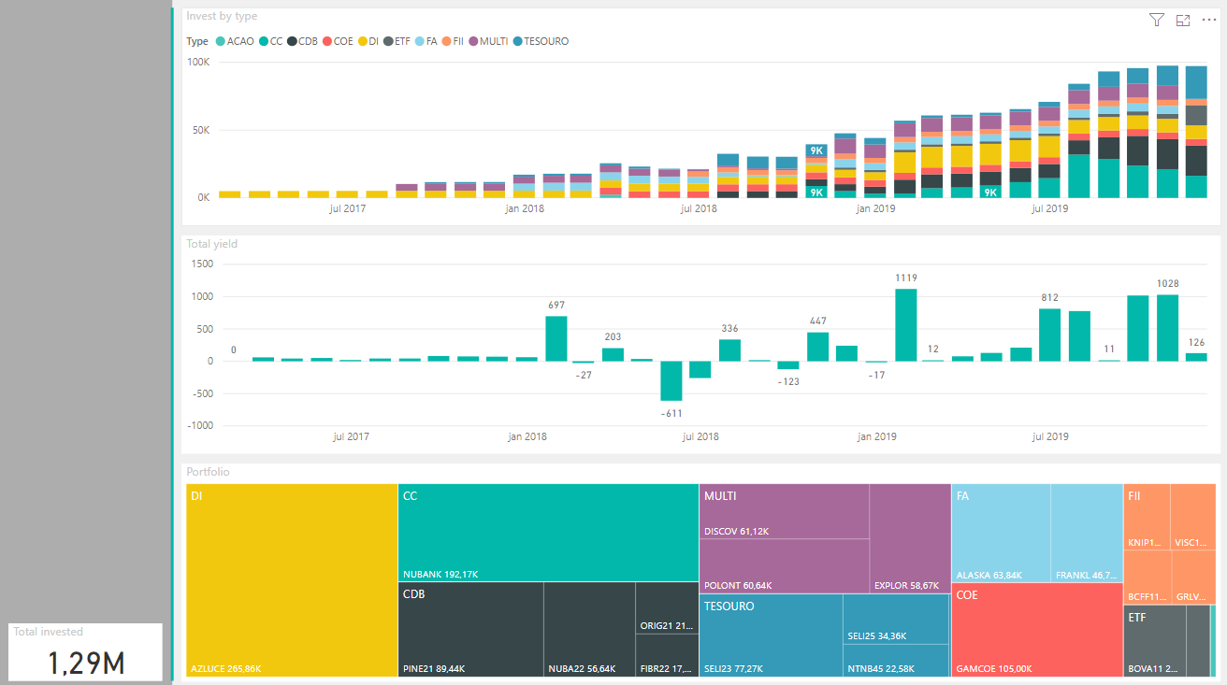
Portfolio 1

Slide 7
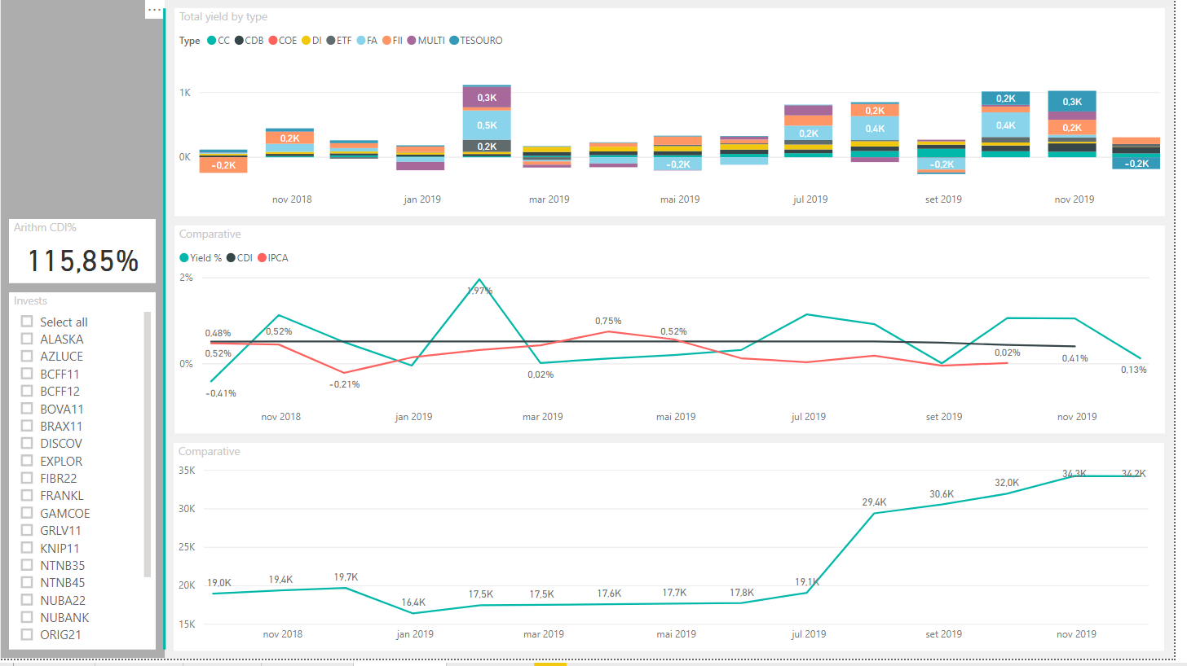
Portfolio 2

Slide 8
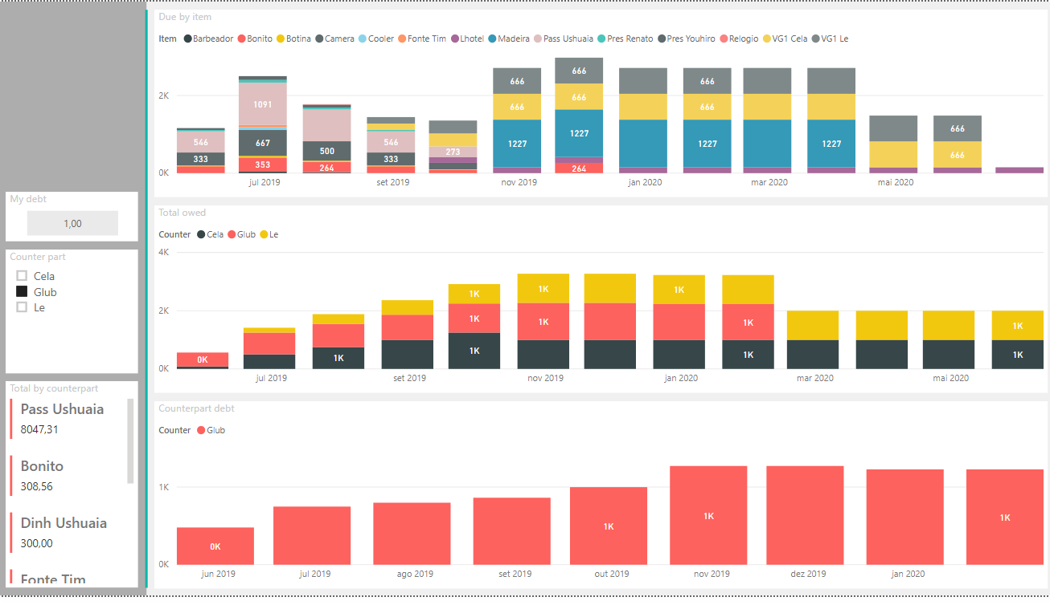
Long

