Slide 1
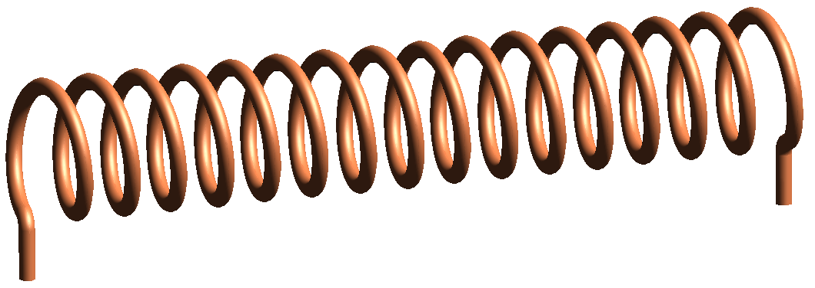
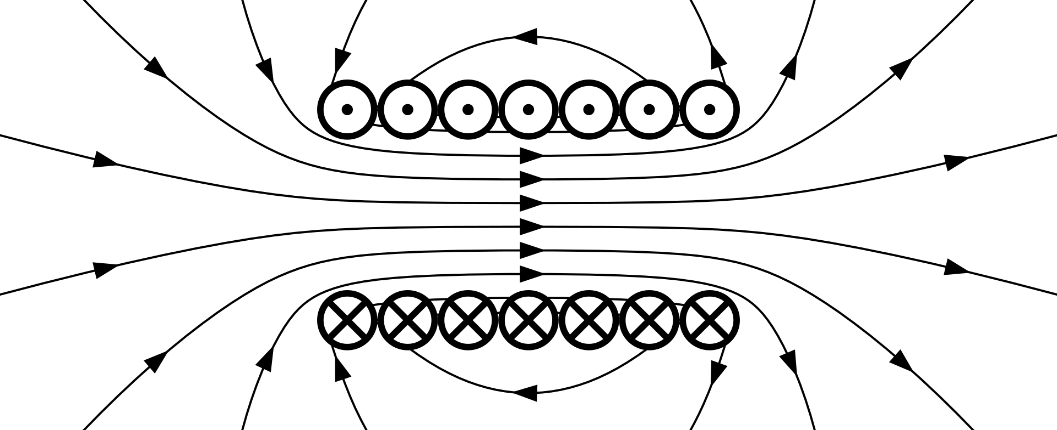
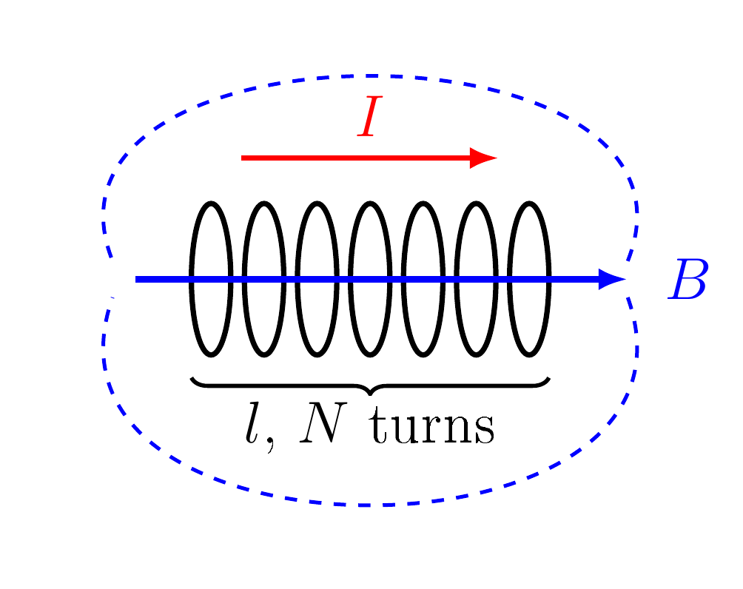
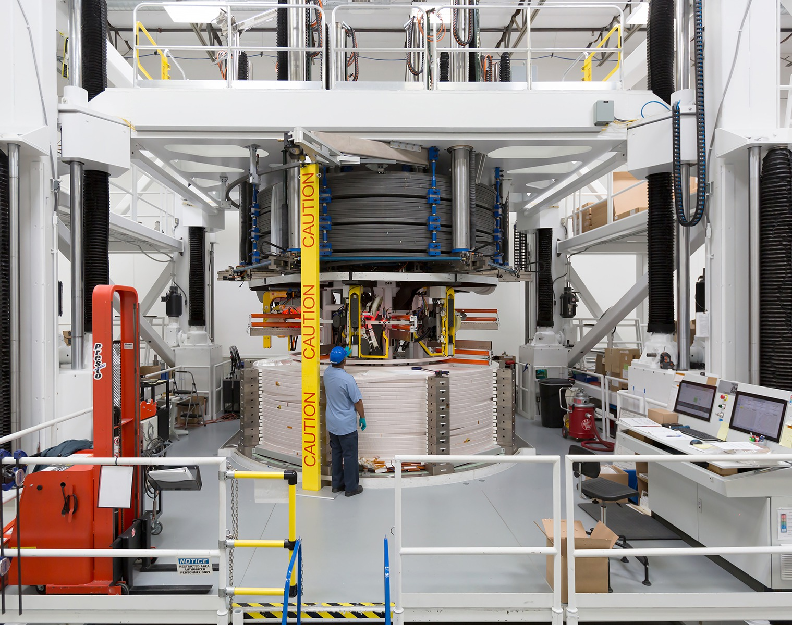
The Solenoid
——————— WHAT IT IS · MAGNETIC FIELD · INDUCTANCE · INDUCTION · USES ———————
WHAT IS A SOLENOID?
A solenoid is a wire wound in a tight helix, a coil whose length is much greater than its diameter.
Each turn makes a small loop field, and the loops add up inside.
Inside: a strong, uniform field along the axis.
Outside: a weak field, like a bar magnet with N and S ends.
$$\oint{B·dl}=μ_{0}I_{enc}$$
$$⇒ Bl=μ_{0}NI$$
I_{enc} : current through the loop, NI
l : length of the coil (m)
Wikimedia Commons
MAGNETIC FIELD
INDUCTANCE & INDUCTION
USES
A current through the coil makes a nearly uniform field inside. The right-hand grip rule gives its direction.
The coil links its own flux, so it has an inductance. A changing field through it induces a voltage.
The same coil sends a field (transmitter) and senses one (receiver).
$$B=μ_{0}\frac{N}{l}I$$
$$L=\frac{μ_{0}N^{2}A}{l}$$
$$e=−NA\frac{dB}{dt}$$
$$m=NIA$$
B : field inside (T)
μ₀ : 4π × 10⁻⁷ H/m
m : magnetic moment (A m²)
Wikimedia Commons
Wikimedia Commons
A : area (m²)
e : induced emf (V)
Wikimedia Commons
🔑 KEY POINTS
💡 EXAMPLE
🔑 KEY POINTS
💡 EXAMPLE
🔑 KEY POINTS
💡 IN EM SURVEYS
Iron core: B rises by μ_{eff}.
B does not depend on r.
N = 500, l = 0.25 m, I = 2 A
B = 5.0 mT
L ∝ N²: double the turns, 4L.
Energy W = ½LI².
Same coil, r = 2 cm
L = 1.58 mH
Relays, valves, locks.
MRI and ITER magnets.
Tx: large m.
Rx: e ∝ NA dB/dt.

