Slide 1
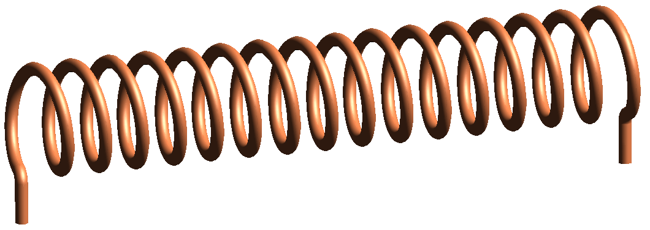

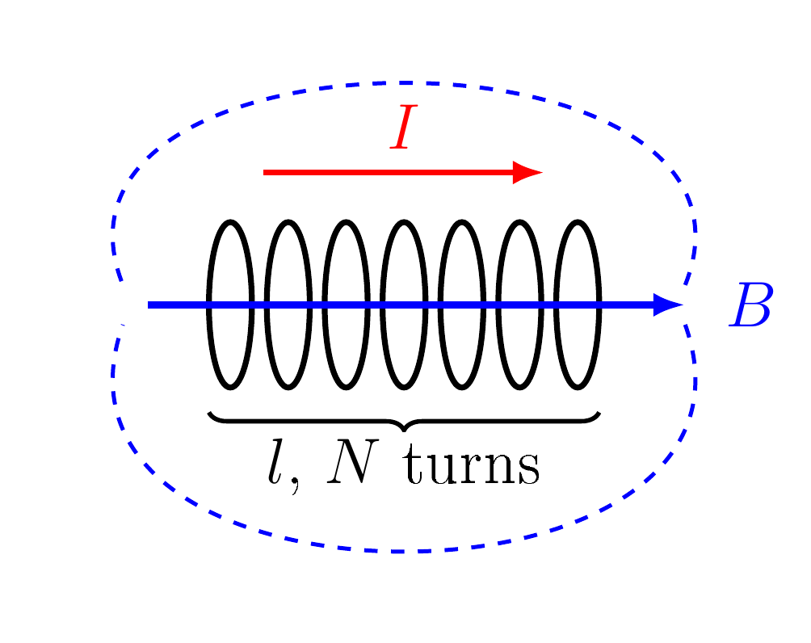
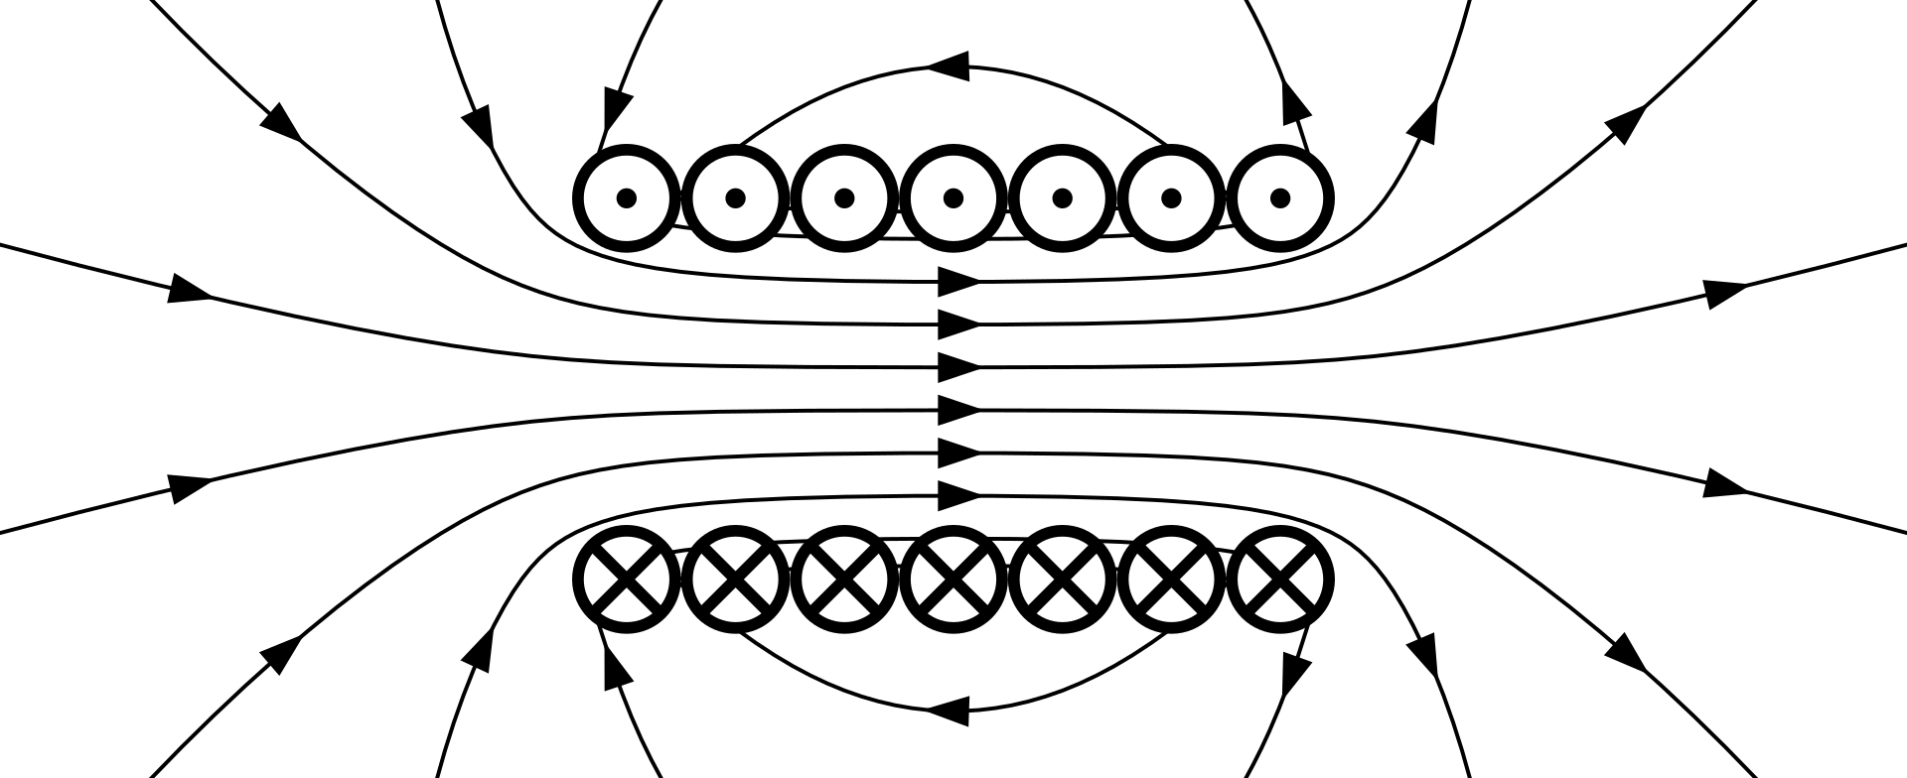
The Solenoid
——————— WHAT IT IS · MAGNETIC FIELD · INDUCTANCE · INDUCTION · USES ———————
WHAT IS A SOLENOID?
A solenoid is a wire wound in a tight helix, a coil whose length is much greater than its diameter.
Each turn makes a small loop field, and the loops add up inside.
Inside: a strong, uniform field along the axis.
Outside: a weak field, like a bar magnet with N and S ends.
$$∮B⋅dl=μ_{0}I_{enc}$$
$$⇒ Bl=μ_{0}NI$$
I_{enc} : current through the loop, NI
l : length of the coil (m)
Wikimedia Commons
MAGNETIC FIELD
INDUCTANCE & INDUCTION
USES
A current through the coil makes a nearly uniform field inside. The right-hand grip rule gives its direction.
The coil links its own flux, so it has an inductance. A changing field through it induces a voltage.
The same coil sends a field (transmitter) and senses one (receiver).
$$B=μ_{0} \frac{N}{l} I$$
$$m=NIA$$
$$L=\frac{μ_{0}N^{2}A}{l}$$
$$e=−NA \frac{dB}{dt}$$
m : magnetic moment (A m²)
B : field inside (T)
μ₀ : 4π × 10⁻⁷ H/m
Wikimedia Commons
A : area (m²)
e : induced emf (V)
Wikimedia Commons
🔑 KEY POINTS
💡 EXAMPLE
🔑 KEY POINTS
💡 IN EM SURVEYS
Iron core: B rises by μ_{eff}.
B does not depend on r.
N = 500, l = 0.25 m, I = 2 A
B = 5.0 mT
🔑 KEY POINTS
💡 EXAMPLE
Relays, valves, locks.
MRI and ITER magnets.
Tx: large m.
Rx: e ∝ NA dB/dt.
L ∝ N²: double the turns, 4L.
Energy W = ½LI².
Same coil, r = 2 cm
L = 1.58 mH

Slide 2
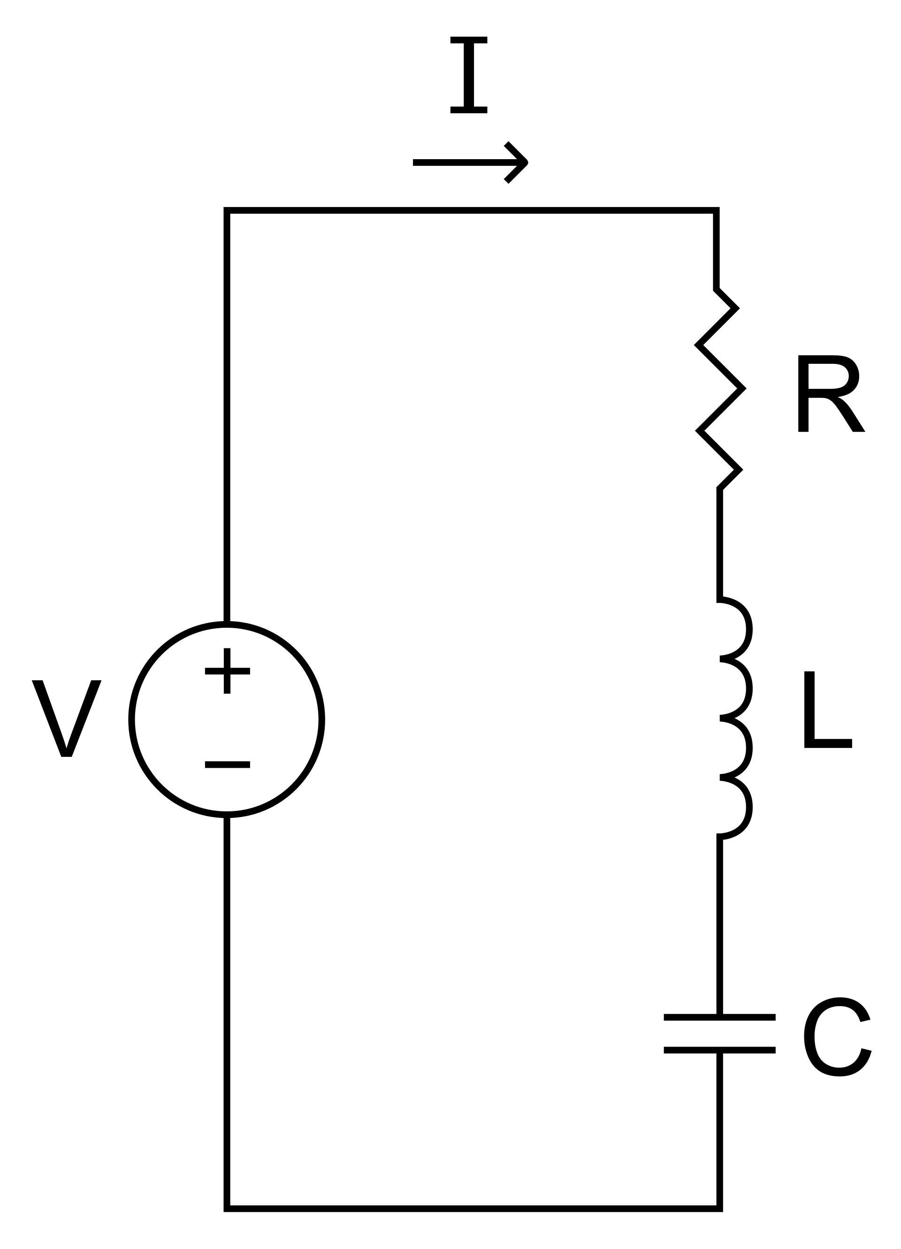
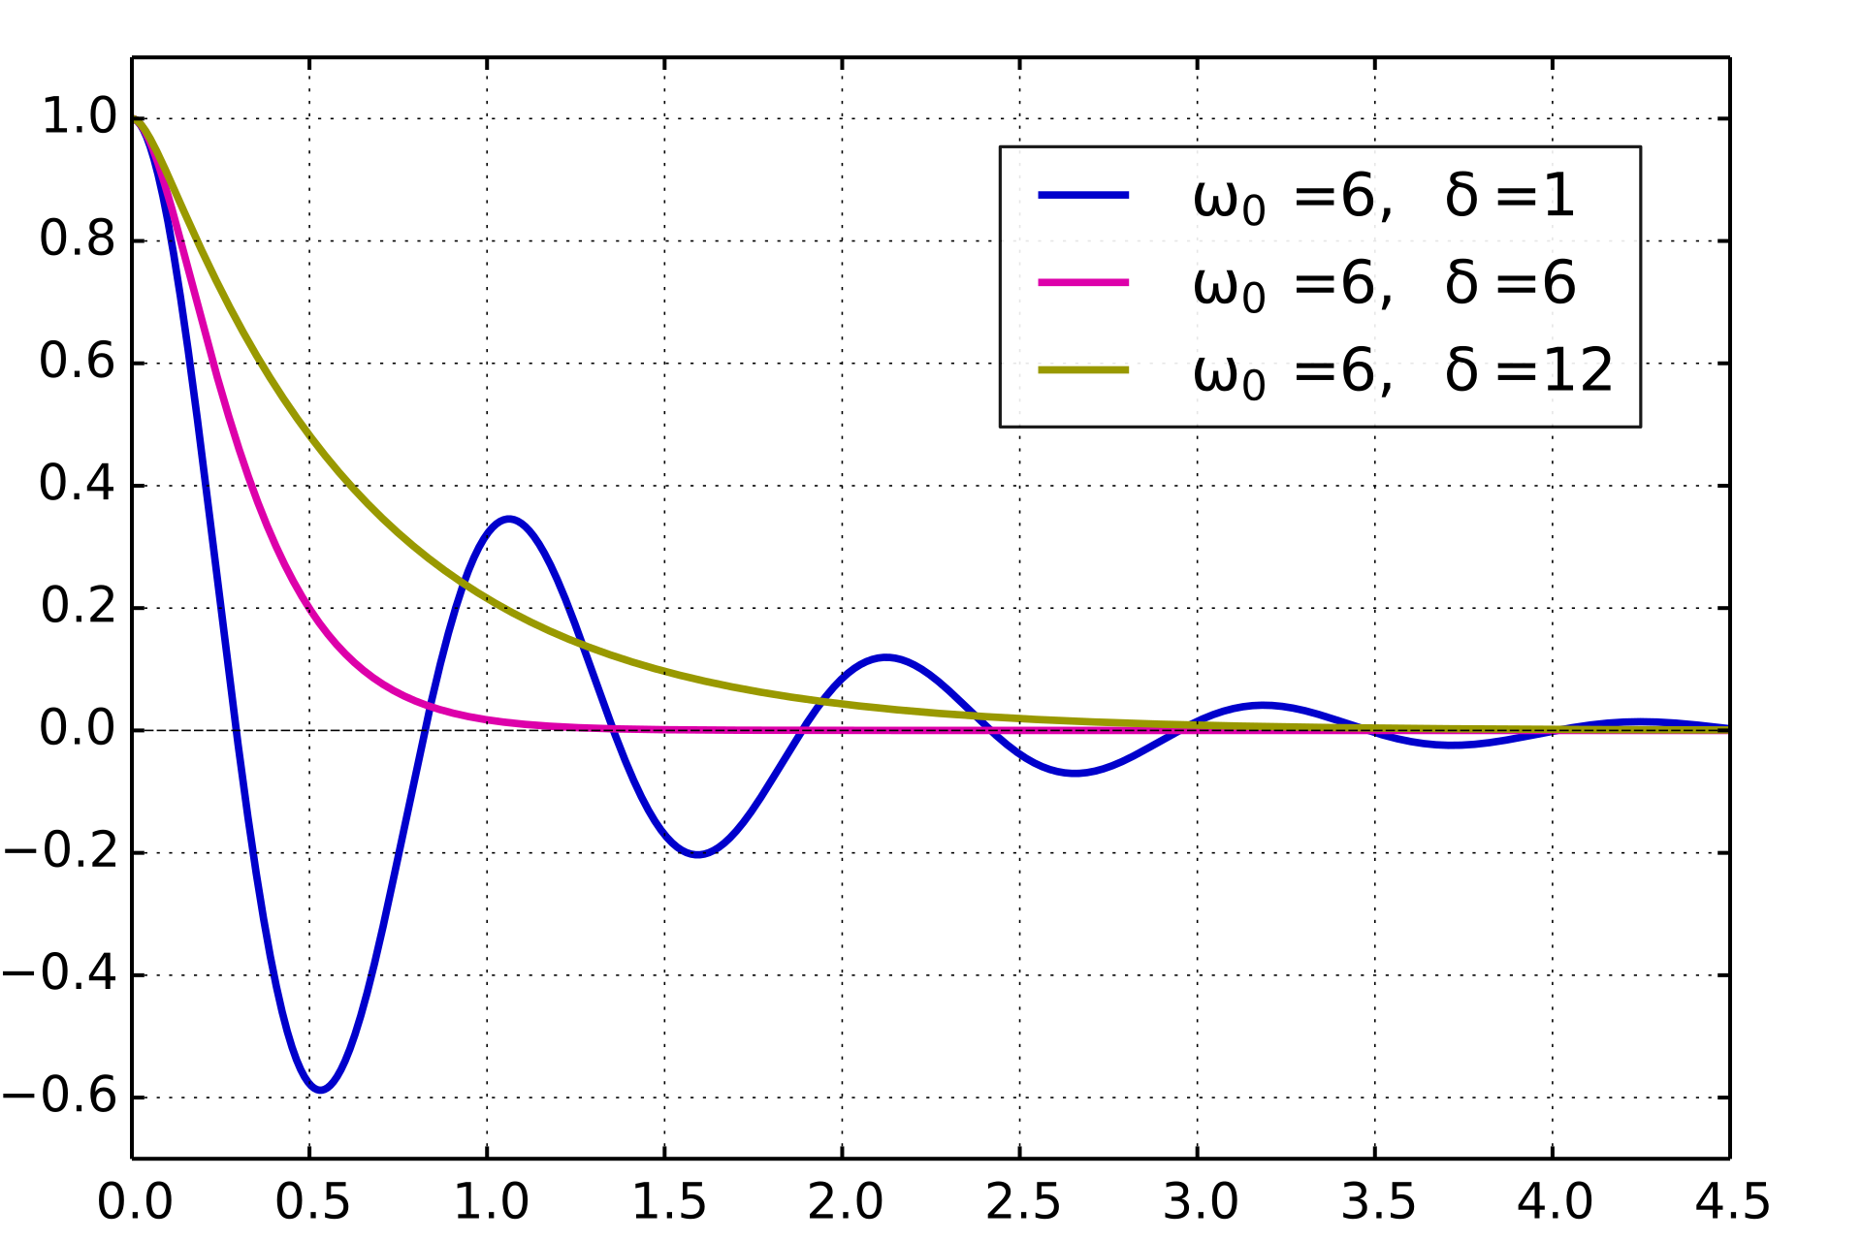
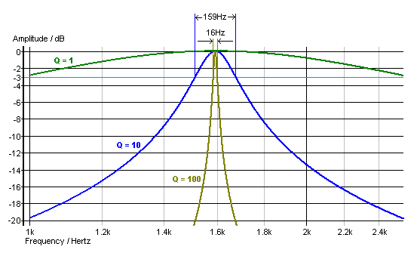
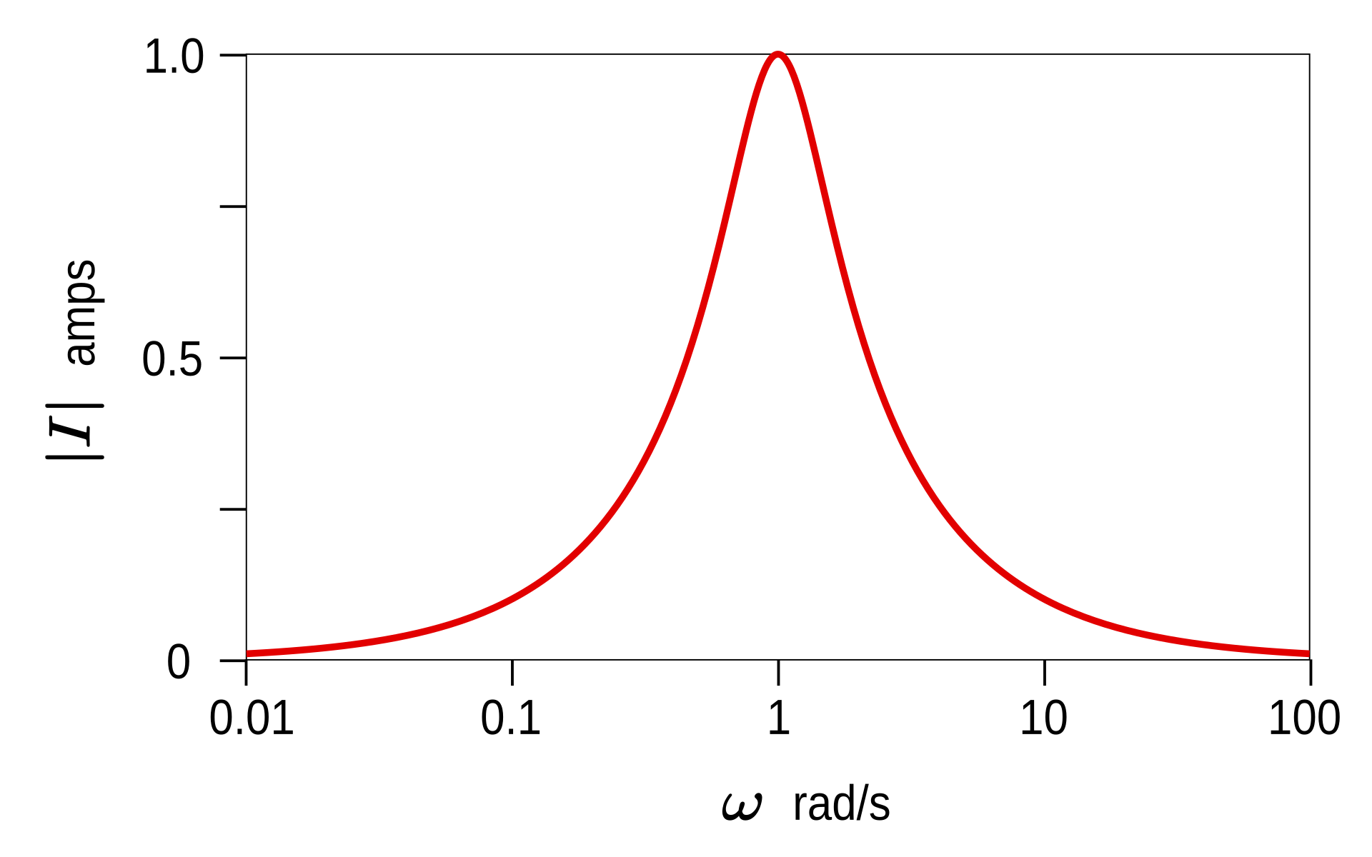
The Series RLC Circuit
——————— WHAT IT IS · RESONANCE · DAMPING · BANDWIDTH · Q FACTOR ———————
WHAT IS AN RLC CIRCUIT?
An RLC circuit is a resistor R, an inductor L and a capacitor C connected to a voltage source.
R loses energy as heat.
L stores energy in a magnetic field, C in an electric field.
Energy swaps between L and C, so the circuit oscillates.
$$L\frac{dI}{dt}+RI+\frac{q}{C}=V(t)$$
q : capacitor charge, I = dq/dt
ω₀ : 1/√(LC), natural frequency
Wikimedia Commons
RESONANCE
DAMPING
BANDWIDTH & Q
At ω₀ the reactances of L and C cancel, so the circuit resonates.
R removes energy, so free oscillations die away.
The bandwidth is the peak width at half power.
$$ζ=\frac{R}{2}\sqrt{\frac{C}{L}}$$
$$Q=\frac{f_{0}}{Δf}$$
$$ω_{0}=\frac{1}{\sqrt{LC}}$$
ζ : damping ratio
Q : 1/(2ζ)
f₀ : ω₀/2π (Hz)
Wikimedia Commons
Wikimedia Commons
Wikimedia Commons
🔑 KEY POINTS
💡 EXAMPLE
🔑 KEY POINTS
💡 USES
High Q: narrow peak.
Low Q: broad, fast.
L = 10 mH, C = 1 μF
R = 10 Ω: Q = 10
🔑 KEY POINTS
💡 USES
ζ < 1: rings.
ζ = 1: critical.
Car suspension.
Damped TEM coils.
V and I in phase.
V_{L} = V_{C} = QV.
Radio tuning.
Tuned EM loops.

