Slide 1
MEC
Mojdeh Karbalaee Motalleb

Slide 2
MEC Architecture
MEC is a layer that resides between cloud and mobile devices. Therefore, the infrastructure is derived as a three-layer hierarchy; cloud, MEC and mobile devices . Mobile edge computing mostly complies with cloud computing to support and enhance performance of the end devices. The formation of a three-layer service model, is depicted in figure
MEC key value proposition is that it offers cloud computing by pushing cloud resources, such as compute, network and storage to edge of the mobile network in order to fulfil application requirement that are compute hungry (e.g. Games applications), latency-sensitive (e.g. Augmented Reality applications) and high-bandwidth demanding (e.g. Mobile Big data Analytics).

Slide 3
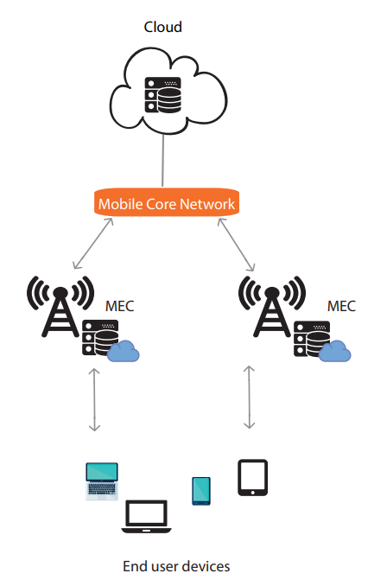
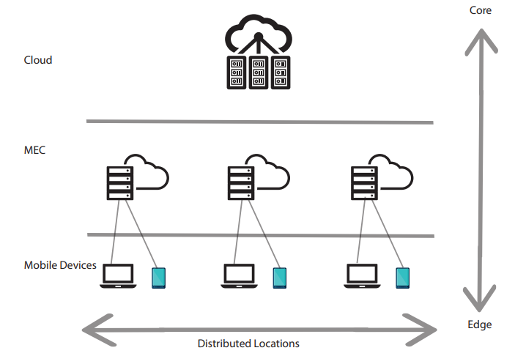
MEC Architecture

Slide 4
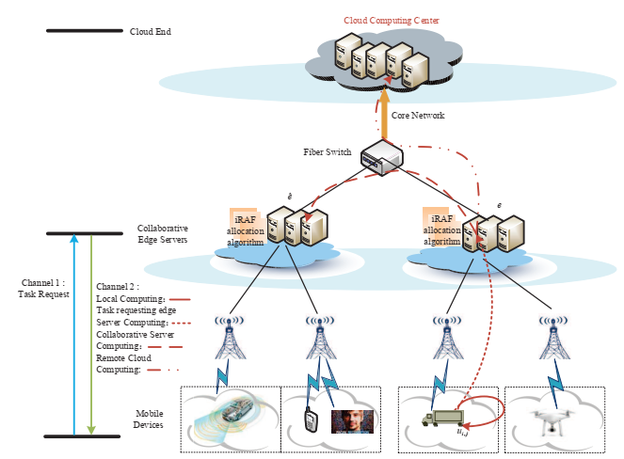
Collaborative Mobile Edge Computing

Slide 5
Collaborative Mobile Edge Computing
We consider a CoMEC network model over fiber-wireless connection as shown in Fig.
The CoMEC system consists of a set of collaborative edge servers connected through a fiber switch in a homogeneous network.
The optical backbone network connects to the cloud server center thousands of miles away.
To distinguish the edge server receiving the task from the collaborative edge servers, we denote a task requesting edge server as e.
The other collaborative edge servers have the same priority and function as the task requesting server e.
Each edge server can serve multiple UEs through base stations (BSs).

Slide 6
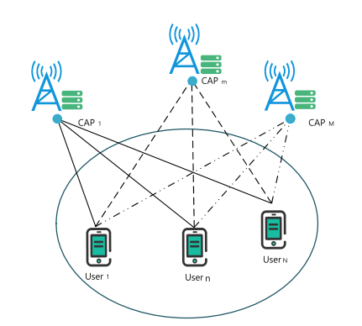
Deep Reinforcement Learning Based Mobile Edge Computing for Intelligent Internet of Things

Slide 7
Deep Reinforcement Learning Based Mobile Edge Computing for Intelligent Internet of Things
we study MEC networks for intelligent IoT, where multiple users have some computational tasks assisted by multiple computational access points (CAPs)
By offloading some tasks to the CAPs, the system performance can be improved through reducing the latency and energy consumption, which are the two important metrics of interest in the MEC networks.
We devise the system by proposing the offloading strategy intelligently through the deep reinforcement learning algorithm
we consider the problem of offloading strategy design for MEC network, in order to determine how many tasks to computed by the CAPs.

Slide 8
MEC and O-RAN Integration
MEC hosts can be combined with the near-RT RIC hosts of O-RAN, and the MEC-based control plane services can be just O-RAN services (data plane services cannot be deployed that way). MEC databases (about UE locations, cell performance, Radio Network Information Service (RNIS)) can be integrated with O-RAN databases; the Mobile Edge Application Orchestrator (MEAO) can be used for xApps orchestration (including SON functions). The MEC application mobility mechanism can be reused in multi-near-RT RIC environment, solving an essential problem of the inter-near-RT RICs cooperation.

Slide 9
NS and MEC/O-RAN Integration
The support of NS is an ongoing technical spec task group effort in O-RAN. It impacts O-RAN in several ways: (i) a slice xApps can be included in NR slice templates and orchestrated by the O-RAN/MEC orchestrator; (ii) each slice needs a separate, secure partition of the O-RAN/MEC databases; and (iii) the slice xApps hosting near-RT RIC architecture modification is required. Moreover, the 5GC (sub-)network slice and O-RAN network slice has to be stitched together using native 5GC network slicing-related mechanisms, as defined by 3GPP

Slide 10
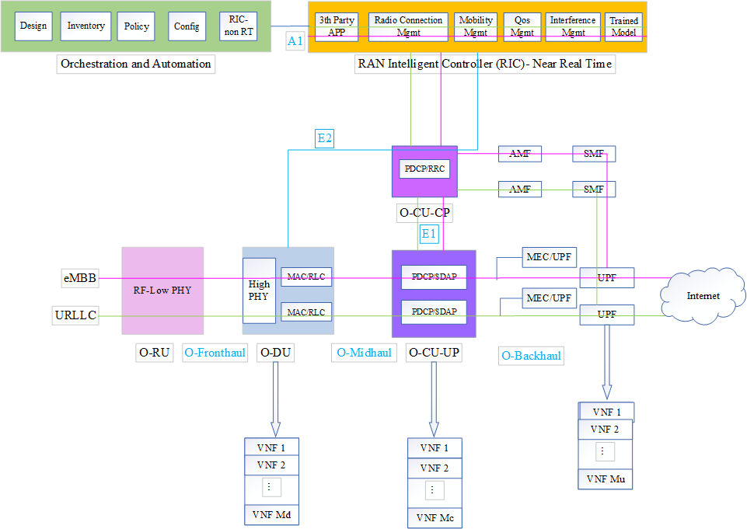

Slide 11
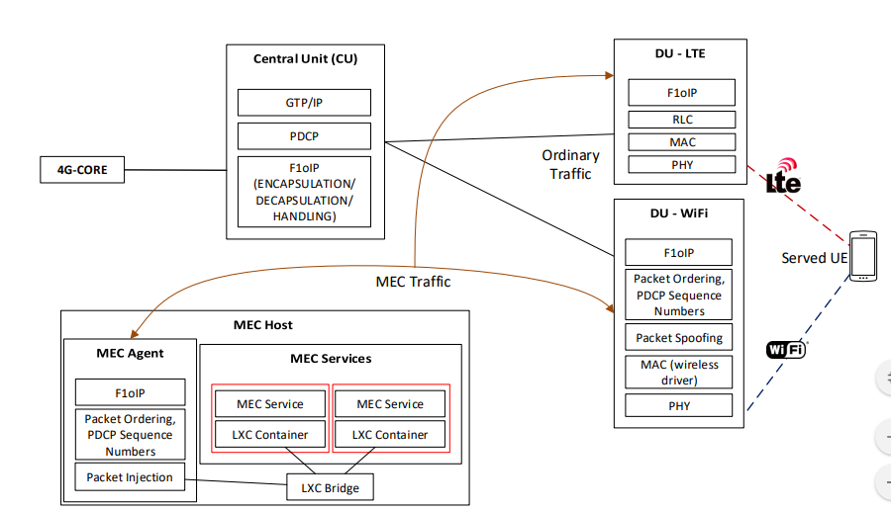
MEC in O-RAN

Slide 12
MEC in O-RAN
In this section we detail the different components needed for realizing the MEC solution over the fronthaul interface. We use as our starting point the F1oIP implementation of the CU/DU split, detailed in and extend it accordingly in order to enable the MEC operation. The implementation is introducing a new signaling mode between the PDCP and RLC layers, resembling the F1AP standardized interface for the communication between CUs and DUs. Originally, F1AP is handling data plane packets over GTP tunnels, established for each served UE of the system. The F1oIP implementation is using UDP/TCP interfaces in order to exchange the traffic between the CUs and DUs, including also some signaling information on the packet headers that is ordinarily exchanged between the PDCP and RLC layers (e.g. DRB/SRB allocation, frame/subframe scheduling, protocol context, etc.). The following sections describe the new packet headers that are introduced over the F1oIP interface, and how they allow applications directly connected to the fronthaul interface handle data-plane user-directed traffic.

Slide 13
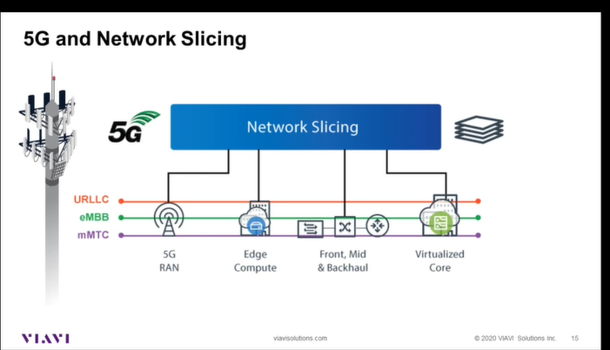

Slide 14
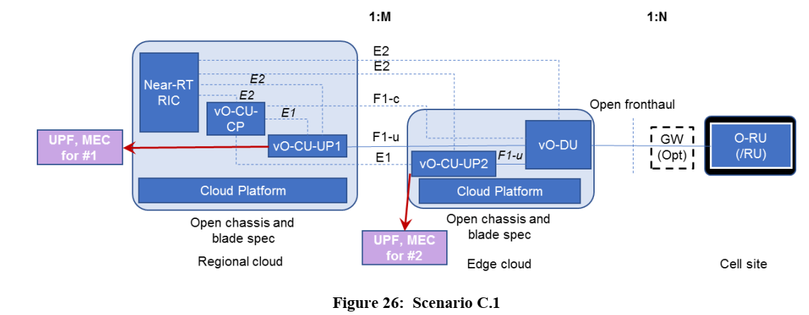

Slide 15
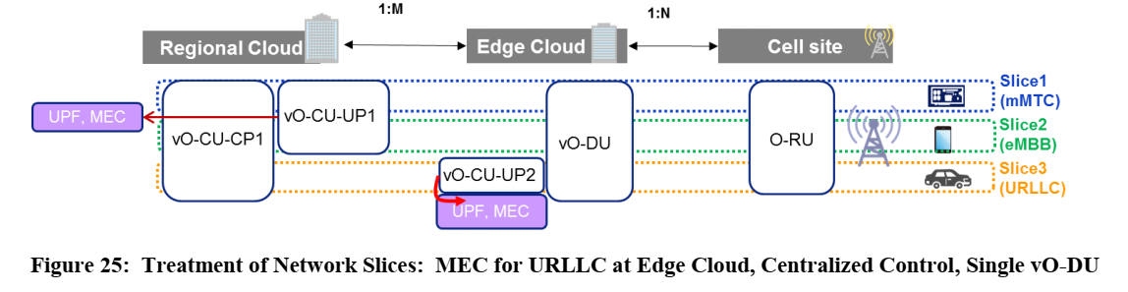
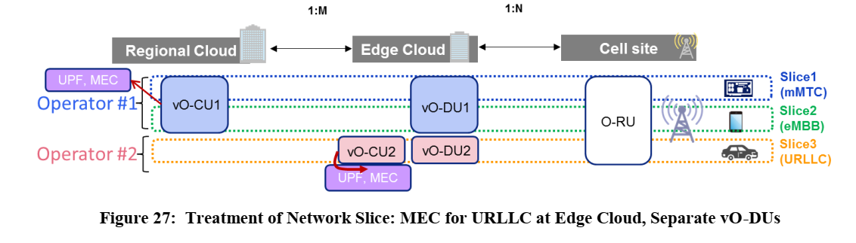

Slide 16
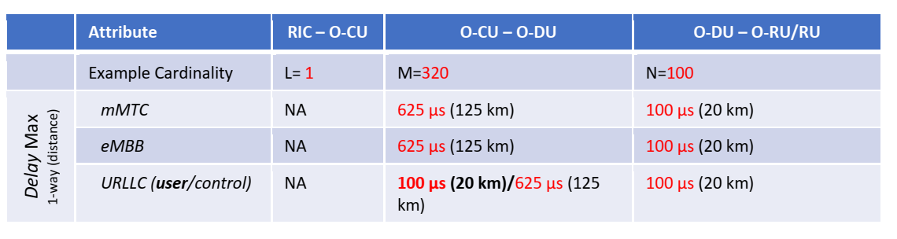
Service Type

Slide 17
MEC architecture
MEC architecture enables cloud computing capabilities close to users or at the network edge .
the computing capabilities are pushed closer to the radio access
Edge refers to the DCs close to the RAN. The edge computing reduces core network traffic, signalling load and end–to-end latency thus improving service environment and user experience.
MEC can expand both coverage and bandwidth as information processing is done locally instead of cloud based or remote DCs.

Slide 18
MEC can expand both coverage and bandwidth as information processing is done locally instead of cloud based or remote DCs
MEC based Open RAN enables certain CN functions/ CN VNFs to be executed at the edge isolated from other parts of network to provide local access to resources and data.

Slide 19
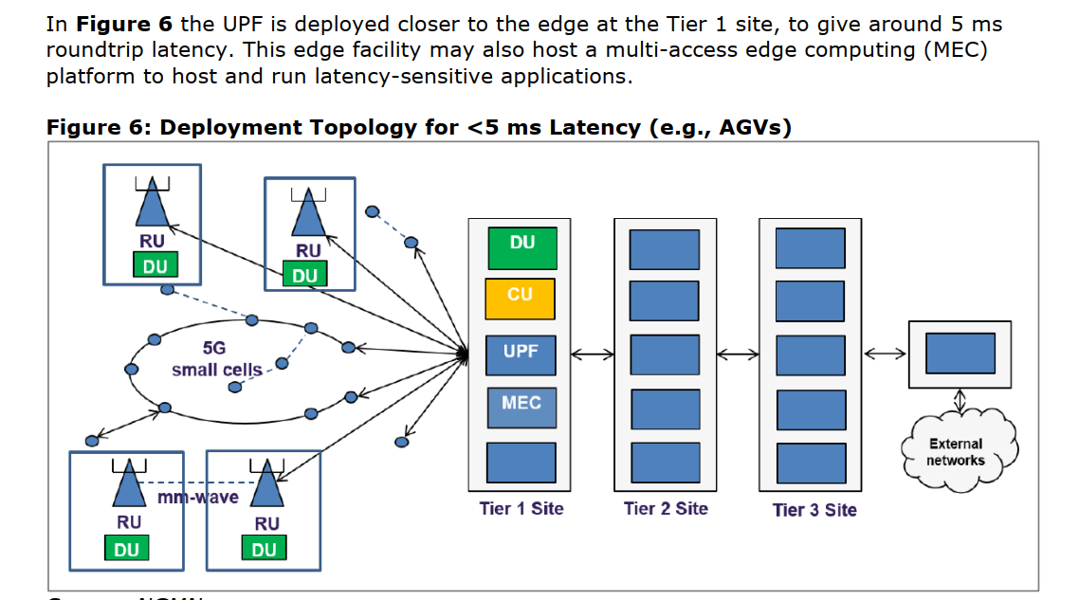

Slide 20
