Slide 1
MEC

Slide 2
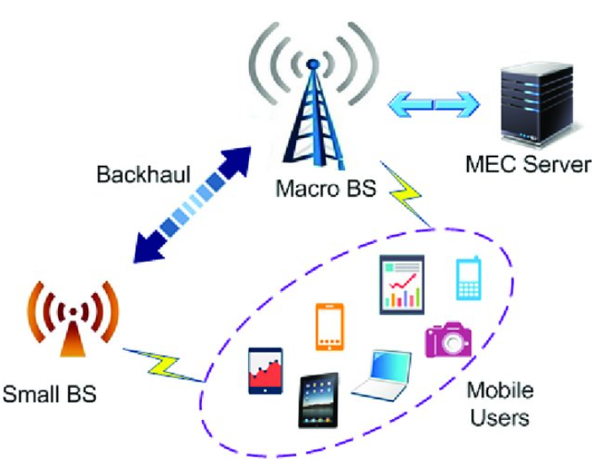
MEC

Slide 3
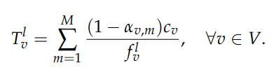
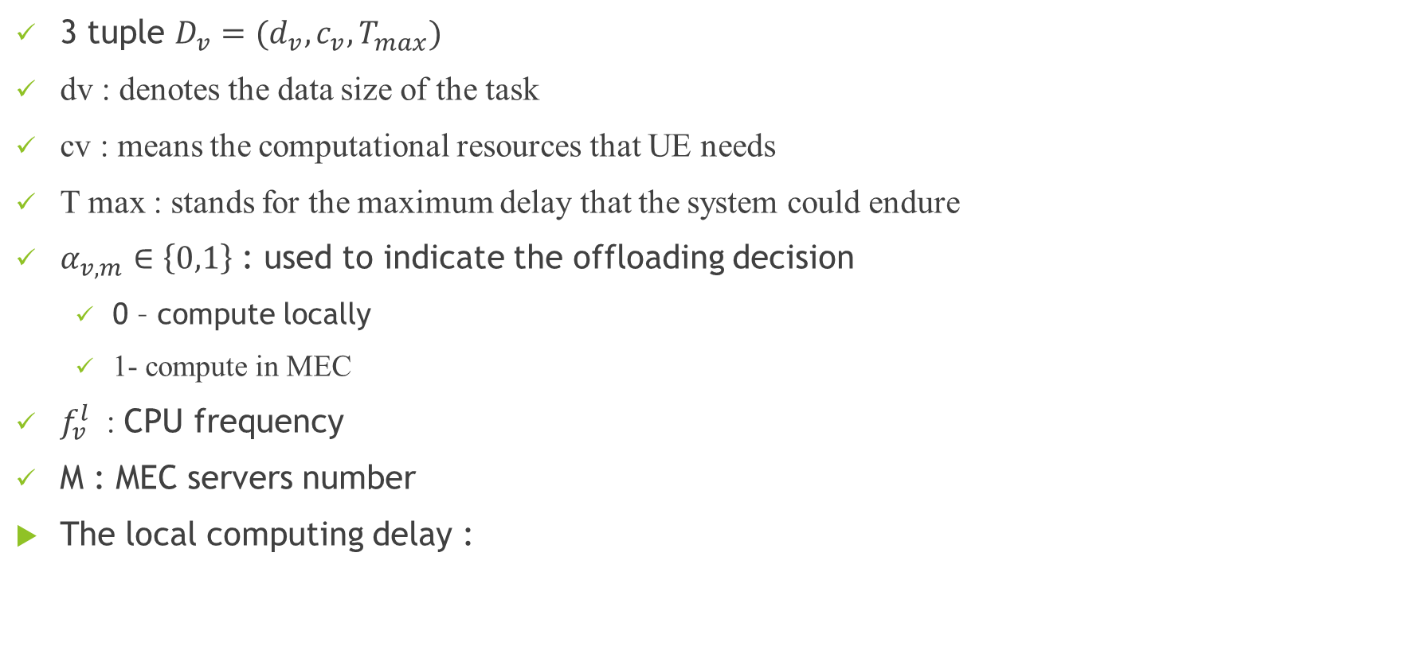
Local computing
3 tuple $D_{v}=(d_{v}, c_{v}, T_{max})$
dv : denotes the data size of the task
cv : means the computational resources that UE needs
T max : stands for the maximum delay that the system could endure
$α_{v,m}∈\left\{0,1\right\}$ : used to indicate the offloading decision
0 – compute locally
1- compute in MEC
$f_{v}^{l}$ : CPU frequency
M : MEC servers number
The local computing delay :

Slide 4



Local computing
Energy for local computing
total cost, of local computing model on VUE v, in terms of computational time energy
$β_{1}$computational time $β_{2}$computational energy $β∈\{0,1\}$

Slide 5


MEC Server
the task transmitting phase
Shannon rate
delay cost of task transmission
the task computing phase
the task return phase
Can be ignored – much less than others

Slide 6


the task computing phase
MEC servers will compute the UE’s tasks
$f_{m,v}$ the computational resources that are allocated to UE v by the MEC server m
the computing delay of the task that is offloaded from UE v to MEC server m

Slide 7



Problem formulation
$T_{v}^{u} =T_{v}^{t}+T_{v}^{e}$, $E_{v}^{U}=p_{v}T_{v}^{t}$
$β∈\left\{0,1\right\}$the sum delay and the energy consumed by transmission

Slide 8
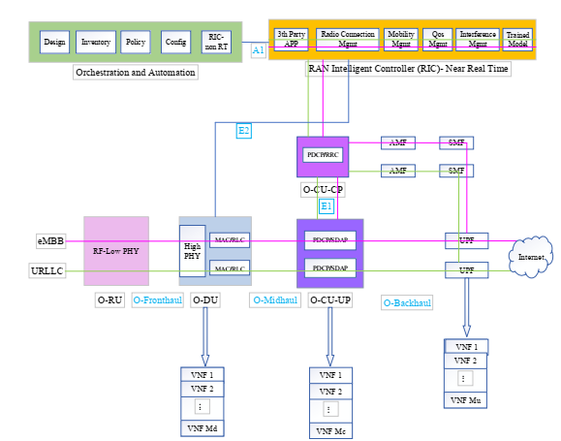
MEC

Slide 9
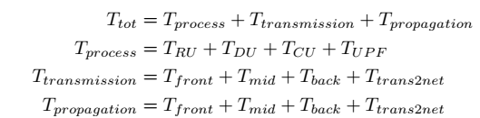
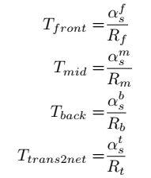
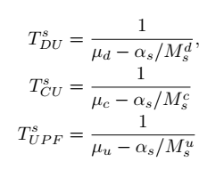
Delays
mean delay for a service

