Slide 1
MEC
Mojdeh Karbalaee Motalleb

Slide 2
MEC Architecture
MEC is a layer that resides between cloud and mobile devices. Therefore, the infrastructure is derived as a three-layer hierarchy; cloud, MEC and mobile devices . Mobile edge computing mostly complies with cloud computing to support and enhance performance of the end devices. The formation of a three-layer service model, is depicted in figure
MEC key value proposition is that it offers cloud computing by pushing cloud resources, such as compute, network and storage to edge of the mobile network in order to fulfil application requirement that are compute hungry (e.g. Games applications), latency-sensitive (e.g. Augmented Reality applications) and high-bandwidth demanding (e.g. Mobile Big data Analytics).

Slide 3
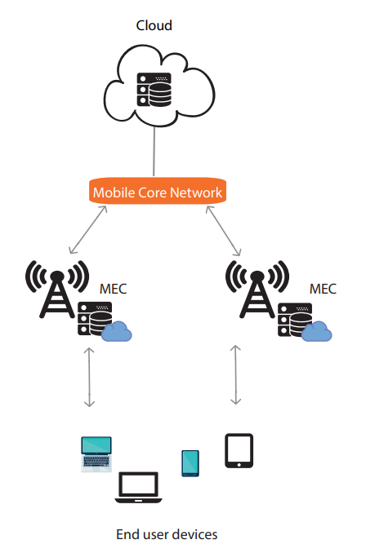
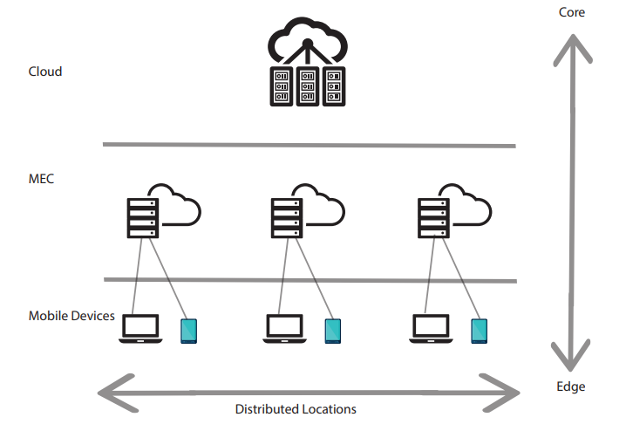
MEC Architecture

