Slide 1
C150: an exactly solved quantum cellular automaton
…and exactly what the solution does not determine
Krylov sector analysis, Tier 1 — report R8
Notes:
Framing for the discussion: C150 is the one rule in the 16-rule unitary family whose sector structure we can write down in closed form. That makes it the right place to ask what a sector does and does not tell you — which is the question that generalises.

Slide 2
The rule, and one naming note
C150 = Wolfram 150 = local symbol table (I, V, V, I)
Hadamard fires at site i ⟺ x(i−1) ⊕ x(i+1) = 1
— the firing condition is exactly classical ECA-90's update
Boundary: obc0, the missing neighbour reads 0
Cycle: brick-wall — even sublattice first, then odd
Same object as HSF rule 6 with gate H (checked from HSF/src/model.jl)
— so the whole Julia eigendata set is a usable independent oracle
Why this rule
R2 saw binomial sector sizes; R1 uses it as the HSF regression fixture;
and its fitted growth exponent 2.022 sat above the informational ceiling 2
Notes:
R8 §1. The 2.022 anomaly is resolved on slide 6 — it was a prefactor being read as a base.

Slide 3
Five results
1. Reduction — sector partition = a single-flip graph
for ANY unitary rule; the brick-wall ordering drops out
2. Solution — walls, hard-core hopping, closed form
|S_w| = C(N+1, w) for even w; the charge is the Ising domain-wall number
3. C150 is symmetry-resolved, NOT fragmented
sector count is linear in N — it is the family's null model
4. Interacting, but not chaotic
#distinct eigenvalues = 3^⌈N/2⌉ exactly — no RMT ensemble fits
5. Area law vs volume law is a sector statement
…but the sector fixes only the ceiling, not the value
Notes:
The through-line: kinematics is solved exactly; everything dynamical sits strictly below what kinematics allows.

Slide 4
Result 1 — the sector partition is a flip graph
Theorem. For a unitary rule the sectors are the connected components of
x ~ x ⊕ 2^i for every site i where the Hadamard fires
Proof sketch
each half-layer is depth-1 ⇒ its image from |x⟩ is a subcube (R1 no-interference)
x lies in its own image (⟨b|H|b⟩ ≠ 0) ⇒ composite image ⊇ both half-layer images
inside a half-layer the V/I pattern is frozen ⇒ the subcube is single-flip connected
Two consequences
the brick-wall ORDER is irrelevant — the partition is a property of the symbol table
cost drops from O(2^N·|succ|) to O(N·2^N) — this is what reaches N = 32
Validated: all 16 unitary rules × both boundaries × N = 3…12 — 320 units, 0 mismatches
Notes:
R8 §2. The validation is against the streamed engine, which knows nothing about the theorem.

Slide 5
Result 2 — walls: the whole rule in one line
Bond variables b_j = x_j ⊕ x_(j+1), j = 0…N, x(−1) = x(N) = 0
x ↦ b is a BIJECTION onto the even-weight strings of length N+1
The elementary move
flipping x_i toggles bonds b_i, b_(i+1), and is allowed iff b_i ≠ b_(i+1)
⇒ a HARD-CORE HOP of one domain wall. Walls are never created or destroyed.
Therefore
conserved charge Q = Σ (1 − Z_j Z_(j+1))/2 — the open Ising domain-wall number
each wall shell is exactly one sector (hard-core hopping is connected on a shell)
Zero charge violations over every state, N = 3…12, both boundary conditions
Notes:
R8 §3. This is the step that turns a numerical observation into a closed form. Everything downstream is bookkeeping on this picture.

Slide 6
Result 3 — the closed form, and the growth law
|S_w| = C(N+1, w) for even w #sectors = ⌊(N+1)/2⌋ + 1 D_max = max over even w
matches every stored Tier-1a unit, N = 6…20, both boundary conditions
C150 is NOT fragmented
sector count is LINEAR in N and every sector is a full Q-eigenspace
no Krylov structure beyond the U(1) charge — contrast W204's 2^N frozen singletons
→ it is the wrong example to quote for Hilbert-space fragmentation
The 2.022 anomaly, resolved
D_max/2^N = 2√(2/π(N+1)) — base is EXACTLY 2, the decay is an N^(−1/2) prefactor
plus a sawtooth at N ≡ 1 (mod 4), where the central binomial sits at odd w
a pure-exponential fit reads prefactor + sawtooth as a base above the ceiling
Notes:
R8 §4. This also corrected two loose statements in R2: sector sizes are the EVEN-WEIGHT entries of Pascal's row N+1 (the 'lower half' phrasing only coincides for even N), and D_max is the central binomial except at N ≡ 1 mod 4.

Slide 7
Numerical frontier — two independent routes
N | 2^N | #sectors | D_max | streamed engine | flip graph
20 | 1,048,576 | 11 | 352,716 | 1.1 h | —
21 | 2,097,152 | 12 | 646,646 | 3.6 h | 0.3 s
22 | 4,194,304 | 12 | 1,352,078 | 10.2 h | 0.4 s
28 | 268,435,456 | 15 | 77,558,760 | — | 37.7 s
30 | 1,073,741,824 | 16 | 300,540,195 | — | 154 s
31 | 2,147,483,648 | 17 | 601,080,390 | — | 297 s
32 | 4,294,967,296 | 17 | 1,166,803,110 | — | 815 s
Notes:
R8 §5. Left route uses exact Z[1/√2] amplitudes and no result of this report; right route uses the flip reduction. They agree at N=21,22 where they overlap, and the reduction is 4×10^4 / 1×10^5 times faster there. N=32 = 4.29e9 basis states, 21.0 GB peak — the uint32 and RAM ceiling; N=33 would need a 64-bit label array (68.7 GB).

Slide 8
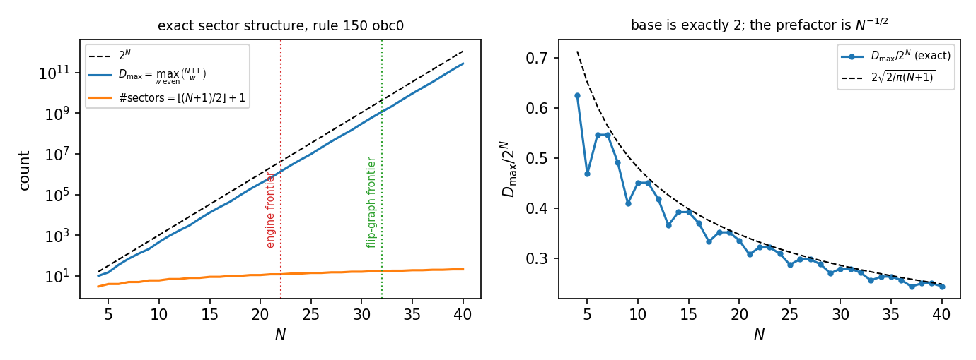
Exact sector structure, and where the numerics stop
Left: the closed form with both computed frontiers marked. Right: D_max/2^N against 2√(2/π(N+1)) — base 2, N^(−1/2) prefactor, sawtooth at N ≡ 1 (mod 4).
Notes:
Talking point: the closed form is exact at every N, so the frontier is a validation frontier, not a discovery frontier.

Slide 9
What the sector does NOT determine
A sector is the maximal reachable set from a basis state — nothing more
An exponentially large stationary space
dim Fix(U_w) = C(⌈N/2⌉, w/2), dim Fix(U) = 2^⌈N/2⌉ = 2^(#even sites)
Fix(U) = Fix(L_A) ∩ Fix(L_B); almost all of it is DARK SUPERPOSITIONS
Hence an inner sector is never a Krylov space
spectrum degenerate ⟺ |S_w| > N+1; dim K(x)/|S_w| = 0.40 … 0.96
Monitored vs unmonitored disagree inside a sector
monitored: provably uniform on S_w (doubly stochastic, irreducible, aperiodic)
unmonitored: diagonal ensemble occupies only 6.6 % … 50 % of the sector
Reflection: commutes for odd N; conjugates U to U⁻¹ for even N
Notes:
R8 §6. This is the precise, rule-specific form of the general caveat in R1 §'What a sector is': the graph gives dim K(x) ≤ |S_w| and away from the extremal shells the inequality is strict.

Slide 10
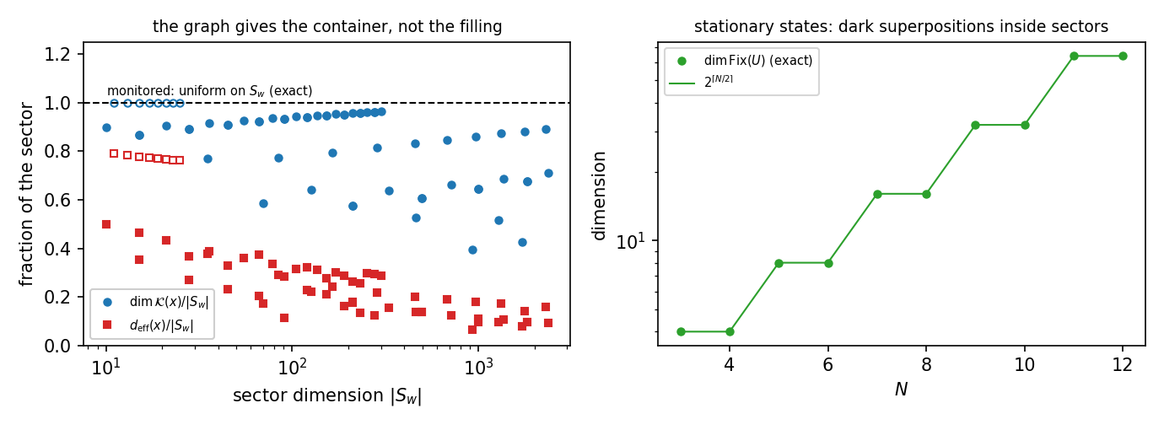
The graph gives the container, not the filling
Left: Krylov and diagonal-ensemble fractions of a sector; the dashed line is the monitored answer, which is exactly uniform. Right: dim Fix(U) = 2^⌈N/2⌉.
Notes:
Open markers on the left are the extremal shells |S_w| ≤ N+1 — the only ones with a nondegenerate spectrum, hence the only ones a basis state's Krylov space fills.

Slide 11
Result 4a — interacting, not free
In the bond basis the gate at site i touches bonds i, i+1 only
identity when both bonds agree; on the one-wall subspace a Hadamard coin
M(c) = (1/√2)[[−(−1)^c, 1], [1, (−1)^c]], det M = −1, c = wall parity to the left
this bond circuit reproduces the engine to 1.1×10⁻¹⁶ — it IS C150
Two diagonal signs spoil gaussianity
det(H) = −1 but the gate acts by +1 on a doubly occupied pair → maximal nearest-neighbour wall interaction exp(iπ n n)
the (−1)^c string sits on the DENSITY term, not the hop → not absorbed by Jordan–Wigner
Sharp test: a Gaussian circuit has additive many-body eigenphases
C150: 0.55 … 1.87 rad remove one defect: still 0.43 … 1.10 rad
remove BOTH: additive to 4×10⁻¹⁵ — so both signs are needed, and C150 is interacting
Notes:
R8 §7. Careful: interacting does NOT imply chaotic — see the next slide. That inference is exactly the one we had to retract.

Slide 12
Result 4b — the spectrum is exponentially degenerate
N | 2^N | #distinct | closed form 3^m / (3^m±1)/2 | fraction
8 | 256 | 81 | 81 | 0.316
9 | 512 | 121 | 121 | 0.236
10 | 1,024 | 243 | 243 | 0.237
11 | 2,048 | 365 | 365 | 0.178
12 | 4,096 | 729 | 729 | 0.178
13 | 8,192 | 1,093 | 1,093 | 0.133
14 | 16,384 | 2,187 | 2,187 | 0.133
Notes:
R8 §7.3. m = ⌈N/2⌉ = number of even sites. The law was fitted on N ≤ 13 and confirmed OUT OF SAMPLE at N = 14 (predicted 2187, got 2187). No tolerance to argue about: at N=12 the gaps split into 3367 below 1e-12 and 728 above 1e-4 with five empty decades between, so the count is identical for thresholds 1e-13 … 1e-5.

Slide 13
Result 4c — no random-matrix ensemble fits
β = 2 (GUE / CUE) excluded by symmetry
U is real orthogonal ⇒ complex conjugation is a time reversal, K²=1
⇒ eigenvalues in mirror pairs; all statistics on θ ∈ (0, π) only
β = 1 (COE / Haar-O) excluded by the degeneracy law
no chaotic Floquet operator has 3^m distinct eigenvalues out of 2^N
Poisson excluded too
ONE universal set Θ_N per N: every shell's spectrum ⊆ Θ_N, and the largest shell realises ALL of it (small shells as little as 1.8 %)
largest shell N=16, w=8: ⟨r̃⟩ = 0.347, BELOW Poisson (0.384) — and superposition can only approach Poisson from above
Structural source: U = L_B·L_A is a product of two involutions
gives the ±θ pairing and explains Fix(U) = Fix(L_A) ∩ Fix(L_B)
⇒ C150 is INTERACTING BUT NOT CHAOTIC — the two are compatible
Notes:
R8 §7.4–7.5. References generated through the identical pipeline: Poisson 0.384, 2×Haar-O 0.418, COE 0.530, Haar-O 0.600, CUE 0.606. Erratum worth mentioning: an earlier draft predicted the statistics 'will not look free', which read as 'will look chaotic' was wrong.

Slide 14
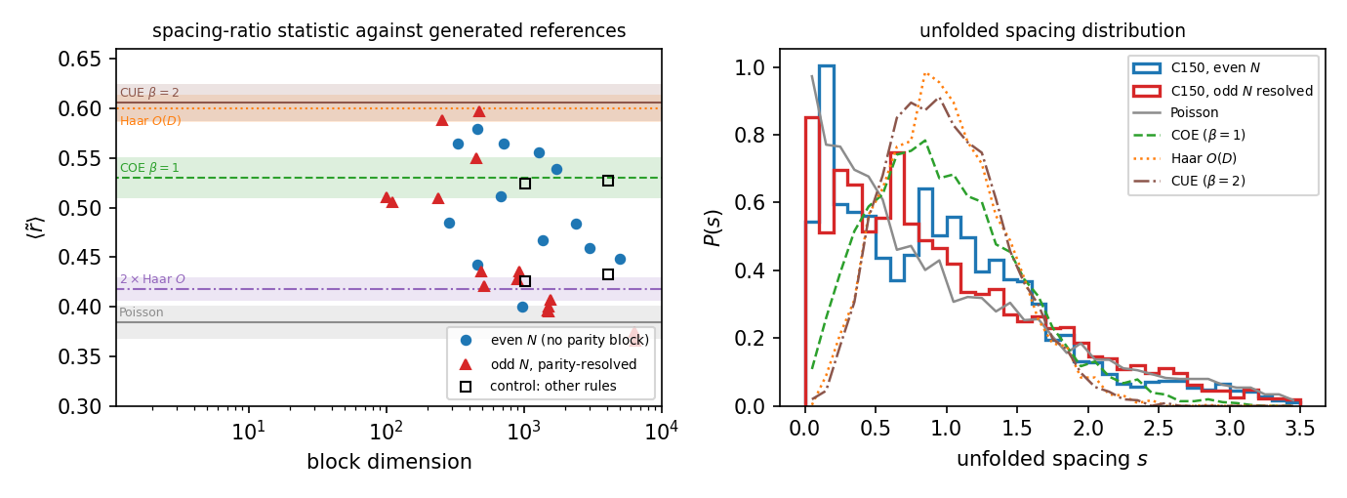
Level statistics against generated references
Left: ⟨r̃⟩ per symmetry block with the reference ensembles as bands. Right: the unfolded spacing distribution.
Notes:
Three things had to be handled or the numbers are meaningless: odd N needs reflection-parity resolution (0.43 → 0.60 at N=11); the odd-N shells w and N+1−w have identical spectra and are counted once; and fixed w with growing N is a FEW-BODY problem that must go Poisson.

Slide 15
Independent check: the HSF Julia eigendata (rule 6 = 150)
N | states | sectors | #distinct | 3^m law | sizes | dim Fix | deg. states
8 | 256 | 5 | 81 | 81 | ✓ | ✓ | 0.43
9 | 512 | 6 | 121 | 121 | ✓ | ✓ | 0.53
10 | 1,024 | 6 | 243 | 243 | ✓ | ✓ | 0.56
11 | 2,048 | 7 | 365 | 365 | ✓ | ✓ | 0.67
12 | 4,096 | 7 | 729 | 729 | ✓ | ✓ | 0.66
13 | 8,192 | 8 | 1,093 | 1,093 | ✓ | ✓ | 0.73
14 | 16,384 | 8 | 2,187 | 2,187 | ✓ | ✓ | 0.74
Notes:
R8 §8. Same operator, verified by reading HSF/src/model.jl; only a bit reversal of the basis and θ = −arg λ differ, neither of which can touch a spectrum. N=14 = 2187 is the out-of-sample prediction reproduced by a different language, sparse assembly, basis ordering and sign convention. CAVEAT for the stored entropies — see next slide.

Slide 16
A caveat for the stored entanglement entropies
On a degenerate eigenvalue the eigensolver returns an ARBITRARY orthonormal basis
and the half-chain entropy is not constant on that basis
Measured
rotating inside one eigenspace moves the stored entropies by up to 0.27 nats
the same test on a simple eigenvalue gives a spread of exactly 0
For this rule that is the typical case, not an edge case
fraction of stored eigenstates in a degenerate eigenspace: 0.43 (N=8) → 0.74 (N=14)
multiplicities up to 35 within a single sector
Not a defect in the HSF code — a property of the spectrum
options: restrict statistics to simple eigenvalues, or use a basis-independent quantity (eigenspace-averaged purity)
worth checking which of the other plotted rules share this
Notes:
The mean stored entropy is sub-thermal throughout, 0.50–0.61 of ln2·⌊N/2⌋ — the direction the rest of the analysis predicts.

Slide 17
Result 5 — why the same rule gives area AND volume law
The three Fig. 3a states are in three very differently sized sectors
single excitation |0…010…0⟩: w = 2 → |S_w| = C(N+1,2), POLYNOMIAL
Néel |0101…⟩: w = N → |S_w| = N+1, LINEAR
pair |001100…⟩: w ≈ N/2 → |S_w| exponential
So the premise fails: C(N+1,w) is exponentially large only near w = (N+1)/2
the Néel state is a ONE-HOLE state in wall language — a wall on every bond but one, hard-core ⇒ JAMMED
The exact ceiling is the bipartite Schmidt rank, not ln|S_w|
from w = w_A + b_cut + w_B; the LOWER limit matters at high filling
verified = the compressed Schmidt dimension for all w, N = 6…14
at N=26: single ln 92 = 4.5, Néel ln 14 = 2.6, pair 9.011 = ⌊N/2⌋ln2 exactly
Notes:
R8 §9. I initially dropped the lower limit and caught it against the actual Schmidt dimensions — without it the Néel state looks unconstrained (64 patterns instead of 7 at N=12).

Slide 18
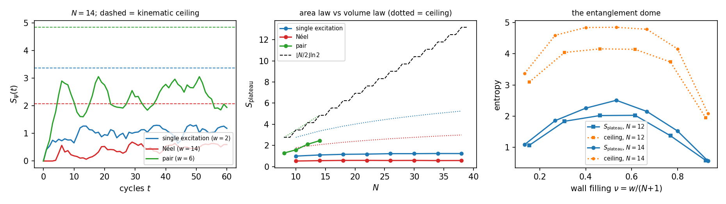
Area law, area law, volume law — predicted by w alone
Left: S(t) at N=14 with the kinematic ceilings. Middle: the plateau vs N — single excitation and Néel are FLAT to N=38, the pair state grows. Right: the entanglement dome vs wall filling.
Notes:
Plateaus: single 1.00→1.24 and Néel 0.53→0.58 over N=10…38, both flat and in fact flatter than their own ln N ceilings; pair 1.29→2.45 over N=8…14 with a ceiling equal to the volume-law value.

Slide 19
Is the sector enough? — the three answers
For the growth TYPE and its N-scaling: YES
via the exact ceiling, not via |S_w| — knowing w already separates ln N from N
For PRODUCT initial states, the sector nearly fixes the value too: ±3 %
six random basis states of the N=14, w=6 shell: plateaus 2.26 … 2.39
Fig. 3a uses product states ⇒ its three curves are set by three integers w
Over ALL states of a shell: NO
the stationary states of the same shell — C(⌈N/2⌉, w/2) = 35 at N=14, w=6 —
have S(t) CONSTANT to 1e-15, at a value ABOVE the product plateau (3.5 vs 2.4)
a 35-dimensional family with zero entanglement growth inside a volume-law sector
The dome's shape is the ceiling's shape; the dynamics supplies only an O(1) fill factor ≈ ½
the same sub-thermal fraction as the HSF entropies — as the degenerate spectrum predicts
Notes:
One sentence: the sector fixes the ceiling and hence the law; the dynamics fixes the prefactor; and only non-product states inside a sector can defy the sector's expectation, by not moving at all.

Slide 20
Open items
Identify the commutant
the 3^m law forces an exponentially large commutant (Σ m_λ²)
its generators would prove the law AND make the block-resolved spacing statistics exact rather than a lower bound
Derive the two closed forms
dim Fix(U_w) = C(⌈N/2⌉, w/2), and a w-resolved version of the 3^m law
The partner-shell intertwiner
for odd N the shells w and N+1−w have identical spectra (1.2e-14),
but the bond particle-hole map does NOT commute with U — unidentified
C150 on the ring
kinematics solved; the quantum layer is obc0 only. The 2-to-1 wall map gives the bond frame a Z₂ gauge redundancy
Frontier
N = 33 needs a 64-bit label array (68.7 GB), or a two-pass compact relabelling
Notes:
Ranked roughly by payoff. The commutant is the one that unlocks the others.

Slide 21
Reproduce
Closed forms, wall bijection, charge conservation, engine cross-check
python -m qca_fragmentation.c150 --verify
Frontiers
python -m qca_fragmentation.run_rule --rule 150 --N 21-22 --bc obc0
python -m qca_fragmentation.c150 --frontier 21-32 --bc obc0
Quantum layer, level statistics, entanglement, HSF check
python -m qca_fragmentation.scaling.c150_report --quantum
python -m qca_fragmentation.quantum.rule150_levels --run
python -m qca_fragmentation.quantum.rule150_entanglement --run
python -m qca_fragmentation.quantum.hsf_compare --all
Report and data
reports/pdf/R8_c150.pdf (18 pp) · analytics/c150_*.json
full test suite: 403 tests
Notes:
This slide exists so the deck is self-contained if someone wants to rerun a number during the discussion.

Slide 22
A Tier-2 view — C150 as an open system
Tier 2 studies the full 256-rule family as CHANNELS: each neighbour pattern carries I, V (Hadamard), D (reset to 0) or E (reset to 1)
C150 = (I, V, V, I) is one of the 16 unitary members — the D/E-free corner
Three questions the sector graph cannot answer, and the channel formalism can
how large is the algebra of conserved operators? (slide 20's first open item)
what survives when the rule is made dissipative — are the sectors fragile?
is the protected coherence a decoherence-free subspace, i.e. usable as a code?
Everything below is an INDEPENDENT re-derivation
separate repository, separate engine (sector_analysis_tier2); obc0 throughout
marked results are exact over ℚ(√2) — rational Gaussian elimination, no eigensolver, no tolerance
first cross-check: the Tier-2 SCC code reproduces #sectors = ⌊(N+1)/2⌋+1 for N = 3…12, and the pbc counts, with no shared code

Slide 23
Dictionary — sectors ↔ open-system language
Tier 1 (unitary) | Tier 2 (channel Φ) | C150, obc0
Krylov sector | terminal SCC of the support graph | every SCC is terminal
— (no counterpart) | transient SCCs → condensation DAG | EMPTY: the DAG has no edges
#sectors | n_recurrent | ⌊(N+1)/2⌋ + 1
Fix(U) | λ = 1 eigenspace of Φ | dim 2^m, m = ⌈N/2⌉
commutant of U | fixed-point algebra; dim = Σ m_λ² = Cesàro rank | 6^m (new — see next slide)
spectral degeneracy | protected coherence: gap = Σ m_λ² − n_recurrent | 33 at N = 4; 6^m − ⌊(N+1)/2⌋ − 1
— (no counterpart) | transient dark states (R-T11) | none — there is no transient region
C150 is the degenerate case of the Tier-2 machinery: a channel with no transient region at all. That is exactly why every attractor question for it collapses to a question about the spectrum of U.

Slide 24
Open item closed (1) — the commutant
The commutant of U is the fixed-point algebra of the channel: dim = Σ_λ m_λ² = the Cesàro rank
measured from the exact multiplicities, N = 3…11, and matched to a formula
dim C(U) = 6^m for even N, (6^m + 2^m)/2 for odd N, m = ⌈N/2⌉
N = 3…11: 20, 36, 112, 216, 656, 1296, 3904, 7776, 23360 — exact, no fit
independently confirmed over ℚ(√2) at N = 4: dim ker(L − 1) = 36 = 6² — tolerance-free, no eigensolver
Growth (√6)^N = 2.449^N — far above the 2^N of the Hilbert space
the naive Cauchy–Schwarz floor from the 3^m law alone is only 4^N/3^m = 2.309^N, so the degeneracy is even more structured than the count implies
only ⌊(N+1)/2⌋+1 of those dimensions are diagonal (the wall charge) — the commutant is overwhelmingly OFF-diagonal
Protected coherence: gap = 6^m − ⌊(N+1)/2⌋ − 1
33 at N = 4, 212 at N = 6, 1291 at N = 8, 46 649 at N = 12

Slide 25
Open item closed (2) — the full spectrum
Spectral factorisation (obc0). m = ⌈N/2⌉; M(N) = m × m tridiagonal, off-diagonal ¼, diagonal ½, with
M₀₀ = 1/√2 − ¼ (all N) and M_(m−1,m−1) = ¾ (odd N only)
cos φ_i = eigenvalues of M(N)
spec(U) = { Σ_i ε_i φ_i }, ε ∈ {−1, 0, +1}^m, multiplicity 2^#{ε_i = 0}
odd N: only sign patterns with an EVEN number of non-zero ε occur
Equivalently, for even N a quantisation condition: sin((m+1)k) = (2√2 − 3)·sin(mk), cos φ = cos²(k/2)
the boundary defect 2√2 − 3 = −(√2 − 1)² is the obc0 edge; the ¾ is a second defect at the far end, present only for odd N
Verified N = 2…12 against the engine
all 729 distinct eigenphases at N = 12 reproduced from SIX numbers: max phase error 5×10⁻⁹, multiplicities exact
it DERIVES the three laws that were stated separately: #distinct = 3^m (the all-patterns count), dim Fix(U) = 2^m (the all-zero pattern), and dim Fix(U_w) = C(m, w/2) (that pattern's split over wall shells)

Slide 26
Is C150 free after all? The two tests differ
The tension, stated plainly
Result 4a: C150 is NOT free. This law: the spectrum factorises over ⌈N/2⌉ modes, which is what a free model does.
Resolution — they test different freeness
Result 4a asks whether the w-wall block is the w-th antisymmetric power of the ONE-wall block: free, NUMBER-CONSERVING walls. That is refuted, and stands.
this law's modes are not wall occupations: each carries ε ∈ {−1, 0, +1} (a ± pair), and there are ⌈N/2⌉ of them, not N+1
direct evidence: the w = 2 shell at N = 6 (21 states) contains 0-mode, 1-mode AND 2-mode phases — 3 + 6 + 12 — so mode number ≠ wall number
Honest summary
C150 is not a free wall gas, but its Floquet spectrum is exactly that of ⌈N/2⌉ particle–hole-paired modes — spectral freeness without wall-number freeness
that is what makes the degeneracy structural rather than accidental, and it is the mechanism behind Result 4c's RMT exclusion
open: exhibit the mode operators. They generate the commutant, and a 4-level block {φ, 0, 0, −φ} per mode gives 6^m immediately

Slide 27
C150 under dissipation — the neighbours
rule | tuple | recurrent classes | Cesàro rank | gap | transient dark | reading
150 | (I, V, V, I) | 3 | 36 | 33 | — | C150 itself
146 | (D, V, V, I) | 1 | 1 | 0 | 0 | total collapse, no coherence
151 | (E, V, V, I) | 1 | 5 | 4 | 0 | one 5-state class: period-3 QLC
148 | (I, D, V, I) | 3 | 9 | 6 | 0 | 3-dim DFS = 3 sectors
134 | (I, V, D, I) | 3 | 9 | 6 | 0 | 3-dim DFS = 3 sectors
158 | (I, E, V, I) | 3 | 15 | 12 | 8 | DFS + dark states
214 | (I, V, E, I) | 3 | 15 | 12 | 8 | DFS + dark states
22 | (I, V, V, D) | 2 | 13 | 11 | 7 | R-T11 rule: vacuum + same QLC
182 | (I, V, V, E) | 2 | 17 | 15 | 4 | vacuum + a 10-state QLC
N = 4, obc0; all entries exact over ℚ(√2). Note the W22 row: the rule whose transient dark states forced the Tier-2 gap definition to be corrected — is C150 with a single symbol changed. The two middle-slot D-mutations preserve the sector count exactly; the E-mutations add transient dark states on top.

Slide 28
The sectors survive dissipation as a DFS
W148 = (I, D, V, I) and W134 = (I, V, D, I): each C150 sector collapses to ONE pointer state, and every coherence between them survives
exact block dimension [n] with n = ⌊(N+1)/2⌋ + 1 = the C150 sector count, verified N = 3…7 for both rules; gap = n(n−1)
N = 3,4 → 3-dim (gap 6); N = 5,6 → 4-dim (gap 12); N = 7 → 5-dim (gap 20)
Explicit, at N = 5: DFS = span{ |00000⟩, |10000⟩, |10100⟩, |10101⟩ }
one maximally packed representative per wall number w = 0, 2, 4, 6 — left-packed for W148, right-packed for W134, the two being boundary mirror images. The dissipation picks a canonical member of each C150 sector and keeps the coherence between them
Reading: the wall charge becomes an error-protecting charge
a logical qudit of dimension ⌊(N+1)/2⌋+1, growing LINEARLY in N, protected passively — no gates, no syndrome extraction
same mechanism as W232 in Tier-2's QEC chapter (R-T12; cf. Guedes, Winter & Müller, arXiv:2309.03608): a classical CA charge promoted to a dissipative code space
caveat: this is protection against the automaton's OWN dissipation. No threshold against extrinsic noise has been computed — that is the next test.

Slide 29
The ring, and the updated open list
C150 on pbc — kinematics in closed form (Tier-2 SCC engine, N = 3…12)
|S_w| = 2·C(N, w) for even w with 0 < w < N; the factor 2 IS the Z₂ gauge redundancy — the two spin states of a bond string are the global flip
w = 0 gives two frozen singletons (all-0, all-1); for even N, w = N gives two more (the two Néel states)
#sectors = N/2 + 3 (even N), (N+3)/2 (odd N) — checked N = 3…12
Closed by this chapter
the commutant dimension (6^m), and its (√6)^N growth
the 3^m law, dim Fix(U) = 2^m and dim Fix(U_w) = C(m, w/2) — all three now follow from one factorisation
Still open
the explicit mode operators; the partner-shell intertwiner; whether the odd-N second defect ¾ has a boundary interpretation
does the W148/W134 DFS dimension keep tracking ⌊(N+1)/2⌋+1 beyond N = 7, and does it hold on the ring?
extrinsic-noise threshold for the inherited code — connects this deck to the QEC literature

