Slide 1

Research
Presentation
A Linear Induction Motor (LIM) system to propel a pod
Liam Waghorn
Mohamed Mahmoud

Slide 2

The Task
Accurately determine pod position
Reliable
Minimal maintenance/hardware
Fast
Scaleable

Slide 3


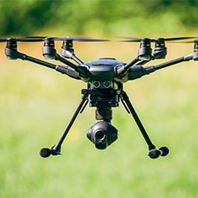
Similar Industry Problem
Aviation
Railway
UAV

Slide 4



Common Industry
Solutions
GNSS/GPS
IMU
Positional Checkpoints
Wifi Positioning

Slide 5
GPS
Accurate to ~4m
Requires Consistent Outside Reference
Poor Availability underground
Not needed for consistent controlled environment

Slide 6
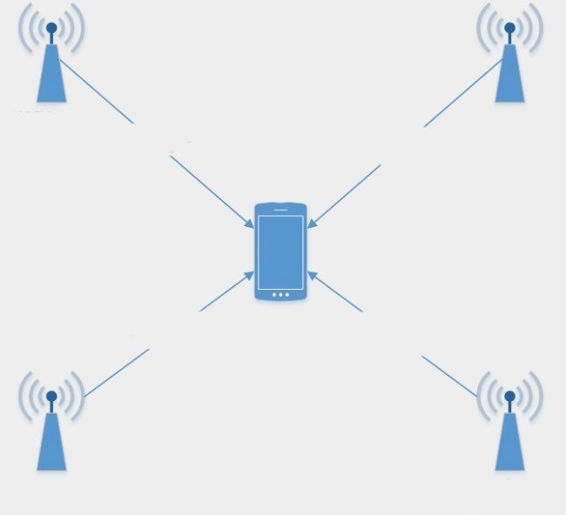
Wifi Positioning

Slide 7
Wifi Positioning
Solves Undergound Problem
Requires Hardware along entire tube
Expensive
Mildly Software Intensive

Slide 8
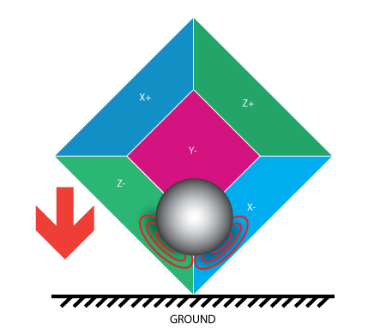
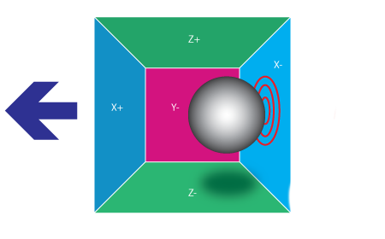
Inertial Measurement Unit
Senses Directional Acceleration
Senses Angular Rate
Use Acceleration to calculate distance traveled

Slide 9
Inertial Measurement Unit
No External Reference - fast
Good for overall Data Collection
Drift Factor at long measurements
Scaling Problems

Slide 10
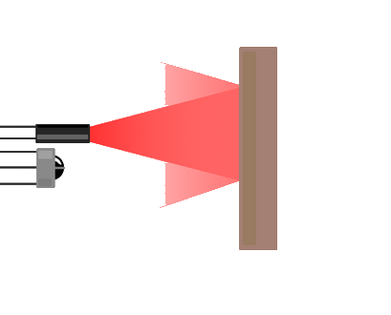
Positional
Checkpoints
Infrared Sensors detect checkpoints along tube
Checkpoints correspond to absolute positions
Varying between sensors acts
“Missed Checkpoint” failsafe

Slide 11

Positional
Checkpoints
No outside reference
Position at checkpoints is
certain
Position between checkpoints
Is unknown

Slide 12
Proposed Solution
IR Sensor
System
IMU
IR Sensors gives position at checkpoints
IMU gives positional data between checkpoints
IMU Drift factor eliminated at checkpoints
Performance data collected through IMU

Slide 13
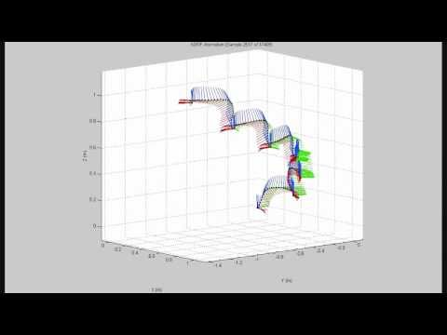
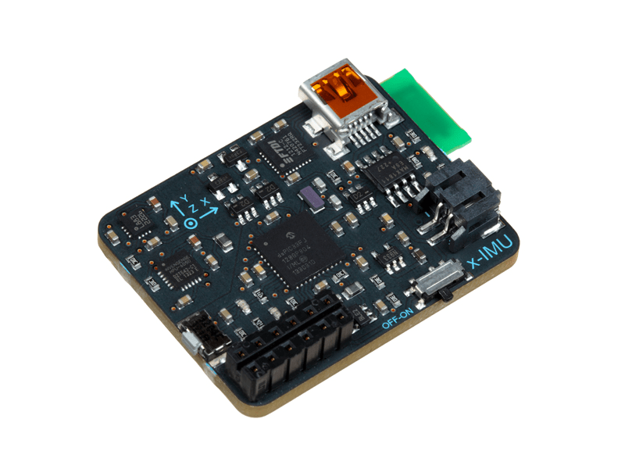

X-IMU
Reference Video
Reads IMU Data
Cost : 249 Euro
Detects a Stationary Value - Threshold detection
1.sqrt(accX.*accX + accY.*accY + accZ.*accZ)
2.HP filter
3.LP filter
Compute Orientation
AHRSalgorithm.Quaternion
Reference - website
Translational
Acceleration
Velocity
Position
MatLab Library
Arduino Library

Slide 14
X-IMU
Reference Video
Reads IMU Data
Cost : 249 Euro
Detects a Stationary Value - Threshold detection
1.sqrt(accX.*accX + accY.*accY + accZ.*accZ)
2.HP filter
3.LP filter
Compute Orientation
AHRSalgorithm.Quaternion
Reference - website
Translational
Acceleration
Velocity
Position
MatLab Library
Arduino Library

Slide 15
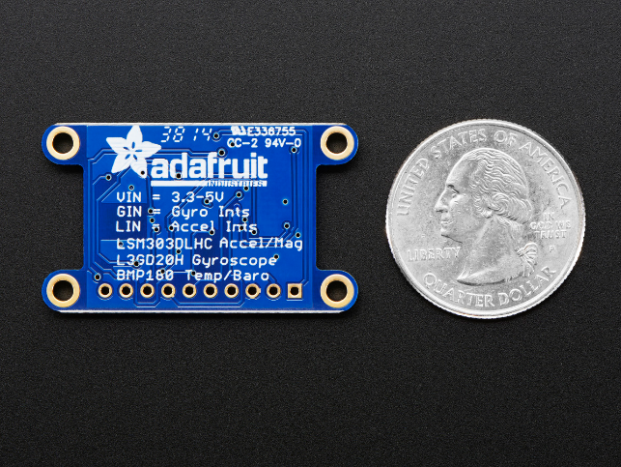
10-DOF
Reads IMU Data
Cost : 29.95 $
Detects a Stationary Value - Threshold detection
1.sqrt(accX.*accX + accY.*accY + accZ.*accZ)
2.HP filter
3.LP filter
Compute Orientation
RTIMULib2.Quaternion
Translational
Acceleration
Velocity
Position
10-DOF Library
RTIMULib 2
Reference Video

Slide 16
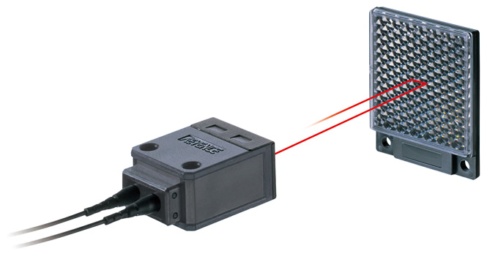
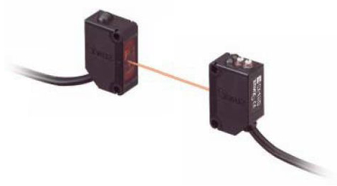
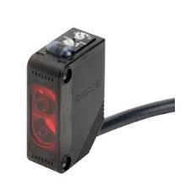
Sensor Selection
Retro Reflective Sensor
Through Beam Sensor
Diffuse Reflection Sensor

Slide 17
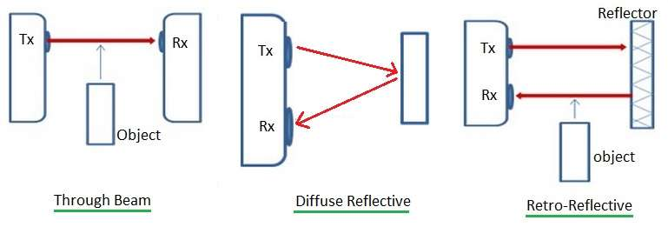
Functionality
Through Beam
Hardware on Pod and Tube
Small room for error
Retro-Reflective
Use sensor specific reflectors
Less Ambiguity in material
Diffuse Reflective
Reflective Surface more flexible
Requires less accuracy
Struggles at further ranges

Slide 18
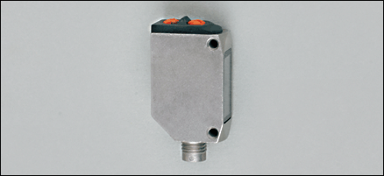
Possible Hardware
O6T306
Switching frequency - 1000Hz
Maximum Distance - 0.7m
~$130USD
25cm at 500km/h

Slide 19

Requirements
January 20XX
March 20XX
Scaleable | Accurate |  | Minimal Hardware |  | Fast

Slide 20
Research
Presentation
Questions...

