Slide 1


KNOW-IT,CDAC-ACTS(ATCTC),PUNE
ART FOR WELFARE
Guided by : Snehal Somawanshi
Delivering by:
Abhinav Kumar (230343020001)
Tushar Dhanorkar (230343020026)
Mahendra Kumar Meena (230343020054)
Nikhil Talmale (230343020063)

Slide 2
CONTENT
Project Introduction
Project Architecture
Database Design
Technology platform used for project
User roles and responsibilities
Contribution
File and Directory structure of project
Use of GitHub in project
Future Scope
Conclusion

Slide 3
Project Introduction
Art for Welfare acts as Bridge between artistic expression and impactful social change
Allowing artists to contribute their talents to support NGOs.
Customers purchase these artworks, with the funds directly benefiting NGOs dedicated to making a positive impact on society.
The project aims to make a meaningful impact on pressing societal issues.
The NGO’S are directly benefited ,they get directly funded.
……

Slide 4
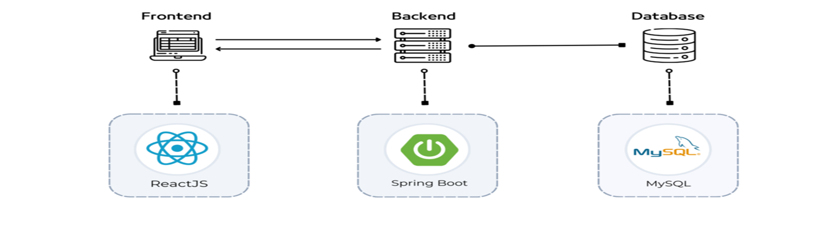
Project Architecture
….
FRONT - END
•UI
•Validations
•Routing
BACK - END
•Request Handling
•Business Logic
•Database Operation
DATABASE
•Permanent Data storage
•Stored Procedures /Triggers
•Data Constraints

Slide 5
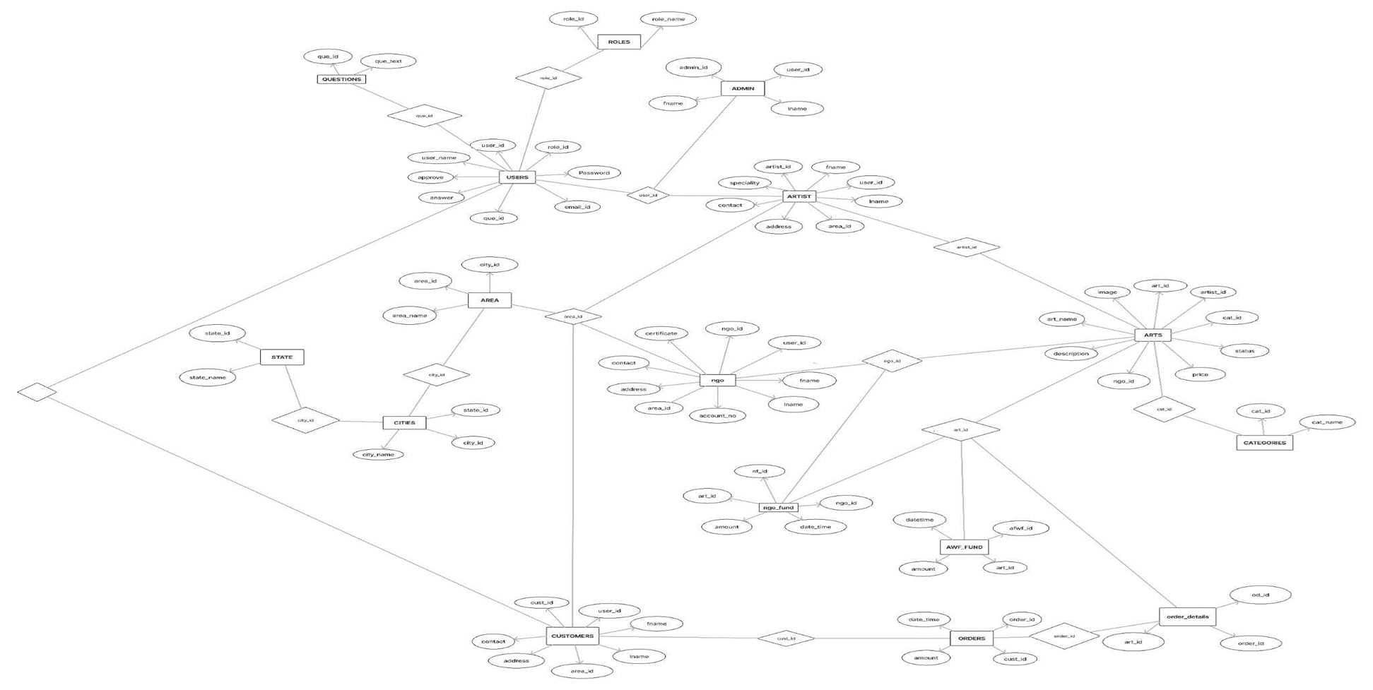
Database Design

Slide 6
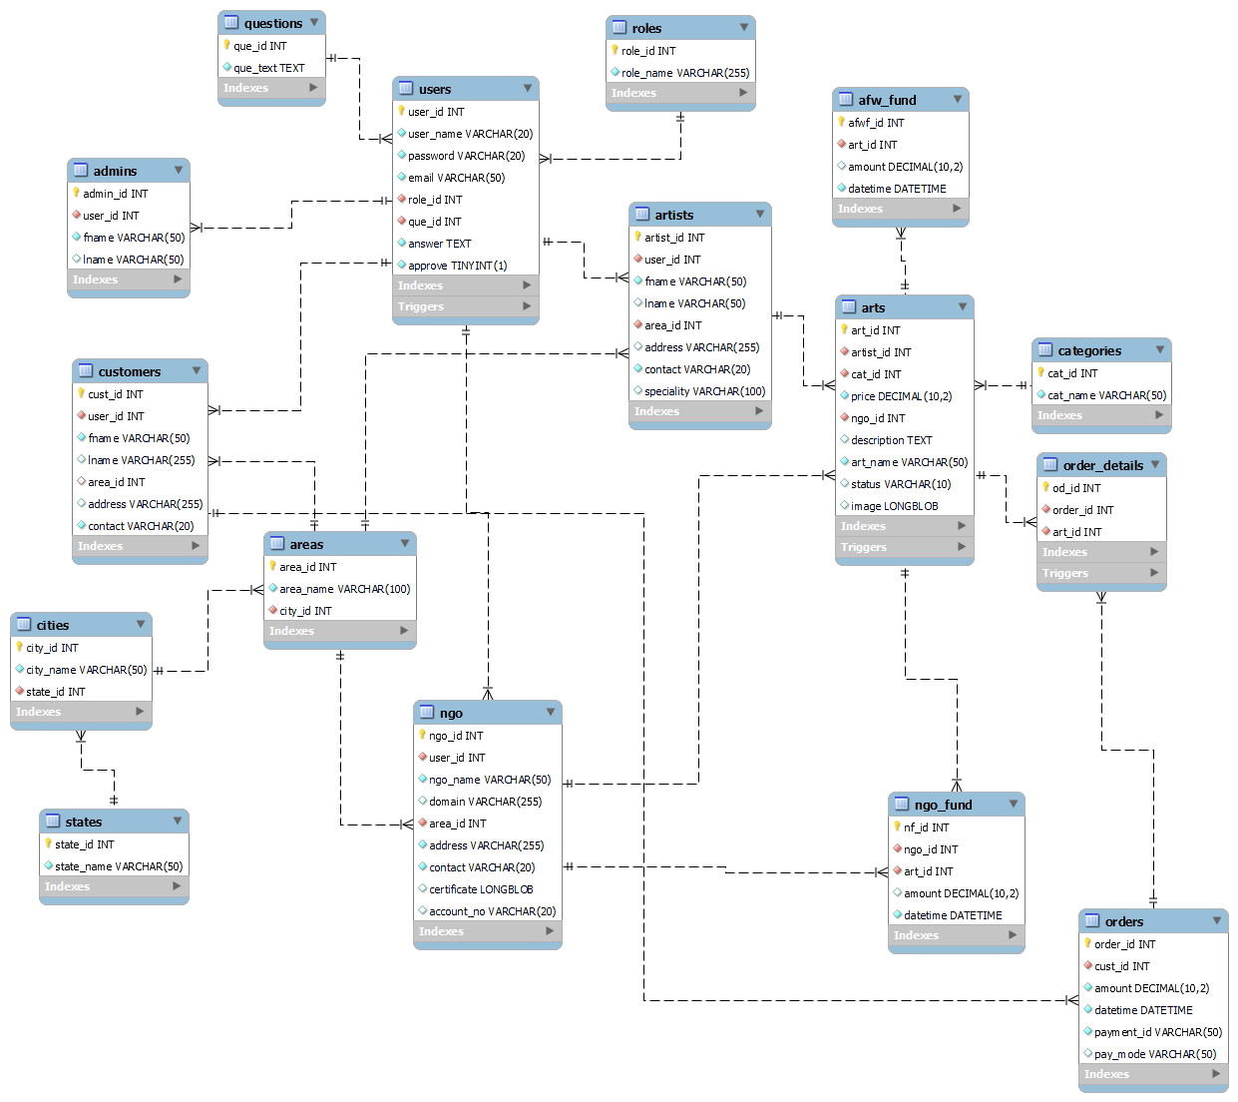
SCHEMA

Slide 7



Technology Platform Used For Project
FRONT-END
HTML/CSS
JAVASCRIPT
JSON
BACK-END
JAVA.ADV.JAVA
JPA
Database
MYSQL
SQL
PLSQL

Slide 8
WHY REACTJS
VIRTUAL DOM
Instead of directly manipulating the actual browser DOM,Reat creates a virtual representation of it and update necessary part of real DOM.
JSX Allows develops to write UI component using Syntax of HTML.
JSX
LARGE ECOSYSTEM
React has vast Libraries,Tools,and Resources.This Includes states management solution like Redux and Mobx,routing Libraries,testing,Framework and more..
COMPONENT BASED ARCHITECTURE
React promotes a modular approach to build user interface. Component can be Thought of reusable building block that encapsulate.

Slide 9

WHY SPRING BOOT
SIMPLICITY AND PRODUCTIVITY
Provides wide range of configuration and Reduce efforts of Boilerplates code. So we can focus on Logic and Feature.
EMBEDDED SERVERS
Spring Boot comes with internal or embedded servers such as Tomcat ,jetty. So we can package our application standalone JAR file
AUTO-
CONFIGURATION
Has a Tendency to automatically configures application based on Libraries and Dependencies which we include in classpath.
TESTABILITY
Test Driven Development by providing tools for unit test,integration test and end to end test.In Order to ensure the Quality.

Slide 10

WHY MySQL
RELATIONAL DATABASE
SQL databases are based on relational model,which organizes data into table and column, and closely assemble real world scenario.
DATA INTEGRITY
Relational database enforce data integrity through constraints,such as primary key,foreign key and unique constraints.
QUERYING
JOINS
ACID PROPERTIES
NORMALIZATION

Slide 11
USE CASE DIAGRAM(ADMIN)
LOGIN
REPORT
GENERATION
ADMIN
VERIFY NGO
System

Slide 12
USE CASE DIAGRAM(NGO)
LOGIN
REGISTRATION
VIEW FUND
NGO
System

Slide 13
USE CASE DIAGRAM(ARTIST)
REGISTER
LOGIN
ADD ART
ARTIST
VIEW ART
System

Slide 14
USE CASE DIAGRAM(CUSTOMER)
System
LOGIN
REGISTRATION
ADD TO CART
CUSTOMER
REMOVE ART
BUY CART ITEMS

Slide 15
DIVISION OF WORK WITHIN GROUP
WORK | COMPLETED BY
DATABASE | ALL
LOGIN,ADMIN MODULE | MAHENDRA KUMAR MEENA
CUSTOMER MODULE | TUSHAR DHANORKAR
ARTIST MODULE | ABHINAV KUMAR
NGO MODULE | NIKHIL TALMALE
CART | COORDINATION
ORDER | COORDINATION
HOME PAGE | ABHINAV KUMAR

Slide 16
GITHUB
GITHUB REPOSITORY URL: https://github.com/mkmeena97/ArtForWelfare
BRANCHES :
https://github.com/mkmeena97/ArtForWelfare/tree/abhinavbranch
https://github.com/mkmeena97/ArtForWelfare/tree/tushar
https://github.com/mkmeena97/ArtForWelfare/tree/mahendra
https://github.com/mkmeena97/ArtForWelfare/tree/nikhilBranch

Slide 17
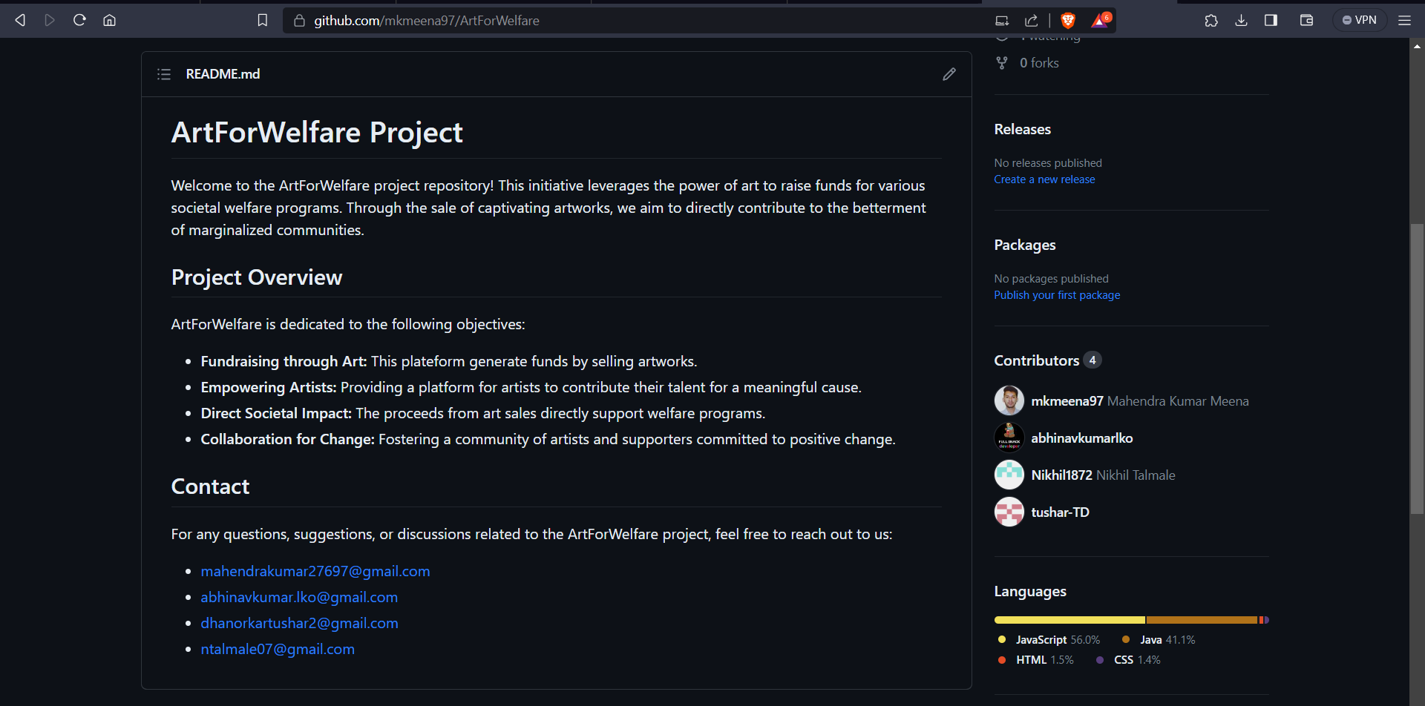
README.md page

Slide 18
FUTURE SCOPE
FUNCTIONAL EXPANSION OF ART GALLERIES: Art galleries will be expanded.
TRACKING: After ordered,supplying a timely ordered sequence of location data for further processing
CUSTOMIZED ARTS CAN BE REQUESTED BY CUSTOMER TO ARTIST
NGOs Functional exapansion.(NGO can request Funding /can create events)
FILTERING/SORTING: Selecting Arts on specific criteria.

Slide 19
CONCLUSION
How to Implement the solution to Real life Problems.
Continuous Innovation and Implementing solution.
Building a product in Team(Make sure the Coordination flow in Proper manner)

Slide 20
ThankYou!

