Slide 1
Rainy Cloud
Aquamaps on the Cloud
Marko Mikulicic - Pasquale Pagano / ISTI - CNR
Venus-C, 15 Dec 2010, Aachen

Slide 2
Workers
Worker
Worker
Partitioner
AMPQ
...
Worker

Slide 3

Data
HCAF (Half-degree Cell Authority File): ~260k
CsquareCode | OceanArea | Whatever...
1000:100:1 | 1.0 | ...
1000:100:2 | 0.8 | ...
HSPEN (Species Enviromental Envelope): ~10k
SpeciesID | LifeStage | TempMin....
Alg-85 | adult | 12
Fis-10199 | adult | 8
HSPEC (Half-degree Species Assignment): 10k*260k = 2.6*10⁹
~60*10⁶
CsquareCode | SpeciesId | Probability | Other...
1000:100:1 | Alg-85 | 0.2 | ...
1000:100:1 | Fis-10199 | 1 | ...
1000:100:2 | Alg-85 | 0 | ...
1000:100:2 | Fis-10199 | 1 | ...

Slide 4
Dataflow
RAM
HSPEN
Partitioner
AMPQ
Worker
RAM
HSPEN
Worker
Cassandra
HCAF (R)
HSPEN (R)
HSPEC (W)
...
RAM
HSPEN
Worker

Slide 5
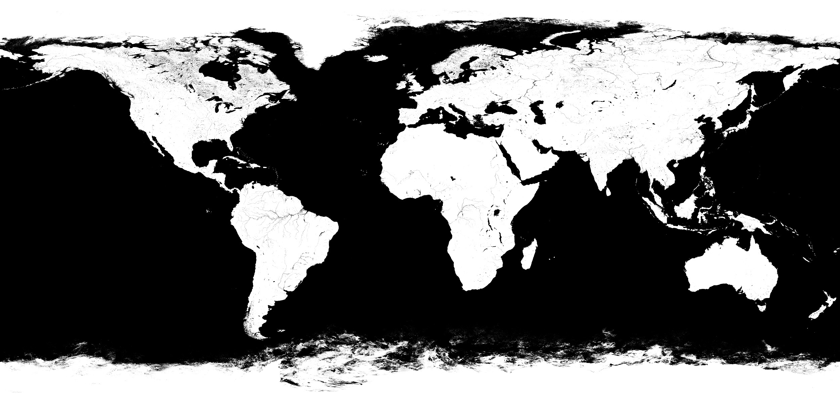
Partitioner
HCAF keys
HCAF key prefixes
1000:100:1
1000:100:2
1000:100:3
1000:100:4
1000:101:1
…
1004:102:2
1004:103:1
1004:103:2
1004:103:3
1004:103:4
1004:104:1
1004:104:2
… …
7817:498:1
7817:498:2
7817:498:3
231 1000
111 1004
398 1005
400 1006
392 1007
387 1008
372 1009
355 1010
292 1011
390 1012
400 1013
400 1014
400 1015
400 1016
400 1017
35 1103
160 1104
awk -F: '{print $1}' /tmp/data | sort | uniq -c
170k rows
Never change
(on earth)
Reasonable chunk size

Slide 6
Queue
{
"task": "it.cnr.aquamaps.HSPECGenerator",
"start": "1006",
"size": 400,
"retries": 10
}

Slide 7

Code
https://github.com/mmikulicic/rainycloud
(shoutkey: bandit)
Worker based on Octobot
  http://octobot.taco.cat

Slide 8
object HSPECGenerator extends Worker {
// ...
// actual logic is here
val algorithm = new SimpleHSpecAlgorithm
// load HSPEN only once
lazy val hspen = HSPENLoader.load
// worker, accepts slices of HCAF table and computes HSPEC
def run(task: JSONObject) {
val start = task.get("start").asInstanceOf[String]
val size = task.get("size" ).asInstanceOf[Long]
val generated = fetch(start, size).flatMap { case (_, v) => compute(v) }
store(generated map (_.toCassandra))
}
// create a domain object from table store columns and compute
def compute(hcafColumns: Iterable[Column]) : Iterable[HSPEC] = {
val hcaf = HCAF.fromCassandra(hcafColumns)
algorithm.compute(hcaf, hspen);
}
}

Slide 9
Partitioner
connection = Connection('localhost', 'foo', 'bar')
ch = connection.channel()
worker = “it.cnr.aquamaps.HSPECGenerator”
for row in open("ranges"):
size, start = row.strip().split()
msg = '{"task": "%s", "start": "%s:", "size": %s, "retries": 1 }'
% (worker, start, int(size))
ch.basic_publish(Message(msg), "aquamapsQueue")

