Slide 1

Lending Club Case study
Author : Sabyasachi Praharaj
Mukesh Kumar Mishra
Up-grad Group : 100164

Slide 2
Introduction
A lending club essentially provides Seamless Access of Financial scope for the Deserving
Our case study is about a General Insight into the Lending business
Using Data as a tool to Enhance & optimize Business of the club
Data Enrichment with technology for Better insights

Slide 3
Problem statement
Our case study is about a detail analysis of the lending club investment data available
The results are to be in a way to enable club to invest in a optimized way
Finding data insights for improvement of business
Using the given data as a tool for carving opportunities for the lending club .

Slide 4
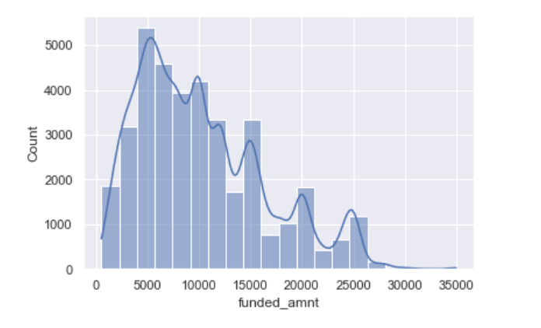
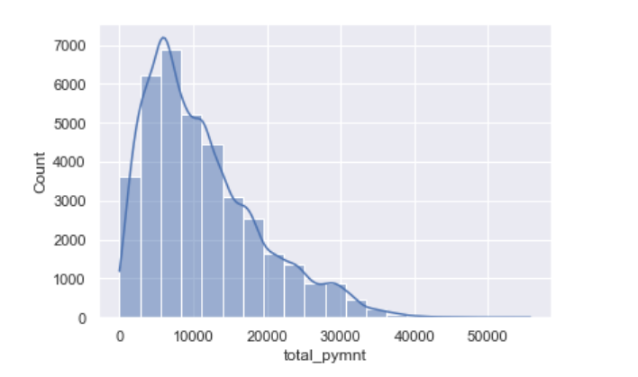
Univariate Analysis
Observations :
Highest Funded loans are in the ranges of 5000 to 20000
Payment received are in the ranges 10000 to 20000
The club funds less loans if the loan amount is higher than 25k

Slide 5
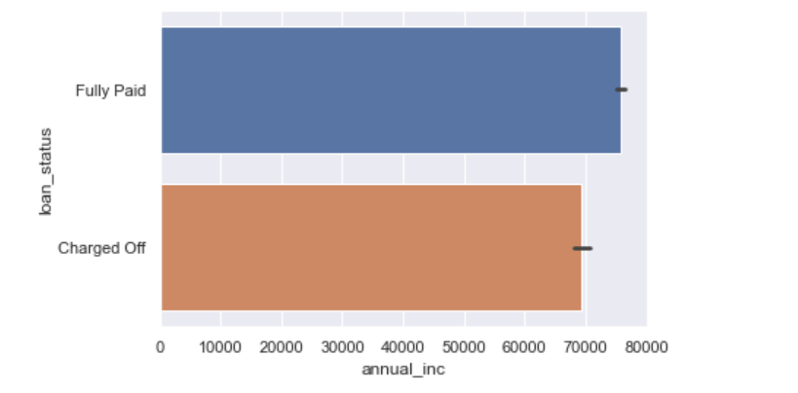
Annual income vs Status (BI variate Analysis )
Observations :
This Bivariate plot displays that beneficiaries with annual income more that 70000 are more likely to repay the loans .Hence the beneficiaries with higher annual income are potential customers
Candidates with annual income lesser that 70k are more likely to default and a potential loss

Slide 6
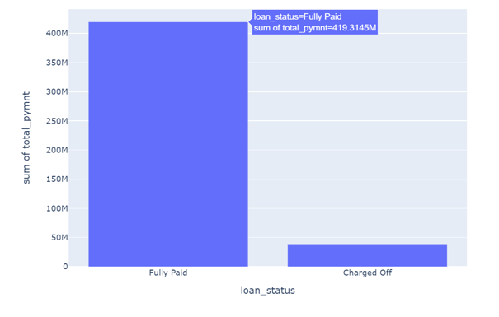
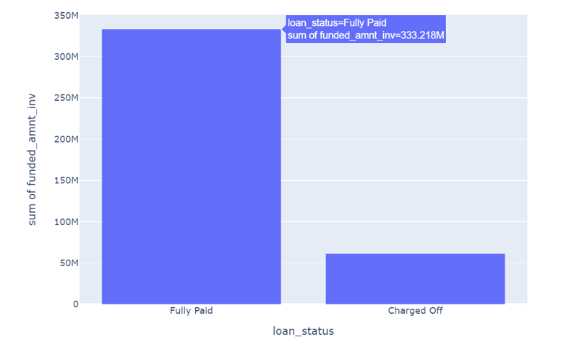
Loan Approved vs Status (BI variate Analysis )
Observations :
General comparison between Loan approved and Loan paid .
Showcases the charged off values against the funded amount

Slide 7
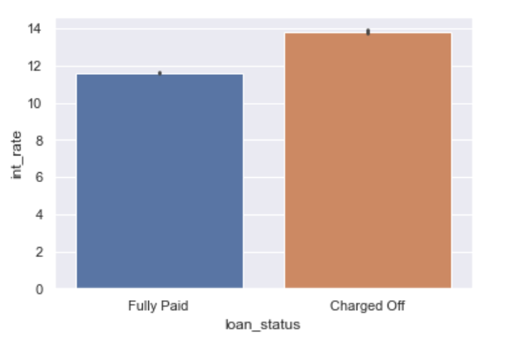
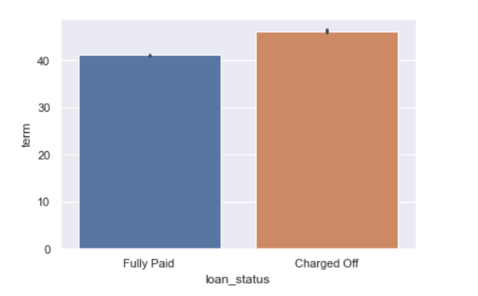
Interest rate/Term vs Status (BI variate Analysis )
Observations :
Loans with higher interest rate (rate > 11 ) are most likely to default
Loans with lower interest rate (rate < 11 ) are most likely to be successful cases
Loans with a greater term( term > 40) are most likely to default

Slide 8
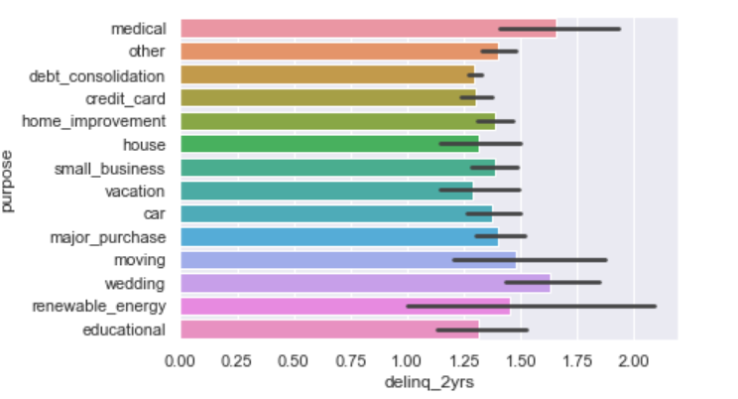
De-linq vs Purpose (BI variate Analysis )
Observations :
Medical loans and Wedding loans have a higher de-linq record
Hence this kind of loans can be taken with caution .

Slide 9
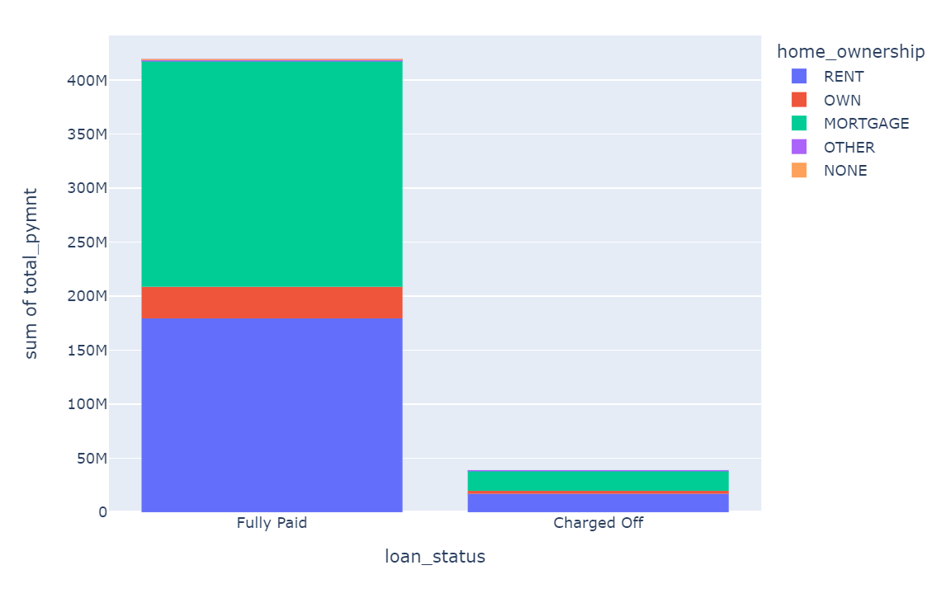
Multi-variate Analysis
Observations :
Beneficiaries with a mortgaged house have a higher rate of fully paid scenario as compared to other home owner ship
Beneficiaries with their own house are least likely to charge off .

Slide 10
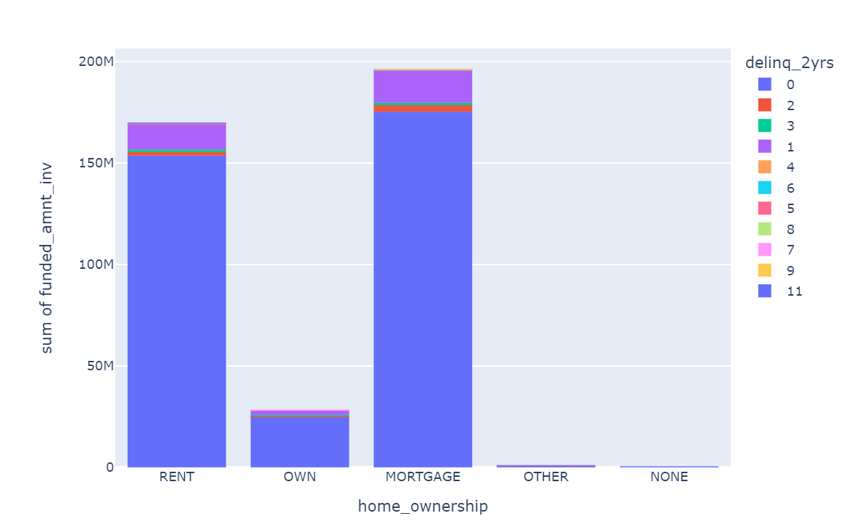
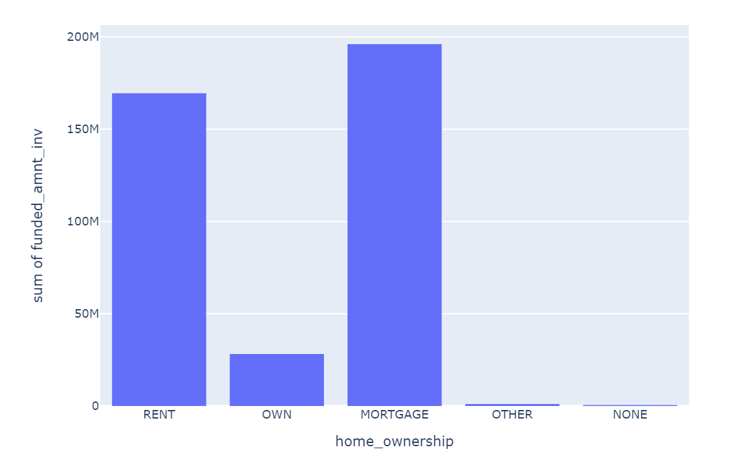
Loan Approved vs Status (BI variate Analysis )
Observations :
Company funds more loans with home mortgaged clients
They fund very less loans for beneficiaries having their own homes. The beneficiaries having their own homes are least likely to delinq.

Slide 11
Thank You

