Slide 1
Enhancing Fraud Detection using Synthetic Transactions Generated by CTGAN
Final Project Presentation
Six Week Internship in AI-ML
GNCIPL

Slide 2
Executive Summary
Fraud detection is challenging due to highly imbalanced transaction datasets.
CTGAN is used to generate synthetic fraud transactions for better class balance.
Machine learning models trained on augmented data show improved recall and F1-score.
Random Forest recall increased from 0.78 → 0.98; F1-score up to 0.99.
Framework enhances rare fraud detection while preserving data privacy.
Applicable to credit card, banking, and other tabular anomaly detection tasks.

Slide 3
Project Objectives
Generate synthetic fraud transactions using CTGAN to address class imbalance.
Improve accuracy, recall, and F1-score of fraud detection models.
Provide a privacy-preserving framework for data augmentation.
Enable better detection of rare fraudulent activities in financial datasets.
Develop a scalable solution applicable to other tabular anomaly detection tasks.

Slide 4
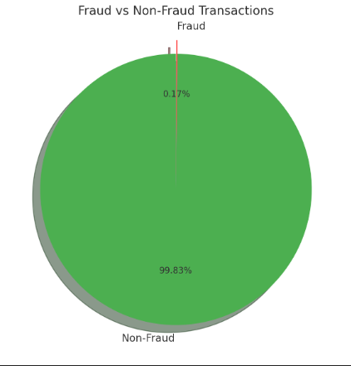
Data Overview
Dataset: creditcard.csv (Kaggle Credit Card Fraud Detection)
Number of Transactions: 284,807
Number of Features: 31 (including transaction amount, timestamp, anonymized user features)
Target Variable: Class (0 = Non-Fraud, 1 = Fraud)
Class Distribution: Highly imbalanced (Fraud << Non-Fraud)

Slide 5
Technical Architecture
1. Collect real dataset (filtered fraud samples).
2. Train CTGAN to generate 5,000 synthetic fraud samples.
3. Combine real + synthetic to create augmented dataset.
4. Train ML models (RF, XGBoost).
5. Evaluate performance with metrics and visualizations.

Slide 6
Methodology
CTGAN Model
- Conditional Tabular GAN
- Trained on minority fraud class
- Output: 5,000 synthetic fraud samples
Model Training
- Algorithms: Random Forest, XGBoost
- Data: Real + Synthetic (augmented)
- Target: Fraud classification

Slide 7
Model Results & Analysis
Baseline (Real only):
• Precision: 0.97 | Recall: 0.78 | F1-score: 0.87 | AUC: 0.936
Augmented (CTGAN):
• Precision: 0.99 | Recall: 0.98 | F1-score: 0.99 | AUC: 0.994
→ Higher recall and F1-score with synthetic augmentation.

Slide 8
Business Impact
Enhanced Fraud Detection: Catch more rare fraud cases.
Cost Savings: Reduced fraud leakage.
Data Compliance: No exposure of real customer data.
Scalability: Synthetic data expands dataset as needed.

Slide 9
Risks & Limitations
Synthetic Overfitting → Mitigate via t-SNE validation.
Bias Propagation → Check fairness metrics.
Generalization Limitations → Blend real + synthetic carefully.
Regulatory Constraints → Ensure compliance.

Slide 10
Recommendations
Integrate synthetic data pipelines into fraud workflows.
Retrain CTGAN periodically for new fraud patterns.
Use explainability tools (e.g., SHAP).
Deploy as modular API for scalability.

Slide 11
Conclusion
Generative AI-powered data augmentation using CTGAN:
Boosted F1-score and AUC.
Preserved privacy and ensured compliance.
Scalable solution for enterprise fraud detection.

