Slide 1

PSN WGR Plots
Oct 2024 – Marcus Kittelson

Slide 2
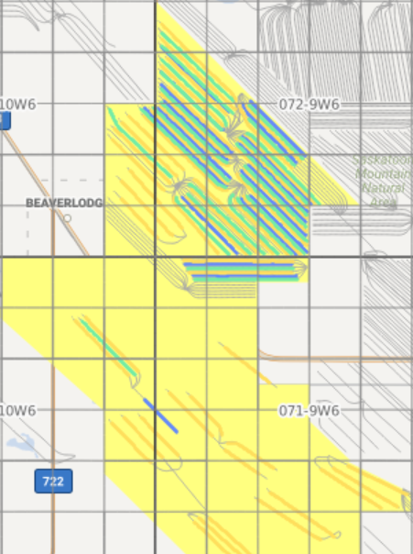
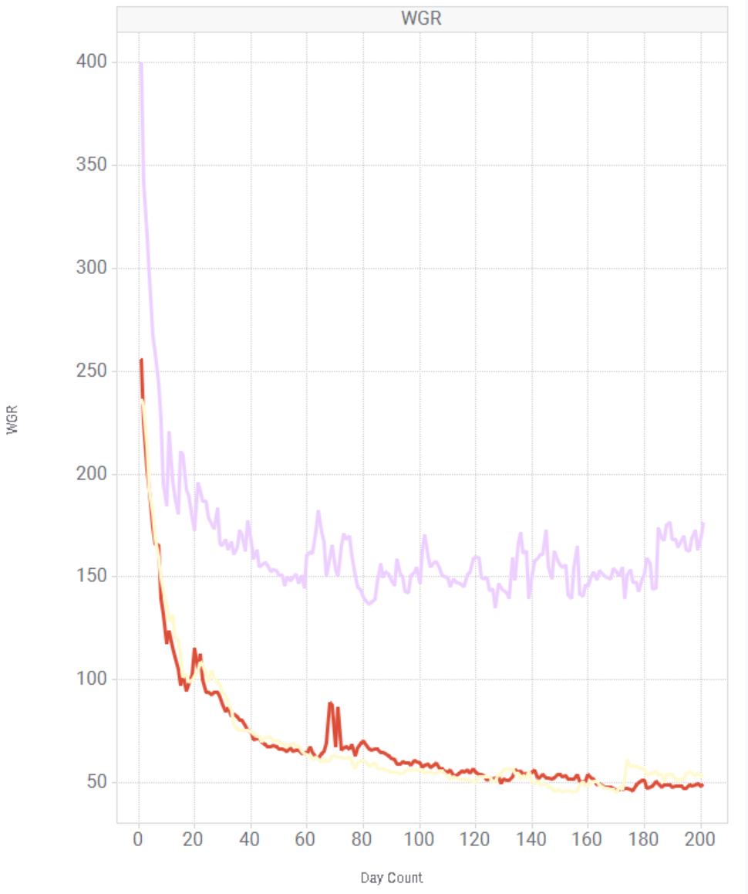
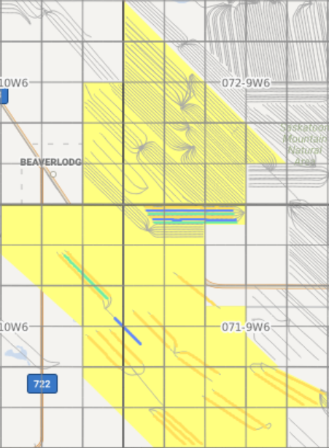
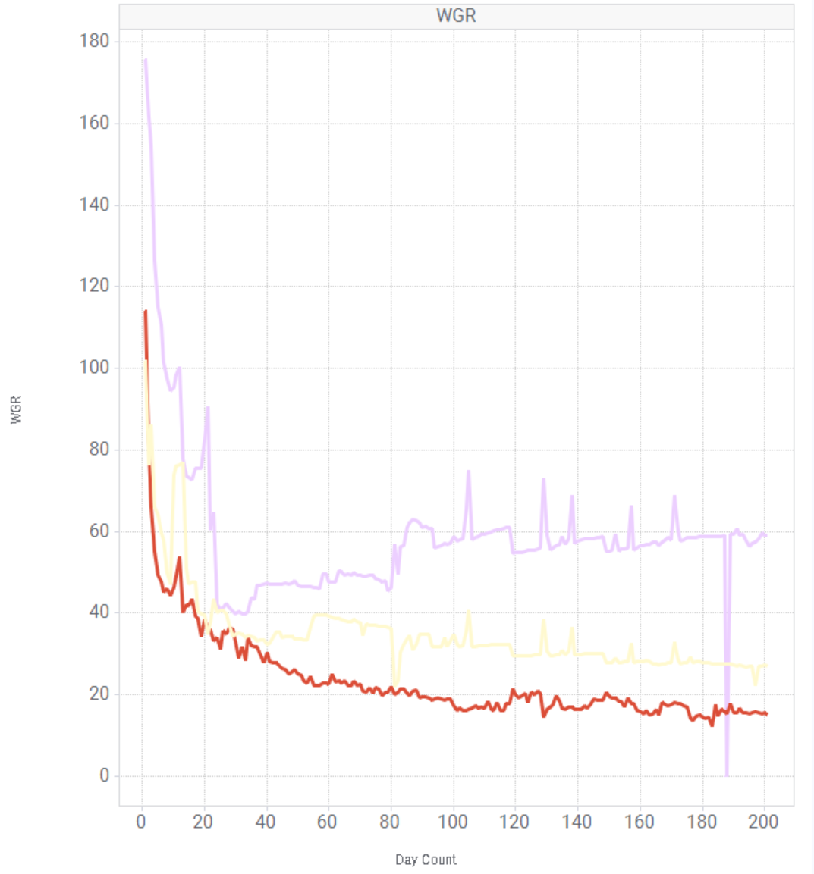
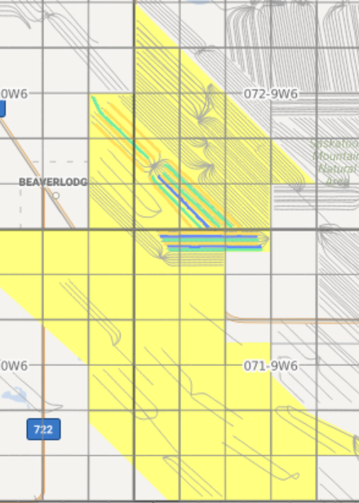
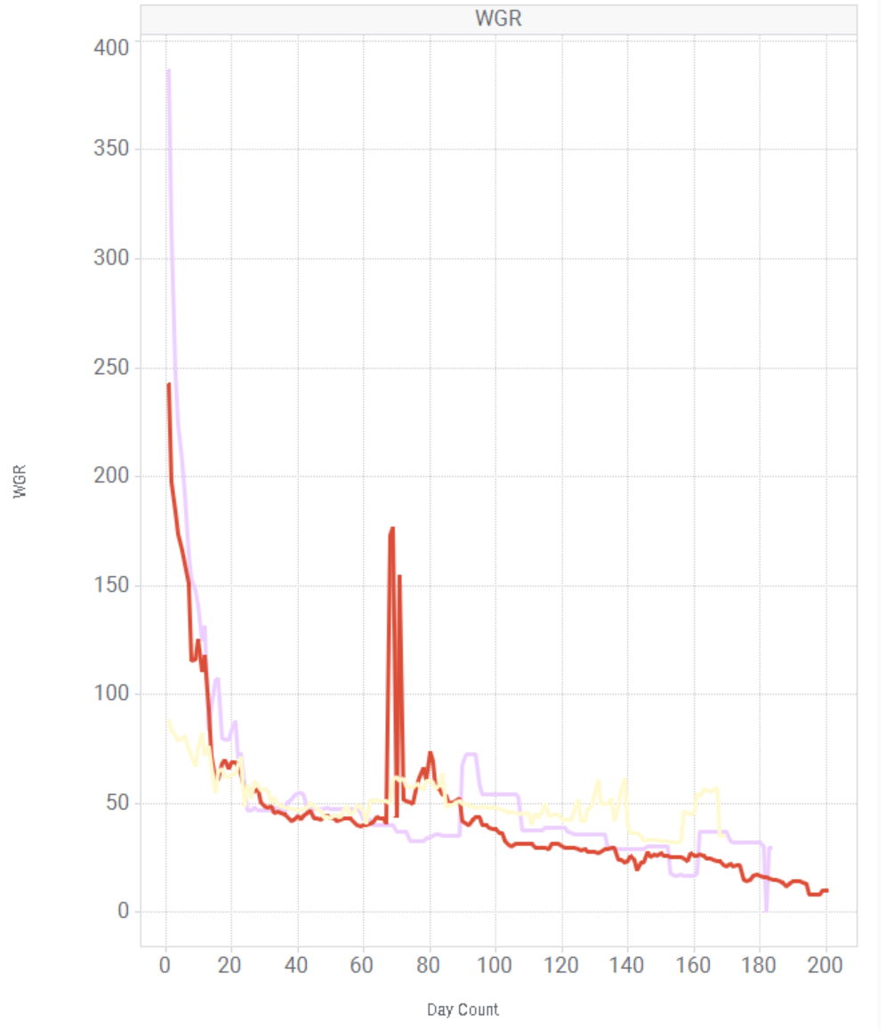
WGR Raw Data Extrapolations
Entire PSN
16-33 & South PSN
16-33 & 06-07
 | MNTN A | MNTN C/D
Month 1 (INITIAL) | 400 | 245
Month 2 | 165 | 80
Month 3 | 160 | 58
Month 4 | 150 | 52
Month 5 | 158* | 50
Month 6 | 155 | 50
 | MNTN A | MNTN C/D
Month 1 (INITIAL) | 175 | 108
Month 2 | 41 | 34
Month 3 | 50* | 30
Month 4 | 60* | 28
Month 5 | 55 | 25
Month 6 | 58* | 24
 | MNTN A | MNTN C | MNTN D
Month 1 (INITIAL) | 387 | 240 | 88
Month 2 | 48 | 49 | 56
Month 3 | 45 | 39 | 46
Month 4 | 70* | 41* | 50*
Month 5 | 39 | 31 | 30
Month 6 | 30 | 26 | 27
C & D Took Midpoint
C & D Took Midpoint
C & D difference too great for grouping
‘*’ Denotes WGR was greater than prior month

Slide 3
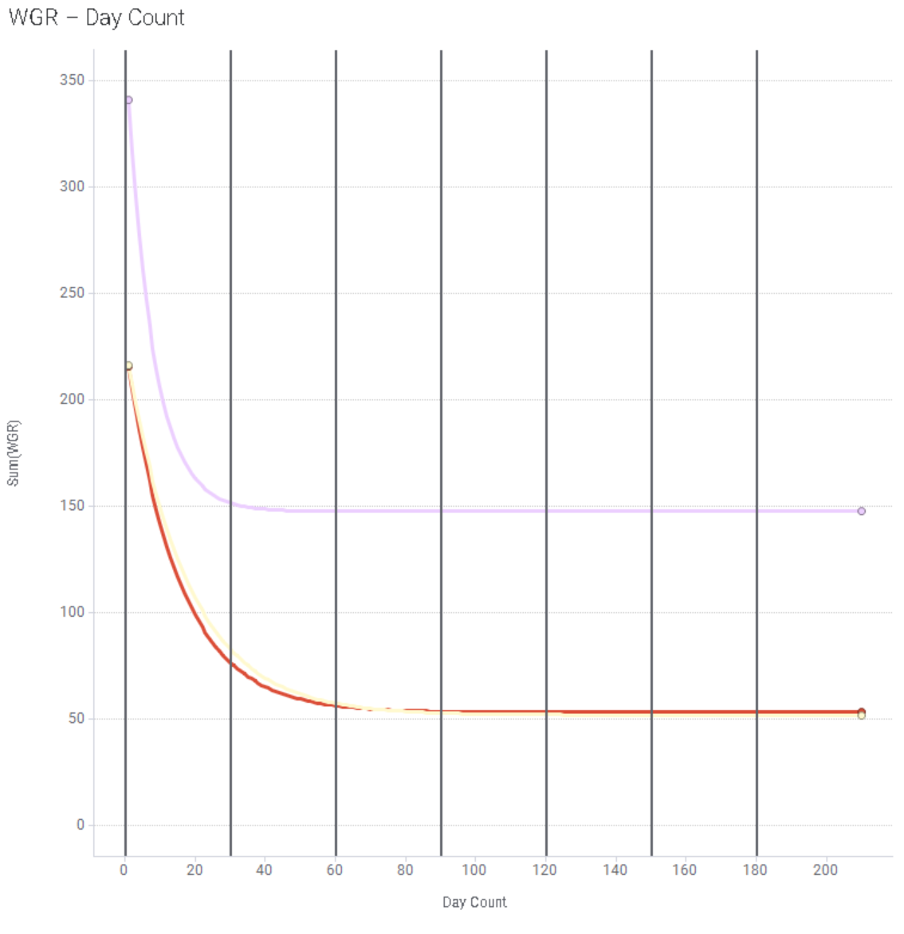
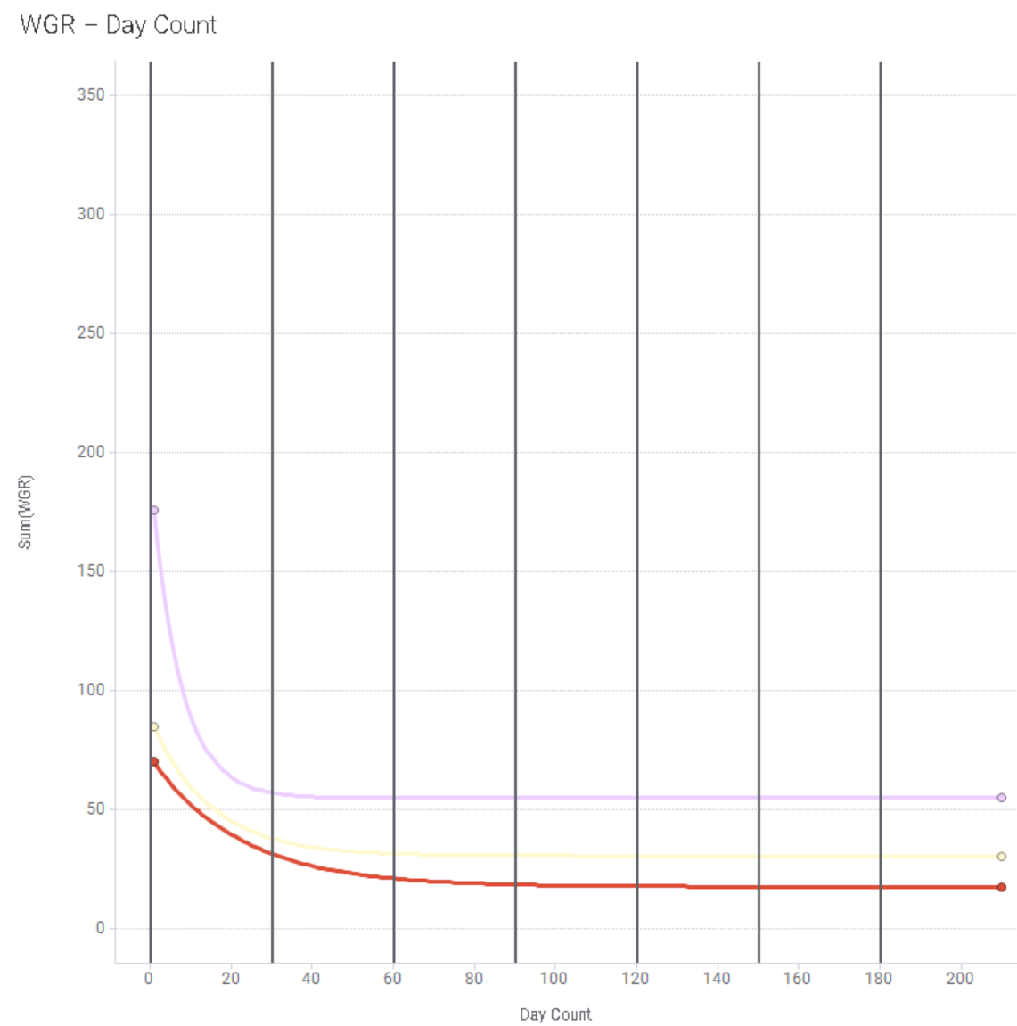
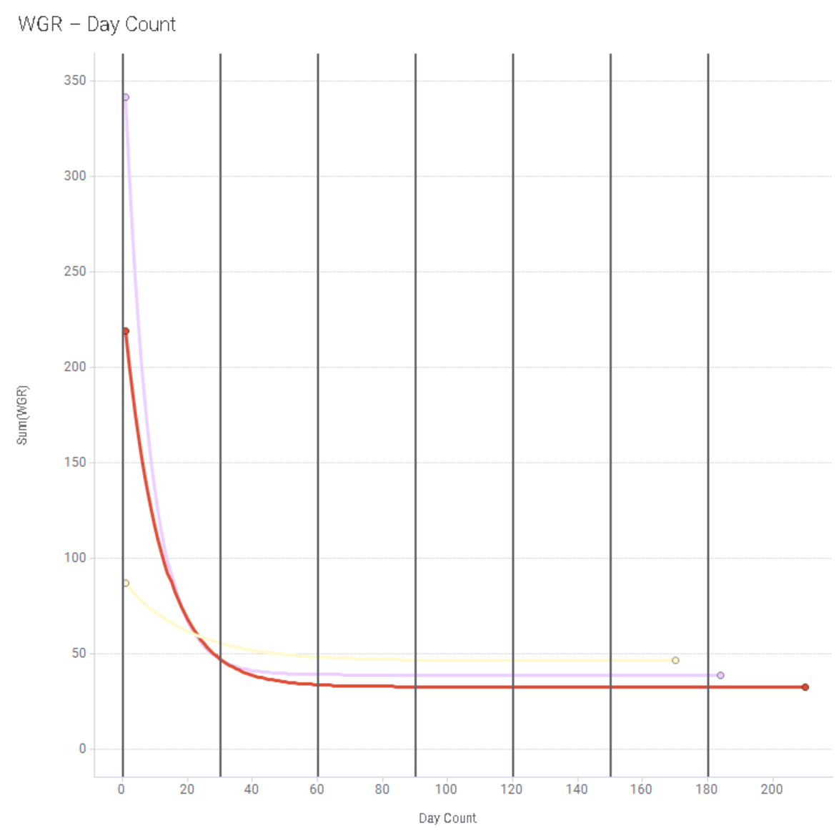
WGR Fitted Exponential Decay Curves
Entire PSN
South of 16-33 PSN
16-33 & 06-07
 | MNTN A | MNTN C/D
Month 1 (INITIAL) | 340 | 210
Month 2 | 150 | 80
Month 3 | 145 | 58
Month 4 | 145 | 52
Month 5 | 145 | 50
Month 6 | 145 | 50
 | MNTN A | MNTN C/D
Month 1 (INITIAL) | 175 | 78
Month 2 | 57 | 36
Month 3 | 55 | 26
Month 4 | 55 | 25
Month 5 | 55 | 25
Month 6 | 55 | 25
 | MNTN A | MNTN C | MNTN D
Month 1 (INITIAL) | 340 | 220 | 87
Month 2 | 48 | 47 | 56
Month 3 | 39 | 34 | 48
Month 4 | 39 | 33 | 47
Month 5 | 39 | 33 | 46
Month 6 | 39 | 33 | 46
C & D Took Midpoint
C & D Took Midpoint
C & D difference too great for grouping

Slide 4
Proposed FDP WGR Curves
Todo: all vals below are invalid and copy pasted
Entire PSN
South of 16-33 PSN
16-33 & 06-07
 | MNTN A | MNTN C/D
Month 1 (INITIAL) | 340 | 210
Month 2 | 150 | 80
Month 3 | 145 | 58
Month 4 | 145 | 52
Month 5 | 145 | 50
Month 6 | 145 | 50
 | MNTN A | MNTN C/D
Month 1 (INITIAL) | 175 | 78
Month 2 | 57 | 36
Month 3 | 55 | 26
Month 4 | 55 | 25
Month 5 | 55 | 25
Month 6 | 55 | 25
 | MNTN A | MNTN C | MNTN D
Month 1 (INITIAL) | 340 | 220 | 87
Month 2 | 48 | 47 | 56
Month 3 | 39 | 34 | 48
Month 4 | 39 | 33 | 47
Month 5 | 39 | 33 | 46
Month 6 | 39 | 33 | 46
C & D Took Midpoint
C & D Took Midpoint
C & D difference too great for grouping

