Slide 1
Scalable Equilibrium Computation in Multi-agent Influence Games on Networks
Fotini Christia, Michael Curry, Constantinos Daskalakis, Erik Demaine, John P. Dickerson, MohammadTaghi Hajiaghayi, Adam Heseterberg, Marina Knittel*, and Aidan Milliff

Slide 2
Previous Work Single-agent Model

Slide 3
Influence Spreading Processes
= has opinion
t =
t→∞
0
4
1
2
3

Slide 4


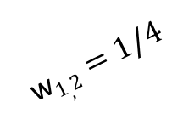
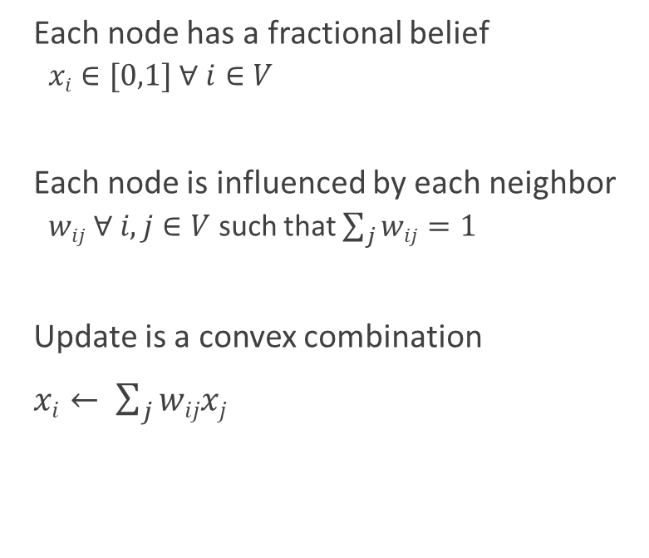




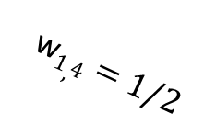
A Simple Weighted Model DeGroot 1974
Each node has a fractional belief
$xi∈[0,1] ∀ i∈V$
Each node is influenced by each neighbor
$wij ∀ i,j∈V$ such that $\sum_{j}{wij=1}$
Update is a convex combination
$xi← \sum_{j}{wijxj}$
$x2=2/3$
w$1,2=1/4$
w$1,3=1/4$
$x1=3/4$
$x3=1/3$
$x1=0$
w$1,4=1/2$
$x4=1$

Slide 5





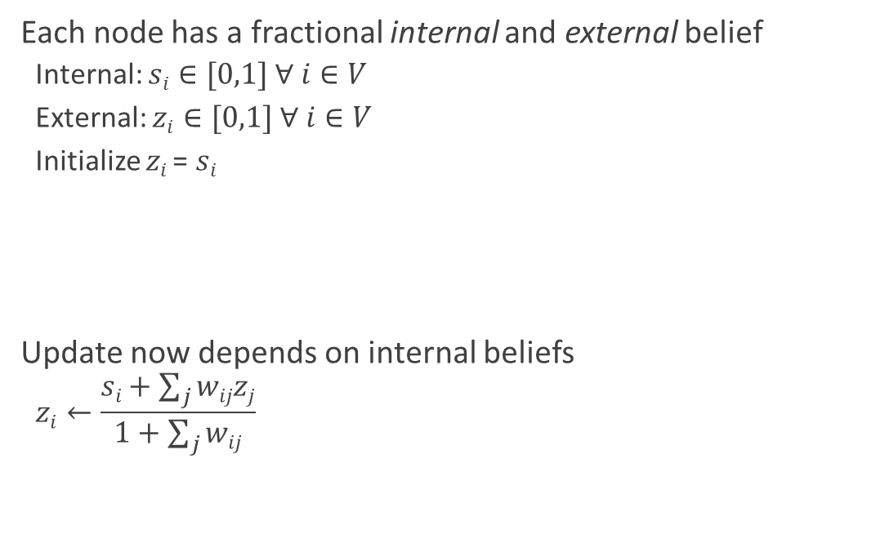




Capturing Internal Beliefs Friedkin and Johnsen 1990
Each node has a fractional internal and external belief
Internal: $si∈[0,1] ∀ i∈V$
External: $zi∈[0,1] ∀ i∈V$
Initialize $zi$= $si$
Update now depends on internal beliefs
$$zi←\frac{si+\sum_{j}{wijzj}}{1+\sum_{j}{wij}}$$
s$2=2/3$
w$1,2=1/4$
z$2=2/3$
s$1=0$
w$1,3=1/4$
s$3=1/3$
z$1=3/8$
z$3=1/3$
z$1=0$
w$1,4=1/2$
s$4=1$
z$4=1$

Slide 6


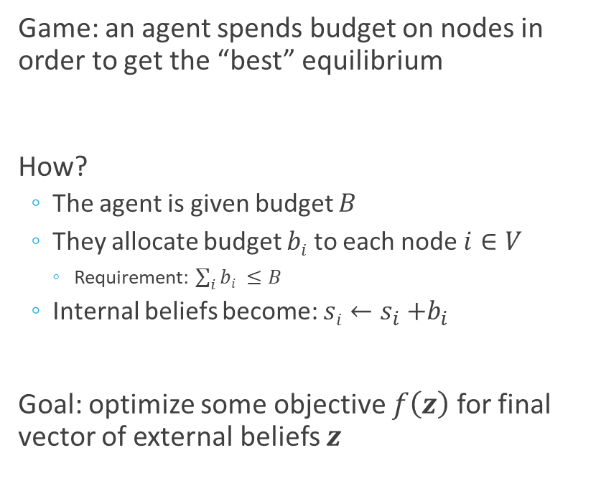








Single-agent Games of Influence Ahmadinejad et al. 2015
Game: an agent spends budget on nodes in order to get the “best” equilibrium
How?
The agent is given budget $B$
They allocate budget $bi$ to each node $i∈V$
Requirement: $\sum_{i}{bi ≤B}$
Internal beliefs become: $si←s_{i}{+b}_{i}$
Goal: optimize some objective $f\left(z\right)$ for final vector of external beliefs $z$
$B=2/3$
Budget vector: $[\frac{1}{6},\frac{1}{6},0,\frac{1}{3},0]$
s$1=2/3$
s$1=5/6$
s$2=1/3$
s$2=1/6$
s$3=0$
s$4=1$
s$4=2/3$
s$5=1/3$

Slide 7
Our Results Multi-agent Model

Slide 8








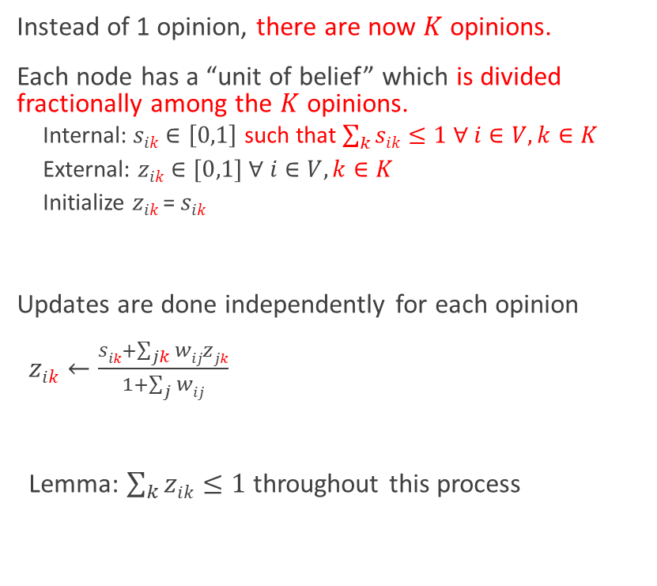










The Multi-agent Model
Instead of 1 opinion, there are now $K$ opinions.
Each node has a “unit of belief” which is divided fractionally among the $K$ opinions.
Internal: $sik∈\left[0,1\right]$ such that $\sum_{k}{sik≤1}$ $∀ i∈V, k∈K$
External: $zik∈[0,1] ∀ i∈V, k∈K$
Initialize $zik$= $sik$
Updates are done independently for each opinion
$zik←\frac{sik+\sum_{jk}{wijzjk}}{1+\sum_{j}{wij}}$
Lemma: $\sum_{k}{zik≤1}$ throughout this process
s$2,1=2/3$
s$2,2=1/3$
w$1,2=1/4$
z$2,1=2/3$
z$2,2=1/3$
s$1,1=0$
s$1,2=1$
w$1,3=1/4$
s$3,1=1/3$
s$3,2=2/3$
z$1,1=0$
z$3,1=1/3$
z$3,2=2/3$
z$1,1=3/8$
w$1,4=1/2$
z$1,2=1$
z$1,2=5/8$
s$4,1=1$
s$4,2=0$
z$4,1=1$
z$4,2=0$

Slide 9




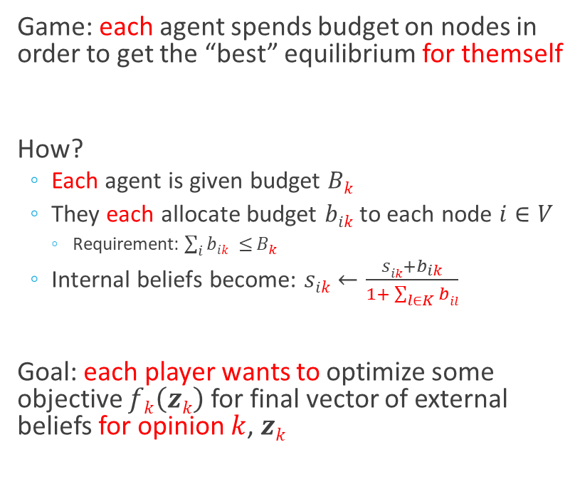




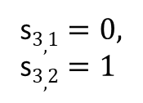

Multi-agent Games of Influence
Game: each agent spends budget on nodes in order to get the “best” equilibrium for themself
How?
Each agent is given budget $Bk$
They each allocate budget $bik$ to each node $i∈V$
Requirement: $\sum_{i}{bik ≤}B_{k}$
Internal beliefs become: $sik←\frac{sik+b_{ik}}{1+ \sum_{l∈K}{bil}}$
Goal: each player wants to optimize some objective $fk\left(zk\right)$ for final vector of external beliefs for opinion $k$, $zk$
$B_{1},B_{2}=2$
Budget vectors: $\left[1,0,0,1,0\right],$ $\left[\frac{1}{3},\frac{1}{3},0,\frac{4}{3},0\right]$
s$1,1=\frac{5}{7},\text{s}1,2=\frac{2}{7}$
s$1,1=\frac{2}{3},\text{s}1,2=\frac{1}{3}$
s$2,1=\frac{1}{6}, \text{s}2,2=\frac{5}{6}$
s$3,1=0,$
s$3,2=1$
s$2,1=\frac{1}{8}, \text{s}2,2=\frac{7}{8}$
s$4,1=\frac{2}{3},$ s$4,2=\frac{1}{3}$
s$4,1=\frac{1}{2},$ s$4,2=\frac{1}{2}$
s$5,1=\frac{1}{3}$ , s$5,2=\frac{1}{3}$

Slide 10

Theoretical Results
Under certain non-restrictive conditions of $f_{k}$, we can show:
There exists a pure Nash equilibrium
The equilibrium is unique
Agents using no-regret learning dynamics will converge to the equilibrium
If $f_{k}$ is linear, the equilibrium can be found with convex programming

Slide 11
Experiments: two-player case
In the two player case, we can treat the constant-sum game as a saddle-point problem.
We use saddle-point mirror descent on the simplex (equivalent to the famous multiplicative weight updates algorithm).
To validate our approach we run this algorithm on large, randomly generated graphs.

Slide 12
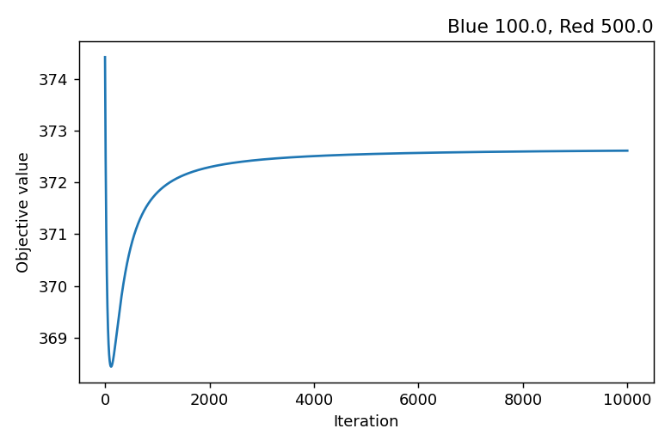
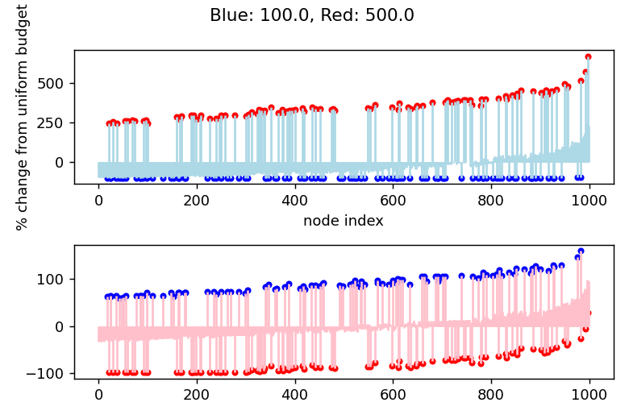
Experiments: two-player case
Convergence of saddle point objective.
Results of one experiment on a Watts-Strogatz graph of 1000 nodes and parameters d=3, p=0.2.
Equilibrium budgets (as % change from uniform budget). Nodes are sorted by second eigenvector of adjacency matrix, reflecting graph structure.
Initially favorable nodes are highlighted with red/blue points respectively.
Notes:
Converges, advertise for enemies, graph structure has something to do with it (eigenvectors)

Slide 13
Future Work
Evaluate model effectiveness on real data
Do nodes actually behave this way?
How do optimal budgeting strategies compare to real strategies?
How well does this generalize?
Can mirror descent-based approaches solve the general multi-agent problem?

Slide 14
Thanks!

