Slide 1
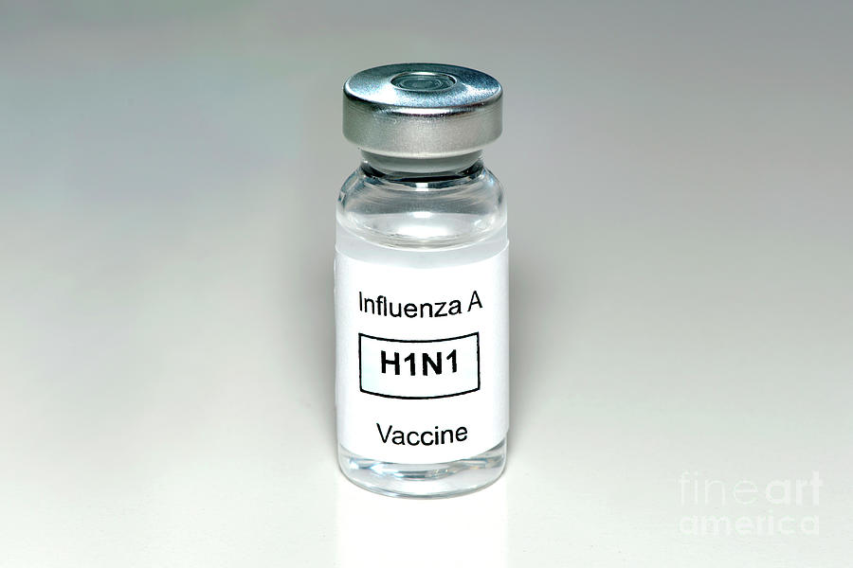

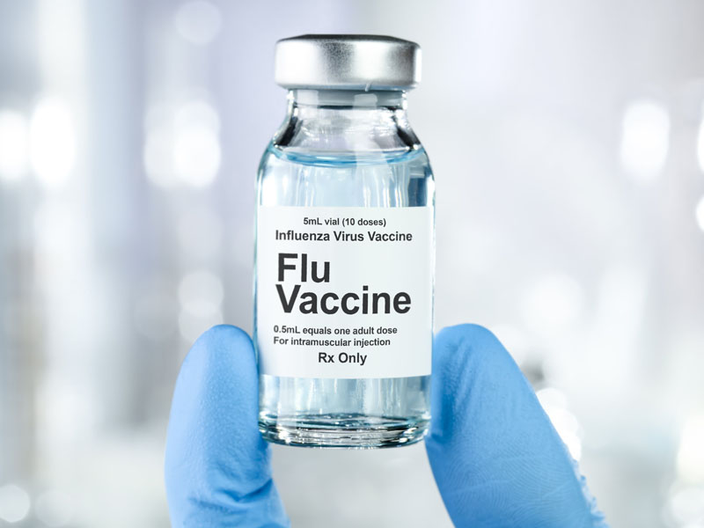
Flu vaccine prediction Using Machine Learning
A Data-Driven Approach to Address Vaccine Hesitancy
Doreen MURUGI, MORINGA SCHOOL
6/6/2025

Slide 2
overview
Predict H1N1 and Seasonal flu vaccine uptake
Analyze individual factors influencing vaccination decisions
Build and evaluate predictive models for actionable insights

Slide 3
Business understanding
Vaccine hesitancy contributes to preventable disease spread
Governments need data-driven tools to improve vaccine campaigns
Identify population segments to target with awareness efforts

Slide 4
Data understanding
opinion_h1n1_vacc_effective | opinion_h1n1_risk | opinion_h1n1_sick_from_vacc | opinion_seas_vacc_effective | opinion_seas_risk | opinion_seas_sick_from_vacc | age_group | education | race | sex
3 | 1 | 2 | 2 | 1 | 2 | 55 - 64 Years | < 12 Years | White | Female
5 | 4 | 4 | 4 | 2 | 4 | 35 - 44 Years | 12 Years | White | Male
3 | 1 | 1 | 4 | 1 | 2 | 18 - 34 Years | College Graduate | White | Male
Dataset: H1N1 Flu Vaccine Prediction
Size: 26,707 rows, 32 features
Features: Demographics, health behaviors, opinions
Targets: H1N1 vaccine, Seasonal flu vaccine (binary)
Sample of the training dataset

Slide 5
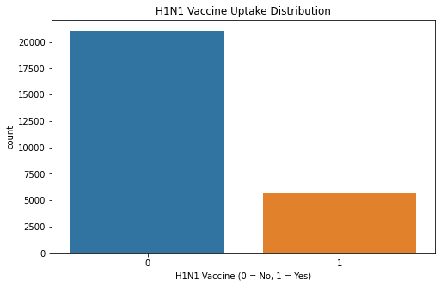
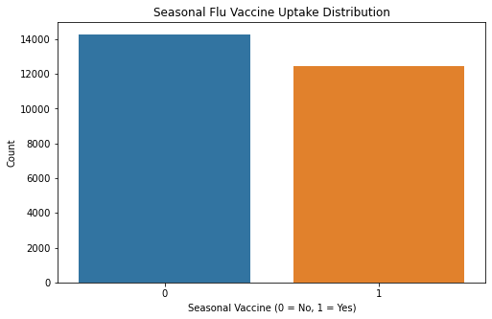
H1n1 and seasonal flu vaccine uptake distribution (0 = not vaccinated, 1 = vaccinated)

Slide 6
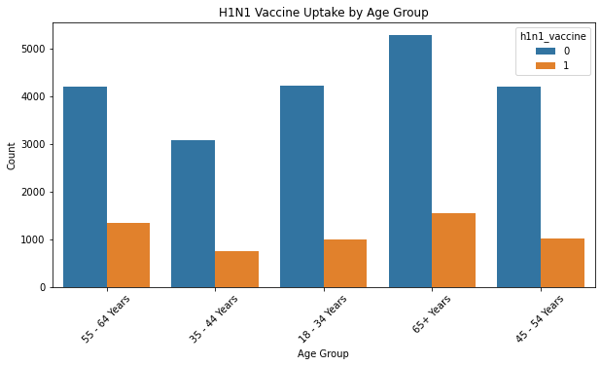
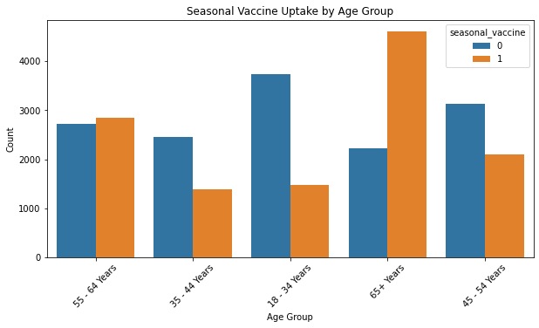
H1n1 and seasonal flu vaccine uptake distribution by age group

Slide 7
modelling
Step 3
Model training & prediction
Step 2 Feature scaling &Train-test split(80/20)
Step 1
Data cleaning & encoding
Models Used:
Logistic Regression
Decision Trees

Slide 8
evaluation
Metric: ROC AUC Score

Slide 9
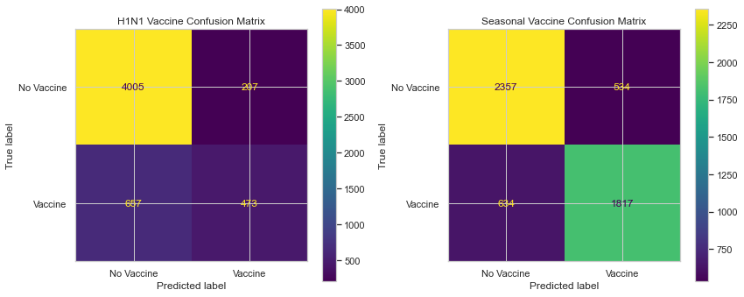
Logistic Regression
H1N1: 0.826
Seasonal: 0.852
True Positives (bottom-right): Correctly predicted vaccinated individuals.
True Negatives (top-left): Correctly predicted non-vaccinated individuals.
False Positives (top-right): Predicted vaccinated but actually not.
False Negatives (bottom-left): Predicted not vaccinated but actually are.

Slide 10
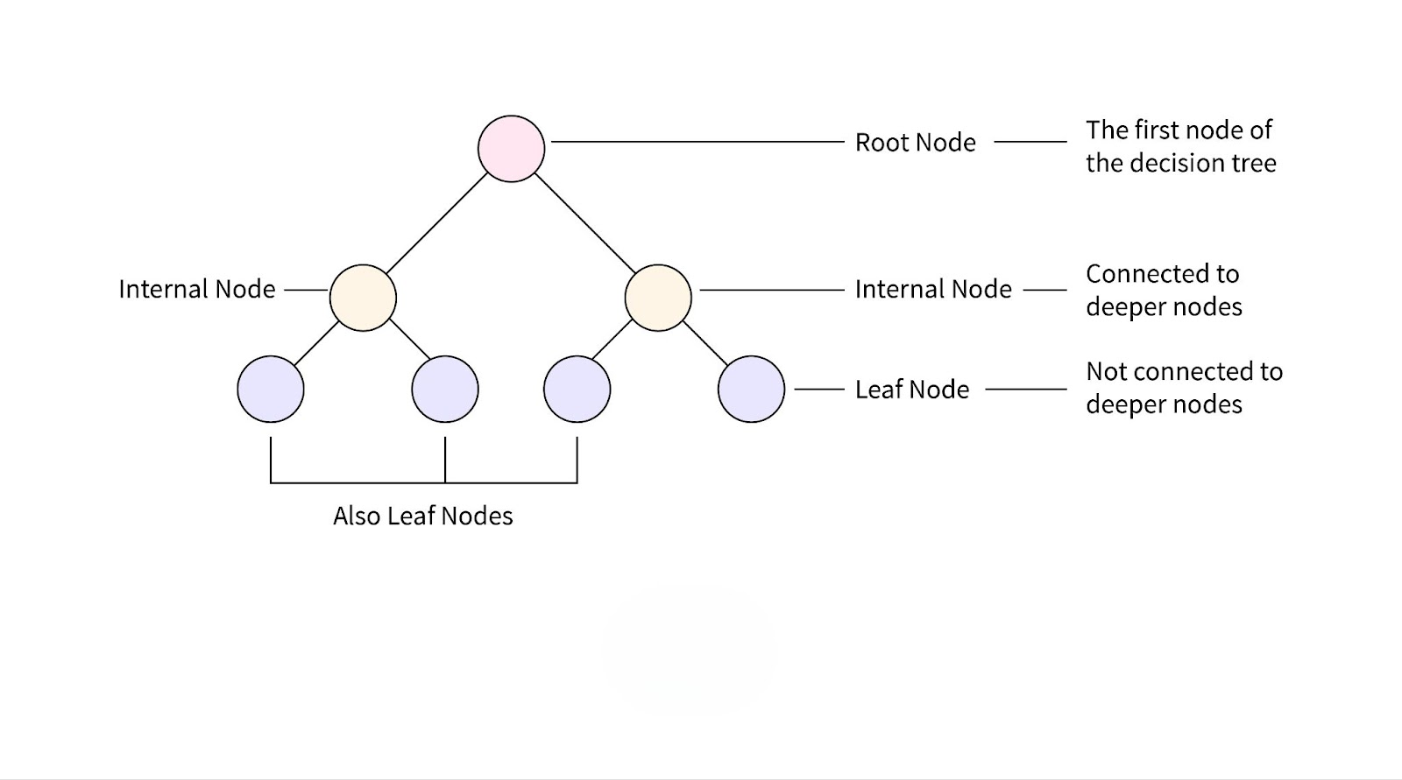
Decision tree
H1N1: 0.818
Seasonal: 0.828

Slide 11
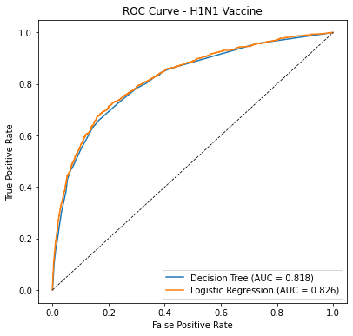
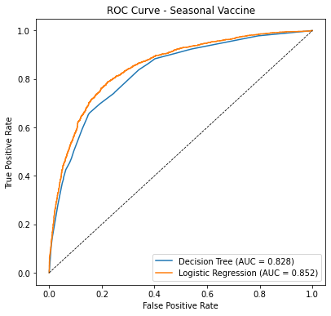
Comparison Between the Two Models Logistic Regression slightly outperformed Decision Tree.
Roc – h1n1 vaccine
Roc – seasonal vaccine

Slide 12
Key insights
H1N1 Predictors:
Doctor recommendation
Belief in vaccine effectiveness
Perceived personal risk
Seasonal Predictors:
Risk perception
Trust in doctors
Age group (65+)

Slide 13
CONCLUSION
Logistic Regression is effective for this task
Behavior, trust in doctors, and risk perception drive vaccine decisions
Predictive models can support public health targeting

Slide 14
recommendations
Train health workers to promote vaccine benefits
Tailor messages for specific age groups
Integrate models into health planning systems to forecast uptake
Made based on the predictions made by the model.

Slide 15

Thank you!
Questions?
Contact Info: doreen.murugi@student.moringaschool

