Slide 1

InDoorZ
Way-finding for Buildings and Campus Settings

Slide 2
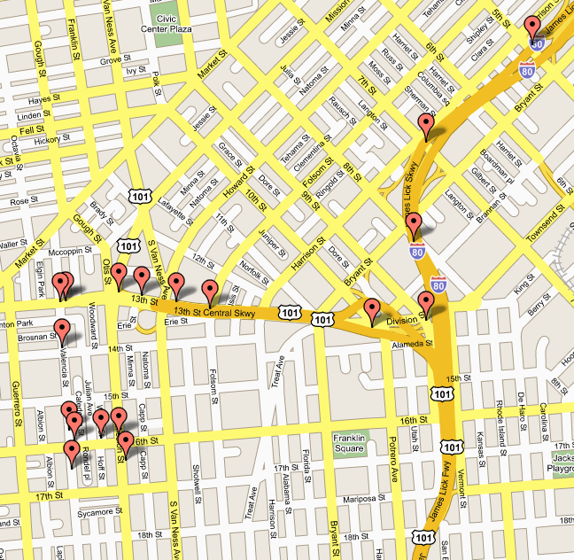
We have GPS and Google Maps for Outside

Slide 3
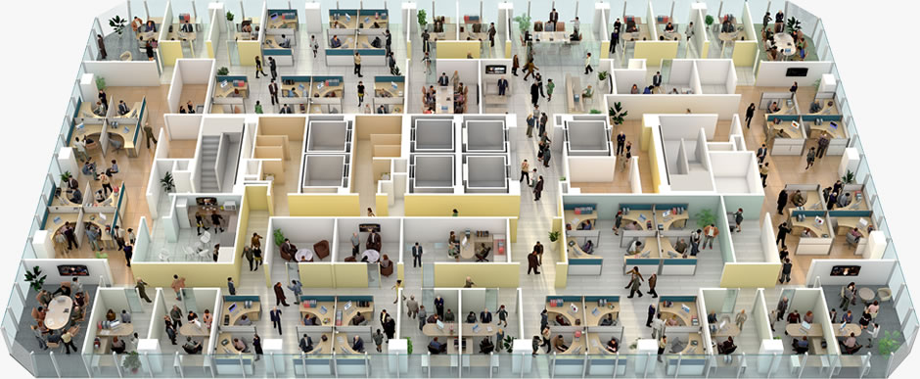
But nothing for inside

Slide 4
InDoorZ – and off-the –shelf technology
The project is using or plans to use:
Smartphones
GPS
Crowd sharing / Social networks
Beacons
Sensors in the smartphone (accelerometer – as a pedometer?)
wearables

Slide 5
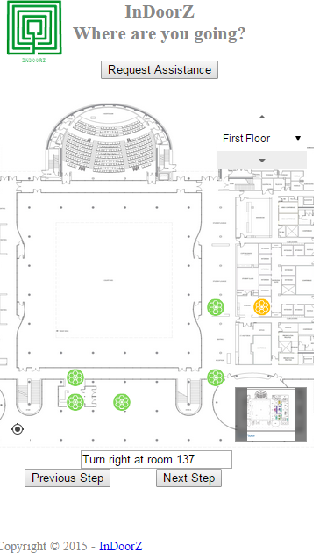
How it works – the demo

Slide 6
Where it stands
Web app (it’s just the demo) on GitHub and hosted at:
http://mkobar.github.io/InDoorZ/
Two APK (Android applications) are in testing now (were built at 3pm today).
Need more good target building and floorplans
Want to add beacons and the social portion next.

Slide 7
InDoorZ – A “Virtual” Curb-Cut
While this could be really valuable for people with vision problems . . .
I think many more people would like a service like this
And anyone can find this useful.
Thanks!

