Slide 1
CLINT: Cognitive Load in Interpreting and Translation
Michael Boos

Slide 2
Fundamental idea of the project
Background:
English as a first global lingua franca
Costs and consequences for non-native speakers
Interpreters/translators vs. untrained multilinguals
Stress and workload related impacts of English as a lingua franca (ELF) on professionals

Slide 3
Interpreters & Translators: Two PhD projects
Shared resources but different experimental set-ups
Project «Interpretation»:
PhD project of Michi
The focus for the rest of the presentation
Project «Translation»:
PhD project of Matthias
More information coming soon ☺

Slide 4
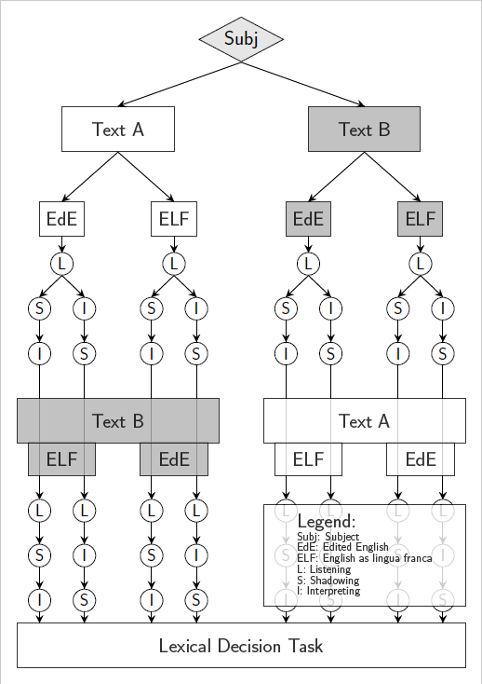
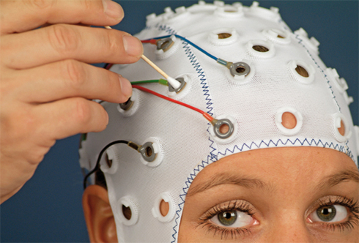

Experimental set-up for the interpreters
The design:
EEG system:

Slide 5
Experimental set-up for the interpreters
The design:
EEG system:

Slide 6
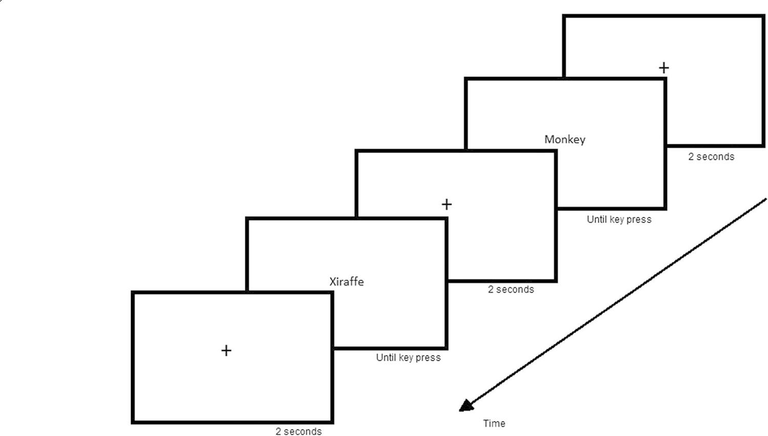
The Lexical Decision Task
Goal: measure (speed of) lexical access (i.e Balota & Chumbley (1984), Barber et al. (2013), Goldinger (1996))
Task: to discriminate between word and non-word or pseudoword stimuli (usually stated per button click → Two-alternative forced choice)
Stimuli can be presented visually or auditorily
Laurence et al. (2018)

Slide 7
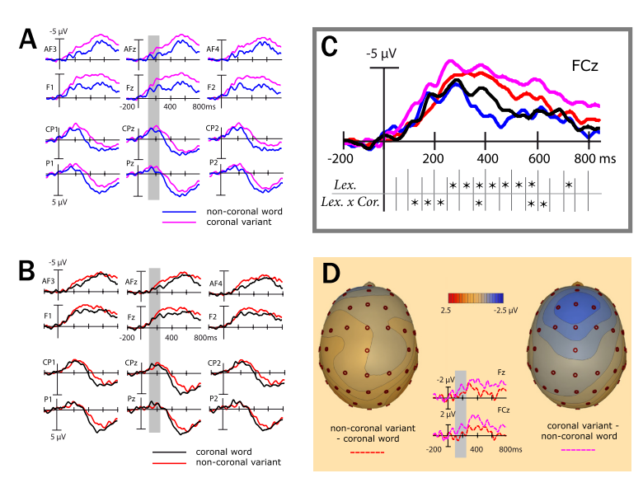
Word-Pseudoword effect
Kutas & Federmeier (2011):
pseudowords elicit a larger N400 component
than words do
Friedrich, Eulitz & Lahiri (2006):
N400 amplitudes for pseudowords > words.
Non-coronal pseudowords are accepted as words
longer than the coronal variants
Lima & Huntsman (1997):
Both word and nonword responses were significantly slower when the previous trial has involved a nonword than when it has involved a word.
Responses to nonwords and pseudohomophones were significantly slower when the previous trial has involved a nonword or a pseudohomophone than when it has involved a word
However, responses to words were not influenced by the nature of the previous trial

Slide 8
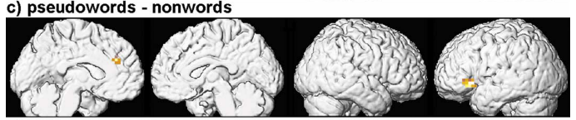
Word-Pseudoword effect
Specht et al. (2003):
Lexical decision during a nonword task is mainly based on a phonological discrimination process, whereas a pseudoword task more strongly requires lexical access resulting in activation of BA 47

Slide 9
Word frequency effect
Goh et al. (2009):
High-density words elicit slower RTs than low-density words & high-frequency words elicit faster RTs than low-frequency words
Frequency effects were larger for low-density words than for high density words
Word frequency plays a role in early auditory word recognition only when there is relatively little competition between similar-sounding words

Slide 10
Language switch effect
Von Studnitz & Green (1997):
RT for switch trials is 118ms slower compared to nonswitch trials
RT for L2 trials slower than L1 trials (63ms)
“Overall, we confirmed a significant effect of cost of switching between two languages in a language-specific lexical decision task both in the overall analysis and in the analysis based on a subset of high-frequency words”

Slide 11
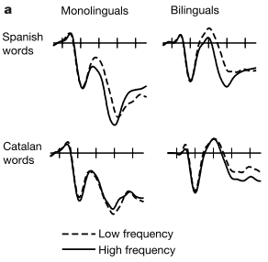
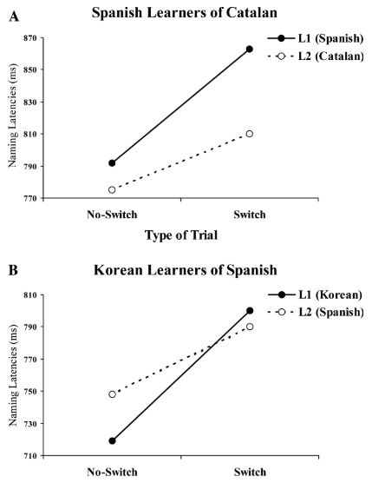
Language switch effect
Rodriguez-Fornells et al. (2002):
While subjects had to respond only to words in the target language (Spanish) and reject both words in the non-target language (Catalan) and pseudowords, the typical modulation of the N400 component was found with respect for a target words’ frequency
ERP effects regarding Catalan and pseudowords were virtually identical in both groups
Costa & Santesteban (2004):
Asymmetrical switching costs are present for L2 learners (to switch into the dominant language is harder than to switch into the weaker language), but not for highly proficient bilinguals
In a language switching task, highly proficient bilinguals are slower in their dominant than in their non-dominant language both on switch and non-switch trials

Slide 12
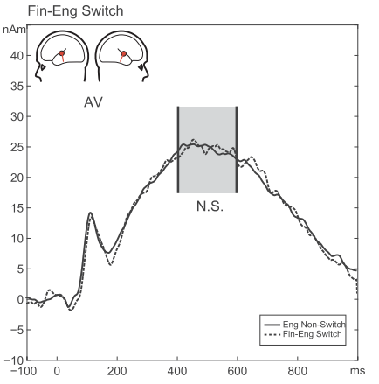
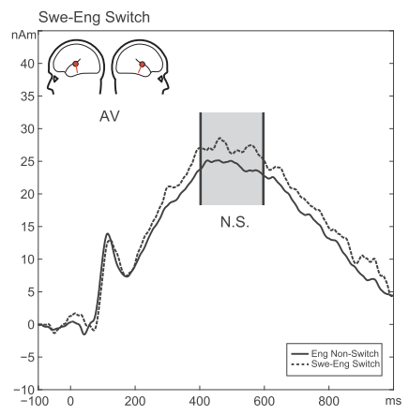
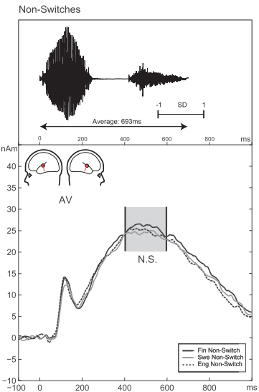
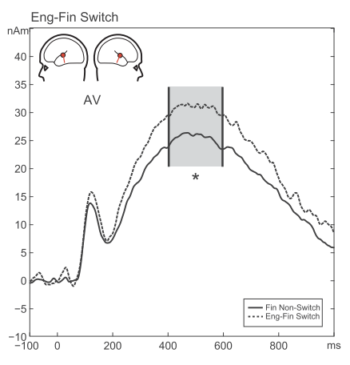
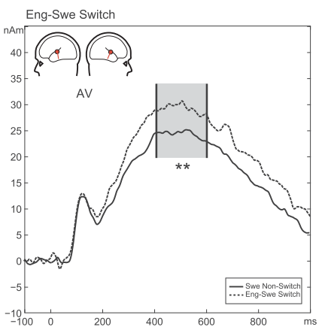
Language switch effect
Hut et al. (2017):
Switches to L2 show an increased N400m compared to Non-Switch trials or switches between native languages.

Slide 13
CLINT – lexical decision task
No one has used the combination of:
A lexical decision task
Two different languages (language switch)
Auditorily presented stimuli
Highly language proficient subjects
ERP measurement (commonly only RTs and accuracy were investigated)

Slide 14


Experimental set-up: Lexical decision task
+
Pseudoword
Word
P – G – G – E – E – G – E – P – P – … (P: Pseudoword (G & E); G: German word; E: English word
Forced choice lexical decision task with instructed as fast as possible left-clicks for pseudowords and right-clicks for words (each either G or E)
Focus on language switch trials (G – E or E – G)
The sequence contains:
160 German words, 160 English words, 160 Pseudowords (80G & 80 E)
Each 54 G – E and E – G switch trials
Each 54 G – G and E – E non-switch trials

Slide 15
CLINT participants
The data I have so far:
Interpreters:
23 Professionals
9 MAs
16 BAs
Multilingual controls:
3 Professionals (e.g. language teachers, journalists…)
2 MAs
4 Bas
8 pilot data sets

Slide 16
Hypotheses
H1: Participants will show an enhanced N400 for pseudoword trials compared to word trials
H2: An enhanced N400 is expected for switch trials compared to nonswitch trials
H3: L1-L2 switches generate a higher switch cost than L2-L1 switches do (especially for trained interpreters)

Slide 17
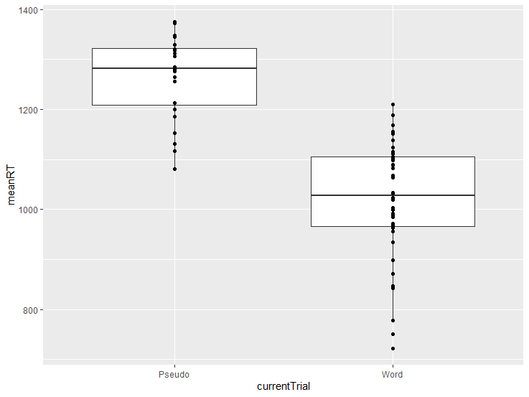
Results:

Slide 18
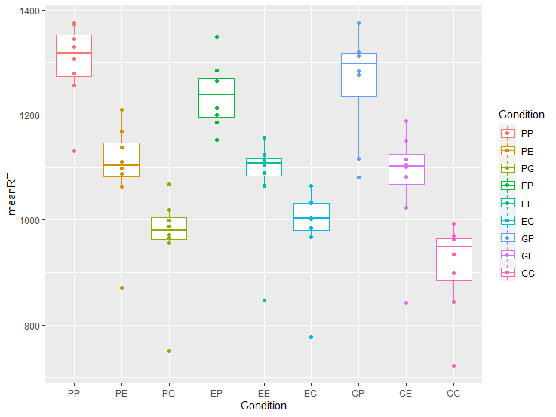
Results:

Slide 19
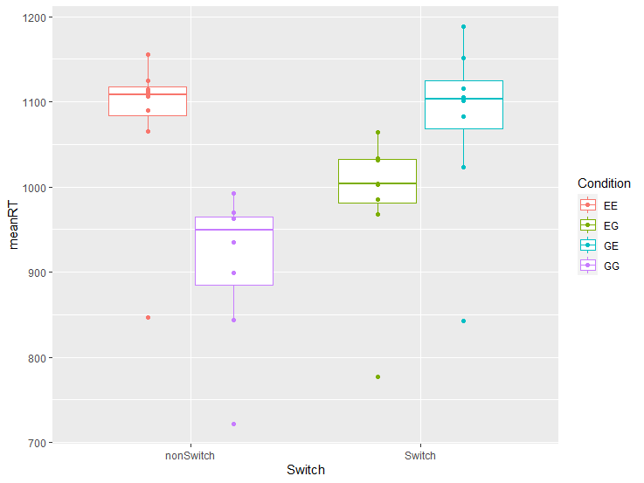
Results:

Slide 20
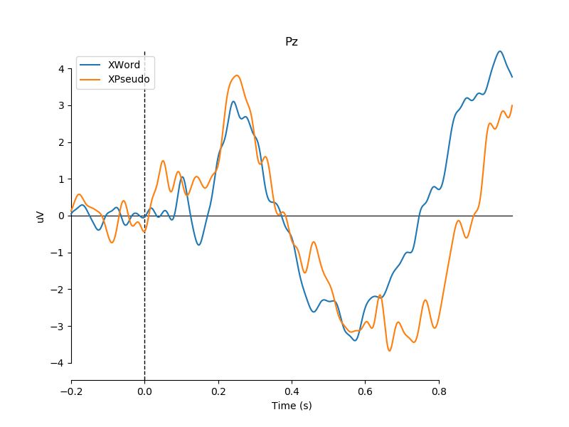
Results:

Slide 21
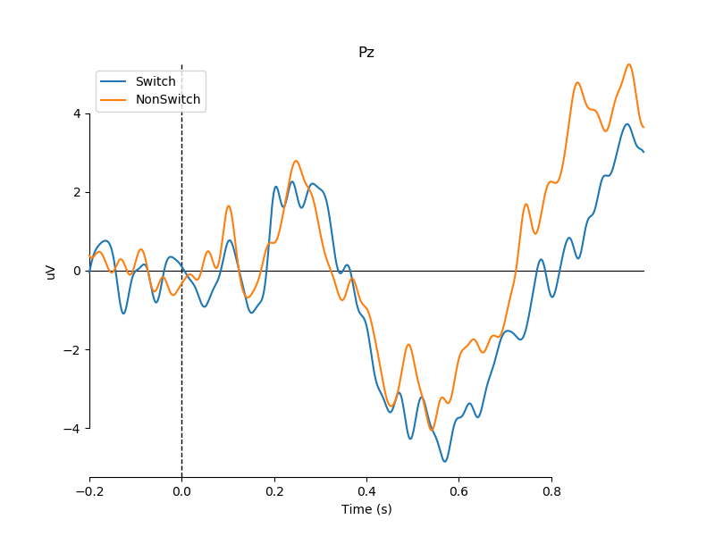
Results:

Slide 22
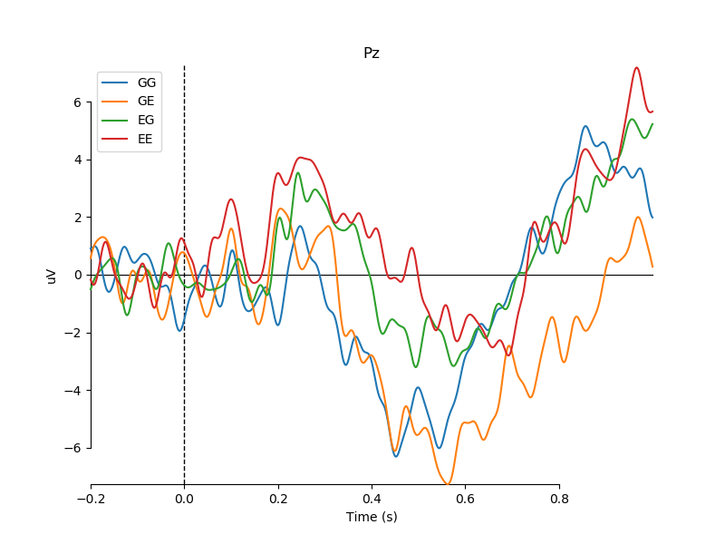
Results:

Slide 23
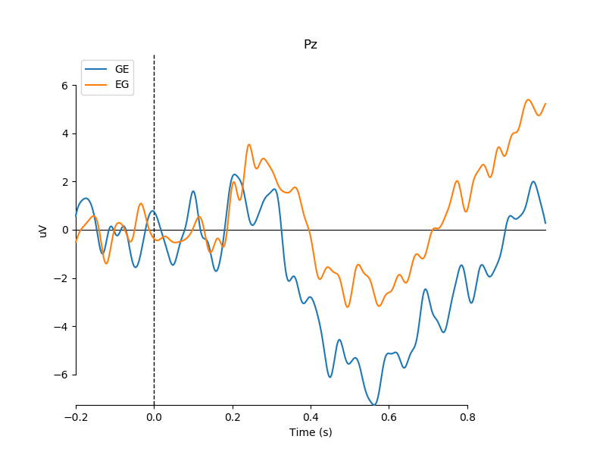
Results:

Slide 24
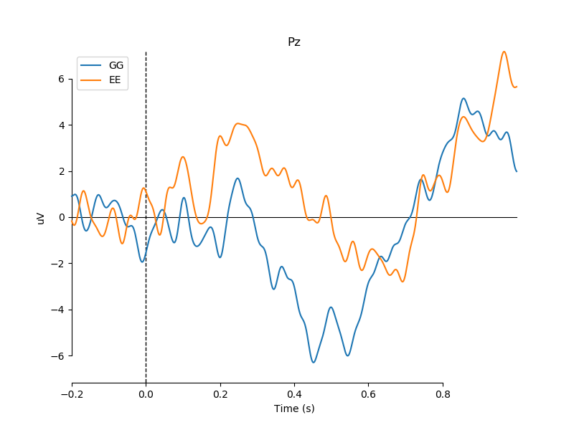
Results:

Slide 25
Current status
Refine the MNE-Python pipeline
Start behavioral data analysis pipeline
Restart data acquisition:
Get more pilot data
Complete actual data aquisition

Slide 26
Add-ons:

Slide 27
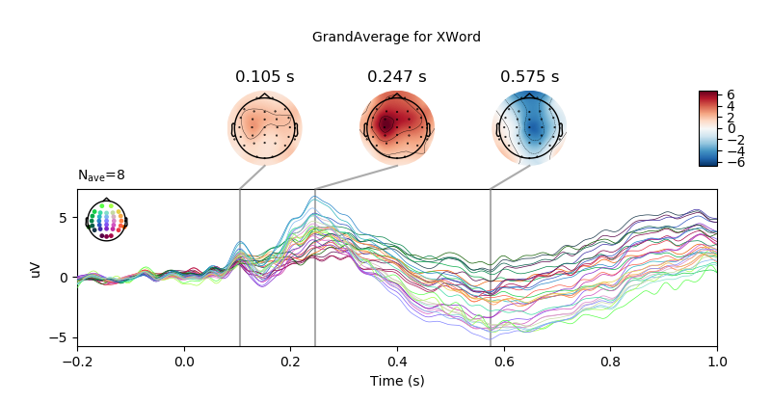
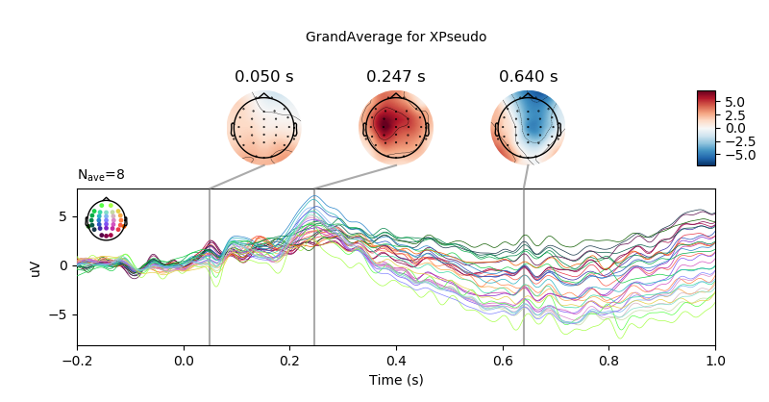

Slide 28
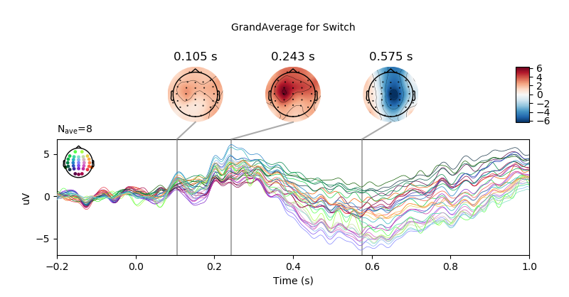
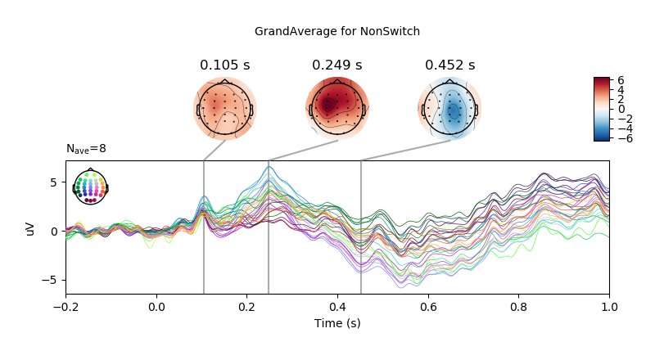

Slide 29
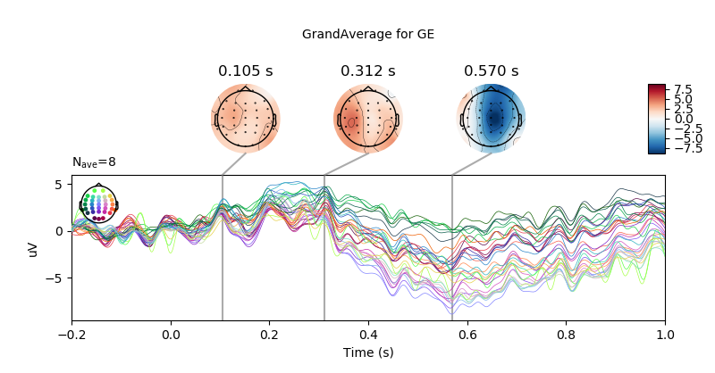
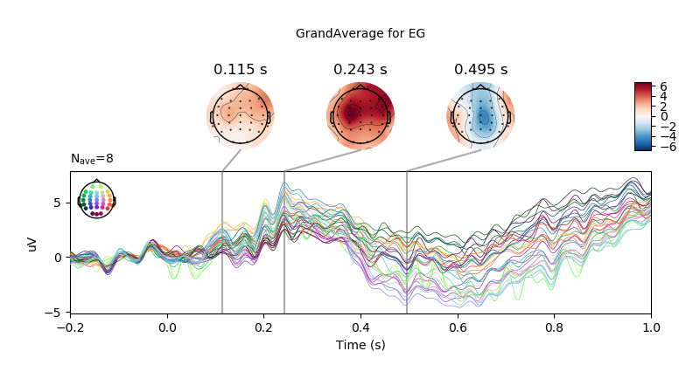

Slide 30
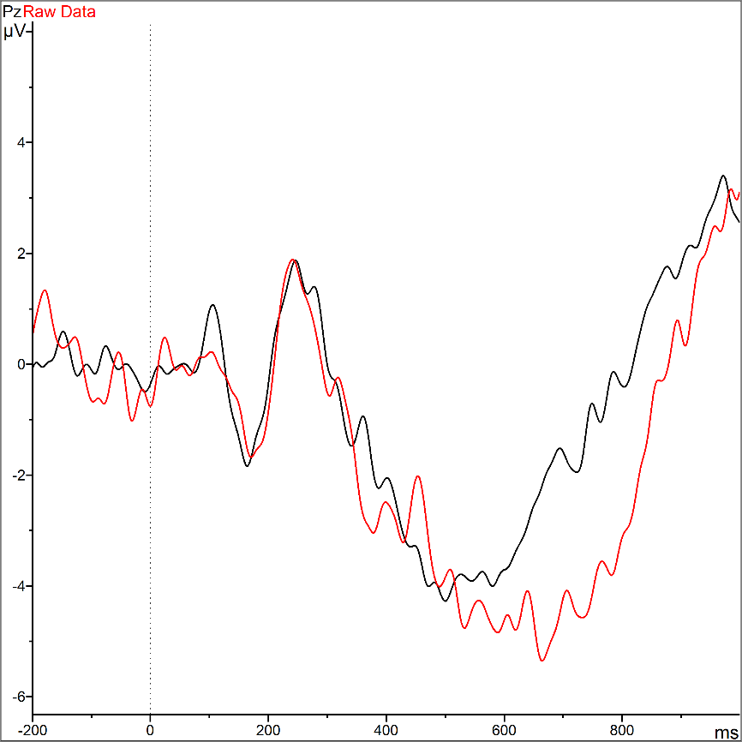
BVA vs. MNE-Python
Words Pseudowords

Slide 31
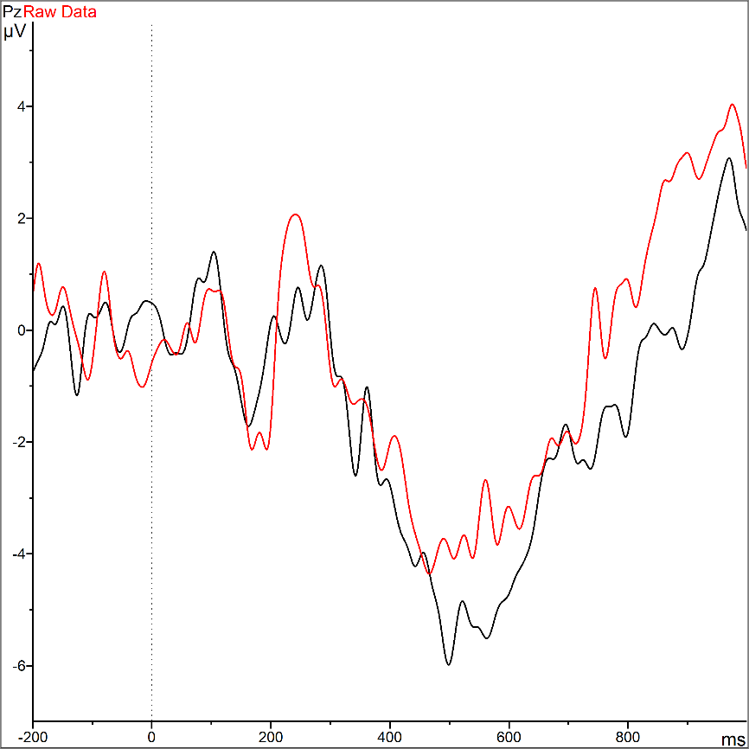
BVA vs. MNE-Python
Switch NonSwitch

Slide 32
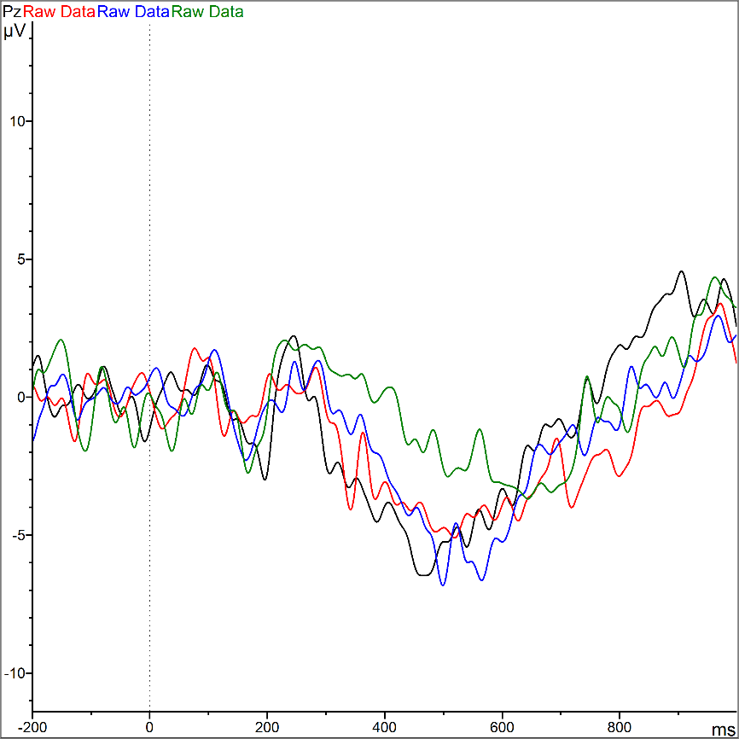
BVA vs. MNE-Python
GG GE EG EE

Slide 33
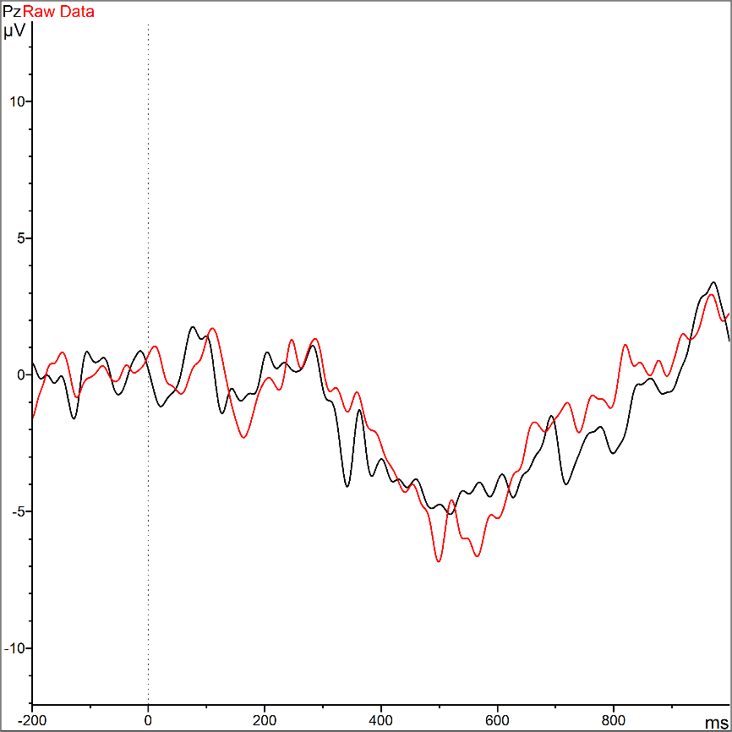
BVA vs. MNE-Python
GE EG

Slide 34
What is English as a lingua franca (ELF)
Defining ELF isn’t easy (e.g. Mortensen, 2013)
«English as a lingua franca constitutes an additionally acquired language system which serves as a common means of communication for speakers of different first languages.» (Vienna-Oxford International Corpus of English (VOICE) FAQ; Seidlhofer)
ELF is NOT a variety of English, but the use of English in ELF situations/scenarios
According to corpus studies (Laitinen, 2018) ELF differs from English as a foreign language (EFL) on structural grounds

Slide 35
What is English as a lingua franca (ELF)
ELF in relation to EFL (based on Jenkins et al., 2011, p.284; from slides of Albl-Mikasa, 2018)
EFL | ELF
Standard English as norm and benchmark | English varieties described independently
EFL: deficient (deficit perspective) | ELF: different (liberational perspective)
Deviations from standard indicative of incompetency | Deviations from standard regarded as manifestations of language contact
Aim: correctness | Aim: successful communication
Emphasis on form (-> errors) | Emphasis on function: solidarity, accommodation, communicative-strategic approach

Slide 36
Workload measurement
Gevins (1997):
frontal midline theta: increased magnitude with increased memory load
Parietocentral alpha: decreased magnitude with increased memory load
Often just frontal theta is used as workload measurement
(i.e. Cavanagh & Frank, 2014; Doppelmayr, Finkenzeller & Sauseng, 2008; Ishii et al.1999; Kubota et al. 2001; Luu, Tucker & Makeig, 2004; Rutishauser et al., 2010; Sammer et al. 2007)

Slide 37
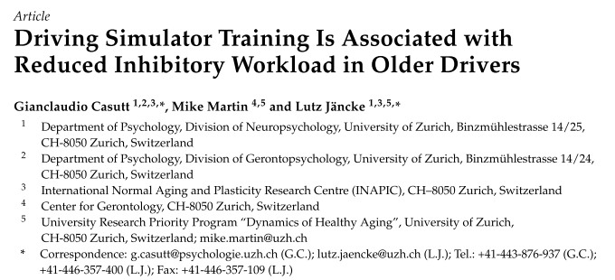
Workload measurement
The theta Fz/alpha Pz-Ratio: (Holm et al., 2009)
Value of index increases with increasing cognitive task demands
Theta Fz/alpha Pz ratio is more sensitive in detecting increased task demands than the absolute power values of frontal theta and parietal alpha (Holm et al., 2009)
In-house application: e.g. Casutt, Martin & Jäncke (2016)

Slide 38
Workload measurement
Psychological or mental stress has strong effects on heart rate and skin conductance (Boucsein, 1992; Reinhardt et al., 2012)
Electrocardiogram data
Shorter inter-beat interval (IBI) during tasks with high cognitive demands (e.g. Fairclough et al., 2005)
Relation of theta band activities and cardiac autonomic functions (e.g. Kubota et al. 2001)
Skin response data
Higher levels of skin conductance with increased workload (e.g. Mühl, Jeunet & Lotte, 2014)
Neurophysiological signals can classify workload with an accuracy of about 75% (Brouwer et al., 2012; Grimes et al., 2008; Mühl, Jeunet & Lotte, 2014).

