Slide 1
Zeitfrequenzanalyse & Wavelets Dr. sc. nat. Carina Klein FDI: Neuropsychologische Untersuchungsverfahren

Slide 2
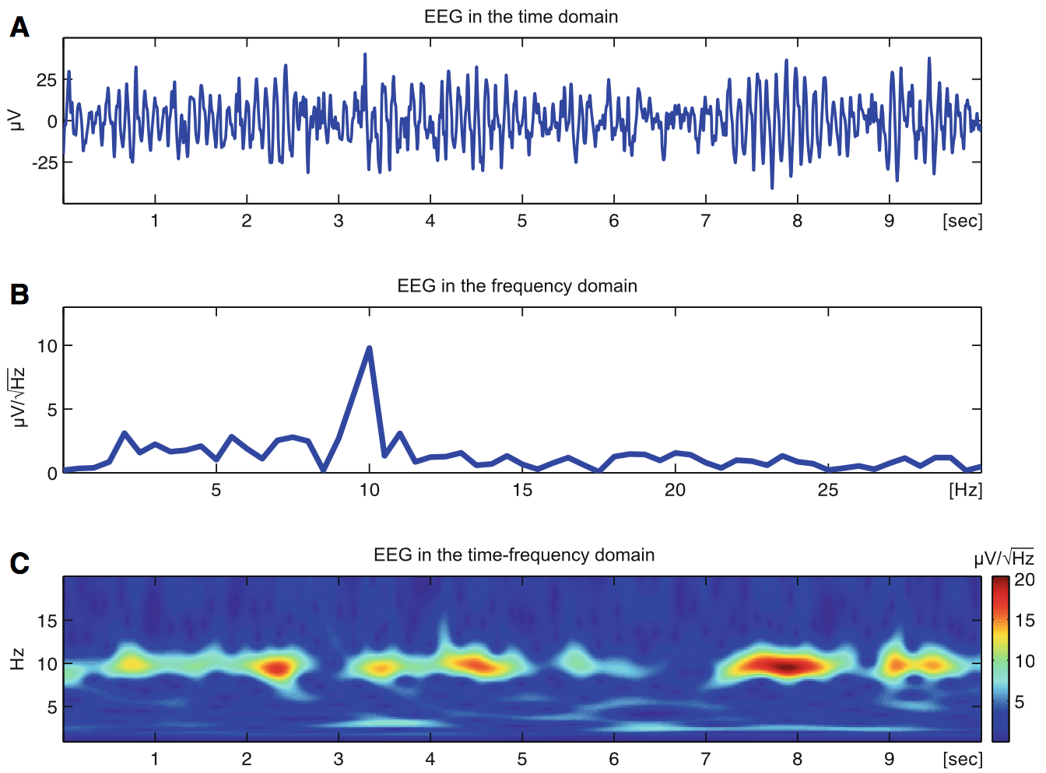
Zeitfrequenzanalyse
Notes:
Ganz einfach: filtern

Slide 3
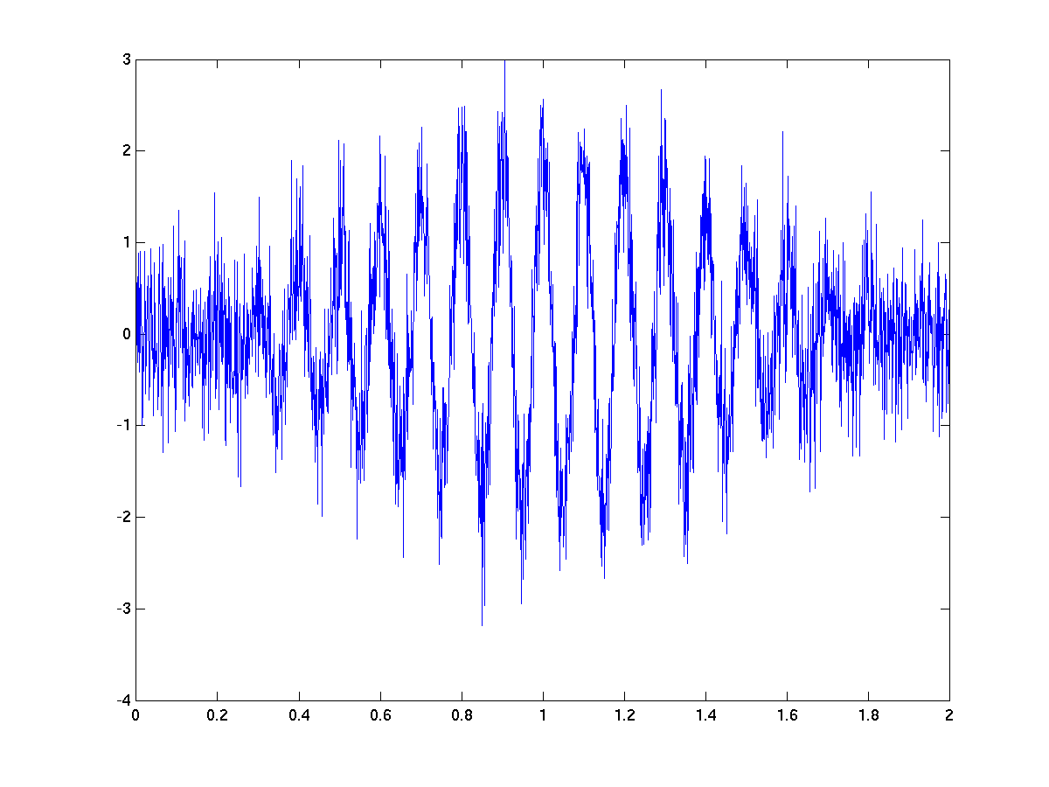
Zeitfrequenzanalyse: sliding window
Time (s)
www.fieldtriptoolbox.org

Slide 4
Zeitfrequenzanalyse: sliding window
Time (s)
FFT
Frequency (Hz)
high
power
0
www.fieldtriptoolbox.org
Time (s)
DFT: discrete Fourier Transformation
Notes:
Erts wenn Daten komplett isn Fenster passen, wird eine FFT berechnet (power is colour-coded)
Concept:
Here is a signal that is not stationary over time, the amplitude changes over time
Cut signal into snippet
compute power spectrum as a function of frequency, over time
compute Spectral Analysis for each snippet, over time
**window must be filled completed with data, in order to compute the spectrum
Rather than explain power as a line, colour code power as a functoin of frequency on y-axis, time on x-axis
- move on -> get TFR
Highest amplitude oscillation constrained in a particular frequency
Take a snippet of our data, snippet defined by toi
apply a DFT (discrete fourier transform) to compute the spectrum, as a function of frequency
we then proceed to do this for each snippet, so we are sliding the time window across the entire time range
The representation of the TFR is then a little different from just a spectral representation
instead of representing power as the vertical axis, and frequency as the horizontal axis
we represent frequency – vertical time; time = horizontal; power = colour
So here, as we move along the signal, we can see in the TFR that there is an increase in power (Amp^2) in the middle of the signal – constrained at a certain freq range

Slide 5
Zeitfrequenzanalyse: sliding window
Time (s)
FFT
Frequency (Hz)
high
power
0
Time (s)
Notes:
Erts wenn Daten komplett isn Fenster passen, wird eine FFT berechnet (power is colour-coded)
Concept:
Here is a signal that is not stationary over time, the amplitude changes over time
Cut signal into snippet
compute power spectrum as a function of frequency, over time
compute Spectral Analysis for each snippet, over time
**window must be filled completed with data, in order to compute the spectrum
Rather than explain power as a line, colour code power as a functoin of frequency on y-axis, time on x-axis
- move on -> get TFR
Highest amplitude oscillation constrained in a particular frequency
Take a snippet of our data, snippet defined by toi
apply a DFT (discrete fourier transform) to compute the spectrum, as a function of frequency
we then proceed to do this for each snippet, so we are sliding the time window across the entire time range
The representation of the TFR is then a little different from just a spectral representation
instead of representing power as the vertical axis, and frequency as the horizontal axis
we represent frequency – vertical time; time = horizontal; power = colour
So here, as we move along the signal, we can see in the TFR that there is an increase in power (Amp^2) in the middle of the signal – constrained at a certain freq range

Slide 6
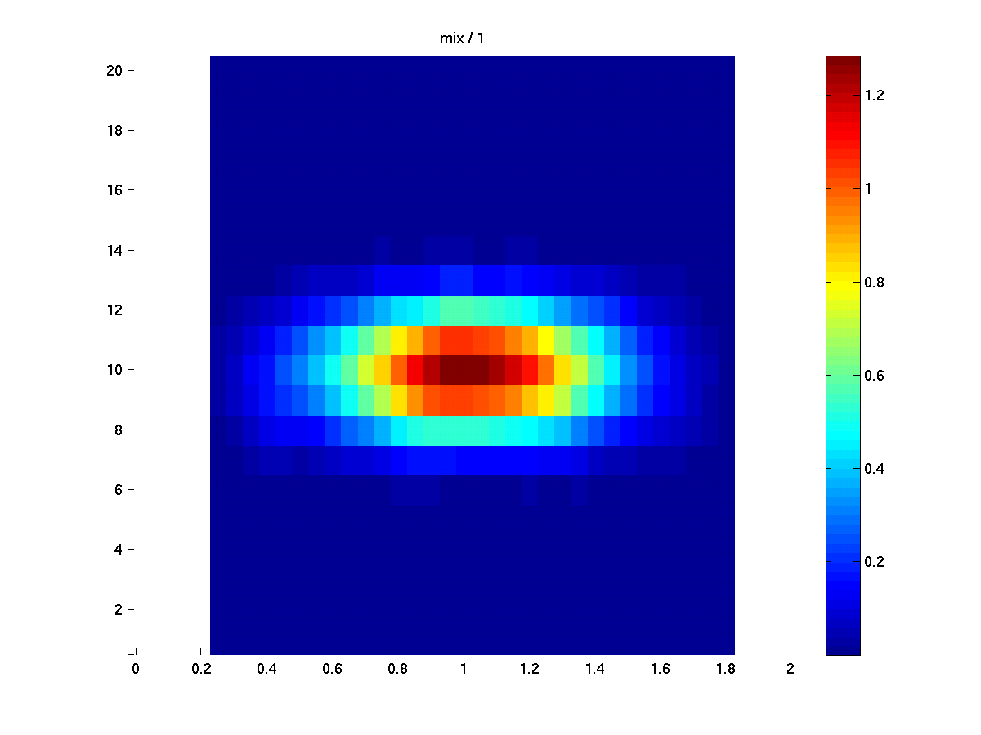
Zeitfrequenzanalyse: sliding window
Time (s)
FFT
Frequency (Hz)
high
power
0
Time (s)
www.fieldtriptoolbox.org
Notes:
Erts wenn Daten komplett isn Fenster passen, wird eine FFT berechnet (power is colour-coded)
Concept:
Here is a signal that is not stationary over time, the amplitude changes over time
Cut signal into snippet
compute power spectrum as a function of frequency, over time
compute Spectral Analysis for each snippet, over time
**window must be filled completed with data, in order to compute the spectrum
Rather than explain power as a line, colour code power as a functoin of frequency on y-axis, time on x-axis
- move on -> get TFR
Highest amplitude oscillation constrained in a particular frequency
Take a snippet of our data, snippet defined by toi
apply a DFT (discrete fourier transform) to compute the spectrum, as a function of frequency
we then proceed to do this for each snippet, so we are sliding the time window across the entire time range
The representation of the TFR is then a little different from just a spectral representation
instead of representing power as the vertical axis, and frequency as the horizontal axis
we represent frequency – vertical time; time = horizontal; power = colour
So here, as we move along the signal, we can see in the TFR that there is an increase in power (Amp^2) in the middle of the signal – constrained at a certain freq range

Slide 7
Zeitfrequenzanalyse: sliding window
Time (s)
FFT
Frequency (Hz)
high
power
0
Time (s)
www.fieldtriptoolbox.org
Notes:
Erts wenn Daten komplett isn Fenster passen, wird eine FFT berechnet (power is colour-coded)
Concept:
Here is a signal that is not stationary over time, the amplitude changes over time
Cut signal into snippet
compute power spectrum as a function of frequency, over time
compute Spectral Analysis for each snippet, over time
**window must be filled completed with data, in order to compute the spectrum
Rather than explain power as a line, colour code power as a functoin of frequency on y-axis, time on x-axis
- move on -> get TFR
Highest amplitude oscillation constrained in a particular frequency
Take a snippet of our data, snippet defined by toi
apply a DFT (discrete fourier transform) to compute the spectrum, as a function of frequency
we then proceed to do this for each snippet, so we are sliding the time window across the entire time range
The representation of the TFR is then a little different from just a spectral representation
instead of representing power as the vertical axis, and frequency as the horizontal axis
we represent frequency – vertical time; time = horizontal; power = colour
So here, as we move along the signal, we can see in the TFR that there is an increase in power (Amp^2) in the middle of the signal – constrained at a certain freq range

Slide 8
Zeitfrequenzanalyse: sliding window
Time (s)
FFT
…….
Frequency (Hz)
high
power
0
Time (s)
www.fieldtriptoolbox.org
Notes:
Erts wenn Daten komplett isn Fenster passen, wird eine FFT berechnet (power is colour-coded)
Concept:
Here is a signal that is not stationary over time, the amplitude changes over time
Cut signal into snippet
compute power spectrum as a function of frequency, over time
compute Spectral Analysis for each snippet, over time
**window must be filled completed with data, in order to compute the spectrum
Rather than explain power as a line, colour code power as a functoin of frequency on y-axis, time on x-axis
- move on -> get TFR
Highest amplitude oscillation constrained in a particular frequency
Take a snippet of our data, snippet defined by toi
apply a DFT (discrete fourier transform) to compute the spectrum, as a function of frequency
we then proceed to do this for each snippet, so we are sliding the time window across the entire time range
The representation of the TFR is then a little different from just a spectral representation
instead of representing power as the vertical axis, and frequency as the horizontal axis
we represent frequency – vertical time; time = horizontal; power = colour
So here, as we move along the signal, we can see in the TFR that there is an increase in power (Amp^2) in the middle of the signal – constrained at a certain freq range

Slide 9
Zeitfrequenzanalyse: sliding window
Time (s)
FFT
…….
…………….
Frequency (Hz)
high
power
0
Time (s)
www.fieldtriptoolbox.org
Notes:
Erts wenn Daten komplett isn Fenster passen, wird eine FFT berechnet (power is colour-coded)
Concept:
Here is a signal that is not stationary over time, the amplitude changes over time
Cut signal into snippet
compute power spectrum as a function of frequency, over time
compute Spectral Analysis for each snippet, over time
**window must be filled completed with data, in order to compute the spectrum
Rather than explain power as a line, colour code power as a functoin of frequency on y-axis, time on x-axis
- move on -> get TFR
Highest amplitude oscillation constrained in a particular frequency
Take a snippet of our data, snippet defined by toi
apply a DFT (discrete fourier transform) to compute the spectrum, as a function of frequency
we then proceed to do this for each snippet, so we are sliding the time window across the entire time range
The representation of the TFR is then a little different from just a spectral representation
instead of representing power as the vertical axis, and frequency as the horizontal axis
we represent frequency – vertical time; time = horizontal; power = colour
So here, as we move along the signal, we can see in the TFR that there is an increase in power (Amp^2) in the middle of the signal – constrained at a certain freq range

Slide 10
Zeitfrequenzanalyse: sliding window
Time (s)
FFT
…….
…………….
………………………………...
Frequency (Hz)
high
power
0
Time (s)
www.fieldtriptoolbox.org
Notes:
Erts wenn Daten komplett isn Fenster passen, wird eine FFT berechnet (power is colour-coded)
Concept:
Here is a signal that is not stationary over time, the amplitude changes over time
Cut signal into snippet
compute power spectrum as a function of frequency, over time
compute Spectral Analysis for each snippet, over time
**window must be filled completed with data, in order to compute the spectrum
Rather than explain power as a line, colour code power as a functoin of frequency on y-axis, time on x-axis
- move on -> get TFR
Highest amplitude oscillation constrained in a particular frequency
Take a snippet of our data, snippet defined by toi
apply a DFT (discrete fourier transform) to compute the spectrum, as a function of frequency
we then proceed to do this for each snippet, so we are sliding the time window across the entire time range
The representation of the TFR is then a little different from just a spectral representation
instead of representing power as the vertical axis, and frequency as the horizontal axis
we represent frequency – vertical time; time = horizontal; power = colour
So here, as we move along the signal, we can see in the TFR that there is an increase in power (Amp^2) in the middle of the signal – constrained at a certain freq range

Slide 11
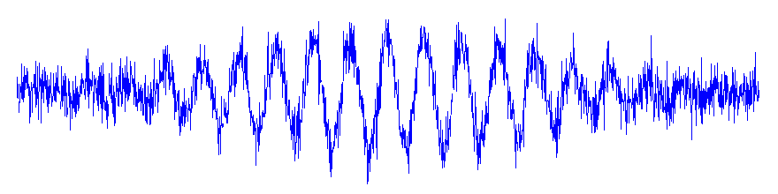
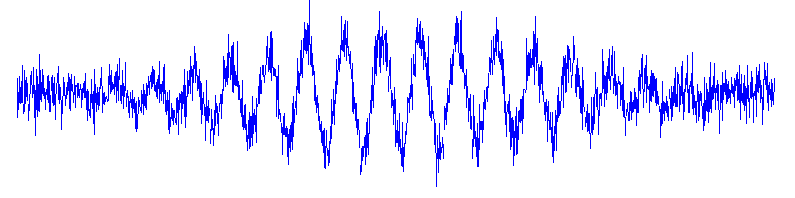
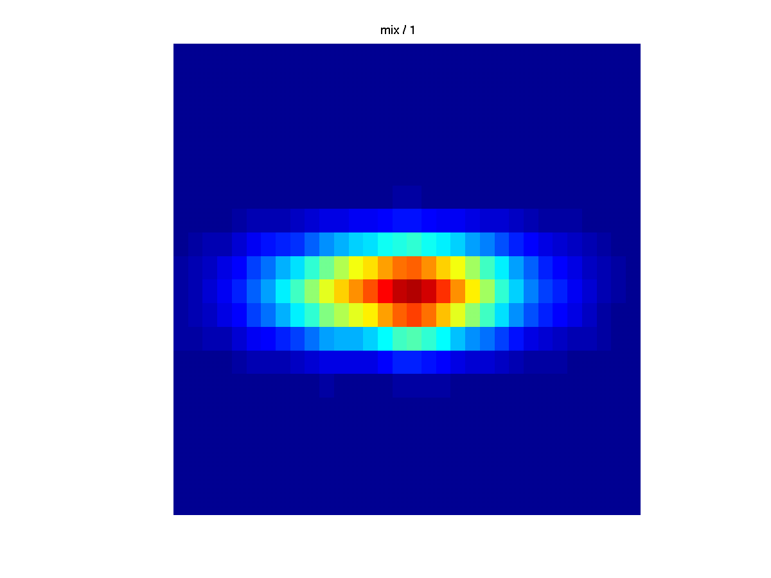
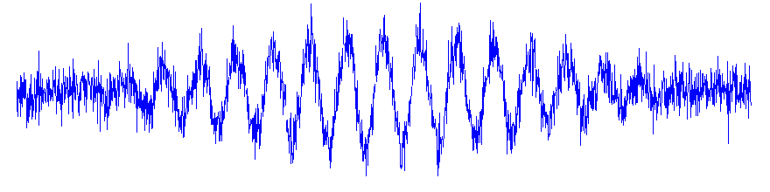
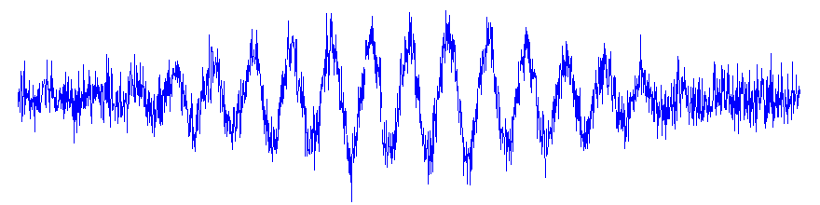
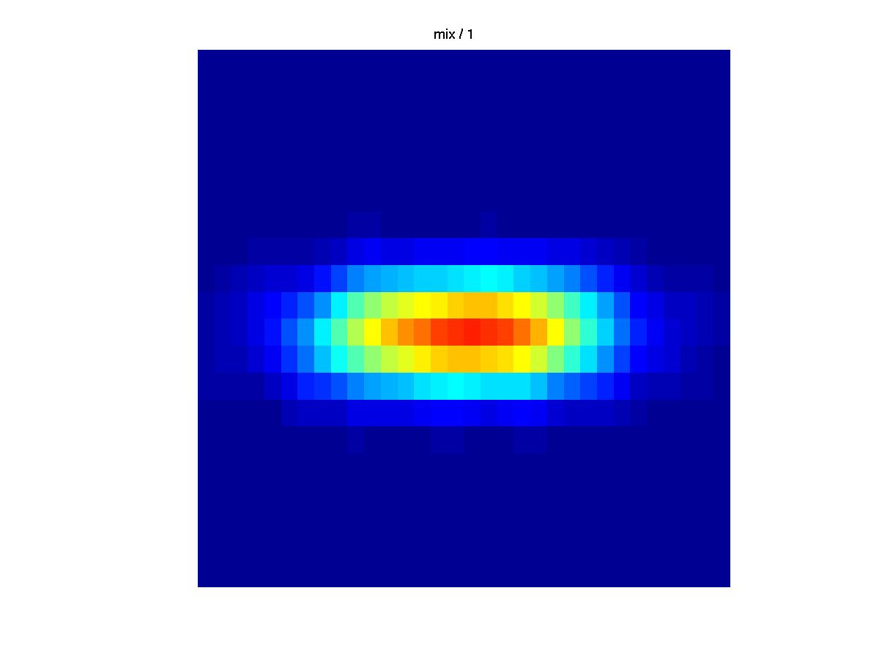
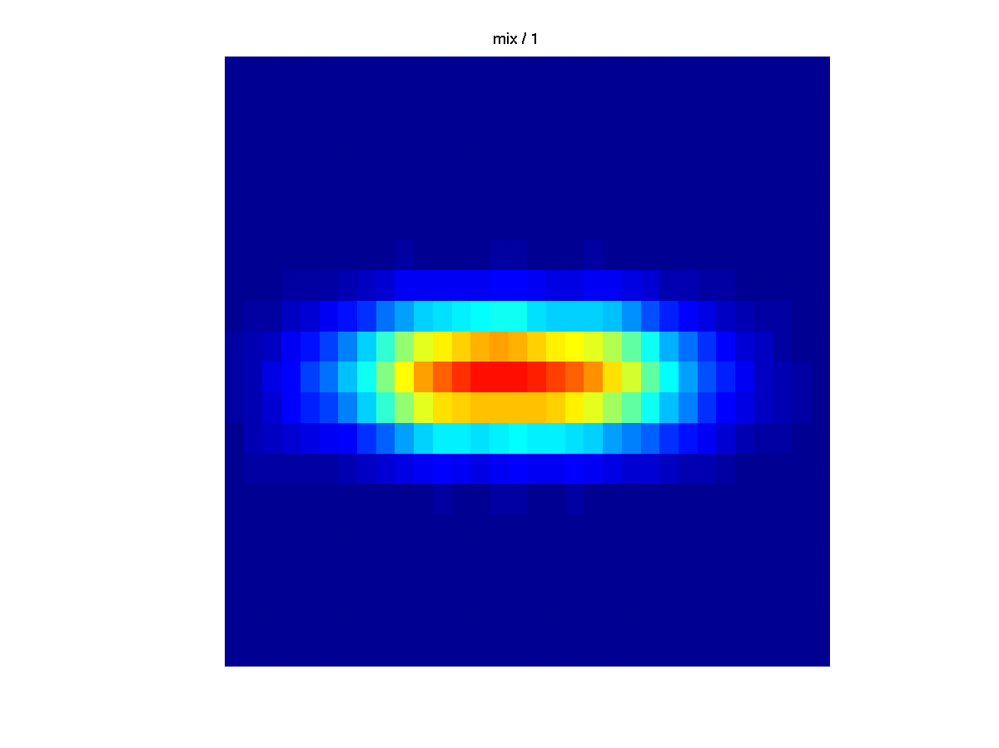
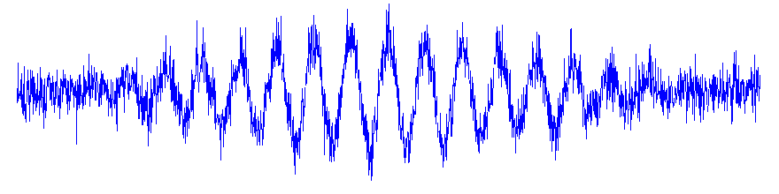
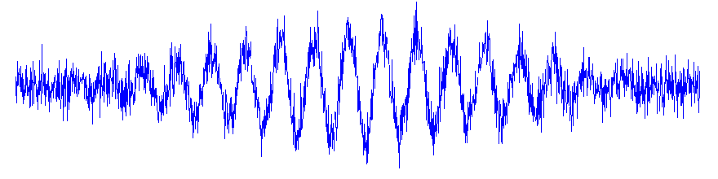
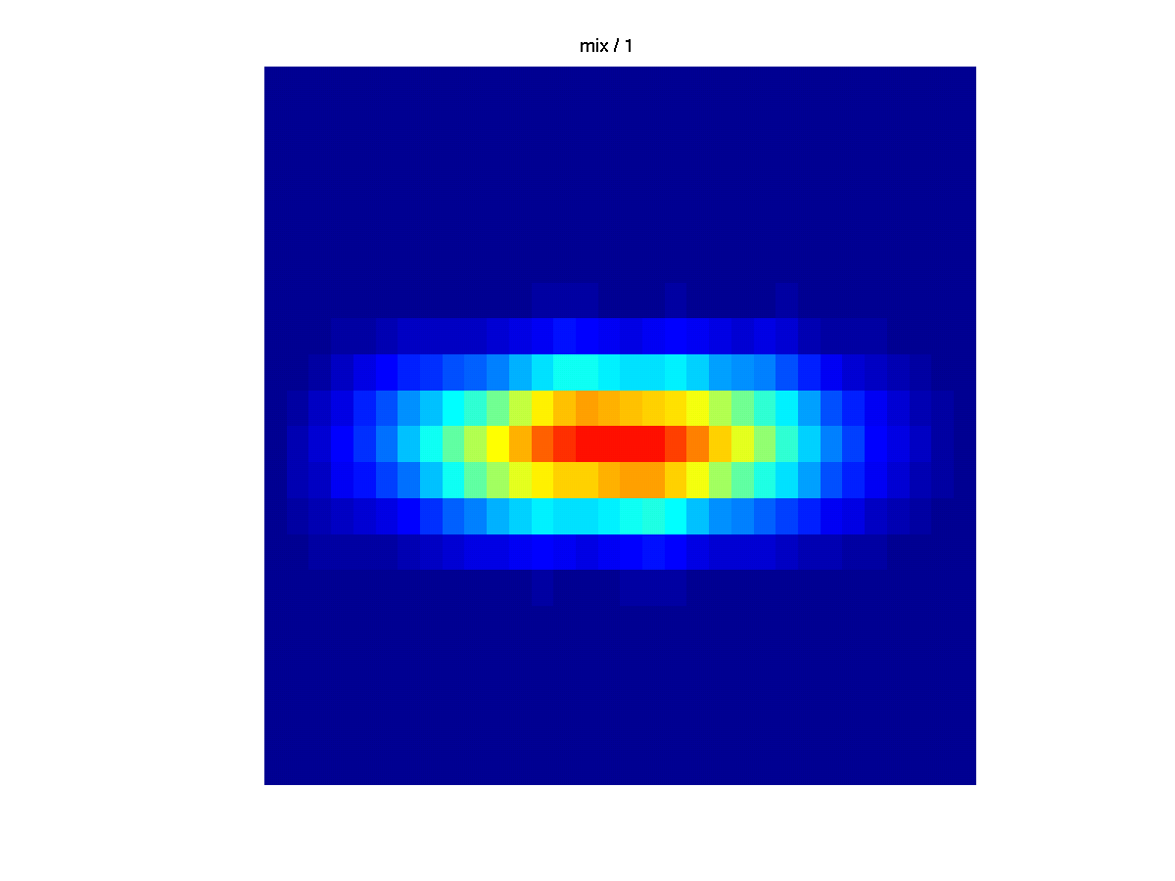
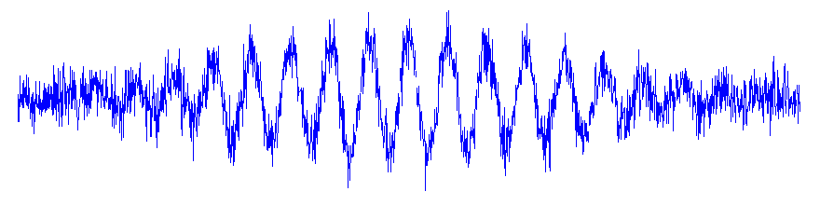
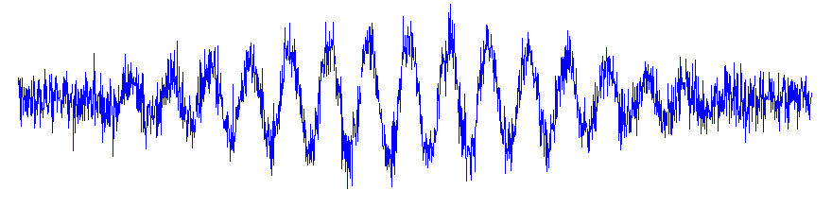
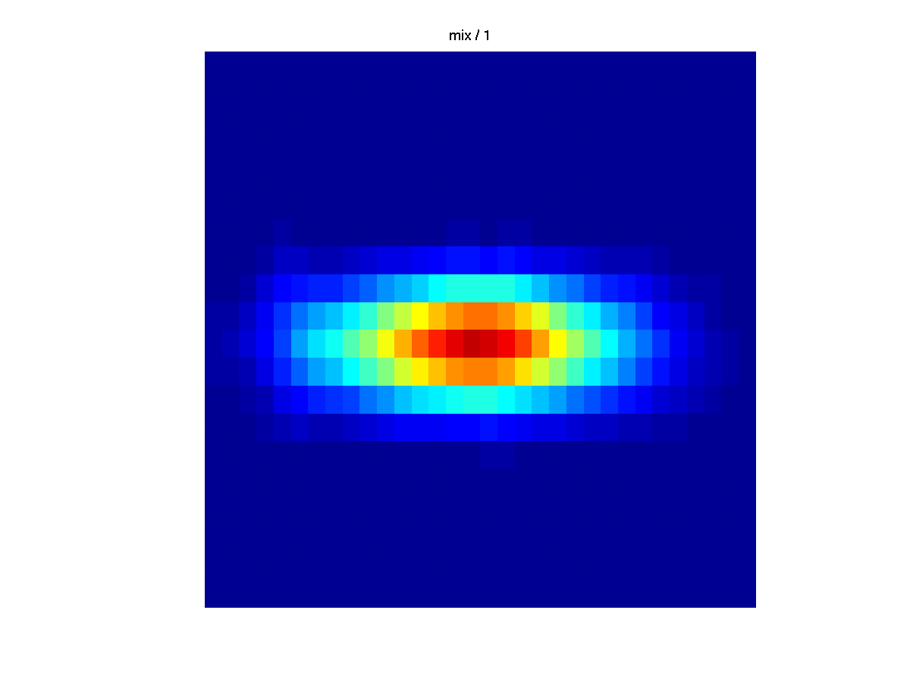
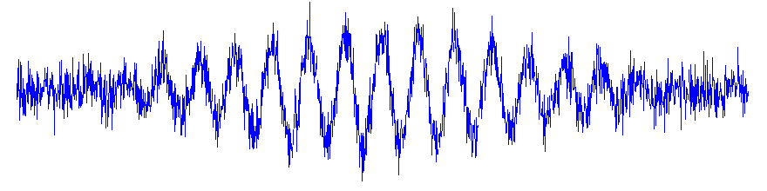
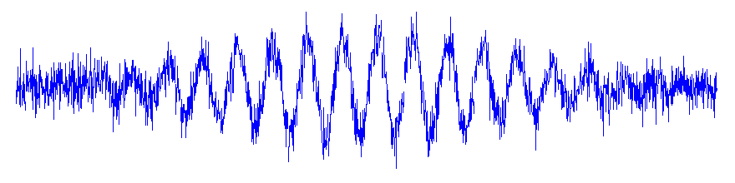
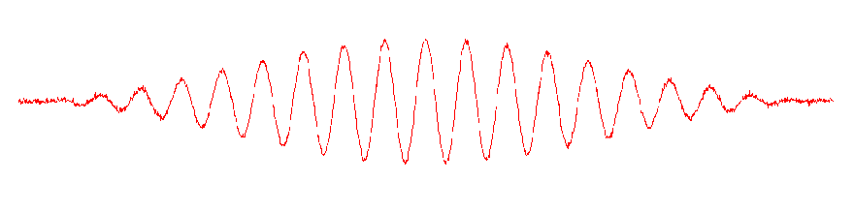
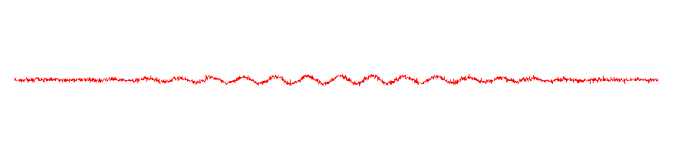
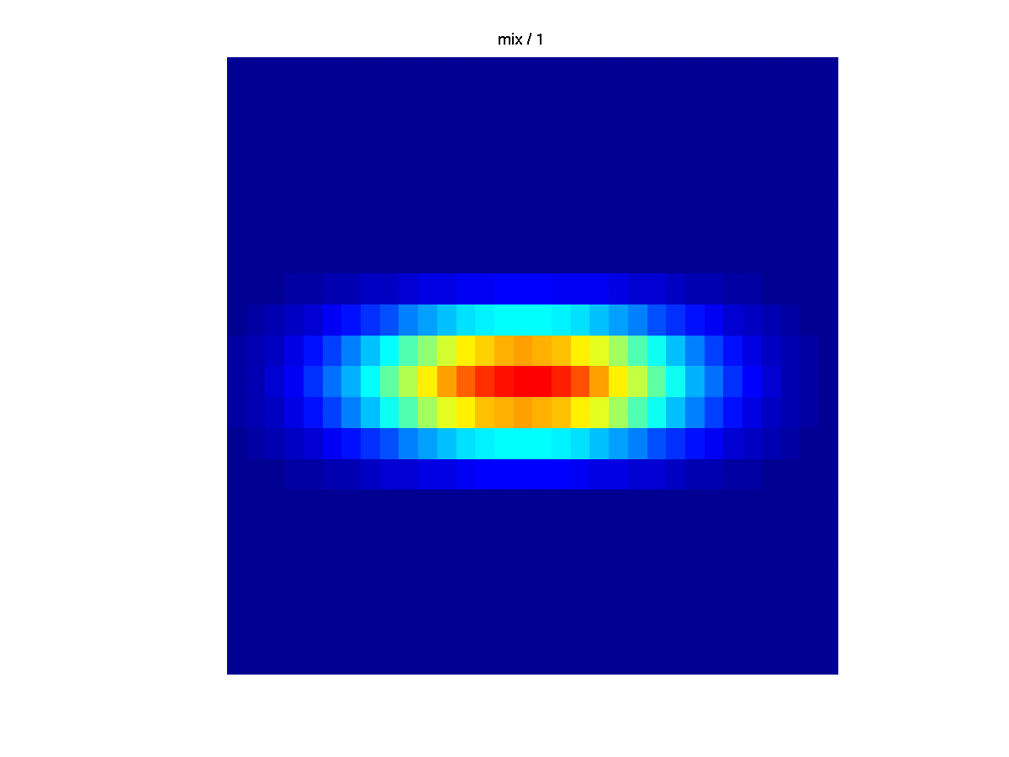
Evoked vs. Induced activity
Time (s)
Freq (Hz)
Time (s)
Time (s)
www.fieldtriptoolbox.org
Notes:
Evoked activity: average over trials to get feature of interest
- Oscillation has same polarity relative to the stimulus each time – you can obtain the feature in the oscillation by averaging
Induced activity: simply averaging does not extract feature because the phases are different/variable across trials
First, we need to compute the

Slide 12
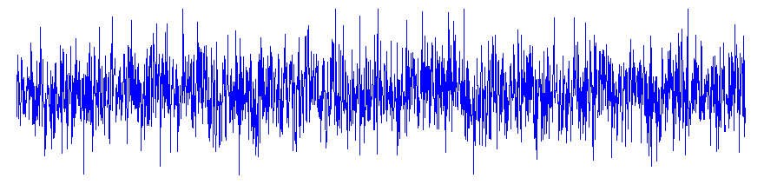
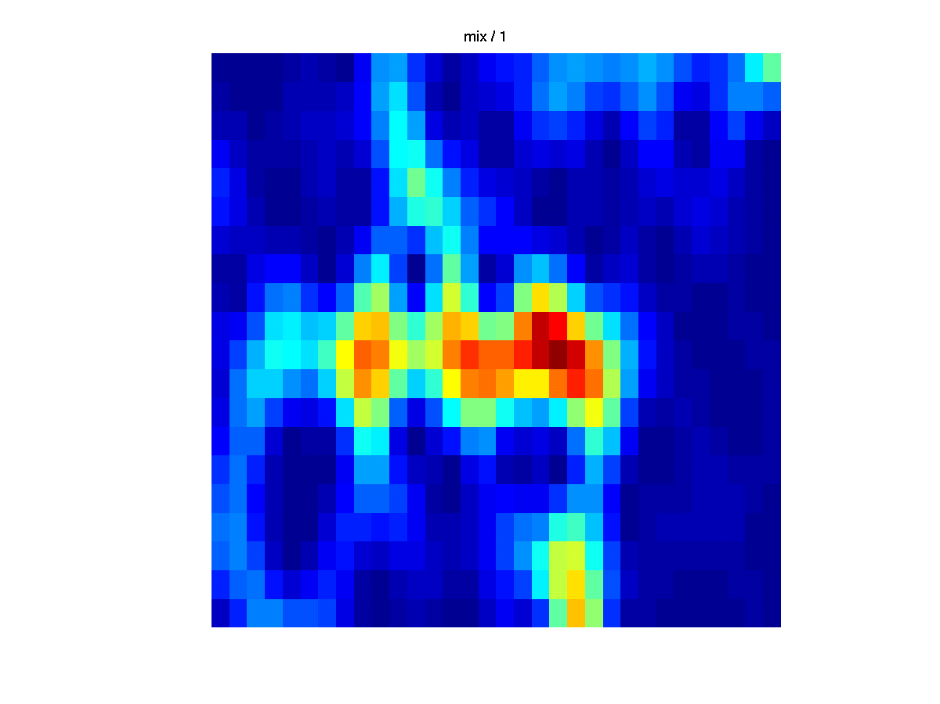
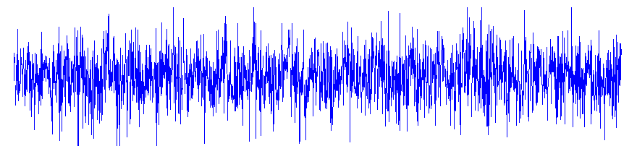
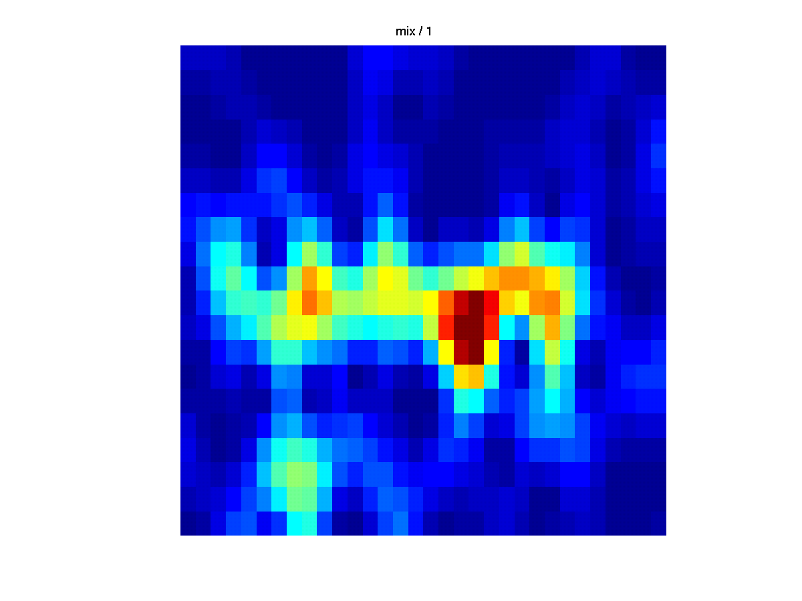
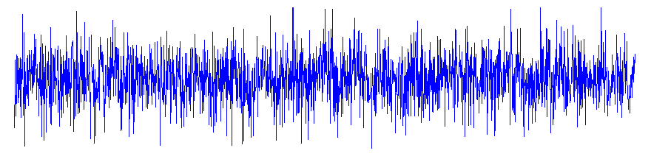
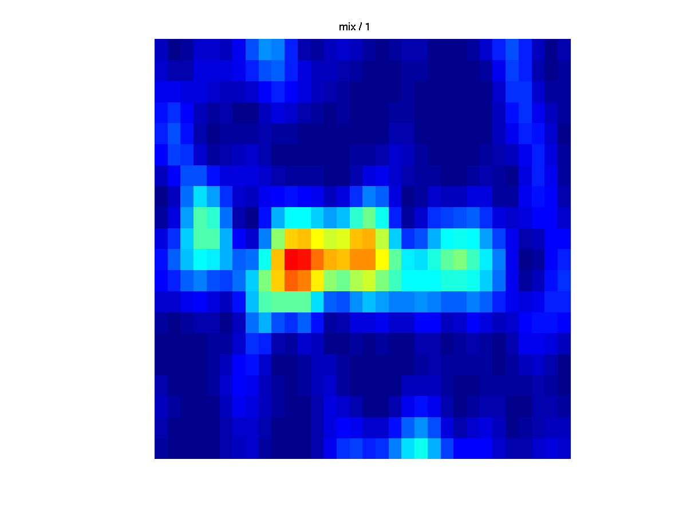
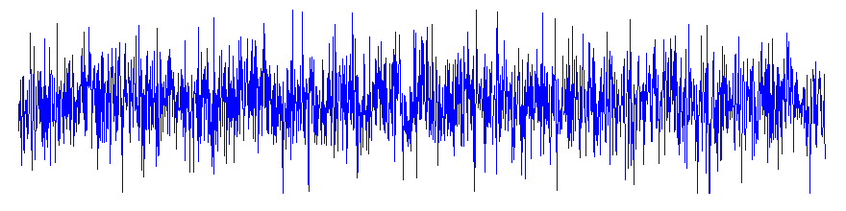
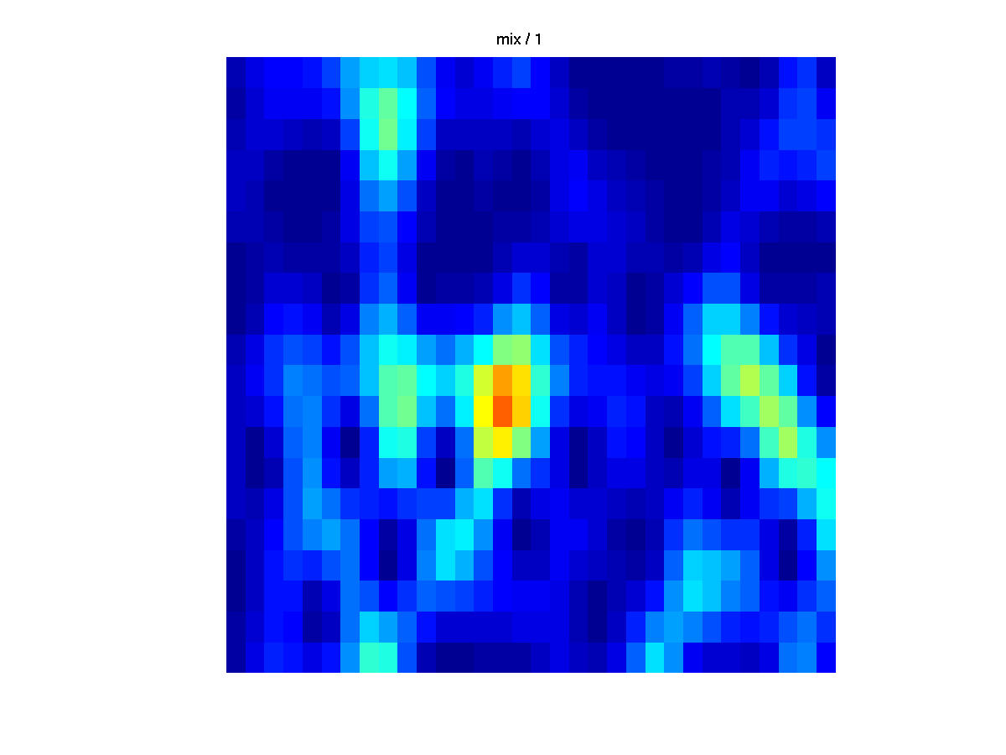
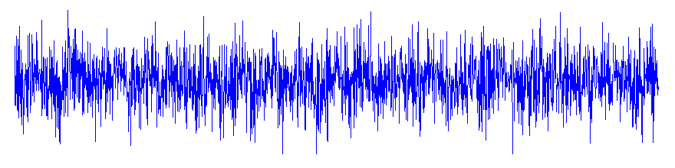
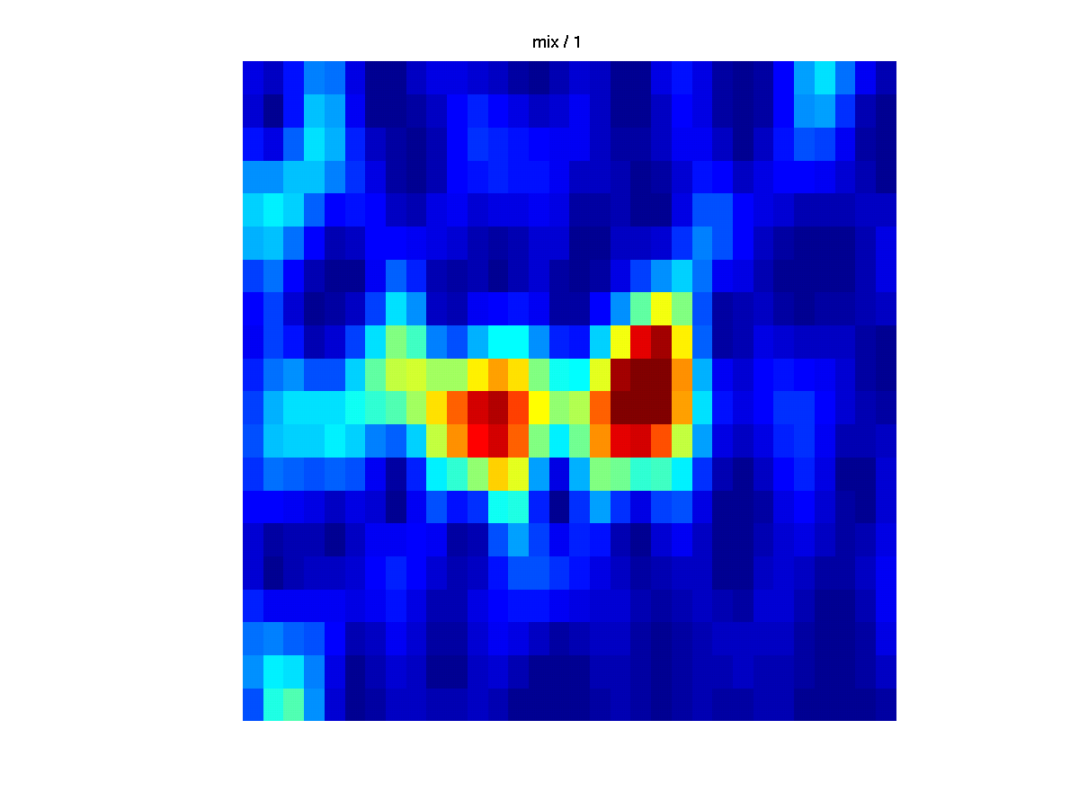
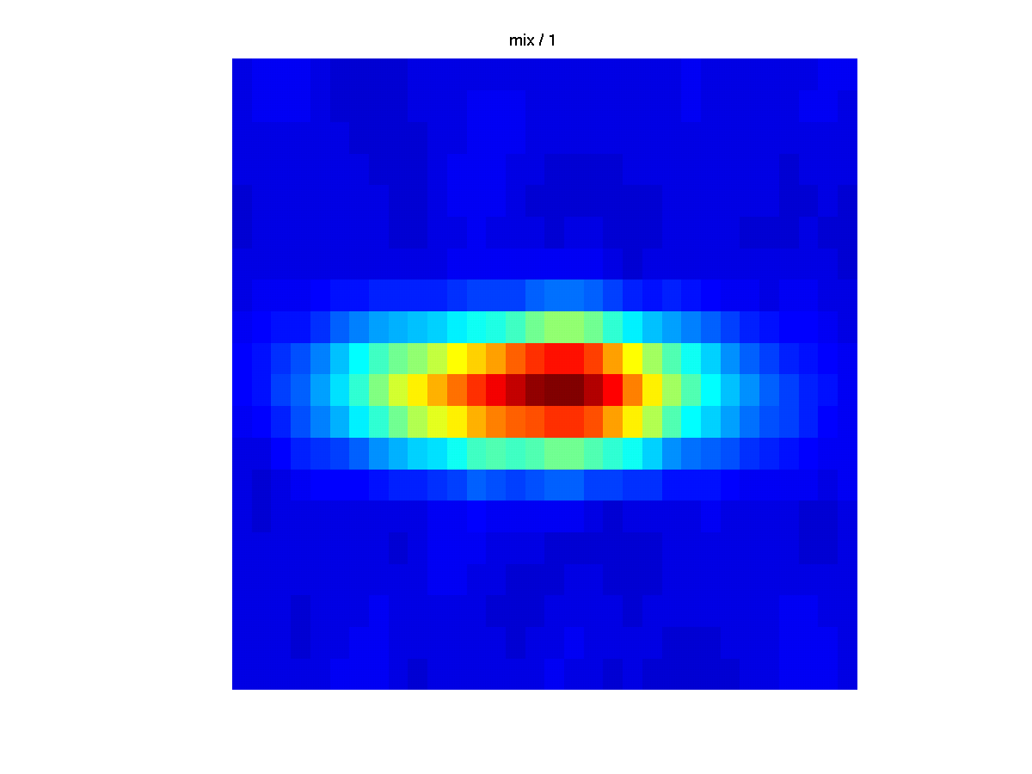
Verrauschtes Signal -> viele Trials!
Time (s)
Freq (Hz)
www.fieldtriptoolbox.org
Notes:
In reality
Noisy single trial
each trial only captures part of the features, but averaging can give the full picture
TF analysis: calculate on single trial level AND THEN average!

Slide 13
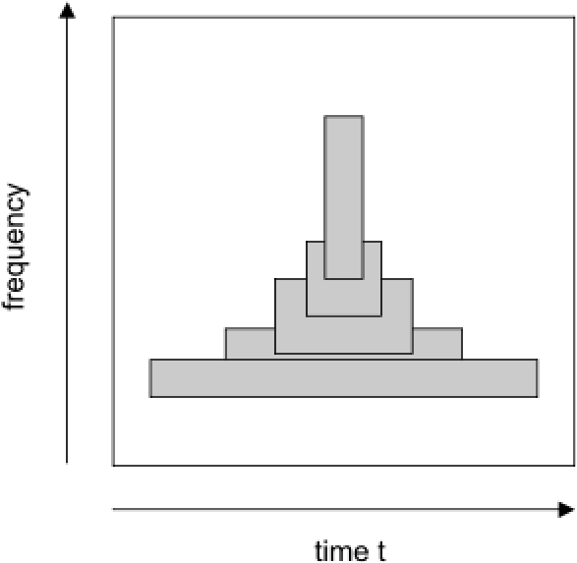
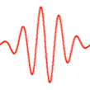

Zeit- vs. Frequenzauflösung
FFT
Frequency (Hz)
Time (s)
www.fieldtriptoolbox.org

Slide 14
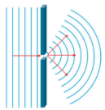
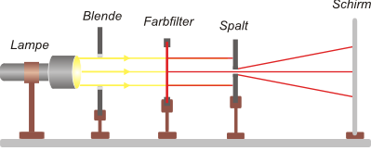
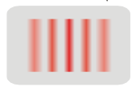
Exkurs: Heisenbergsche Unschärferelation bei Quantenobjekten
Interferenzmuster
✓
✗
Richtung
Ort
Richtung
Ort
Richtung
Ort
✗
✓
∆x * ∆p = h
Ablenkung der Teilchen im Spalt durch Wirkung des Querimpulses → Ortsbestimmung nach dem Spalt eines Teilchens ist unmöglich
Notes:
Quantenobjekte: zB Elektron: ist ein Teilchen und eine Welle -> Teilchen hat einen Ort, Welle breitet sich aus und hat damit keinen Ort, aber eine Richtung und eine Geschwindigkeit = Impuls (gibt Geschwindigkeit und Richtung eines Teilchens an)
Durch Beugung breitet sich die Welle hinter dem Spalt (Einzel oder Doppelspalt) in alle Richtungen aus -> Überlagerung der Wellen auf dem Schirm (konstruktive und destruktive Interferenz ((zB Nulllinie wenn Wellen um halbe Wellenlänge zueinander verschoben sind)) lässt das Muster entstehen
Delta x = Ortsunschärfe
Delta p = Impulsunschärfe
H = Planck‘sches Wirkungsquantum (Konstante) => wenn x gross ist, ist y klein und vice versa => nur eine von beiden Eigenschaften ist bestimmbar

Slide 15
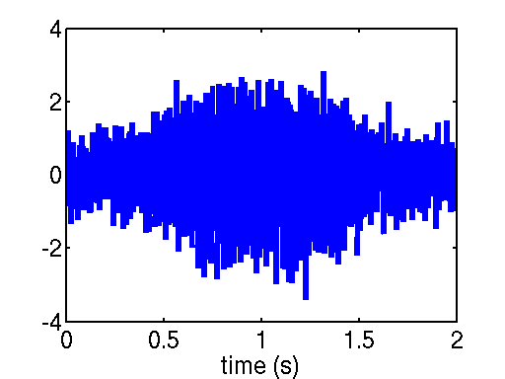
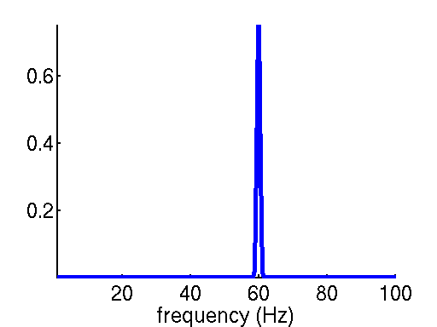
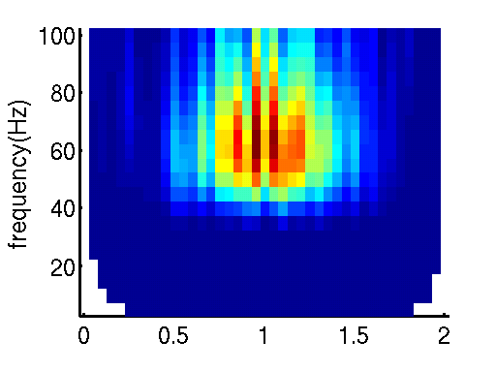
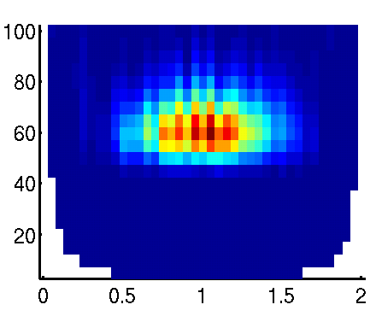
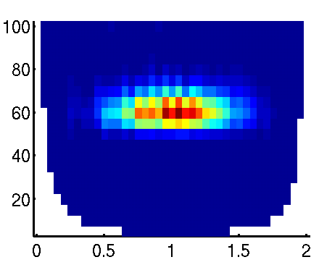
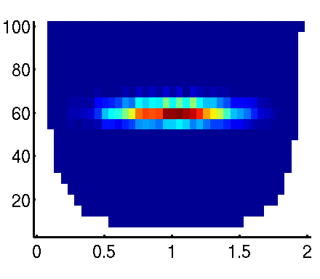
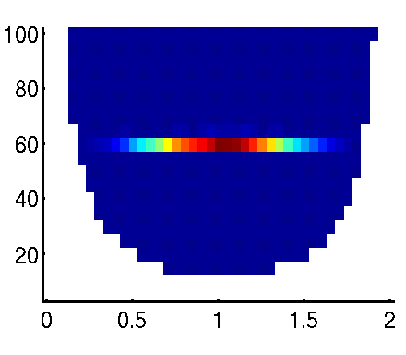
Zeit- vs. Frequenzauflösung
Kurzes Zeitfenster
Langes Zeitfenster
www.fieldtriptoolbox.org
Notes:
Be aware of time-frequency tradeoff
Simulated 60 Hz signal
Frequenzauflösung: Relay frequency: 1/legth of time window -> spectral reolution
Increase length of time window -> reduce spectral leakage
Narrow time window = poor frequency resolution -> poor estimate of signal
Large time window = poor temporal resolution -> can’t tell where the effect is
4th window = good
Bottom line: be aware of the values chosen for your foi, toi, and time window; avoid fishing expedition; determine parameters on pilot data

Slide 16
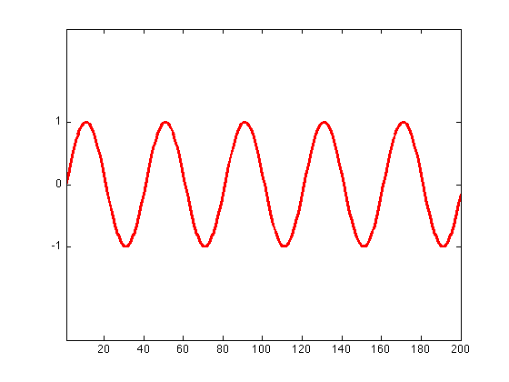
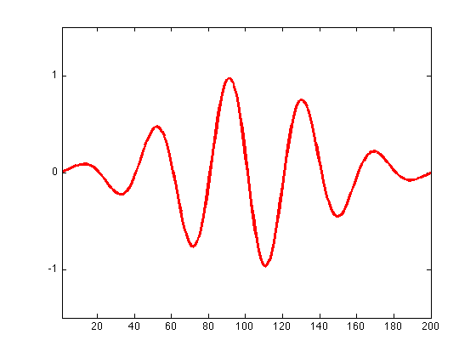
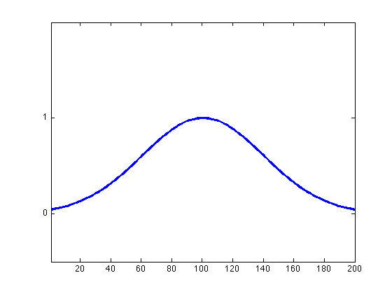
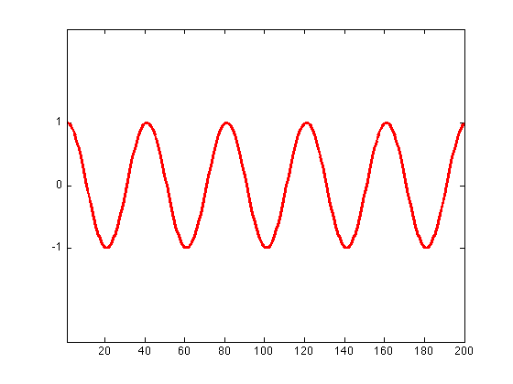
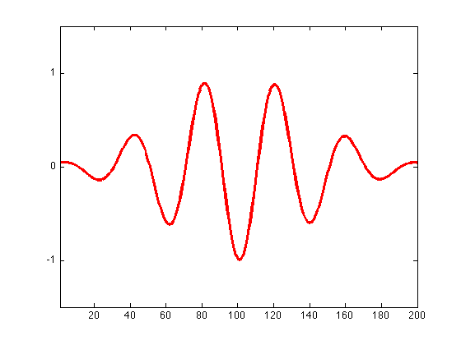
Wavelet-Analyse
Alternative zur Zeit-Frequenzanalyse „sliding window“
Wavelet von franz. ondelette = „kleine Welle“
Abgleich der Waveletfunktion mit den realen Daten
Sine wave
Taper
=
X
Cosine wave
=
www.fieldtriptoolbox.org
Notes:
A wavelet is
Wavelet analysis: convolution (=local correlation) of the eeg signal with a family of waveletswhich capture different frequency components
Taper is applied to the basic functions (sine and cosine waves).
Ondelette franz. Wellchen

Slide 17
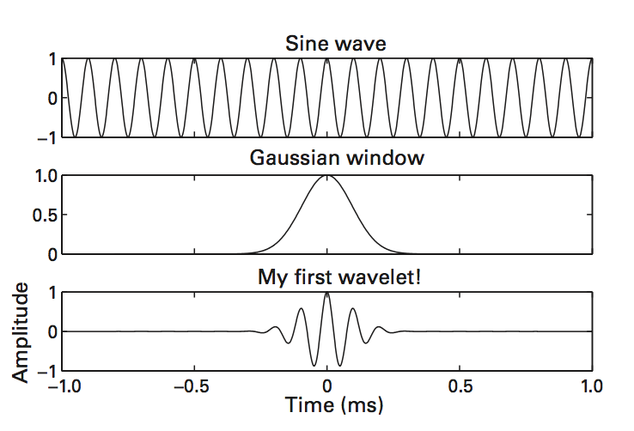
Was ist ein Wavelet?
Frequenz die interessiert
↓
Taper auf Frequenz anwenden
↓
Wavelet
Luck (2005)
Notes:
Ein Wavelet pro interessierendem Frequenzband -> Funktion wird getapert (Unterschied zur FFT bei der die Daten getapert werden) -> ergibt Form der Wavelet

Slide 18

Typische Wavelets

Slide 19

Wavelets: Zeit- vs. Frequenzauflösung
www.fieldtriptoolbox.org
Notes:
Wavelet width determines the time-frequency resolution
Frequency: usually 5 cycles -> are tapered -> stretchend/compress (= temporal resolution) (number of cycles within a wavelet remains the same)
Gaussian taper => Morlet Wavelet (most popular one)

Slide 20

Wavelets: Zeit- vs. Frequenzauflösung
Waveletlänge (Anzahl Zyklen) ist limitierend für Zeit-/Frequenzauflösung
Tiefe Frequenzen („lange Wavelets“)
Zeitauflösung ✗
Frequenzauflösung ✓
Hohe Frequenzen („kurze Wavelets“)
Zeitauflösung ✓
Frequenzauflösung ✗
www.fieldtriptoolbox.org
Notes:
For Y-axis: specify for which signal you want to ahve an estimate in your freuqency resolution (foi (frequency of interest) & toi (time of interest)) = grid of resolution (for every grid point one value is estimated) -> spectral and temporal smoothing
Division is up to you

Slide 21


Wavelets
Punktweise Faltung der Waveletfunktion mit den EEG-Daten (pro Frequenz)
www.fieldtriptoolbox.org
Notes:
Convolve: point wise correlation
Blue = signal
Red = wavelet
Higher correlation between wavelet and earlier part of signal; low correlation = poor fit

Slide 22
Literatur
Luck, S.J. (2005) An introduction to the event-related potential technique. MIT Press, 2nd edition. ISBN: 978-0262525855.

