Slide 1
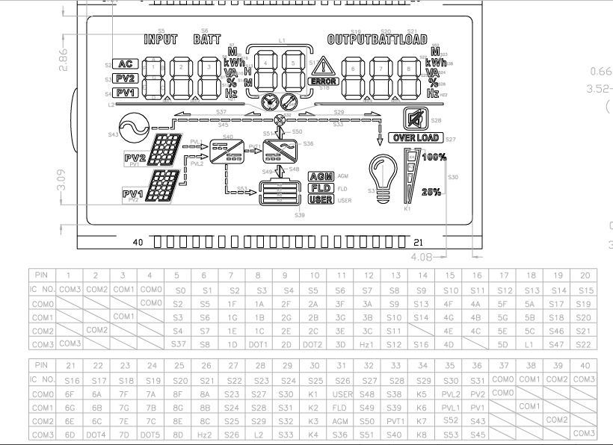
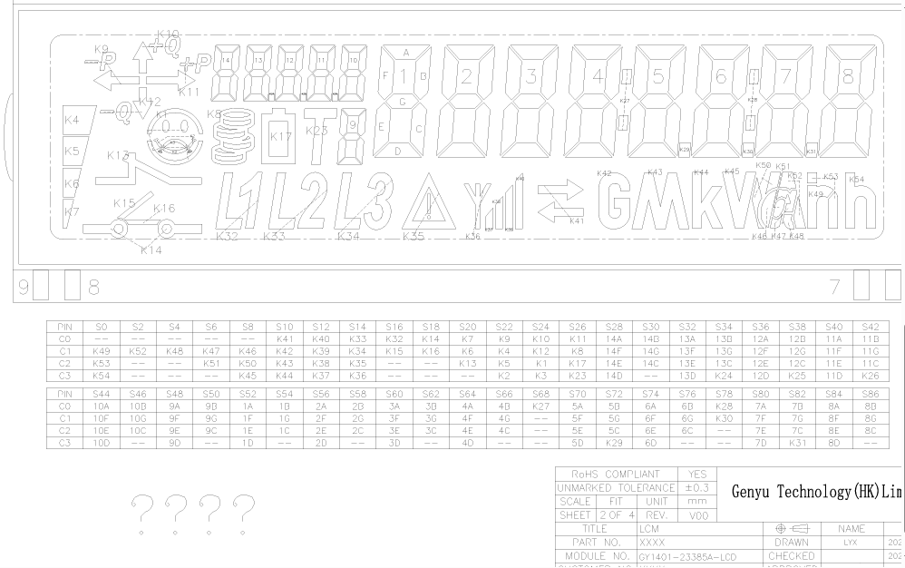
Segmented LCD configuration
for C2000 energy meters
GY1401 and GY0801 implementation brief
Prepared for future C2000-based energy meter UI integration
Notes:
[Sources]
C:/Users/mkoda/workspace_ccstheia/LCD_I2C
C:/Users/mkoda/workspace_ccstheia/GY0801_LCD
C:/Users/mkoda/Documents/lcd materials
C:/Users/mkoda/Documents/Premauda/GY0801 LCD Materials

Slide 2
GY1401 / C2000 ENERGY METER
GY1401 work established the C2000 LCD path
The implementation proves the CN91C4S48-based GY1401 can be configured and updated from the C2000 firmware using a small reusable LCD abstraction.
Core result
Numbers display correctly through MeterLcd::Print(), which writes packed byte patterns into the LCD main message window.
01
I2C controller path initialized on C2000Ware driverlib.
02
CN91C4S48 command sequence sets display timing, contrast, blink and enable state.
03
A display RAM shadow lets numeric and fixed-symbol writes stay isolated.
Notes:
[Sources]
C:/Users/mkoda/workspace_ccstheia/LCD_I2C/hw/hw_i2c.cpp
C:/Users/mkoda/workspace_ccstheia/LCD_I2C/hw/meter_lcd.cpp
C:/Users/mkoda/Documents/lcd materials/CN91C4S48_i2c.pdf

Slide 3
GY1401 CONFIGURATION
Configure GY1401 before segment writes
01
Target address: 0x3E on the I2C bus.
02
Startup sends ICSET, DISCTL, EVRSET, BLKCTL, APCTL and MODSET.
03
After enable, DDRAM is cleared so every later update starts from known state.
04
C2000 I2C transport chunks longer RAM writes and waits for FIFO/STOP completion.
Configuration separates controller bring-up from UI content.
Notes:
[Sources]
C:/Users/mkoda/workspace_ccstheia/LCD_I2C/hw/includes/meter_lcd.h
C:/Users/mkoda/workspace_ccstheia/LCD_I2C/hw/meter_lcd.cpp
C:/Users/mkoda/Documents/lcd materials/COM_SEG Mapping Table.PNG

Slide 4
GY1401 PROGRAMMING
Numeric display depends on packed LCD byte patterns
The display is not an ASCII LCD. Digits are converted to controller-specific segment bytes, then written at the main message DDRAM window.
Example digit LUT
Write target
0 -> 0xFA
1 -> 0x0A
8 -> 0xFE
9 -> 0xCE
DDRAM 0x18
11 bytes
right-aligned digit packing
Notes:
[Sources]
C:/Users/mkoda/workspace_ccstheia/LCD_I2C/hw/meter_lcd.cpp
C:/Users/mkoda/Documents/lcd materials/lcd mspm0 code/util_ui_lcd_lu.h
C:/Users/mkoda/Documents/lcd materials/lcd mspm0 code/util_i2c.h

Slide 5
GY1401 SYMBOLS
Fixed glass symbols are controlled as named segments
Units and status marks such as kW, kWh, Ah, arrows, warning, signal bars and battery segments are physical glass symbols, not arbitrary text.
01
The COM/SEG table maps each etched symbol to a controller RAM bit.
02
Raw testing uses SetGlassSegment(Kxx, ON/OFF).
03
Future helpers can group symbols into ShowUnitKWh(), ShowWarning(), and SetBatteryLevel().
Notes:
[Sources]
C:/Users/mkoda/Documents/lcd materials/Displayable Characters.txt
C:/Users/mkoda/Documents/lcd materials/COM_SEG Mapping Table.PNG
C:/Users/mkoda/workspace_ccstheia/LCD_I2C/hw/includes/meter_lcd.h

Slide 6
GY1401 APPLICATION PATH
GY1401 is ready to become an energy-meter display layer
The next firmware step is to stop driving demo values directly and bind display content to measured meter states.
transport
01
Voltage, current, power, energy and credit values feed numeric fields.
encoding
02
Relay, tariff, warning and communication states feed fixed icons.
state UI
03
The LCD layer remains hardware-specific; the meter UI layer chooses what to show.
Notes:
[Sources]
C:/Users/mkoda/workspace_ccstheia/LCD_I2C/app/main.cpp
C:/Users/mkoda/workspace_ccstheia/LCD_I2C/hw/meter_lcd.cpp
C:/Users/mkoda/Documents/lcd materials/Displayable Characters.txt

Slide 7
GY0801 / PRO CI TARGET
GY0801 targets a richer status display for PRO CI
GY0801 uses an HT1621-compatible controller and exposes multiple labeled numeric regions plus application icons for inverter, battery and load states.
01
Input, battery and output/load values have separate digit groups.
02
Icons cover AC, PV, battery, output, load, error, overload and flow states.
03
This makes it a better match for PRO CI operational status screens.
Notes:
[Sources]
C:/Users/mkoda/workspace_ccstheia/GY0801_LCD/hw/includes/gy0801_lcd.h
C:/Users/mkoda/Documents/Premauda/GY0801 LCD Materials/gy-modified.PNG
C:/Users/mkoda/Documents/Premauda/GY0801 LCD Materials/ht1621b.PDF

Slide 8
GY0801 CONFIGURATION
GY0801 communication is GPIO-driven, not I2C
01
C2000 GPIOs: CS=5, WR=4, DATA=9, backlight=8; RD is unused.
02
The driver sends HT1621-style command, write and read mode frames.
03
Startup enables system clock, RC oscillator, 1/3 bias 4-COM mode and LCD output.
04
A configurable pulse delay keeps timing portable across C2000 clock settings.
Notes:
[Sources]
C:/Users/mkoda/workspace_ccstheia/GY0801_LCD/app/main.cpp
C:/Users/mkoda/workspace_ccstheia/GY0801_LCD/hw/gy0801_lcd.cpp
C:/Users/mkoda/Documents/Premauda/GY0801 LCD Materials/AN0468e HT162x Application Guidelines -HOLTEK (1).pdf

Slide 9
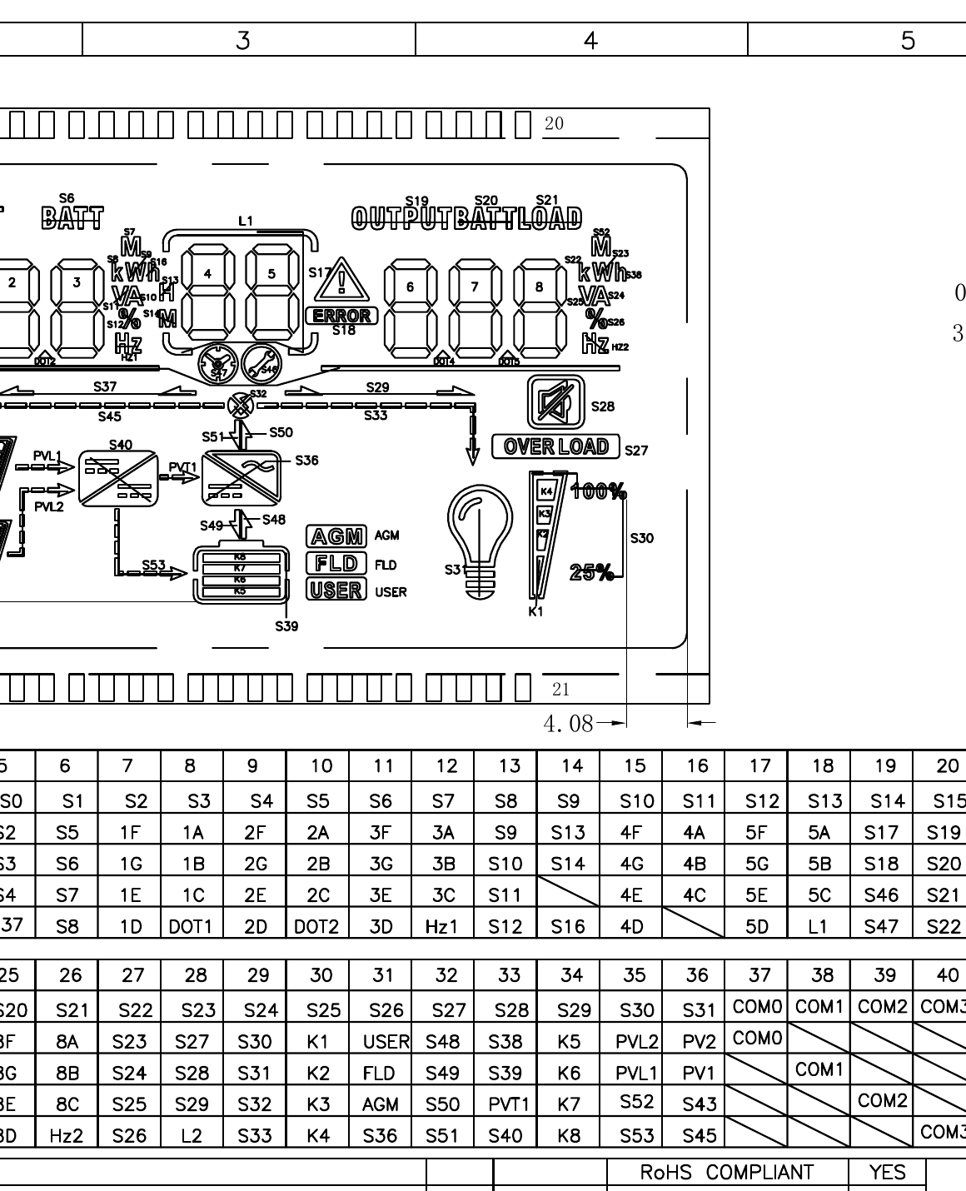
GY0801 PROGRAMMING
GY0801 uses shadow RAM and typed symbols
The driver stores a 32-address shadow RAM, updates bits locally, and flushes nibbles to the controller in burst writes.
01
writeText() and writeNumber() handle digit rendering.
02
setIcon() groups several low-level symbols into one display intent.
03
setSymbol() and setRawSegment() support bring-up and mapping tests.
Notes:
[Sources]
C:/Users/mkoda/workspace_ccstheia/GY0801_LCD/hw/gy0801_lcd.cpp
C:/Users/mkoda/workspace_ccstheia/GY0801_LCD/hw/includes/gy0801_lcd.h
C:/Users/mkoda/workspace_ccstheia/GY0801_LCD/tmp/pdf_pages/gy0801_truth_table_current.png

Slide 10
GY0801 APPLICATION HELPERS
Application helpers already mirror the glass layout
The application layer splits visible values into the same regions printed on the glass: INPUT, BATT, OUTPUT and LOAD.
writeInput()
writeBattery()
writeOutput()
3 digits, DOT1/DOT2
2 middle digits
3 digits, DOT4/DOT5
These helpers are the natural integration point for PRO CI state formatting.
Notes:
[Sources]
C:/Users/mkoda/workspace_ccstheia/GY0801_LCD/app/main.cpp
C:/Users/mkoda/workspace_ccstheia/GY0801_LCD/hw/includes/gy0801_lcd.h

Slide 11
FUTURE PLAN
Next step: integrate GY0801 into PRO CI state display
The planned work is to replace the standalone demo loop with a PRO CI display adapter that renders system states consistently.
01
Define PRO CI display states: idle, charging, discharging, fault, overload, low battery and communication status.
02
Map each state to digits, labels, flow arrows, battery gauge and warning icons.
03
Add a periodic refresh task that updates the GY0801 shadow RAM only when state changes.
04
Keep hardware driver, display formatting and application state logic in separate modules.
Outcome: a reusable LCD UI layer that can move from bring-up code into production energy-meter firmware.
Notes:
[Sources]
C:/Users/mkoda/workspace_ccstheia/GY0801_LCD
User-provided future plan: integrate GY0801 in pro_ci to display different states.

