Slide 1
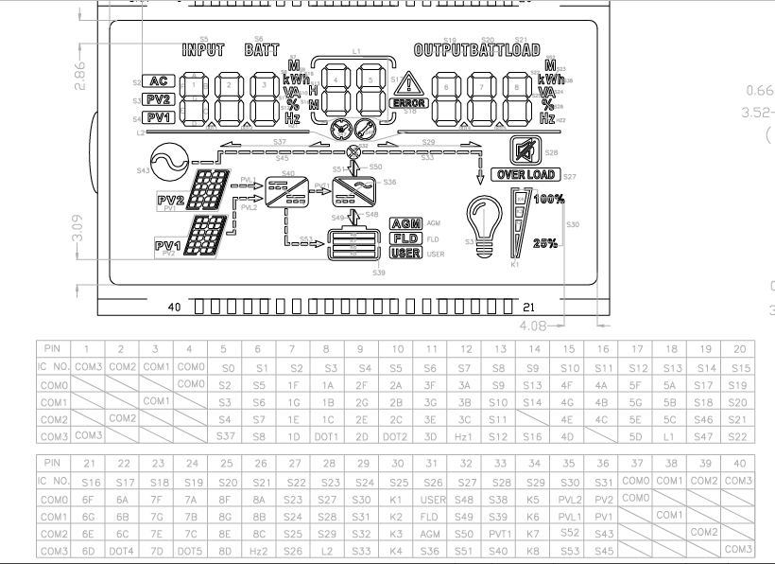
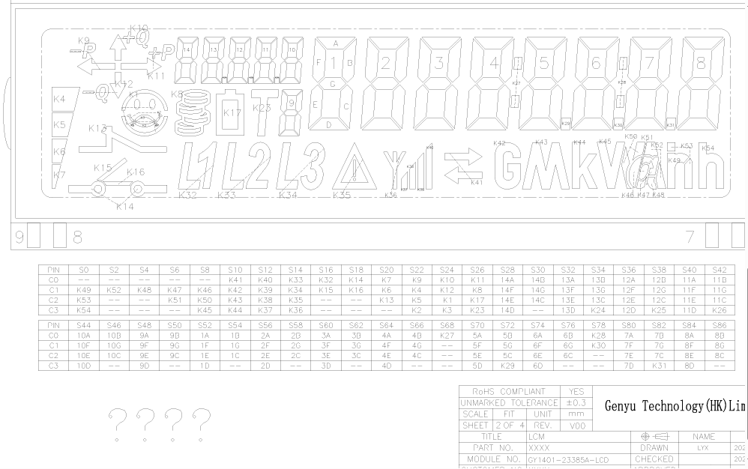
C2000 LCD UI BRING-UP
Segmented LCD drivers for energy meter displays
GY1401 over I2C + GY0801 over HT1621-style GPIO
Future C2000-based energy meter application
Notes:
[Sources]
C:/Users/mkoda/workspace_ccstheia/LCD_I2C
C:/Users/mkoda/workspace_ccstheia/GY0801_LCD
C:/Users/mkoda/Documents/lcd materials
C:/Users/mkoda/Documents/Premauda/GY0801 LCD Materials

Slide 2
GY1401 CONFIGURATION
I2C brings the CN91C4S48 glass to life
C2000
I2CA
0x3E
LCD address
CN91C4S48
setup
DDRAM
writes
tested path
Startup sequence
ICSET -> DISCTL -> EVRSET -> BLKCTL -> APCTL -> MODSET -> Clear RAM
Notes:
[Sources]
C:/Users/mkoda/workspace_ccstheia/LCD_I2C/hw/hw_i2c.cpp
C:/Users/mkoda/workspace_ccstheia/LCD_I2C/hw/meter_lcd.cpp
C:/Users/mkoda/Documents/lcd materials/CN91C4S48_i2c.pdf

Slide 3
GY1401 PROGRAMMING
Digits are packed bytes, not ASCII characters
LUT
Window
0 = FA
1 = 0A
8 = FE
9 = CE
DDRAM 0x18
11 bytes
right aligned
Fixed units and icons use the etched COM/SEG map: kWh, Ah, arrows, warning, battery and signal indicators.
Notes:
[Sources]
C:/Users/mkoda/workspace_ccstheia/LCD_I2C/hw/meter_lcd.cpp
C:/Users/mkoda/Documents/lcd materials/lcd mspm0 code/util_ui_lcd_lu.h
C:/Users/mkoda/Documents/lcd materials/COM_SEG Mapping Table.PNG

Slide 4
GY1401 ENERGY METER USE
The LCD layer should stay separate from meter state logic
Measurements
V, A, kW, kWh
Formatter
number + unit
LCD Driver
bytes + icons
GY1401
Glass
This keeps hardware mapping changes out of application logic.
Notes:
[Sources]
C:/Users/mkoda/workspace_ccstheia/LCD_I2C/app/main.cpp
C:/Users/mkoda/workspace_ccstheia/LCD_I2C/hw/includes/meter_lcd.h
C:/Users/mkoda/Documents/lcd materials/Displayable Characters.txt

Slide 5
GY0801 CONFIGURATION
GY0801 uses GPIO timing for an HT1621-compatible controller
CS 5
WR 4
DATA 9
chip select
serial clock
write data
Startup enables SYS, RC oscillator, 1/3 bias 4-COM mode, clears RAM, then turns LCD on.
Notes:
[Sources]
C:/Users/mkoda/workspace_ccstheia/GY0801_LCD/app/main.cpp
C:/Users/mkoda/workspace_ccstheia/GY0801_LCD/hw/gy0801_lcd.cpp
C:/Users/mkoda/Documents/Premauda/GY0801 LCD Materials/ht1621b.PDF

Slide 6
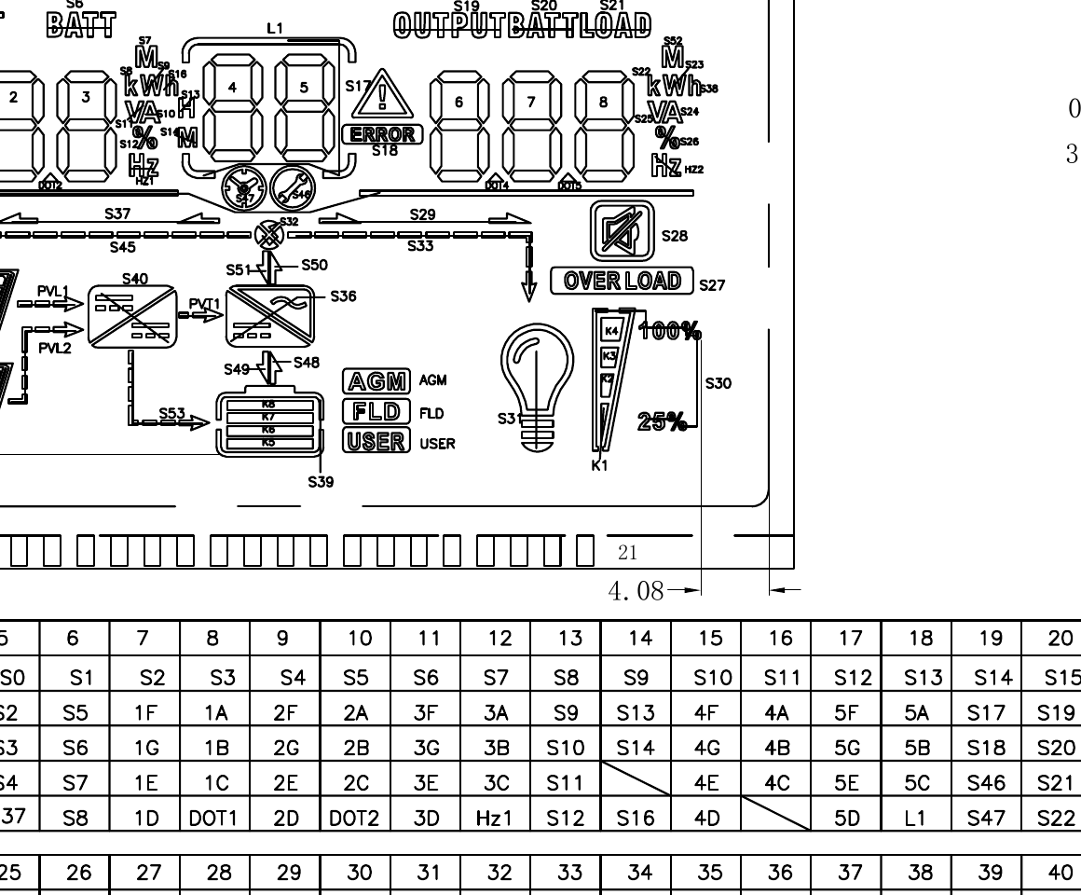
GY0801 PROGRAMMING
A shadow RAM makes icons and numbers composable
32-address
shadow RAM
writeText()
writeNumber()
setIcon()
setSymbol()
flush()
burst write
Digits, decimal points and named icons update the same shadow buffer before a single controller refresh.
Notes:
[Sources]
C:/Users/mkoda/workspace_ccstheia/GY0801_LCD/hw/gy0801_lcd.cpp
C:/Users/mkoda/workspace_ccstheia/GY0801_LCD/hw/includes/gy0801_lcd.h
C:/Users/mkoda/workspace_ccstheia/GY0801_LCD/tmp/pdf_pages/gy0801_truth_table_current.png

Slide 7
PRO CI DISPLAY STATES
GY0801 can become the visible state machine
IDLE
CHARGING
DISCHARGING
FAULT
LOW BATTERY
Each state maps to:
numeric regions | flow arrows | battery gauge | warning / overload icons
Integration target: a small display adapter that listens to PRO CI state changes and writes only the LCD symbols that changed.
Notes:
[Sources]
C:/Users/mkoda/workspace_ccstheia/GY0801_LCD/app/main.cpp
User-provided future plan: integrate GY0801 in pro_ci to display different states.

Slide 8
NEXT STEP
Move from LCD bring-up to production display behavior
1
Define state map
2
Create adapter
3
Refresh on change
Deliverable: reusable C2000 LCD UI module for energy meter status and measurement display.
Notes:
[Sources]
C:/Users/mkoda/workspace_ccstheia/GY0801_LCD
C:/Users/mkoda/workspace_ccstheia/LCD_I2C
User-provided future plan.

