Slide 1
Monitro: Health Monitoring and Inhaler Tracking System
A Dual Device System for Continuous Health Monitoring and Medical Equipment Accessibility
Team: Monitro
Institution: Federal University of Technology, Akure

Slide 2
Abstract
This project presents a wearable health monitoring system that records real-time health metrics and transmits data to a Firebase cloud for analysis by healthcare providers. It includes a beacon attachable to inhalers, enabling asthmatic patients to prevent loss of their inhalers. Our design enhances healthcare accessibility and patient safety.

Slide 3
Problem Statement
Many patients face challenges in maintaining continuous health monitoring and tracking essential medical items like inhalers, leading to emergencies. Existing devices lack integrated systems for both real-time health tracking and item location awareness. This project addresses these issues, offering a combined health monitoring and tracking solution.

Slide 4
Solution Overview
Our project combines a wearable device for health monitoring with a beacon attachable to an inhaler, providing continuous tracking and secure, real-time data access for healthcare providers. This dual approach enhances patient safety by keeping health data accessible and inhalers within reach.

Slide 5
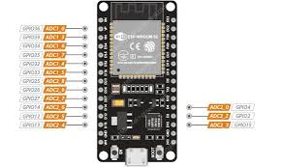
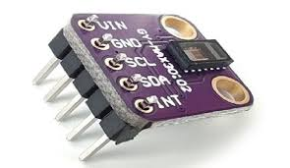
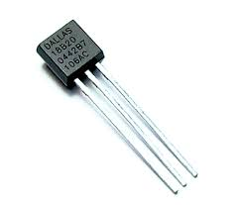
System Architecture
The wearable device includes an ESP32 microcontroller, MAX30102 pulse oximeter, and DS18B20 temperature sensor, while the beacon connects to the inhaler to prevent misplacement. This architecture ensures seamless data flow and enhances health monitoring and device tracking.
DS18B20
ESP32
MAX30102

Slide 6
Flowchart
Start
Setup Wifi, pins & libraries
No
Read from Sensors & Beacon range
Send & Receive Values to Cloud
If Range > Threshold
Activate Notification
Yes

Slide 7
Device Design and Components
ESP32 handles processing and data transmission; MAX30102 monitors heart rate and oxygen level; DS18B20 measures body temperature; and the beacon attaches to inhalers, sending alerts if the inhaler is misplaced. Together, they create a compact, reliable health monitoring system.

Slide 8
Methodology
The methodology covers device construction, data transmission, user interface design, and testing. Data from ESP32 is transmitted to Firebase, alerts are generated for unusual readings, and users are alerted if their inhaler is out of range.

Slide 9
Societal Impact & Economic Advantage
This project enhances patient safety and reduces health risks associated with lost inhalers while providing an economic advantage by minimizing emergency healthcare costs and hospital visits. It supports proactive healthcare management with potential insurance incentives.

Slide 10
Conclusion
This project meets the need for remote health monitoring and secure, accessible devices for emergencies. It improves healthcare access, particularly for individuals with chronic illnesses, offering timely diagnosis and reducing emergency risks.

