Slide 1

Project Name: PowerTread Date: 30th of October, 2023
TEAM AUTO-X

Slide 2
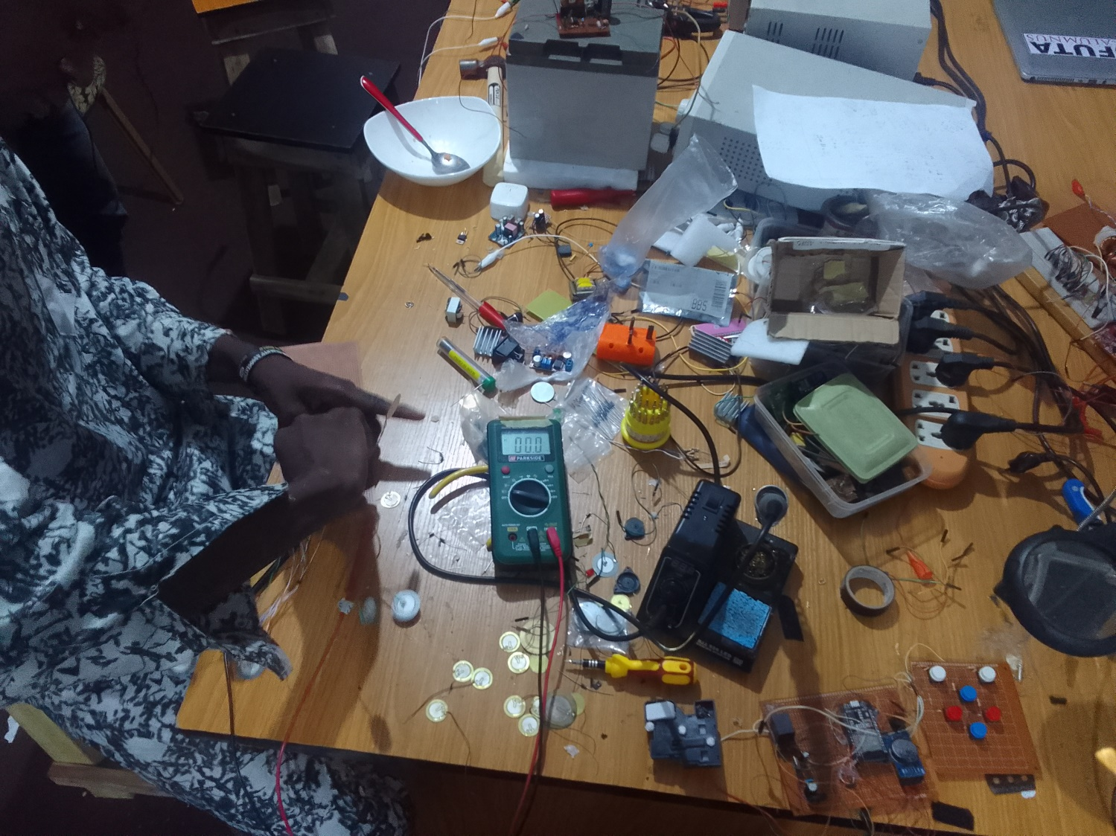
Work-done & Progress
Soldering of Transducers
Design of the rectification circuit
Setup of the rectification circuit

Slide 3
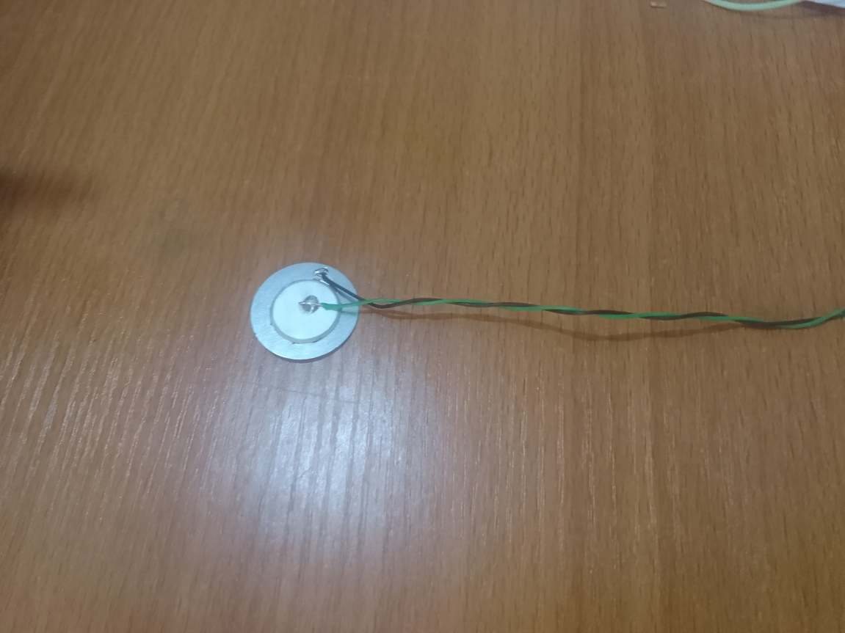
PowerTread Circuit
Soldering of individual Transducers

Slide 4
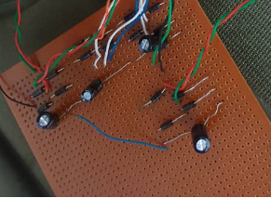
PowerTread Circuit
Design of the rectification circuit
and capacitor boost

Slide 5
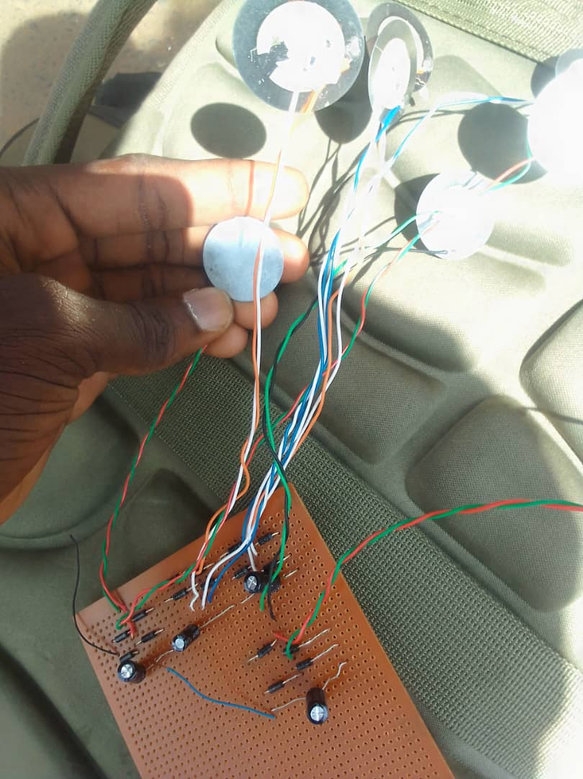
PowerTread Circuit
Setup over 20 Transducer for rectification

Slide 6
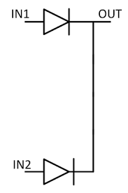
Rectification
Rectifier configuration
Two Diode Full Wave Rectifier

Slide 7
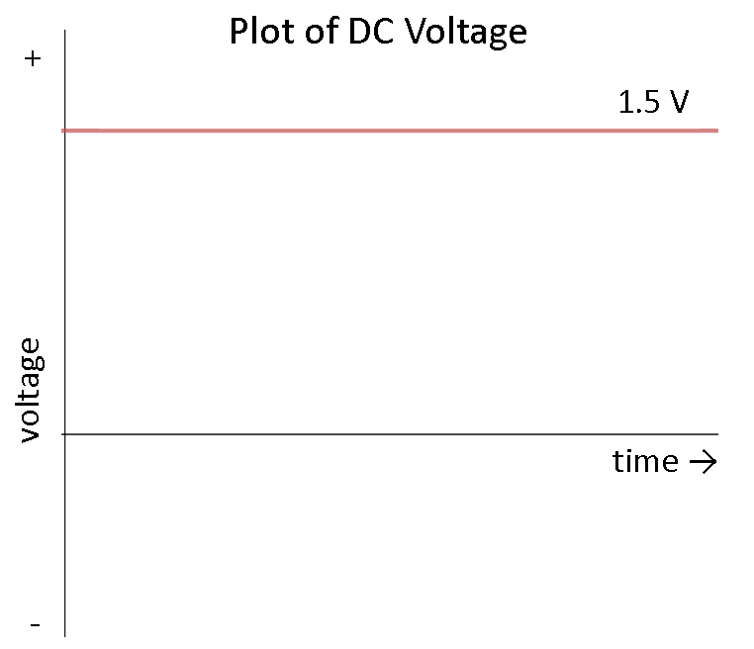
PowerTread Circuit Testing
Voltage Output Results
Rectified Peak voltage: 2v
2v

Slide 8
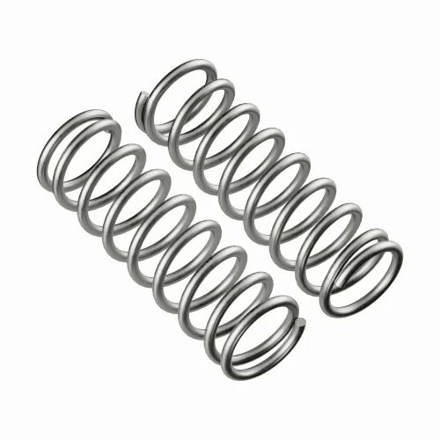
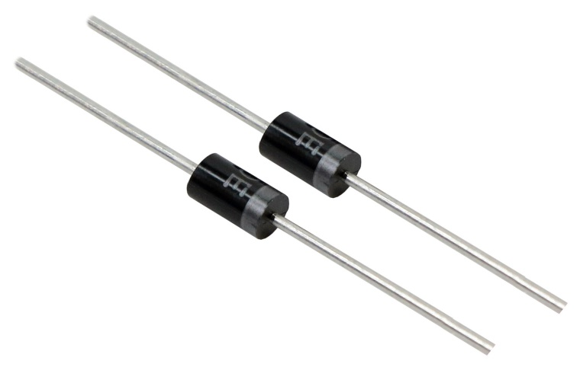
Challenges
Its appears more Spring is needed
More Diodes are needed

