Slide 1
SafeSwitch

Slide 2


Profile
Name: Daramola Oluwafemi Michael
Department: Electrical/Electronics Engineering
Status: Undergraduate [4th Year]
Skills: Embedded Systems, Software Dev, Automation, Electronics & Robotics
Federal University of Technology, Akure

Slide 3
The Problem

Slide 4
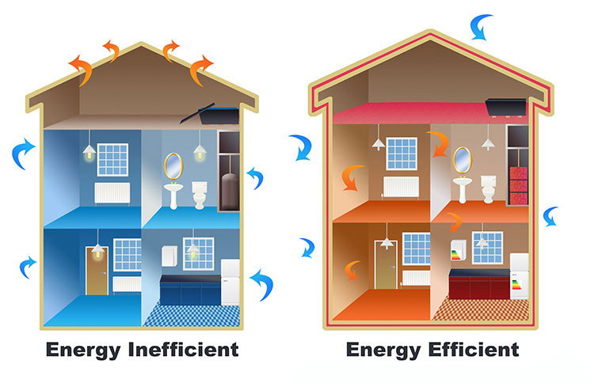
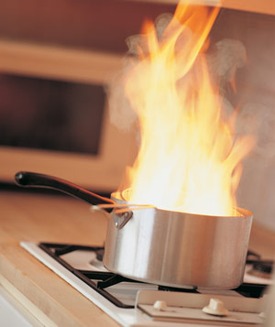


The Problem
Inefficient energy usage
Over-powering of sensitive appliances
safety hazards due to appliances left unattended or overpowered
Food Burning
Fire Outbreaks
Human Forgetfulness

Slide 5
Project Overview

Slide 6

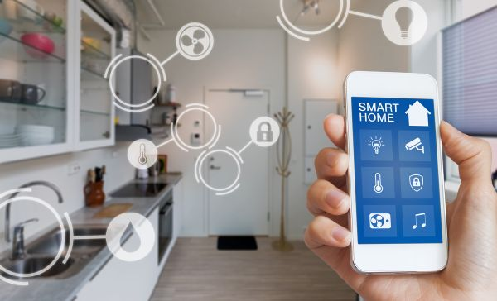
Project:
Device Purpose: Prevent over-powering of sensitive appliances, reduce electrical hardwares, reduce fire risks, promote energy conservation, home automation, remote accessibility, enhance better appliance control.
Features: Scheduled automatic shutdown, Bluetooth and IoT remote control, aligning with sustainability goals

Slide 7
Key Features

Slide 8
Key Features of FeedBot
Intelligent Scheduling: Personalized appliance schedules to avoid overuse, preventing accidents.
Home Automation & Sensor Integration: Customizable smart home automation, enhancing comfort and efficiency.
Remote Accessibility: Control appliances from anywhere, ensuring safety and convenience.
Energy Efficiency: Reduces energy wastage, trimming down electricity bills and carbon footprint.
Appliance Safety: Automatic shutdown minimizes fire hazards, ensuring home safety.
Feedback Mechanism: SafeSwitch incorporates a feedback mechanism that allows users to remotely determine the status of their appliances, providing real-time insights into which devices are powered on or off.

Slide 9
SafeSwitch as Solution

Slide 10
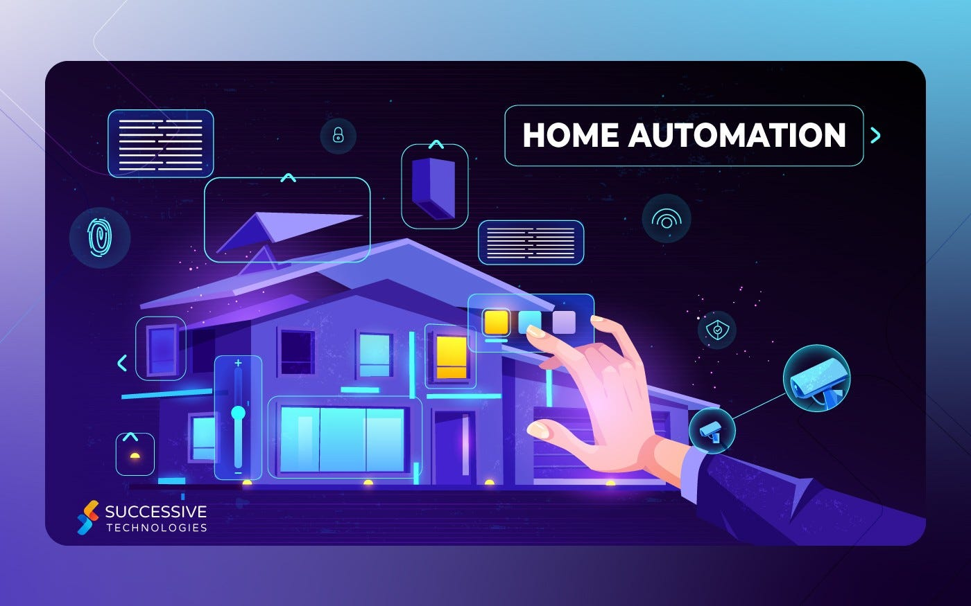
Solution
Timer Switch for Safety & Efficiency
Prevention of Over-Powering
Reduced Risks
Remote Control & Connectivity
Bluetooth & IoT Integration
Convenience & Control
Promoting Sustainable Living
Alignment with Sustainable Development Goals
Enhanced Safety

Slide 11
Methodology

Slide 12
Methodology: Block Diagram
On-Board Input Control
Control
Internet (Wifi/ Bluetooth) Input Control
Power Supply
Microcontroller(ESP32)
Output
(Automation)
Sensors

Slide 13
Uniqueness

Slide 14
Uniqueness
SafeSwitch(SmartSoc) brings automation, remote control, and energy-consciousness into a single, powerful device.
It creates customized schedules for multiple appliances,
Sensor integration options (Home Automation), sets it apart in the market.
With SafeSwitch, you're not just controlling sockets – you're shaping a smarter, more efficient future for your home.

Slide 15
Development

Slide 16
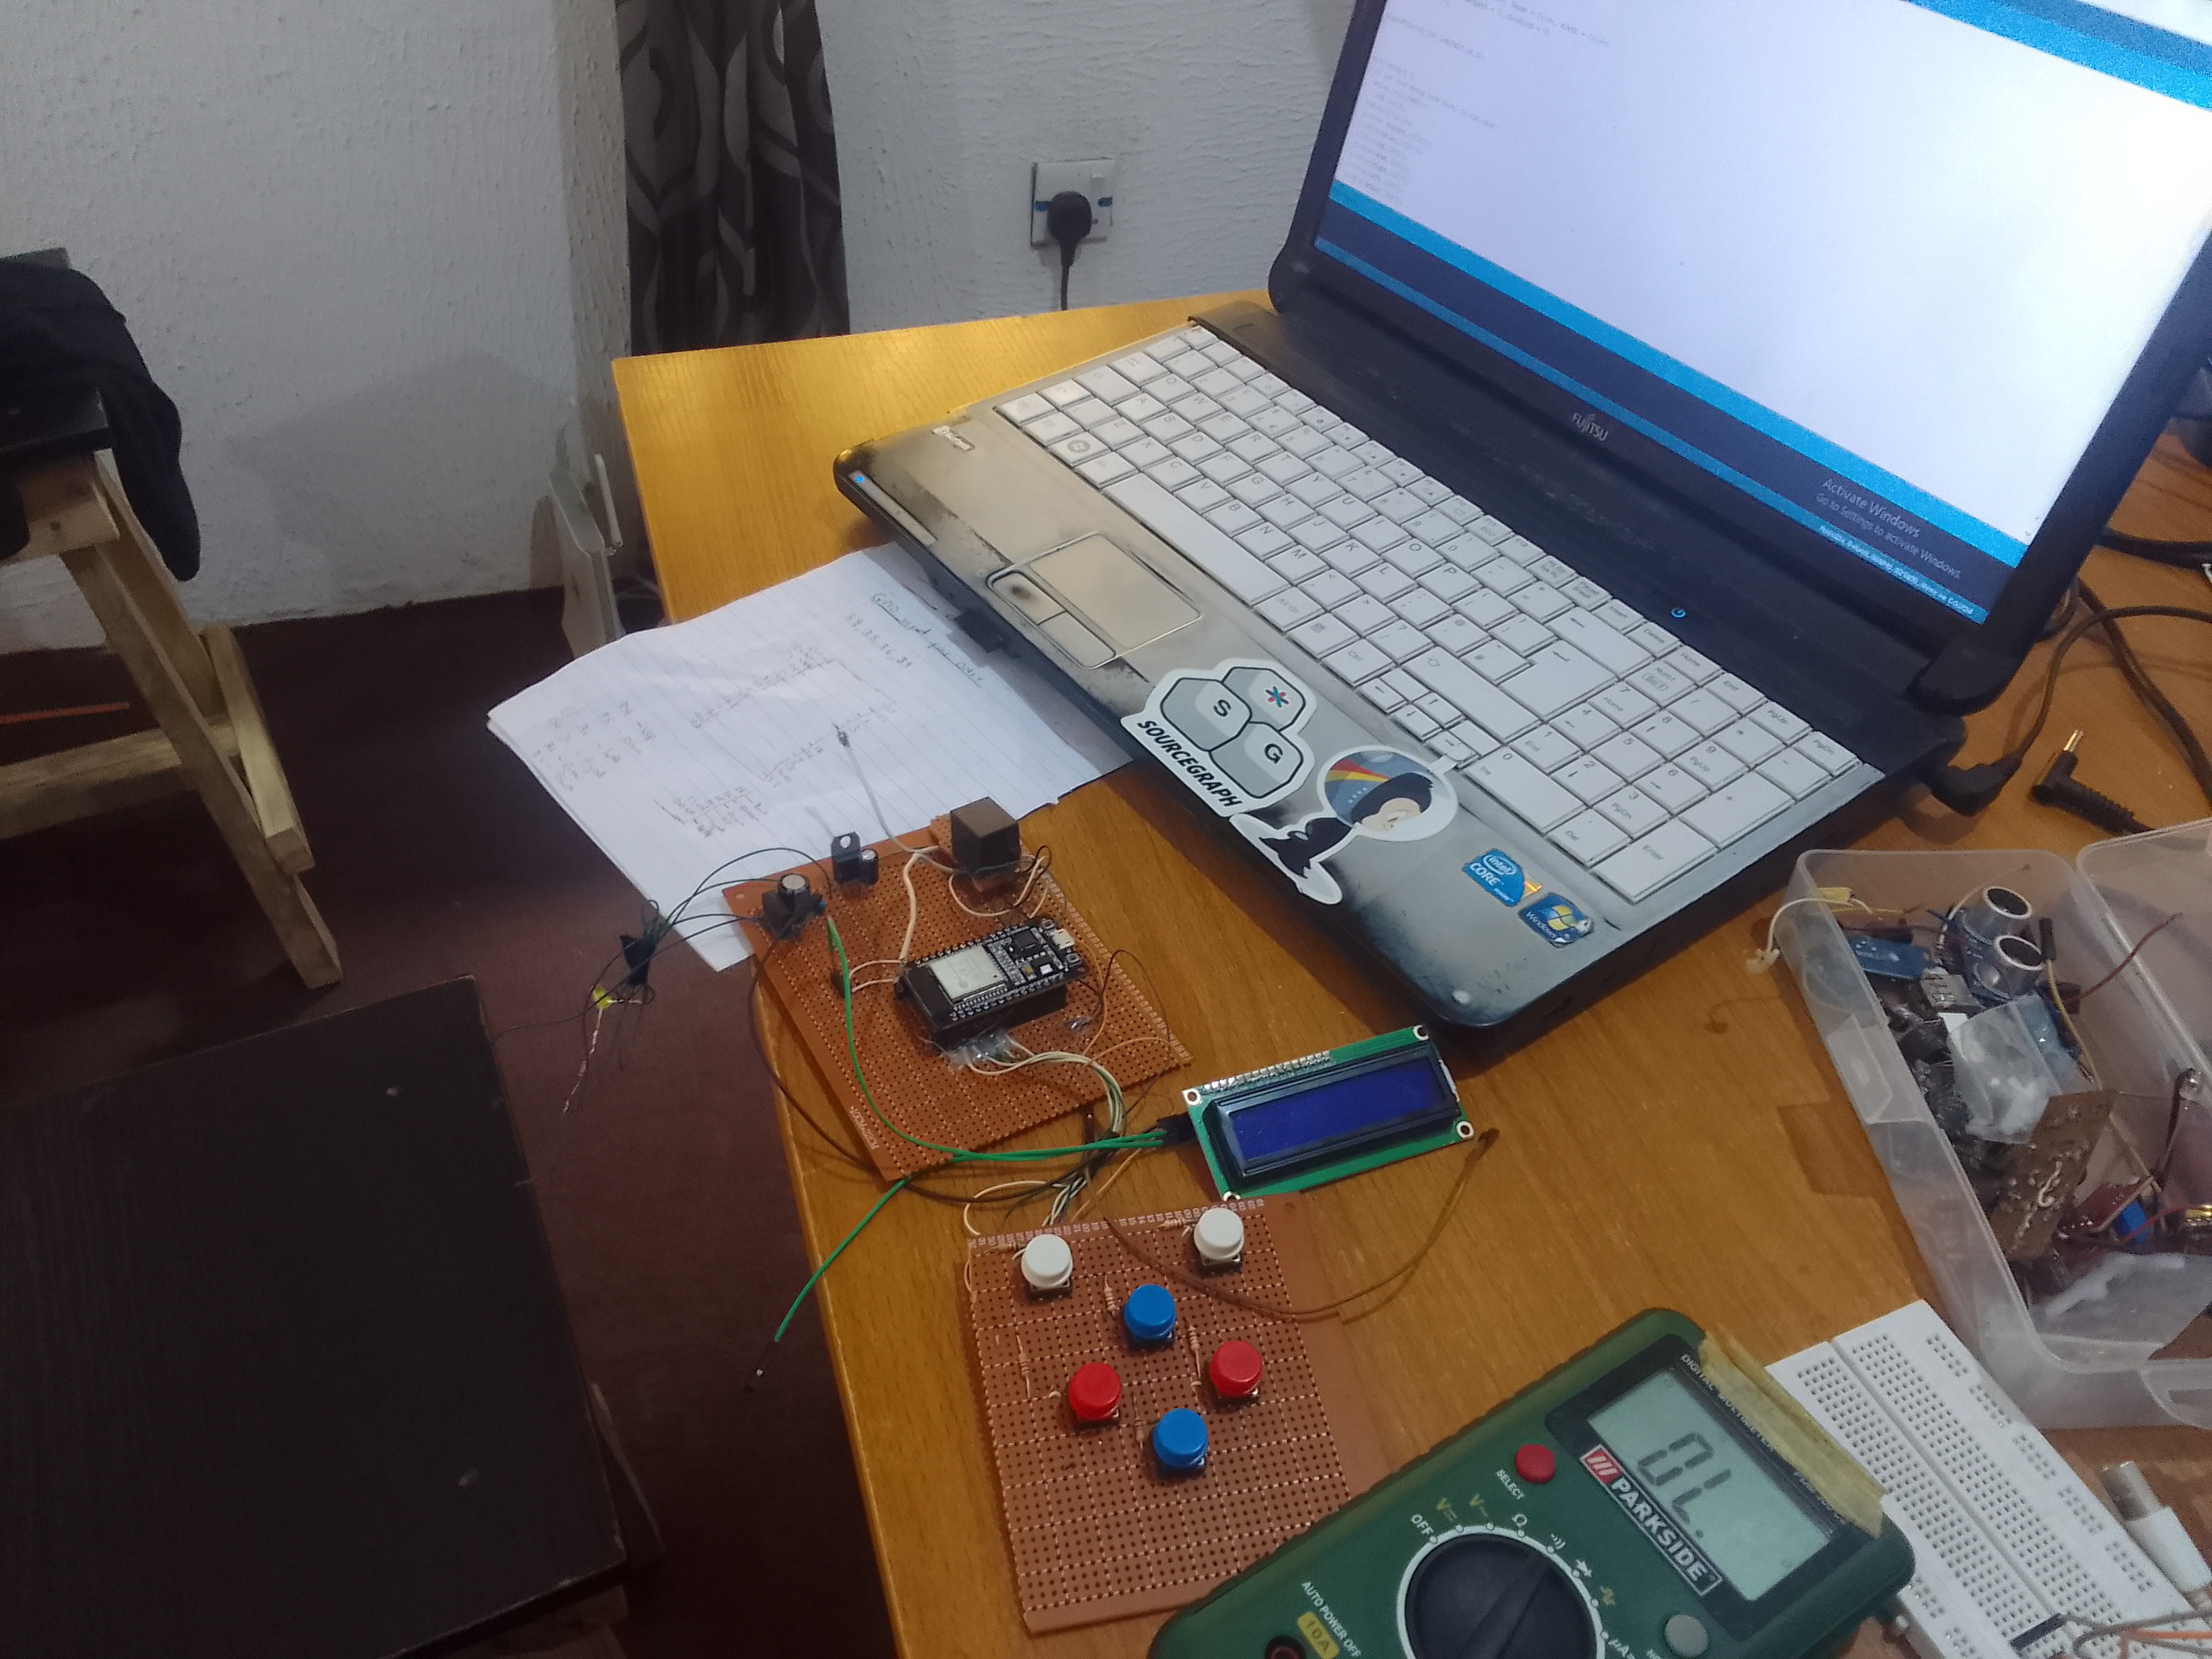
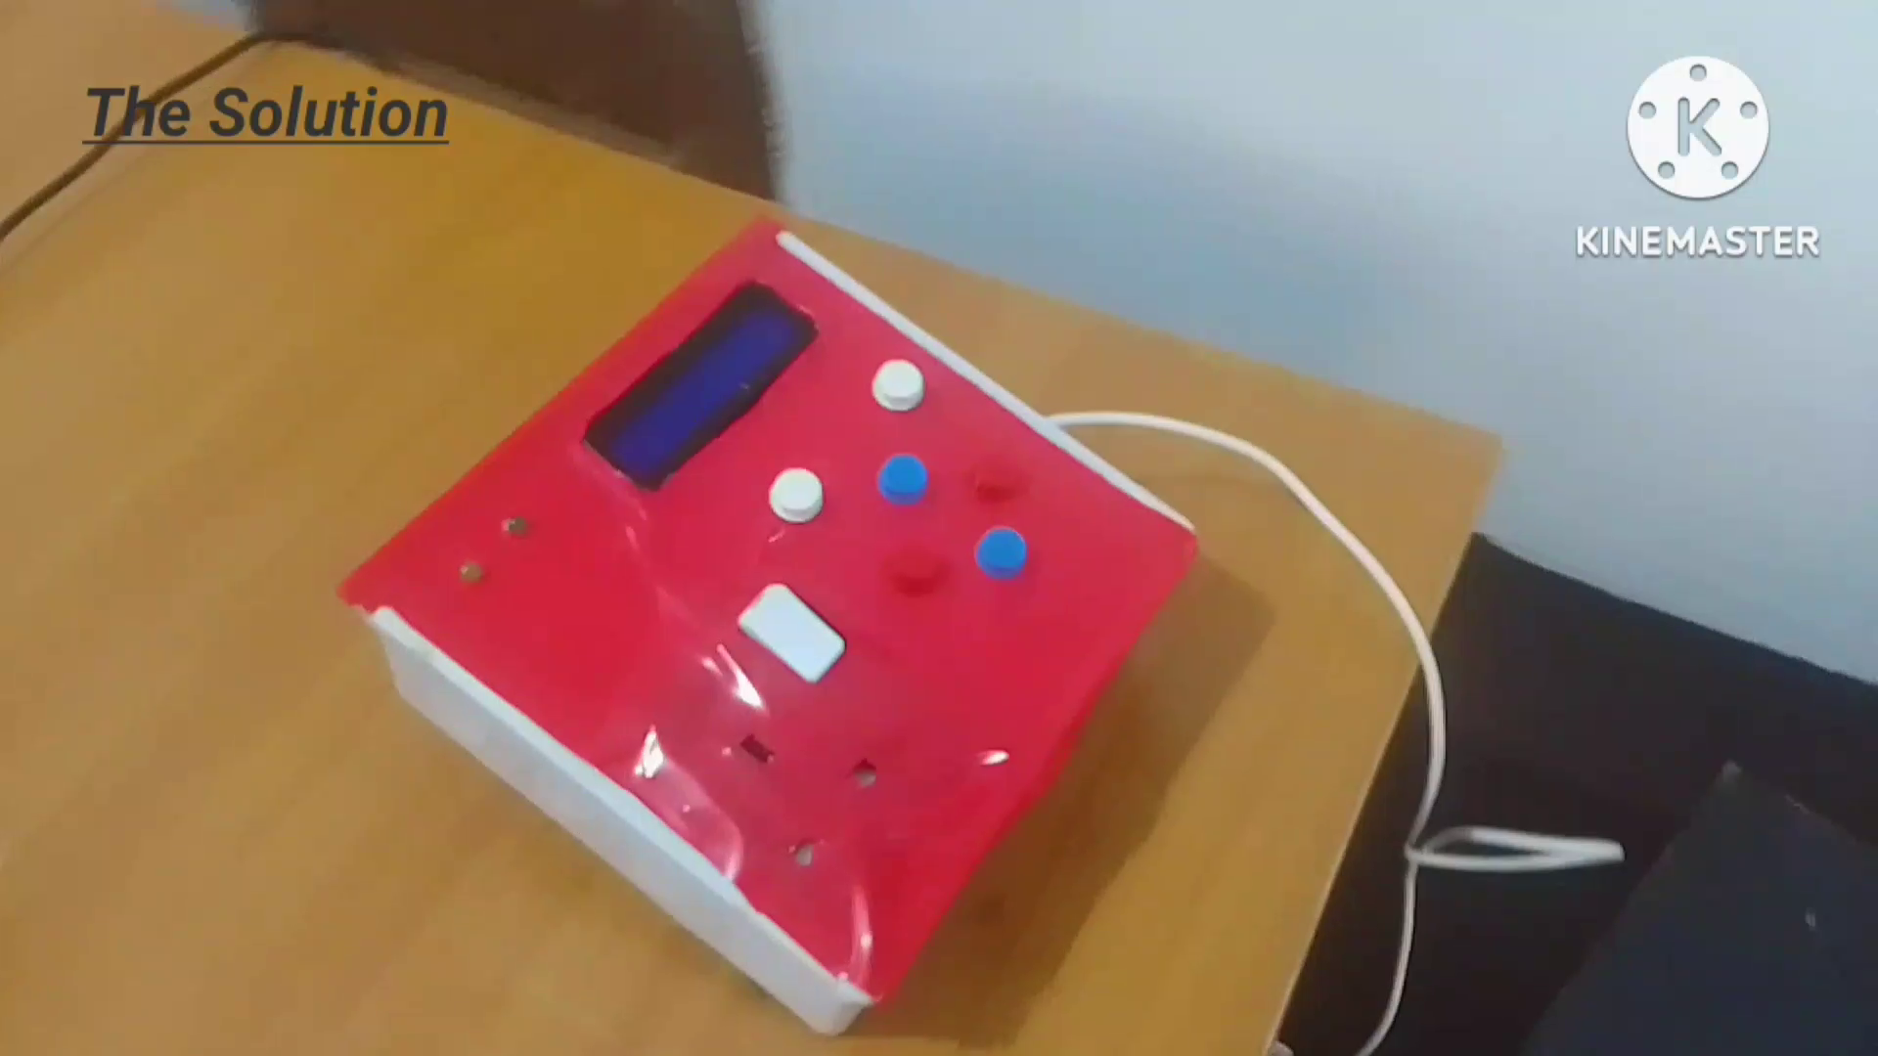
Development
SafeSwitch During Design Stage
SafeSwitch After Design

Slide 17
Conclusion

Slide 18
In conclusion:
SafeSwitch revolutionizes the way one interact with their electrical appliances, bringing a new level of convenience, energy efficiency, and safety to ones daily life. Imagine having the power to control your appliances with unparalleled precision and ease, all from the palm of your hand.
SafeSwitch(SmartSoc) empowers users for a smarter, safer, and more efficient home

Slide 19
Thank you

