Slide 1

Wi-Stick

Slide 2
Problem Statements

Slide 3

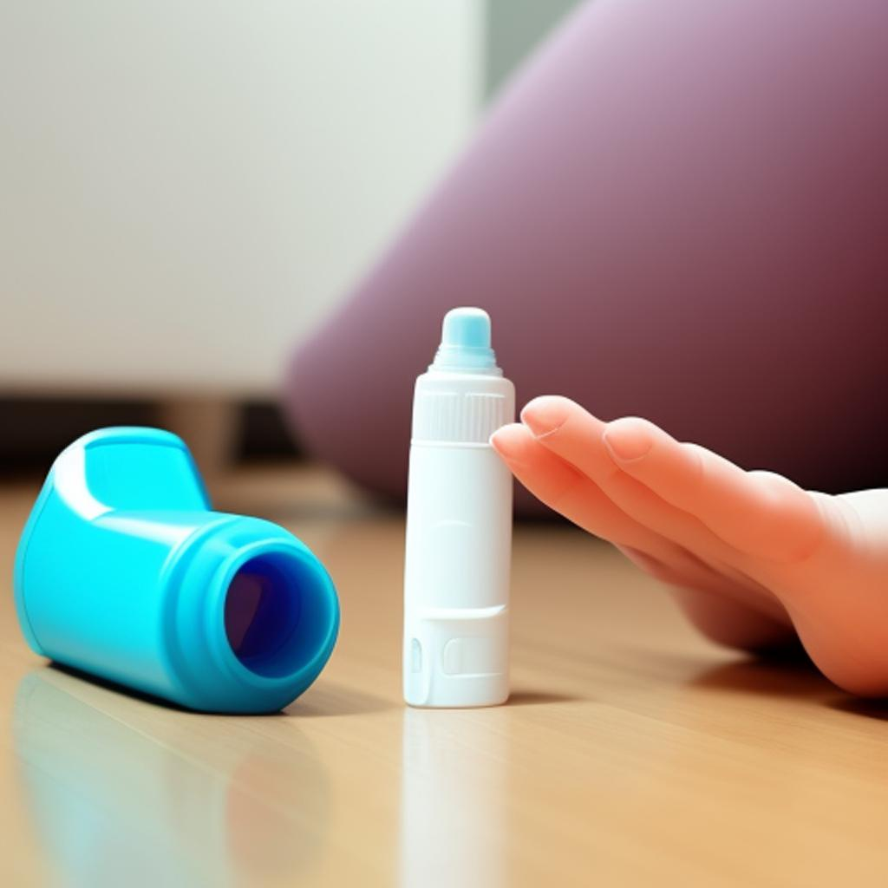
Problem Statements
In the United States, an estimated 1,640 people with asthma die each year.
Approximately 10% are attributed to an asthma attack that occurs when the person's inhaler is not available.
This means that approximately 164 people die each year in the United States from asthma attacks that could have been prevented if the person had had their inhaler with them.
Around the world, more than 300 million people suffer from asthma
Around 250,000 people dies each year

Slide 4
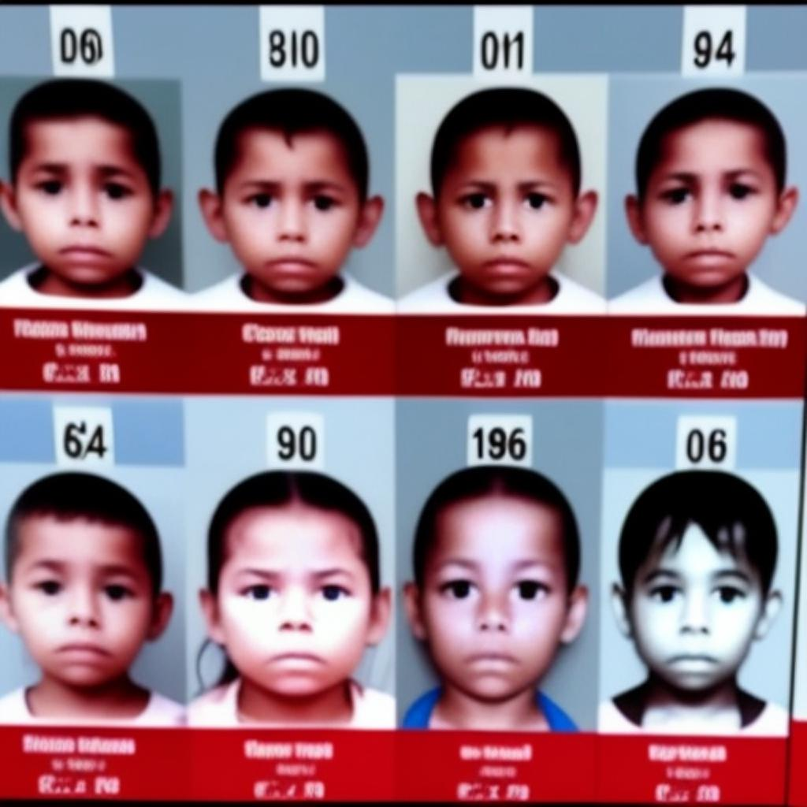
Problem Statement
According to the National Center for Missing and Exploited Children (NCMEC):
an average of 2,300 children are reported missing every day in the United States.
About 1,000 are abducted by strangers, and the rest are lost or runaways.

Slide 5

Problem Statement
An estimated $20 billion worth of valuable materials are lost or misplaced each year.
The most common reasons for misplacing valuable materials are forgetfulness, carelessness, and theft.

Slide 6
INTRODUCTION
What makes a project great is not basically in its sophistication, but in its ability to solve real life problem.
WiStick is about solving real life problem

Slide 7
About the device

Slide 8
About the device
Wi-Stick offers a unique beacon-based solution to prevent separation and loss of personal belongings.
Its uses Wi-Fi as a means of communication (ESP8266).
The device is versatile, easily attachable to various items, and provides dual functionality by notifying users when they are near a lost item which can also be use to track the item.
It operates without requiring mobile internet data, resulting in cost savings.
It's a reliable and efficient way to safeguard valuables, prevent loss, and provide peace of mind.

Slide 9
Working principle
The device uses beacon technology to establish a wireless connection between itself and a paired device or other beacons.
It continuously monitors the distance between connected devices or beacons using Wi-Fi signals.
When the distance exceeds a certain threshold, the device triggers vibrating and buzzing alerts to notify the user of potential separation, helping them to avoid losing or forgetting their belongings.
The implementation of this project requires both Hardware and Software

Slide 10

Beacon to Beacon
This design involves multiple beacons communicating with each other to determine the distance between them.
Each beacon would emit a Wi-Fi signal that can be detected by nearby beacons.
When two beacons are separated by a distance of 5m, they can send signals to each other to trigger the vibrating and buzzing alerts.
This design allows for a network of beacons to be set up, creating a broader coverage area.
Beacon 1
Beacon 2

Slide 11

Beacon to Mobile Phone
In this design, the beacon communicates directly with a mobile phone via a Wi-Fi connection.
The beacon would emit a signal that can be detected by the mobile phone when they are in proximity to each other.
When the beacon and the phone are separated beyond a specific distance, the phone can receive a signal from the beacon and trigger the alerts, such as vibrating and buzzing.
Smart phone
WiStick Beacon

Slide 12
Problem-solving scenarios where Wi-Stick can be beneficial

Slide 13
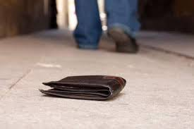
Preventing Loss of Valuables

Slide 14
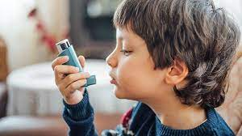
Ensuring Inhaler Availability

Slide 15

Child Monitoring

Slide 16

Livestock/Pet Monitoring

Slide 17

Preventing Bag Theft

Slide 18

Wandering Elderly Assistance

Slide 19
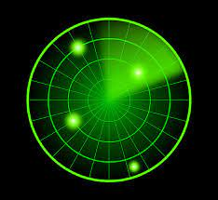
Equipment Monitoring

Slide 20
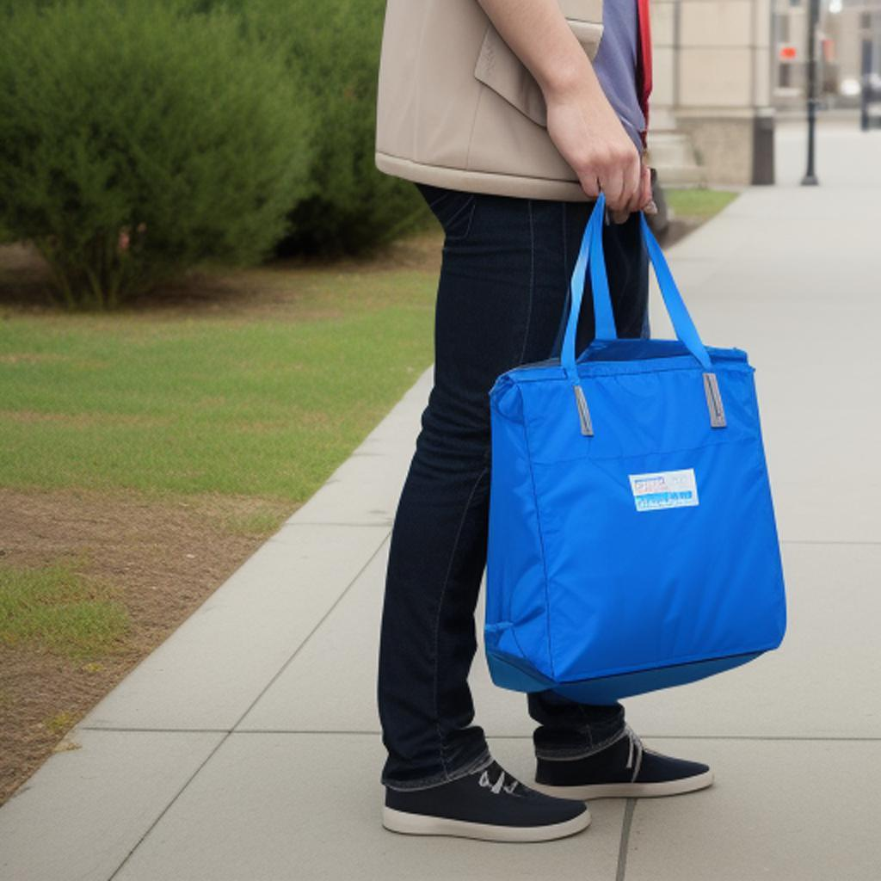
Preventing Lost Luggage

Slide 21
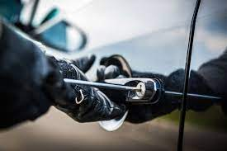
Vehicle Security

Slide 22
Asset Tracking

Slide 23
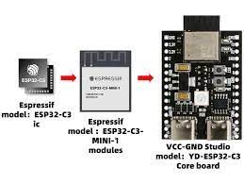
Future Upgrade
Using ESP32-C3
BlueStick

Slide 24
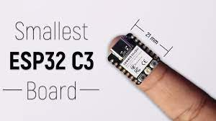
Width: 21mm
Height: 17mm

Slide 25
The project has several unique features
1. Cost-Effective Solution: Unlike many other tracking devices, this project does not rely on mobile internet data, resulting in cost savings for users.
2. Dual Functionality: In addition to preventing separation and loss, the device can also act as a tracker. It notifies the owner when they are in close proximity to a lost device by varying the intensity of the buzzer and vibration based on the nearness.
3. Versatile Attachment Options: The device is designed to be easily attachable and detachable. It can be secured to various items such as wristwatches, belts, keys, phones, and more, providing flexibility and convenience for users.
4. Scalability and Continuous Improvement: The project has a scalable nature, allowing for future enhancements and improvements. This ensures that the device can evolve and adapt to meet changing needs and technological advancements over time.
5. No connection is required
By emphasizing these unique aspects, the project distinguishes itself from other solutions in terms of cost-efficiency, functionality, versatility, and the potential for ongoing development.

Slide 26
CONCLUSION
By emphasizing these unique aspects, the project distinguishes itself from other solutions in terms of cost-efficiency, functionality, versatility, and the potential for ongoing development.

Slide 27
Thanks for listening

