Slide 1

Javachess
Jia jie

Slide 2
contents
Motivation
Authentication
Frontend
Frontend framework – code structure
Chess game implementation
Communicating with the server
Backend
spring boot
Websockets
Problem: file uploading to heroku
Mildly interesting things
Dynamic theme with css
Image fit cover
Problems I faced
SceneBuilder
Loading fonts with JavaFX css

Slide 3
motivation
Play chess for leisure
Needed to implement an online chess game for another project

Slide 4
authentication
Decided to use JWTs – a common authentication mechanism
Persisted in appdata/javachess/token.txt
Spring Security & Java's io.jsonwebtoken.jjwt package
UserDetailsService fetches a user by username according to spring
Realised setting the username as subject (content) of jwt instead was a problem, should have stored userid instead
On client side, auth header is sent with each request to the server

Slide 5
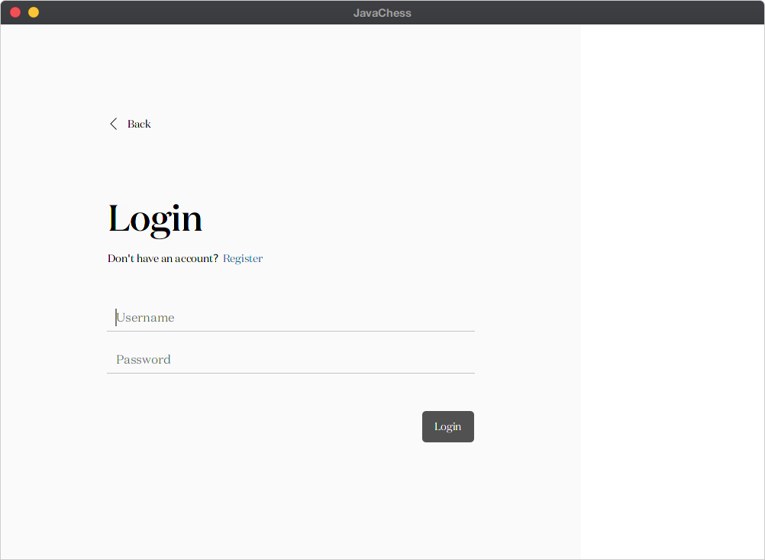

Slide 6
Frontend
JavaFX, retrofit2, spring websocket client

Slide 7
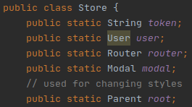
Frontend framework
I adopted a structure inspired by Javascript web frameworks
Router & Modal classes
Store.router.push(fxmlFile, data) (e.g. this.$router.push())
Store.router.pop()
Store.modal.showMessage(title, body)
State management with a simple central Store
Information such as current user, authentication token
Also contains static instances of Router and Modal

Slide 8
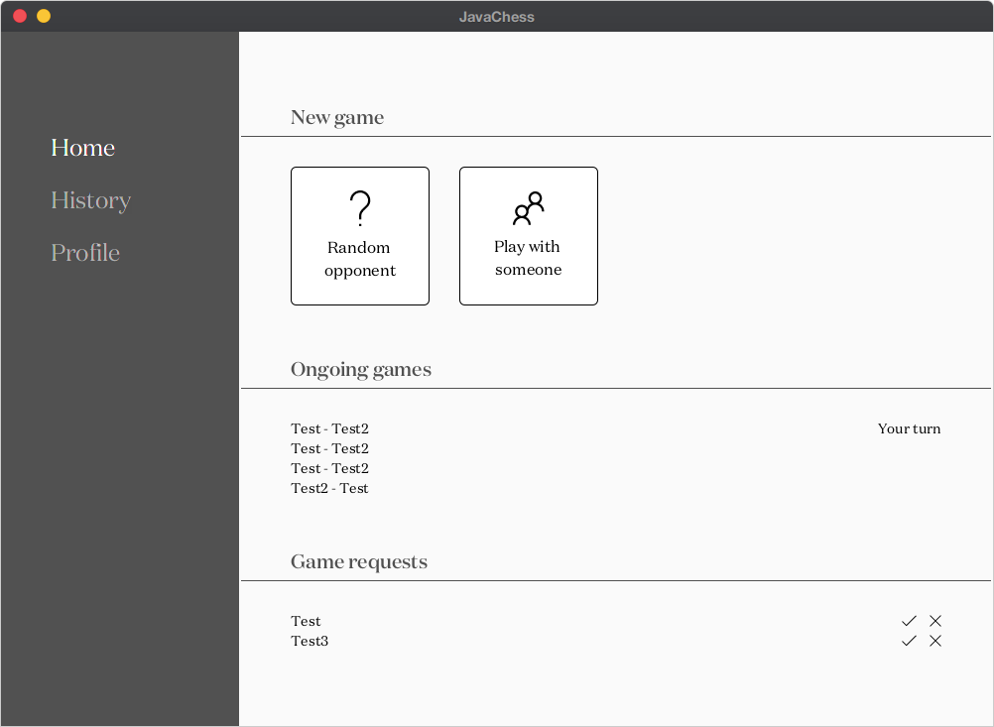
Sample home page

Slide 9
Chess game implementation
More complex than expected
Chess class contains all logic for the game
Abstract class Piece
Each piece knows its position, and finds out which are its available squares on its own – findAvailableMoves()
MoveType (e.g. capture, en passant is known, potential to highlight special moves)
Could not implement some rules due to time constraints

Slide 10
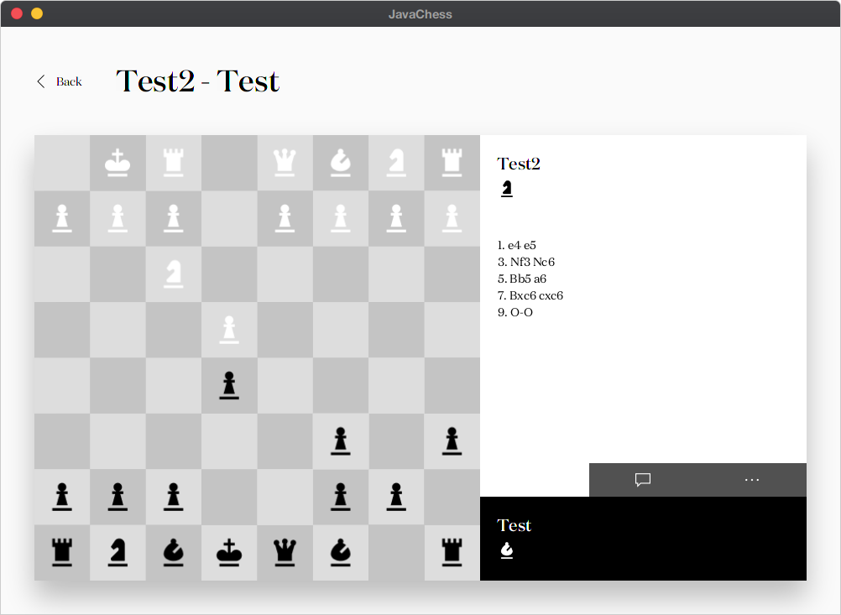

Slide 11
Communication with server
Used retrofit2 to send http requests
Spring websocket client & messaging was used for websocket connection
Listen for moves & messages on /topic/moves/{userId} or /topic/messages/{userId}

Slide 12
backend
Spring boot
Websockets
File uploading problem

Slide 13
Spring boot
Most popular Java backend framework
CRUD interface with authentication / appropriate permissions
Base url of /api, here are some example routes
/auth
GET: return current user object
POST /login: send username & password to login, returns auth token
POST /register: same as above, but creates new user
/user
PUT: update current user details. Only username, bio, pic, settings
DELETE: delete user account
PUT /password: update password (must send old password)
GET /{userId}/profile: return limited, public information on that user

Slide 14
Spring websockets
Initiating games / requests involving games were made with http requests
Actual game (moves & chatting) were through websocket messages
e.g. endpoint could be ws://localhost:8081/api/ws/game to initiate a connection
When a move is played, the object is sent to /app/move/{toUserId}
Similarly, messages are sent to /app/message/{toUserId}

Slide 15
File uploading to heroku
I just realised (now) that Heroku clears the filesystem when the dyno is shut down or something, so it can't be used to store static files
This mean the profile pic functionality doesn't work for now

Slide 16
Mildly interesting things
Dynamic themeing
Image fit cover

Slide 17
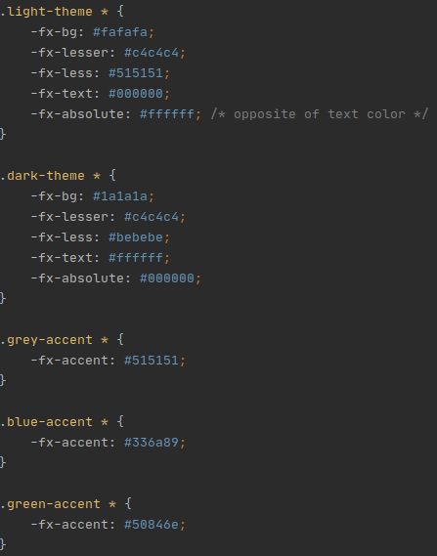
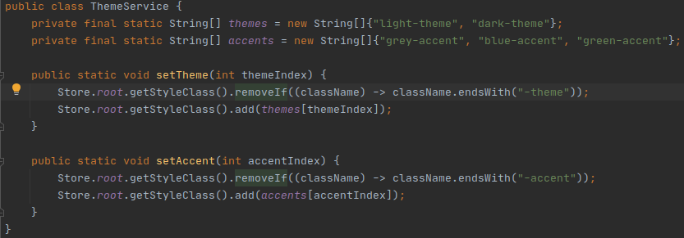
Dynamic themeing with javafx css
I found out that using css variables for dynamic themeing works in JavaFX
main.css, included by all fxml pages
I'll only need to change the class of the root element, managed in ThemeService

Slide 18
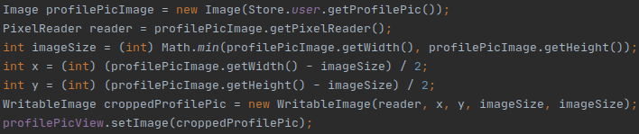
Image fit cover
For some strange reason ImageView doesn't provide an easy way to set a cover image fit
Easily done in css with background-image: cover; or object-fit: cover;
JavaFX requires manual calculation:
The above snippet sometimes does not work as JavaFX Image class has problems loading an image from the internet, even preventing profile page from loading.

Slide 19
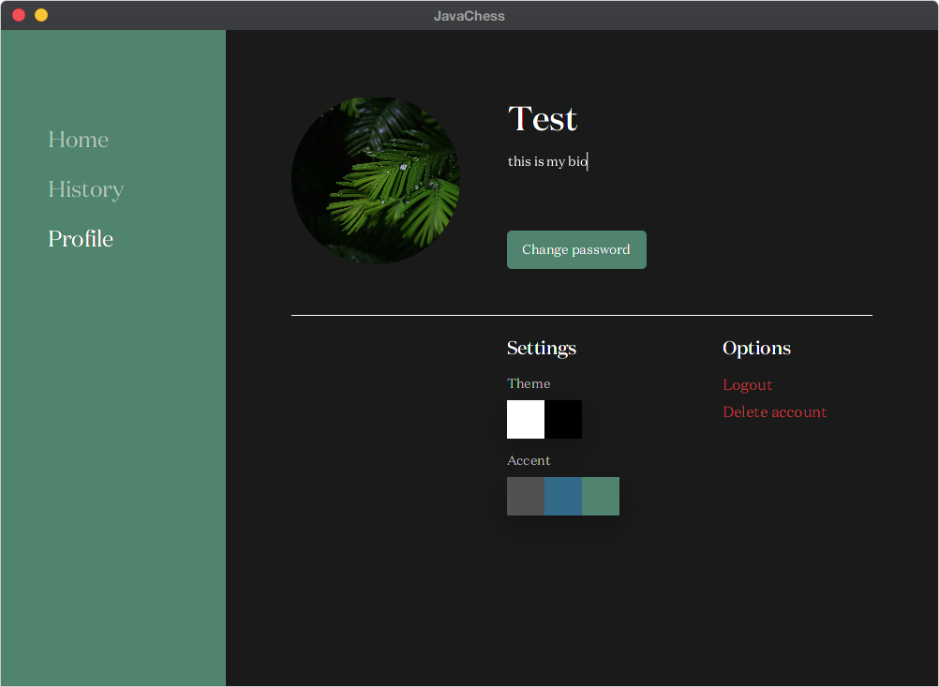

Slide 20
Problems I faced
Scenebuilder
Loading fonts with javafx css

Slide 21
Scenebuilder
One day it kept crashing
Does not truly reflect actual UI

Slide 22
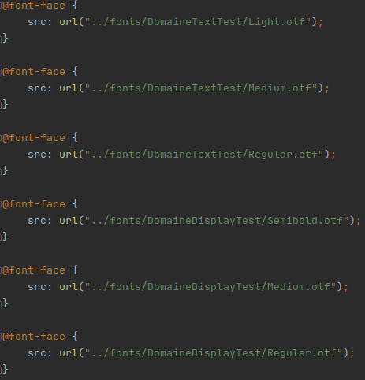
Loading fonts with javafx
Standard @font-face declaration did not work
Had to specify relative path using `../fonts`
Could not specify different weights, with font-weight or –fx-font-weight
Including the regular font size after other sizes worked
Something that JavaFX could work on

Slide 23
The end
Thanks for listening

