Slide 1
Knitting a Picture: Algorithmically Generated Patterns from Drawing Inputs
Mae Koger

Slide 2
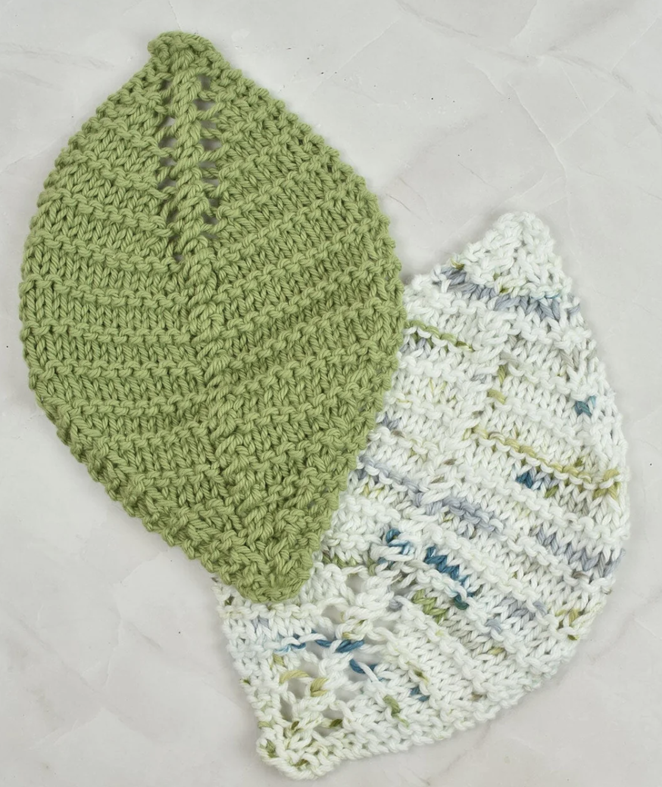
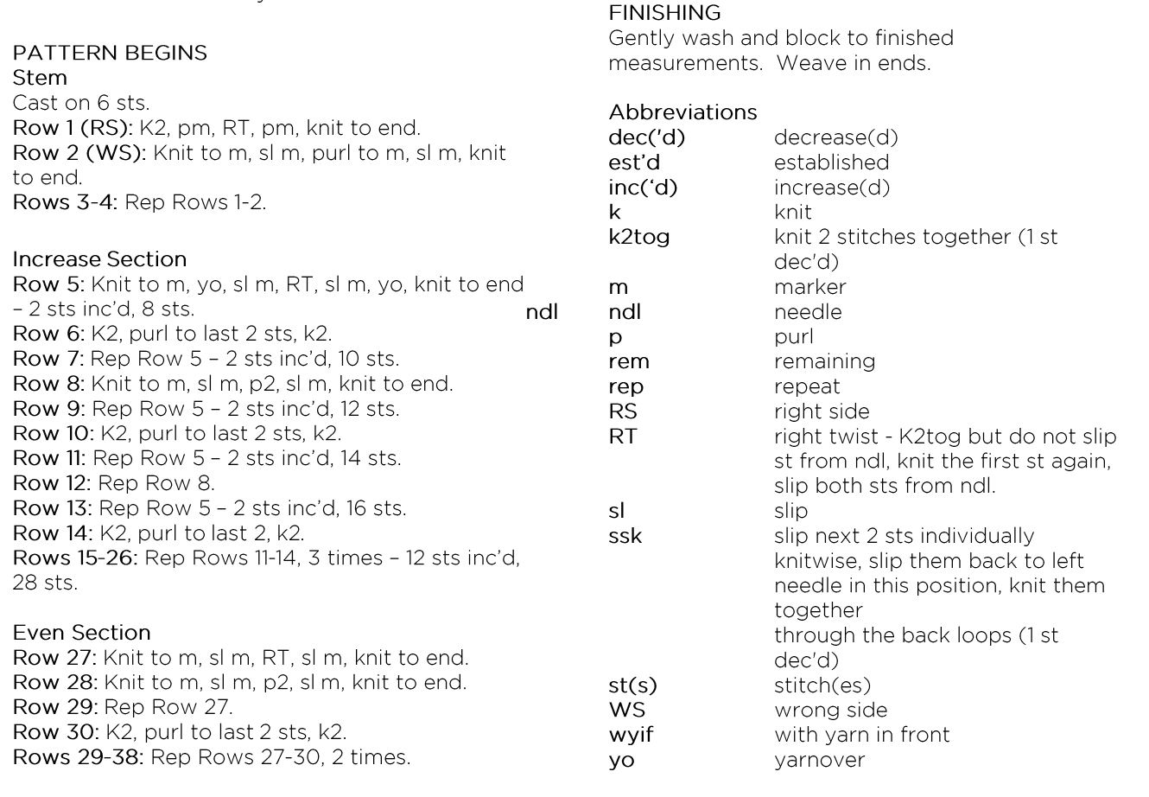
Knitting Patterns

Slide 3
Knitting Patterns
Looks similar to an algorithm
Traverse the knitted piece in a bustrophedic manner
How can we algorithmically create a knitting pattern from an image in this manner?

Slide 4
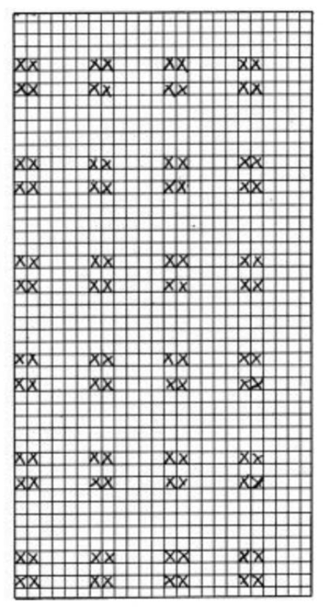
Knitting Patterns
Generally used for colorwork or patterns
Read top-to-bottom, bustrophedically

Slide 5
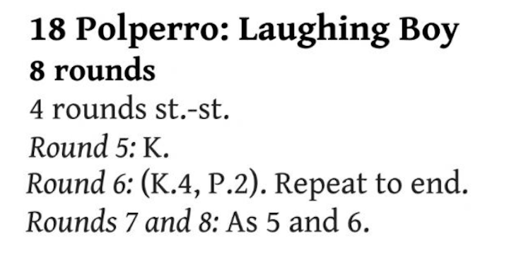
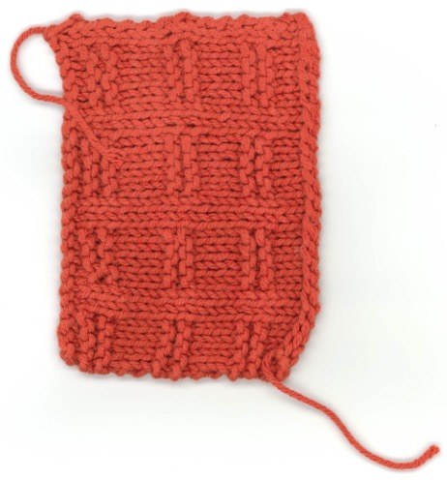
Knitting Patterns

Slide 6
Knitting Techniques
Functionality for:
Increasing & decreasing
Casting on & casting off
No functionality for:
Purl stitches
Cable knitting
Knitting in the round

Slide 7
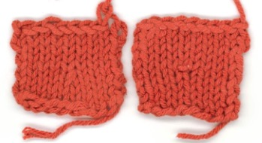
Decreasing and Increasing
Calculated by comparing the number of stitches from one row to the next
There are multiple methods for increasing and decreasing
Methods used in this case are k2tog and kfb, respectively

Slide 8
Casting on and off
Top edge will be the cast-on edge
Bottom edge will be the cast-off edge

Slide 9
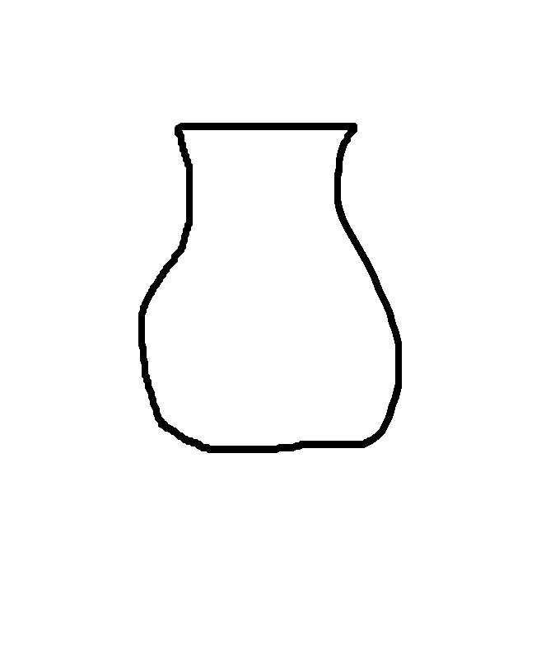
Knitting an Algorithm
Aims to algorithmically create knitting patterns from a drawn shape
How?
Edge detection and math!

Slide 10
Gauge
This is where the math comes from!
How tight you hold your yarn
This can be useful in determining how many stitches and rows will be needed to make the fabric.

Slide 11
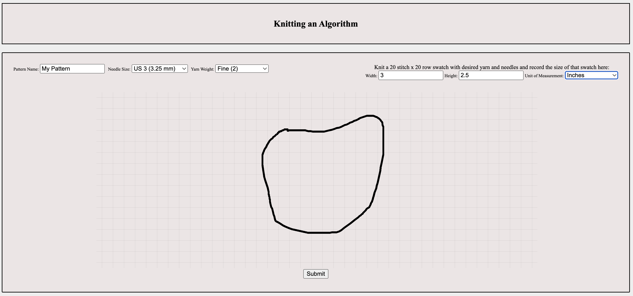
Knitting an Algorithm

Slide 12
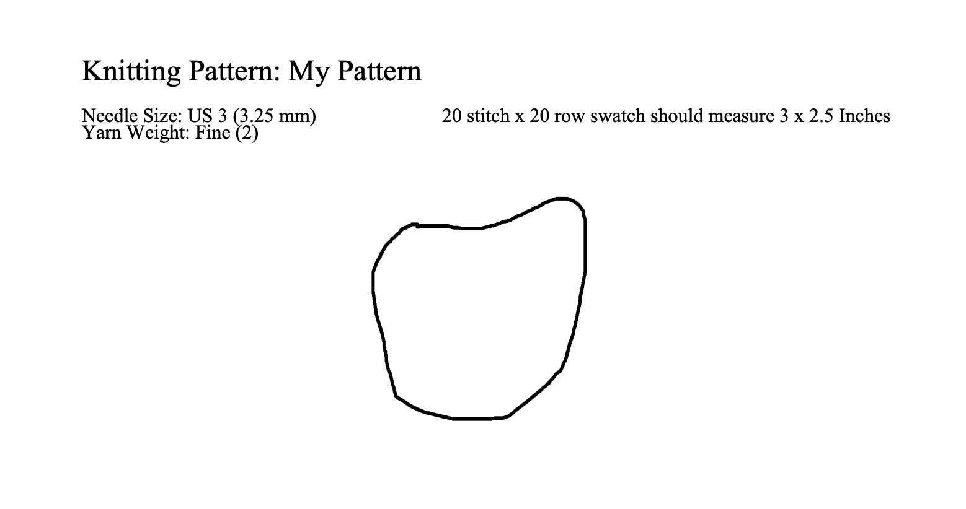
Knitting an Algorithm

