Slide 1
Hardware is cheap.
Notes:
The story so far...
The price difference between 8-bit and 32-bit processors is small and dwindling. (Raspberry Pi slide)
That means there are more and more places we can use Python.
There are a wide variety of embedded systems, with great differences between them. To try and cover this range, I'm going to use 3 examples of embedded systems:
kiosk, like an ATM
home router
thermostat

Slide 2


Notes:
Programmers develop faster with Linux and Python than a micro-controller or commerial real-time operating system and C.
With better tools, better documentation (the source!), and a higher-level language

Slide 3
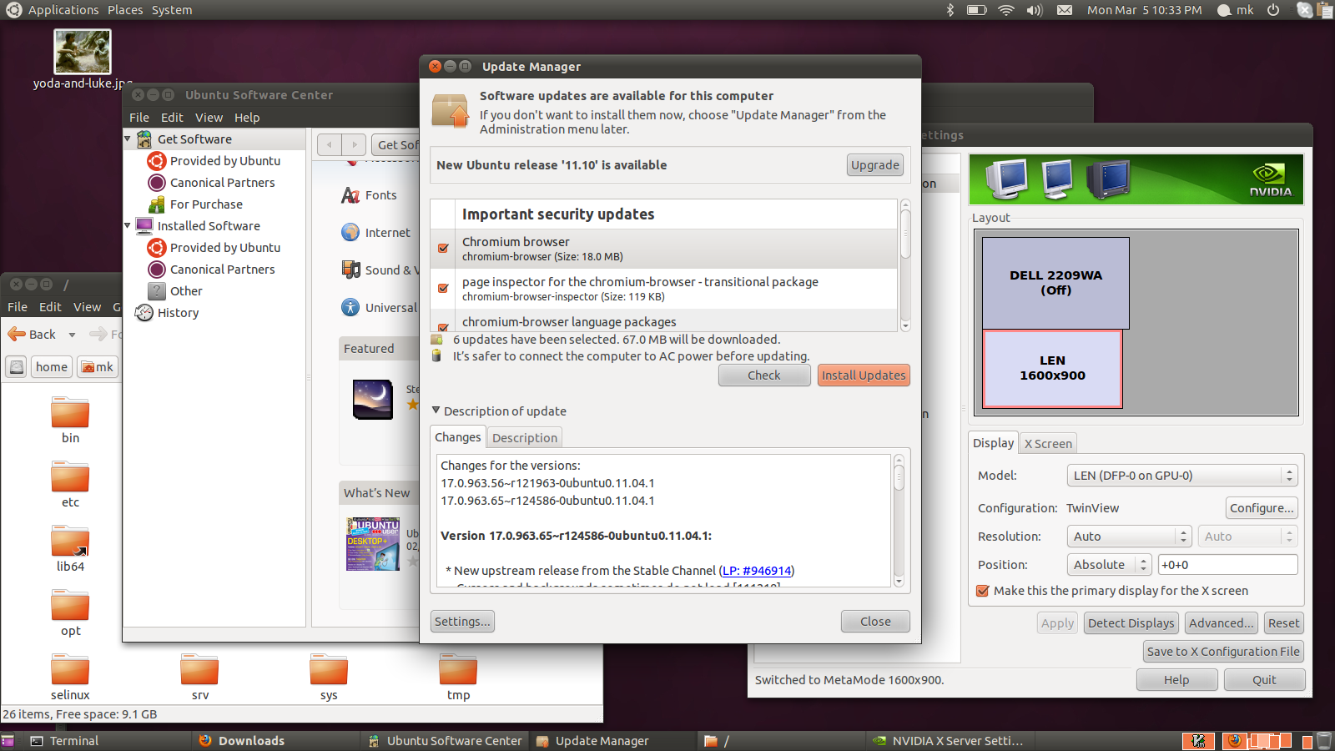
Notes:
The problem is, Linux distributions are not designed for embedded systems.

Slide 4

Solution: Use what you can from the distribution and use Python to build the rest.
Notes:
Solution: Use what you can from the distribution and use Python to build the rest.

Slide 5
Act 2, Scene 1

Slide 6
Choose the right distribution.

Slide 7
For a kiosk, choose Ubuntu.
Notes:
A kiosk is like a desktop. Kiosks usually use PC-class hardware; a screen, an Intel x86 processor, and a touchscreen or pointing device, and tens of gigabytes of storage
Some differences:
only one application
no administrator - all configuration must be automatic
no user login
Ubuntu has great support for Linux desktops.
Chrome and Firefox have kiosk modes.
You can write your user interface software for a browser, or you have a wide choice of toolkits like Qt and GTK.

Slide 8
Why not Fedora?
Notes:
Ubuntu is based on Debian and the Debian project has packaged a lot more software than Fedora. So it is more likely that the software you want is already packaged.
Further, the packages are more granular, so if you are tight on space, it is much easier to slim down your storage requirements, by just removing packages.

Slide 9
For a home router, choose Debian.

Slide 10
Debian supports more processor types than Ubuntu
Notes:
amd64, armel, i386, ia64, mips, mipsel, powerpc, s390, sparc

Slide 11
Debian supports cross-compilation with the Emdebian project.
Notes:
If Emdebian supports your processor, using their environment will save you from creating your own cross gcc toolchain.

Slide 12
Why not Ubuntu for home routers?
Notes:
Ubuntu is always shipping core components (kernel, boot and early userspace, filesystems, C libraries) that are on the ragged edge, usually to support something new for desktop users and useless for embedded systems.
The best example of this is the effort that has gone into supporting compositing window managers.

Slide 13
For a thermostat,
use BusyBox
and Linux from Scratch.
Notes:
For this class of device, your design must be very low cost, very low resources. You might need to use a less common processor and you definitely have much less storage.

Slide 14
What is BusyBox?
Notes:
BusyBox is a very small user-space implementation for Linux.
People often use it with a scaled-down C library to create very small custom distributions.

Slide 15
What is Linux from Scratch?
Notes:
Linux from Scratch and its companion Cross Linux from Scratch are book-based distributions that explain issues like:
creating and use a cross-compilation gcc toolchain
building custom kernels
using unusual boot loaders
customizing the boot process

Slide 16
Eliminate desktop assumptions
Notes:
For BusyBox, this has either been done for you, or you've created everything yourself.
Find these assumptions, and code around them in Python.

Slide 17
Handle upgrades automatically.

Slide 18
Simplest approach: upgrades are filesystem images

Slide 19
Ping-Pong

Slide 20
Using Debian's package manager: APT

Slide 21
General Principle: Upgrading software should control the process.

Slide 22
Review

Slide 23
Time is hard.
Notes:
Be wary of code related to dates and times.
This is an area notorious for bugs but it is especially true when you adapting desktop code to an embedded system.
This year, Microsoft's cloud computing platform had an unusal amount of downtime on...Feb 29.

Slide 24
Avoid time zones.
Notes:
Avoid time zones, if possible. Wristwatches do.
There are a huge number of time zones, and they are
constantly changing.
When I lived in Argentina, the government changed the time zone rules on the day before they were to take effect. (Ubuntu had an update, but how many embedded systems were patched in time?)

Slide 25
GPS time is not UTC.
Notes:
GPS time does not use leap seconds.
The current offset betwene GPS time and UTC is 15 seconds, but that offset will change over...time.

Slide 26
Linux is only free if your time has no value.
- Jamie Zawinski
Notes:
This is almost right.
In Linux, elapsed time has no value.
Linux does not have direct support for elapsed time.
Applications get the system time and do their own calculations.

Slide 27
t1 = gettimeofday() something_happens() t2 = gettimeofday() elapsed_time = t2 - t1
Notes:
Applications expect to be able to do this.
And that will often work. But not always.

Slide 28
settimeofday()
Notes:
The problem is, in Linux, time is implemented as a single global counter, and a privileged process can set the time whenever it wants.
What should this do?
Depending on how how the time is adjusted by, different
assumptions break.

Slide 29
Time is relative.
Notes:
For adjustments under half a second, time is slewed and seconds are made longer
or shorter. See adjtimex(2)

Slide 30
Time is not monotonic.
Notes:
For adjustment of more than a half a second, system time immediately jumps forward or back. This affects timeouts and cron jobs.
Why are all of the hourly cron jobs running at once? Because time jumped forward an hour.
Time can be quite off depending on whether you have been taking good care of the hwclock. On many Linux systems, the hw clock is only set on shutdown. If you shutdown uncleanly, the clock doesn't get set, and you will have a big time jump in your future.
Avoid time changes except at startup and shutdown.

Slide 31
Don't manage NetworkManager.
Notes:
Desktop systems use NetworkManager to control a set of network interfaces, choosing the best one as connectivity changes over time.
This approach may work if your embedded system roams across networks, e.g. phones, ebook readers.
However, many embedded systems (home routers, thermostats, set-top boxes) act more like servers than clients, and it is not appropriate to bring up and down network interfaces every time their is a brief connectivity outage.
My recommendation is to only use NetworkManager if it is really appropriate to your product. Otherwise, use the interfaces that NetworkManager uses, directly.

Slide 32
sudo is the new setuid
Notes:
Right or wrong, if you are using Ubuntu or Debian, you have inherited the Linux desktop security model.
As a result, as your automating away administrative configuration changes, you will need root privileges.
sudo can be configured to automatically give root privileges to a select list of commands, and this is often the easiest way to handle the privilege escalation that is required when you are automating changes in configuration.

Slide 33
Write portable code.
Notes:
We talked about Linux. Now we can talk about Python.
And I want to talk about a particular aspect of program design that is especially important to embedded systems software.
ISn't Python portable?
I want everyone to write portable code in Python.
I've never seen endian macros in Python code.
I haven't seen near and far pointers.
I haven't seen 36-bit words.
Yes, Python is portable across *processors*.
But there is more than one type of portability.

Slide 34
Types of portability
Notes:
The kind of portability I'm talking about is using one source base across a range of products, which is very common in embedded systems.
You need to support a common core of functionality, but with somewhat varying features, and varying hardware platforms.
Hardware: Different sensors, different network interfaces, etc.
On the feature side, marketing says there should be a a basic model, and a luxury or professional model.

Slide 35
if considered harmful
Notes:
Python has support for this. It is called the if statement. You just write your code and when you get to a difference between the models you write:

Slide 36
if model == PRODUCT_A: do_this() elif model == PRODUCT_B: do_that()
Notes:
That works. So what's the problem? Why I am talking about this?
The problem with this approach is that the number of code paths increases with each product.
The complexity increases.
And when you're working on the software, regardless of which product you are working on, you see the complexity of the sum total of all the products.
Another problem is that the differences between products are hidden in the leaves of your code.

Slide 37

Trunk and Leaves
Notes:
By that, I mean, the core or trunk is the main body of common code. The leaves are code which don't call other code you've written. They use libraries or system calls to control hardware.
Is a program written this way modular? Let's come back to that.

Slide 38
#ifdef Considered Harmful by Henry Spencer
Notes:
If any of you have programmed in C, you know that C has two different kinds of if statements: the kind that evaluates at compile-time and the kind that evaluates at run-time.
The compile time if is “#ifdef”
Traditionally, people have used the compile to address portability concerns. Linux vs. BSD vs SunOS.
But the same problem of increasing complexity arises. For more about this in the C world, I highly recommend Henry Spencer's paper.

Slide 39
Separate common and model-specific code.
Notes:
So we're using this "if" statement, and we're starting to feel like we're losing.
We'd really like to be able to work on the core code, without seeing the complexity of all of the product varieties.
I can use abstraction. Draw a circle around the leaves. This is Better.
But let's ask again, is this program modular?
We have these leaves of code that contain
We contained the complexity, but we're not reducing it. The common parts of the software depends on these leaves that keep getting more and more complex.

Slide 40

What are we hiding?
Notes:
In 1972, David Parnas wrote a paper called "On the Criteria To Be Used in Decomposing Systems into Modules". And he said:
"We propose instead that one begins with a list of difficult design decisions or design decisions which are likely to change. Each module is then designed to hide such a decision from the others."
In our program, what are we hiding?
We are hiding the model-specific code from the core code, and that's good. But the model-specific code is all mixed together.
We want to *hide* the differences, the parts of the program that have changed before, and thus are likely to change again, from the other parts of the software.

Slide 41

Interface Stability
Notes:
Another problem. We have these interfaces between the core code and the model-specific code. Are they stable? By that, I mean,do they remain the same over time? Or do we need to change them every time we add a new model?

Slide 42
Libraries vs Frameworks
Notes:
Who likes frameworks?
Who prefers libraries?

