Slide 1
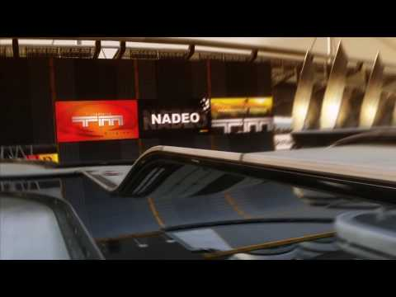
TMCHALLENGER
By:
Kamal Nimmagadda
Mehul Kohli
Ritika Singhal
Rohan Marathe

Slide 2
Project Description
Creating a racing agent for the game of TrackMania
Training the model to find the best path to complete the speedrun for any given map

Slide 3
Objective
To be able to perform a speedrun capable of going head to head with world top performers on A01-race.
To be able to perform a speedrun on multiplayer online maps.

Slide 4
How do we Train?
Training data corpus from professional streamer gameplays.
A CNN based training model to extract player strategies and control sequences.

Slide 5
School of thought
A Deep-Q Learning approach with reward points for each time the bot gets a personal best.
A Genetic algorithm to perform a dynamic speedrun.

Slide 6
Thank you

