Slide 1
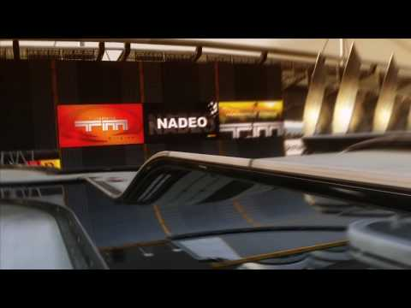
TMCHALLENGER
By:
Kamal Nimmagadda
Mehul Kohli
Ritika Singhal
Rohan Marathe

Slide 2
PROGRESS
AND
ISSUES

Slide 3
Data Generation Demo

Slide 4


Slide 5
Deep Q-Learning
States: set of 20 frames captured (subject to tuning), trend in change of speed according to the timestamp.
Actions: Keystrokes
Input to the model: State-Action pairs
Output: Q values for the action corresponding to the transition between the states.

