Slide 1

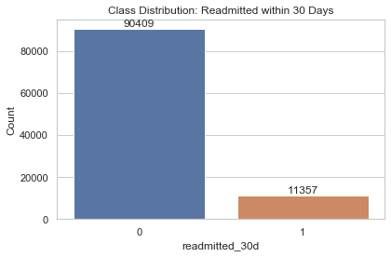
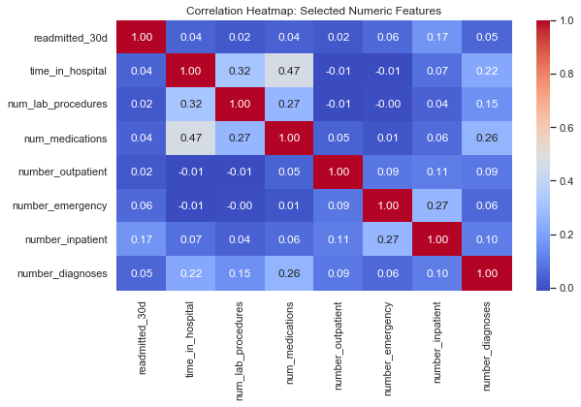
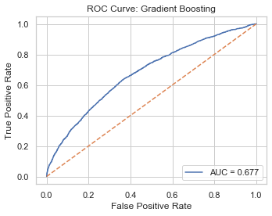
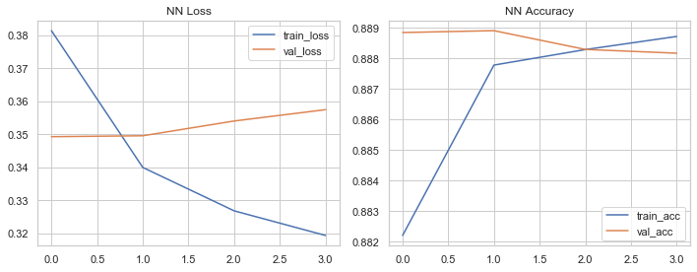
Hospital Readmission Prediction
Using Machine Learning and Deep Learning
Final Capstone Presentation • Diabetes 130-US Hospitals dataset
From data wrangling and EDA to model comparison, deep learning, and operational recommendations
101,766
~11%
4
0.677
Takeaway
Core result: Gradient Boosting ranks risk best, but Logistic Regression captures far more true readmissions at the default threshold.
encounters
readmission rate
models compared
best ROC-AUC

Slide 2
Business problem and project objective
Why this problem matters
Project objective
30-day readmissions increase cost and can signal incomplete recovery, poor discharge planning, or inadequate follow-up.
Hospitals need a risk model that helps prioritize patients for transitional care and closer monitoring.
A useful solution must balance statistical performance with the practical goal of identifying high-risk patients.
Predict readmission within 30 days using structured encounter data.
Compare linear, ensemble, and deep learning approaches under severe class imbalance.
Translate model behavior into operational recommendations for care-management teams.

Slide 3
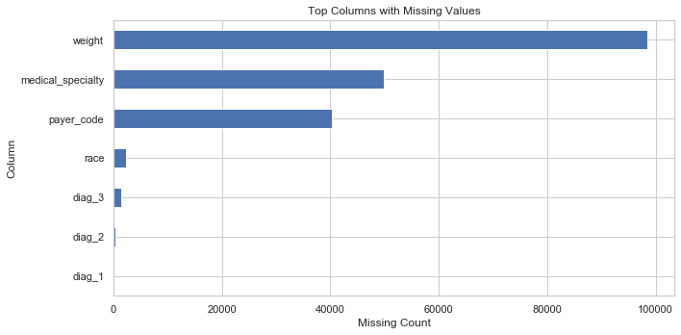
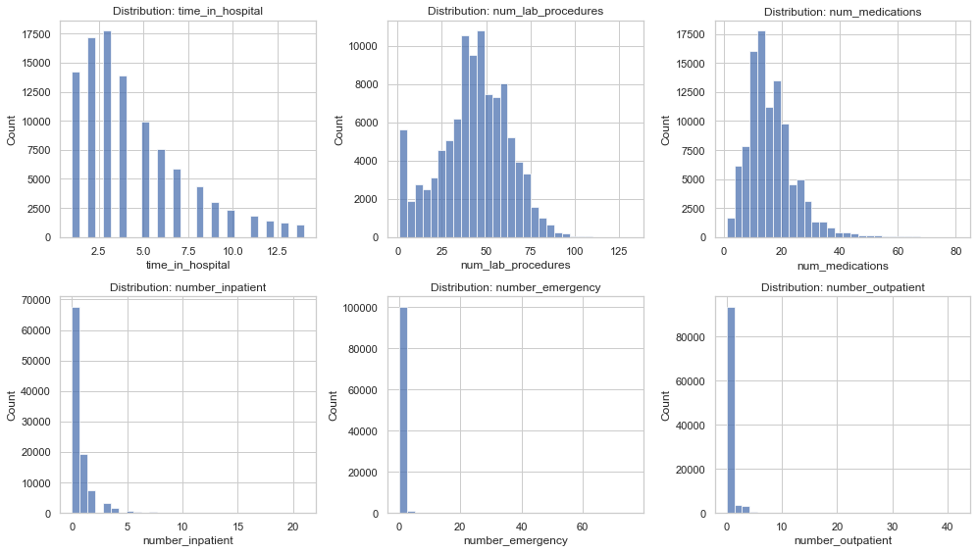
Data, preprocessing, and workflow
Pipeline from raw encounters to final model comparison
Wrangling
EDA
Preprocessing
Modeling
Convert ? to nulls
Drop IDs
Create binary target
Imbalance
Missingness
Utilization patterns
One-hot encoding
Scaling where needed
Stratified split
LR • RF • GB • NN
Compare metrics
Select final model
Missing-value structure from the EDA notebook
Core utilization distributions
Correlation structure for selected numerical features
Workflow aligns with final report and notebooks

Slide 4
EDA - class imbalance and why metrics matter
Scientific interpretation
Only about 11% of encounters belong to the positive class, so a majority-class model can appear strong on accuracy while still failing clinically.
This figure explains why recall, F1 score, ROC-AUC, and precision–recall behavior are more informative than raw accuracy alone.
The imbalance directly drives the later tradeoff: ensemble models achieve high accuracy but miss most true readmissions at the default threshold.
90,409
11,357
~11.2%
non-readmitted
readmitted
positive class rate
Figure 1. Class distribution for 30-day readmission
Takeaway
Key implication: the best model is not the one with the highest accuracy; it is the one whose behavior matches the hospital’s tolerance for missed high-risk patients.

Slide 5
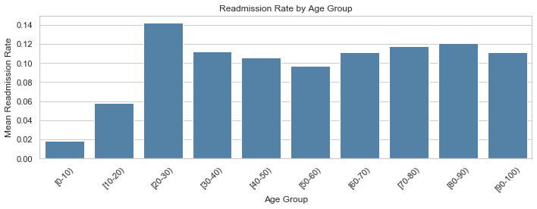
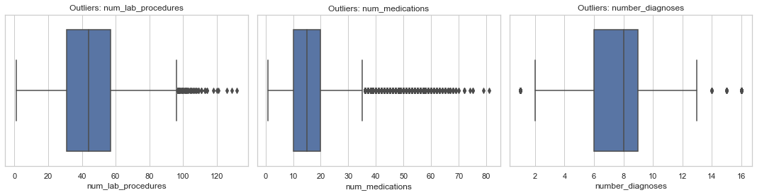
EDA - missingness and feature behavior
Why these figures matter
Weight, medical specialty, and payer code contain substantial missingness, which justifies a structured preprocessing pipeline rather than ad hoc cleaning.
Healthcare utilization variables are heavily right-skewed: most patients cluster at low values, while a smaller subset shows very high use.
Those extreme values are clinically meaningful rather than obvious noise - they likely proxy for disease burden, acuity, or unstable care trajectories.
Figure 2. Top columns with missing-value markers
Figure 3. Distributions of core utilization features
Figure 7. Outlier review
Figure 5. Readmission rate by age group

Slide 6
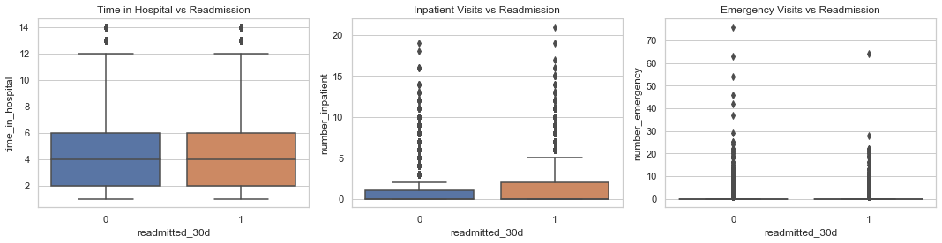
EDA - why nonlinear models are plausible
Scientific interpretation
Readmitted encounters tend to show higher inpatient and emergency use, as well as longer hospital stays, which is clinically consistent with unstable or unresolved illness.
The correlation structure is modest rather than dominated by a single linear driver. That suggests the signal is distributed across variables and may emerge through interactions.
Together, these figures motivate comparing linear and nonlinear models rather than assuming a simple linear decision boundary is sufficient.
Figure 4. Utilization features versus readmission
Takeaway
EDA supports a two-part story: utilization history is informative, and nonlinear interactions are likely important for ranking risk.
Figure 6. Correlation heatmap

Slide 7
Modeling strategy and test-set comparison
Models compared
What the table says
Logistic Regression - interpretable baseline with strong minority-class sensitivity
Random Forest - nonlinear ensemble baseline
Gradient Boosting - strongest overall ranking model
Neural Network - deep learning extension from the proposal
Logistic Regression detects far more true readmissions than the other models, which is why it dominates on recall.
Gradient Boosting produces the highest ROC-AUC, meaning it ranks patients by risk better across thresholds.
The ensemble models achieve strong overall accuracy largely because they favor the majority class.
The Neural Network adds methodological breadth but does not improve minority-class behavior.
Held-out test metrics
Model
Accuracy
Precision
Recall
F1
ROC-AUC
Logistic Regression
0.6358
0.1656
0.5605
0.2556
0.6373
Random Forest
0.8885
0.5625
0.0040
0.0079
0.6674
Gradient Boosting
0.8886
0.5625
0.0079
0.0156
0.6775
0.5605
0.6775
Neural Network
0.8884
0.3333
0.0004
0.0009
0.6246
best recall (LogReg)
best ROC-AUC (GB)

Slide 8
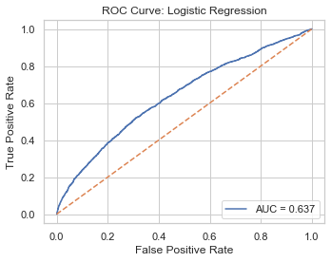
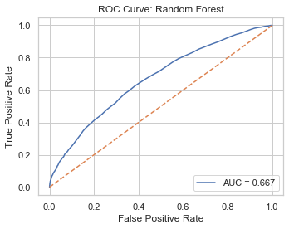
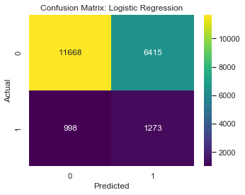
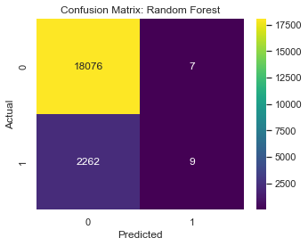
Model behavior - Logistic Regression vs Random Forest
Interpretation
Logistic Regression is recall-friendly: it predicts many more positives, so it captures true readmissions at the cost of many false positives.
Random Forest improves ROC-AUC relative to Logistic Regression, but its confusion matrix shows that it rarely predicts the minority class at threshold 0.5.
This comparison makes the core tradeoff visible: sensitivity versus conservative majority-class prediction.
Figure 8. ROC — Logistic Regression
Figure 10. ROC — Random Forest
Takeaway
LogReg is the better model when the operational goal is maximum case capture without threshold tuning.
Figure 9. Confusion matrix — Logistic Regression
Figure 11. Confusion matrix — Random Forest

Slide 9
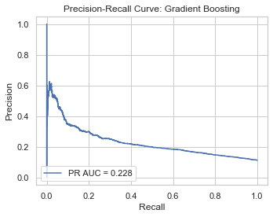
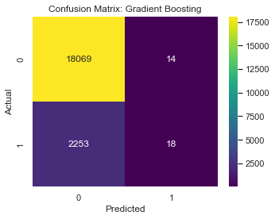
Final model - Gradient Boosting diagnostics
Figure 12. ROC curve — Gradient Boosting
Figure 13. Precision–Recall curve — Gradient Boosting
Figure 14. Confusion matrix — Gradient Boosting
Why this is still the final model
Gradient Boosting produces the strongest overall ranking performance.
Its ROC curve sits consistently above the baseline, showing useful discriminatory structure.
The PR curve confirms the expected tradeoff under imbalance: higher recall requires lower precision.
The confusion matrix reveals the limitation directly - the default threshold is too conservative for practical minority-class capture.
Takeaway
Best ranking ≠ best detection. Gradient Boosting is the strongest risk-ordering model, but it needs threshold tuning before deployment.

Slide 10
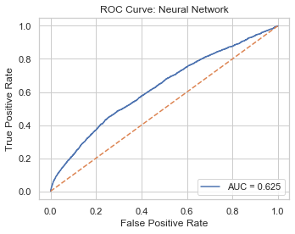

Deep learning extension - what the Neural Network adds
Deep learning metrics
Accuracy
0.8884
Precision
0.3333
Recall
0.0004
F1
0.0009
Figure 15. ROC — Neural Network
ROC-AUC
0.6246
Training converged without major instability, so the issue is not simple optimization failure.
The model still rarely predicts the positive class, showing that added nonlinear capacity alone does not solve the imbalance problem.
For this structured tabular dataset, tree-based ensembles remain the stronger practical choice.
Figure 16. Confusion matrix — Neural Network
Figure 17. Training and validation history

Slide 11
Critical insight, recommendations, and next steps
Recommendations
Most important finding
Use Gradient Boosting as a risk-ranking system rather than a direct binary alert.
Tune the decision threshold before deployment so the model reflects the hospital’s tolerance for false positives versus missed high-risk patients.
Focus future feature engineering on utilization history, diagnosis burden, and structured missingness.
Best ranking model
≠
Best detection model
Gradient Boosting ranks risk best. Logistic Regression captures more true readmissions.
Next steps
Probability calibration and cost-sensitive learning
Resampling strategies for rare-event detection
Richer temporal history and follow-up variables
Conclusion: this capstone demonstrates a credible end-to-end workflow with evidence-based model selection.

Slide 12
Thank you!

