Slide 1

Insurance Claim
Prediction Using
Machine Learning
Springboard Capstone presentation
Two linked business questions
• Who is likely to file a claim?
• What charges should the insurer expect?
Dataset: 1,338 policyholders · six predictor fields · classification + regression
Notes:
[Sources] User-provided project files: insurance.csv, insurance_EDA_continuation_FINAL_v2.ipynb, insurance_modeling.ipynb, capstone_report_expanded.docx [/Sources]

Slide 2
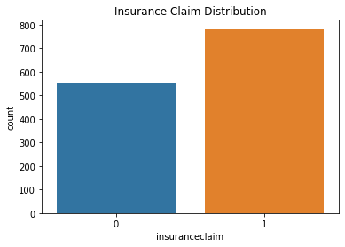
Business problem and project objective
Why the problem matters
1,338
58.5%
Insurance pricing and underwriting improve when claim risk is estimated consistently rather than by judgment alone.
records
claim rate
A second model for charges helps quantify the financial magnitude behind each customer segment.
Insurance claim distribution
Takeaway
The project aims to turn EDA insights into decisions an insurer can use.
Claims are common in this dataset, so evaluation needs to balance precision and recall—not accuracy alone.
Project objective
This motivates reporting F1 for classification and RMSE/R² for regression.
Predict the binary target insuranceclaim.
Estimate charges for budget and premium planning.
Identify the strongest cost and risk drivers.
Notes:
[Sources] User-provided insurance_EDA_continuation_FINAL_v2.ipynb (claim distribution plot). User-provided capstone_report_expanded.docx (problem framing and narrative). [/Sources]

Slide 3
Data, preprocessing, and workflow
How the pipeline turns raw fields into model-ready inputs
Dataset snapshot
Workflow used across notebooks
Features: age, sex, BMI, children, smoker, region
Targets: insuranceclaim (classification) and charges (regression)
Wrangling
EDA
Feature engineering
Modeling
Structured tabular data from a public insurance dataset
Validate fields
and completeness
Find risk drivers
and hypotheses
Scale + prepare
train/test data
Compare models
and pick final ones
Compact, clean dataset preserved without dropping rows
Preprocessing choices
Validated dummy-ready categorical fields
Why two tasks?
Standardized feature magnitudes with StandardScaler
The claim model answers, “who is likely to file,” while the charge model answers, “how costly could that policyholder be.” Together they support triage, pricing, and segmentation decisions.
Used a consistent 80/20 train-test split with random state = 42
Notes:
[Sources] User-provided insurance_feature_engineering_from_eda.ipynb and insurance_modeling.ipynb. User-provided project report. [/Sources]

Slide 4
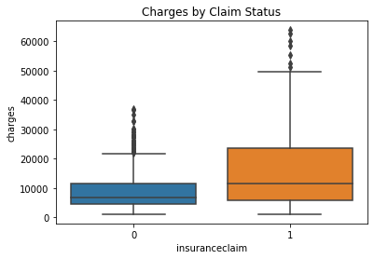
EDA: where the signal first appears
Figure: claim distribution
Figure: charges by claim status
Why this matters
The target is business-relevant: claims are frequent enough to act on.
Charges rise sharply for the claim class, linking cost burden to claim behavior.
The EDA justifies building both a classification model and a cost model.
Roughly three out of five policyholders are labeled as claim filers.
Claim-positive customers show a clear upward shift in charges.
Notes:
[Sources] User-provided insurance_EDA_continuation_FINAL_v2.ipynb: claim distribution and charges by claim status. [/Sources]

Slide 5
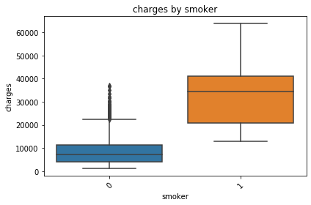
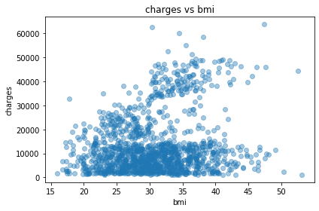
EDA: the strongest risk drivers are visible early
Smoker status and BMI stand out before any model is trained
Charges by smoker status
Charges versus BMI
Practical interpretation
Smoker status behaves like a high-risk segmentation variable.
BMI adds health-related signal that the claim model can learn.
Age contributes too, but less sharply than smoker and BMI in EDA.
Smokers form a distinctly higher-cost segment.
The expensive tail becomes much heavier as BMI rises.
Notes:
[Sources] User-provided insurance_EDA_continuation_FINAL_v2.ipynb: charges by smoker; charges vs BMI. [/Sources]

Slide 6
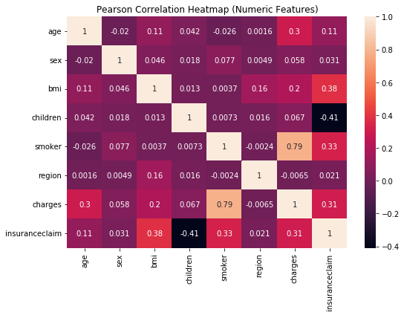
EDA: correlation view of the portfolio
The heatmap compresses the main relationships into a single diagnostic
Key findings from the heatmap
Charges have the strongest positive correlation with insuranceclaim in the EDA notebook.
BMI and age show smaller but meaningful positive relationships with cost and claim risk.
Region and sex appear weaker on their own, suggesting limited standalone signal.
The feature story is consistent across the EDA and final model importances.
↑
↑
↑
cost burden
BMI
age
Notes:
[Sources] User-provided insurance_EDA_continuation_FINAL_v2.ipynb: Pearson correlation heatmap. [/Sources]

Slide 7
Modeling strategy
Three models were compared for each task, then the most effective operational choice was selected
Classification target: insuranceclaim
Regression target: charges
Logistic Regression — interpretable linear baseline
Linear Regression — baseline estimate of cost
Decision Tree — flexible nonlinear benchmark
Decision Tree Regressor — threshold-based nonlinear model
Tuned Random Forest — ensemble model with GridSearchCV
Tuned Random Forest Regressor — best fit for nonlinear cost patterns
Evaluation focus
Evaluation focus
Accuracy, precision, recall, F1, and a ROC diagnostic for the final classifier.
RMSE for error size and R² for explained variance on the held-out test set.
Notes:
[Sources] User-provided insurance_modeling.ipynb and model_metrics.csv. [/Sources]

Slide 8
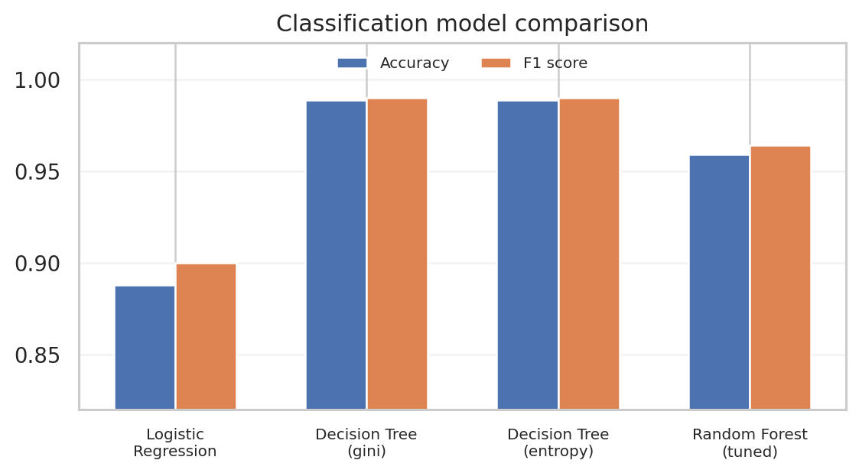
Classification results
Decision trees win the split on raw F1, but the tuned Random Forest remains the better stakeholder model
Held-out test metrics
Model
Acc.
Prec.
Recall
F1
Logistic Regression
0.888
0.906
0.894
0.900
Decision Tree (gini)
0.989
0.987
0.993
0.990
Decision Tree (entropy)
0.989
0.987
0.993
0.990
Random Forest (tuned)
0.959
0.955
0.974
0.964
Operational choice
Random Forest selected for its strong F1 plus ensemble robustness and clearer stakeholder diagnostics.
The Decision Tree models post the top point estimate on this test split. The Random Forest remains close behind while offering a more stable ensemble decision rule.
Notes:
[Sources] User-provided model_metrics.csv and insurance_modeling.ipynb. [/Sources]

Slide 9
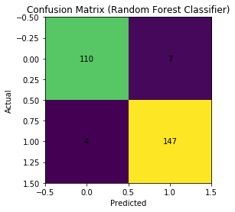
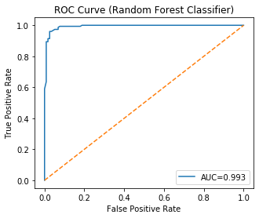
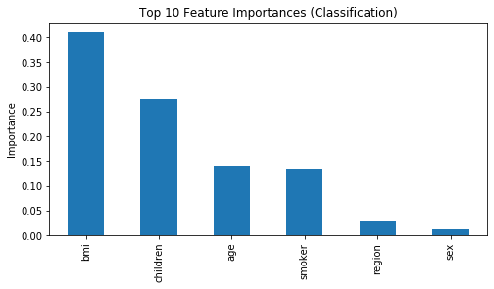
Final classifier diagnostics
The tuned Random Forest separates classes well and leans on the same features highlighted in EDA
Confusion matrix
ROC curve
Feature importance
AUC ≈ 0.993
BMI, children, age, and smoker rank highest in the final classifier output from the notebook.
Notes:
[Sources] User-provided insurance_modeling.ipynb: confusion matrix, ROC curve, classifier feature importance. [/Sources]

Slide 10
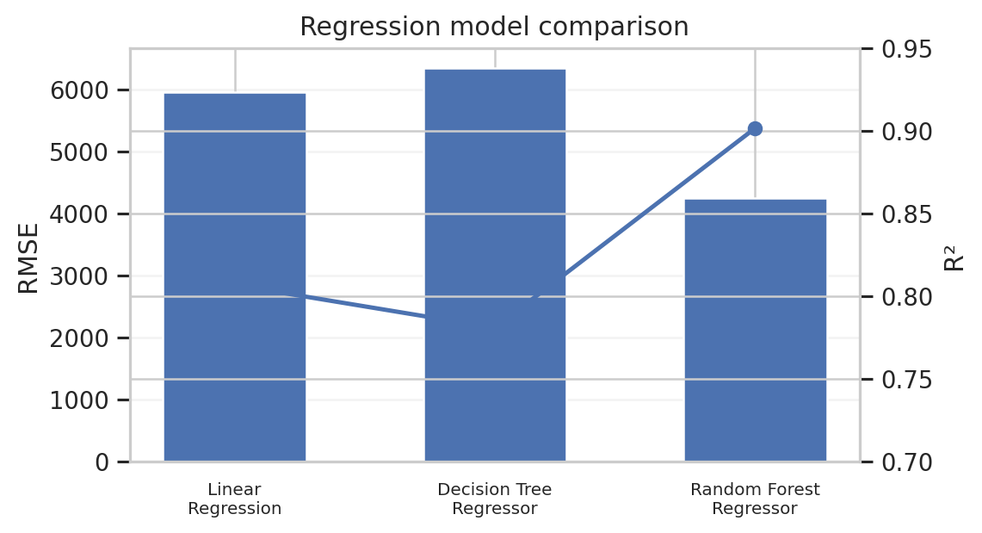
Regression results
The tuned Random Forest regressor produces the lowest error and the highest explained variance
Held-out test metrics
Model
RMSE
R²
Linear Regression
5,958
0.807
Decision Tree Regressor
6,345
0.781
Random Forest Regressor
4,253
0.902
Final regressor
The tuned Random Forest regressor was chosen because it combines the lowest prediction error with the strongest overall fit to actual charges.
Random Forest improves RMSE materially versus linear regression and the single decision tree.
4,253
0.902
RMSE
R²
Notes:
[Sources] User-provided model_metrics.csv and insurance_modeling.ipynb. [/Sources]

Slide 11
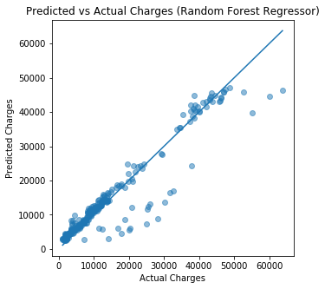
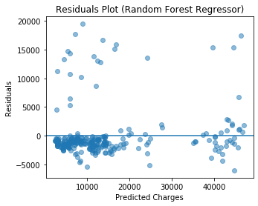
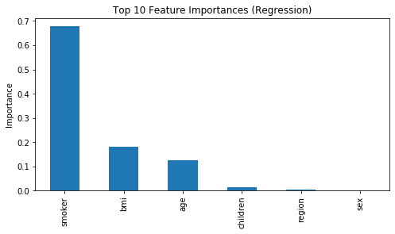
Final regressor diagnostics and recommendations
Predictions track actual charges well enough to support practical segmentation decisions
Predicted vs actual charges
Residual check
Regressor feature importance
Actions
Use the classifier for risk stratification and closer underwriting review.
Design preventive outreach around smoker status and BMI, which dominate the EDA and model importance plots.
Use the charge model to support pricing and segmentation—while layering in fairness checks before deployment.
Notes:
[Sources] User-provided insurance_modeling.ipynb and capstone_report_expanded.docx. [/Sources]

Slide 12
Limitations and next steps
What this capstone shows now, and what should be improved before production use
Limitations
Next steps
Bottom line
Small dataset compared with real production insurance portfolios.
Benchmark XGBoost to match the original proposal more closely.
The project shows a credible, end-to-end machine learning workflow: strong EDA, clear model comparisons, and practical business recommendations grounded in the notebook evidence.
Only structured tabular features are available—no richer medical history or claims history.
Add SHAP-based explanations for local interpretability.
Some strong predictors may reflect downstream cost burden and would need governance review.
Stress-test fairness and cross-validated stability before operational rollout.
Notes:
[Sources] User-provided project proposal and project report. [/Sources]

