Slide 1
Velocity Determination of Rifle and Pistol Ammunition
The Chronograph
Matt Kokshoorn
4SH
University of Canterbury

Slide 2
Key Points
An introduction to Velocity Chronographs
The Specification Decisions
The Final Design
Costs and Competition

Slide 3
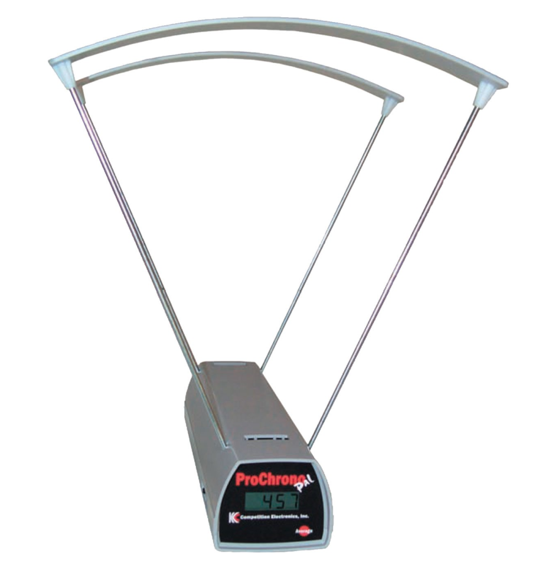
What is a Velocity Chronograph ?

Slide 4
Why Need a Velocity Chronograph ?
Hobbyist Interest
Safety
Competitions
The Law
Ammunition Optimisation

Slide 5
Specification Decisions
Need to select …
Method of Velocity Determination
Power Supply
Mechanical Mounting
User Interface
Communication System

Slide 6
Existing Methods of Velocity Determination
Doppler Radar
Ballistic Pendulum
Acoustic Detection
Optical
Electromagnetic

Slide 7
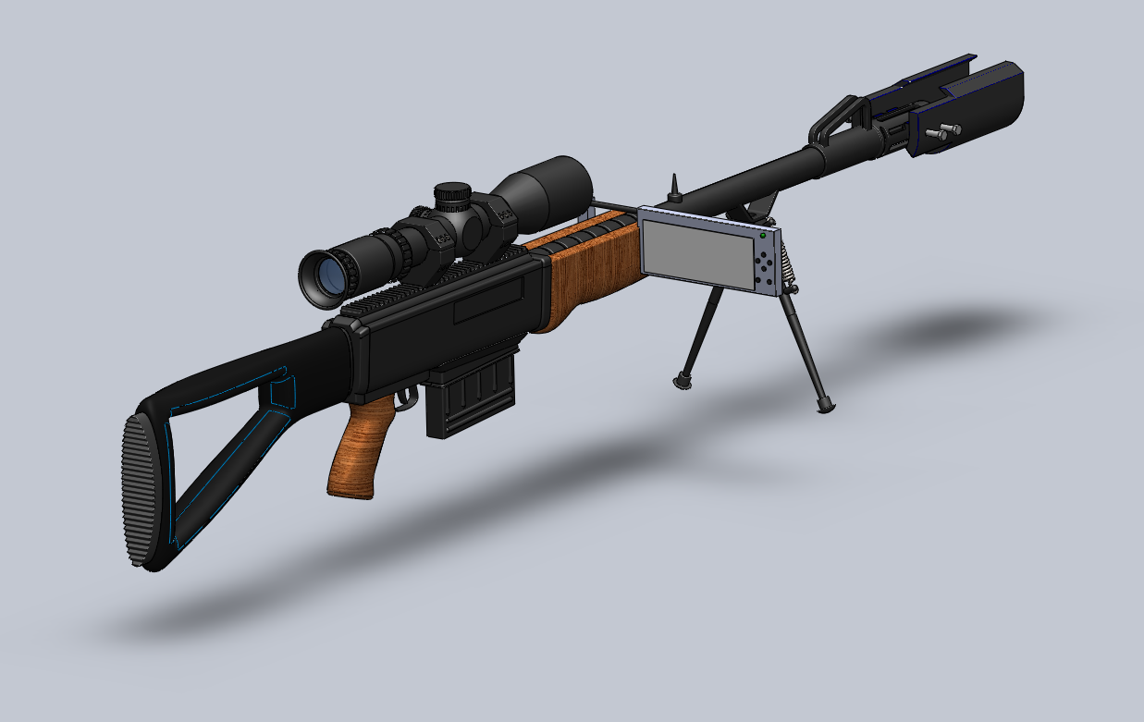
Final Design

Slide 8
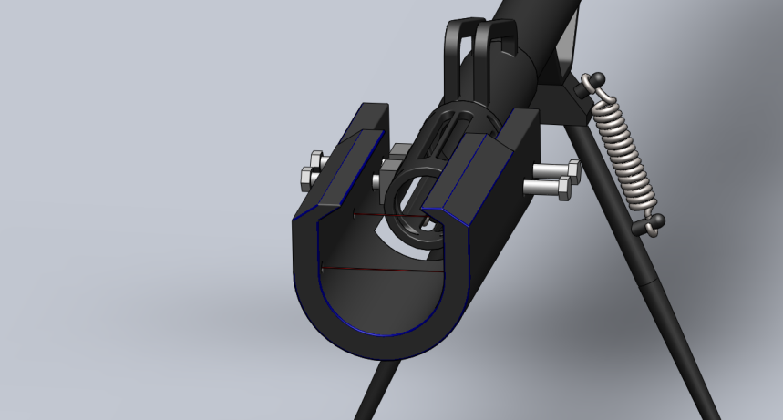
Selected Method: Optical Detection
Accurate
Easy to Mount
Low Cost
Simple
to Implement

Slide 9
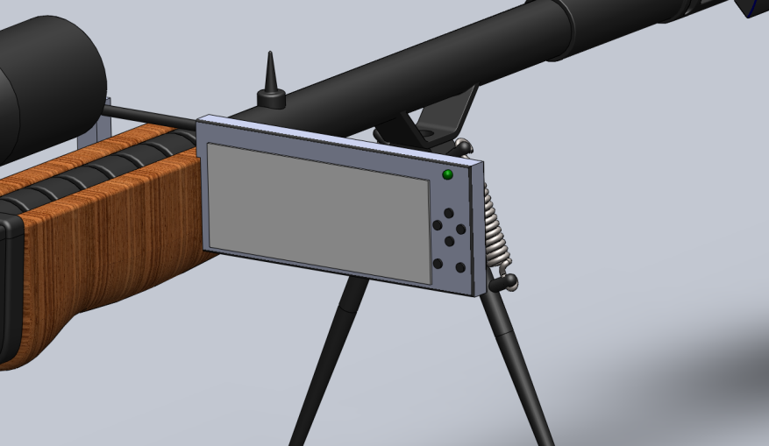
Display and User Interface
OLED Display
Adjustable
Clamp
Clear of sights
Green Laser
Active LED

Slide 10
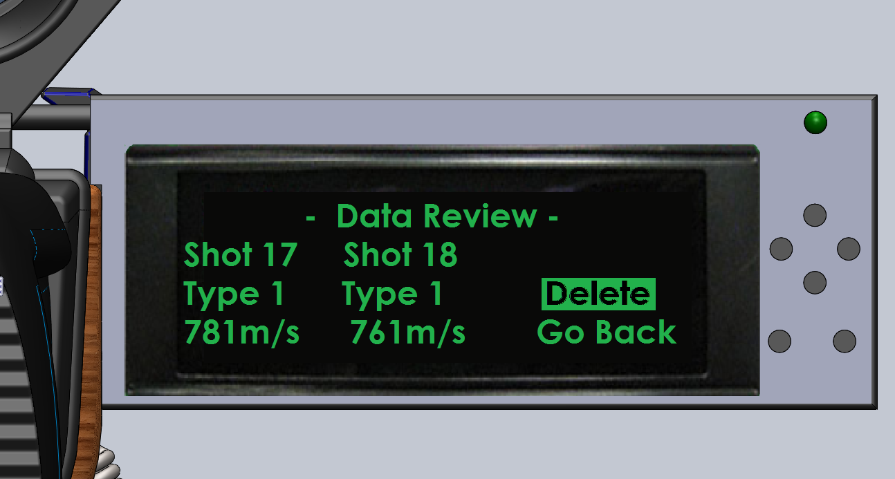
Display and User Interface
Uses 5 Navigation buttons.
Ability to delete
Out liars and
Change Data
Types

Slide 11
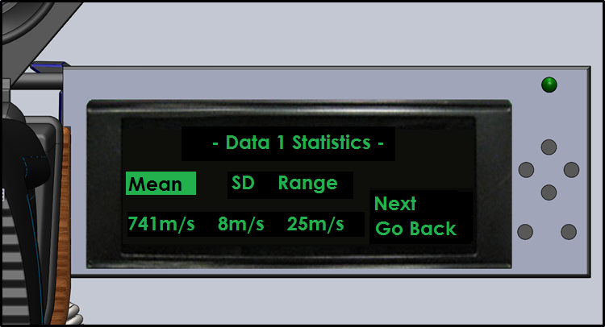
Display and User Interface

Slide 12
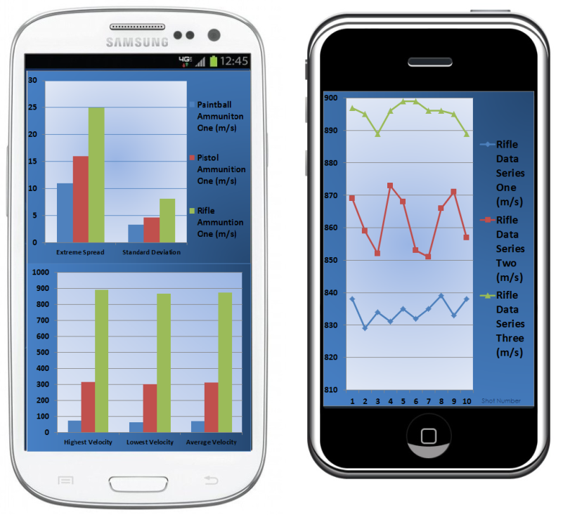
Smartphone Functionality
Bluetooth Upload
Real Time
Android and iOS
Shows Statistical
Graphs and Trends

Slide 13

Costs and Competitors
Final design is estimated to cost a maximum of $116.39NZ.
Current market prices are in
excess of $300NZ.

Slide 14
Summary
Numerous needs for velocity chronographs.
Many specification decisions evaluated.
The final design believed to be successful and is at a competitive cost.

Slide 15
Questions ?

