Slide 1
CloudGuard Controller - Generic DC objects sourced from Kubernetes APIs using custom middleware service (bash script in Pod)
Martin Koldovský, Beyond Perimeter Security Expert, Eastern Europe
+Pavel Krejčí, SE Czech Republic

Slide 2
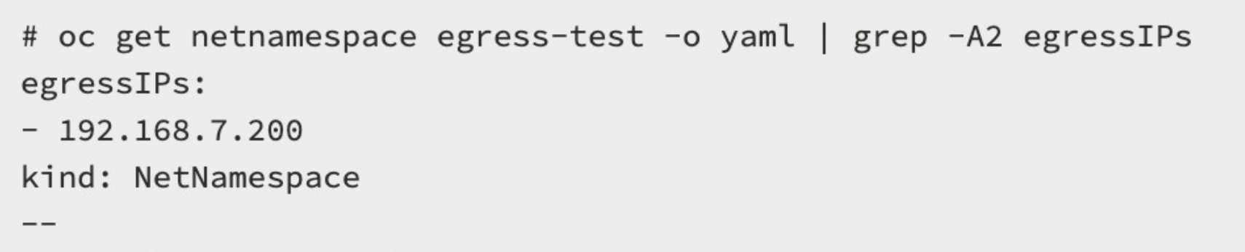

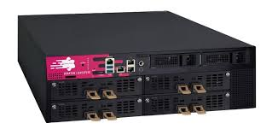
Pod
Internet
Perimeter FW
OpenShift Cluster

Slide 3
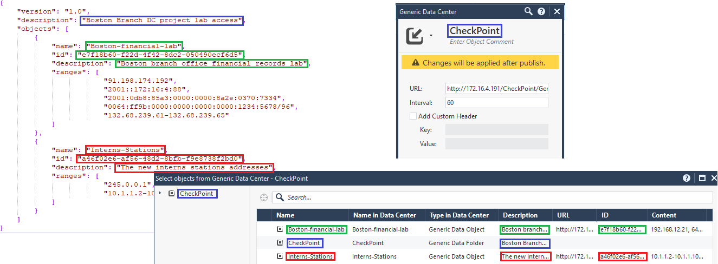
CloudGuard Controller – Generic Data Center objects
Notes:
https://supportcenter.checkpoint.com/supportcenter/portal?eventSubmit_doGoviewsolutiondetails=&solutionid=sk167210&partition=Basic&product=Quantum

Slide 4
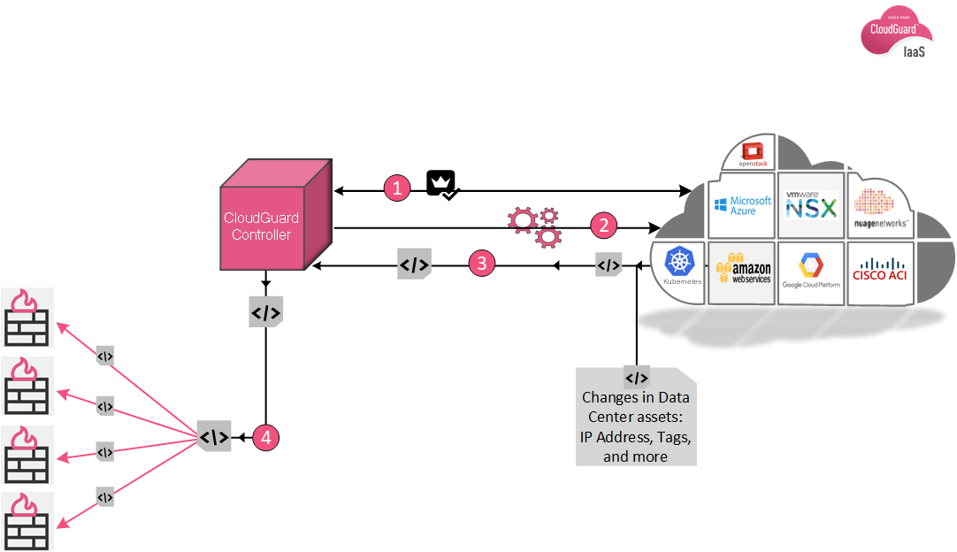
CloudGuard Controller
Enables Check Point Security Management integrations with SDDCs including:
Amazon Web Services
Cisco ACI
Cisco ISE
Google Cloud Platform (GCP)
Kubernetes
Endpoints
Pods
Services
nodes
Microsoft Azure
Nuage Networks VSP
OpenStack
VMware vCenter
VMware NSX-T
VMware NSX-V

Slide 5
CloudGuard Controller – new in R81.10
K8S DC support
Data Center QUERY object
NAT – supports DC objects in original source and original destination

Slide 6
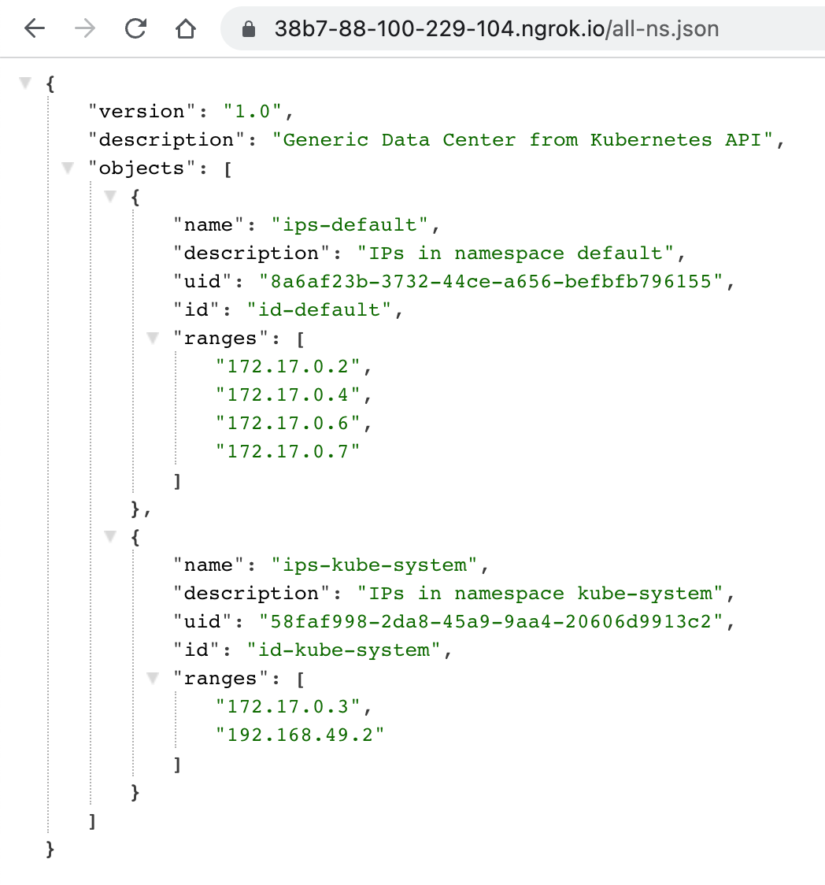
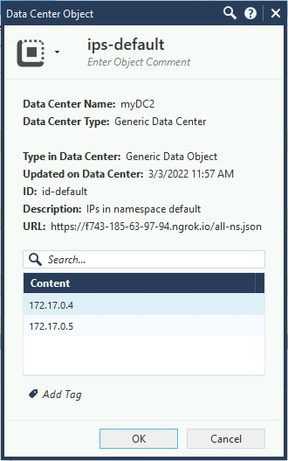
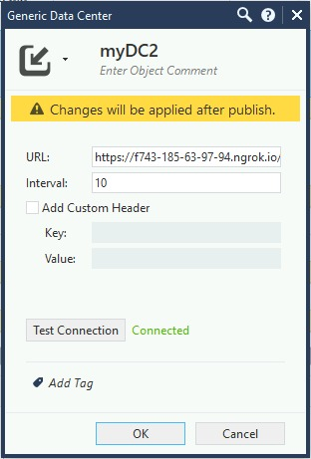
sk167210 Generic DC integration
CHKP Security Gateway
CHKP Security Management
CHKP integration middleware
list of IP ranges or IPs
K8S API

Slide 7
Documentation
CloudGuard Controller R81.10 Administration Guide
https://sc1.checkpoint.com/documents/R81.10/WebAdminGuides/EN/CP_R81.10_CloudGuard_Controller_AdminGuide/Topics-CGRDG/Introduction-to-CloudGuard-Controller.htm?tocpath=_____4
Generic Data Center feature
https://supportcenter.checkpoint.com/supportcenter/portal?eventSubmit_doGoviewsolutiondetails=&solutionid=sk167210&partition=Basic&product=Quantum

Slide 8
The end

