Slide 1
DATA606 HW #5.27 Presentation
Misha Kollontai 10/16/19

Slide 2
Background:
5.27 Relaxing after work.
The General Social Survey asked the question: \After an average work day, about how many hours do you have to relax or pursue activities that you enjoy?" to a random sample of 1,155 Americans. A 95% confidence interval for the mean number of hours spent relaxing or pursuing activities they enjoy was: (1.38, 1.92).
n = 1,155
1.38 < Mean (95% confidence interval) < 1.92

Slide 3
Question (a):
Interpret this interval in context of the data.
From the sample of 1,155 respondents, an actual average time was calculated as being (1.92+1.38)/2 = 3.3/2 = 1.65 hours
A normal distribution was assumed for the population overall
Given the sample size and the data collected, the researchers are 95% confident that the mean of the population data falls between 1.38 and 1.92 hours of relaxation after work

Slide 4
Question (b):
Suppose another set of researchers reported a confidence interval with a larger margin of error based on the same sample of 1,155 Americans. How does their confidence level compare to the condence level of the interval stated above?
The confidence level of the new set of researchers would be higher (greater than 95%), since a larger margin of error would yield more confidence in validity.

Slide 5
Question (c):
Suppose next year a new survey asking the same question is conducted, and this time the sample size is 2,500. Assuming that the population characteristics, with respect to how much time people spend relaxing after work, have not changed much within a year. How will the margin of error of the 95% confidence interval constructed based on data from the new survey compare to the margin of error of the interval stated above?
If the mean and sd remain relatively unchanged from the first survey, the confidence interval would narrow by a factor of (sqrt(1155)/sqrt(2500)) = 0.6797
We would expect the interval to become approximately
(1.46 < m < 1.88)

Slide 6
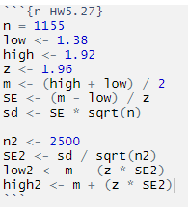
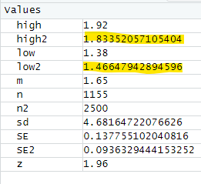
Question (c) Calculated:

