Slide 1


DEPLOYING
Internet and Intranet Firewalls
A Virtual Instructor-led Course Designed Specifically for FDIC Risk Management Examiners

Slide 2
An Important Resource
Ideally you have already visited: https://class.hillvt.com/
and found the page corresponding to our class
If you have not, please do it now, and bookmark that page
We use this site for file and knowledge sharing
We’ll put various things there for use during class
Nothing there is:
Required or mandatory, just maybe useful
Secret or confidential to FDIC or anyone else
It will disappear soon
We’ll leave it up for a week or so after class, so no real rush, but save what you want to keep.

Slide 3
Time for introductions: Hi, I’m Matt
We have ~21 hours together this week. I’ll go first:
My name is Matt Kolon, I’m a Senior MTS at Hill Associates
I’m a long-time networking, telecom, and security nerd
I’ve worked for Cisco, Juniper, and Brocade as well as Hill
From 2005 to 2017 I lived in 香港, 北京, and 東京
Now I live in Underhill, Vermont where I ski and ride bikes a lot
It sounds like I’m pandering, but the FDIC is my favorite client!
No, really!
I’ve had many bank and regulatory customers
I spent some time in the Reston / Herndon, VA area on various agency and other government contracts
Projects ranged from engineering to policy to consulting

Slide 4

Introductions
Now it’s your turn:
Name and location
Function or position: Risk Management Examiner? IT Examiner? S&S? ITEA? Something else?
Any experience in cybersecurity topics?
What would you like to learn this week?

Slide 5

Classroom Ops
Class runs 8:30-4:30 each day
First ~10 min break around 10, hourly thereafter
Lunch around noon unless we decide otherwise
Please limit distractions and stay tuned in
If you need to leave/disconnect/drop, do so quietly
Check with FDIC class admin regarding significant absences, they determine class credit
Any specific products/services mentioned are meant as examples, not endorsements
I’ve worked for Juniper, Cisco, and Broadcom in the past, but have no ties to or investments in them now

Slide 6

Reviews and Exercises
Bring any questions to class each morning
We do a morning review of the previous day’s materials
We’ll also review whatever’s new on the web page
Group exercises augment learning and knowledge, so we have three this week:
Pine Valley Network Design Review
Review a branch network for Pine Valley.
Find us a Small Bank Firewall
Recommend a firewall for the bank to buy or lease.
Build your exam toolkit
Imagine what you’d ask and request in an exam
We sometimes also make up other fun activities as we go
If you want to suggest something, please do!

Slide 7
Course Roadmap
Ch | Topic | Purpose
1 | Introduction | Establish the bank, examiner perspective, and course framework.
2 | Networking | How bank information moves across networks and where controls fit.
3 | Firewalls | Understand what modern firewalls do and how banks manage firewall risk.
4 | Threats | Recognize important network threats, including DoS/DDoS, and the controls used against them.
5 | Segmentation | How banks limit communication and contain risk within the network.
6 | Availability | How firewalls and related controls support resilient banking services.
7 | Monitoring | Understand how logs, alerts, and monitoring help banks detect events requiring attention.
8 | Administration & Governance | Evaluate how security controls are administered, governed, and maintained over time.
9 | Incident Response | Evaluate whether the bank can recognize, contain, recover from, and learn from significant events.
What else would might you expect, or want to cover, this week?

Slide 8
Introduction to Firewalls and Network Security
Chapter 1

Slide 9

Objectives
FDIC Technology Supervision Branch—IT Section, sponsor of the program, expects the following topics to be covered
A solid introduction to key topics relating to security principles of firewalls
Essential baseline terminology and concepts relating to key topics of Internet and Intranet Security threats
In accordance with the Federal Financial Institutions Examination Council (FFIEC ) IT handbook and its applications
And relevance to the world today, especially with regard to implementation and management of firewalls

Slide 10
So why are we here?
Banks increasingly depend on technology they neither own nor operate themselves, yet they remain responsible for managing the associated risks
Examiners need to know this terrain to some extent
A first examiner question might be:
What am I trying to learn about this bank during an exam?
How the bank communicates
How the bank protects itself
How the bank detects problems
How the bank recovers when something goes wrong
Ultimately: How well does the bank manage IT and network risk?
This class mostly view this question through a lens called The Firewall

Slide 11
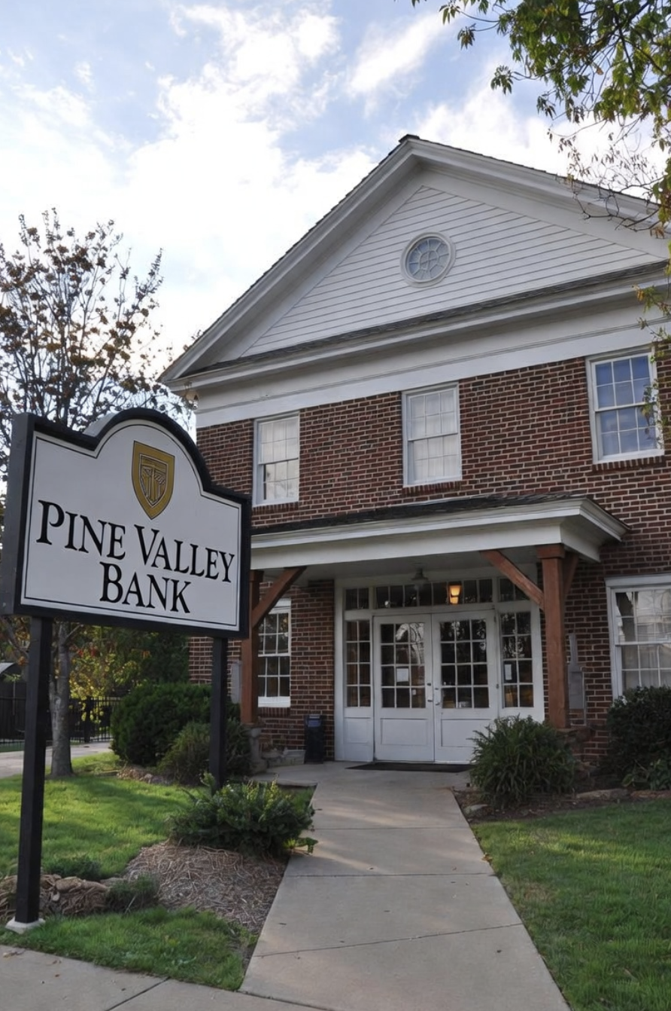
Introducing Pine Valley Bank
We’ll talk about them a lot this week!
$1B community bank in New England
5 branches, 90 employees
15,000 customers
Retail banking, residential mortgages, Small business lending, some small agricultural business

Slide 12

Tom Alvarez
IT manger, Pine Valley Bank
Nice guy, Red Sox fan ☹
Responsible for all IT/network/security
Completely overwhelmed
On call 24/7
Wears 10 hats
Has CompTIA A+ and Microsoft Windows Server certs. Working on Security+.
Outsources everything he can to Northwoods Technology Services
Reports to Cindy Chen, Ops Officer

Slide 13
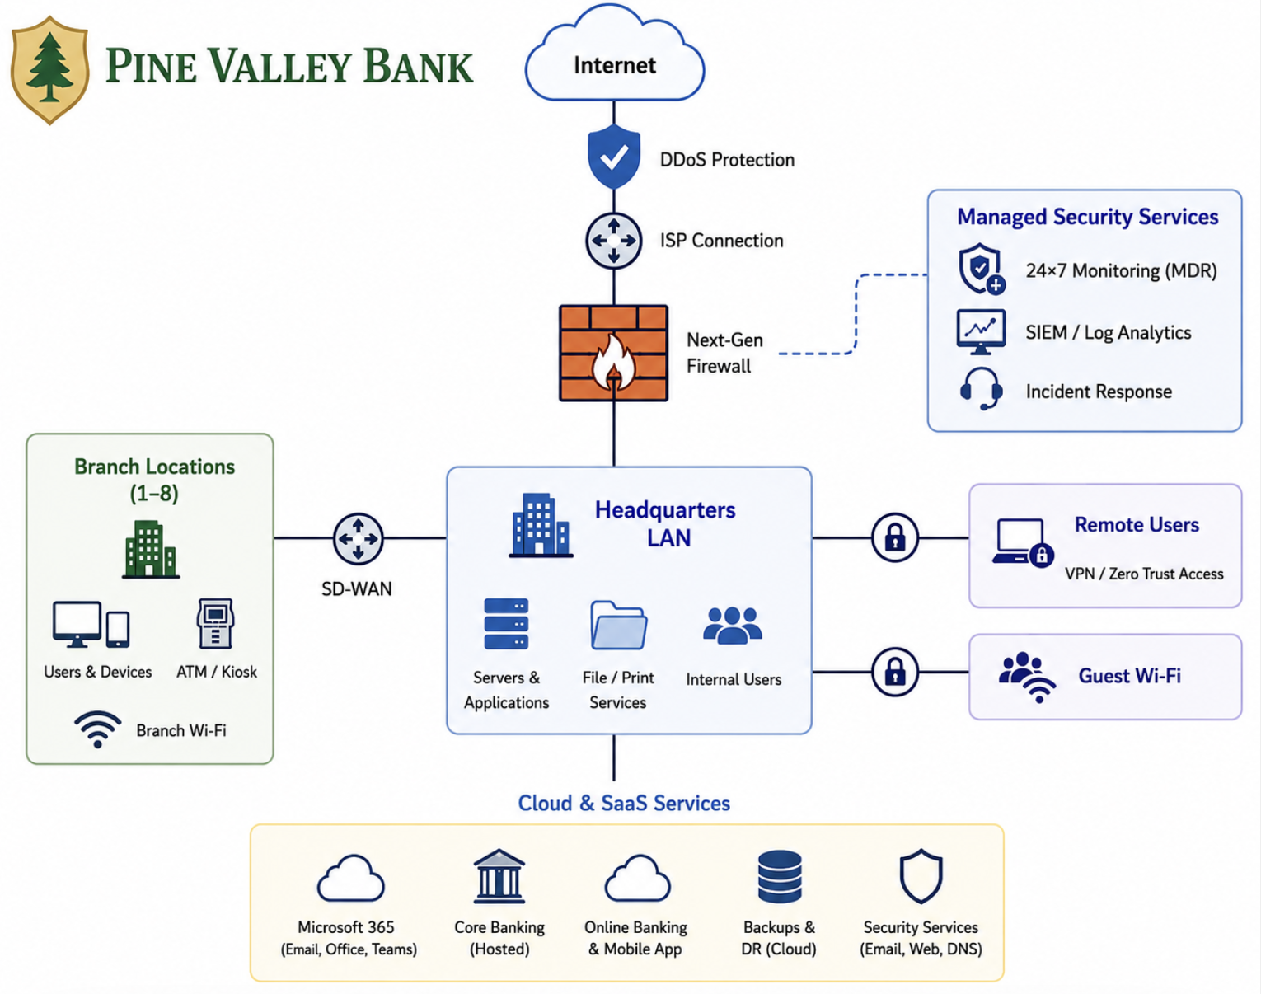
PVB’s Network
What do you see here? What’s new?
Does this seem like a typical bank?
What do you do when you’re given a diagram like this?

Slide 14
Small Bank Operational Components
Who are the players in this game? Let’s draw our own diagram:
Branches
Cloud
Providers
Vendors
Users (remote and local)
ATMs
Internet Banking
What else?

Slide 15
Security is about Managing Risk
In multiple simultaneous layers:
Technology
Policy
People
Firewalls and other tools don’t run themselves
They are subject to poor planning, operations, policies, and skills
Sometimes they have bugs!
We must consider firewalls in the context of these facts
There are more components to this story than just firewalls (hint, hint)

Slide 16
What makes community bank IT different?
Large Bank | Pine Valley Bank | Why It Matters
Hundreds of IT employees | Zero to two IT employees | Individuals wear many hats
Dedicated cybersecurity staff | IT staff share security responsibilities | Generalists rather than specialists
Internal SOC | Monitoring outsourced | Vendor oversight is critical
Dedicated network engineers | One IT manager plus an MSP | Simpler architectures
Many custom applications | Mostly commercial & cloud services | Third-party risk is significant
Large technology budget | Limited resources | Risk-based prioritization
Multiple business units | Relatively simple organization | Fewer organizational layers
Technology is a business function | Technology supports the business | IT is an operational risk
Different does not mean less secure. It means security is achieved differently.

Slide 17
Putting Information Technology in Perspective
The FDIC’s Role
The Bank’s Role
Information Technology Examiner (ITE) and/or Risk Management Examiner (RME) examines the bank
How well did the bank perform its Information Technology tasks?
RME: High-level assessment
ITE: Detailed assessment
Ask important, relevant questions at both levels of detail
Information Technology risk is an operational risk
The bank is responsible for
Information Security
Information Technology Risk Assessment
Information Technology Audit
Business Continuity and Disaster Recovery Planning

Slide 18
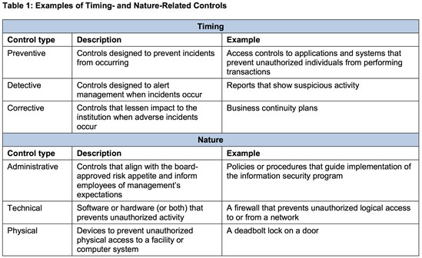
Firewalls as Controls
Firewalls can serve as both timing- and nature-related technical controls
FFIEC suggests a “layered control system” and we have one right here!
Clearly “firewall” means many different things
Notes:
"Important, relevant questions"

Slide 19
What are community banks defending against?
Ransomware remains one of the highest-impact threats.
Credential theft increasingly bypasses traditional perimeter defenses.
Attackers increasingly log in rather than break in
Third-party compromises can directly affect bank operations.
Business email compromise continues to cause financial loss.
AI is changing everything and making
Phishing and social engineering more convincing.
Attacks of many kinds overwhelmingly faster
The speed of attack evolution is its own huge concern

Slide 20
Why Networking Matters
To evaluate a bank's security architecture, you first must understand how information moves through the bank.
Networks connect people, devices, and services.
Every connection creates both business value and risk.
Security begins with understanding those connections.
So that’s where we’re going next

Slide 21
The Journey Ahead

Slide 22
Networking Fundamentals
Chapter 2

Slide 23
Examiner Question
How does information move through the bank, and what should I understand before evaluating its security?
We need to be sure we can:
Understand the components of a bank network.
Follow data from one endpoint to another.
Recognize where security controls operate.
Understand that “firewalls” are only a subset of these
We should also build vocabulary for the rest of the course.

Slide 24
What is a Network?
A surprisingly subtle question, depending on context
For now: Connected devices sharing information on the LAN
teller workstation
printer
ATM
loan officer laptop
cloud application
Later: Everything that bank can connect to across the WAN
Literally everything on the internet

Slide 25
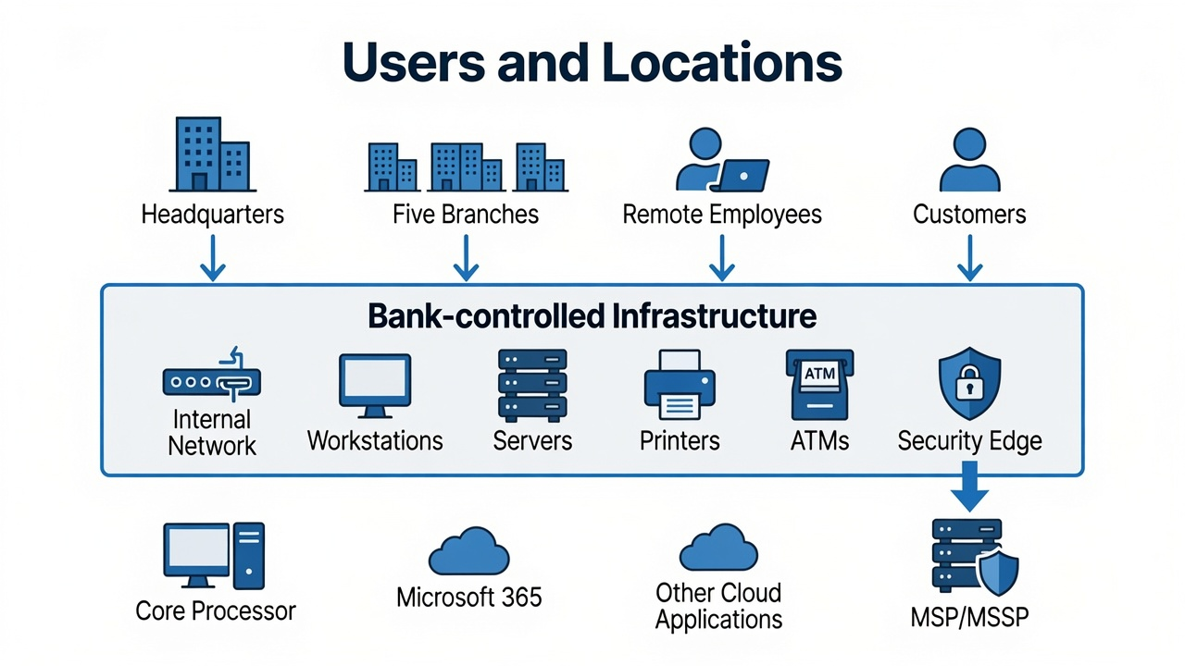
PVB Network Resources
Elements and Locations

Slide 26
Common Network Components
Network Equipment
Switches
Routers
Firewalls
Wireless access points
Endpoints
Clients
Desktops/laptops/phones/tablets
Servers
Devices
Phones
Cameras
IoT thingies
What’s missing here?
What else have you seen in a bank?

Slide 27
Following a Transaction: Teller Balance Inquiry
PINE VALLEY EAST BRANCH
Customer
“What’s my balance?”
Teller
Receives the request
Teller Workstation
Core application client
Response returns
along the same path
Branch Switch
Moves traffic within the branch LAN
↑
encrypted provider connection
Branch Router / Firewall
Forwards traffic outside the branch
PROVIDER NETWORK
Telecommunications Provider Network
WAN / VPN / MPLS transport
CORE PROCESSOR DATA CENTER
Vendor-Hosted Core Processor
Core banking application
Customer Account Database
Account balance found
Every transaction depends on addressing, forwarding, transmission, delivery, and a return path.

Slide 28






LANs, WANs, and others
Do banks have LANs or WANs?
What kind of AN is the internet?
Service
Providers
internet
Private
Network
Branches
HQ/datacenter

Slide 29






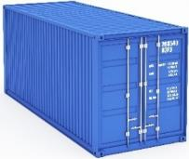






How Internetworks Work—An Analogy
Something to be Shipped
Break it up for Transport
Forward Containers Between Locations
Containers Ride in Various Vehicles
Vehicles Ride over Various Media

Slide 30





Applying the Analogy
Something to be Sent
Something to be Shipped
Break it up for Shipping
Break it up for Sending
Route Containers Between Locations
Forward Packets Across Internetwork
PACKET
PACKET
PACKET
Carry Packets Over Each Network
Containers Ride in Various Vehicles
DOCSIS
Wi-Fi
Ethernet
Vehicles Ride over Various Media
Various Media in Each Network
Coax
Radio
UTP
Fiber

Slide 31
IPv4 Address
32 binary digits (bits) long
Represented in dotted decimal notation (for us humans)
Hierarchical structure
Like your phone number (area code + phone number)
Two parts: Network Identifier (NETID) + Host Identifier (HOSTID)
But unlike a phone number, there is no fixed format. The line between NETID and HOSTID can be anywhere! What to do?
10000000
01000011
00100110
00010111
= 128.67.38.23
NETID
HOSTID

Slide 32
IP Address Assignment with DHCP*
DHCP dynamically assigns addresses from a pool
Assigned with a “lease” for hours or days
Leases are often renewed without any changes
It’s almost like a static assignment in this regard
Built for roaming systems, but in common use for clients everywhere
Servers and routers are not usually DHCP clients
They need to be consistent and easily found
Usually have statically configured addresses.
DHCP often provides additional information:
Local router (so-called “default gateway”)
“Who do I give a packet to if it’s destined for someone not on this network?”
Local DNS server address
“Who do I ask for help changing names to addresses?”
Sometimes OS settings stuff (Windows servers, etc.)
*Dynamic Host Configuration Protocol

Slide 33
Well-Known TCP/UDP Ports
Port identifies application layer protocol
Firewalls can identify if an application is allowed
Port | Protocol | Port Name (Function)
20 | TCP | ftp-data (File Transfer Protocol data channel)
21 | TCP | ftp (File Transfer Protocol control channel)
22 | TCP | ssh (Secure Shell Protocol)
23 | TCP | Telnet
25 | TCP | smtp (Simple Mail Transfer Protocol)
53 | TCP; UDP | domain (Domain Name System information)
69 | UDP | tftp (Trivial File Transfer Protocol)
80 | TCP | http (HyperText Transfer Protocol)
110 | TCP | pop3 (Post Office Protocol)
119 | TCP | nntp (Network News Transfer Protocol)
123 | TCP | ntp (Network Time Protocol)
143 | TCP | imap4 (Internet Message Access Protocol)
161 | TCP | snmp (Simple Network Management Protocol)
443 | TCP | https (HyperText Transfer Protocol Secure)

Slide 34
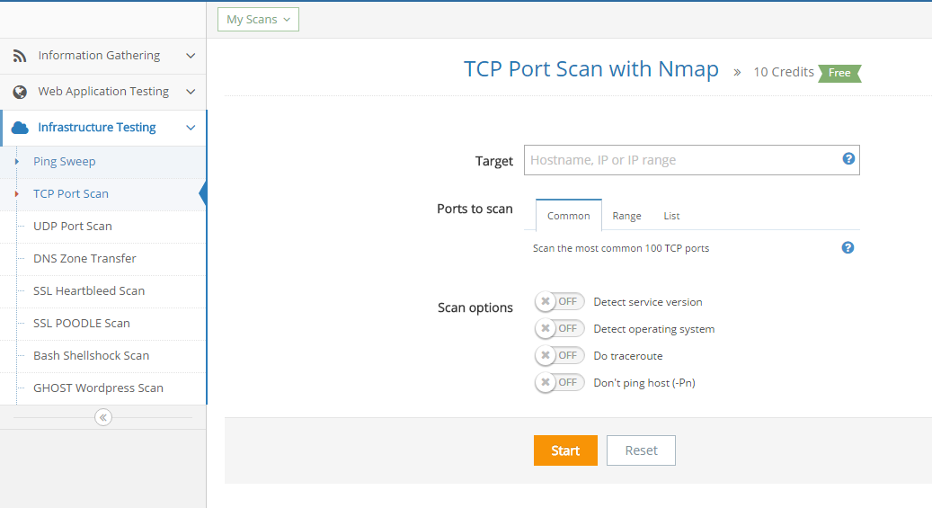

Scanning for Listening Ports
Many tools available for download
Also as an online tool (e.g., pentest-tools.com)

Slide 35


Private Address Space and NAT
There are three address ranges reserved for use by private* networks
Class A (10/8), Class B (172.16/12), and Class C (192.168/16)
These can’t exist (be forwarded to) on the “public” internet
They are nevertheless used for almost every internet client through the magic of Network Address Translation
Internet
123.231.22.11
Bank’s ISP
123.231.0.0/16
192.168.1.1/24
NAT
* meaning “belonging to a single non-provider entity,” not “safe from prying eyes.”

Slide 36
The Internet: A Global, Public, Packet Network
Service
Providers
Internet
Service
Providers
ISP
ISP
ISP
ISP
ISP
ISP
ISP
ISP
ISP
ISP

Slide 37
Encryption in Transit
Remember that IP is connectionless and doesn’t guarantee delivery!
IP needs help to build the reliable internet banks demand
Most encryption happens using Transport Layer Security (TLS)
This used to be called the Secure Sockets Layer (SSL)
Remember CIA triad: Confidentiality, Integrity, Availability
TLS, TCP, and IP work together to fulfil the CIA triad
TCP answers "Did the data arrive?"
TLS answers "Can I trust that data?”
QUIC is a new protocol that’s rapidly replacing the TCP/TLS combo

Slide 38
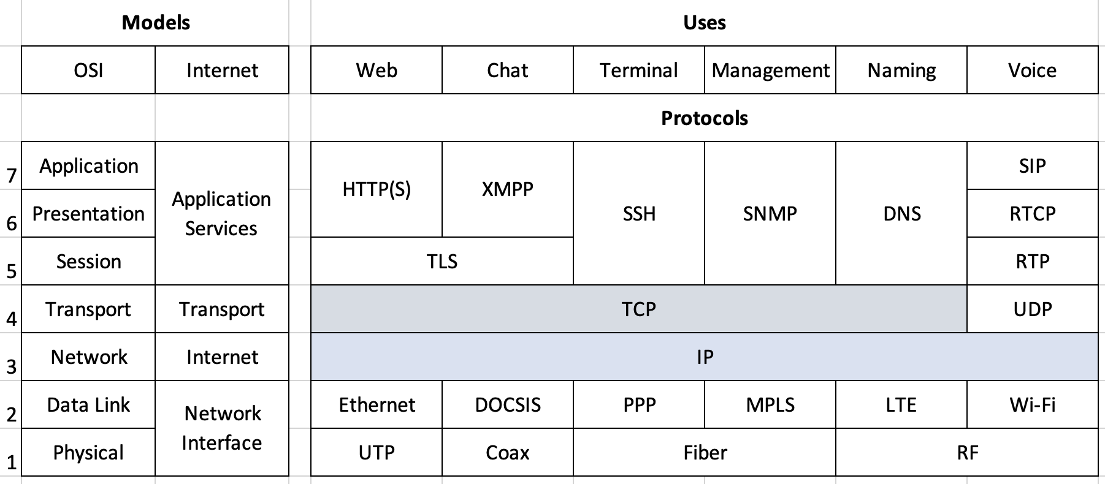
Models and the TCP/IP Protocol Stack
This is a summary view of a very detailed topic. It’s mostly correct but not even close to comprehensive. Quibbles could go on forever!
The framework is what’s important, we’ll give specific details later.

Slide 39
Where do Security Controls Live?
General Security Management
Anti-DoS service
Firewalls (duh)
IDS/IPS
EDR/XDR
SIEM
VPN/ZTNA
MS security
Core Security
General tools
Plenty of others!
It gets messy!

Slide 40
What an Examiner might ask at PVB
Is the network documented?
Is it understood? By whom?
Are critical systems identified?
Are internet connections understood and protected?
What solutions or platforms are in use, and for what?
Who manages the infrastructure?

Slide 41

Summary
Having completed this chapter, you should be able to:
Read and discuss a bank network diagram.
Follow a transaction across a network.
Understand the basic purpose of TCP/IP.
Recognize where common security controls operate.
Ask informed questions during an examination.
But there’s still a lot to learn about security
Firewalls are an important part of that, but
Only one part
That exists in many forms and names
In many places in the network

Slide 42
Firewalls and Security Architecture
Chapter 3

Slide 43
Examiner Question
How does the bank control, inspect, and protect the movement of information within and between networks?
We need to be sure we can:
Know what a firewall is supposed to do
Understand bank network security architecture
Have some idea of how a firewall works
Identify risk related to various security functions
We should also learn some cybersecurity concepts

Slide 44
What can go wrong with the PVB Balance Inquiry?
PINE VALLEY EAST BRANCH
Customer
“What’s my balance?”
Teller
Receives the request
Teller Workstation
Core application client
Response returns
along the same path
Branch Switch
Moves traffic within the branch LAN
↑
encrypted provider connection
Branch Router / Firewall
Forwards traffic outside the branch
PROVIDER NETWORK
Telecommunications Provider Network
WAN / VPN / MPLS transport
CORE PROCESSOR DATA CENTER
Vendor-Hosted Core Processor
Core banking application
Customer Account Database
Account balance found
Every transaction depends on addressing, forwarding, transmission, delivery, and a return path.

Slide 45

What is a Firewall?
Outside (Security Zone 1)
Blocks or permits traffic
based on a set of rules
In the VPN course, we learn how outmoded – yet persistent – this “zone” way of thinking is.
“Outside” no longer means “untrusted” and “inside” is no guarantee of trust.
Inside
(Security Zone 2)

Slide 46

Why Bank Use Firewalls
Provide a network control point
Establish different security zones
Limit access to sensitive data
Meet compliance requirements
Protection from litigation
Gather statistics on network usage
Block unauthorized types of traffic
Limit transfers to known safe locations

Slide 47
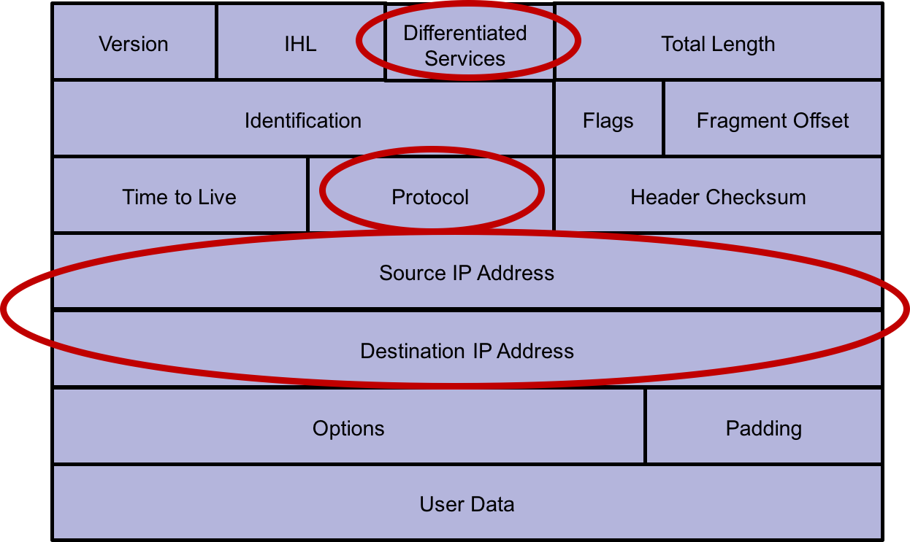
IP Header Filters

Slide 48
Packet Filtering
Basic firewall feature
Usually implemented in the router
Treats each packet independently
Filters based on source and destination addresses (IP and Port)
For example:
filter all outbound private IP addresses

Slide 49
Stateful Inspection
Improves on packet filters
Tracks the state connections for TCP and other protocols
TCP connections can be in three states
Connection establishment
Established
Termination
Connectionless UDP still follows protocol sequence, e.g., a DNS response is always preceded by a DNS query
State table tracks the status/state of connections

Slide 50
Sample Connection State Table
Source Address | Source Port | Destination Address | Destination Port | Connection State
10.0.1.50 | 1024 | 13.107.7.190 | 25 | Established
10.0.1.67 | 1025 | 173.194.207.101 | 80 | Initiated
10.0.1.50 | 1030 | 173.194.207.101 | 80 | Established
10.0.1.100 | 1033 | 173.252.90.132 | 443 | Established

Slide 51
What are Firewall rules?
Used to be:
“Don’t allow connections from outside”
“No TCP to ports other than 80, 443, 22, 25”
Lots of others
Stateful inspection allows much more fine-grained control
Application knowledge even more so
What are some examples of this?
Do you review bank firewall rules?
Should you?

Slide 52
(Web) Application Firewalls
Deeper inspection of the packet
Understands how the protocols should work
Analyzes activity to ensure protocol sequences are normal and any application specific rules are followed
For example:
Multipurpose Internet Mail Extensions (MIME)
Allows for email attachments
Application Firewall rule might exclude .exe attachments
Any such attachment would be blocked at the firewall

Slide 53
Unified Threat Management (or NGFW)

Slide 54
Today one platform (sometimes) does it all
Twenty years ago, firewalls were simple:
Allow or deny connections.
Route packets.
Maybe terminate VPNs.
Everything else was separate devices:
Firewall
VPN concentrator
IDS
IPS
Web filter
Email gateway
Anti-virus gateway
DLP appliance
But now, because:
These functions need the same information
Traffic is usually encrypted
Software ate the world
Banks want simplicity
These devices are integrated into one or a few
This eases admin burden
It also changes what an examiner might ask…
Notes:
Large banks could afford all those separate systems. Community banks generally could not.
Instead of asking
"Do you have IDS?"
ask
"How are intrusion prevention functions provided?"
Instead of
"Where is your VPN appliance?"
ask
"How is remote access terminated?"
Instead of
"Where is web filtering?"
ask
"How do you control users' web access?"
You're examining functions, not boxes.

Slide 55
UTM the New Norm
Integrates multiple security functions
Advanced threat analysis
Policy controls
Applications
Users
Content
Network and endpoint security
Appliance and cloud driven
Next Generation Firewall

Slide 56
Where Firewalls Live
Internet Edge
Internal Segmentation
Branches
Cloud Services

Slide 57
Security is a Multi-layer Problem
Firewalls are commonly the first thought for security
Despite integration, other platforms lead for other functions
This is just one interpretation; there are many potential solutions
Security Function | Often Provided By
Traffic control | Firewall
Secure remote access | Firewall, VPN gateway, ZTNA
Intrusion prevention | Firewall, dedicated IPS, cloud security
Malware detection | Firewall, endpoint software, cloud gateway
Identity verification | Microsoft Entra ID, Okta, Active Directory
Endpoint protection | EDR/XDR platform
Monitoring & logging | SIEM, MDR
Email Security | Microsoft 365, Proofpoint, Mimecast
DNS filtering | Cisco Umbrella, Cloudflare, firewall

Slide 58
What firewalls don’t do
Firewalls play a limited role in addressing:
Many parts of the phishing problem
Only if the phishing target site is known to it
Insider threats
A threat that doesn’t cross a firewall can’t be detected by it
Poor governance
If the patch didn’t get applied, it can’t do its job
Most endpoint compromises
Bugs, zero-day exploits

Slide 59
Zero Trust Network Access
Core principle: never trust, always verify
No implicit trust based on network location, even inside the corporate network
Every access request is authenticated, authorized, and continuously validated
How it differs from firewall-based trust
A firewall trusts by zone: reach the right interface or segment, and traffic is allowed
ZTNA trusts by identity and context, not by which network segment a request comes from
Being "inside the firewall" no longer implies being trusted
Key components
Strong identity verification, typically multi-factor
Device posture checks before granting access
Session-based, continuous authorization rather than one-time login

Slide 60
ZTNA in Practice
Common deployment models
Service-based (cloud broker) ZTNA — vendor-hosted broker mediates every connection
Client-based agent ZTNA — endpoint agent enforces policy before allowing access
Benefits for banks
Shrinks what a compromised zone can reach — no more broad access just for being inside the perimeter
Least-privilege access for remote staff and third-party vendors, enforced per application
Granular, per-session visibility and logging the firewall alone can't provide
What examiners should ask
Where does the bank still rely on firewall zone placement alone as its access control?
How is device posture validated before access is granted?
Are vendor and third-party sessions logged, time-limited, and reviewed?

Slide 61
Managing Firewall Risk
Configuration Management
Rule Management
Monitoring
Maintenance
Governance
What are some examples of these elements of management?
What questions should the examiner ask about them?
Notes:
Configuration Management
Changes follow an approved process.
Firewall rules are documented.
Emergency changes are reviewed afterward.
Examiner asks:
Who can change the firewall, and how are those changes controlled?
Rule Management
Rules are periodically reviewed.
Unused rules are removed.
"Allow Any" rules are minimized and justified.
Examiner asks:
How do you know your rule base is still appropriate?
Monitoring
Logs are collected.
Alerts are reviewed.
Significant events are investigated.
Examiner asks:
Who is watching the firewall after business hours?
Maintenance
Firmware is kept current.
Security updates are applied.
Configuration backups are performed.
Hardware lifecycle is managed.
Examiner asks:
How do you ensure the firewall remains supported and secure?
Governance
Policies define acceptable traffic.
Management approves significant changes.
Responsibilities are clearly assigned (bank vs. MSP).
Examiner asks:
Who is accountable for the firewall?

Slide 62
When someone else manages the firewall
Responsibility
Change control
Provider monitoring
Incident response
Bank oversight
Who manages the firewall day to day?
What responsibilities remain with the bank?
How are changes controlled?
Who approves rule changes?
Is there documentation?
Is there an audit trail?
How is the provider monitored?
Does the bank receive reports?
Are alerts reviewed?
How is performance evaluated?
Who responds to incidents?
Who receives after-hours alerts?
What are the response expectations?
How are responsibilities divided?
How does the bank maintain oversight?
Does management understand the arrangement?
Is the service periodically reviewed?
Is it covered by vendor management?
It’s almost easier to do it yourself!

Slide 63
Firewalls and Security Architecture
Is the network documented? Is it understood? By whom?
Are critical systems identified?
Are internet connections understood and protected?
What solutions or platforms are in use, and for what?
Who manages the infrastructure?
Notes:
Chapter title.

Slide 64
Teller Balance Inquiry: Where are the controls?
PINE VALLEY EAST BRANCH
Customer
“What’s my balance?”
Teller
Receives the request
Teller Workstation
Core application client
Response returns
along the same path
Branch Switch
Moves traffic within the branch LAN
↑
encrypted provider connection
Branch Router / Firewall
Forwards traffic outside the branch
PROVIDER NETWORK
Telecommunications Provider Network
WAN / VPN / MPLS transport
CORE PROCESSOR DATA CENTER
Vendor-Hosted Core Processor
Core banking application
Customer Account Database
Account balance found
Every transaction depends on addressing, forwarding, transmission, delivery, and a return path.

Slide 65
Key Takeaways
Firewalls control communications between security zones.
Today’s firewalls understand much more than addresses and ports.
Many security functions are now integrated into a single platform.
Firewalls are one part of a broader security architecture.
Firewall management depends on governance and technology.
Examiners evaluate whether security functions are effective—not whether particular products are present.
Understand the function. Then ask how the bank accomplishes it.
Notes:
Chapter title.

Slide 66

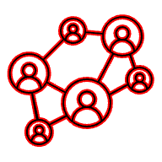



Looking Ahead: Where are the attacks?
PINE VALLEY EAST BRANCH
Customer
“What’s my balance?”
Phishing/Social Engineering
Teller
Receives the request
Malware / Ransomware
Teller Workstation
Core application client
Response returns
along the same path
Branch Switch
Moves traffic within the branch LAN
↑
Network Attack
encrypted provider connection
Branch Router / Firewall
Forwards traffic outside the branch
PROVIDER NETWORK
Telecommunications Provider Network
Interception
WAN / VPN / MPLS transport
CORE PROCESSOR DATA CENTER
3rd-party Compromise
Vendor-Hosted Core Processor
Core banking application
Customer Account Database
Account balance found

Slide 67
Network Vulnerabilities and Attacks
Chapter 4
Notes:
Chapter title.

Slide 68
Examiner Question
What threats should an examiner understand, and what controls should they expect a bank to have?
We need to be sure we can:
Know major categories of threats facing community banks.
Understand principal controls used by banks.
Understand that controls overlap and change over time.
Recognize risk-based thinking.
No security control stops every attack. Good security comes from matching controls to threats.

Slide 69

Thinking Like an Attacker
There are many ways to attack a network resource.
Firewalls can help with some of the problem.
Each type is worth some discussion.
Many attacks combine methods.
Integrity
Confidentiality
Availability
Notes:
Introduce the idea that every attack targets some point along the Pine Valley transaction path.

Slide 70
Remember the Cyber Kill Chain?
Discussed in Introduction to Security
The Lockheed Martin model can be very useful when thinking like a cyber-crook:
Find a target.
Gain access.
Establish persistence.
Move around.
Achieve the objective.
What else?

Slide 71
Attacking People
People are almost always the weakest link
AI has made this almost exponentially more exploitable
Notes:
Show that social engineering and phishing are often the easiest path into a bank.

Slide 72
Attacking Credentials
Credential theft is at least as common brute force
Crooks would much rather waltz in than break in
Notes:
Explain how credential theft and MFA bypass have become more common than direct network intrusion.

Slide 73

Attacking Systems
Malware, ransomware, and exploits target end stations
Systems that aren’t well-secured may be penetrated by:
Automated port-scanning for script attachment.
Automated password or passphrase guessing.
Exploits of well-known openings in legacy systems.
Bad actors in these hacks aren’t always masterminds.
Many tools for this type of hack are available online for use by even beginner hackers, so-called “script kiddies.”
The largest organizations are usually well-protected, but smaller ones are often users of older, even out-dated, technology that’s more susceptible to BFH.
Not all of these attacks are from outside!
Therefore, tight system security management is a primary defense.
Notes:
Introduce malware, ransomware, and software exploits that target endpoints and servers.

Slide 74
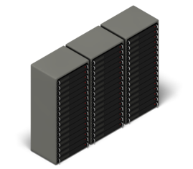
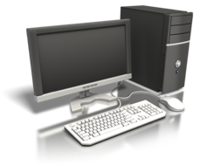
Attacking Communications
Legitimate Session
Something-in-the-middle attacks are most obvious
Notes:
Explain man-in-the-middle attacks and the role of encryption and authentication.

Slide 75
Who Initiates DDoS Attacks
Who | Why
Hackers or “Hacktivists” | Publicize a cause Gain a reputation
Criminals | Extort Cover up another attack Financial gain
Governments | Move a nation’s agenda Politics War Espionage
Businesses | Eliminate the competition Impact market reputation
Notes:
FDIC, OCC, and FRB are no longer examining for reputation risk, and remove in the future.

Slide 76








Botnets
Infect a computer with malware that allows it to be controlled
Do this to hundreds or thousands of computers
Control all of these by a command and control computer (not necessarily your own)
Initiate a coordinated attack on the desired target. I dunno, a bank?
Attack

Slide 77


Example SYN Flood
Exploits the function of a TCP connection 3 way handshake
Normal operation:
Attack operation:
SYN
From real address
Allocate memory etc.
SYN, ACK
ACK
From spoofed address
SYN
Allocate lots and lots memory etc.
SYN
SYN
SYN

Slide 78
DDoS Mitigation Technology Approaches
On Premises
A security device placed as the first device passed through for Internet traffic entering a customer’s location
Scrub traffic clean
ISP Solution
Arrangement with local ISP to “black hole” traffic during a DDoS attack
Relieve impact on other services
Specialist Cloud Provider
A specialty service that takes all of a customer’s traffic and “scrubs” it to remove the DDoS traffic and then forwards only the good traffic to the customer
Scrubs traffic clean
Hybrid
Combines a cloud service with an on premises service
Scrubs traffic clean

Slide 79
Compare Solutions
High
On Prem
+
Cloud
On
Premises
Price
Cloud
Scrubbing
Cloud
CDN
Do
Nothing
Low
Poor
Performance
Excellent

Slide 80
Defense in Depth Revisited
Attack | Primary Controls | Secondary Controls
Phishing | User training, Email security | Sandboxing, DNS filtering
Credential theft | MFA, Conditional Access | Monitoring, User training
Malware | EDR, Patching | NGFW, Application control
MitM | TLS, Certificates | MFA, VPN
DDoS | ISP mitigation, Cloud scrubbing | NGFW, Redundant Internet
Insider misuse | Least privilege | Logging, SIEM
Third-party compromise | Vendor management | Segmentation, Monitoring

Slide 81
What an Examiner Might Look For
Look For | Why It Matters
Multi-factor authentication (MFA) | Reduces credential theft.
Security awareness training | Helps defend against phishing and social engineering.
Patch management | Closes known software vulnerabilities.
Endpoint detection and response (EDR) | Detects malware and ransomware on workstations and servers.
Email security | Filters malicious messages before users see them.
Network monitoring and logging | Detects suspicious activity and supports investigations.
Backups and recovery testing | Limits the impact of ransomware and other destructive events.
DDoS planning | Ensures critical services remain available during attacks.
Vendor management | Third parties often operate critical systems or controls.

Slide 82
Key Takeaways
Remember
✓ Every attack has an objective.
✓ Every attack has a preferred target.
✓ Every attack has one or more countermeasures.
✓ Every countermeasure has limitations.
✓ Banks reduce risk through layers of controls.
Good security is about managing risk—not eliminating it.
Notes:
Attackers exploit people, systems, communications, and availability.
No single security control prevents every attack.
Multiple overlapping controls provide better protection than any one technology.
Every control should mitigate one or more identified threats.
An examiner's job is to determine whether the bank's controls are appropriate for its risks.

Slide 83
Looking Ahead: Limiting the Damage
PINE VALLEY EAST BRANCH
Customer
If one computer is compromised…
“What’s my balance?”
Teller
Receives the request
Teller Workstation
Core application client
Branch Switch
Moves traffic within the branch LAN
encrypted provider connection
Branch Router / Firewall
Then how do we keep the attack from reaching everything else?
Forwards traffic outside the branch
PROVIDER NETWORK
Telecommunications Provider Network
WAN / VPN / MPLS transport
CORE PROCESSOR DATA CENTER
Vendor-Hosted Core Processor
Core banking application
Customer Account Database
Account balance found

Slide 84
Network Segmentation
Chapter 5
Notes:
Chapter title.

Slide 85
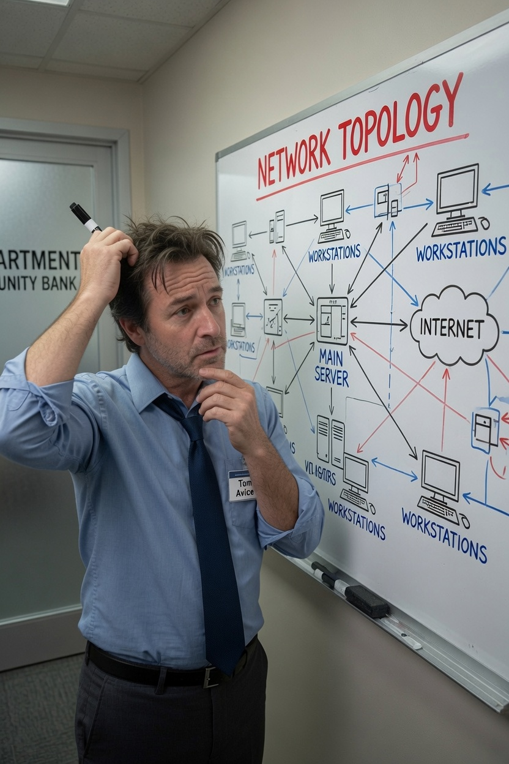
Why Segment a Network?
Tom wonders:
“Do we have to? Our perimeter and FW rules are tight. And we have an IDP!”
But what if:
They get in anyway?
They’re already inside!?
A zero-day on a router hits us?
A legit update is corrupted?
Or the unknown happens
As it always seems to…
Notes:
Introduce segmentation as a way to limit access and reduce the blast radius of attacks.

Slide 86
Examiner Question
Does the bank's network architecture appropriately separate systems with different security requirements?
ATMs
Guest Wi-Fi
Servers
Vendor access
Management networks
User workstations
How does the bank's network architecture limit the spread of an attack?
Notes:
If one system is compromised, what prevents the attacker from reaching everything else?

Slide 87
Security Zones
Group systems with similar trust levels and business functions
Focus on the groups rather than the mechanisms
Internet
Internet Firewall
Public Services
VPN Users
Microsoft 365
Other Cloud Services
Internal Firewall
User PCs
Core Banking
Servers
Management Network
Guest Wi-Fi
Notes:
Explain how banks group systems with similar trust levels and business functions.

Slide 88
VLANs, SSIDs, and Subnets
Banks separate different types of users and devices in order to apply different security policies to each.
These technologies are different, but they often work together to create security boundaries.
Technology | What it Separates | Example at Pine Valley
SSID | Wireless users | Employee Wi-Fi vs. Guest Wi-Fi
VLAN | Layer-2 broadcast domains | Tellers, ATMs, Servers, VoIP
Subnet | IP address ranges | 10.10.10.0/24, 10.10.20.0/24
Notes:
Introduce logical network separation and explain why separate address spaces matter.

Slide 89
Routing and Policy Enforcement
This is the question of traffic between security zones
Segmentation creates boundaries. Policy determines what is allowed to cross them.
In Chapter 3 we learned that a firewall is a policy enforcement point.
Once you've separated systems, you need rules governing which systems are allowed to talk to each other.
Business Requirement | Technical Policy
Tellers need core banking | Allow connections to core banking servers.
Tellers need email | Allow Microsoft 365.
Tellers don't manage firewalls | Deny access to management VLAN.
Guests need Internet | Allow Internet only.
Guests don't need bank systems | Deny internal networks.
Notes:
Show that communication between segments should be deliberate and controlled.

Slide 90
Internal Firewalls
Why would a bank put a firewall between internal networks?
This is the “intranet firewall” use case from the course title
The implementation changes with scale
A $75M bank may use one FortiGate to separate guest Wi-Fi from teller systems.
A $1B bank may use internal firewalls between server networks.
Microsoft 365 uses Conditional Access to segment users based on identity.
Azure uses Network Security Groups and virtual networks.
But the goal doesn’t change
Limit communication to only what is necessary for the business.
Notes:
Explain how firewalls enforce policy between internal security zones, not just at the Internet edge.

Slide 91
What an Examiner Should Ask
Which systems are intentionally separated?
Why are they separated?
Who is allowed to communicate across those boundaries?
How are exceptions approved?
Have segmentation rules changed as the bank's technology has changed?
How are vendor and cloud connections restricted?
We are determining whether the bank's controls are appropriate for the risks it faces.
Notes:
Summarize practical examination questions related to segmentation and internal network design.

Slide 92
Key Takeaways / Looking Ahead
Segmentation limits the impact of successful attacks.
Security policies determine which communications are allowed.
Different technologies can implement the same security objective.
Examiners evaluate whether the bank's architecture appropriately separates systems with different security requirements.
Notes:
Segmentation limits damage after prevention fails and sets the stage for availability and resilience.

Slide 93
Availability & Resilience
Chapter 6
Notes:
Chapter 6

Slide 94

Why Availability Matters
When core banking goes down, Tom gets a visit from Cindy
More importantly, most bank tasks stop
At Pine Valley, availability can mean:
Applications (like core banking)
Internet
Power
Branch
Cloud
Firewall (and other security devices)
What else?
Notes:
Tom gets a call: the bank's primary Internet circuit has failed. Introduce availability as a business problem, not just a technical one.

Slide 95
Examiner Question(s)
Which systems and services are critical to bank operations?
What happens if a critical system fails?
Has the bank implemented reasonable controls to maintain operations?
Notes:
Can the bank continue operating when systems, communications, or providers fail?

Slide 96
Availability in the CIA Triad
The “foundation” of the triad
Availability doesn't mean "Nothing ever breaks."
It means "The bank can continue performing critical business functions."
Customers withdraw cash.
Tellers process deposits.
ACH files are sent.
Wire transfers continue.
Integrity
Confidentiality
Availability
Notes:
Availability means critical banking functions remain available, even during failures or attacks.

Slide 97
Single Points of Failure
X
Having no single points of failure is a great idea, but often impossible
What are the consequences of these failures?
How should a bank plan for such occurrences?
X
X
X
X
X
Notes:
Identify common single points of failure in a community bank and discuss how examiners recognize them.

Slide 98
Building Resilience
What steps can a bank take to build resilient systems?
Redundant Internet
HA firewalls
UPS
Generators
Clustered servers
Cloud redundancy
What do each of these terms mean?
What’s the difference between “highly available” and “redundant”?
Let’s review them and build some vocabulary
Notes:
Modern firewall platforms often provide high availability, multiple WAN links, SD-WAN, VPN, and automatic failover.

Slide 99
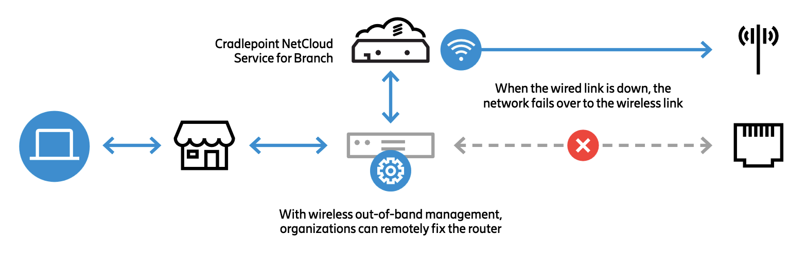
Internet Failover
There is HA, failover, dual-homing, and other approaches
They are all somewhat alike, but have important differences
Remember your OSI model:
Layer 1 – addresses broken links
Layer 2 – addresses carrier access issues
Layer 3 – addresses routing and IP problems
Application redundancy can sometimes help
Device-centric solutions can provide simple solutions
This is Cradlepoint/Ericsson
What do you think of it?
Notes:
Use a Pine Valley example of automatic failover from fiber to 5G/LTE to keep essential banking services operating.

Slide 100
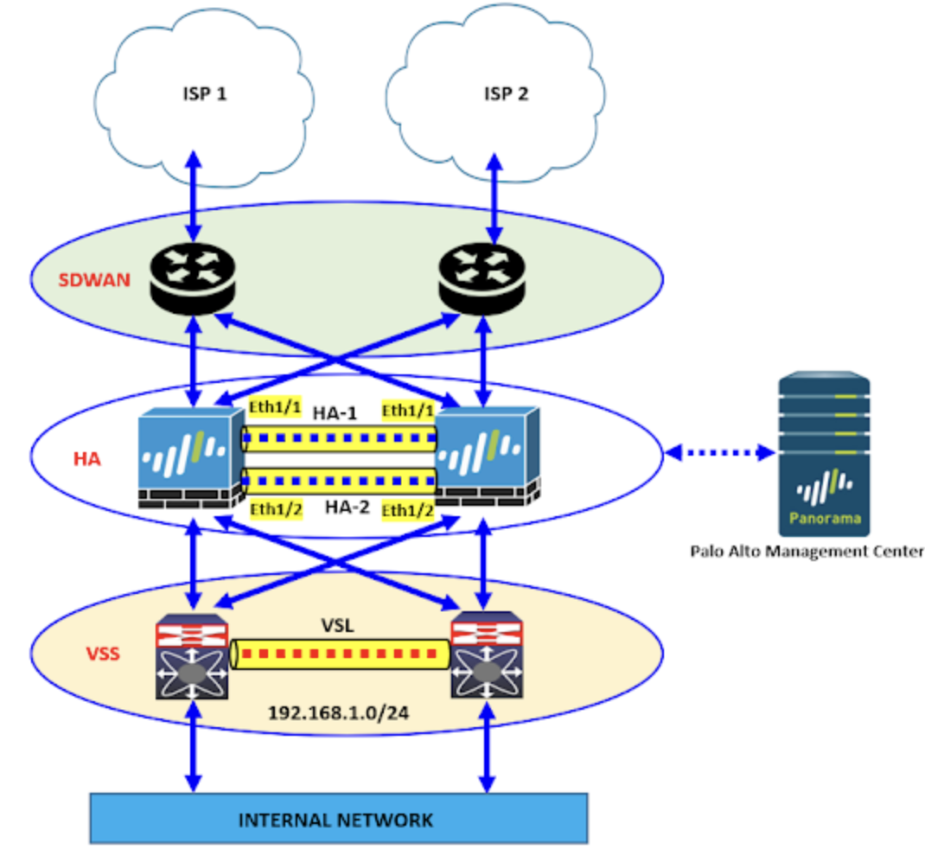
Firewall Availability
High Availability
Deploy two firewalls instead of one
Configuration Synchronization
Security policies
VPN settings
Routing information
User objects
Certificates
Active Session Synchronization
Session synch is hard and expensive
Probably not for the smallest banks

Slide 101
Third-Party Dependencies
Community banks depend heavily on third-party providers.
The bank remains responsible even when services are outsourced.
Do you understand and oversee the dependency?
What processes do you have in place to monitor these?
Availability planning should include vendors, partners, cloud providers, and telecommunications providers.
What critical services does the bank depend on that it does not directly control?
Notes:
Discuss core processors, Microsoft 365, ISPs, and MSPs as dependencies that affect availability.

Slide 102
Business Continuity vs. Disaster Recovery
Business Continuity
Disaster Recovery
Continue serving customers.
Minutes to hours.
Keep the bank operating.
HA firewall configs
VPN redundancy
SD-WAN
Cellular backup
Restore technology.
Hours to days.
Return the bank to normal.
Firewall configuration backups
Rebuilding failed appliances
Restoring VPNs
How do Firewalls relate to each?
Notes:
Differentiate continuing operations from restoring technology after an outage.

Slide 103
What an Examiner might look for
What are the bank's most critical services?
What would interrupt those services?
Which single points of failure remain?
How has the bank reduced those risks?
Has failover or recovery actually been tested?
Are important third-party dependencies understood?
We’re looking for evidence that resilience has been planned, implemented, and tested.
Notes:
Focus on evidence: testing, redundancy, failover, recovery objectives, and provider dependencies.

Slide 104
Key Takeaways / Looking Ahead
Availability is about keeping the bank operating.
Firewalls and edge platforms contribute to resilience as well as security.
Redundancy, failover, and testing reduce operational risk.
Community banks depend on both internal systems and third-party providers.
Next: How does the bank recognize when something is wrong?
Notes:
Availability depends on planning and resilience. Next: How does the bank detect problems when they occur?

Slide 105
Monitoring & Detection
Chapter 7

Slide 106
Examiner Question
How does the bank detect operational and security problems?
There are several components to this:
What are the sources of alarms?
Which events are monitored?
Who reviews any alarms?
Who responds when something unusual occurs?
What evidence determines that monitoring works?
Variants of this question drive the issue of awareness.

Slide 107
A Cycle of Awareness
Firewall
Log
Alert
Tom/NW
Investigation
Resolution
The cybersecurity industry has created many products with overlapping capabilities.
Rather than memorizing acronyms, ask three questions:
What information is collected?
Who reviews it?
What happens when something important is detected?"

Slide 108
Not Every Event Is a Security Incident
Event | Security Issue? | Why?
ISP outage | Maybe | Could be a carrier failure rather than an attack.
Firewall reboot | Maybe | Could be planned maintenance or a hardware fault.
Administrator login at 2 AM | Maybe | Unusual activity deserves investigation.
IPS exploit alert | Probably | Indicates a possible attack attempt.
VPN tunnel down | Depends | May be routine or may indicate a larger problem.
Detection comes before response.
Problems may be operational or security-related.
Good monitoring reduces response time.

Slide 109
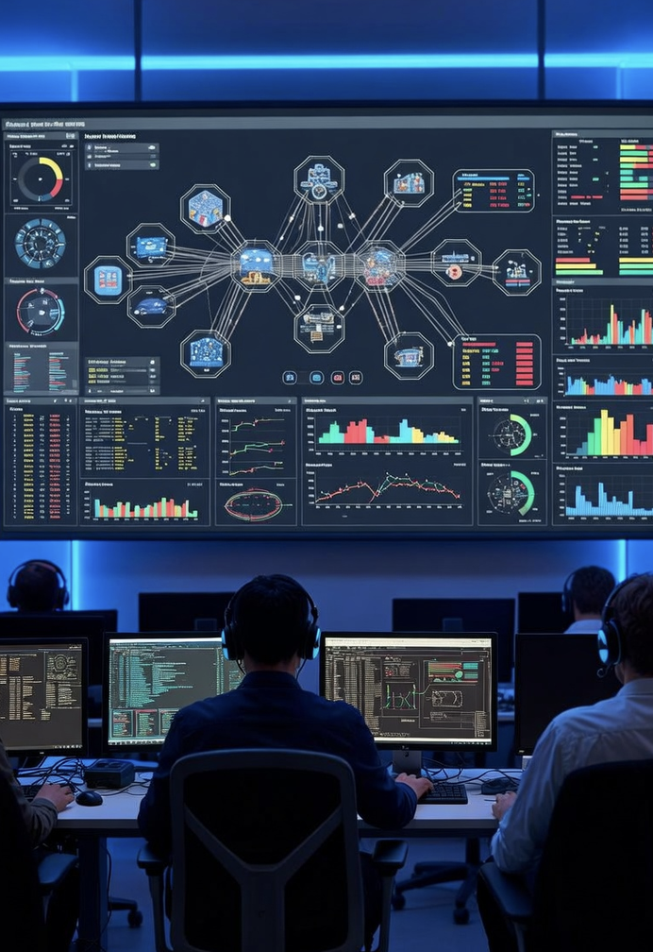
What Should Be Monitored?
Can we monitor everything on the network?
Maybe not, but some seem obvious:
Devices: Firewalls, routers, switches
Connections: VPNs, Internet circuits
Security Events: IPS, malware, scans
Users: Logins, privilege changes
Availability: Interfaces, CPU, storage
What else?
At some point, alerts become overwhelming

Slide 110
Firewall Logs
Firewalls produce both operational information and security information. Both are valuable to an examiner:
Traffic activity – Allowed and denied connections reveal how the firewall is enforcing policy.
Remote access – VPN connections and administrator logins show who is accessing the bank and when.
Configuration changes – Changes to rules or settings may affect security and should be authorized and auditable.
Security events – IPS detections, scans, or other alerts may indicate attacks or suspicious activity.
System health – Interface status, HA failovers, resource utilization, and reboots help identify operational problems.

Slide 111
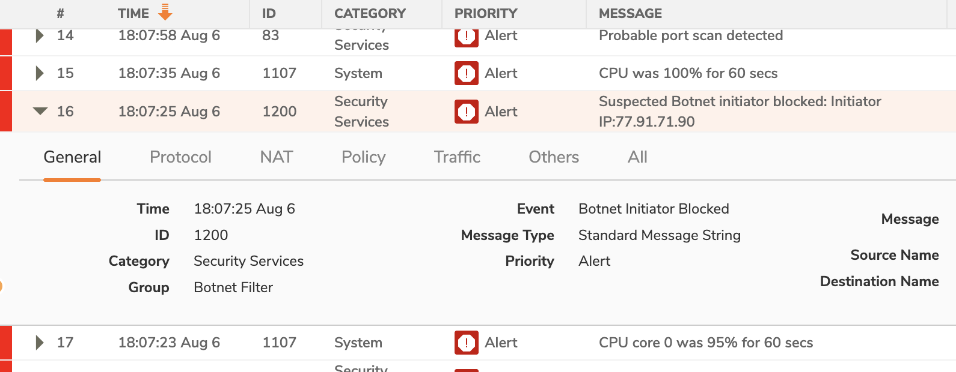
Alerts vs. Logs
Logs are everything that happened.
Alerts are the small subset that someone decided deserved attention.
More specifically:
Logs record activity for analysis, auditing, and troubleshooting.
Alerts identify events that may require investigation.
Good monitoring turns large volumes of logs into a manageable number of meaningful alerts.
Devices have many logs!

Slide 112
Who Watches the Alerts?
Monitoring is a shared responsibility – different concerns for different roles
Internal IT (Tom): Reviews operational issues, manages infrastructure, coordinates response.
Outsourced SOC/MSP: Monitors systems, investigates alerts, provides 24×7 coverage when contracted.
Management (Cindy): Receives significant alerts, makes business decisions, allocates resources.
Board: Receives summary reporting and provides oversight, not real-time monitoring.

Slide 113
Modern Monitoring Platforms
Banks and their partners increasingly use platforms that combine information from many sources to help identify and respond to important events.
SIEM — Collect and correlate logs
EDR — Monitor and protect endpoints
XDR — Correlate across security tools
MDR — Third-party monitoring
SOAR — Automate repetitive response tasks
Alphabet soup here, don’t let it bother you
When someone tells you "We use Microsoft Sentinel." your next question shouldn't be, "Is that SIEM or XDR?"
It should be "What information does it collect, and who reviews it?"

Slide 114
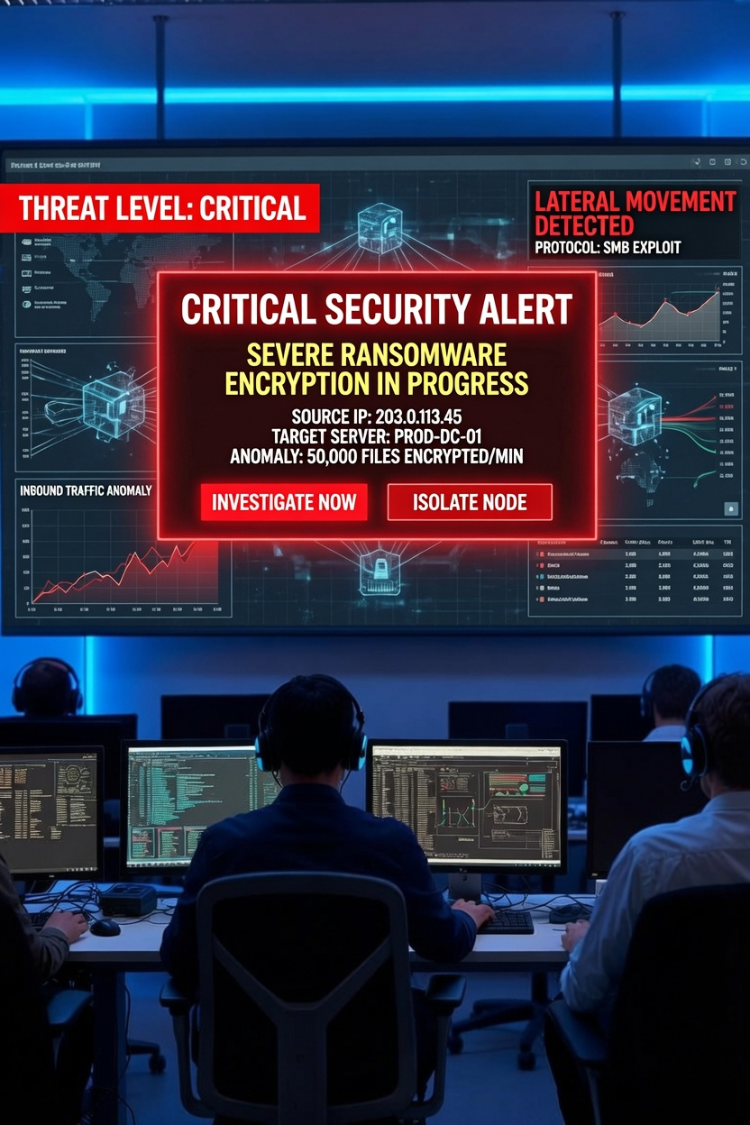
What Makes a Good Alert?
Actionable
You just learned something, what should you do now?
Specific
Details about the threat
Worth investigating
We’ve seen examples of alerts that were just distractions
Hopefully, your bank never sees anything like this!

Slide 115
Key Takeaways / Looking Ahead
Monitoring turns information into action.
Not every event is important—but important events must be recognized and investigated.
Modern firewalls provide valuable operational and security information, but people and processes determine whether that information improves security.
Firewalls don't manage themselves. How are security policies maintained, reviewed, and changed over time?

Slide 116
Administration & Governance
Chapter 8

Slide 117
Examiner Question
Who is responsible for managing security controls?
What’s the difference between administration and governance, anyway?
Doing the work
Making sure the right work is being done, right.
Administration asks: "How is this control operated and maintained?"
Governance asks: "Who decided what is required, who is accountable, and how do we know it's being done?”
The responsibility for each rests with different teams.

Slide 118
Security Is a Process, Not a Project
Security requires ongoing management.
The threat landscape evolves every day
Different motivations, goals, capabilities, methods, tools
Technology changes continuously.
Firewalls have evolved enormously
Firewalls aren’t even just firewalls any more…
Governance keeps controls effective over time.
Some degree of “watching the watchmen”
Also just steering the ship of tech
Must be part of running the business
Seen as opex by some
More enlightened idea is opportunity

Slide 119
Roles & Responsibilities
Board: Oversight
Cindy: Risk management
Tom: Administration
Northwoods: Technical implementation
Audit: Independent review

Slide 120
Security Policies
Define expectations.
Assign responsibilities.
Provide the basis for consistent decisions.

Slide 121
Change Management
Request
Assess
Approve
Verify
Strategy
Consult security strategy
Request
Assess & Review
Approval (or not)
Implementation
Verification & documentation
What triggers the tasks in a change management process?
Events
Periodic
What else?

Slide 122
Firewall Rule Review
Formerly simply looking for open ports
Modern firewall capabilities make this much more subtle
Firewalls exist on many devices, for different reasons
Perimeter firewalls (attempt to) protect everything inside the bank
Device firewalls only address internals
Others might be deployed for specific reasons
Review perimeter firewall rules periodically.
Remove obsolete rules.
Verify business justification for exceptions.
The examiner doesn't need to judge every firewall rule; the examiner needs to determine whether the bank has a credible process for doing so.

Slide 123
Administrative Access Review
Who is allowed to make what changes?
Perhaps the most critical security question of all!
Named accounts
Least privilege
MFA
Administrative activity is logged
Often exists in an “obvious” matter-of-fact zone
But should be reviewed often

Slide 124
Vendor Oversight
Outsourcing does not outsource responsibility.
Define and document:
Expectations
Roles
Escalation
Review reports, changes, and service performance.
How does Cindy know that Northwoods is doing what Pine Valley expects?

Slide 125
Documentation
Network diagrams
Firewall rules
Recovery procedures
Vendor contacts

Slide 126
Governance in Practice
Tom identifies a need
Cindy evaluates risk
Management approves
Northwoods implements
Tom verifies
Board receives summary

Slide 127
Evidence for Examiners
Policies
Change records
Rule reviews
Configuration backups
Audit logs
Testing results

Slide 128
Building a Security Program
Architecture
Firewalls
Monitoring
Administration
Continuous improvement

Slide 129
Key Takeaways / Looking Ahead
Security is managed, not installed.
Governance keeps controls effective.
Next: Board Risk Briefing / Incident Response
Administration operates the controls; governance ensures they remain appropriate and effective.
Examiners look for evidence that both are actually happening.

Slide 130
Incident Response
Chapter 9

Slide 131
Examiner Question
How does the bank recognize and respond to a significant security event?
Furthermore, it may be worth asking:
What makes an event significant?
Who decides when an event becomes an incident?
Who needs to know, and how quickly?
How does the bank know its response will work?
Incident response is literally waiting for an accident to happen
If only every incident were an accident!

Slide 132
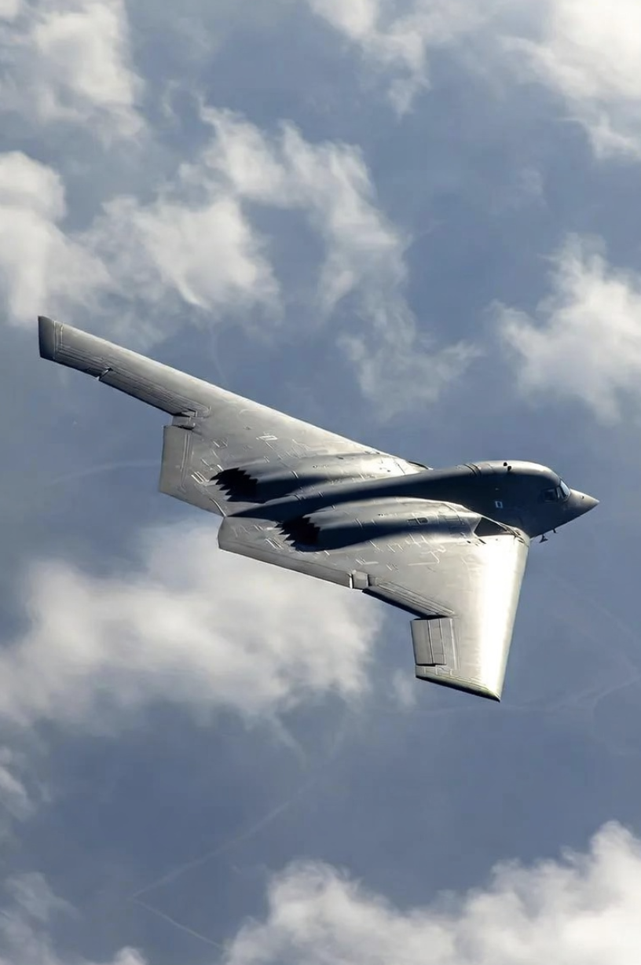
Assume Something Will Get Through
Preventive controls reduce risk; they do not eliminate it.
Modern attacks are stealthy!
Detection, containment, recovery, and learning limit the damage.
A prepared bank makes fewer decisions for the first time during a crisis.
Preparation is everything, even when there are unknowns
Pilots use checklists to handle emergencies and novel situations

Slide 133
What Counts as an Incident?
Security compromise
Malware, ransomware, unauthorized access
Data compromise
Loss, theft, disclosure
Operational disruption
Systems, network, DDoS, critical services
Third-party incident
Provider incident affecting the bank
An incident doesn't have to involve stolen data.

Slide 134
Incident Response Planning
Banks should have a plan that:
Defines what constitutes an incident and how severity is determined
Establishes roles, responsibilities, and decision authority
Defines escalation, communication, and regulatory notification
Documents response and recovery procedures
Include contact information for critical third parties

Slide 135
The Response Lifecycle
Prepare
Detect & analyze
Contain
Eradicate
Recover
Learn & improve
NIST Incident Response

Slide 136
Roles During an Incident
Tom / IT — technical coordination and evidence
Northwoods / providers — investigation, containment, recovery
Cindy / management — business decisions and escalation
Legal, compliance, communications — notification and messaging
Board — oversight and significant-event awareness

Slide 137
The Firewall During an Incident
Modern firewalls have many capabilities, all of which can play different roles during an incident
Detect | Contain | Recover
Logs & Evidence | Block Traffic | Restore Controlled Access
EDR/XDR telemetry | Isolate Segments | Alternate Connectivity
Identify Connections | Emergency Rules | Monitor Restored Traffic

Slide 138
Containment: Stop the Spread
Isolate affected systems or network segments.
Disable compromised accounts and remote access.
Block malicious destinations, addresses, or services.
Preserve enough evidence to understand what happened.

Slide 139
Communication & Escalation
Who declares an incident?
Who must be contacted, and when?
How are executives and the board kept informed?
How are vendors, customers, regulators, law enforcement, or insurers involved?
Regulatory Notice Plan
Material disruption or degradation must be reported in < 36 hours

Slide 140
Third Parties in Incident Response
Know which providers are expected to respond, and their roles
Document contacts, authority, escalation paths, and service expectations.
Coordinate evidence, containment, recovery, and communications.
Test the handoffs before an actual incident.

Slide 141
Recovery Is More Than Turning It Back On
Restore systems and connectivity safely.
Verify that the cause has been addressed.
Monitor closely for recurrence.
Return to normal operations deliberately, not merely quickly.

Slide 142
Testing the Plan
Tabletop exercises test decisions and communication.
Technical tests validate backups, failover, access, and recovery.
Lessons learned should produce documented improvements.
An untested plan is evidence of intent, not evidence of capability.

Slide 143
Evidence for Examiners
Incident response policy and plan
Roles, contacts, and escalation procedures
Exercise and test results
Incident tickets, timelines, and after-action reports
Evidence that findings led to corrective action
Regulatory notification records

Slide 144

Key Takeaways
Prevention will sometimes fail; preparation limits the consequences.
Effective response combines technology, people, decisions, and communication.
The examiner's job is to determine whether the bank can manage cyber risk
Not whether it can eliminate it.

Slide 145
Thus Endeth the Lessons
Congratulations on a completing a big three days!

Slide 146

Thank You!
Matt Kolon
matt@hillvt.com
(802) 899-0704
My main social media is Strava. I’ll follow you back! ☺
The class.hillvt.com site will be up for a couple weeks at least.

Slide 147
Who We Are
At Hill Associates, we excel at creating custom talent development programs. Our experts help identify and assess your needs, and create training and educational programs that exactly meet those needs. Though we specialize in information technology, we’ve strengthened companies and organizations in a wide range of industries for over 30 years. Let us help you create a world-class talent development program that moves your business forward.
Hill Associates, Inc.
PO Box 9
Milton, VT 05468
+1.802.655.0940

