Slide 1


INTRODUCTION
To Telecommunications and Networking
An Instructor-led Course Designed Specifically for FDIC Risk Management Examiners

Slide 2
Chapter 1: Orientation

Slide 3
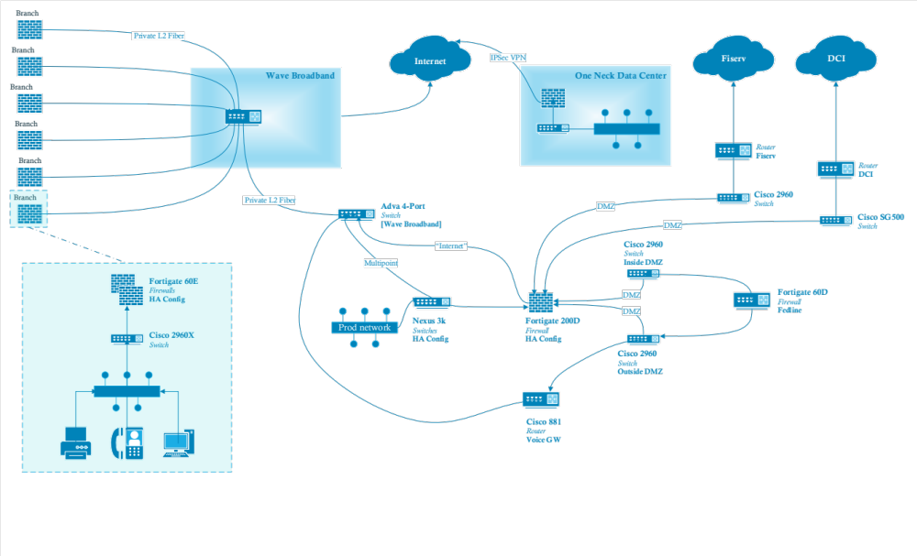
Our Goal for this Week
Is to begin cracking this code
What are all these things? Which of them have I seen before?
  Which do I use myself, and how, and for what?
Why switches, routers, firewalls, modems, and other boxes?
  What do they do, and how do they work?
  What standards govern their behavior and operation?
What’s in the cloud-things, and lines that show connections?
  Are all the connections alike or equivalent?
What is safe and what is not?
Where are the risks? There is always risk!
What questions can I ask to learn about a bank’s network?
  How can I know if my banks are using best practices?
Is the banking industry taking advantage of available value?

Slide 4
An Important Resource
Ideally you have already visited: https://class.hillvt.com/
  and found the page corresponding to our class
  If you have not, please do it now, and bookmark that page
We use this site for file and knowledge sharing
We’ll put various things there for use during class
Nothing there is:
  Required or mandatory, just maybe useful
  Secret or confidential to the FDIC or anyone else
The class page will disappear soon
  We’ll leave it up for a week or so after class, so no real rush, but save what you want to keep.

Slide 5

Classroom Ops
Class runs 8:30-4:30 each day
First ~10 min break around 10, hourly thereafter
Lunch around noon unless we decide otherwise
Please limit distractions and stay tuned in
If you must step away for a bit that’s fine with me
  Check with FDIC class admin regarding significant absences, they determine class credit
Any specific products/services mentioned are meant
as examples, not endorsements
I’ve worked for Juniper, Cisco, and Broadcom in the past, but have no ties to or investments in them now

Slide 6
Introductions
We have 4.5 days together this week, so I’ll go first:
My name is Matt Kolon, I’m a Senior MTS at Hill Associates
  I’m a long-time networking and telecom geek
  I’ve worked for Cisco, Juniper, and Brocade as well as Hill Associates
  From 2005 to 2017 I lived in 香港, 北京, and 東京
  Now I live in Underhill, Vermont where I ski and ride my bikes a lot.
  This week I’d like us to find places where risk is hiding in bank networks!
Telecom and IT are very interesting worlds right now
  2026 is turning into a pretty crazy year!
  Even if you’re not looking at bank topologies as much as in the past
  We will also share some more general networking knowledge

Slide 7

Introductions
Now it’s your turn:
Name and location
Function or position: Risk Management Examiner?
IT Examiner? S&S? ITEA? Something else?
Any experience in cybersecurity topics?
What would you like to learn this week?

Slide 8





Agenda
Monday
The branch
Tuesday
Out of the building
Wednesday
Data center, cloud, vendors
Thursday
Applications and risk
Friday
Putting it together
Orientation
The communications landscape
A short history of financial networking
Designing bank networks
LANs in depth
WANs in depth
Wireless WANs
The internet and applications
IP addresses
IP routing
Transport layer: confidentiality and integrity
Cryptography
Virtualization
Cloud basics and the Big Three
Outsourcing and vendor risk
Managed services and shadow IT
Applications on the network
Core banking
SaaS and business applications
DNS in depth
Voice
Internet of Things
The risk landscape
Looking ahead
Fintech and the changing bank
Course wrap-up
Ends 11:00
Ex 1: Annotate the LAN
Ex 2: Annotate the WAN
Ex 3: Vendor risk tabletop
Ex 4: The lookalike domain
Ex 5: Capstone
Notes:
The week follows one path: from the branch, out over the WAN and the internet, into the data center, the cloud and the vendors, and finally to the applications the bank runs. Friday looks ahead and pulls it together.
Monday, the branch: orientation, the communications landscape, a short history of financial networking, how bank networks are designed, and LANs and Wi-Fi in depth. Exercise 1: tables annotate the LAN segments on a real bank network diagram.
Tuesday, out of the building: WANs and wireless WANs, the internet, IP addressing and routing, and the transport layer, including TLS and certificates. Exercise 2: the same diagrams, now the WAN.
Wednesday, the data center, the cloud and vendors: cryptography, virtualization, cloud basics, outsourcing and vendor risk, and managed services. Exercise 3: a vendor risk tabletop on the diagrams.
Thursday, the applications and the risk landscape: core banking, SaaS, DNS, voice, IoT, and how ransomware, supply chain attacks and incident response play out on a bank network. Exercise 4: a lookalike-domain wire fraud scenario.
Friday (ends 11:00): where networking is headed, quantum and encryption, fintech and M&A, and the capstone, where each table names the three biggest risks on the diagram it has annotated all week.
Point out the diagram thread: the same diagram comes back every day, so by Friday each table has a full picture of one bank.

Slide 9
Things you might sometimes wonder about
Is my phone listening to me?
Why are landline telephones disappearing?
Can crooks steal info from a bank’s Wi-Fi?
What’s the difference between iMessage and This Green Stuff?
Why are core provider connections no longer private lines?
Can wireless internet backup reduce risk for a small bank?
Should banks use VPNs for some things?
When will the cloud replace bank mainframes?
Does a bank need gigabit internet service? Do I?
Everything depends on AWS so it must be solid, right?
Isn’t the internet going to just melt down some day?
No
$
No*
Apple vs Carrier
$
Yes*
Yes*
Probably never
Maybe and No
Uh...
Probably not*
* as long as it’s configured correctly!

Slide 10
Chapter 2:
The Communications Landscape

Slide 11

The Communications Challenge Today
Today’s communications challenge is to create an infrastructure that will deliver information any time, to any place, via any device
Meeting this challenge involves many moving parts and players, and many networks
Constant change is the name of the game
This change occurs in many domains

Slide 12
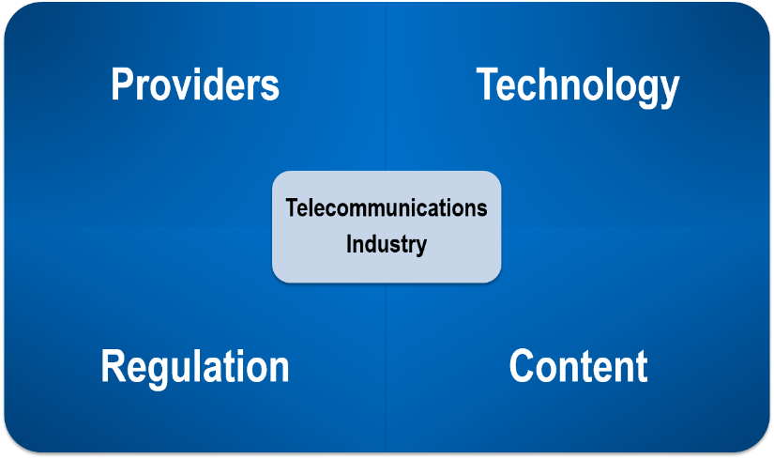
Telecommunications Domains

Slide 13
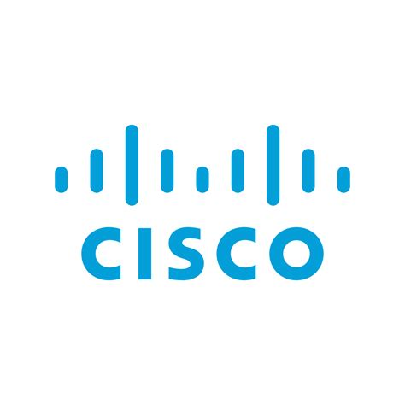







Technology
Innovation has played a critical role in telecommunications and networking
Standards also play a significant role
Together they drive new capabilities and interoperability
Increasingly security is becoming an integral part of new products and services

Slide 14



Regulation
Various forms of regulation exist in telecommunications and networking
Wired and wireless networks in the US fall under federal, state and international jurisdictions, areas covered may include
  Licensing
  Provider interconnection
  Customer support
  Availability
  Reliability
  Technology
  Security

Slide 15

Voice Network Providers
Not too long ago, there was only one: AT&T
Telephone network technology and structure has undergone major shifts every 20–30 years
In the past, technology replacement was based on
economics driving when replacement took place
Last move was to VoIP, drivers included
  Economics
    Data now more important than voice
    Mobility adds convenience
    Demise of the wireline phone
  Regulation
    Reduced need
  Applications
    Integration with conferencing and IM

Slide 16

Data Network Providers
Computer technology has evolved at an unprecedented rate
Businesses first used computers in the 1960s and all communication used private connections of modified voice circuits
Public data networking appeared in the 1970s, but the real change occurred with the commercialization of the internet in the 1990s
Network technology has moved from proprietary
to internet-based, even for private networks
The internet continues to change everything
Wireless access has grown in importance

Slide 17

Video Network Providers
Video networks started with over the air broadcast of television
Over time many households moved to cable pay-tv to get access to more and more diverse content
Technology has moved viewing from live to “when convenient” and from the TV to a wide variety of devices
Increasing drive to internet distribution
  Traditional players trying to figure out their roles
  Content owners exploring new distribution models
  Streaming services fighting for eyeballs
  TVs have had to become smarter
Business video
  Was expensive and required specialized equipment
  Now we have many affordable options on the desktop

Slide 18


Content
Then
Now: the line runs through companies, not between them
Content
Studios, broadcasters, publishers
Carriers bought content
Comcast owns NBCUniversal. AT&T bought Time Warner in 2018, then spun it off in 2022.
Content companies built networks
Netflix puts servers inside ISPs. Google, Meta, Amazon and Microsoft own or co-own many undersea cables.
The cloud sits in the middle
The same few companies host the content, deliver it, and sell the cloud banks run on.
kept apart, partly by regulation
Carriers
Phone, cable and broadcast networks
Most internet traffic is now video, so content lives as close to the user as possible.
The bank is a content provider too.
Its website and app are usually delivered through a CDN such as Akamai or Cloudflare, often its DDoS protection as well.
Notes:
The fourth domain from the Telecommunications Domains slide. The old version of this slide contrasted content (what we watch, read and use) with the providers on the three networks slides that carry it. That clean line is gone.
Left, then: content companies (studios, broadcasters, publishers) made the programs, and carriers (phone companies, cable systems, broadcast networks) delivered them. Regulation helped keep the two apart.
Right, now: the line runs through companies, not between them.
Carriers bought content: Comcast owns NBCUniversal. AT&T bought Time Warner in 2018 and spun it off in 2022, so the combination doesn't always stick.
Content companies built networks: Netflix puts its own caching servers inside ISPs' networks so video travels a short distance. Google, Meta, Amazon and Microsoft own or co-own many of the undersea cables that carry the world's internet traffic; the 'content' companies now run some of the biggest networks there are.
The cloud sits in the middle: the same few companies host the content, deliver it, and sell the cloud services banks run on (Wednesday).
Most internet traffic is now video, which is why content lives as close to the user as possible.
The twist for examiners: the bank is a content provider too. Its website and mobile app are usually delivered through a content delivery network (CDN) such as Akamai or Cloudflare, which is also where the bank's DDoS protection often comes from. We come back to this Thursday with internet and mobile banking.
Deal examples are illustrative and will date; that's fine, the pattern is the point.

Slide 19
Chapter 3: A Short History of Financial Networking

Slide 20
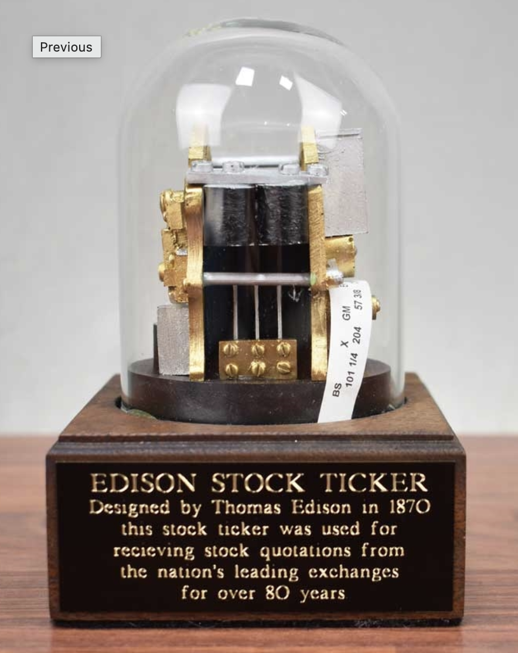
From Ticker Tape to Terabits
The stock ticker (Calahan in 1867, then
Edison’s improvements) sent prices over
telegraph wires.
  Market data was networked a century
  before computers.
Fedwire started in 1918 as a telegraph
network linking the twelve Reserve Banks.
  The Fed’s payment network is older than most
  banks we examine.
Banks sent money by telex authenticated
messages with “test keys” (codes agreed
in advance.)
  Message authentication was a banking problem long before TLS.

Slide 21
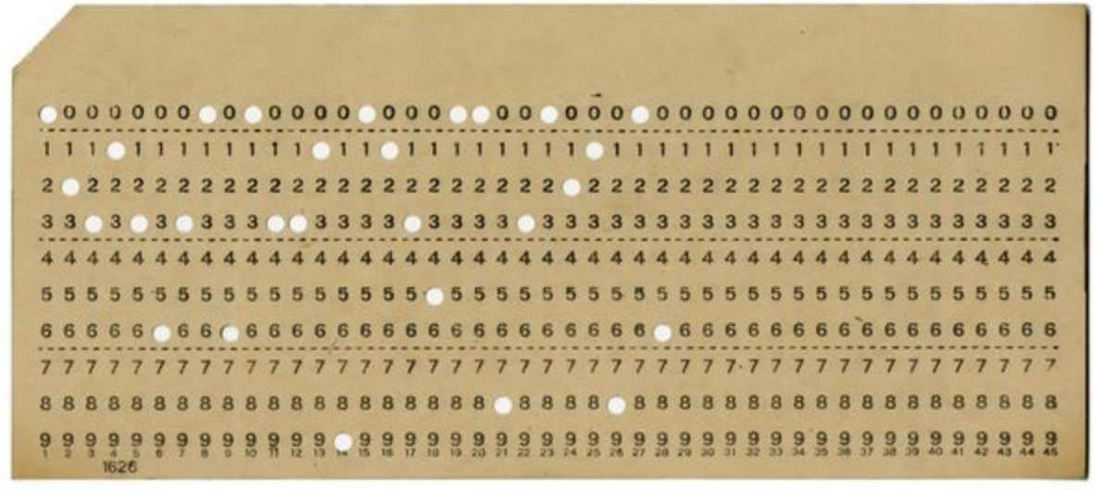
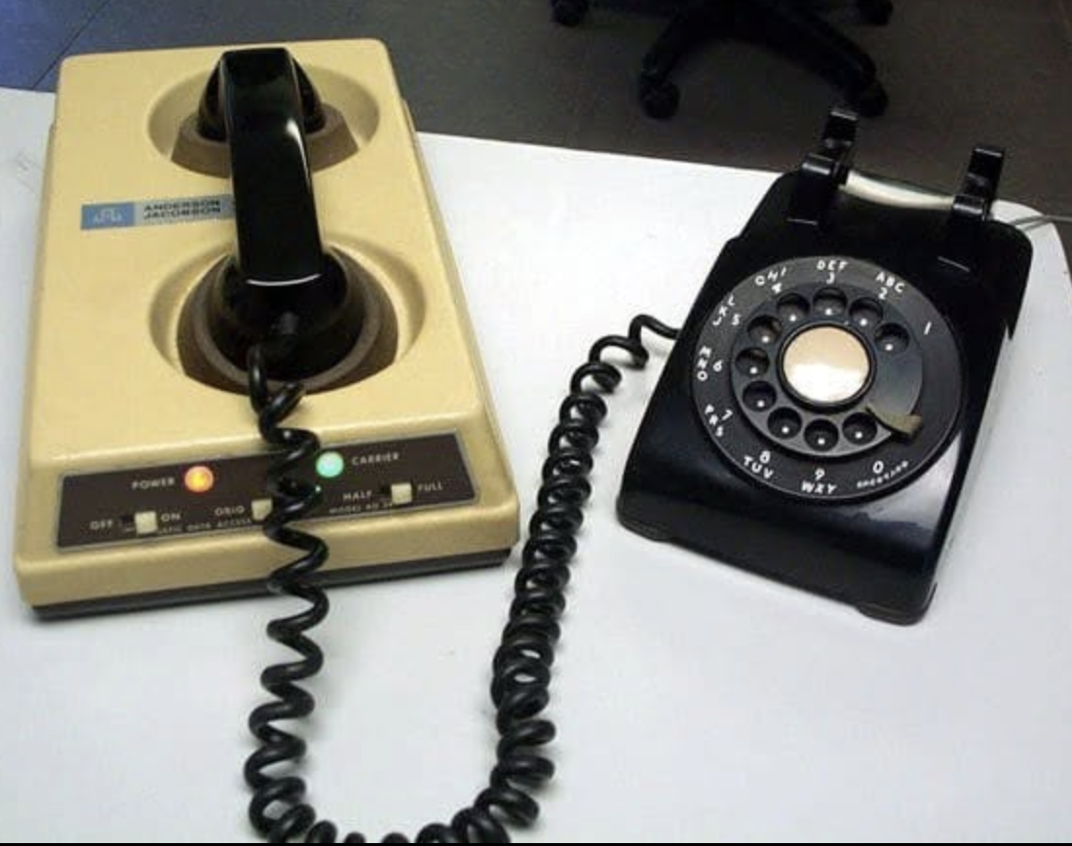
Early Banking Telecom
Bank of America’s ERMA system (Electronic Recording Machine, Accounting) automated check processing. It gave us MICR, the magnetic-ink numbers still printed along the bottom of every check.
Acoustic couplers were 300bps (!) modems to press a telephone handset into, They existed because you couldn’t connect your own equipment to the phone network until the Carterfone decision in 1968.

Slide 22
People Give Way to Machines in Both Industries
Banking: Tellers gave way to ATMs, first at Barclays in 1967 and in the US in 1969, then to mobile deposit.
Networking: Human operators gave way to automatic switches.
Checks: When 9/11 grounded flights, planes carrying checks between clearing centers stopped. That pushed Congress to pass Check 21 in 2003, letting banks clear check images over the network.
Risk changed: When people did the job, the controls were human controls (e.g. dual signatures and a teller who knew the customer.) When a machine or network does it, the controls must be technical.
  This is why we’re here this week!

Slide 23
Chapter 4:
Designing Bank Networks

Slide 24
Branch Office Network
What devices are in the branch, and what does each do?
Do we need LANs, WANs, or what?
How does this differ for different bank offices?
How are they connected to each other and the outside?
How does this differ from another SMB or other business?
Who builds, run, maintains, and secures all this?

Slide 25











A Simple Branch LAN
Internet
Encrypted tunnel to the core
Core processor
Router / firewall
or SD-WAN appliance
Core VPN device
from the core processor
LTE backup
Ethernet switch
VLANs keep teller, ATM, voice, camera and guest traffic apart
Staff Wi-Fi
Guest Wi-Fi
Teller workstations
Printers
IP phones
Branch server
ATM
Cameras
and DVR
Alarm panel
Staff laptops
Customer phones
Ethernet
Wi-Fi
Backup link
VPN tunnel
Notes:
A small, simple branch. One switch connects everything wired; two access points provide Wi-Fi, with guest Wi-Fi kept separate from staff. One router/firewall (or an SD-WAN appliance) connects the branch to the internet, with an LTE backup. The core processor supplies its own VPN device, which builds an encrypted tunnel back to the core.
Questions for the room: Which of these devices does the bank manage, and which does a vendor manage? Which ones can reach the core? What happens to the branch if the firewall fails? Is guest Wi-Fi really separate?

Slide 26
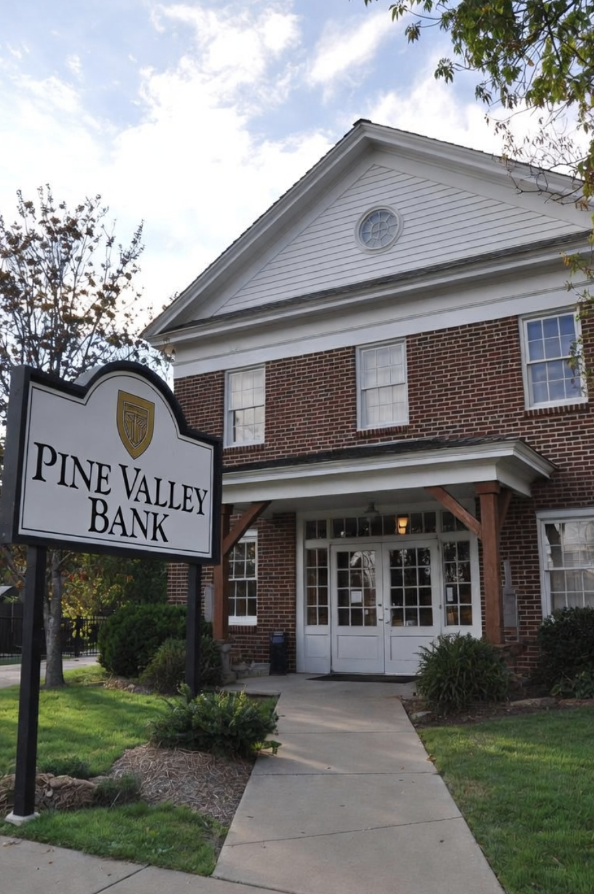
Community Bank Innovation
Small banks are conservative followers, right?
  They better not be, or they will lose!
Many big bank tools are available to all banks
  Big Data
  Hosted core
  Cloud-hosted applications
  Artificial Intelligence / Machine Learning
  Modern tools + personal service
The speed, capacity, security, and capability of all these depend on the network

Slide 27



From Corner Bank to Global Conglomerate
Household
Shop
Core processor
Corner bank
Household
Factory
1 One building: a teller line, a few PCs, and one line out to the core processor
Notes:
1 One building: a teller line, a few PCs, and one line out to the core processor

Slide 28
From Corner Bank to Global Conglomerate
Customers still walk in
Private WAN
Main office
Core processor
Branches
2 A few branches: the WAN appears to tie branches to the main office and the core
Notes:
2 A few branches: the WAN appears to tie branches to the main office and the core

Slide 29


From Corner Bank to Global Conglomerate
Mobile banking
Internet
Firewall
Work from home
Private WAN
Business customers
Datacenter
Core processor
Branches
HQ
Main office
3 Headquarters and a datacenter: an internet connection, a firewall, online banking, remote staff
Notes:
3 Headquarters and a datacenter: an internet connection, a firewall, online banking, remote staff

Slide 30
From Corner Bank to Global Conglomerate
Mobile banking
Internet
Firewall
Work from home
SD-WAN
Business customers
Datacenter
Cloud & SaaS
Hosted core
Branches
HQ
Main office
4 Cloud and SaaS: Microsoft 365, hosted core, and branches that ride the internet
Notes:
4 Cloud and SaaS: Microsoft 365, hosted core, and branches that ride the internet

Slide 31




From Corner Bank to Global Conglomerate
Mobile banking
Internet
Firewall
Work from home
SD-WAN
Business customers
Datacenter
Cloud & SaaS
Hosted core
Card processor
Fed & ACH
Branches
HQ
Main office
Managed security
Fintech partners
5 Vendors and partners: card processing, payments, fintech connections, managed security
Notes:
5 Vendors and partners: card processing, payments, fintech connections, managed security

Slide 32
From Corner Bank to Global Conglomerate
International offices
Internet
SD-WAN
Branches
Datacenters
Cloud & SaaS
HQ
Acquired bank
Hosted core
Multi-cloud
6 Regional, then multinational: hundreds of branches, an acquired bank, many clouds, international links
Notes:
6 Regional, then multinational: hundreds of branches, an acquired bank, many clouds, international links

Slide 33
Current Themes: Bank Network Evolution
What changed | What it did to the network
The internet replaced private circuits Leased lines and MPLS gave way to broadband, SD-WAN and cellular backup | Cheaper and more resilient, but the bank now rides the public internet, and security has to live at every site
Staff work from anywhere Home offices, laptops and phones | Remote access went from an exception to the norm (maybe)
Payments went real-time FedNow, RTP and same-day ACH | No overnight batch to catch up in; an outage is felt by customers immediately
Systems moved out of the building Core, email and files went to vendors and the cloud | The connection out of the branch became the lifeline; no connection means no business
Fewer IT people, more vendors Managed service and security providers | Outsiders run parts of the network, so trust and oversight become the issue
Customers went digital Online and mobile banking | The bank's front door is now an app, often hosted by a vendor, and expected to be up all the time
Notes:
Day mapping (not on the slide): internet replacing private circuits, remote work and real-time payments are Tuesday; systems moving out of the building and the shift to vendors are Wednesday; customers going digital is Thursday.
Takeaway: the network used to support the bank. Now it is the bank.

Slide 34
Branch Transformation: Fewer, Smaller, Self-Service
Before: the traditional branch
Router / firewall
or SD-WAN appliance
Core VPN device
from the core processor
Internet
Core processor
LTE backup
Ethernet switch
Every device in the branch plugs in here
Staff Wi-Fi
Guest Wi-Fi
Teller line
Printers
Desk phones
Branch server
ATM
Cameras
and DVR
Alarm panel
Staff laptops
Customer phones
Ethernet
Wi-Fi
Backup link
Encrypted tunnel
Notes:
The traditional branch: a teller line of full workstations, a local server, desk phones, an ATM, and a router/firewall. The core processor supplies its own VPN device. Most of the work happens inside the building.

Slide 35


Branch Transformation: Fewer, Smaller, Self-Service
After: the transformed branch
SD-WAN appliance
managed remotely
Cloud & SaaS
Internet
two providers
Hosted core
5G / LTE backup
Ethernet switch
Fewer devices, and most of them depend on the connection out
Staff Wi-Fi
Guest Wi-Fi
Thin client
Receipt printer
Video teller
live remote teller
Teller Cash
recycler
Cameras
cloud-recorded
Alarm panel
Banker tablets
Customer phones
Ethernet
Wi-Fi
Backup link
Encrypted tunnel
Notes:
What changed:
- FEWER people: one thin client replaces the teller line; desk phones are gone (calls run on laptops and tablets).
- SMALLER: the branch server is gone. Core, files and apps live in the hosted core and the cloud, reached through encrypted tunnels from the SD-WAN appliance, which is managed remotely.
- SELF-SERVICE: a video teller machine replaces the ATM and streams live video to a remote teller; a cash recycler sits in the teller area; universal bankers use tablets on Wi-Fi.
- Two internet providers plus cellular backup, because nothing works if the branch is offline.
Questions for the room: What still works here if both internet links fail? Who manages the SD-WAN appliance and the video teller, and from where? Where is customer data now?

Slide 36
Chapter 5: LANs in Depth

Slide 37
Ethernet
Ethernet is the wired LAN technology of choice
Standards created by the IEEE 802.3 Committee
Equivalent to the Physical and Data Link Layers of the OSI model and the Network Interface in the Internet Protocol Suite
A variety of Physical Layer options meet a wide variety of application needs
  Twisted pair
  Optical fiber
  Coaxial cable (almost extinct for Ethernet now)

Slide 38
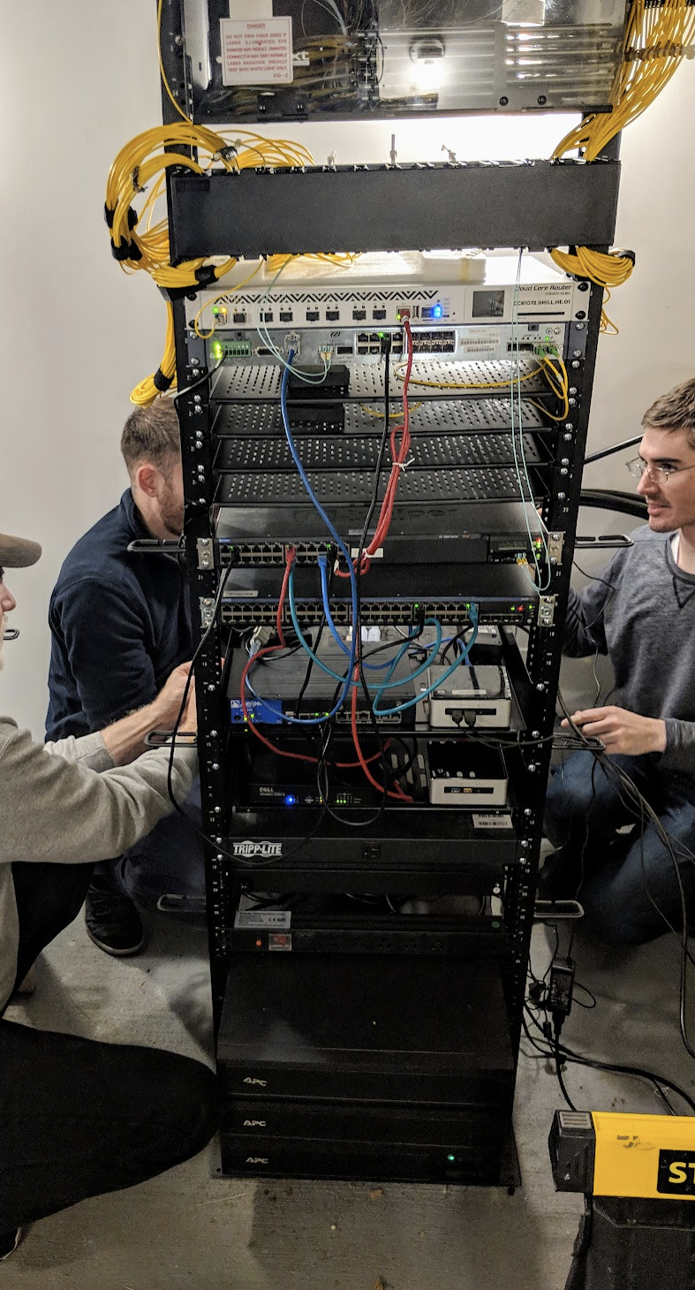
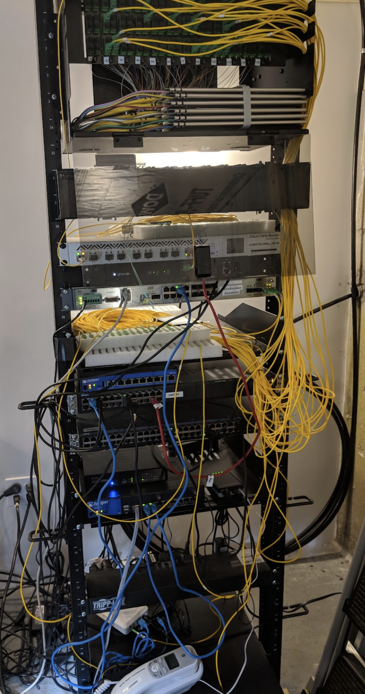
(un) Structured Cabling
Which cabling job is better?
What might the cabling say about the IT team?
What do you see in the average community bank?

Slide 39
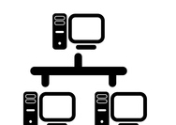


Ethernet Evolution
Ethernet LAN
Invented
IEEE 802.3 LAN
Standards
MEF WAN
Standards
1973
1980
2001
1973 to early 1980s
1980s
1990s to present day
Hub
Switch

Slide 40
Some Popular Ethernet Physical Layers
Standard | Length | Cable
10BASE-T | 100 m | Cat 3, 4, 5 UTP
100BASE-TX | 100 m | Cat 5 UTP
1000BASE-SX | 2000 m | MMF
1000BASE-LX | 3000 m | SMF
1000BASE-T | 100 m | Cat 5e, 6, 7 UTP

Slide 41
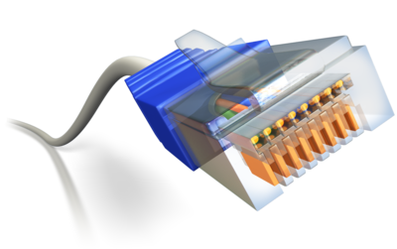
Typical Ethernet LAN
Most devices use a standard Ethernet chipset and use twisted pair connections
Autosensing selects speeds 100, 1000 Mbps
Connections go from the desk to a patch panel or switch
  Allows different speeds on its ports
  Provides the ability to have older devices in the same LAN as newer ones, such an old laser printer that only supports 100 Mbps
Switches can be interconnected
  Twisted pair if close and on the same floor
  Optical fiber used when further apart or on different floors

Slide 42
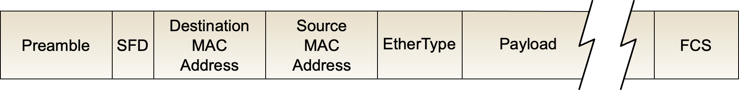
Ethernet Frame
Ethernet LANs allow any device on the LAN to talk to any other device on the LAN (any-to-any)
Addresses are needed to identify who the information is for
Ethernet frames include an address (referred to as the MAC address)
MAC address is assigned by device manufacturer

Slide 43
Multiple LAN Configuration
Allows traffic segmentation, for example data and voice
Simplest way to create multiple LANs (networks) is to have separate physical networks, requires
  Multiple cable drops to the desk
  Switches for each LAN
  Separate inter-switch (trunk) connections for each LAN
Note each LAN (network) will have its own block of IP addresses assigned to it, more on this later
What if we could use one infrastructure and create multiple logical LANs to create separate segments?

Slide 44


Virtual LANs (VLANs)
VLAN 1
Personnel
VLAN 2
Engineering
Switch
From B ⇒ All
From B ⇒ All
From B ⇒ All
From B ⇒ All
From B ⇒ All
From B ⇒ All
From B ⇒ All
From B ⇒ All
From B ⇒ All
A
From B ⇒ All
B
C
D
E
F
G
H
From B ⇒ E
From B ⇒ E
From B ⇒ All
Separates End Systems

Slide 45
VLANs
Logically creates multiple LANs within a switch
Tags used between switches to identify which LAN the frame belongs to
Configured on the switches
Change requires software update versus physical connection change for separate switches
Centralizes switch management

Slide 46
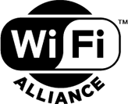
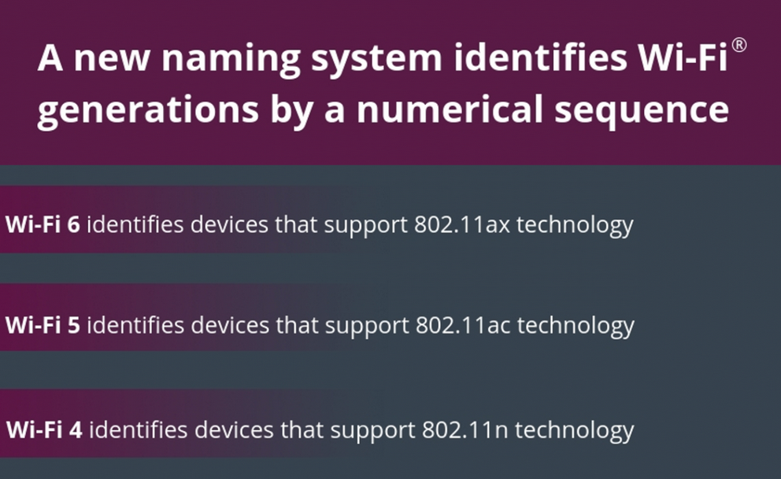
Wi-Fi
As ubiquitous as Ethernet in the LAN now
Part of IEEE 802.x family of LAN standards
802.11 is the IEEE name, but we just say Wi-Fi
The Wi-Fi Alliance is helping keep things simple
Theoretical speeds run to multi-gigabits, but the reality is usually slower
Huge variations in experience and
management between vendors
Ethernet frame with Wi-Fi extras

Slide 47
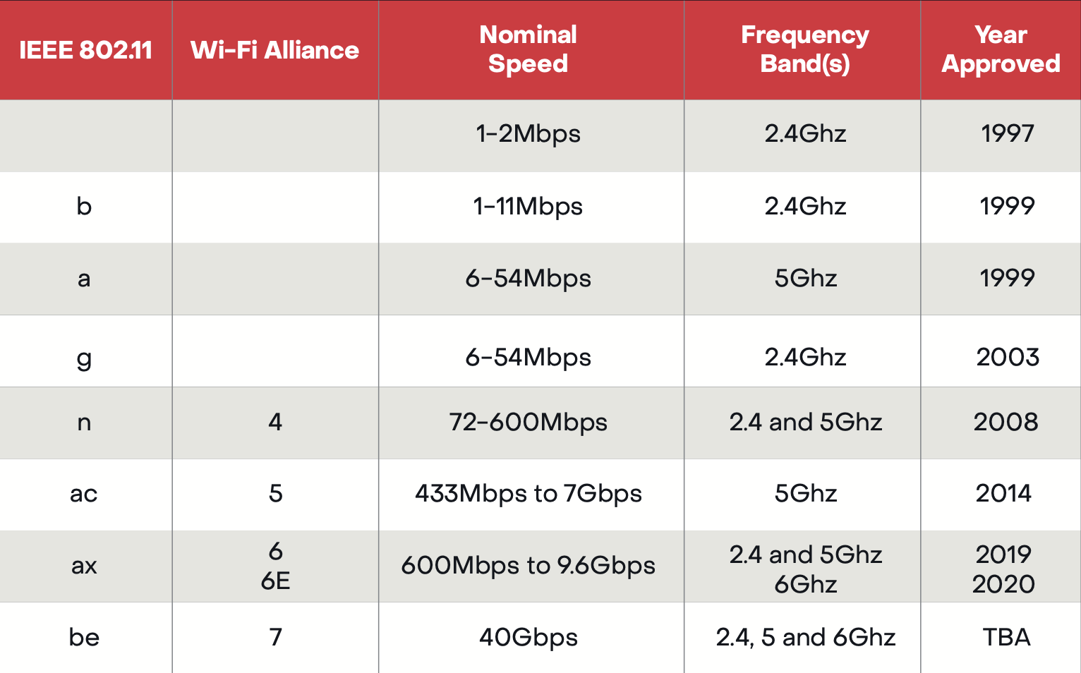
Wi-Fi Standards

Slide 48
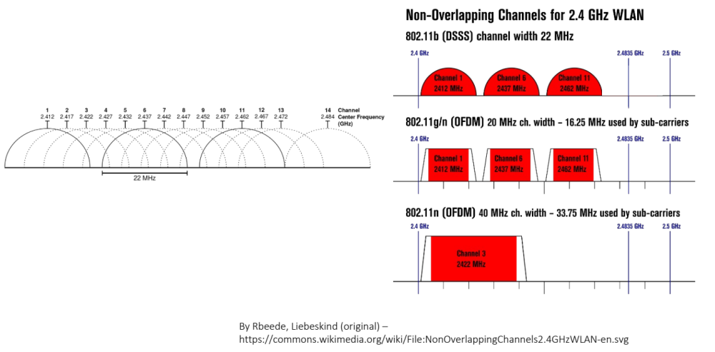
Bands and Channels - 2.4 Ghz

Slide 49
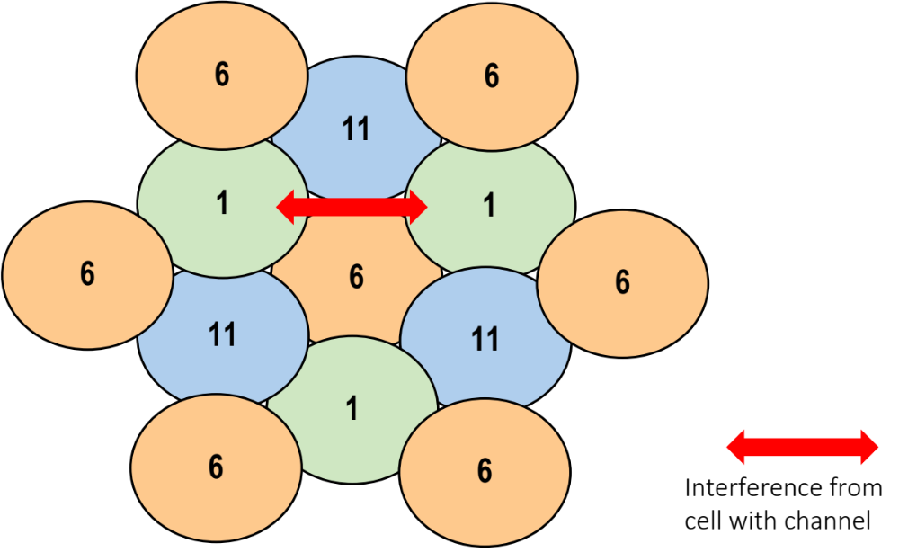
2.4 GHz Channel Reuse

Slide 50
Service Set Identifier (SSID)
Sometimes referred to as a network name in Wi-Fi
Clients connect to a specific SSID
Multiple SSIDs may exist in Wi-Fi channel
  Used to create multiple logical networks
    FDIC CU and FDIC Guest being good examples
AP broadcasts name so devices can join
Like VLAN concept with client required to join
Sometimes an SSID may not be broadcast to hide the network
  This is almost always a bad idea and adds no security

Slide 51

802.11 Security Issues
Unbounded nature of the medium
  Need for encryption and authentication
Original goal to be “equivalent” to wired LAN
  Service set identifiers (broadcast by access point)
  Wired equivalent privacy (WEP)
    Turned off by default
    No user authentication (MAC address only)
WEP problems
  64-bit RC4 encryption
    24-bit known initialization vector (IV) plus 40-bit secret key
    RC4 itself considered relatively weak
  No key distribution system
    All nodes share same key
  No longer supported

Slide 52
Wi-Fi Protected Access (WPA3)
Ratified by Wi-Fi Alliance January 2018 as a replacement for WPA2
Based on a subset of IEEE 802.11i
Designed for use with an IEEE 802.1X authentication server
Different 192-bit key distribution to each user
Temporal Key Integrity Protocol (TKIP)
  Dynamically changes keys as the system is used
Improved payload integrity
Stronger, safer
Many APs still support WPA2 along with WPA3

Slide 53
Now We Have LANs
LANs provide links between devices within a network
What makes the network a network?
  Common link
  Assigned block of network addresses (IP)
Connecting to devices (applications) outside of the network needs a gateway (router) between networks
Connections within the same network need a way to identify the LAN address of the destination
IP and associated protocols create networks and ways to interconnect them

Slide 54
Exercise 1: Annotate the LAN Segments
Your table will receive a bank network diagram
Annotate your diagram thus:
  Circle each LAN in green
  Trace Ethernets in blue
  Mark Wi-Fi with a blue X
  All network exits get a red box
  Question marks for anything weird
We’re not trying to be perfect, we’re trying to give us something to think and talk about.

Slide 55
InTREx Tie-In: Wireless Networks
Information Technology Profile · Network
“
4. Does the institution have a wireless network? Check all that apply.
Appropriately segment guest wireless networks from the internal network and accurately depict on the network topology diagram.
No
Stand-alone guest network
InTREx expanded analysis: guest wireless networks
Production internal network
Did your diagram show it?
Where question 4 leads
Network architecture
Segmentation, with wireless named, and documentation of the network topology
Security monitoring
Whether wireless configuration and monitoring are appropriate
Encryption
Baseline: strong encryption for Wi-Fi authentication and transmission
Wireless expanded analysis
Management approval, minimum standards, periodic testing, guest-network controls
Source: InTREx Information Technology Profile and Support & Delivery modules (September 2023 version)
Notes:
Follows Exercise 1. Question 4 is the first thing an examiner learns about a bank's Wi-Fi, and the bank answers it before the exam starts.
Debrief: the expanded wireless procedures say guest Wi-Fi should be segmented from the internal network AND accurately shown on the network topology diagram. Ask each table: did your diagram show the guest Wi-Fi? Could you tell it was separate?
The bottom row is a map, not a lesson: question 4 is a doorway into the Network Architecture, Security Monitoring and Encryption procedures, and into the wireless expanded analysis when the bank has Wi-Fi. Procedure numbers are from the September 2023 version; verify against the current version.

Slide 56
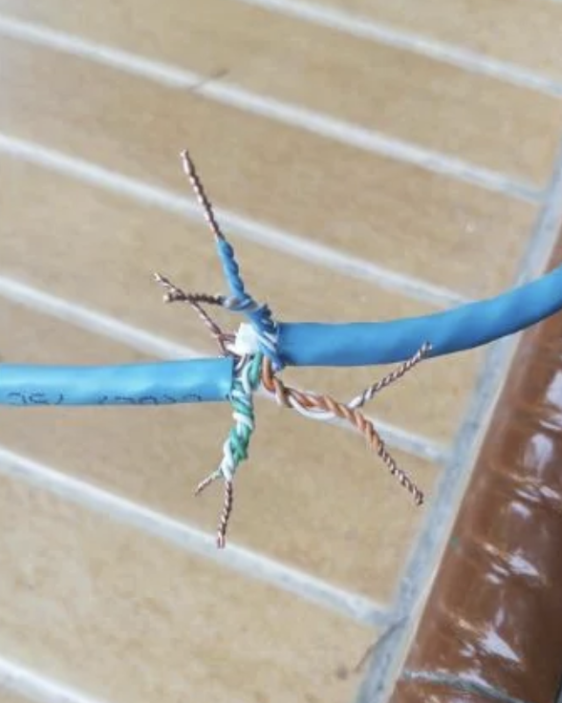
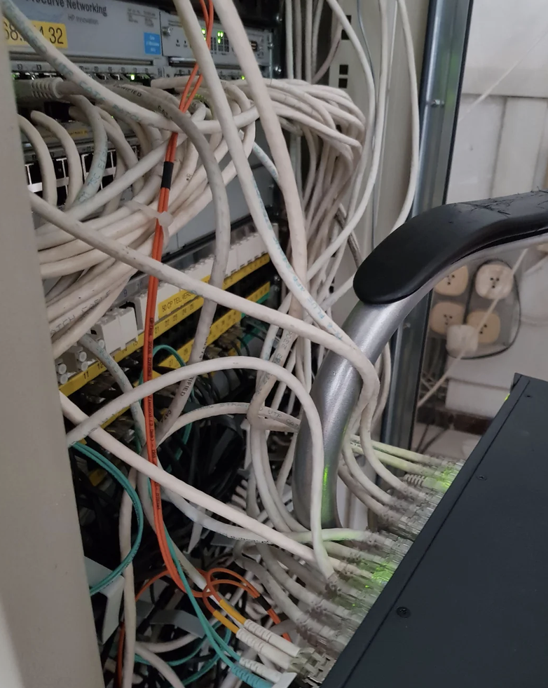
What Could Go Wrong on a LAN?
Anyone who plugs in is “in”
Networks are often flat and undivided
IoT means lots of potential unknown devices
Weak Wi-Fi security, passwords, encryption
Single points of failure that are hard to find
What do you see on your Ex 1 diagram that fits?
There are good controls available for most of this
Question is, have they been applied?

Slide 57
Chapter 9: WANs in Depth

Slide 58
Bank Branch Connection
Branches need to access applications
  Internal applications at the datacenter
  Core applications at a service provider
  Cloud applications at a cloud datacenter
Common network architecture uses private network connection to the internal datacenter for all traffic
We have a variety of options for the connection
  Private Line
  MPLS
  Carrier Ethernet
  VPN

Slide 59
Private Lines
Dedicated physical connection or bandwidth between sites or as access to carrier service
Old school technology, such as T1, were originally designed for the public voice network
Most private connections today are optical fiber Ethernet connections to other services
  MPLS
  Carrier Ethernet
Carriers are investing heavily in expanding their fiber footprint
Private wireless networks are an option in come cases

Slide 60
Ethernet Access
Ethernet has expanded from the LAN to the WAN
Optical fiber is the medium of choice
Dedicated fibers frequently used for business services
  MPLS
  Carrier Ethernet
  Internet access
Shared access offers lower cost option based on Passive Optical Networking (PON) technology
  Originally used for home services
  Cost effective approach for business internet access

Slide 61
Passive Optical Network (PON) Access
1 fiber → 32 or 64 customers
ONT
Bank branch
One shared fiber
ONT
Homes
OLT
up to about 20 km
ONT
Shops
Provider
central office
Passive splitter
no power in the field
ONT
Businesses
Shared
One fiber from the provider feeds dozens of customers through an unpowered splitter. Everyone on it shares the capacity.
Fast and inexpensive
GPON: about 2.5 Gbps down and 1.25 Gbps up. XGS-PON: 10 Gbps both ways. Usually far cheaper than dedicated fiber.
What to ask the bank
Business or residential service, and what does the SLA promise? Is there a second, diverse connection? Does the ONT have battery backup?
Notes:
PON is how most fiber-to-the-premises service is delivered, including the business fiber a small branch may buy from a local ISP.
OLT (optical line terminal) sits at the provider. ONT (optical network terminal) sits at each customer and hands off Ethernet. In between, a passive splitter divides one fiber's light among many customers, typically 32 or 64, with no powered equipment in the field.
Shared medium: downstream traffic reaches every ONT on the splitter, so GPON encrypts each customer's downstream traffic; capacity is shared, unlike a dedicated fiber or Ethernet circuit.
Contrast with the Ethernet Access slide: dedicated access gives guaranteed capacity and a business SLA at a higher price. Examiner questions: is this business-class service with an SLA, is there a diverse second path (cable, cellular, a second provider), and is the ONT on battery backup?

Slide 62
Cable Modem
Cable company data infrastructure
Hybrid Fiber Coax (HFC)
  Fiber from cable company headend to a node (near customer)
  Coaxial cable from node to customers (shared access)
DOCSIS protocols control access and transmission format
  Service speeds available vary based on technology deployed
  Asymmetric speeds often 1.2 Gbps down and 35 Mbps up
  Multi-gigabit symmetric services starting to be deployed
Cable
Modem
Node
CMTS
internet
Coax
Fiber Pair

Slide 63
Private WAN Services

Slide 64
MLPS: MultiProtocol Label Switching
MPLS provides a private IP network between sites
Introduced in the late 1990s it became the predominant private networking solution
It does not use the internet
Connections to the MPLS service use a variety of private lines
Available everywhere
Carrier Ethernet started to displace MPLS in mid-00’s for higher speed applications
Recently SD WAN has started to become the service of choice for branch networks

Slide 65

Carrier Ethernet
Carrier networks have become fiber rich
Growth of fiber in metro areas enabled widespread access to services using Ethernet
Led to industry development of Carrier Ethernet service specifications through the Metropolitan Ethernet Forum (MEF)
Certification of carriers, equipment and professionals has helped interoperability and grown the market
Very popular in metro areas where fiber is widely available

Slide 66
Private WAN Deployment Types
Point-to-Point
Data replication between datacenters
Connection to partner
  Service provider
  Cloud services
Internet access
Point-to-Multipoint
Secure connection to customers
  Hospital to specialty providers or another hospital system
School district connections from schools to datacenter
Any-to-Any
General connectivity between sites
WAN functions like a big LAN switch
Customers usually put routers on the edge of their network

Slide 67
Site-to-Site VPN
Offers low-cost approach to building a WAN
Point-to-Point VPN configured at network edges
Branches
VPNs over
the internet
HQ/datacenter

Slide 68
Work From Home
VPN offers a secure connection to the bank, cloud and service providers
Encrypted tunnel to VPN server coupled with multifactor authentication
Where should the VPN server be?
  On premises
  In the cloud
Is there anything else we could do for the home network?
  Separate SSID or Access Point
  Corporate owned and managed home-based firewall

Slide 69
VPN as a WAN Challenges
Historically a manual configuration in edge devices
  Potential for errors
  Unlikely to change keys frequently due to effort required
Limited visibility into performance
No control of applications
If only there were a way for these challenges to be solved automatically, with intelligence of some kind…

Slide 70
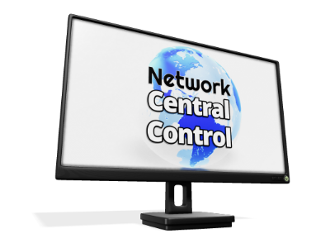
Software Defined WAN
SD WAN modernizes the approach to deploying a VPN WAN
PORTAL
Configuration management
Network visibility
Business continuity rules
Security policies
Branch #1
Control
Data
SD WAN
CPE
SD WAN
CPE
VPN
Branch #2
HQ
Datacenter
SD WAN
CPE

Slide 71
SD WAN
Central configuration and orchestration automates deployment
Greater visibility than traditional WAN solutions
Application-level routing and management
Simple deployment of BCP rules
Often sold as a managed or co-managed solution
Security at the branch level or in the cloud
Secure cloud connectivity
Various implementation models

Slide 72
Sample SD WAN Implementation
Performance
Data Gathering
BCP Rules
ISP 1
Application Routing
VPN
Security
internet
ISP 2

Slide 73

Observations for SD WAN Branch Networks
Benefits
  Simpler configuration and implementation
    Connectivity
    Security
    Business continuity
  Greater visibility
    Overall performance
    Application specifics
  Lower cost
  Cloud integration

Slide 74
InTREx Tie-In: Remote Access
Information Technology Profile · Network
“
3. Who has remote access capability to network resources? Check all that apply.
Remote access to critical systems by employees, contractors, and third parties uses encrypted connections and multifactor authentication.
No one
Vendors
Employees or Board Members (bank-owned device)
InTREx baseline cybersecurity statement: remote access
Employees or Board Members (personal device)
Who’s behind your red boxes?
Where question 3 leads
Remote access controls
Approvals and audits, secure setup at both ends, strong authentication, vendor accounts on only when needed
Logging and monitoring
Remote sessions logged and watched, especially vendors and privileged users
Policies
Remote access, bring-your-own-device and bank-issued mobile device policies
Business continuity
Can staff still connect remotely when working from the backup site?
Source: InTREx Information Technology Profile, Management and Support & Delivery modules (September 2023 version)
Notes:
Follows the WAN chapter, where remote access and site-to-site VPNs are taught. Question 3 is how the bank tells examiners who can reach its network from outside: no one, vendors, or employees and board members on bank-owned or personal devices. The personal-device box is the one to dwell on.
Debrief: on Monday the tables starred remote access on their diagrams. Ask who is behind each star, and whether the diagram tells you how they authenticate. The baseline statement expects encrypted connections and multifactor authentication for employees, contractors and third parties alike.
The bottom row is a map: the Remote Access procedure, monitoring of third-party access, the required policies (remote access, BYOD, bank-issued mobile devices), and remote connectivity at the backup site. Wording is from the September 2023 version; verify against the current version.

Slide 75
Chapter 10:
Wireless WANs

Slide 76
Connecting to the Internet
A wide variety of access options already discussed
  DSL
  Cable Modem
  Ethernet
Wireless options have increasingly grown in access share
  Mobile phones
  Fixed wireless access
    Mobile
    Wi-Fi
    Satellite
    Terrestrial Microwave

Slide 77
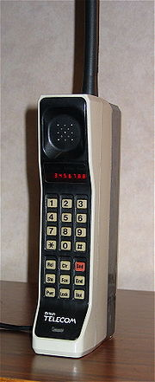
Cellular (Mobile?) Networks
Many similarities to Wi-Fi
  Specific bands allocated for the service
  Multiple generations of the technology with each improving performance
  Bands vary by country and regulation
  Current generations have added new bands to increase capacity
  Frequency (channel in Wi-Fi) reuse provides coverage in a wide area
Some differences
  Original application was voice, data added over time
  Handoff between cells creates a WAN
  Protocols to interconnect carrier networks part of the standards
  Spectrum requires a license from the FCC

Slide 78
Cellular Network Evolution
Analog to digital
Voice to data
  Beginning to sound familiar?
Single frequency band to multiple bands (varies by country)
Multiple technology standards globally to one
Increased use of fixed wireless access (FWA) for residential and business internet access
Move to edge computing to support low latency applications (industrial controls and self-driving cars being examples)

Slide 79
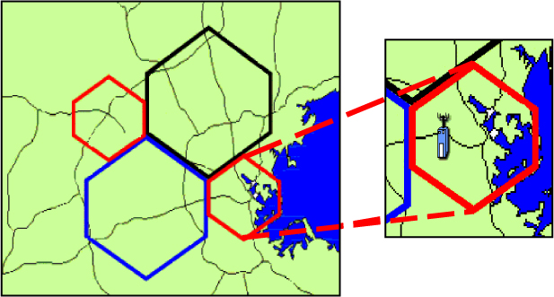
Why “Cellular”?
Cells defined by antennas and base stations
Frequency reuse between base stations
Base station to base station handoff
Base station connection to voice and internet at Mobile Switching Center

Slide 80
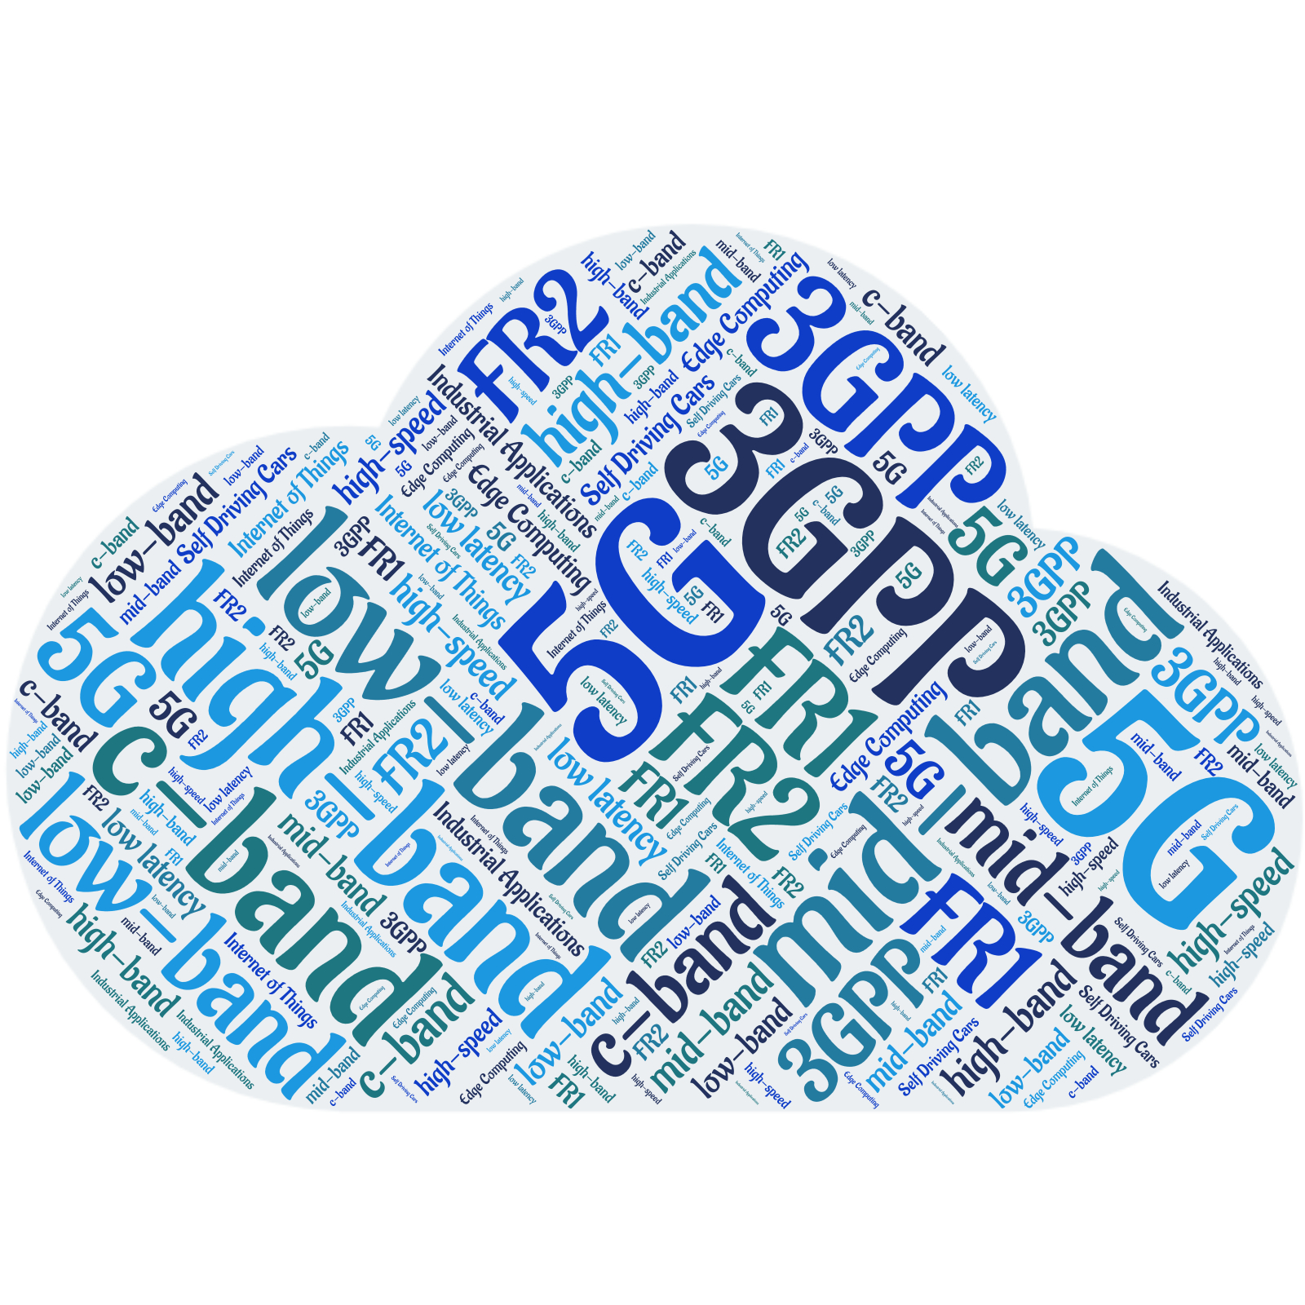
5G
The current generation of cellular wireless
  Widely deployed in urban and suburban environments
  Rural areas lagging, as usual (it’s expensive)
  Lots of variations in 5G deployments globally
Key changes from 4G
  New modulation schemes
  More frequency bands
  Higher speeds
  Lower latency
  Fixed wireless options
  Internet of Things (IoT) support

Slide 81
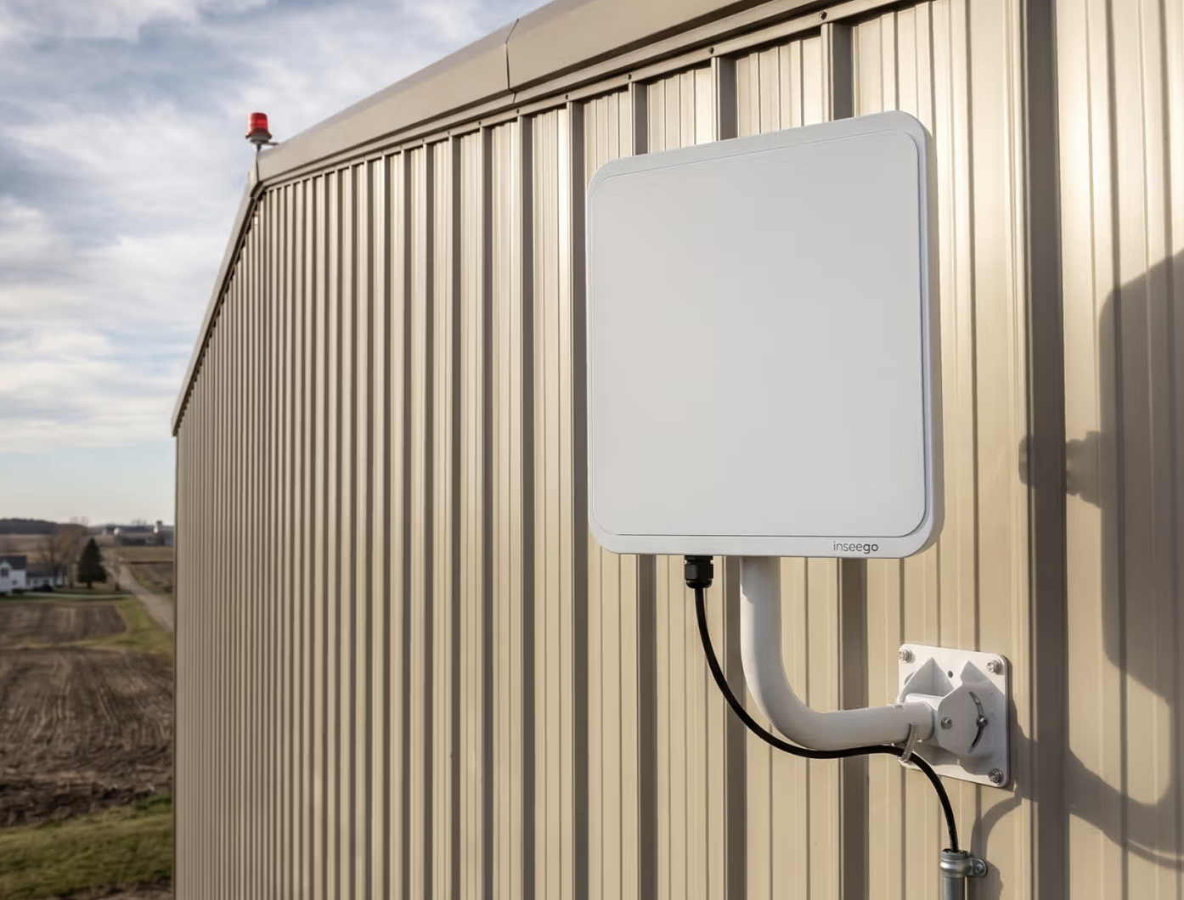
Fixed Wireless Internet
Internet delivered by radio to a building that doesn’t move
1
Cellular 4G / 5G
A carrier’s box in the window or outside, using the cellular network
2
Local wireless ISP
A rooftop antenna aimed at the provider’s tower; common in rural areas
3
Point-to-point link
The bank’s own radio link between two buildings in line of sight
Why banks might use it
The best option at some rural branches
Fails differently from wireline, so it makes a natural backup
Installed in days, not months
What to watch
Line of sight and weather
Shared capacity; on cellular it may get lower priority than phones
Consumer terms: no SLA, no static IP
The tower may ride the same fiber as the bank’s wireline provider
Examiner questions
Is it the primary connection or the backup?
A business plan with an SLA?
Can it carry the branch if the wireline fails?
Notes:
Fixed wireless is internet delivered by radio to a building that doesn't move. Three kinds: the big mobile carriers' 4G/5G home and business internet (the fastest-growing kind), local wireless ISPs with rooftop antennas aimed at their towers, and point-to-point links the bank sets up itself between two of its buildings.
Why banks use it: sometimes it is the best connection at a rural branch; it fails differently from wireline (a backhoe in the street won't touch it), so it is a natural second link; and it installs in days.
What to watch: line of sight, trees and heavy rain; shared tower capacity, and on cellular networks fixed-wireless customers may be deprioritized when the network is busy; consumer-grade terms with no SLA or static IP; and tower backhaul that may share fiber with the bank's wireline provider, so the 'diverse' backup may not be. Point-to-point links are the bank's own: it owns their encryption, maintenance and the antennas on its roof.
Leads into the Starlink and backup-path slides.

Slide 82


Starlink: Satellite Internet
Traditional satellite
about 36,000 km up
~20–40 ms
typical delay, vs. ~600 ms for traditional satellite
laser links between satellites
Why banks use it
Shares nothing with the wires in the street
Set up in a day, even after a storm
Works at the most rural branches
Backup seems obvious, perhaps for main connection too?
Low-earth orbit
about 550 km up
What to watch
Needs a clear view of the sky
One provider, one company
  Although competition seems to be coming soon.
Shared capacity; priority plans cost more
Traffic leaves at a distant gateway, so location-based fraud tools may see the wrong city
Let’s leave politics out of it…
Internet
Bank branch
with a user dish
Gateway
ground station
Notes:
Starlink is satellite internet from a constellation of more than 10,000 low-earth-orbit satellites (mid-2026), roughly 550 km up. Traditional internet satellites sit in geostationary orbit about 36,000 km up, which is why they feel slow: roughly 600 ms round trip, versus about 20-40 ms for Starlink. Typical downloads run roughly 100-400 Mbps depending on plan and location.
How it works: the user dish talks to whichever satellite is overhead; satellites pass traffic to each other by laser; a gateway ground station hands it to the internet.
Why banks use it: it shares nothing with terrestrial wires, so it is a true second path; it can be set up in a day after a storm or for a temporary branch; it reaches the most rural sites.
What to watch: obstructions (trees, buildings) interrupt service; it is a single provider and a single company; capacity is shared and priority data costs more; traffic exits at a gateway that may be far away, so IP geolocation (used by fraud and access controls) can show the wrong location; most plans have no static public IP, so the bank's VPN or SD-WAN must cope.
Leads into 'Choosing a Backup Path: Wireless vs. Second Wireline'.

Slide 83
Backup Path: Wireless vs. Second Wireline
A backup is only as good as what it doesn’t share with the primary.
The trap: two providers, one trench
Better: wireline plus wireless
fiber + cable
fiber in the street
One backhoe, two outages
No shared cable, conduit or pole
Option | What it may share with the primary | Time to install | Watch for
Second wireline provider | Poles, conduit, building entry, even the same central office | Weeks to months | Ask for a route map; “diverse” may not be
Cellular 4G / 5G | Nothing on the street; possibly the tower’s backhaul | Days | Capacity, priority, data caps
Fixed wireless ISP | The tower’s backhaul | Days | Line of sight, weather, consumer terms
Satellite (Starlink) | Almost nothing on the ground | A day | Sky view, single provider, no static IP
Notes:
Key point: a backup is only as good as what it doesn't share with the primary. Two wireline providers often share the same poles, conduit, building entrance, or even central office, so one backhoe or one fire can take out both. Ask the bank whether it has a route map showing physically diverse paths, or whether 'diverse' is just two bills.
Wireless backups (cellular, fixed wireless, satellite) avoid the street entirely, which is why they pair well with a wireline primary. Each has its own catch: cellular and fixed wireless towers may ride the same fiber backhaul; satellite needs a clear sky and comes from one company.
Other questions: Is failover automatic (SD-WAN) or does someone have to move a cable? Is the backup sized to run the branch, or just to keep the lights on? Does the backup gear (modem, ONT, router) have battery power? When was failover last tested?

Slide 84
Exercise 2: Annotate WAN Segments
As with Exercise 1 yesterday, consider your table’s topology diagram:
  What kind of WAN(s) do(es) it show?
  How is it integrated with the bank’s LAN(s)?
  What’s the relationship between WAN and internet access?
Mark it up:
  Question marks for things that seem strange
  Purple for any backup services or links
  What if there’s no purple? Is that risk?

Slide 85
Chapter 12:
The internet and applications

Slide 86
The Internet
Everything we’ve discussed so far is quite “flat” and local
LANs and even classic WANs are just “one hop” networks
The internet is almost the only network used by most people, banks, and other organizations
  Banks formerly built or bought their own private WANs to connect to their own private locations, systems, and database applications
  Today we all share the same resources and rent access to them
The applications that banks and others use are almost entirely based on internet protocols and infrastructure
Understanding how bank networks work beyond their own systems means understanding internet technology

Slide 87




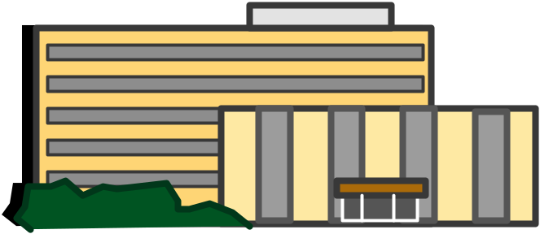
The Internet: A Global, Public, Packet Network
Service
Providers
Internet
Service
Providers
ISP
ISP
ISP
ISP
ISP
ISP
ISP
ISP
ISP
ISP

Slide 88
Models and Layers

Slide 89
The Language of Networking
Networking is complex
  Risk is often hidden in that complexity
We have developed approaches to describe and build networks, these include
  Protocols
  Network models
  Layers
Together these concepts provide the basis for the networkers’ lexicon
Familiarity will help in your conversations with a bank’s network team

Slide 90
Protocols
To communicate, we must have agreements
  Example: Don’t interrupt
  Example: Speak English
  Example: Say, “Please”
Agreements that facilitate communication are called protocols
The study of communications is the study of protocols
The study of data communications is the study of data and network protocols
The complete set of protocols used in a particular network environment is known as a protocol suite

Slide 91

Models
A hypothetical description of a complex entity or process
  Identifies the major elements and their relationship to one another
  Does not provide implementation details
  An architecture
Model of a home
  Walls, roof, floors, doorways, windows, types of room
  Does not include specific materials, design, construction
Networking model is about the functions
that must be present in a network and
their relationship to one another

Slide 92
Layering
Layering breaks a big problem into smaller pieces
Large number of protocols required for
interoperability between two applications
Break protocols into subsets, each of which
addresses specific, closely related issues
Each layer
  Provides a well-defined set of services to the layers above it
  Receives services from the layer below it
  Knows the set of services that are provided to it
  Does not know how those services are provided

Slide 93
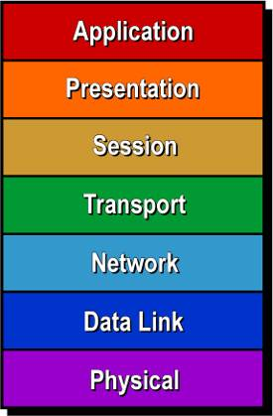
Understanding the OSI RM Layers
Where They Live
What They Do
Interoperability
(Meaningful Work)
End-to-End Layers
(End Systems)
Connectivity
(Successful Exchange)
Chained Layers
(All Systems)

Slide 94
A Closer Look at the Layers
Application
Information Semantics (email, Web, voice)
Presentation
Information syntax (compression, encryption)
Session
Dialogue/session control (logon, checkpointing)
Transport
End-to-end correctness (sequencing, loss)
Network
Routing (addressing, congestion control)
Data Link
Node-to-node correctness (access, bit errors)
Physical
Bit transmission (distance, speed, medium)

Slide 95



OSI Provides a Reference Framework
Application
Application
Presentation
Presentation
Session
Session
Transport
Transport
Network
Network
Network
Data Link
Data Link
Data Link
Data Link
Physical
Physical
Physical
Physical
Gives us a language to talk about data network technologies

Slide 96

Different Look, Same Idea: The TCP/IP Model
Application
Services
Application
Services
Transport
Transport
Internet
Internet
Internet
Network
Interface
Network
Interface
Network
Interface
Network
Interface

Slide 97
Data Link Layer
Technically distinct from the physical layer, but usually considered together
Connects devices on a shared link
Data is sent in a frame
Common topologies are:
  Point-to-Point
  Any-to-Any
Examples
  Ethernet
  Wi-Fi
  DOCSIS (what cable modems use)

Slide 98




Common Link Topologies
Point-to-Point
Any-to-Any
internet
Access
Data Link Functions
Framing
Addressing
Error check

Slide 99
Point-to-Point Protocol (PPP)
Commonly found on leased (private) lines and dial-access
Features
  Framing (synchronization, data delimiting, transparency)
  Additional capabilities
    Authentication
    Compression
    IP address configuration
    Multilink operation (MLPPP required) enables multiple channels to
    carry single data streams (inverse multiplexing)
internet
PPP

Slide 100
Chapter 13:
IP Addresses and Operations

Slide 101
The Internet Protocol
The Network Layer (Layer 3) protocol used on the internet
  Has become the protocol for most networks
  Primary responsibility is building routing tables, forwarding and delivering packets
Current version is IPv4 with IPv6 growing (largely invisibly)
  Packet-oriented
  Connectionless
Related protocols include
  Routing protocols (RIP, OSPF, EIGRP, BGP)
  Address Resolution Protocol (ARP)
  Dynamic Host Configuration
  Protocol (DHCP)
  Network address translation (NAT)

Slide 102

The IPv4 Address
Binary (base two) representation:
    01000111 00111100 10011000 10100000
Better known as:
    71.60.152.160
Hierarchical structure
Like your phone number (area code, phone number)
IP address has the Network Identifier (NETID)
and Host Identifier (HOSTID)
Slash notation indicates where the boundary
between the NETID and HOSTID is located
128.67.38.23 /16

Slide 103
Role of IP Addressing
IP addresses are used to identify the client computer and the server
All packets have a destination address (where it is going) and a source address (the sender’s address)
IP addresses
  Assigned to devices
    Static: Permanently assigned to a device
    Dynamic: Temporarily allocated to a device
  Public
    Unique and valid over the Internet
  Private
    May not be sent over the Internet
    Translated by network address translation (NAT) for internet transit

Slide 104

Private vs. Public IP Address
To overcome address exhaustion private address are used
  10.0.0.0 /8
  172.16.0.0 /12
  192.168.0.0 /16
Private IP address not to be used on the Internet
  Must use NAT/PAT to a public address obtained from ISP
class.hillvt.com
66.228.126.195
Private
internet
10.1.1.1
NAT
192.168.1.1
192.168.1.2
200.1.1.1

Slide 105
Static vs. Dynamic IP Address
An IP address can be assigned to a system statically or dynamically
Static assignment is fixed and permanent
  Does not change when a system reboots
  Ideal for inbound communication
    Web servers
    Email servers
    FTP servers
    DNS servers
    VPN access appliances
    Routers
Dynamic assignment means assignment occurs when a system boots
  May change over time
  Ideal for outbound communication (e.g., Web, email)
  Makes it hard for others to find your IP (not linked to DNS)
Dynamic Host Configuration Protocol (DHCP) typically used to assign both static and dynamic IP addresses

Slide 106
Dynamic Host Configuration Protocol (DHCP)
Is used to give initial configuration to hosts
Comes from a router or other central server
Supplies:
  IP Address, subnet
  Nearest router (default gateway)
  DNS server address
  Sometimes other information
Essential to network operation
Key part of “automatic” network
configuration.
Wait...
Where am I?
Help me wake up!
Your IP Address is 123.45.67.111
Your nearest router is 123.45.67.1
Your DNS server is
123.45.67.10

Slide 107
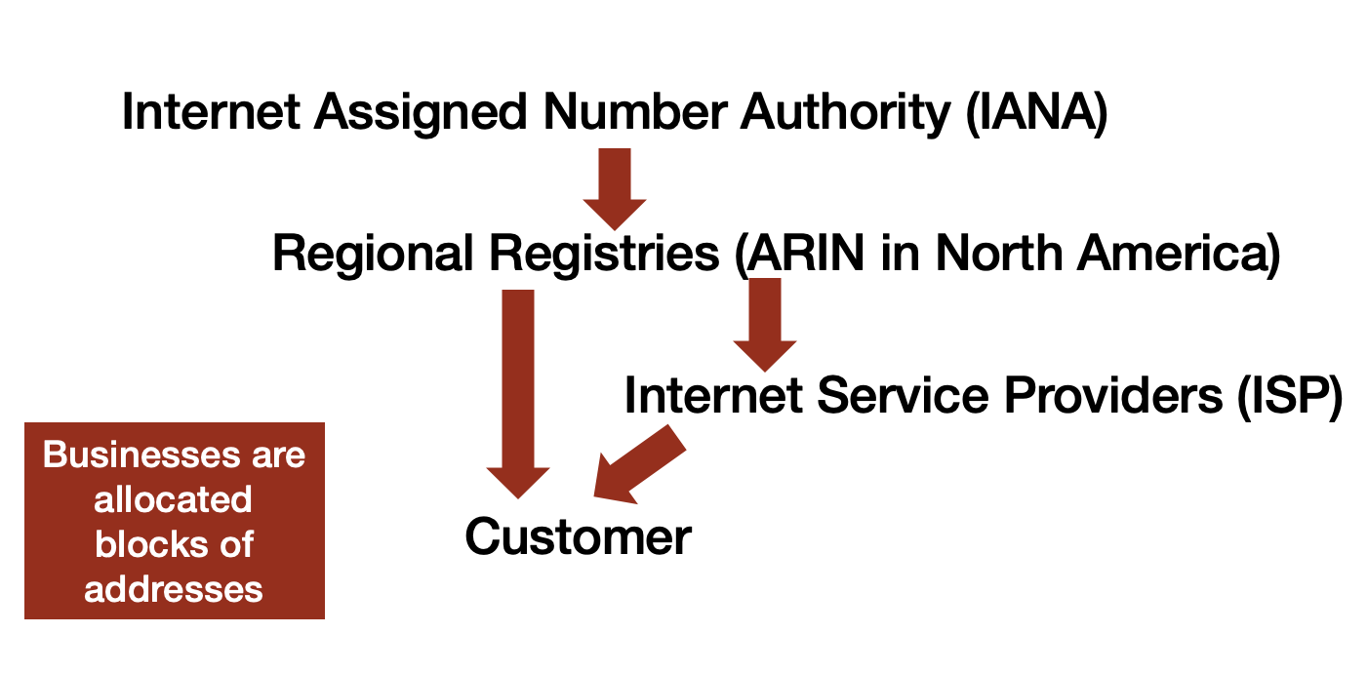
IP Address Allocation
Public addresses are managed by the Internet Assigned Number Authority (IANA)
  Addresses allocated by geographic region
  Regional Registries assign to Internet Service Providers (ISP) and large businesses
Private IP blocks allow businesses to allocate addresses internally without regard to the public addresses
  Network Address Translation (NAT) at the edge converts from private addresses to public addresses

Slide 108

IPv6: What, Where, When, How?
The next generation of IP motivated by the anticipated exhaustions of IP addresses
Developed in the 1990s
New packet header structure
Expanded address range, 128 bits!
Improved security?
Flow definition
Auto configuration built-in
Anycast
Significant effort required to fully migrate

Slide 109
Chapter 14: IP Routing

Slide 110
Routing and Forwarding
These are what routers do to make the internet work.
  Forwarding packets from the source to the destination.
  Building tables of destination networks and the neighbors who can get them one “hop” closer to them. This is called Routing.
Annoyingly, forwarding is based on the routing table
Routing information is shared between routers using routing protocols
  Routers can contain rules that determine behavior

Slide 111
IP Routing
The forwarding of IP packets to the destination
End-to-end path is not predetermined
  Hop-by-hop routing
  Router selects next router based on destination address
Often described as best-effort service
Net
Address
Next Hop
Network A
.
Network A
Network B
.
.
Router 1
Router 2
.
Router 1
To Network A
To Network A
Network B
Router 2

Slide 112

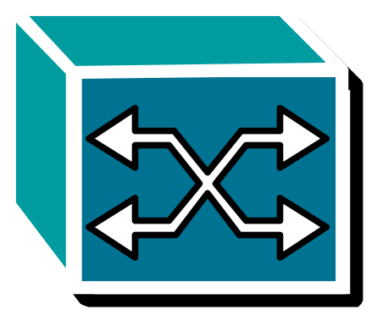

Following a Packet
Net
Address
Next
Hop
TRL
Packet
HDR
Packet
.
Network A
Network B
.
.
Router 1
Router 2
.
HDR
Packet
TRL
Packet
Packet

Slide 113
Chapter 15
The Transport Layer:
Network Confidentiality and Integrity

Slide 114
Transmission Control Protocol
  Manages connection to the destination server
    Addressing
    Data transfer
    Receipt acknowledgement
    Disconnects from the server
Messages need to get to the destination server using SMTP
Email
Server
SMTP
Email
Server
Sender
TCP
Receiver

Slide 115
Transport Layer Connections
Connects client to server
Internet Protocol Suite offers two options
  Transmission Control Protocol (TCP)
  User Datagram Protocol (UDP)
Transport Protocols
Client
Server
Network

Slide 116
Connectionless Communication
Stuff
Data
Transfer

Slide 117
Connection-Oriented Communication
Can we talk?
Connection
Establishment
Sure!
Stuff
Data
Transfer
Got it!
I’m Done
Connection
Release
K thx bye!

Slide 118
Other Transport Layer Functions
Connectionless and connection-oriented operation
Error detection
  Bit errors
  Packet loss
  Out-of-sequence delivery
Error correction
  Bit errors
  Packet loss
  Out-of-sequence delivery
Application addressing
Flow control
Enhanced capabilities
  Security
  Timing

Slide 119
Certificates: Proving Who You’re Talking To
The chain of trust
Before the padlock appears, the browser checks:
Root certificate authority
Built into every browser, phone and computer
1
Signed by an authority it trusts
Follows the chain back to a root it already knows
2
The name matches
The certificate says examplebank.com, and that is where you are
vouches for
3
Still valid
Not expired, not revoked
Intermediate authority
Issued and vouched for by the root
4
Then: encryption starts
Only after these checks does TLS set up the encrypted session
vouches for
Like a passport: issued by an authority everyone trusts, with a name and an expiry date — and worthless if anyone could print one.
www.examplebank.com
The bank’s own certificate, with its name and an expiry date
Where it can go wrong
An expired certificate can take a website, app or VPN down overnight
Maximum lifetimes are shrinking: 200 days now, 47 days by 2029 — renewal has to be automated
Notes:
A certificate is how a server proves it is who it says it is. The bank's certificate names its website and is signed by a certificate authority; that authority is vouched for by a root authority whose certificate is built into every browser, phone and operating system. That is the chain of trust.
Before showing the padlock, the browser checks that the chain leads to a root it trusts, that the name on the certificate matches the site, and that the certificate has not expired or been revoked. Only then does TLS (next slide) set up the encrypted session.
Examiner angle: who at the bank (or which vendor) tracks certificates and their expiry dates? Expired certificates cause real outages. Under the CA/Browser Forum's schedule, maximum public TLS certificate lifetimes dropped to 200 days on March 15, 2026, go to 100 days in 2027 and 47 days in 2029, so manual renewal will not keep up. Also: users trained to click through certificate warnings undo all of this.
Wednesday's cryptography chapter goes deeper on PKI, how certificates are signed, and key management.

Slide 120
Transport Layer Security
Provides secure encrypted connection between client and server
Replaced Secure Socket Layer (SSL) although the terminology of SSL continues to be used
Part of HTTPS (port 443) for secure web traffic
Combines authentication and encryption
Current version 1.3
Some systems may still use v1.2
  Would you be okay with that?

Slide 121
QUIC: TLS’s Faster Cousin
TCP + TLS: the classic way
QUIC: connection and TLS in one step
Client
Bank server
Client
Bank server
TCP: hello
QUIC + TLS: hello, here are my keys
TCP: hello back
certificate, keys, done
TLS: hello, here are my keys
Data
TLS: certificate, keys, done
Data
Two round trips before any data
One round trip — zero when reconnecting
Faster
Sets up the connection and the encryption together. It’s the engine under HTTP/3, used by many of the biggest websites and apps.
Survives a network change
A phone moving from branch Wi-Fi to cellular keeps its session instead of starting over.
Harder to see into
Runs over UDP and encrypts almost all of its own control information. Firewalls that inspect TLS may not inspect QUIC.
Ask: does the bank inspect QUIC, block it, or let it through?
Notes:
QUIC is a newer transport protocol, standardized by the IETF in 2021 (RFC 9000), that combines what TCP and TLS do. Instead of setting up a TCP connection and then a TLS session on top of it, QUIC does both in one exchange, using TLS 1.3 inside. It runs over UDP. HTTP/3 is HTTP running over QUIC, and much of the traffic to the largest websites and apps (search, video, social media, cloud services) now uses it.
Benefits: one round trip to start instead of two, and zero when reconnecting to a server it has used recently; connections survive a change of network (Wi-Fi to cellular).
Risk angle for examiners: QUIC encrypts almost all of its own control information, so firewalls and web filters that decrypt and inspect TLS often cannot inspect QUIC the same way. Many organizations block outbound UDP port 443 so browsers fall back to TCP + TLS, which their tools can inspect. Question for the bank: does its firewall or web filter handle QUIC, block it, or let it through uninspected?
Simplified diagram: TCP + TLS 1.3 shown with the TCP handshake and one TLS round trip; older TLS versions took longer.

Slide 122
Real-Time Payments (FedNow/RTP): What Always-On Means for the Network
Customer
Sending bank
Core processor
FedNow or RTP
Receiving bank
Recipient
Seconds end to end · any hour, any day · final once settled
FedNow
Run by the Federal Reserve since July 2023 · 1,800+ banks and credit unions · $10 million cap
RTP
Run by The Clearing House since 2017 · 1,200+ institutions · $10 million cap
What always-on means for the network
No quiet hours
Maintenance windows and weekend changes now land on live payments.
Every link is in the path
Branch, core processor and the connection to the Fed or TCH all need redundancy and tested failover.
Someone has to be watching
Monitoring and incident response at 3 a.m. on a Sunday, by the bank or its provider.
Final means fast fraud
No take-backs: authentication and fraud checks have to work in real time too.
Notes:
Real-time payments move money between banks in seconds, any hour of any day, and the payment is final once it settles. Two U.S. networks: FedNow, run by the Federal Reserve (launched July 2023, more than 1,800 participating banks and credit unions by mid-2026), and RTP, run by The Clearing House, owned by large banks (launched 2017, more than 1,200 institutions). Both have a $10 million network cap; banks can set lower limits.
Most community banks reach these networks through their core processor or another service provider rather than connecting directly, so the payment path runs through vendors.
Network implications: there is no overnight batch window to absorb an outage or a maintenance change; every link in the path (branch or app, core processor, connection to the network) needs redundancy and tested failover; someone has to be monitoring around the clock; and because payments are final, fraud controls and authentication have to work in real time.
Examiner questions: Does the bank (or its processor) send real-time payments, receive them, or both? Who monitors overnight and on weekends? When did the bank last change its maintenance windows? What happens to payments if the processor link fails?

Slide 123
Where Customer Data Lives and Travels on the Bank Network
Customers
Branch
HQ & datacenter
Cloud & SaaS
Core processor
Other vendors
Phones and home computers
Online and mobile banking sessions
Teller PCs and printers
Scanned checks and IDs
Paper files
File shares and servers
Backups
Staff laptops
Email and documents
CRM, HR and loan apps
The system of record: accounts, balances, history
Card processor
Fintech partners
Statement printing
Every box stores customer data (at rest) · every arrow is a network link it crosses (in transit)
At rest
Every box above holds customer data — including laptops, backups and paper.
Is it encrypted where it sits?
In transit
Every arrow is a network link: branch to HQ, HQ to cloud, everything to the core and vendors.
Is it encrypted on the way?
The examiner’s question
Can the bank draw this map for its own data, vendors included?
InTREx expects the risk assessment to identify “all information assets and systems, including cloud-based, virtualized, and paper-based systems.”
Notes:
Customer data (GLBA's nonpublic personal information) doesn't live in one place. Walk the anchor scenario left to right: it starts with the customer, sits on teller PCs, scanned check and ID images and paper in the branch, on file shares, backups and laptops at HQ, in email and SaaS applications in the cloud, in the core processor's system of record, and with other vendors such as the card processor, fintech partners and the statement printer.
Every box is data at rest; every arrow is data in transit across a network link. Both need protection, which the next slide covers.
Examiner angle: can the bank produce a data map like this, including its vendors? InTREx's Management module expects the IT risk assessment to identify all information assets and systems, including cloud-based, virtualized and paper-based systems (September 2023 version).

Slide 124
Data at Rest, Data in Transit
At rest
In transit
Stored somewhere: a disk, a database, a backup, a phone
Moving across a network: inside the bank or out to the world
Where
Servers and databases, laptops and phones, backups, cloud storage, USB drives
Where
Branch to HQ, HQ to cloud, everything to the core and vendors, customer to app
How it’s protected
Disk and database encryption, encrypted backups, access controls
How it’s protected
TLS for web and apps, VPN and SD-WAN tunnels between sites, encrypted email
What goes wrong
A lost laptop or backup drive that wasn’t encrypted
What goes wrong
Old unencrypted protocols, or internal traffic assumed to be safe
InTREx baseline: “Confidential data are encrypted when transmitted across public or untrusted networks” and mobile devices are encrypted if they store it. Both depend on the cryptography coming next.
Notes:
Two states for the same data. At rest: stored on a disk, in a database, on a backup or a phone. In transit: moving across a network, whether between the bank's own sites or out to vendors, the cloud and customers. (A third state, data in use, is beyond this course.)
Protection at rest: full-disk and database encryption, encrypted backups, plus access controls. Typical failure: a lost laptop or backup drive that wasn't encrypted.
Protection in transit: TLS for web and app traffic, VPN or SD-WAN tunnels between sites, encrypted email. Typical failure: older unencrypted protocols (plain FTP, unencrypted email relays), or the assumption that traffic inside the bank's own network doesn't need protection.
InTREx (Support & Delivery, Encryption procedure, September 2023 version) asks examiners to consider encryption of databases, mobile devices, email, backup media, transmissions with third parties and password databases, and its baseline statements include encrypting confidential data sent across public or untrusted networks and encrypting mobile devices that store it.
Both depend on cryptography, which is the next chapter.

Slide 125
Chapter 18:
Cryptography In (some) Depth

Slide 126
Cryptography
The science of writing in secret codes
  Dates back to 1900 BC in Egypt (nonstandard hieroglyphics); probably appeared spontaneously soon after writing was developed
Necessary in telecommunications when communicating over any untrusted medium or storing sensitive information
Three types
  Hash functions
  Secret key
  Public key

Slide 127

Hash Functions
No key
  Plaintext is not recoverable from the ciphertext
  Examples: MD2, MD4, MD5, SHA-1, SHA-256
  Also called message digests or one-way encryption
Primary uses: digital signatures and password storage

Slide 128

Secret Key Cryptography
Single key
  Same key is used for encryption and decryption
  Examples: DES, Triple-DES, IDEA, RC4, RC5, AES
  Also called symmetric cryptography
Primary use: Privacy

Slide 129
Advanced Encryption Standard (AES)
Symmetric key cypher with key sizes of 128, 192, and 256 bits
Block substitution-permutation cypher based on 128-bit block
Number of cycles based on key size
Each cycle performs multiple block substitutions, permutations, and mixing to encrypt the data
ation of the algorithm

Slide 130

Public Key Cryptography
Two keys based on the prime factors of a large number
  One key is used for encryption and the other for decryption
  Examples: RSA, Diffie-Hellman
  Also called asymmetric cryptography
VPN functions
  Identity verification
  Secret key exchange

Slide 131
RSA
Diffie-Hellman started the path to public key cryptography
RSA was the first approach to public key systems
Developed at MIT in 1977
Based on creating a public key from the product of two large prime numbers
Key length today is 2048 bits
Used in certificates
Being replaced by Elliptic-curve cryptography using 256-bit keys

Slide 132
Back to TLS: The Same Three Tools in Every Web Session
Public key
Secret key
Hash
The introduction
The conversation
The seal
Proves the server is who it claims (certificate) and lets both sides agree on a secret key without sending it
Encrypts every byte of the session with that shared key — fast enough for video and file transfers
Fingerprints that reveal any tampering, and a part of every signature
One web session, start to finish
Handshake
Encrypted session
Public key: a few milliseconds
Secret key + hash checks on every packet, for as long as the session lasts
Slow, clever math sets up a fast, simple key. VPNs, SD-WAN tunnels and encrypted email work the same way.
Notes:
Callback to Tuesday's TLS and certificate slides, now that the class has seen the three kinds of cryptography.
Public key cryptography does the introductions: the server proves who it is with its certificate, and the two sides agree on a shared session key without ever sending it across the network (in TLS 1.3 this is an elliptic-curve Diffie-Hellman exchange, with the server signing it). It's slow, so it's used only for a moment at the start.
Secret key cryptography (AES) then encrypts everything that follows, because it's fast.
Hash functions run throughout: they are part of every signature, they help derive the session keys, and the ciphers TLS uses include an integrity check so any tampering is detected.
Takeaway: the slow, clever math is used briefly to set up a fast, simple key. The same pattern appears in VPNs, SD-WAN tunnels and encrypted email.

Slide 133
Public Key Infrastructure: Who Vouches for Whom
Inside a certificate
Who does what
1
Certificate authorities
Check that the requester controls the name, then issue and sign certificates
Subject
www.examplebank.com
Public key
the bank server’s public key
2
Browser and phone makers
Decide which root authorities billions of devices trust
Issuer
Example Trust CA
3
Transparency logs
Public record of every certificate issued — a bank can spot fakes for its own name
Valid
Mar 1 – Sep 17, 2026
Signature
the issuer’s seal over all of the above
4
The bank’s own private PKI
An internal authority for VPN, Wi-Fi logins and devices. Who runs and protects it?
A certificate is only as trustworthy as the authority that signed it — and the people protecting that authority’s keys.
Notes:
Public key infrastructure (PKI) is the system of authorities, certificates and rules that makes the chain of trust from Tuesday work.
Anatomy of a certificate: who it belongs to, the public key, who issued it, the dates it is valid, and the issuer's signature over all of it.
Who's who: certificate authorities issue certificates after checking the requester controls the domain (and, at higher levels, that the organization is real). Browser and operating-system makers (Apple, Google, Microsoft, Mozilla) decide which root authorities are trusted on billions of devices. Certificate Transparency logs publicly record certificates as they are issued, so a bank can watch for certificates issued for its own names that it didn't request.
Banks also run private PKI: an internal certificate authority for VPN, Wi-Fi logins (802.1X) and devices. Someone has to run and protect it.
Examiner questions: Who runs the bank's internal certificate authority, and how is it protected? Does the bank (or a vendor) monitor Certificate Transparency for its domains?

Slide 134
Certificate Lifecycle: Expiry, Revocation, and the Outages They Cause
Request
Validate
Issue
Install
Monitor
Renew
and around again — before the old one expires
Or revoke early if the key is lost or stolen
Maximum certificate lifetime
When renewal is missed
The website, app, VPN or monitoring tool stops working — often at night or on a weekend, and nobody knows which certificate it was.
Before Mar 2026
398 days
Mar 2026
200 days
Mar 2027
100 days
It happens to big organizations too
2017: an expired certificate on Equifax’s traffic-inspection equipment left the breach unseen for months.
2020: an expired certificate briefly took down Microsoft Teams.
Mar 2029
47 days
We are here: renewing roughly twice a year, heading to every few weeks
Notes:
Every certificate goes through the same cycle: request, validate, issue, install, monitor, then renew before it expires, or revoke it early if its key is compromised. Most certificate outages come from the renew step being missed: nobody owned the certificate, the reminder went to someone who left, or one system was forgotten.
Lifetimes are shrinking. Under the CA/Browser Forum schedule, the maximum lifetime of a public TLS certificate fell from 398 days to 200 days on March 15, 2026, drops to 100 days in March 2027 and to 47 days in March 2029. That means renewing many times a year, which only works if renewal is automated (for example with the ACME protocol).
Real examples: in 2017 an expired certificate on Equifax's traffic-inspection equipment meant the breach went unseen for months; in 2020 an expired certificate briefly took down Microsoft Teams.
Examiner questions: Does the bank have an inventory of its certificates, with owners and expiry dates? Is renewal automated? Who gets the alert, and what happens on a weekend? How are certificates revoked if a key is lost?

Slide 135
Key Management: Who Holds the Keys?
Encryption doesn’t remove the risk — it moves it to the keys. Whoever holds the key holds the data.
1
Generate
strong and random
2
Store
where only the right systems can use it
3
Use
with access logged
4
Rotate
on a schedule
5
Retire
destroyed when no longer needed
Where keys live
A file on a server
Easy to copy, easy to lose. The weakest option.
Cloud key service
AWS KMS, Azure Key Vault, Google Cloud KMS: access-controlled and logged
Hardware security module
A tamper-resistant device that uses keys without ever revealing them
weaker → stronger
Examiner questions
Where are the bank’s keys, who can use them, and is there dual control for the most sensitive ones?
For cloud and vendor systems: does the bank or the provider hold the keys — and what happens to them when the contract ends?
Notes:
Encryption moves the problem from protecting the data to protecting the keys. Whoever has the key has the data.
Key lifecycle: keys are generated, stored, used, rotated on a schedule, and destroyed when retired. Weak points are keys left in files or code, keys shared by email, keys nobody rotates, and keys that only one person can reach.
Where keys live, from weakest to strongest: a file on a server; a cloud key management service (AWS KMS, Azure Key Vault, Google Cloud KMS); a hardware security module (HSM), a tamper-resistant device that uses keys without ever revealing them. Payment networks and core processors rely heavily on HSMs.
Cloud choice: the provider can manage the keys (simplest), the bank can manage keys inside the provider's key service (customer-managed keys), or the bank can bring or hold its own keys outside the provider (more control, more work). This sets up the shared-responsibility discussion in the cloud chapter.
Examiner questions: Where are the bank's encryption keys stored, and who can use them? Is there dual control for the most sensitive keys? How often are they rotated? For cloud and vendor systems, does the bank or the provider hold the keys, and what happens to them when the contract ends?

Slide 136
Final Comments on Cryptography
Cryptography alone cannot guarantee 100% security
But we can achieve a high level of risk acceptance where benefits outweigh the losses
The goal is to balance the possible with the acceptable
Strong cryptographic systems can withstand attacks up to a point
The mathematics is rarely the weak link!
Must consider the threat, system design, implementation, users, and legal/political environment

Slide 137
InTREx Tie-In: Encryption
Support & Delivery module · Encryption procedure
“
Evaluate the use of encryption for sensitive institution and customer data at rest and in transit. Consider:
All passwords are encrypted in storage and in transit.
Databases
Mobile devices
Email
Backup media and storage devices
InTREx baseline cybersecurity statement: encryption
Transmissions with third parties
Password databases
Which box would a community bank struggle to check?
Encryption shows up all over InTREx
Information security program
Encryption of customer information in transit and in storage is a required element (GLBA)
Remote access
Encrypted connections and multifactor authentication for employees, contractors and vendors
Wireless
Strong encryption for Wi-Fi authentication and transmission
Vendors and cloud
Banks must assess whether critical vendors encrypt the customer information they hold
Source: InTREx Management, Support & Delivery and Management Expanded Analysis modules (September 2023 version)
Notes:
Unlike wireless and remote access, encryption has no IT Profile question; it shows up as its own procedure in the Support & Delivery module. Examiners evaluate encryption of sensitive institution and customer data at rest and in transit, considering databases, mobile devices, email, backup media and storage devices, transmissions with third parties, and password databases.
Baseline cybersecurity statements under that procedure: all passwords are encrypted in storage and in transit; confidential data are encrypted when sent across public or untrusted networks; mobile devices are encrypted if they store confidential data; wireless uses strong encryption for authentication and transmission.
Debrief: which of the six boxes would a typical community bank struggle with? (Often email, backups held by a vendor, or old file transfers with third parties.)
Encryption also appears in the Management module's information security program elements (encryption of electronic customer information in transit and in storage, from the GLBA standards), in the remote access and wireless baseline statements, and in the expanded analysis that asks banks to assess critical vendors' information security programs, including encryption. September 2023 version; verify against the current version.

Slide 138
Chapter 19: Virtualization

Slide 139

Software Eats the World
Marc Andreesen (Netscape, Andreesen Horowitz)
Every device, appliance or box in this course is going away or being consolidated with others
They are being replaced with software running on:
  General purpose silicon (CPUs)
  Graphics processors (GPUs)
  Embedded Devices
  Almost everything else (IoT, appliances, smart devices)
This trend is not confined to networking!

Slide 140
Virtualization
Virtualization started with the recognition that server power had increased significantly and most servers were underutilized
Servers often support a single application only
The 1960’s virtual machine concept came to the rescue
One server can now act as multiple virtual servers
Concept has expanded to storage and networks
Application
Operating
System
Hardware

Slide 141

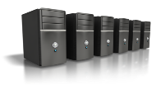


Virtual Machines Benefits
Application
Application
Application
Operating System
Operating System
Operating System
Virtual Machine
Virtual Machine
Virtual Machine
Virtual Infrastructure
Servers
Storage
Network
Network
Storage

Slide 142
Virtual Networks: From VLANs to Overlays
1
VLANs
2
Tunnels
3
Overlays
One switch, several LANs · Monday
A private network across the internet · Tuesday
In the datacenter and the cloud · today
virtual networks (overlay)
Switch
VM
VM
VM
VM
server
server
Teller VLAN
Guest VLAN
Encrypted VPN or SD-WAN tunnel
Physical network underneath (underlay)
Same idea every time: networks defined by configuration, not by cables
Invisible on the diagram
Virtual networks don’t appear on a cable map. InTREx asks whether the topology accurately depicts the virtualized environment.
Traffic the firewall never sees
Two virtual machines on the same server can talk without ever crossing a physical firewall.
One change, many networks
A single configuration mistake can merge networks that were meant to stay apart.
Notes:
Callback to Monday's VLANs and Tuesday's VPNs and SD-WAN: it's the same idea each time. A logical network is defined by configuration and carried over shared physical equipment.
1. VLANs: one physical switch carries several separate LANs, such as teller traffic and guest Wi-Fi.
2. Tunnels: VPN and SD-WAN tunnels carry a private network across the public internet.
3. Overlays: in datacenters and the cloud, virtual networks connect virtual machines across many physical servers. The physical network underneath is called the underlay; the virtual networks on top are overlays (VXLAN is a common technology). A cloud virtual private network (AWS VPC, Azure VNet) is an overlay the bank configures with a few clicks.
Risks: virtual networks don't appear on a cable diagram; two virtual machines on the same server can talk without crossing a physical firewall (so security has to move into the software); and one configuration mistake can merge networks meant to be separate.
InTREx tie: the Support & Delivery expanded analysis for virtualization asks about the accuracy of network topology in depicting the virtualized environment (September 2023 version).

Slide 143
A Step Beyond Virtualization
Clouds initially took existing applications and placed them on virtual servers
Each virtual server has its own full-blown operating system
Containerization looks at separate (isolated) application space
  Operating System (OS)
  Application
Multiple application containers may run in the same OS container (virtualized OS)
OS container may offer limited functions (lightweight) reducing processor load
Automated orchestration to manage cloud workloads (e.g. Kubernetes)

Slide 144
Traditional Application Approach
Application a single entity with multiple functions built-in
Developed using a single programming language
Large complex code set
Difficult to modify and redeploy
If one function is busy a whole new instance needs to be turned up to meet the demand
Monolithic
Application
User
Interface
Browse
Function
Shopping
Cart
Payment
User
Profile
Product
Database

Slide 145
Containers and Microservices
Cloud infrastructure offers offers a highly scalable environment for computing, storage and communication across multiple datacenters
Containers along with automated orchestration offer a flexible, scalable computing environment
Microservices implement functions independently in their own container
Microservices communicate with one another to deliver business services
User
Interface
Browse
Function
Shopping
Cart
Product
Database
User
Profile
Payment

Slide 146
Microservices
Independent processes for every application or function
Processes connect via APIs and send data through a communications or messaging system
If one process is loaded a new instance can be spun up
Benefits
  Independent development (small teams, different languages...)
  Easier to update
  Scalable
  Expandable
Many support tools to facilitate orchestration, communication, workload assignment, security, deploy updated services…

Slide 147
Chapter 20: Cloud Basics and the Big Three

Slide 148
Cloud Deployment Models
Cloud services come in four variants
  Private – infrastructure deployed for a single entity
  Community – provisioned for a community (e.g. government agencies)
  Public – open to use by anyone
  Hybrid – combination of two or more cloud infrastructures
Many organizations use cloud services for select applications
Multi-cloud is the norm
Migration ongoing for most organizations
Responsibilities depend on deployment and service model

Slide 149
Cloud Service Models
Colo
IaaS
PaaS
SaaS
Access Controls
Application
Application
OS
OS
Hypervisor
Hypervisor
Hardware
Hardware
Facility, power, rack, environment controls, fire control
Responsibility
Customer
Provider

Slide 150
Shared Responsibility: Who Secures What
IaaS
PaaS
SaaS
Never moves to the provider
Data
Bank
Bank
Bank
The bank's data, and knowing where it is
Who can log in, and with what (MFA)
How the service is configured, including its network settings
Overseeing the vendor that runs it
Identities and access
Bank
Bank
Bank
Configuration and settings
Bank
Bank
Bank
Applications
Bank
Bank
Provider
Operating systems
Bank
Provider
Provider
How it usually goes wrong
Network and virtualization
Provider
Provider
Provider
A storage bucket left public
Anyone with the address can read the files
Hardware and facilities
Provider
Provider
Provider
Admin accounts without MFA
One phished password opens the whole tenant
Above the red line: the bank's job in every model.
Below it, the line moves as the bank buys more of the stack.
Logging turned off
No way to reconstruct what happened
Notes:
The provider secures the cloud itself: buildings, hardware, the network backbone, the virtualization layer. The bank secures what it puts in the cloud. Providers call this security OF the cloud versus security IN the cloud.
Walk the grid left to right. With IaaS the bank rents bare servers and manages almost everything above the hardware. With SaaS (Microsoft 365, a digital banking platform) the provider runs the application too. But the top three rows never move: the bank's data, who can log in, and how the service is configured.
The famous cloud breaches are almost never the provider being hacked. They are customers leaving a storage bucket public, admin accounts without MFA, or logging switched off so nobody can reconstruct what happened.
Networking angle: in the cloud, 'the network' is a set of settings (security groups, routes, public or private endpoints). Those settings are the bank's job, or its vendor's, and they're on the bank's side of the line.

Slide 151
The Big Three: AWS, Azure, and Google Cloud
AWS
Amazon Web Services
Azure
Microsoft
Google Cloud
Google
~30%
~20%
~13%
of cloud infrastructure spending
of cloud infrastructure spending
of cloud infrastructure spending
Oldest (2006) and largest. Many fintechs, SaaS products and digital banking platforms run here.
Behind Microsoft 365, Teams and Entra ID. Most banks are already customers through email and logins.
Third place; strongest in data analytics and AI. Also behind Google Workspace.
A bank that says “we don't use the cloud” almost certainly does, through its vendors.
Source: Synergy Research Group estimates for Q2 2025, reported by CRN. Shares are approximate and shift quarter to quarter.
Notes:
Three companies hold roughly two-thirds of the worldwide cloud infrastructure market. Figures are Synergy Research estimates for Q2 2025 as reported by CRN; they move a point or two each quarter, so treat them as rough shares, not precise numbers.
AWS is the oldest and largest; many fintechs, SaaS products and digital banking platforms run on it. Azure is the one most banks already use without thinking of it as 'cloud': Microsoft 365, Teams and Entra ID (formerly Azure AD) sit on Microsoft's cloud. Google Cloud is third, strongest in data analytics and AI.
Key point for examiners: a community bank that says 'we don't use the cloud' almost certainly does, through its vendors. The core processor, the digital banking provider, the email system and the backup service are often hosted on one of these three. That's where concentration risk (later in this chapter) comes from.

Slide 152
Regions, Availability Zones, and What a Cloud Outage Looks Like
Region: US-East
e.g. Northern Virginia
Region: US-West
e.g. Oregon
October 20, 2025
AWS US-East-1, Northern Virginia
A DNS problem with an internal database service spread through other AWS services for most of a day.
Down or degraded: Venmo, Coinbase, Square, Lloyds and Halifax banks, and thousands of other apps.
Many affected firms had no AWS contract. Their vendors did.
Availability Zone 1
Availability Zone 1
Availability Zone 2
Availability Zone 2
Availability Zone 3
Availability Zone 3
Multi-AZ: survives one data center
Multi-region: survives a whole region
Where does it run?
Which provider and which region does each critical vendor use?
Is failover tested?
Multi-AZ, multi-region, or neither? When was it last exercised?
What does the branch do?
Which services stop if the cloud is unreachable, and for how long?
Source: AWS post-event summary and press coverage of the October 20, 2025 US-EAST-1 outage
Notes:
A region is a geographic area (Northern Virginia, Oregon). Inside each region are availability zones: separate data centers, or clusters of them, with their own power, cooling and network, a few miles apart and linked by fast fiber.
Multi-AZ design survives the loss of one data center, and it's cheap and common. Multi-region design survives the loss of a whole region, but it costs more and has to be built and tested on purpose; many vendors don't do it.
October 20, 2025: a DNS problem tied to DynamoDB, an internal AWS database service in US-EAST-1 (Northern Virginia), cascaded through other AWS services for most of the day. Customer-facing outages included Venmo, Coinbase, Square, and the UK's Lloyds and Halifax. Banks that never signed an AWS contract were affected through their vendors.
US-EAST-1 is AWS's oldest and busiest region, and many global services depend on it, which is why trouble there spreads.
Examiner questions are on the bottom row: where does the vendor run, has failover been tested, and what does the branch do meanwhile?

Slide 153
How a Bank Connects to the Cloud: Internet, VPN, Private Interconnect
Encrypted?
Performance
Cost and setup
1. Internet + TLS
Yes, app by app
Best effort; shares the internet
Lowest; nothing to set up
Most SaaS: Microsoft 365, vendor portals
2. IPsec VPN
Yes, the whole tunnel
Still rides the internet
Low; firewall configuration
Encrypted tunnel from the bank's firewall
3. Private interconnect
Not by default! Add MACsec or IPsec
Predictable, low latency
Highest; circuits and ports, weeks to order
Direct Connect, ExpressRoute, Cloud Interconnect
Private isn't the same as encrypted.
Notes:
Three ways traffic gets from the bank to a cloud service.
1. Over the internet, protected by TLS. This is how nearly all SaaS works: Microsoft 365, a vendor's web portal. Nothing to set up, but performance is best effort and depends on the bank's internet circuits.
2. An IPsec VPN tunnel from the bank's firewall to the bank's private cloud network. Everything in the tunnel is encrypted, but it still rides the internet, so latency and outages follow the internet path.
3. A private interconnect: AWS Direct Connect, Azure ExpressRoute, Google Cloud Interconnect. A carrier circuit or a cross-connect in a colocation facility goes straight into the provider's network, with no public internet. Predictable and fast, but it costs more, takes weeks to order, and, the surprise for many, it is NOT encrypted by default. Private isn't the same as encrypted; MACsec or an IPsec tunnel on top fixes that.
Most community banks use paths 1 and 2. Path 3 shows up at larger banks and at the core and digital-banking providers themselves. Tie back to Tuesday: the private interconnect is just a leased line or Ethernet circuit with a cloud provider at the far end.

Slide 154
Not just Much Cheaper, the cloud is Much Better.
21st Century bank IT To-dos:
Build new data center.
Buy and deploy new servers.
Acquire offside DR location.
Reinvent the wheel. Again.
Take an application-focused approach.
Support innovation for the bank.
Access the same tools as the big guys.
Use data to remain competitive.
Lower expenses, owned>hybrid>public.
Improve and secure network access.
Performance, Business Continuity, and Disaster Recovery are all improved by a cloud approach.
  Geographic diversity, fate-sharing, availability risk of all kinds is well-addressed in the hyperscale clouds.
  Things better centralized, like compliance, become much easier with a single point of access.
The advantages are worth the risks (to most.)
  Security is still a concern, but being addressed by advances in e.g. authentication and encryption.
  More comprehensive, better correlated customer data can improve outcomes for banks and customers.
These benefits come with a new reliance on the network.
Which is why telecom and data communications are such important topics for banks and regulators.

Slide 155

The Changing IT Landscape
Businesses are undergoing a digital transformation
New applications increase knowledge and efficiency
Applications are migrating to the cloud
Networks need
  Increased bandwidth
  Simplified management
  Greater visibility
These all improve in a cloud context!

Slide 156
InTREx Tie-In: Cloud Services
Information Technology Profile · Network
“
2. Does the institution utilize any of the following types of cloud services? Check all that apply.
Institution has an exit strategy, including a de-conversion plan, for cloud services.
Software as a Service (SaaS)
Infrastructure as a Service (IaaS)
InTREx expanded analysis: cloud computing
Platform as a Service (PaaS)
N/A
Could the bank leave its cloud provider?
Where question 2 leads
Policies
Do the bank's policies and processes address cloud computing?
Data classification
Is data in the cloud identified, classified and protected to match?
Controls tested
Are cloud controls tested, and does the BCP cover cloud services?
Vendor security
The provider's security program, including encryption
Source: InTREx Information Technology Profile and Management expanded analysis (September 2023 version; verify against the current version)
Notes:
IT Profile question 2 asks which cloud services the bank uses: SaaS, IaaS, PaaS, or none. Like the other profile questions, the bank answers it before the exam.
Point out that 'N/A' is rarely the honest answer for a modern community bank: Microsoft 365 alone is SaaS. Ask the room which box their own institution checked.
The quote is from the cloud computing expanded analysis in the Management module. The exit strategy is the item banks most often lack: if the provider fails, raises prices, or the relationship sours, how does the bank get its data out and move it somewhere else, and how long would that take?
The bottom row is a map of where a 'yes' leads: cloud policies, data classification, testing of controls, and the vendor's security program, including encryption. Wording and procedure locations are from the September 2023 version; verify against the current version.

Slide 157
Chapter 21: Outsourcing and Vendor Risk

Slide 158
Why Community Banks Outsource
Scale and cost
A processor spreads its costs over hundreds of banks
Expertise
Specialists the bank couldn't hire or keep
Around the clock
24x7 monitoring and support with three IT staff? No.
Technology
Mobile apps, real-time payments, fraud models the bank couldn't build
What a community bank typically outsources
Core processing
Card processing
Online and mobile banking
Network management (MSP)
Security monitoring (MSSP)
Email and files (Microsoft 365)
Backup and recovery
Statement printing
You can outsource the work, not the responsibility.
Banner paraphrases the Interagency Guidance on Third-Party Relationships: Risk Management (June 2023)
Notes:
A $500 million bank might have three or four IT staff. It cannot build and run a core system, a 24x7 security operations center, and a mobile app on its own, and it shouldn't try.
Four reasons, left to right: scale (a processor spreads its costs across hundreds of banks), expertise (specialists the bank couldn't hire or keep), round-the-clock operations, and technology the bank couldn't build itself.
The middle row is what typically goes out the door at a community bank. Ask the room which of these their own institution outsources; usually it's most of them.
The banner paraphrases the core idea of the 2023 interagency guidance on third-party relationships: using a third party does not diminish the bank's responsibility to operate safely and soundly and in compliance with law. That's why the rest of this chapter is about oversight.

Slide 159
Every Vendor Is a Network Connection
Core processor
VPN or private circuit
Carrier / ISP
The circuits themselves
Card processor
Private circuit or VPN
Statement printer
Secure file transfer
MSP / MSSP
Remote access, always on
The bank
ATM network
Circuit to the ATM switch
SaaS apps
Over the internet
Fintech partner
API over the internet
Each line is a door into the bank.
Notes:
Redraw the vendor list as a network diagram. Every vendor that does work for the bank connects to it somehow: a VPN tunnel, a private circuit, a remote-support session, an API over the internet, or a file transfer.
Each line on this slide is a door into the bank. Some are always open (the core processor's circuit), some open on demand (the MSP's remote session), and some the bank doesn't control at all (a SaaS app reached over the internet).
Questions for each line: who can use it, what can it reach once it's in, is it encrypted, is it logged, and who would notice if it were misused?
This is the setup for Exercise 3, where each table marks these doors on its own diagram. The carrier is on here on purpose: carriers are vendors too (next slides).

Slide 160




Core Processing in the Cloud
Historically, Core Processing was owned by a handful of specialized companies
Moving to the cloud poses both advantages and risks for core processors
Fintech solutions can rapidly add new capabilities and change what “core” means
Will the cloud come to the core before the core comes to the cloud?

Slide 161
Fintech Partnerships: New Connections Into the Bank
app
API
API
Customer
Uses the fintech's app
Fintech app
Owns the customer relationship
Middleware
Keeps the ledger (sometimes)
Partner bank
Holds the money
New doors
APIs reachable from the internet, protected by keys and tokens instead of a VPN
Someone else's traffic
Volume and peaks driven by the fintech's growth and marketing, not the bank's
Who has the ledger?
If the middleware holds the records, the bank may not know whose money it holds
Synapse, 2024: the middleware firm failed, its records didn't match the banks', and over 100,000 customers couldn't reach their money for months.
Notes:
In a bank-fintech partnership, the customer uses the fintech's app, but the deposits or loans sit at the bank. Often there is a middleware or 'banking-as-a-service' platform in between that keeps the ledger of which customer owns which dollars.
Network view: the connection into the bank is an API over the internet, authenticated with keys or tokens rather than a VPN. Transaction volume is driven by someone else's marketing, and the customer relationship and support desk belong to someone else.
Synapse, 2024 (from memory; verify details before class): the middleware company went bankrupt, and its records of who owned what didn't match the partner banks' records. Over 100,000 fintech customers lost access to their money for months while the shortfall was sorted out. The lesson for the network: if the bank can't see the ledger, it can't know whose money it holds.
Regulators have been focused on these arrangements since; several partner banks have been under enforcement actions.

Slide 162
Carriers and ISPs Are Vendors Too: Network SLAs
What “the nines” allow
Read the SLA for
How availability is measured, and whether maintenance counts
Time to repair, not just time to respond
Latency, jitter and packet loss, for voice and real-time payments
How outages are reported, and how fast
Credits: a slice of the bill, not compensation
Route diversity, in writing, with a map
99.9%
about 8.8 hours a year down
99.99%
about 53 minutes a year down
99.999%
about 5 minutes a year down
99.9% is about 44 minutes a month: an afternoon of a dark branch, every quarter, inside the SLA.
Is the carrier on the bank's vendor list?
Notes:
Banks put their core processor through due diligence, but the carrier that delivers every byte to that processor often isn't on the vendor list at all.
The nines: 99.9% availability sounds great, but it allows about 8.8 hours of downtime a year, or about 44 minutes a month. 99.99% allows about 53 minutes a year; 99.999% about 5 minutes. Ask how the carrier measures it: per month or per year, and whether planned maintenance counts.
Read the SLA for time to repair, latency and packet loss, and how outages are reported. Credits are usually a small slice of the monthly bill; they don't compensate the bank for a branch that can't open.
Route diversity: two circuits from two carriers can still share a conduit, a pole line or a building entrance. If diversity matters, get it in writing, with a map.
Examiner question: is the carrier in the bank's vendor inventory and risk assessment?

Slide 163
Concentration Risk: When Every Bank Uses the Same Few Providers
CrowdStrike, July 2024
A faulty security update crashed about 8.5 million Windows computers in hours. Airlines, hospitals and banks went down at once.
AWS US-East-1, October 2025
Companies with no AWS contract went down through their vendors.
One provider
Core processors
A handful of providers serve most U.S. community banks. One bad morning reaches hundreds of banks.
Many banks, one point of failure.
No single bank can diversify this away. It can know its dependencies and plan to cope.
Notes:
Each bank can do excellent vendor management and still share the same weak point as thousands of others: the same cloud, the same security tool, the same core processor.
CrowdStrike, July 19, 2024: a faulty update to a widely used endpoint security product crashed about 8.5 million Windows computers in a few hours. Airlines, hospitals, broadcasters and banks went down at once, and recovery often meant hands-on fixes, one machine at a time.
AWS, October 2025: covered earlier in this chapter. Companies with no AWS contract went down through their vendors.
Core processing: a handful of providers serve most U.S. community banks, so an outage at one affects hundreds of banks the same morning.
A single bank can't diversify this away. What it can do: know which providers it depends on, ask how they would recover, and plan how its own branches and customers would cope.
Figures here are from memory and widely reported; verify before class if you'll quote them.

Slide 164
Fourth Parties: Your Vendor's Vendors
Its cloud host
Kaseya, 2021
Ransomware rode MSPs' remote-management software to about 1,500 businesses.
Their vendor was the MSP. The MSP's vendor was Kaseya.
Vendor
third party: contract, due diligence, SOC report
Its data center
Its remote-management software
The bank
Its offshore help desk
Fourth parties: no contract with the bank
SOC report carve-outs
Subservice organizations left out of the audit, and who covers them
Subcontracting clause
Must the vendor tell the bank, or get approval, before adding one?
Ask for the list
Which critical subcontractors touch the bank's data or network?
Notes:
A fourth party is a vendor's vendor: the cloud the core processor runs on, the data center that hosts the MSP, the software the MSP uses to manage the bank's machines, the offshore help desk the digital banking provider subcontracts to.
The bank has no contract with these companies, but they can reach its data or its network.
Kaseya, July 2021 (from memory; verify): ransomware attackers exploited Kaseya's VSA remote-management software, which MSPs use to manage their clients' computers. Through about 60 MSPs, the ransomware reached up to about 1,500 businesses downstream. The victims' 'vendor' was their MSP; the MSP's vendor was Kaseya.
Where to look: the SOC report's carve-outs (subservice organizations excluded from the audit), the contract's subcontracting clause, and a request for the vendor's list of critical subcontractors.

Slide 165
Due Diligence Before Signing
The standard list
Financial condition and sustainability
Experience, reputation and complaints
Qualifications of principals and staff
Use of subcontractors
Internal controls, information security, privacy and audit coverage
Business resumption and contingency plans
Insurance coverage
Record retention practices
Add the network questions
1
How will you connect to us?
VPN, private circuit, or API over the internet
2
Who gets remote access?
How it's authenticated, and whether it's logged
3
Where will our data live?
Which provider, region and country
4
Is it encrypted?
In transit and at rest, and who holds the keys
5
What happens when you fail?
Failover site or region, and how long until we're back
Source: InTREx Development and Acquisition, procedure 2 (September 2023 version; verify against the current version)
Notes:
Left column: the core of what InTREx Development and Acquisition procedure 2 lists for key vendors (September 2023 version). The full list is longer; these are the items students will recognize. The control test asks whether the depth of due diligence matched how critical the service is.
Right column: the network questions that standard due-diligence checklists often skip. These are the questions this class has prepared students to ask:
- How will you connect to us: VPN, private circuit, API over the internet?
- Who on your side gets remote access, how is it authenticated, and is it logged?
- Where will our data live: which provider, which region, which country?
- Is it encrypted in transit and at rest, and who holds the keys?
- What happens when your primary site or region fails, and how long until we're back?
Due diligence happens before signing because that's when the bank has leverage.

Slide 166
What Belongs in the Contract: SLAs, Audit Rights, Incident Notice
Service levels
Availability, repair time, performance, and what happens when they're missed
Audit and exam rights
The bank can audit; regulators can examine the service
Incident notice
Vendor notifies the bank fast; bank tells its regulator within 36 hours
Security
Safeguards for customer information, encryption, access control
Subcontracting
Notice or approval before handing work to a fourth party
Business continuity
Recovery targets, and joint testing with the bank
Data ownership and return
The data is the bank's; returned in a usable format
Exit and termination
Transition help, timelines, and proof of data destruction
Sources: InTREx Development and Acquisition, procedure 3 (September 2023 version); Computer-Security Incident Notification rule (2021)
Notes:
Eight clauses worth checking in any contract for a critical service, with the network angle on each.
Incident notice: under the 2021 interagency computer-security incident notification rule, a bank service provider must notify its bank customers as soon as possible when an incident has disrupted or degraded, or is likely to disrupt or degrade, covered services for four or more hours. The bank in turn must notify its primary regulator within 36 hours of determining it has a notification incident. The contract should make the vendor's obligation concrete: who gets called, how fast, with what information.
Audit rights: the bank's right to audit, and acknowledgement that services are subject to regulatory examination under the Bank Service Company Act.
Exit: how data comes back, in what format, how fast, and proof the vendor destroyed its copies. This links back to the InTREx cloud exit-strategy item.
These track the contract topics in InTREx Development and Acquisition procedure 3. The rule details are from memory; verify before class.

Slide 167
SOC Reports: What They Tell You and What They Don't
SOC 1
Financial reporting controls
e.g. a core processor posting transactions
SOC 2
Security, availability, confidentiality, privacy
The one for IT and the network
SOC 3
Public summary of a SOC 2
No detail; fine for marketing, not oversight
Type I vs. Type II
Type I: one day
Type II: tested over 6–12 months. Ask for this one.
design vs. operation
What the report doesn't say unless you look
Scope
Does it cover the service and site the bank uses?
Carve-outs
Fourth parties left out of the audit
Period gaps
Ended months ago? Ask for a bridge letter
Exceptions
Controls that failed, and the response
CUECs
Controls the vendor assumes the bank has. The bank's homework.
Notes:
SOC reports are audits of a service provider, done by an independent CPA firm, that the provider shares with its customers.
SOC 1: controls that affect the customer's financial reporting (a core processor posting transactions). SOC 2: controls for security, and optionally availability, processing integrity, confidentiality and privacy. Most relevant to IT and the network. SOC 3: a short public summary of a SOC 2, with no detail; nice for marketing, not much use for oversight.
Type I describes the controls at a point in time. Type II tests whether they actually worked over a period, usually 6 to 12 months. Ask for Type II.
What to check:
- Scope: does it cover the service and the data center the bank uses?
- Carve-outs: subservice organizations (fourth parties) excluded from the audit.
- Period: if it ended months ago, ask for a bridge letter covering the gap.
- Exceptions: controls that failed testing, and management's response.
- CUECs, complementary user entity controls: the controls the vendor assumes the BANK has in place. That section is the bank's homework.

Slide 168
FedRAMP: What a Federal Cloud Authorization Does and Doesn't Tell a Bank
What it is
U.S. government program for authorizing cloud services for federal agencies
Independent assessor tests against NIST-based security controls
Continuous monitoring after authorization
What it tells a bank
The provider's security program was examined in depth
Controls are monitored, not checked once
Good evidence for due diligence
What it doesn't
How the bank configures it (shared responsibility)
The vendor's financial condition or the bank's contract
Whether the bank is buying the authorized version
Changing in 2026
“FedRAMP 20x” is moving to faster, more automated authorizations with new classes A through D; the older Rev5 process is set to phase out by the end of 2028. Ask which authorization, for which service.
Sources: FedRAMP program announcements; Crowell & Moring summary of FedRAMP 20x changes (2026)
Notes:
FedRAMP is the U.S. government's program for authorizing cloud services for federal agency use. Vendors increasingly put 'FedRAMP authorized' in front of banks as a selling point.
What it tells a bank: the service was assessed by an accredited third-party assessor against a large, NIST-based set of security controls, and it is under continuous monitoring. That's meaningful evidence about the provider's security program.
What it doesn't: it doesn't cover the bank's configuration (shared responsibility), it isn't a financial-condition review, it doesn't address the bank's specific contract, resilience needs or data location, and it may cover a government version of the service that the bank isn't buying. It's an input to due diligence, not a substitute for it.
2026: FedRAMP is mid-overhaul under the 'FedRAMP 20x' initiative, moving toward more automated, faster authorizations with new certification classes (A through D). The legacy Rev5-based process is slated to be phased out by the end of 2028. Expect vendors' FedRAMP claims to come in new labels for a while; ask exactly which authorization they hold, for which service.

Slide 169
Ongoing Monitoring: The Relationship After Signing
Tier by risk
What to review
SOC reports and audits
Financial statements
Information security and cyber resilience
Incident response
Business continuity, tested with the bank's plan
Service level agreement compliance
Report to the board
Plus the network view
Carrier SLA and outage reports
Logs of vendor remote sessions: who, when, what
Changes in how the vendor connects
New subcontractors or hosting locations
Vendor-caused incidents and near misses
Critical
Core processor, MSP, main carrier
Annual or more frequent full review
Moderate
Card processor, SaaS with customer data
Periodic review of key reports
Low
Office supplies, lawn care
Contract and inventory on file
Source: InTREx Management, procedure 13 (middle column paraphrased) (September 2023 version; verify against the current version)
Notes:
Due diligence is a snapshot; monitoring is the movie. The bank's leverage drops after signing, so monitoring has to be built into the routine.
Risk-based tiering: not every vendor needs the same attention. A critical vendor (core processor, MSP with remote access, the carrier for the main circuits) gets annual or more frequent review of its SOC report, financials, BCP testing and SLA performance. A low-risk vendor may need little more than a contract on file.
The middle column paraphrases items from InTREx Management procedure 13 (September 2023 version), which lists what ongoing monitoring may include.
Network-specific monitoring, right column: the bank's own data about the vendor. SLA and outage reports from carriers, logs of vendor remote sessions (who connected, when, what they touched), changes in how the vendor connects, and new subcontractors. Results should go to the board.

Slide 170
Network Talent and Trust as Risks
As network service become more powerful, they become more complex
Management software and AI should make things easier
But understanding and trusting solutions is still important
What happens if the one person at the bank who understands the network quits?
What happens if the bank can’t trust an outsourcing provider?
Education
Certification
Standards
Cross-training
Knowledge in Depth
Outside opinions
What else?

Slide 171
InTREx Tie-In: Vendor Management
Development and Acquisition · Vendor Management
“
2. Evaluate the due diligence process in selecting key vendors. Consider management's review of:
A list of third-party service providers is maintained. A risk assessment is conducted to identify criticality of service providers.
Financial condition
Use of subcontractors
Internal controls and security
Business resumption plans
InTREx Management module baseline statements
Is the telecom carrier on the list?
Where vendor management leads
Due diligence
Depth matched to how critical the service is (D&A 2)
Contracts
Rights and responsibilities of each party (D&A 3)
Reporting relationships
Telling regulators about service-provider relationships (D&A 4)
Ongoing monitoring
Risk-based program after signing (Management 13)
Source: InTREx Development and Acquisition and Management modules (September 2023 version; verify against the current version)
Notes:
Vendor management in InTREx is split across two modules: due diligence and contracts at acquisition in Development and Acquisition (procedures 2 to 4), and ongoing monitoring in Management (procedure 13). The form excerpt on the left is from procedure 2.
The quote pairs two baseline statements from the Management module: the bank keeps a list of its third-party service providers, and it assesses how critical each one is. Everything else depends on the list being complete.
Ask the room: is the telecom carrier on the list? The MSP's remote-management tool? The SaaS app the marketing team signed up for? This sets up Exercise 3, where each table finds the vendors on its own diagram.
Procedure numbers are from the September 2023 version; verify against the current version.

Slide 172
Exercise 3: Vendor Risk Tabletop
1
Circle every third party
Use the new color. Add vendors you know exist but aren't drawn.
About 40 minutes
25 at tables, 10–15 report-out
2
Label each connection
How it connects, and what it can reach once it's in
Each table needs
Its diagram from Exercises 1 and 2
A marker in a new color
3
Star the biggest worry
One vendor per table. Be ready to say why.
4
Write five questions
For one vendor, what you'd ask before signing or renewing
Report out
The vendor you starred, and why
Your best question of the five
One vendor you suspect but couldn't see
5
Report out
Two minutes per table
Notes:
Same tables, same diagrams as Exercises 1 and 2. This time the question is: where do outsiders touch this bank's network?
Hand out a different colored marker. Steps:
1. Circle every third party on the diagram: core processor, carrier, MSP, card processor, cloud and SaaS services, ATM network. If a vendor obviously exists but isn't drawn, add it.
2. Next to each, label how it connects (VPN, private circuit, remote access, internet) and what it can reach.
3. Star the one the table would worry about most, and be ready to say why.
4. Pick one vendor and write the five questions you would ask before signing, or renewing, with them.
5. Report out: two minutes per table.
Timing: about 25 minutes at tables, 10 to 15 for report-out.
Debrief points: Did anyone circle the carrier? The MSP's remote-management tool? Were there vendors you suspected but couldn't see on the diagram? That gap is exactly what an examiner would ask about. Compare tables' 'most worried' choices; there's rarely one right answer.

Slide 173
Chapter 22: Managed Services and Shadow IT

Slide 174

Managed Security Solutions
Security has become a critical infrastructure issue
Threats growing more complex and sophisticated
Skilled security personnel shortages drive outsourcing
Outsourcing some or all of security a growing industry
Usually called Managed Security Service Providers

Slide 175
Many Players
Network equipment manufacturers
  Moved to offer security in their offerings
  Security capabilities include subscription for capabilities and ongoing monitoring, updates and management portal access
Security software and equipment providers
  Historically limited focused offerings
  Many expanded service set or have been acquired
    Broader range of security offerings (e.g. perimeter security added endpoint)
    With AI and ML, monitoring has become integral to the product
    Expansion into network space
    Professional services (design and incident response)

Slide 176
Some More Players
Computer manufacturers
  Extension of their professional services business
  SOC services
Telecommunications service providers
  Networks need protecting security often an integral part of the service
  Expansion into professional services
Systems integrators
  Natural expansion of their professional service offerings
Local IT providers
Financial service technology providers

Slide 177
Let’s take a look at a few MSSPs
Research an MSSP and see what they do, and how. Feel free to glance at them all, but you need only “report” on yours.
I’d like to know:
  What did you think of this company’s pitch?
  What surprised you about them? Anything particularly impressive?
  Would you be happy to see them at a bank you examined?
No stress, you don’t need to make a slide deck! Just informal thoughts and impressions.
Group assignments:
  Group 1: SBS Cybersecurity https://sbscyber.com/
  Group 2: Arraya Solutions https://www.arrayasolutions.com/
  Group 3: SilverSky https://www.silversky.com/
  Group 4: Optiv https://www.optiv.com/

Slide 178
InTREx Tie-In: Network Monitoring and Operations
Information Technology Profile · Network
“
5. Indicate whether network monitoring and network operations are managed in-house or outsourced.
The institution is able to detect anomalous activities through monitoring across the environment.
Monitoring: outsourced
Monitoring: in-house
Operations: outsourced
Operations: in-house
InTREx Support and Delivery baseline statement
Who's watching at 3 a.m.?
Where question 5 leads
Security monitoring
What's monitored, by whom, and how alerts are reviewed
MSSP oversight
Reports, SLAs, and who at the bank reads them
Third-party access
Vendor access to critical systems is itself monitored
Incident handoff
How an MSSP alert becomes the bank's incident response
Source: InTREx Information Technology Profile and Support and Delivery module (September 2023 version; verify against the current version)
Notes:
IT Profile question 5 asks whether network monitoring (performance, intrusion detection, web filtering) and network operations are handled in-house or outsourced. Both boxes can be checked: many banks run day-to-day operations themselves and outsource 24x7 monitoring to an MSSP.
The quote is a Support and Delivery baseline statement. Ask the room: who's watching at 3 a.m.? At most community banks the honest answer is the MSSP, which makes the bank's oversight of the MSSP the real control.
The bottom row is where a 'yes, outsourced' leads: how monitoring works, how the bank oversees the provider, whether third-party access to critical systems is itself monitored, and how an alert at the MSSP becomes an incident response at the bank.
Wording and locations are from the September 2023 version; verify against the current version.

Slide 179
SaaS Sprawl and Shadow IT: The Vendors Nobody Approved
Approved
Core, Microsoft 365, the vendors on the list
How banks find it
DNS and web proxy logs: which SaaS sites do staff reach?
A CASB that inventories cloud app use
Single sign-on: apps outside it stand out
Expense reports and card statements
What staff actually use
File sharing
E-signature
AI chatbots
Note apps
What works better than blocking alone
A catalog of approved apps, and a fast way to request one
A clear policy on AI tools and customer data
Browser extensions
Personal email
Survey tools
Free PDF converters
Examiner question: does the vendor inventory include SaaS, and how does the bank know what staff use?
All of it is HTTPS to the same big clouds as everything else.
Notes:
Shadow IT is technology staff use without IT's knowledge or approval. With SaaS it takes a credit card and an email address: a file-sharing account, an e-signature service, a note-taking app, a browser extension, and now AI chatbots that staff paste customer information into.
Each of these is a vendor holding bank data with no due diligence, no contract review and no monitoring. And the network can't easily see it: it's all HTTPS to the same big cloud providers as everything else.
How banks find it: DNS and web proxy logs (which SaaS domains are staff reaching?), a CASB (cloud access security broker) that inventories cloud app use, single sign-on (apps outside SSO stand out), and expense reports (who's paying for subscriptions).
What works better than blocking alone: a catalog of approved apps, a fast way to request a new one, and a clear AI-use policy.
Examiner questions: does the vendor inventory include SaaS? How does the bank know what staff actually use?

Slide 180
Chapter 23: Applications on the Network
Notes:
Thursday opens with the reason the network exists: the applications. Everything we built Monday through Wednesday carries application traffic. This chapter reviews how applications talk (clients, servers, ports) and then maps where a community bank's applications actually live today.

Slide 181




It’s All About The Applications
Applications perform tasks to deliver services to users
Communications is the act of users interacting with software performing the desired function
Application services define the protocols for communication and services supporting communication
Two models exist
  Client-server
  Peer-to-peer

Slide 182

Application Layer Concerns
Information syntax
Information semantics
  What the information means
    What information elements are required
    How the information elements are exchanged
Applications types
  User applications
  Network support facilities
  Resource sharing utilities
  Network management packages

Slide 183



Clients and Servers
I’ve got something that system wants…
That system’s got something I need…
Network
Client
Server
Desktops
Laptops
Tablets
Cell phones

Slide 184
Service Relationship: Client/Server
Applications have clearly defined roles
  Client initiates request
  Server responds to client’s request
Server software is passive but available
  Connects to local Transport Layer
  and waits for connection requests
Client transient in nature
  Application is enabled on-demand
  Connection to local Transport Layer
  is made/broken as needed
Examples
  HyperText Transfer Protocol (HTTP)
  Simple Mail Transfer Protocol (SMTP)
Application
Protocols
Client
Server
Network

Slide 185
Service Relationship: Structured Peer-to-Peer
Unstructured peer-to-peer is difficult to coordinate
  How do you find the peers?
  Many support the concept of seeds or “super peers”
Structured peer-to-peer combines client/server with unstructured peer-to-peer model
  Servers used for search,
  discovery, coordination
  Peers used to do
  the actual work
Examples
  BitTorrent
  Instant messaging (IM)

Slide 186
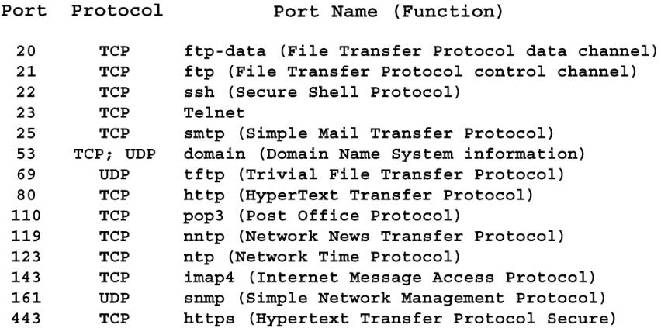
Well-Known TCP/UDP Ports
Port identifies higher layer protocol

Slide 187
Where the Bank's Applications Live Now: On-Premises, Hosted, SaaS
Branch
Headquarters
Bank data center
Cloud
Vendors
Teller and platform PCs
ATM
Cameras and alarm
File and print servers
Phone system
Loan and ops workstations
Active Directory
Backup
In-house core (a few banks)
Microsoft 365
CRM and HR
Board portal
Core processor
Card processing
Online and mobile banking
On-premises
The bank owns and runs the servers, in its own building
Hosted
The vendor runs a copy dedicated to the bank, in the vendor's data center
SaaS
One shared application for many customers, reached over the internet
Every arrow between these columns is a network path.
Notes:
The anchor scenario one more time, now through the lens of applications: branch, headquarters, the bank's own data center (or a colocation cage), the cloud, and vendors.
Walk left to right. Very little runs in the branch any more: the teller PC is mostly a window onto applications that live elsewhere. Headquarters may still hold file and print servers and the phone system. A few community banks still run their core in-house; most don't. Microsoft 365, CRM and HR systems are SaaS. The core, card processing and digital banking usually live at vendors.
Three delivery models on the bottom row. On-premises: the bank owns and runs it. Hosted: the vendor runs a copy dedicated to the bank in the vendor's data center. SaaS: one shared application for many customers, reached over the internet.
The point for examiners: every arrow between these columns is a network path, and the further right an application lives, the more the bank depends on circuits and vendors it doesn't control.

Slide 188
Chapter 24: Core Banking
Notes:
The core is the bank's most important application and, for most community banks, the most important vendor connection. This chapter covers what a core does, who provides it, the network path from the branch to the core, and where core technology is heading.

Slide 189
What a Core System Does
Tellers
Deposit accounts
ATMs and debit
Loan accounts
Customer information file
Online and mobile
The core
the bank's system of record
Interest and fees
ACH and wires
General ledger
Card networks
If the core is down, or the path to it is,
the bank can't post a transaction.
Statements and notices
Channels feed it
What it keeps
Notes:
The core is the bank's system of record: the official books. If it isn't in the core, it didn't happen.
Left side: the channels that feed it. Tellers, ATMs and debit cards, online and mobile banking, ACH and wires, and card networks all end up posting to the core.
Right side: what the core keeps. Deposit and loan accounts, the customer information file (CIF, one record per customer across all accounts), interest and fee calculations, the general ledger, and the statements and notices that go out.
Many cores still run a nightly batch: during the day, transactions are 'memo posted' so balances look current, and the official posting happens overnight. Real-time payments (Tuesday) are pushing cores toward posting in real time.
Network point: every channel on the left is a connection into the core. If the core or the path to it is down, the bank can't post a transaction, and the branches feel it first.

Slide 190
The Big Core Providers: Jack Henry, Fiserv, FIS
Fiserv
Jack Henry
FIS
~42%
~21%
~9%
of U.S. banks
of U.S. banks
of U.S. banks
Largest by number of banks. Several core platforms, many from acquisitions.
Focused on community banks and credit unions. Building a cloud-native core.
Stronger among larger banks. Also a major card and payments processor.
Together, the core provider for more than 70% of U.S. banks: concentration risk, in one slide.
Source: Federal Reserve Bank of Kansas City, "Market Structure of Core Banking Services Providers" (2022 data). Shares are approximate.
Notes:
Three companies provide the core for most U.S. banks. In a Kansas City Fed study of 2022 data, Fiserv served about 42% of banks, Jack Henry about 21%, and FIS about 9%: together more than 70%.
Each sells several core platforms, often from acquisitions, and each delivers them in different ways: in-house licenses, service bureau, and hosted or cloud. Fiserv is the largest by bank count. Jack Henry is heavily focused on community banks and credit unions. FIS skews toward larger institutions.
Why examiners care: concentration risk from Wednesday. When one of these providers has an outage or a security incident, hundreds of banks are affected the same morning. And because a core conversion is expensive and slow, banks rarely switch, which limits their leverage in contract negotiations.
The 2022 figures are the most recent published study I found; treat them as approximate.

Slide 191
How the Branch Talks to the Core: The Network Path of a Transaction
1
2
3
4
5
Teller PC
Deposit entered
Branch router
Leaves the LAN
WAN
MPLS, SD-WAN or VPN
Processor
Data center
Core
Posts and replies
Round trip: well under a second, hundreds of times a day per branch.
What breaks it
Branch circuit
No backup path means no transactions
Tunnel or circuit to the processor
Down at the bank end or the processor end
Processor outage
Hundreds of banks at once
The quiet ones
An expired certificate, a DNS error, a bad firewall change
Ask: does the teller system have an offline mode, and when was it last used?
Notes:
Trace one deposit, the way we traced traffic on Tuesday.
1. The teller enters the deposit in the teller application on the branch PC.
2. The request crosses the branch LAN to the branch router or firewall.
3. It leaves the branch over the WAN: an MPLS circuit, an SD-WAN tunnel, or an IPsec VPN over the internet, sometimes through headquarters first.
4. It arrives at the core processor's data center (or the bank's own, for an in-house core), over a VPN or private circuit to the processor.
5. The core posts the transaction and sends back an approval and a new balance. The teller prints the receipt.
All of that happens in well under a second, hundreds of times a day per branch.
What breaks it: the branch circuit, the tunnel, the processor, or something quieter like an expired certificate or a DNS problem. Many teller systems have an offline or store-and-forward mode for exactly this reason. Ask whether the branch has used it and how the backlog was posted afterward.

Slide 192
From Service Bureau to Cloud: How Core Delivery Has Changed
In-house
Service bureau
Hosted
Cloud-delivered
Bank's own hardware and staff
Processor runs one system for many banks
The bank's own instance, in the vendor's data center
Vendor runs it in its cloud or a public cloud
Connects by
Inside the bank's LAN
Connects by
Leased line to the processor
Connects by
Private circuit or VPN
Connects by
Internet, VPN and APIs
Older → newer. All four still exist today.
The connection to the processor became the bank's most important circuit, and its backup just as important.
Notes:
Four ways a bank has gotten its core, roughly in historical order. All four still exist today.
In-house: the bank buys or licenses the core and runs it on its own hardware with its own staff. Now rare at community banks.
Service bureau: the processor runs the core in its data center for many banks; the bank connects with a leased line and, historically, sent work in batches. This is the oldest form of outsourcing in banking.
Hosted (sometimes called 'remote' or 'outsourced in-house'): the bank has its own instance and often its own staff using it, but it runs in the vendor's data center. Connection: private circuit or VPN.
Cloud-delivered: the vendor runs the core in its own cloud or on a public cloud provider. The bank connects over the internet or a VPN, often through APIs.
What changed for the network: the connection to the processor became the most important circuit the bank has, and its backup became just as important.

Slide 193
What's Next for Core: APIs and Modular Cores
Traditional: one big system
Modular: components linked by APIs
Deposits
Lending
Payments
Ledger
Deposits
Loans
Customers
API layer
Ledger
Payments
Reports
Digital banking
Fintech partner
Analytics
Integrations go through the core vendor
Add a product or partner without waiting on one vendor
More API traffic
Much of it over the internet
More parties in the path
Each one a vendor to manage
Keys and tokens
The new credentials to protect
Which ledger is official?
Remember Synapse
Notes:
Traditional cores are monolithic: deposits, loans, customer records and the ledger are one big system, often decades old, and integrations happen through the vendor.
The newer approach breaks the core into components (deposits, lending, payments, ledger) that talk to each other and to everything else through APIs. Banks can add a new product, or a new fintech partner, without waiting for the core vendor. This is the same microservices idea from Wednesday's virtualization chapter.
Both the big three and newer cloud-native firms are building these. Few community banks have fully converted; more are running a modern component alongside the old core, for example a new digital deposit product on a separate ledger.
Network view, bottom row: more API traffic, more vendors in the path, keys and tokens to protect, and the question of which system holds the official record. That last one is Synapse from Wednesday.

Slide 194
Open Banking and the API Economy: The Network View
Screen scraping
API with a token
password
logs in as you
approves
API + token
The app holds the customer's password. The bank can't tell the app from the customer.
A limited token instead of the password. The bank sees who's calling and can revoke it.
CFPB Section 1033 rule
Finalized October 2024. Being rewritten since 2025; a court blocked enforcement in October 2025.
Deadlines effectively on hold. Check the news before class.
Either way, the network needs
An API gateway in front of the bank's data
Rate limits and monitoring
A clear answer to who is calling
Sources: CFPB Personal Financial Data Rights rule (Oct 2024); Open Banking Tracker, Section 1033 status (June 2026)
Notes:
Customers want to connect their bank accounts to other apps: budgeting tools, payment apps, lenders checking income. For years that worked through screen scraping: the customer gave the app their online banking username and password, and the app logged in as them. The bank couldn't tell the app from the customer, and the app held the customer's password.
The better way is an API: the customer approves access at the bank, the app gets a limited token rather than the password, and the bank can see and revoke it. Industry groups such as FDX have built standard APIs for this.
Regulation (as of mid-2026): the CFPB finalized its Section 1033 'personal financial data rights' rule in October 2024, which would require banks to provide this data through APIs. In 2025 the CFPB said it would rewrite the rule, and in October 2025 a federal court blocked enforcement while it does. The original 2026 to 2030 deadlines are effectively suspended. Check for news before class; this is moving.
Network view: whichever way the rule lands, banks (or their digital banking vendors) are exposing APIs to the internet. Those need an API gateway, rate limits, monitoring, and a clear answer to who is calling.

Slide 195
InTREx Tie-In: Core Processing
Information Technology Profile · Core Processing
“
1. Indicate whether core applications are outsourced or hosted in-house. (Each: Outsourced or In-House)
The critical business processes that are dependent on external connectivity have been identified.
General Ledger
Loans
Deposits
Investments
InTREx Management module baseline statement
Trust
If the circuit to the core went down at 10 a.m.?
Where question 1 leads
Vendor management
Due diligence, contracts and monitoring of the core processor
Network path
The circuit to the processor, and its backup
Business continuity
What the branches do when the core is unreachable
Data flow diagrams
Baseline: information flow to external parties is documented
Source: InTREx Information Technology Profile and Management module (September 2023 version)
Notes:
Question 1 on the IT Profile, the very first thing the bank tells examiners about its technology: is each core application outsourced or hosted in-house? General ledger, loans, deposits, investments, trust. Most community banks check 'outsourced' for nearly everything.
The quote is a Management module baseline statement, and it's the network question hiding behind question 1: has the bank identified which critical business processes depend on external connectivity? If the core is outsourced, the answer is 'almost all of them'.
Ask the room: if the circuit to the core processor went down at 10 a.m., which processes stop, and does the bank's business continuity plan say what happens next?
The bottom row is where an 'outsourced' answer leads: vendor management (Wednesday), the network path and its backup (Tuesday), business continuity, and the data flow diagrams the next baseline statement asks for.

Slide 196
Chapter 25:
SaaS and Business Applications
Notes:
Beyond the core, a bank runs on SaaS: Microsoft 365, digital banking, CRM, HR. Each is a vendor reached over the internet, and each holds bank data.

Slide 197
Microsoft 365: Email, Files, and Identity in the Cloud
Microsoft 365
Identity is the new perimeter
A stolen password without MFA opens email, files and more, from anywhere, without touching the bank's firewall.
Branch
Exchange Online
email
SharePoint and OneDrive
files
Teams
chat, meetings, calls
Home office
Anywhere
Entra ID: identity
One login for all of it, and often other SaaS apps too
Over the internet, from anywhere
MFA and conditional access
Who can log in, from what device, from where
Tenant configuration
The bank's side of shared responsibility
Outages
No email, files or Teams: what's the plan?
Backup
Retention isn't backup; many banks add a third-party backup
Notes:
Microsoft 365 is the SaaS almost every community bank runs. It replaced the email server, the file server and often the phone system, and it's where staff log in to everything else.
Four pieces: Exchange Online for email, SharePoint and OneDrive for files, Teams for chat, meetings and often calling, and Entra ID (formerly Azure AD) for identity. Entra ID is the important one: the same login opens email, files, Teams, and frequently other SaaS apps through single sign-on.
That makes identity the new perimeter. A stolen password plus a missing MFA prompt opens everything, from anywhere, without touching the bank's firewall.
Bottom row, what examiners should ask about: MFA and conditional access (rules like 'only from bank devices' or 'not from overseas'); tenant configuration, which is the bank's side of shared responsibility; what happens during a Microsoft outage; and backup. Microsoft keeps the service running, but recovering deleted or encrypted data beyond retention settings is the bank's job, which is why many banks add a third-party backup.

Slide 198

Email Services
Your_Name@aDomain.TLD

Slide 199

Let me ask you…
Is Google Gmail an email service, a WWW service or something else?

Slide 200


Simple Mail Transfer Protocol
POP3,
IMAP
SMTP
SMTP
Sending
Client
Sender’s
Server
Recipient’s
Server
Intended
Recipient
Client/server model
Simple, text-based command language
  Identify sender and receiver(s), transmit message, and provide confirmation
Developed to transport simple text notes only
  Extended using MIME to include attachments
Requires retrieval protocols
  Post Office Protocol v3 (POP3)
  Internet Message Access Protocol (IMAP)
  HyperText Transfer Protocol (HTTP) for web-based access

Slide 201
Internet and Mobile Banking: Usually Someone Else's Servers
VPN, circuit or API
Customer
Phone or browser
Internet
Digital banking vendor
Vendor data center or public cloud
Core
Core processor
IT Profile question 6
Consumer and commercial internet banking, mobile banking, mobile deposit, remote deposit capture: outsourced or in-house? Expect “outsourced.”
The bank's own network: often not in the path
Front-door protection
Who handles DDoS and bot attacks?
Customer authentication
MFA, device recognition, step-up for risky actions
Always on
Customers expect 24x7; what does the SLA promise?
Real or fake?
FDIC digital sign on the login page by April 1, 2027
Sources: InTREx IT Profile Q6 (September 2023 version); FDIC final rule amending 12 CFR Part 328 (Federal Register, January 29, 2026)
Notes:
When a customer logs in to their bank's website or app, they almost never reach a server the bank owns. Online and mobile banking at community banks is usually provided by a digital banking vendor, sometimes the core provider and sometimes a separate company, running in the vendor's data center or in a public cloud. The vendor connects back to the core over a VPN, private circuit, or API.
The bank's own network is often not in the path at all. The bank's brand is on the front door; the vendor runs the house.
IT Profile question 6 asks exactly this: consumer and commercial internet banking, mobile banking, mobile deposit and remote deposit capture, each outsourced or in-house. Expect 'outsourced' for nearly everything.
Questions: who runs DDoS protection for the front door? What authentication does the vendor provide (MFA, device recognition)? What's the uptime commitment, since customers expect 24x7? And how would a customer tell the real site from a lookalike? The FDIC's official digital sign, required on the login page by April 1, 2027 under the amended Part 328 rule, is one small piece of that answer.

Slide 202
CRM, HR, and the Rest of the SaaS Stack
CRM
HR and payroll
Loan origination
Board portal
Holds: Customer contacts, sales pipeline
Holds: Employee SSNs and bank accounts
Holds: Full credit files
Holds: Minutes, exam findings
E-signature
Accounting and AP
Training
Marketing email
Holds: Signed loan and account documents
Holds: Vendor payments
Holds: Staff records
Holds: Customer email lists
Each holds bank data, each is a vendor, each is reached over HTTPS.
Single sign-on and MFA help. Is every one of these in the vendor inventory?
Notes:
Beyond the core and Microsoft 365, a typical community bank subscribes to a long list of SaaS applications. Each holds bank data, each is a vendor, and each is reached over HTTPS from wherever staff happen to be.
Walk the grid and ask what data each one holds. HR and payroll systems hold employees' Social Security numbers and bank accounts. Loan origination holds full credit files. The board portal holds board minutes and exam findings. These are sensitive, and they're all outside the bank's network.
This is the approved list. Wednesday's shadow IT slide was about the apps nobody approved.
Network-side controls that help: single sign-on through Entra ID (one place to turn off a departing employee's access), MFA everywhere, and the vendor inventory. Examiner question: does the vendor inventory include all of these, and is each one tiered by the data it holds?

Slide 203
Chapter 26: DNS In Depth
Notes:
DNS is the phone book every application depends on. This chapter goes deeper than Tuesday: how resolution works, who controls the bank's domain, the records that matter, email authentication, how DNS fails, and protective DNS. Ends with Exercise 4.

Slide 204
How Do We find Applications?
The Domain Name System (DNS) provides a distributed directory of internet resources
Essentially the directory assistance of the internet
Converts uniform resource locators (URLs) to IP addresses
Registries are databases that contain the domain names under the top-level domains they administer
Registrars are accredited companies that delegate domain names to interested parties

Slide 205
Resolving a Name, Step by Step
Looking up
online.examplebank.com
Root servers
“Ask .com”
steps 2–3
1
Resolver
bank DNS, ISP, or protective DNS
caches answers
The .com servers
“Ask examplebank's servers”
steps 4–5
8
Teller laptop
examplebank.com authoritative
“Here's the address”
steps 6–7
The resolver sees every lookup
Caching is why changes take time
Control any step, redirect everyone
Notes:
What happens when a teller's browser goes to online.examplebank.com.
1. The laptop asks its resolver. At a bank, that's usually the bank's own DNS server, the firewall, the ISP's resolver, or a protective DNS service.
2. If the resolver doesn't have the answer cached, it asks a root server: who handles .com?
3. The root points to the .com servers (run by Verisign).
4. The resolver asks .com: who handles examplebank.com?
5. The .com servers point to examplebank.com's authoritative name servers, wherever the bank (or its DNS host) put them.
6. The resolver asks the authoritative server for online.examplebank.com.
7. The answer comes back: an IP address, often the digital banking vendor's.
8. The resolver caches it for the record's time-to-live (TTL) and hands it to the laptop.
Takeaways: the resolver sees every name everyone looks up (that's why protective DNS works), caching is why DNS changes take time to spread, and an attacker who controls any step can send the bank's staff or customers somewhere else.

Slide 206
Who Controls the Bank's Domain
Registry
Runs the top-level domain. Verisign runs .com; fTLD runs .bank
Registrar
Sells and manages the registration. The account that controls the domain
Registrant
The legal owner. Should be the bank, not a person
DNS host
Runs the authoritative servers. May be another company again
How banks lose control of their domain
Ask
Whose name and email is the registrar account in?
Is MFA on? Auto-renew?
Is registry lock enabled?
Who gets alerted to changes?
Registered years ago by a former employee or web designer, on a personal email
Expired because the renewal card expired
Registrar account phished, no MFA
Records changed with no alert
Notes:
Three roles. The registry runs a top-level domain: Verisign runs .com; fTLD Registry Services runs .bank. The registrar is the company the bank pays to register its name (GoDaddy, Network Solutions, and many others, often through the bank's web or IT vendor). The registrant is the bank, the legal owner. A fourth, DNS hosting, is whoever runs the authoritative servers, and it may be a different company again.
Whoever controls the registrar account controls the domain: they can point the website and email anywhere. So the questions are about that account. Who has the login, is it in the bank's name, is MFA on, is auto-renew on, and is 'registry lock' enabled so changes need extra verification?
Real failure modes: a domain registered years ago by a former employee or a long-gone web designer on a personal email address; a domain that expires because the renewal card expired; a registrar account phished without MFA.
.bank is a restricted top-level domain only verified banks can register, with required security such as DNSSEC and email authentication. It makes lookalikes harder, but adoption among community banks is limited.

Slide 207
DNS Records That Matter to a Bank
Record
Example
Why it matters to a bank
A / AAAA
www.examplebank.com → 203.0.113.10
Where the website is
MX
examplebank.com → mail.protection.outlook.com
Where email is delivered
CNAME
online.examplebank.com → bankname.digitalvendor.com
Points to a vendor; dangling after a vendor change
TXT
v=spf1 include:spf.protection.outlook.com -all
Email authentication and ownership proof
NS
examplebank.com → ns1.dnshost.net
Who's in charge of the domain
Someone should know what records exist, and clean them up when vendors change.
Notes:
Five record types cover almost everything an examiner will hear about.
A and AAAA: a name to an IPv4 or IPv6 address. www.examplebank.com points to the web server.
MX: where the domain's email is delivered. For most banks that's Microsoft 365 or an email security gateway in front of it.
CNAME: an alias. online.examplebank.com is often a CNAME pointing to the digital banking vendor's platform. If the bank later leaves that vendor and forgets the CNAME, an attacker who claims the old vendor address can take over the bank's subdomain. That's called a dangling record or subdomain takeover.
TXT: free-form text, used for SPF, DKIM and DMARC (next slide) and for proving domain ownership to services like Microsoft.
NS: which servers are authoritative for the domain, which is to say who's in charge.
Examiner angle: someone at the bank (or its vendor) should know what records exist and why, and should clean them up when vendors change.

Slide 208
DNS Email Authentication: SPF, DKIM, DMARC
SPF
Who may send for us
A list of allowed sending servers
DKIM
Proof it came from us
A signature on each message; the key is in DNS
DMARC
What to do if checks fail
None, quarantine or reject, plus reports to the bank
examplebank.com TXT "v=spf1 include:spf.protection.outlook.com -all"
_dmarc.examplebank.com TXT "v=DMARC1; p=reject; rua=mailto:dmarc@examplebank.com"
p=none is monitoring, not protection.
Ask what the bank's DMARC policy is, and how long it's been there.
Protects the bank's own domain.
Does nothing against examp1ebank.com. That's Exercise 4.
Notes:
Email was built with no way to prove who sent a message. These three DNS-based standards add that proof for a domain.
SPF: a TXT record listing the servers allowed to send mail for the domain. The receiving server checks the sender's IP address against the list.
DKIM: the sending server signs each message; the public key is published in DNS so receivers can verify the signature and know the message wasn't altered.
DMARC: ties the two to the visible From address and tells receivers what to do when checks fail: nothing (p=none), send to spam (p=quarantine), or block (p=reject). It also sends the domain owner reports on who is sending mail as them.
The trap: p=none is monitoring, not protection. Plenty of banks have published DMARC at p=none and stopped there.
Large mailbox providers (Google, Yahoo, and Microsoft for Outlook.com) now require SPF, DKIM and DMARC from bulk senders, which pushed many organizations to finally set them up.
Tie to business email compromise: these protect the bank's own domain from being spoofed exactly. They do nothing against a lookalike domain, which is Exercise 4.

Slide 209
When DNS Fails: Outages, Hijacking, and Lookalike Domains
Outages
Names stop resolving; working servers become unreachable.
Example
Dyn, 2016; AWS, October 2025
Hijacking
Attacker changes where the bank's name points.
Example
Registrar or DNS host account taken over
Lookalike domains
Attacker registers a name that looks like the bank's.
Example
examp1ebank.com, examplebank-secure.com
What helps
Redundant DNS hosting
What helps
Registry lock, MFA, DNSSEC, change alerts
What helps
Lookalike monitoring, sender warnings, call-back checks
Notes:
Three ways DNS hurts a bank.
Outages: if the bank's DNS host or a major provider fails, names stop resolving and everything that depends on them stops, even though the servers are fine. The 2016 attack on DNS provider Dyn took down major websites across the U.S. east coast, and the October 2025 AWS outage (Wednesday) started with a DNS problem. Ask whether the bank's DNS hosting has redundancy.
Hijacking: an attacker changes where the bank's name points, by taking over the registrar account or the DNS host, and sends customers to a fake site or reads incoming email. State-backed campaigns have done this to government and company domains. Registry lock, MFA, DNSSEC and change alerts are the defenses.
Lookalike domains: the attacker doesn't touch the bank's DNS at all. They register examp1ebank.com or examplebank-secure.com and use it for phishing and business email compromise. Defenses: monitoring for newly registered lookalikes, external-sender warnings in email, protective DNS that blocks newly registered domains, and verification by phone for payment changes.
Facts here are from memory and widely reported; verify before quoting dates.

Slide 210
Protective DNS and Filtering
“Where is badsite.com?”
Normal site: answered
Protective DNS
Checks every lookup against threat intelligence
Known bad or brand-new domain: blocked
Every lookup logged
Blocks
Phishing sites, malware call-backs, newly registered domains
Logs
What staff and devices actually reach: shadow IT, incident evidence
Bypassed by
Laptops at home, phones on cellular, browsers using encrypted DNS
Who provides it
Usually the firewall vendor or MSSP
Notes:
Protective DNS is a resolver that checks each lookup against threat intelligence before answering. If the name is a known phishing site, malware command server, or a domain registered yesterday, it refuses to answer or sends the user to a block page, and it logs the attempt.
Why it's popular: cheap, simple, and it works for every device that uses it, including IoT devices that can't run security software. Malware that has to 'phone home' usually starts with a DNS lookup, so blocking that lookup can stop it. CISA runs a protective DNS service for federal agencies; for banks it typically comes from the firewall vendor, the MSSP (Wednesday), or services such as Cisco Umbrella, Cloudflare or Quad9.
The logs are as valuable as the blocking: they show which sites and SaaS services staff actually reach (shadow IT again) and help reconstruct an incident.
Limits: it only works if devices actually use it. Laptops at home, phones on cellular, and browsers using encrypted DNS (DNS over HTTPS) can bypass it unless the bank configures them not to. And it's one layer, not a firewall.

Slide 211
Exercise 4: The Lookalike Domain
Monday, 9:12 a.m.
1
Would SPF, DKIM or DMARC have stopped it?
On the bank's real domain
From: Tom Reilly, CEO <ceo@examp1ebank.com>
To: CFO
2
What could have flagged it?
Email, DNS and monitoring controls
Need a wire of $48,000 to our new title company today. I'm traveling and can't talk. Instructions attached. Thanks, Tom
3
What would stop the wire anyway?
Process controls
The real domain is examplebank.com.
4
If the wire already went out, who do you call first?
In order
About 30 minutes
20 at tables, 10 report-out
No diagram needed for this one
Report out
Your answer to question 4, and the one control you'd add first
Notes:
Scenario, read it aloud: Monday, 9:12 a.m. The bank's CFO gets an email from the CEO asking her to wire $48,000 to a new title company today; the CEO is traveling and can't talk. The From line shows the CEO's name. The address is ceo@examp1ebank.com, with the digit 1 in place of the letter l. The real domain is examplebank.com.
Tables work through four questions:
1. Would SPF, DKIM or DMARC on examplebank.com have stopped this message? (No. The attacker owns examp1ebank.com and can set up perfectly valid SPF, DKIM and DMARC for it. Email authentication protects the bank's real domain from exact spoofing, not lookalikes.)
2. What could have flagged it? External-sender banner on email from outside the bank; protective DNS or the email gateway flagging a newly registered domain; lookalike-domain monitoring; display-name warnings.
3. What process control would stop the wire even if the email got through? Call-back verification to a known number, dual control on wires, a rule against changing payment instructions by email.
4. If the wire already went out, who does the bank call first, and in what order? Its own bank's wire room and the receiving bank (recall), law enforcement (FBI IC3), and the incident response plan, including whether this is a notification incident.
Timing: about 20 minutes at tables, 10 minutes report-out. Debrief point: the network controls narrow the odds; the process control is what actually saves the money.

Slide 212
Chapter 27: Voice
Notes:
Voice is an application too. A short arc from PBX and key systems to VoIP, SIP, hosted voice and cloud contact centers, with the network and security considerations for each.

Slide 213
Thoughts on Telephony
It changed the world
Ability to talk in real time over long distances changed society
  News could be learned in real time
  Commerce could be conducted quickly
  Relationships made and maintained
Spurred technology innovation
  AT&T Bell Labs was a global leader in invention and development
  AT&T competition was equally inventive
Was the home of tech giants in its heyday
Telephone networks were used to connect computers
Now relegated to being an application in a world of data

Slide 214
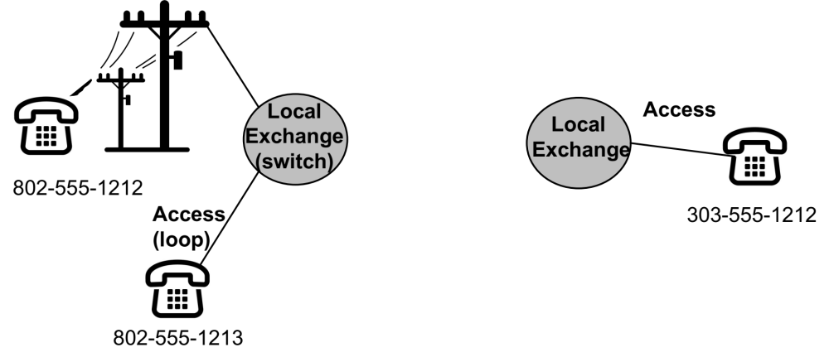
Telephone Network Elements
Trunk

Slide 215
Private Branch Exchange
PBX places telephone switch on business site
  CapEx reduces OpEx
Phones connect to switch using premises wiring
Switch connects to the PSTN using a trunk
Offered lots of features
Very popular 1980s to early 2000s
Many business have migrated to hosted solutions

Slide 216
Key Systems: The Small-Office Phone System
L1
L2
L3
Also on copper, same closet
Alarm and fire panels
Elevator phones
Fax machines
Backup dial lines
3 lines
Key system unit
in the closet
L1
L2
L3
Carrier
copper lines
L1
L2
L3
L1
L2
L3
Every phone has a button for every line
Carriers are retiring copper phone lines. Everything on them needs a new path.
Is there an inventory of copper lines?
What is each one for?
What replaces it: cellular or VoIP?
Notes:
Between a single phone line and a full PBX sits the key system, the classic small-office phone system and for decades the standard in bank branches.
A small cabinet (the key service unit) in the closet connects a handful of carrier lines to every desk phone. Each phone has a button for each line: anyone can pick up line 2, put it on hold, and someone else can take it from another desk. There's no switching intelligence to speak of, which is the difference from a PBX.
Where you'll still find them: older branches that never moved to VoIP. More important for examiners are the other copper lines in the same closet: alarm panels, fire panels, elevator phones, fax machines, and sometimes ATMs or point-of-sale backup dial lines.
Carriers are retiring copper phone lines (POTS) across the country, with regulators allowing it. When a branch's copper goes away, every one of those devices needs a new path, usually cellular or VoIP. Ask whether the bank has an inventory of its copper lines and what each one is for.

Slide 217
Voice moves to IP
The 1990s saw the commercialization of the internet
As the internet took off, millions of users were looking for things to do in this new world
Innovation drove significant advances in technology of networking, computing and applications
As corporate networks moved to IP technology, so did the world of telephony
Voice over IP (VoIP) has almost completely replaced the old phones and switching systems
VoIP may, or may not, use the internet for connection and transport

Slide 218
VoIP Brings New Capabilities
Greater call control capabilities managed via a portal
Allows simple call forwarding to other devices (phones, apps)
  One number, many devices, anywhere
Mobile phone apps allow calling from the office number within the app
Rich in traditional telephony features, simpler to use
Integration with conferencing capabilities (video, chat/IM, etc.)
Improved business continuity options

Slide 219
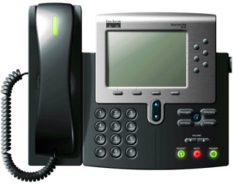

Signaling Control: The Role of SIP
Signaling protocol for multimedia sessions
Dominant IPT signaling protocol
Signaling
Control
IP Phone
SIP

Slide 220
SIP Trunks
An IP telephony (IPT) trunk
Designed for use with an IP PBX
Typically shares voice and data
  Burst data when voice not in use
  Maximum concurrent calls configured
Call signaling over the trunk is SIP
Carrier
Voice Services
IP Network
SIP Trunk
Private
Corporate IP
Network

Slide 221
Hosted VoIP
Back to the old model of the intelligence (switch) being in a provider’s network
Looks and acts like a land line.
Offers many business continuity capabilities
Generally lower cost than premises solution for small and medium sized businesses
Like old systems most features are lightly used
Solutions may use the internet for access or private (trunk) connection

Slide 222
Contact Centers Move to the Cloud
Cloud contact center
Branch
CRM and core
customer record pops up for the agent
Phone menu (IVR)
Queues and routing
Ops center
Customer
Call recording
AI agents
Home
Agents, over the internet
Voice quality
Depends on the internet path to every agent
Recordings
Customer information, stored in the vendor's cloud
Caller authentication
The phone menu can move money: a fraud target
AI on both sides
AI agents answering; cloned voices calling
Notes:
Bank call centers, even small ones, have moved to cloud contact center platforms (often called CCaaS): Five9, NICE CXone, Genesys Cloud, Amazon Connect and others, or contact-center features built into the bank's hosted phone system.
How it works: the customer's call reaches the platform in the cloud, which handles the phone menu (IVR), queues, and recording, and routes the call to an agent anywhere with an internet connection: a branch, the operations center, or home. The platform connects to the CRM and core so the agent sees the customer's record when the call arrives.
Network considerations: voice quality now depends on the internet path to every agent (latency and jitter from Tuesday). Call recordings contain customer information and live in the vendor's cloud. The IVR often authenticates callers and can move money, so it's a fraud target. And AI is arriving fast here: AI agents answering calls, and on the other side, cloned voices impersonating customers.
Questions: where do recordings live and who can reach them? How are callers authenticated? What happens if the platform is down?

Slide 223
VoIP Network Considerations
Does the VoIP traffic share a LAN with data?
How is voice quality ensured?
What type of connection is used to connect to the PSTN?
If this connection goes down, what happens to the ability to make and receive calls?
Do employees have portal access to manage their phone service? If so, what access controls are in place for them?
What bank functions may be impaired by the loss of telephone services?

Slide 224
Voice Security Considerations
Management access and controls
Patching
Separate LAN zone
Encryption
On premises or hosted
Connection to provider
  Private
  Internet
Business continuity

Slide 225
Chapter 28: Internet of Things
Notes:
Cameras, door controls, HVAC, ATMs: devices on the bank network that IT often doesn't manage. Short chapter; the key point is inventory and segmentation.

Slide 226
Internet of Things: Some Sample Things
Automation
Communication
Monitoring
Transportation
Management
Intelligence?

Slide 227
IoT in the Bank: Cameras, HVAC, Door Controls, ATMs
Cameras
Managed by: Security integrator
Alarm panel
Managed by: Alarm company
Door and vault access
Managed by: Security integrator
HVAC and building
Managed by: HVAC contractor
ATM
Managed by: ATM vendor
Video teller
Managed by: Vendor
Digital signage
Managed by: Marketing vendor
Printers
Managed by: Copier vendor
Often managed by someone other than IT, with remote access, on the bank's network.
Inventory
Know every device
Segment
Not on the teller network
Vendor access
Controlled and logged
Defaults
Passwords changed, firmware updated
Notes:
A branch is full of network-connected devices that aren't computers: cameras and the video recorder, the alarm panel, door and vault access controls, the HVAC and building controls, the ATM and video teller machines, digital signage, and printers.
The pattern that matters: many of these are installed and managed by someone other than IT. The alarm company, the HVAC contractor, the ATM vendor and the security integrator each may have remote access to their device, and some of those devices sit on the bank's network.
The classic case: in 2013 attackers got into Target's network using credentials stolen from its HVAC contractor, then moved to the payment systems. The lesson isn't HVAC; it's that a vendor-managed device on a flat network is a path to everything else.
Four controls on the bottom row. Cards from the reused slides that follow go deeper.

Slide 228
IoT Security Concerns
Estimates for IoT suggest 20 billion devices will be connect via the internet in the next 10 years
What emphasis will be placed by developers on security?
Will consumers and businesses implement controls?

Slide 229
IoT Things to Consider
What mechanism is used to track the devices?
How are updates made to the device?
Can the device be checked by the vulnerability scanner?
What data is collected by the device and where is it stored?
What software is on the device? Can it be hardened?
How are the devices configured and managed? Can access be recorded in the log system?
What connectivity options are there for the device? How are they managed?

Slide 230
Chapter 29: The Risk Landscape
Notes:
Pulls the week together from the risk side: recap the network considerations from Monday and Tuesday, then ransomware, supply chain attacks, zero trust, baseline frameworks, and incident response, each framed around how it moves across or depends on the network.

Slide 231
Networks
Customers
WFH
Service
Providers
internet
Branches
Where are the threats to security in this diagram?
What questions do we need to ask?
Private
Network
HQ/datacenter

Slide 232
Network Security
It starts with taking inventory
  End user systems
  Servers
  Network elements
  Networks
Followed by risk analysis
Activities and tools designed to protect the usability, reliability, integrity of a network and corporate data housed within.

Slide 233
Inventory
If we don’t know we have it, we can’t protect it
End user systems and servers contain networking elements that need to be kept current (patched)
Many systems are now being networked and are classified as part of the Internet of Things (IoT)
Networking elements and networks need to be protected and require attention beyond those supporting end user systems
Technology refresh needs to be part of the plan

Slide 234
Ethernet Considerations
Switch location and access
Administrative access control
  Limit who has access
  Log access and changes
  Closely manage remote access
Firmware and management software patching
Rogue device identification
VLAN design, management, interconnectivity
Encryption

Slide 235

Wi-Fi Considerations
Access Points should be commercial grade
Firmware upgrade
Control access to resources through the creation of separate networks (SSIDs) based on need
Use strong passwords
  Change policy
Rogue devices
Management access controls
Implement time profiles to stop after hour access
Mesh management

Slide 236
WAN Considerations
Management access controls and logging
Provider and customer roles
Access
Business continuity
Private
  SLAs
  Encryption
  Zone implementation
Internet
  Perimeter protection (firewall, IDS/IPS…)
  VPN management
    Certificates, AAA...
    Licenses
Private Line
Ethernet
MPLS
internet

Slide 237
Ransomware: How It Moves Across a Bank Network
1. Way in
2. Foothold
3. Spread
4. Steal
5. Encrypt
6. Extort
Phishing, stolen VPN password, unpatched firewall, vendor access
One PC or one account
Moves laterally, collects admin passwords
Copies data out over the internet
Servers, shares, backups
Pay to decrypt; pay to not publish
MFA on all remote access; patch edge devices
Endpoint detection (EDR)
Segmentation; separate admin accounts
Egress monitoring; protective DNS
Offline or immutable backups
A tested incident response plan
Six chances to break the chain, and most are network controls from this week.
Notes:
Ransomware is rarely one click and done. It's a sequence, and nearly every step depends on the network.
1. Way in: a phishing email, stolen VPN or remote-access credentials without MFA, an unpatched firewall or VPN appliance, or a vendor's remote access.
2. Foothold: one compromised PC or account.
3. Spread: the attacker moves laterally, often over days or weeks, collecting administrator credentials and mapping the network. A flat network makes this easy.
4. Steal: data is copied out over the internet before anything is encrypted, so the attacker can threaten to publish it (double extortion).
5. Encrypt: servers, file shares and, if they can reach them, backups.
6. Extort: pay to decrypt, pay to not publish.
Under each step is the control that breaks the chain. Point out that most of them are network controls we've covered this week: MFA on remote access (Tuesday), segmentation (Monday), egress monitoring and protective DNS (today), offline or immutable backups (Tuesday's backup discussion). Defenders get six chances; the attacker has to succeed at all six.

Slide 238
Supply Chain Attacks: When the Vendor Is the Way In
trusted channel
What helps
Know which vendor software has broad network access
Give it only the access it needs
Watch its outbound traffic
Contracts that require prompt incident notice
Vendor
software update
thousands at once
SolarWinds, 2020
Backdoor in network monitoring software updates; about 18,000 customers installed it
Kaseya, 2021
Ransomware through MSPs' remote-management tool (Wednesday)
MOVEit, 2023
File-transfer flaw; data stolen from thousands of organizations, many of them banks' vendors
Notes:
A supply chain attack compromises something the bank trusts, a vendor's software or service, and rides that trust into many customers at once.
SolarWinds, 2020: attackers inserted a backdoor into updates for Orion, network monitoring software. About 18,000 customers installed the tainted update, and the attackers then chose a smaller set of high-value targets, including U.S. government agencies. Monitoring tools are a prize because they have broad network access by design.
Kaseya, 2021: covered Wednesday. Ransomware pushed through MSPs' remote-management software.
MOVEit, 2023: a flaw in a widely used file-transfer product let the Cl0p group steal data from thousands of organizations, many of them banks' vendors rather than banks. Customers learned they were affected through their vendors' breach notices.
What helps, right column: know which vendor software has broad network access, give it only the access it needs, watch its outbound traffic, and make sure vendor contracts require prompt incident notice (Wednesday). These figures are from memory; verify before quoting.

Slide 239
Zero Trust: Stop Trusting the Network
Castle and moat
Zero trust
Who is the user?
Every request, every time
Is the device healthy?
Is this access allowed?
Inside: trusted
Outside: not
Least privilege
Keep checking
A direction, not a product. Practical steps for a community bank:
MFA everywhere
Staff, admins, vendors
Conditional access
Rules on device and location
Segmentation
Monday's lesson, still the core
App access, not network access
Replace always-on VPN (ZTNA)
Vendor access
Specific systems, logged
References: NIST SP 800-207, Zero Trust Architecture (2020); CISA Zero Trust Maturity Model
Notes:
The traditional model is a castle and moat: a strong firewall at the edge, and anything inside the network is trusted. This week has shown why that breaks down: staff work from home, applications live in the cloud and at vendors, vendors have remote access, and ransomware spreads freely once it's inside.
Zero trust flips it: being on the network earns nothing. Every request is checked every time: who is the user (strong authentication), is the device healthy and managed, is this access allowed by policy, with the least privilege needed, and keep checking during the session.
It's a direction, not a product, whatever vendors say. NIST SP 800-207 (2020) is the standard reference, and CISA publishes a Zero Trust Maturity Model.
For a community bank, practical zero-trust steps look familiar: MFA everywhere, conditional access in Microsoft 365, segmentation, replacing the always-on VPN with access to specific applications (ZTNA), and tight control of vendor access. Examiners shouldn't expect a bank to 'have zero trust'; they can ask which of these steps it has taken.

Slide 240
Many Sources for Baseline Security Measures
NIST Cybersecurity Framework
Council on Cybersecurity Critical Security Controls
ISO 27001/2
International Information Systems Security Certification Consortium (ISC²)
Vendor whitepapers and case studies
The NIST CSF is doing heavy lifting these days.
With the FFIEC Cybersecurity Assessment Tool retired in August 2025, many banks moved to the CSF.
Notes:
Reused slide, with one addition: the NIST CSF is doing heavy lifting these days.
The FFIEC retired its Cybersecurity Assessment Tool (CAT) at the end of August 2025 and pointed institutions to other frameworks. Many banks moved to the NIST Cybersecurity Framework, now version 2.0 (February 2024), which added a sixth function, Govern, to Identify, Protect, Detect, Respond and Recover. Others use the CRI Profile, which is built on the CSF and tailored to financial services. Examiners are asking what each bank replaced the CAT with.

Slide 241
Incident Response: When Something Goes Wrong on the Network
Prepare
Detect
Contain
Recover
Learn
The clocks
36 hours
Bank to its primary regulator, after determining a notification incident
4+ hours
of disruption: service provider notifies the bank as soon as possible
Also
SARs, customer notice, law enforcement, the cyber insurer
Network's part
Logging on and kept: firewall, VPN, DNS, Microsoft 365
Network's part
Alerts from the MSSP, EDR, protective DNS
Network's part
Isolate a segment, disable accounts, cut vendor access
Network's part
Rebuild; restore from backups the attacker couldn't reach
Network's part
What would have caught it sooner?
Learn feeds back into Prepare.
If the logs weren't kept, nobody can say what the attacker touched.
That answer decides how many customers must be notified.
Sources: NIST SP 800-61 Rev. 3 (2024); Computer-Security Incident Notification rule (2021); InTREx Support and Delivery (September 2023 version)
Notes:
The standard lifecycle, from NIST SP 800-61: prepare; detect and analyze; contain, eradicate and recover; and learn from it. Revision 3 (April 2024) reorganized it around the CSF 2.0 functions, but the phases are still the right way to talk it through.
Under each phase is what the network contributes. Prepare: logging turned on and kept (firewall, VPN, DNS, Microsoft 365). Detect: alerts from the MSSP, EDR and protective DNS. Contain: isolate a segment, disable an account, block at the firewall, cut a vendor's access. Recover: rebuild and restore from backups that weren't reachable from the infected network. Learn: what would have caught it sooner.
Notification clocks, right panel: under the 2021 computer-security incident notification rule, a bank notifies its primary regulator within 36 hours of determining a notification incident occurred, and a bank service provider must notify its bank customers as soon as possible when an incident disrupts covered services for four or more hours. Separately: SARs, customer notice under the GLBA response-program guidance, law enforcement, and the cyber insurer, who often must be called before outside responders are hired.
Practical point for examiners: if the logs weren't kept, nobody can say what the attacker touched, and that drives how many customers must be notified.

Slide 242
InTREx Tie-In: Incident Response
Support and Delivery · Incident Response
“
13. Evaluate the incident response plan. Consider whether the plan:
Tools and processes are in place to detect, alert, and trigger the incident response program.
Defines responsibilities
Escalates to management and Board
Says when to notify regulators
Covers third-party incidents
InTREx Support and Delivery baseline statement
Recovers critical systems
Requires periodic testing
When the MSSP calls at 2 a.m., who answers?
Where incident response leads
Detection
Alert parameters, monitoring, MSSP reporting
Notification
Regulators within 36 hours; customers; law enforcement; SARs
Third parties
Incidents at service providers, and their notice to the bank
Testing
Exercises that include the MSSP and the core processor
Source: InTREx Support and Delivery, procedure 13 (September 2023 version)
Notes:
Incident response is Support and Delivery procedure 13 in the September 2023 InTREx. The left side lists some of what examiners evaluate in the plan: defined responsibilities, escalation including to senior management and the Board, when to notify law enforcement, regulators and customers (with an explicit reference to the incident notification rule), incidents at third-party service providers, recovery of critical systems, and periodic testing.
The quote is a baseline statement from the same procedure, and it's the network piece: tools and processes to detect, alert and trigger the plan. For most community banks those tools are the MSSP's monitoring, endpoint detection and log alerts, which loops back to Wednesday's network monitoring tie-in.
Ask the room: when the MSSP calls at 2 a.m., who at the bank answers, and does the plan say what they do next? And has the plan been tested with the MSSP and the core processor on the call, not just internally?

Slide 243
Chapter 30: Wrap-Up
Notes:
Close Thursday: recap the day, take questions, preview Friday.

Slide 244
Thursday Wrap-Up: Applications and the Risk Landscape
Applications
Most of them live somewhere other than the bank
Core banking
The circuit to the core is the bank's most important connection
SaaS
Each app is a vendor holding bank data
DNS
The phone book everything depends on
Voice
Copper to cloud; mind the alarm lines
IoT
Devices other people manage, on the bank's network
Risk landscape
Segmentation, MFA, vendor access, logging
Tomorrow (ends 11:00)
Looking ahead, quantum, fintech and M&A, and the capstone
Questions?
Notes:
Quick recap of the day, one line per chapter, then questions.
Applications: everything on the network exists to carry them, and most of a community bank's applications now live somewhere other than the bank.
Core banking: the system of record, usually outsourced, and the circuit to it is the bank's most important connection.
SaaS: Microsoft 365, digital banking and a long tail of apps, each a vendor holding bank data.
DNS: the phone book every application depends on, and a target in its own right.
Voice: from copper to cloud; watch the copper lines that alarms and other devices still use.
IoT: devices other people manage, on the bank's network.
Risk landscape: ransomware, supply chain and zero trust all come back to segmentation, MFA, vendor access and logging.
Friday preview: where networking is headed, quantum and what it means for encryption, fintech and M&A, then the capstone on the diagrams.

Slide 245
Chapter 31: Looking Ahead
Notes:
Friday morning: where networking is going, one natural AI touchpoint, and the quantum story, which ties back to Wednesday's cryptography.

Slide 246
Where Networking Is Headed
SASE and SSE
Wi-Fi 7 and 6 GHz
Cellular as primary
Security delivered from the cloud, not a box per branch
Much faster wireless; 6 GHz requires WPA3
5G and fixed wireless for small branches and ATMs
For the bank: The firewall becomes a vendor service
For the bank: Older, weaker Wi-Fi security retires
For the bank: Carrier diversity, cellular SLAs
Satellite
IPv6
Automation
Low-orbit service as backup, or primary in rural areas
Mobile networks and big clouds already run on it
Networks configured by software, not by hand
For the bank: A real second path
For the bank: Security tools must see it
For the bank: A bad change spreads everywhere at once
Notes:
Six trends worth knowing, each with what it means for a community bank.
SASE and SSE: security (firewall, web filtering, ZTNA) delivered from the cloud instead of a box in each branch. Branches and home workers connect to the nearest point of the service. For examiners: the firewall may now be a vendor's service, so it's vendor management too.
Wi-Fi 7 and 6 GHz: much faster wireless; the 6 GHz band requires WPA3, which quietly retires older, weaker security.
Cellular and 5G as a primary connection: cellular has gone from backup to primary for some small branches and ATMs (fixed wireless, Tuesday).
Satellite: low-orbit service like Starlink (Tuesday) as a real backup path, and a primary one in rural areas.
IPv6: slowly becoming unavoidable; mobile networks and the big clouds already run on it, and a bank's security tools need to see it.
Automation: networks configured by software and templates rather than by hand, which is faster and more consistent but means a bad change spreads everywhere at once.

Slide 247
AI and the Network: Operations, Traffic, and Risk
Running the network
AIOps: anomaly detection, root cause, suggested or automatic changes
Traffic on the network
Chatbots and AI features in SaaS, all HTTPS to the cloud
Risk, both directions
Attackers: better phishing, cloned voices. Defenders: AI in EDR and MSSP tools
Who approved the change the AI made?
Shadow AI: customer data pasted into unapproved tools
Call-back verification matters more, not less
Is there an AI use policy?
Which AI tools do staff use?
Do vendors use AI on the bank's data?
Notes:
AI touches the network in three ways, and this is the one place this week we stop to look at it directly.
Running the network: network and security vendors are building AI into their products (often called AIOps): spotting anomalies, finding the cause of an outage, suggesting or making configuration changes, and answering plain-language questions about the network. Useful, and it raises the question of who approved a change the AI made.
Traffic on the network: staff use AI chatbots and AI features inside SaaS tools (Microsoft 365 Copilot and similar). All of it is HTTPS to cloud providers. The risk is customer information pasted into tools the bank hasn't approved: shadow AI, the newest form of Wednesday's shadow IT.
Risk: attackers use AI to write convincing phishing in any language and to clone voices and video for wire-fraud calls (Exercise 4 with a phone call). Defenders use it too: most EDR and MSSP services now rely on machine learning to spot attacks.
Examiner questions, bottom: does the bank have an AI use policy, does it know which AI tools staff use, and do its vendors use AI on the bank's data?

Slide 248
Quantum Computing and Today's Encryption
Algorithm
Used for
A large quantum computer
RSA
Key exchange, signatures, certificates
Broken
Elliptic curve (ECC)
Key exchange, signatures, certificates
Broken
AES-128
Encrypting data
Weakened
AES-256
Encrypting data
Still safe
SHA-256
Hashing, integrity
Still safe
When? Nobody knows. Government planning uses 2030–2035 to finish moving off RSA and ECC.
Notes:
Callback to Wednesday's cryptography: public-key algorithms like RSA and elliptic-curve cryptography protect key exchange, digital signatures and certificates in TLS, VPNs, and code signing. Their security rests on math problems (factoring, discrete logarithms) that ordinary computers can't solve in any useful time.
A large enough quantum computer running Shor's algorithm could solve them. That would break RSA and ECC outright. Symmetric encryption like AES and hashes like SHA-256 are only weakened (Grover's algorithm roughly halves their effective strength), so AES-256 stays safe.
When? Nobody knows. Today's quantum computers are far too small and error-prone. Estimates for a cryptographically relevant machine range from about a decade to never; U.S. government planning uses 2030 to 2035 as the window to finish moving off RSA and ECC.
The table is the slide's takeaway: the problem is public-key crypto, which is everywhere on the network.

Slide 249
Harvest Now, Decrypt Later
Today
Attacker records encrypted traffic: internet, VPN, vendor links
Years of storage
Kept until it can be read
Quantum day
Recorded traffic decrypted
The question isn't when quantum arrives. It's how long the data must stay secret.
Mosca's rule of thumb
How long the data must stay secret
How long migration takes
Time until a quantum computer arrives
Top bar longer than the bottom? You're already late.
A card number: a few years. A Social Security number or a mortgage file: decades.
Notes:
Why the quantum problem matters today, even if the computer is a decade or more away.
An attacker who can record encrypted traffic today, crossing the internet, a VPN, or a vendor link, can store it and decrypt it once a quantum computer exists. Intelligence services are widely assumed to be doing exactly this.
So the question isn't 'when will quantum computers arrive?' but 'how long must this data stay secret?' A card number that expires in three years doesn't matter much. A Social Security number, a mortgage file, or a customer's financial history stays sensitive for decades.
Bottom: Mosca's rule of thumb, from researcher Michele Mosca. If how long the data must stay secret plus how long it takes to migrate is longer than the time until a quantum computer arrives, you're already late. Migration across a bank and all its vendors takes years.
Network point: traffic leaving the bank over the internet is the traffic that can be harvested, which is why VPNs and TLS to vendors are first in line for post-quantum protection.

Slide 250
Post-Quantum Cryptography: What Banks Will Need to Do
The new standards (NIST, August 2024)
The timeline (NIST IR 8547, draft)
FIPS 203
ML-KEM
Key exchange
FIPS 204
ML-DSA
Signatures
FIPS 205
SLH-DSA
Backup signatures
2024
2030
2035
Standards published
RSA and ECC deprecated
RSA and ECC disallowed
Already happening: browsers and big cloud providers use hybrid post-quantum key exchange by default.
What banks will need to do
Inventory
Where RSA and ECC live: VPNs, TLS, certificates, HSMs, vendor links
Ask vendors
Core, digital banking, VPN and firewall: what's the roadmap?
Crypto agility
Systems that can swap algorithms without being replaced
Start where it counts
Long-lived data and links that cross the internet
Sources: NIST FIPS 203, 204, 205 (August 2024); NIST IR 8547 initial public draft (November 2024)
Notes:
The replacements exist. In August 2024 NIST published the first three post-quantum standards: FIPS 203 (ML-KEM, for key exchange), FIPS 204 (ML-DSA, signatures) and FIPS 205 (SLH-DSA, a backup signature scheme). More are coming.
The timeline: NIST's draft transition guidance, IR 8547 (November 2024, still a draft as of mid-2026), would deprecate RSA and elliptic-curve algorithms after 2030 and disallow them after 2035. Federal agencies already plan to that 2035 date.
It's already happening quietly: major browsers and cloud providers use hybrid post-quantum key exchange by default, so a lot of a bank's web traffic to big providers is already protected without anyone doing anything.
What banks will need to do, bottom row: build a cryptographic inventory (where is RSA and ECC used: VPNs, TLS, certificates, HSMs, payment systems, vendor links), ask vendors for their post-quantum roadmaps, favor crypto agility (systems that can swap algorithms without being replaced), and start with the long-lived data and the links that cross the internet.
Examiner question: does the bank, or its core provider, have a cryptographic inventory?

Slide 251
Chapter 32: Fintech and the Changing Bank
Notes:
Two short reused slides: fintech, and mergers and acquisitions. When companies come together, their networks come together too.

Slide 252







Fintech
Not just for the big banks any more
Innovation available to everyone in many areas
  Payments - Apple Pay, Google Pay, and many other Pays
    How much do banks lose to Square, PayPal and Venmo?
  Microsoft Cloud for Financial Services and other clouds
  Blockchain – bitcoin and other cryptocurrencies
  Crowdfunding – Patreon, Kickstarter, Gofundme
  Insurance – disruptive companies and new policies
As these compete, they seek to partner
Cloud platforms and APIs make partnering easy
  Even small banks can get in on the action

Slide 253

M&A
Small banks often get bought, or merge with other small banks
  Networks have made this inevitable
When companies come together, their networks come together too
Connections must be made between
  Systems
  Devices
  Networks
  Policies
  Services

Slide 254
Chapter 33: Course Wrap-Up
Notes:
Exercise 5, the capstone on the diagram each table has annotated all week, then the course review and close.

Slide 255
Exercise 5: Capstone
1
Walk the diagram, layer by layer
LAN, WAN, cloud, vendors, applications. Mark anything new.
About 35 minutes
20 at tables, 15 report-out
2
Pick the three biggest risks
Three for the whole bank, not three per layer
Each table needs
Its diagram, with all the week's annotations
3
Write the question for each
What you'd ask management, and where InTREx takes you
Report out
Your three risks
The question you'd ask for each
Where InTREx would take you
4
Report out
Three minutes per table
Notes:
The capstone. Each table gets back the diagram it has annotated all week: LAN segments from Monday, WAN from Tuesday, vendors and third-party connections from Wednesday.
1. Walk the diagram layer by layer: LAN and Wi-Fi, WAN and internet, cloud, vendors, and the applications and DNS from Thursday. Add anything new you'd mark now.
2. As a table, agree on the three biggest risks across the whole bank. Not three per layer: three total.
3. For each risk, write the question you'd ask management, and where InTREx would take you.
4. Report out: three minutes per table.
Timing: about 35 minutes (20 at tables, 15 report-out), which fits Friday's tight schedule.
Debrief: compare the tables' risks. Common answers will be flat networks, vendor remote access, a single circuit to the core, and unknown SaaS. Point out that none of those required knowing how a router works. They required knowing where the connections are and asking who controls them, which is the course in one sentence.

Slide 256
Network Diagram Review, Revisited
The week's layers
Monday
LAN and Wi-Fi
Tuesday
WAN and internet
Photo of a table's annotated diagram goes here
Wednesday
Cloud and vendors
Thursday
Applications and DNS
Friday
Three biggest risks
Notes:
Placeholder for the report-out: drop in a photo of one table's annotated diagram (or each table's in turn) and walk the room through it.
The legend on the right is the layers the tables annotated through the week, so the room can follow whose marks are whose.
Good closing question while it's up: what would you ask first if this were the bank you're examining on Monday?

Slide 257
Branch to Cloud in Five Days: Course Review
Monday
The branch
LANs, Wi-Fi, segmentation
Tuesday
Out of the building
WANs, internet, backup paths, remote access
Wednesday
Data center, cloud, vendors
Crypto, virtualization, cloud, vendor risk
Thursday
The applications
Core, SaaS, DNS, voice, IoT, risk
Friday
What's next
Looking ahead, capstone
Five questions for any network, at any bank
Where are the connections?
Who manages each one?
What's separated from what?
What's encrypted?
What happens when it fails?
The network used to support the bank. Now it is the bank.
Notes:
One last walk along the anchor scenario we've used all week.
Monday, the branch: LANs, Ethernet and Wi-Fi, how a small branch network fits together, and segmentation.
Tuesday, out of the building: WANs, the internet, SD-WAN, backup paths, remote access, and real-time payments.
Wednesday, the data center, the cloud and vendors: cryptography, virtualization, the big three clouds, outsourcing and vendor risk.
Thursday, the applications: core, SaaS, DNS, voice, IoT, and the risk landscape.
Friday, what's next.
The five questions at the bottom are the course in portable form: they work on any network diagram at any bank. Encourage students to write them on the inside cover of their exam binder.
Close with the line from Monday's themes slide: the network used to support the bank. Now it is the bank.

Slide 258

Thank You!
Matt Kolon
mkolon@hillvt.com
mattkolon.com
(802) 899-0704

