Slide 1
MAAME AFUA S. KOME-MENSAH
Web Tech Summer 2025 Final Exams

Slide 2
Maame Afua is building ConsultEASE – a website that helps small business businesses find and work with business consultants in our company without needing personal connections.
It solves the frustrating search for professional advice by creating a simple platform where clients can easily book consultations, and consultants can have sessions with them to share structured guidance – all in one organized place

Slide 3
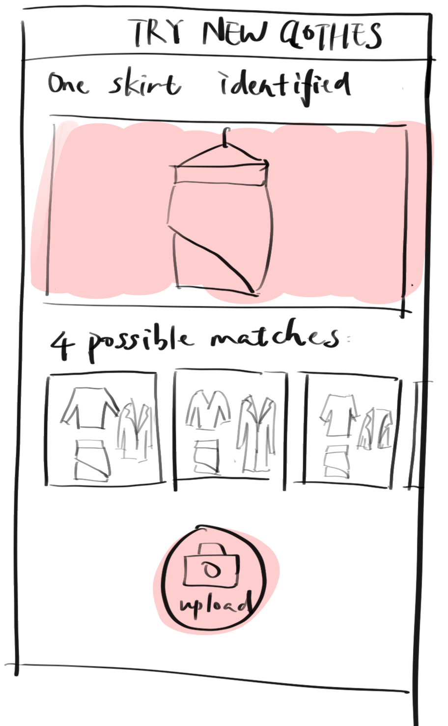
Project Title
ddd
PROBLEM:What is the problem the website will solve
PAYOFF: What is a simple drawn screen that is illustrative of something the website shows that helps solve the problem. It is likely a report or some results of data entered by the participants. This is the most important square
PERSONA(s) who are the people involved in using the website and what are their background
FINISH: Why are the users better off with the website than before.

Slide 4
About ConsultEase
ConsultEASE Platform
This is a consultancy matchmaking service that connects Ghanaian startups with business consultants. Its purpose is to democratize access to professional business advice by removing networking barriers through technology.
Services Provided:
Consultant discovery and matching
Appointment scheduling and management
Secure messaging between clients and consultants
Feedback feature
Admin control (managing users, audit logs)

Slide 5
User / Customer
Clients | Business owners who book consultations to get professional advice for their companies.
Consultants | Experts from ConsultEase who offer their business advice through scheduled sessions and provide structured feedback.
Administrators | Platform managers who oversee all users, approve users , and ensure system integrity.

Slide 6
Main Functions of the Website
1. CONSULTANT DISCOVERY SYSTEM : Browse verified experts by expertise without personal connections
2. TRANSPARENT AVAILABILITY CALENDAR: Book real time slots with a live calendar, preventing past date and time bookings (GMT)
3. ONE-CLICK BOOKING SYSTEM: Reserve sessions instantly with confirmed time slots without double booking
4. INTEGRATED MESSAGING: Secure communication within the platform between clients and consultants

Slide 7
Main Functions of the Website
1. CONSULTANT DISCOVERY SYSTEM : Browse verified experts by expertise without personal connections
2. TRANSPARENT AVAILABILITY CALENDAR: Book real time slots with a live calendar, preventing past date and time bookings (GMT)
3. ONE-CLICK BOOKING SYSTEM: Reserve sessions instantly with confirmed time slots without double booking
4. INTEGRATED MESSAGING: Secure communication within the platform between clients and consultants

Slide 8
Architecture
Image of 3 tier architecture and how they connect, programing languages for each tier and why, other technologies (frameworks, etc).

