Slide 1
Identifying Loan Default Risk Using Exploratory Data Analysis (EDA)
Members:
Maruthi Komera Shriya Magadal
8/28/2024

Slide 2
Problem Statement:
The objective is to find patterns in loan default behavior through Exploratory Data Analysis (EDA). Two key risks in loan approval are:
Loss of business when a loan that could be repaid is denied.
Financial loss when a loan is granted to a borrower who defaults.
Business Understanding:
Lending companies encounter two main types of risks:
Loan Accepted: There are three possible outcomes—fully paid, currently active, or charged-off (defaulted).
Loan Rejected: The dataset lacks transactional history for applicants whose loans were rejected.
Business Objective:
The goal is to reduce credit losses by identifying high-risk applicants and potential defaulters through EDA. The emphasis is on understanding the key factors that lead to loan defaults and mitigating financial losses.

Slide 3
Loan Approval Scenarios
When a loan is approved, there are three possible outcomes:
Fully Paid: The loan has been completely repaid.
Current: The loan is still in the process of being repaid.
Charged-Off: The loan has defaulted.
Data Understanding
Dataset Overview:
Key Variables: Includes int_rate, dti, loan_amnt, grade, annual_inc.
Target Variable: loan_status, which indicates whether a loan is fully paid or charged-off.
Problem Approach
Through EDA, we will analyze the dataset to gain insights into:
Consumer attributes.
Loan characteristics that impact the risk of default.

Slide 4
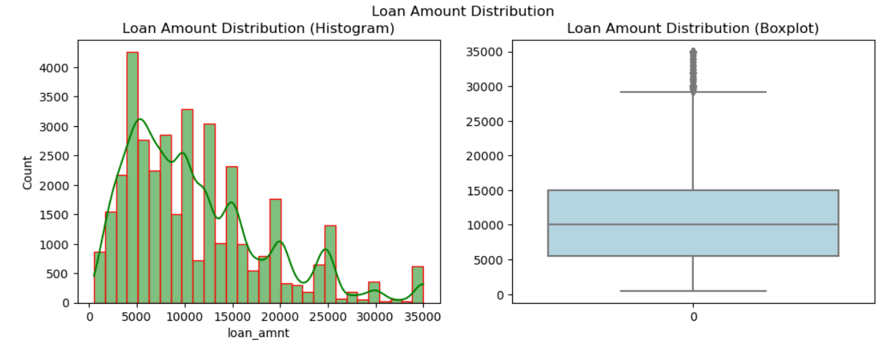
Loan Amount Distribution
Distribution of the loan amount using Histogram and Boxplot

Slide 5
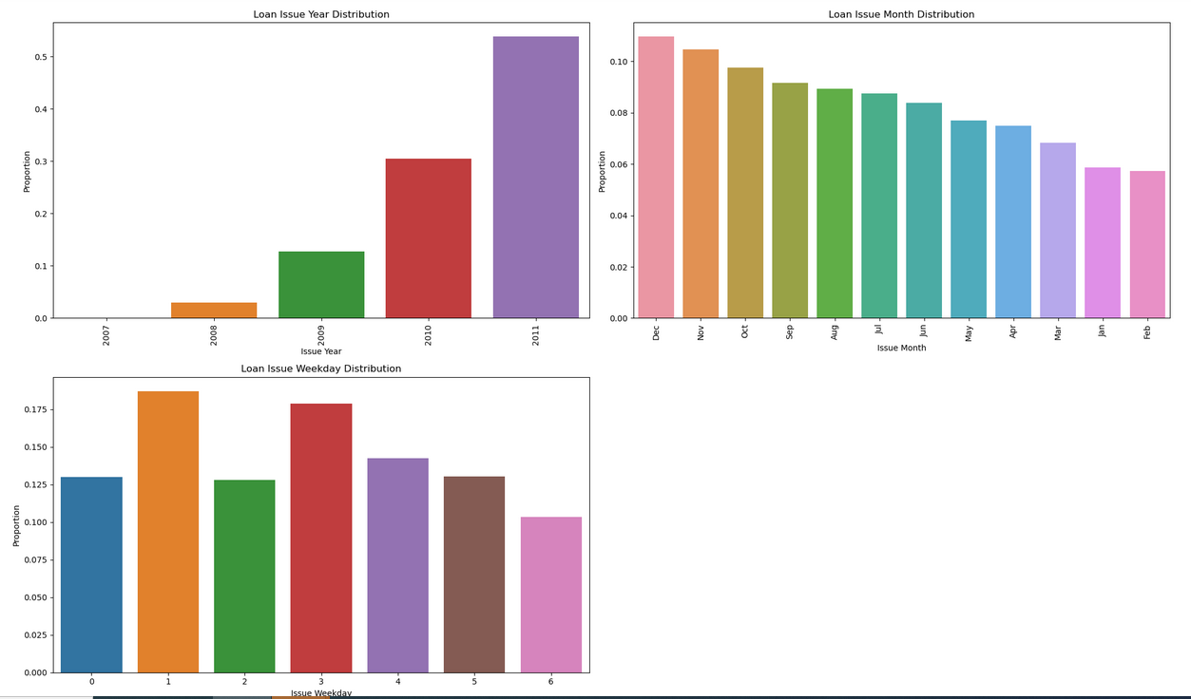
Analysis- Issued Year, Month
Lending Club (LC) has been increasing its loan issuance annually. Moreover, there is a surge in loan issuances during the final quarter of the year, specifically in October, November, and December.

Slide 6
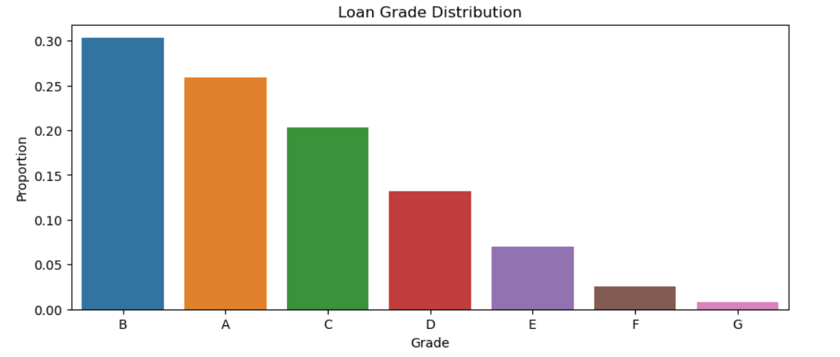
Loan Grade Distribution
Most of the loans are classified as Grade B and A.

Slide 7
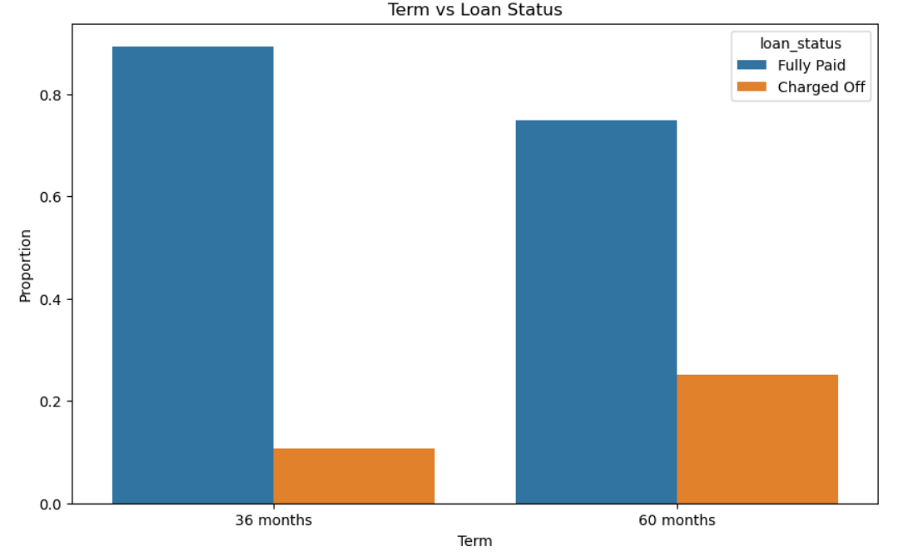
Analysis of Term Vs Loan Status
Approximately 75% of borrowers opted for loans with a 36-month term.

Slide 8
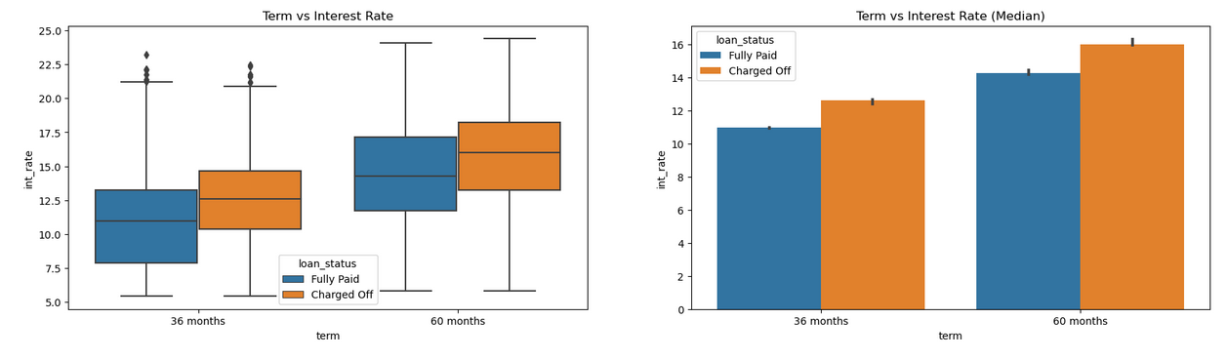
Analysis Of Loan Status Vs Interest rate
The interest rate rises as the loan term increases.

Slide 9
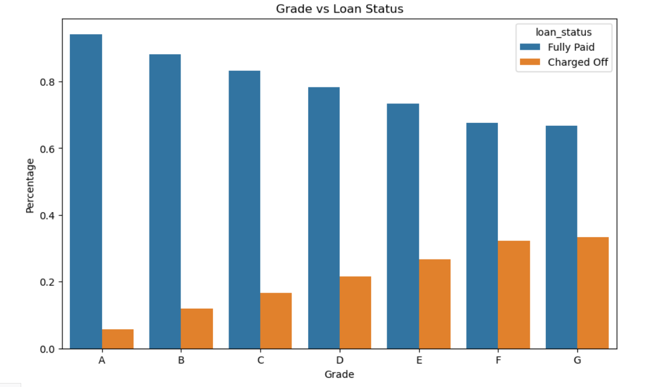
Analysis Of Loan Status Vs Grades
Number of charged-off loans increases as credit grades decrease.

Slide 10
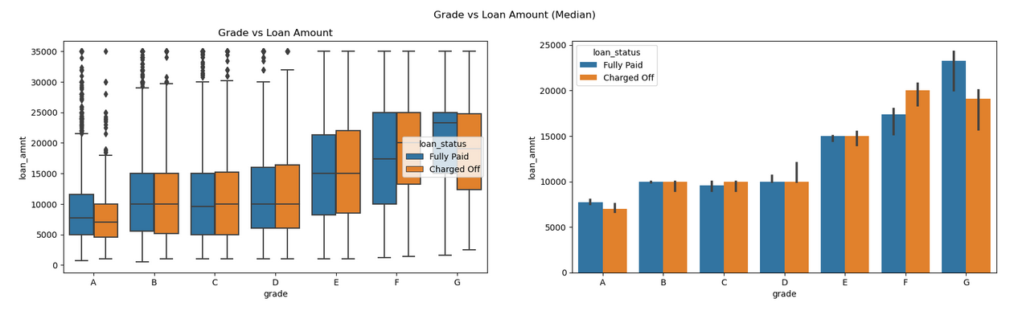
Analysis Of Grade Vs Loan Amount
Loans are more often charged off in lower credit grades, where borrowers usually take bigger loans and are more likely to default.

Slide 11
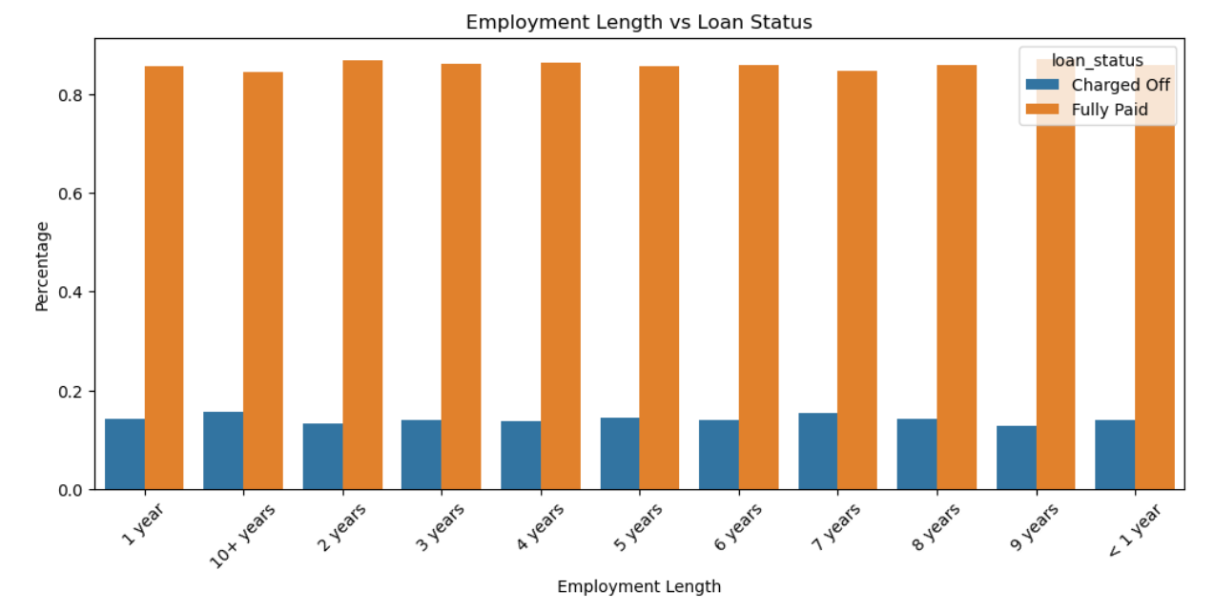
Analysis Of Employment Years Vs Loan Status
No significant patterns in default rates across different employment lengths.

Slide 12
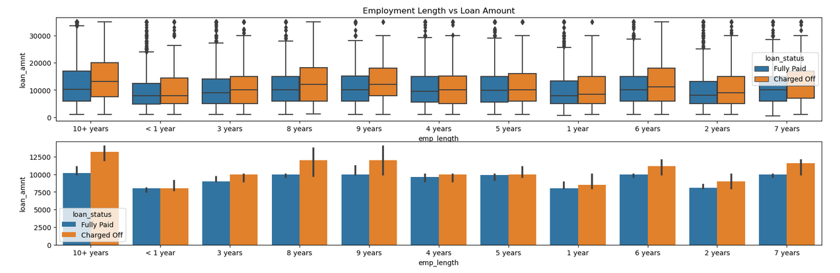
Analysis Of Employment Years Vs Loan Amount
Borrowers with longer job tenures who take out larger loans generally have higher default rates.

Slide 13
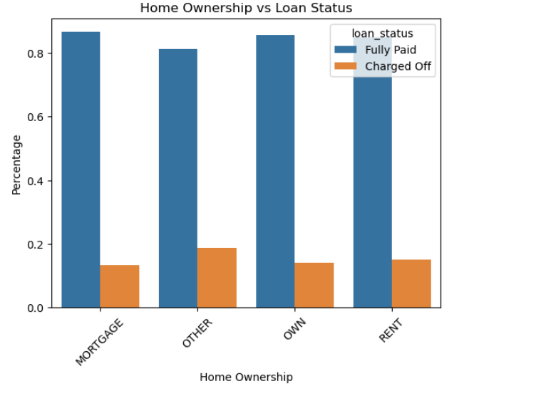
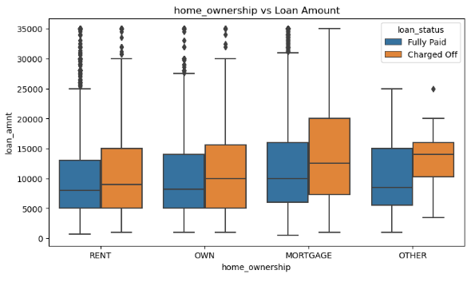
Analysis-Purpose vs Loan Status
There is around 20% chance of loan default in each home ownership category.
From the 2nd plot we can see the people with higher loan amounts in mortgage home ownership has
high default rate than others

Slide 14
Insights from EDA
Key Insights:
Interest Rates and Defaults:
Higher interest rates are strongly associated with higher default rates, irrespective of loan tenure and verification status.
Borrowers with high revolving credit utilization face higher interest rates and tend to default more frequently.
Loan Amount and Defaults:
Larger loan amounts, particularly in small business and home loan categories, are associated with higher default rates.
High loan amounts in small business loans show a strong correlation with defaults.
Credit Grades and Defaults:
Lower credit grades (F and G) are associated with higher default rates and larger loan amounts. Borrowers in these grades have higher public derogatory records.
A-grade borrowers have fewer derogatory records and a lower default rate.
Home Ownership and DTI:
Borrowers with mortgage ownership have higher incomes but also higher loan amounts, which correlates with higher default rates.
"Other" home ownership categories have a lower DTI ratio, but an equal likelihood of default compared to other categories.
Public Records:
Public derogatory records are highly correlated with public bankruptcy records, indicating that higher derogatory records are a strong predictor of default.
Borrowers with 4 public derogatory records are predominantly in the mortgage ownership category and "Not Verified" status.

Slide 15
Recommendations to Lending Club.
Refine Home Ownership Criteria:
Adjust lending criteria for different home ownership categories based on observed default rates and DTI ratios.
Consider offering tailored financial products that align with the risk profile of borrowers in different home ownership categories.
Improve Verification Processes:
Increase focus on thorough verification processes to ensure that loans are given to verified borrowers, as they tend to have more reliable repayment behavior.
Explore options for improving verification for categories with higher default rates, such as the "Not Verified" category.
Monitor and Analyze Trends:
Continuously monitor default rates and interest rate impacts across different loan types, credit grades, and home ownership categories.

