Slide 1
Debugger Frontent for the SharpDevelop IDE
Martin Koníček

Slide 2
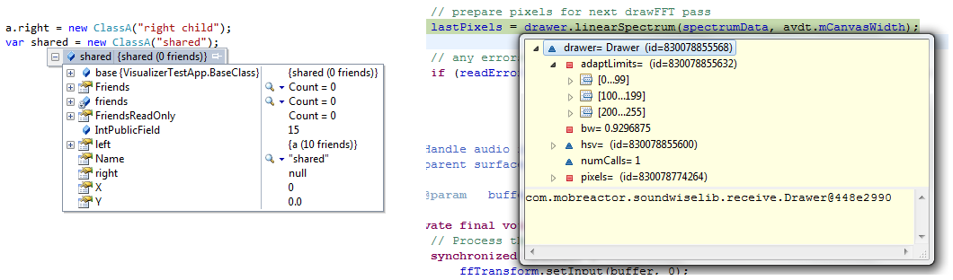
Current state of debugging
Breakpoints, watches, etc.
Basically the same in any current IDE

Slide 3
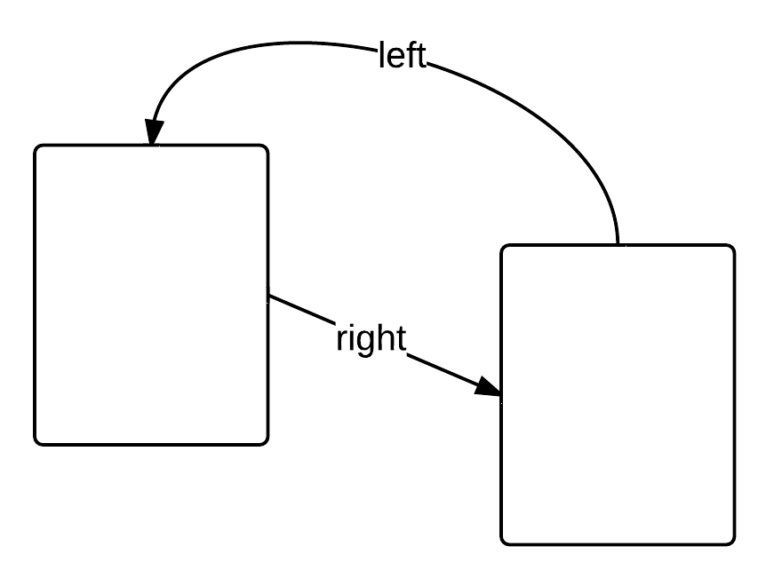
What about data structures?

Slide 4
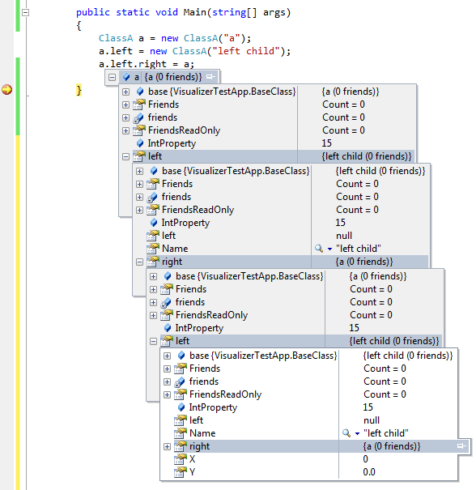
What about data structures?
Debugger does not provide a useful view of reality

Slide 5
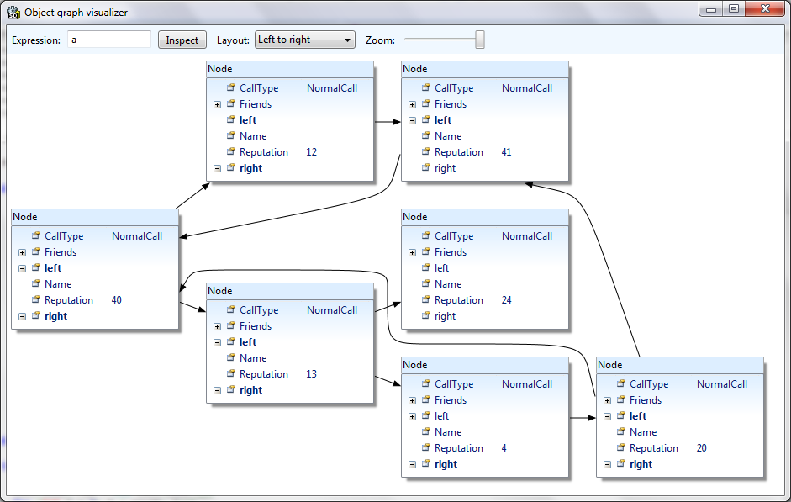
Solution
Object graph visualizer

Slide 6
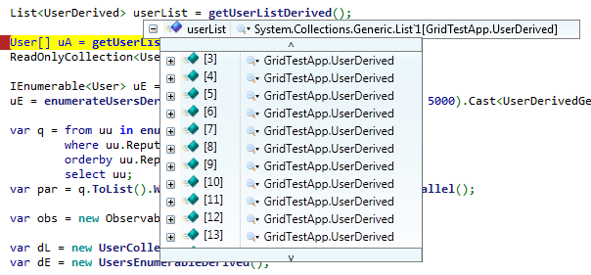
Debugging collections
Very common case – collections of objects

Slide 7
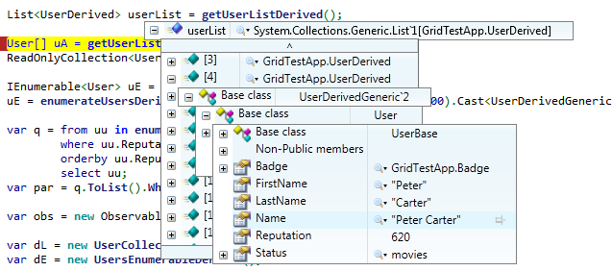
Debugging collections
Users have to expand each item to see anything

Slide 8
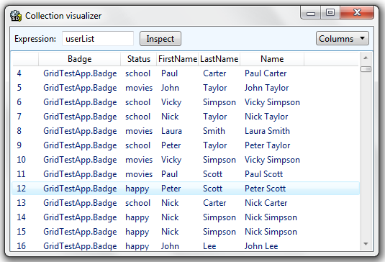
Solution
Collection visualizer

Slide 9
Problems faced
Determining how the graph looks in memory
The graph lives in a separate process, GC moves objects while the debugger is trying to analyze the graph
Dynamic layout and animation of the graph
Small graph changes -> small layout changes
Calculating “natural” edge routes

Slide 10
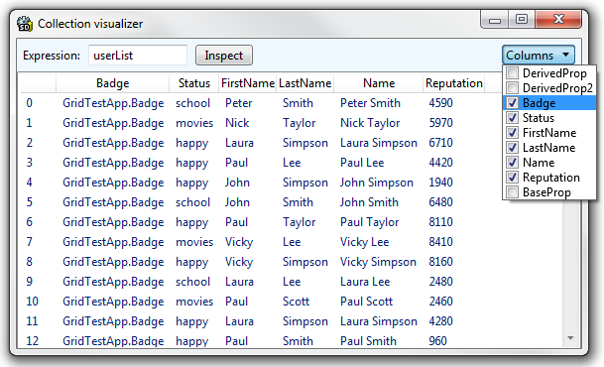
Problems faced
Achieving reasonable performance
Interprocess communication very expensive
Need to handle large collections
Solution: everything is as lazy as possible. What is not on the screen is not being calculated.

Slide 11
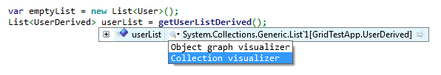
Results
Already integrated in the standard release of SharpDevelop
Extensibility
users can plug in new visualizers
Notes:
Say that I implemented the tooltips, the visualizers extensible architecture, and the 2 visualizers.

Slide 12
Thank you for your attention
Questions?

