Slide 1


Cross-Scanner Breast Adenocarcinoma Image
Segmentation with Deep Learning Algorithms
Maria Kontaratou
Academic Year: 2024-2025
Supervised by: Maria Vakalopoulpou
Athens
December 2025

Slide 2
Presentation outline
Introduction
Context in digital pathology
The challenge: Domain Shift
Problem Definition and related work
Methodology
Dataset - COSAS 2024
Model overview and experiments
Training setup
Results
Critical Discussion
Conclusion

Slide 3
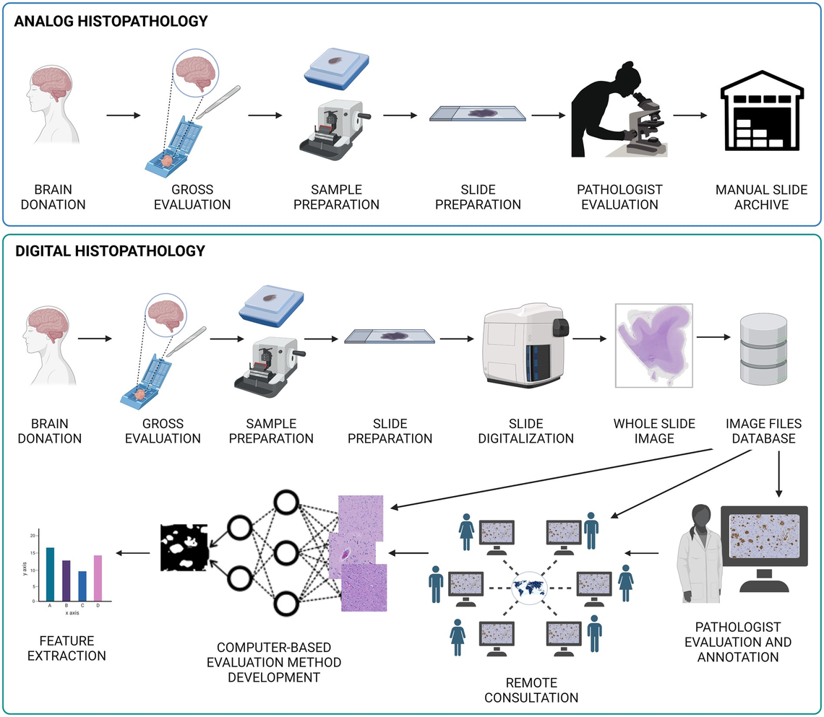
Introduction
Methodology
Results
Critical Discussion
Conclusion
Context in digital pathology
With Whole Slide Images (WSIs), pathology could finally be fully digitalized. This shift made computer-based image analysis faster and more consistent
Why is this important?
Digital pathology allows slides to be stored, shared, and analyzed → computational pathology + AI
Deep Learning + Breast Cancer
Breast cancer is one of the most common and complex diseases affecting women
Deep learning models can automatically detect and segment tumor regions in WSIs →
Faster and more consistent analysis with reduced workload
Figure 1: A landscape of the main differences in the workflows of analog and digital histopathology (The status of digital pathology and associated infrastructure within Alzheimer’s Disease CentersJ Neuropathol Exp Neurol,2023)
Notes:
Whole Slide Images (WSIs) are high-resolution, digital scans of entire microscope slides containing tissue samples.
SLIDES ARE STAINED FOR VISIBILITY

Slide 4
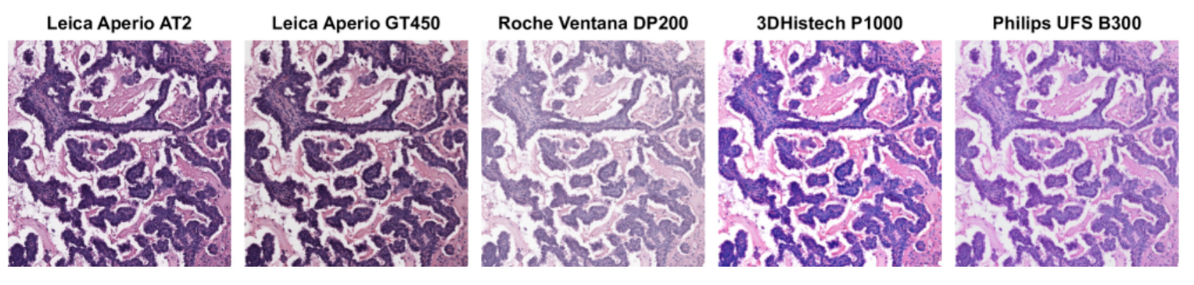
Introduction
Methodology
Results
Critical Discussion
Conclusion
The Challenge: Domain Shift
WSIs from different scanners vary in:
Color, contrast, texture and illumination
These changes don’t affect pathologists - but confuse AI models
Segmentation models learn pixel-level patterns and overfit to one scanner’s “style”
When tested on new scanner →performance drop - domain shift
Figure 2: Example of scanner-induced variability in SCORPION dataset (Ryu, H., Lee, J., Jeong, H. et al. SCORPION: Addressing Scanner-Induced Variability in Histopathology, 2024)
Objective
Scanner-robust, generalizable models
Notes:
Digital pathology relies on scanners to convert glass slides into WSIs.
But every scanner manufacturer uses different optical systems, sensors, and color calibrations.
As a result, two slides from the same tissue can look noticeably different depending on the device.
For humans, this variation is small.
For deep learning models, however, these differences are significant.
AI models learn from pixel-level statistics.
When the color distribution or texture changes, the model sees this as a different domain altogether.
This is known as domain shift:
- Training data comes from one distribution
- Testing data comes from a different one
-> The model struggles to generalize because it expects the training style
In real hospitals, this is a critical limitation. A model might perform extremely well on images from one scanner but fail on a new scanner the hospital acquires.
This lack of robustness prevents AI tools from being used reliably across institutions.
The COSAS challenge is built around this exact problem.

Slide 5
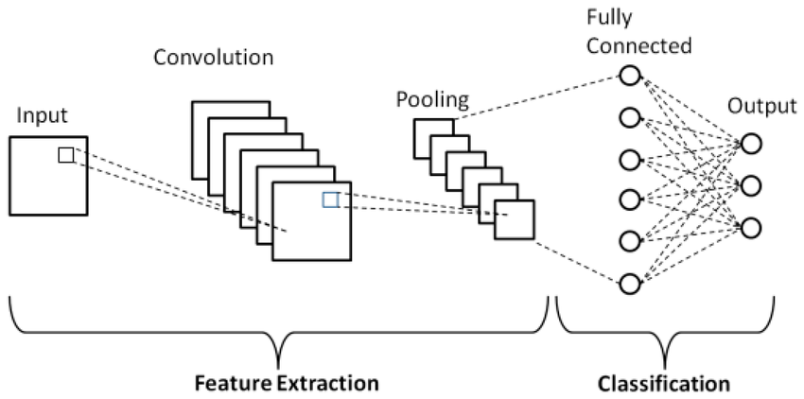
Introduction
Methodology
Results
Critical Discussion
Conclusion
From CNNs to Foundation Models: Toward Scanner-Robust Pathology
CNNs (Convolutional Neural Networks)
Vision Transformers (ViTs)
Figure 3: Schematic diagram of a basic convolutional neural network (CNN) architecture, Phung, Van & Rhee, Eun. (2019)
Domain Generalization (DG)
Capture fine local details (nuclei, textures)
Miss global tissue context
Sensitive to colour/texture changes → weaker across scanners
Pathology Foundation Models
Notes:
“In digital pathology, one of the biggest challenges is building models that work reliably across different scanners.
Traditional CNNs have been extremely successful for tasks like nuclei detection and tumour segmentation because they capture local details very well.
CNNs slide a small filter (e.g., 3×3 or 5×5) across the image → Detect edges, textures, nuclei
They apply convolutions → local feature extraction
Then pooling → reduces resolution, keeps only strongest features
Finally fully connected layers → make a classification decision

Slide 6
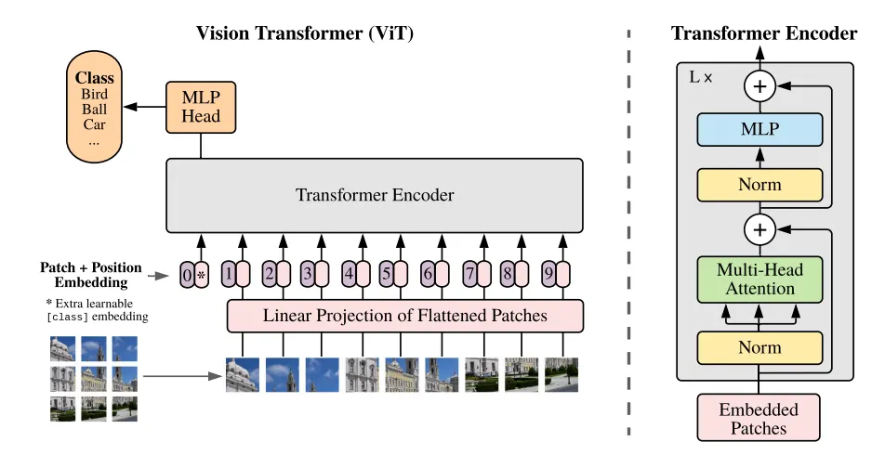
Introduction
Methodology
Results
Critical Discussion
Conclusion
From CNNs to Foundation Models: Toward Scanner-Robust Pathology
CNNs (Convolutional Neural Networks)
Vision Transformers (ViTs)
Figure 4: ViT architecture, Phung, Van & Rhee, Eun. (2019).
Domain Generalization (DG)
Use self-attention to model long-range structure
Capture global + local information
More resilient to scanner variation and stain differences
Pathology Foundation Models
Notes:
🟣 What ViTs do
Split the image into patches (e.g., 14×14)
Treat each patch like a “token”, similar to words in NLP
Use self-attention to let every patch communicate with every other patch → Model sees global context from the start
🟣 Why ViTs are powerful
Capture relationships across the entire image at once
Not biased toward local textures (unlike CNNs)
Better at dealing with shape, structure, and long-range patterns
🟣 Why ViTs help in pathology
Tumor structure depends on global architecture, not just texture
Self-attention adapts better to colour changes across scanners
Backbone becomes more scanner-robust than CNNs

Slide 7
Introduction
Methodology
Results
Critical Discussion
Conclusion
From CNNs to Foundation Models: Toward Scanner-Robust Pathology
CNNs (Convolutional Neural Networks)
Learn features that remain stable across scanners
Aim: rely on tissue morphology, not scanner appearance
Helps models perform well on unseen domains
Vision Transformers (ViTs)
Domain Generalization (DG)
Pathology Foundation Models
Notes:
Domain generalization (DG): the ability of a model to perform
well on unseen target domains, when trained on source
domains
Train a model on several “domains” (e.g., scanners)
Goal: perform well on brand-new scanners the model never saw
🟤 Why DG is hard in pathology
Colour, brightness, contrast, stain intensity vary a lot
Morphology stays the same, but the appearance changes
Models often learn scanner-specific colour shortcuts → and fail when the scanner changes
🟤 What DG techniques aim to do
Learn domain-invariant features (shapes, gland boundaries, nuclei patterns)
Reduce reliance on colour
Improve robustness and generalization to unseen scanners

Slide 8
Results
Conclusion
Introduction
Methodology
Critical Discussion
Conclusion
From CNNs to Foundation Models: Toward Scanner-Robust Pathology
CNNs (Convolutional Neural Networks)
Vision Transformers (ViTs)
Large ViT-based encoders (UNI, Virchow2, Midnight)
Pretrained on millions of WSI patches with self-supervised learning
Domain Generalization (DG)
Pathology Foundation Models
Notes:
🔵 What they are
Vision Transformers trained on millions of histology tiles
Learn universal, stain-invariant tissue representations
Examples: UNI2-H, Virchow2, Midnight
🔵 Why they are a big shift
Capture both local (nuclei) and global (tissue layout) info
Much more robust to scanner differences than CNNs
Can be fine-tuned for segmentation with fewer labels
🔵 Why they matter for scanner-robust pathology
Pretraining on many hospitals teaches colour diversity → scanner robustness
They already understand structures like glands, stroma, tumour patterns
They provide strong, stable features → better DG performance
Models like UNI, Virchow2, and Midnight follow this strategy:
UNI is trained purely within the pathology domain, on over 100 million tiles. It learns features that work across many tissue types and downstream tasks.
Virchow2 uses mixed magnification during pretraining, so it sees the same tissue region at different zoom levels (5×, 10×, 20×). This helps it capture both cellular detail and larger tissue architecture.
Midnight focuses on data efficiency: it uses far fewer slides than UNI or Virchow2, but with strong regularization and augmentation to still learn robust features.
Because these models are trained on such diverse data — different scanners, staining protocols, and organs — their internal representations become naturally scanner-robust.
Instead of learning the style of one device, they learn stable morphological patterns like nuclei shapes, gland structures, and tumour textures.
In practice, we then freeze or lightly fine-tune these encoders and add a task-specific head for segmentation or classification.
This lets us reach strong performance even when we only have a relatively small labelled dataset — like the 180 images in COSAS.

Slide 9
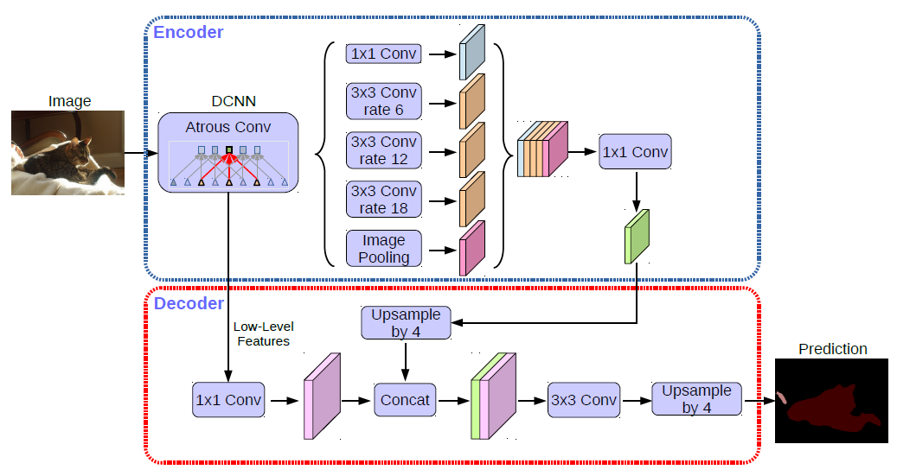
Introduction
Methodology
Results
Critical Discussion
Conclusion
DeepLabv3+: A Strong Baseline for Medical Image Segmentation
Used in natural & medical image segmentation tasks
Combines local details + global context
Uses Atrous Spatial Pyramid Pooling (ASPP) to capture multi-scale features
Computationally efficient for WSIs
Strong baseline decoder for transformer-based encoders (e.g., ViT)
Figure 5: DeepLabv3+ architecture, Chen et al., Encoder-Decoder with Atrous Separable Convolution for Semantic Image Segmentation, ECCV 2018.
Notes:
- - Why DeepLabV3 Was Chosen
🔴 1. DeepLabV3 is a proven, high-performing baseline
One of the most cited segmentation architectures in computer vision, PAPERS
Gastric cancer segmentation (Wang & Liu, 2021)
Nuclei segmentation improvements
Cross-domain histopathology segmentation
🔴 2. ASPP gives essential multi-scale reasoning
🔴 3. Works extremely well with ViT / foundation encoders
🔴 4. Computationally efficient for 1500×1500 pathology tiles
Unlike heavy decoders (U-Net++, SegFormer, UNETR): MANY SKIP CONNECTIONS, he model would receive no skip connections
🔴 6. Fits perfectly with the goal of the thesis
The thesis focuses on foundation encoders + decoder comparison
DeepLabV3 gives you:
A clean, interpretable decoder
Reacts clearly to architectural changes
Helps isolate the effect of multi-scale fusion, FPN, queries, etc.
Ideal baseline to study how decoder design affects cross-scanner generalization
ASPP repeatedly shown to improve boundary precision under stain shifts

Slide 10
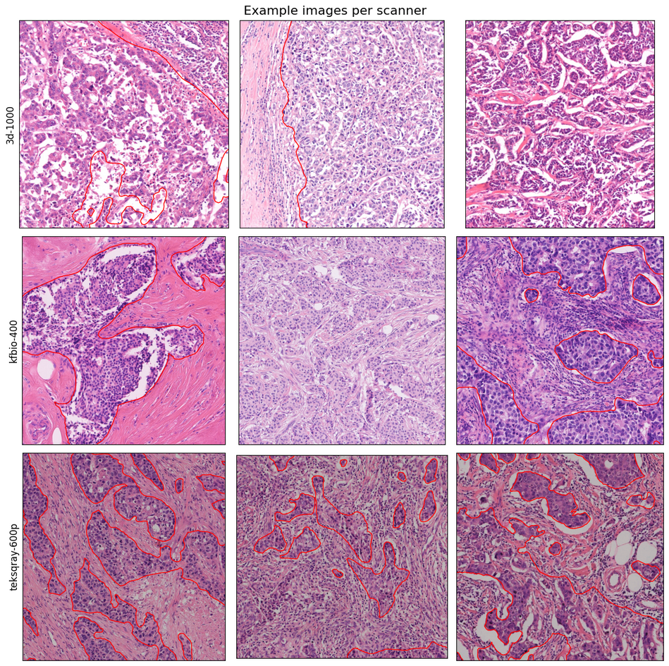
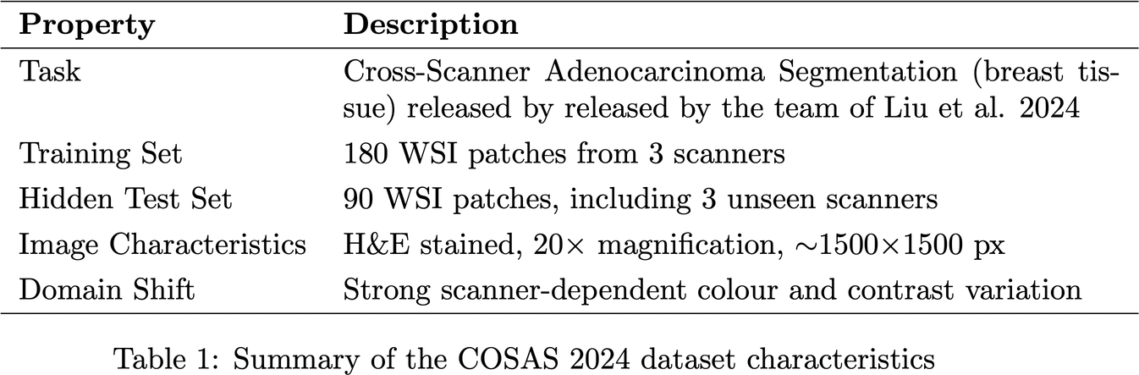
Introduction
Methodology
Results
Critical Discussion
Conclusion
Dataset: COSAS 2024 Challenge
Notes:
“The dataset consists of RGB histopathology image patches in 8-bit PNG format.
Each patch is approximately 1500 by 1500 pixels and corresponds to 20× optical magnification, which gives us a high level of detail at the cellular level. All patches have a nearly square aspect ratio and consistent spatial resolution, which simplifies the preprocessing pipeline.
However, the key challenge is that the visual appearance varies significantly across scanners.
Some scanners produce warmer, brighter tones, while others generate cooler, darker, or more desaturated images. These differences come from scanner optics, lighting, colour calibration, and compression.

Slide 11
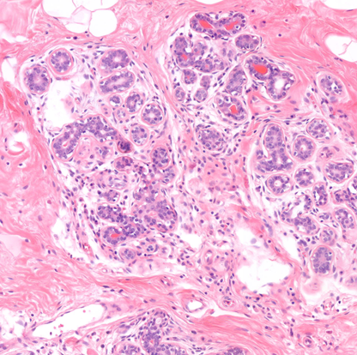
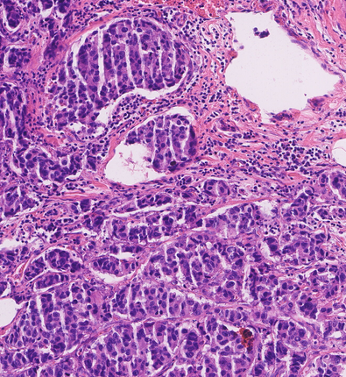
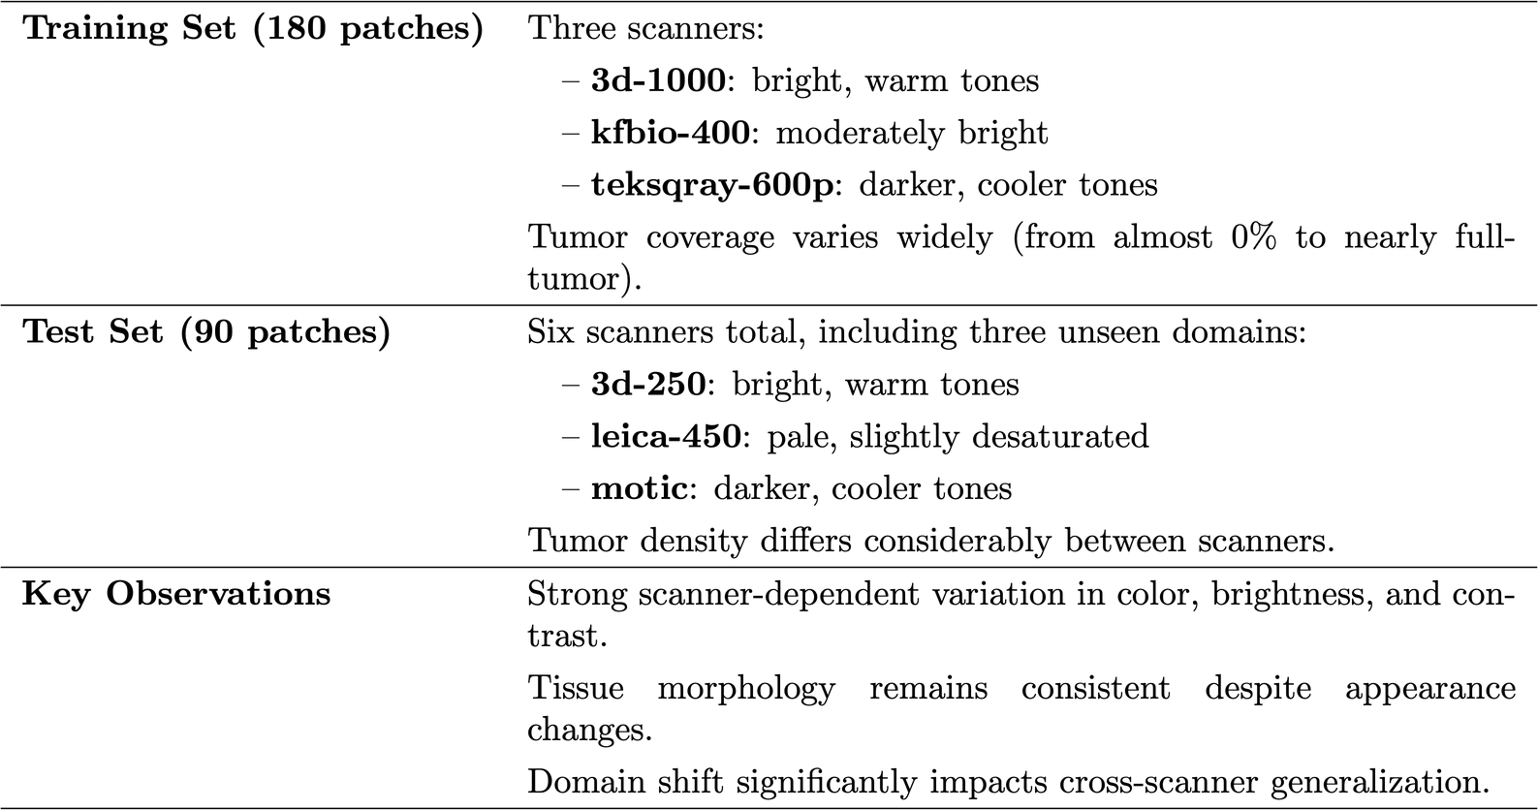
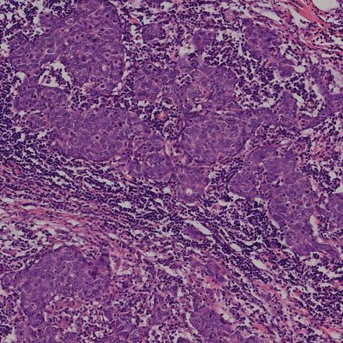
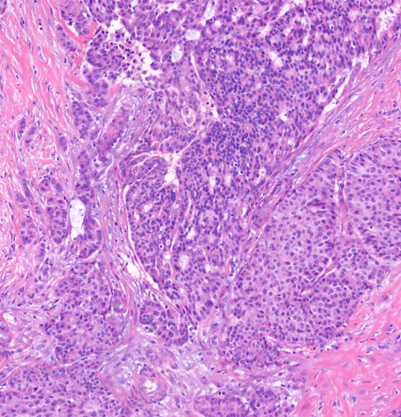
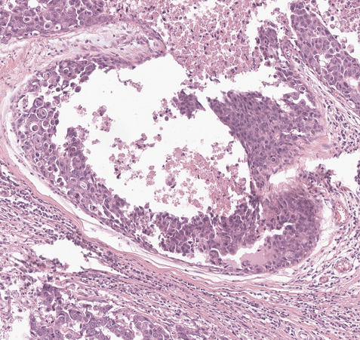
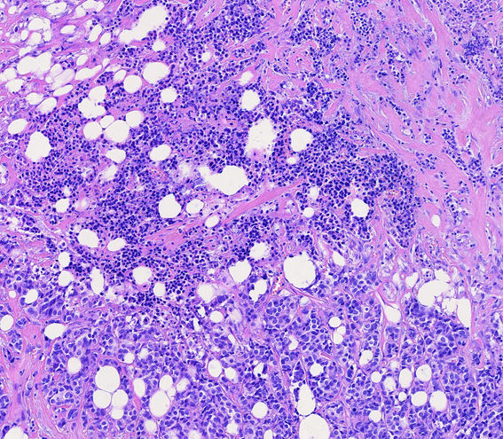
Introduction
Methodology
Results
Critical Discussion
Conclusion
Data exploration
Sample from 3d-1000
Sample from kfbio-400
Sample from teksqray-600p
Sample from 3d-250
Sample from leica-450
Sample from motic
Notes:
“The training set contains 180 labelled patches evenly distributed across three scanners: 3d-1000, kfbio-400, and teksqray-600p.
Each scanner has a distinct visual style.
3d-1000 and kfbio-400 tend to be brighter and slightly warmer, while teksqray-600p produces darker, cooler images.
These appearance differences create domain shift even within the training data.
Tumour coverage varies substantially:
- some patches contain almost no tumour, while others are dominated by tumour regions.
- On average, tumour occupies about half of each patch, but the standard deviation is large.
- This variation introduces mild class imbalance but also provides diverse learning examples.
The test set contains 90 patches from six scanners — the three from training plus three unseen scanners: leica-450, motic, and 3d-250.
These new scanners introduce additional colour styles:
leica-450 appears pale and slightly desaturated, motic is cooler and darker, and 3d-250 produces bright, warm tones similar to 3d-1000 but with slightly different contrast.
Interestingly, tumour density also differs between scanners.
3d-250 and 3d-1000 tend to have more tumour-rich regions, while motic and teksqray-600p have smaller tumour percentages.
All these variations — colour, tone, contrast, tumour ratio — are important because they can significantly affect model performance.
They highlight why scanner generalization is challenging and why foundation models and strong augmentation strategies are necessary.”

Slide 12
Introduction
Methodology
Results
Critical Discussion
Conclusion
Preprocessing & Data Augmentation
Resized images to 1512×1512 pixels
Reflective padding to avoid artificial edges
Masks padded with zeros
Heavy augmentation to simulate scanner/stain variation:
Flips, rotations, scaling, elastic transforms
Brightness/contrast, hue/saturation, RGB shift
Noise, sharpening
Tumor-focused cropping to increase useful samples
Normalization using ImageNet statistics
Validation: only resize, pad, normalize (no augmentation)
Notes:
“To prepare the data for training, all images were resized and padded to a uniform resolution of 1512×1512 pixels.
This size was chosen deliberately because it is divisible by 14, which ensures compatibility with the ViT-H/14 patch embedding and avoids mismatches in the encoder’s token grid.
Reflective padding was used to avoid introducing artificial black borders, and masks were padded with zeros to keep the background clean. (So the pixel values near the edge are simply duplicated in reverse order.) -> PRESERVES NATURAL TEXTURE, It prevents the model from seeing black stripes at the borders that don’t exist in real pathology slides, COLOR CONTINUITY!!!!
We applied a rich set of augmentations using Albumentations.
The reasoning behind this is that with only 180 training images, the model needs to see as much variability as possible.
So we introduced geometric transformations like flips, rotations, scaling, and mild elastic deformations to mimic slide preparation artifacts.
We also used colour-based augmentations — brightness, contrast, hue–saturation shifts, RGB shifts — to simulate scanner-induced variation.
This helps the model avoid overfitting to a specific colour distribution and encourages scanner-invariant feature learning.
Noise, sharpening, and JPEG compression were added to imitate real-world imperfections in digital scanners.
Tumour-focused cropping ensured that most patches contained informative regions, since some images have very little tumour tissue.
Finally, all images were normalized using the standard ImageNet mean and standard deviation before entering the model.
Validation preprocessing was intentionally minimal — only resizing, padding, and normalization — to ensure consistent evaluation without random transformations.”

Slide 13
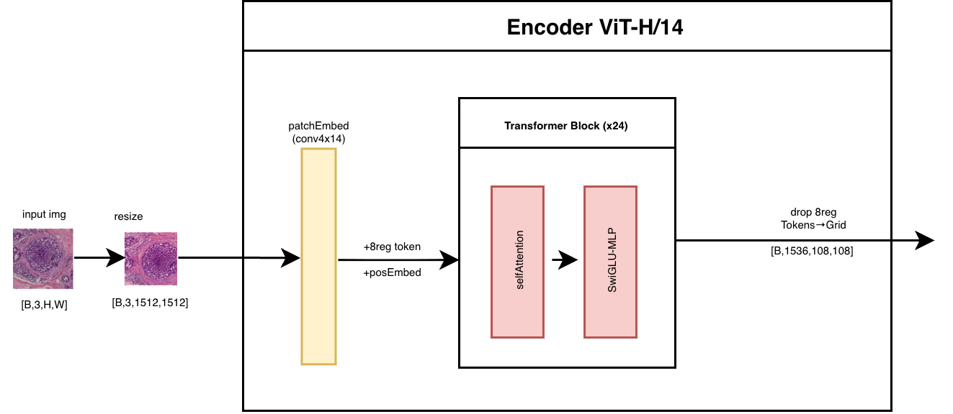
Introduction
Methodology
Results
Critical Discussion
Conclusion
Foundation Encoder: UNI2-h
Notes:
- ViT-H/14 backbone pretrained on >100M pathology tiles
Uses 8 register tokens for global information flow
Input split into 14×14 patches → 1536-D embeddings
24 transformer blocks, 24 attention heads
SwiGLU MLPs for stable and expressive feature learning
Input resized to 1512×1512 px → 108×108 token grid
Speaker Notes
UNI2-h is a foundation model trained specifically for pathology, unlike generic ViTs trained on ImageNet or natural images.
Patch size is 14×14; this is important because keeping the same patch/token ratio as pretraining leads to better performance.
The 8 register tokens allow information to flow globally — instead of relying only on a CLS token, which is a known limitation in classical ViTs.
SwiGLU is a gated activation function that improves gradient flow and representation quality.
Output: a dense grid of 1536-dimensional tokens (108×108 locations), which becomes the input for the decoder.

Slide 14
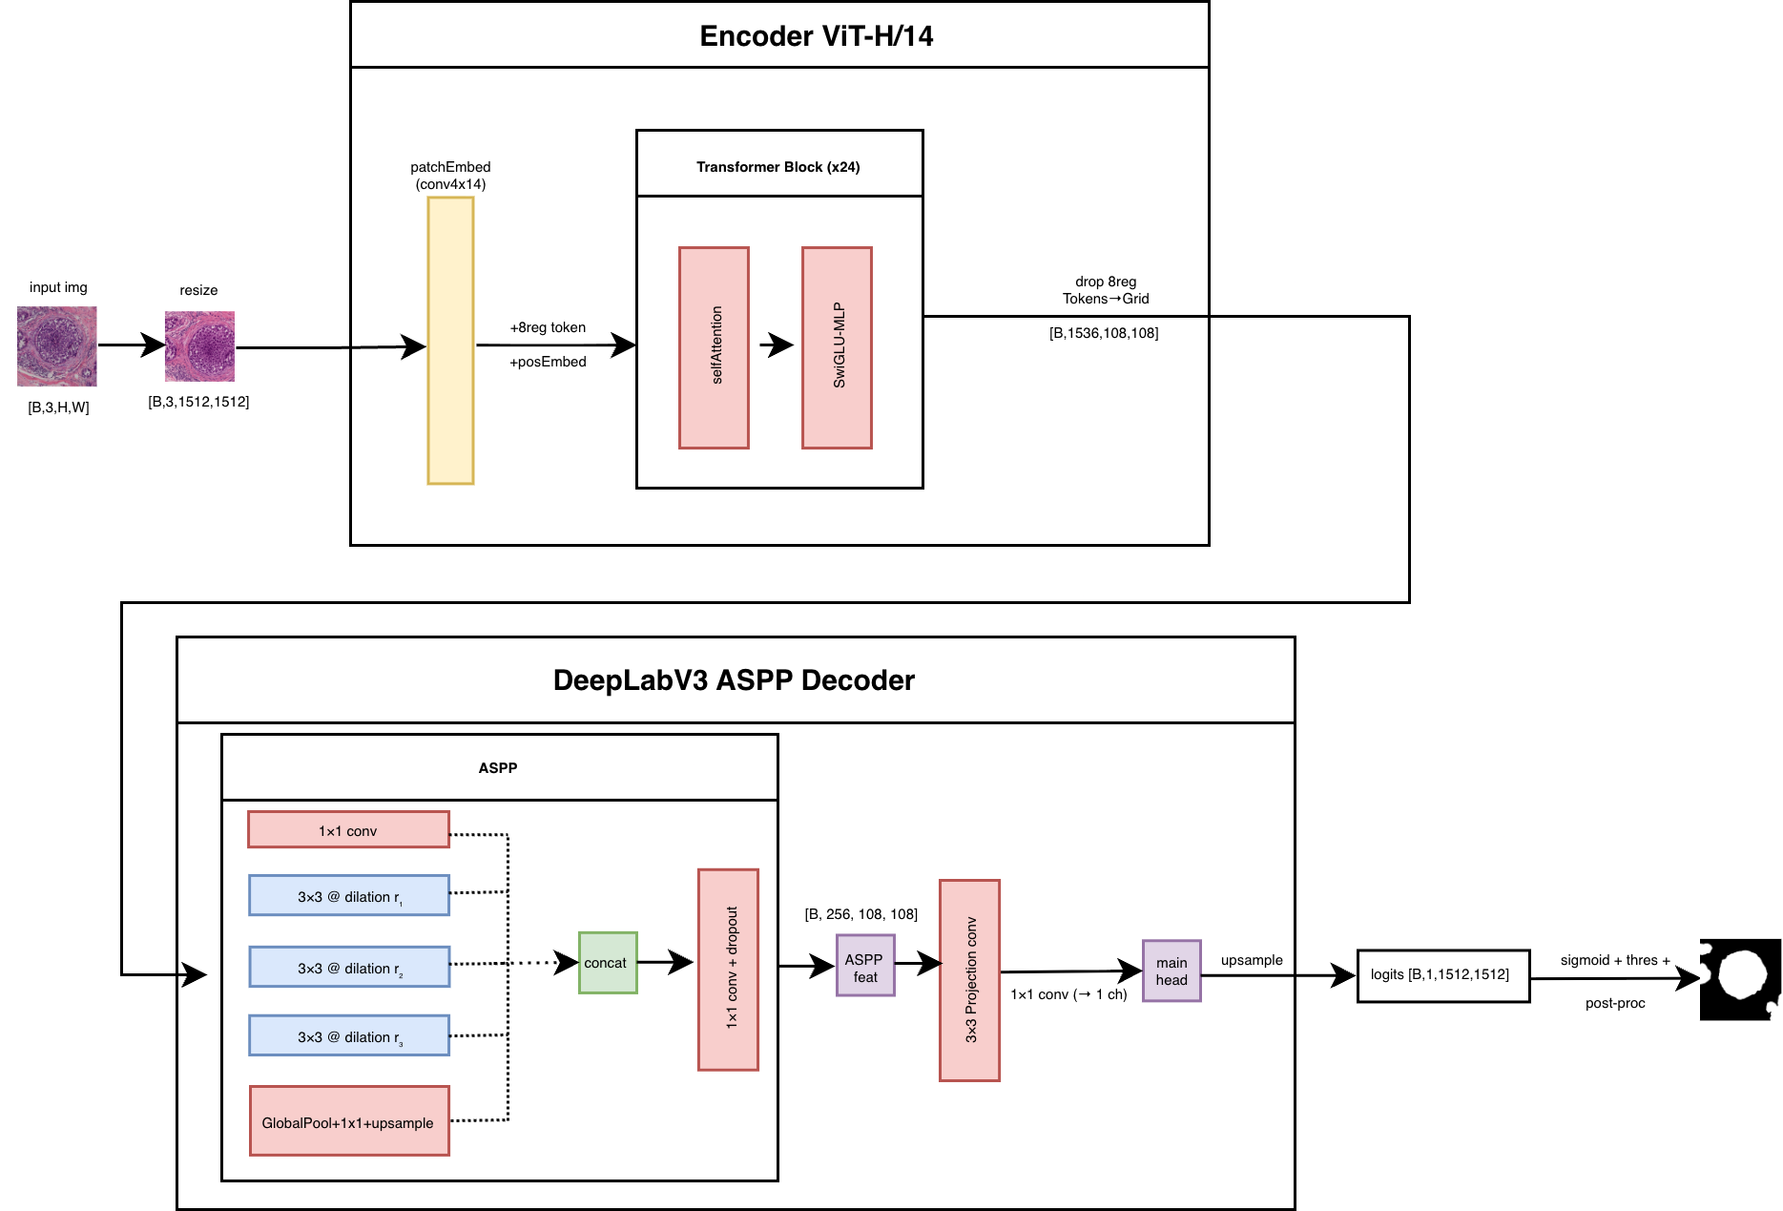
Introduction
Methodology
Results
Critical Discussion
Conclusion
Decoder: DeepLabV3-Style ASPP
Notes:
DeepLabV3 ASPP Decoder
Multi-scale context via Atrous Spatial Pyramid Pooling (ASPP)
5 branches:
• 1×1 convolution - fine details
• Three 3×3 dilated convolutions (rates 12, 24, 36) - zoom levels
• Global pooling branch - entire view of img
CONCAT - stack outputs
1x1 conv -> fuse to get features
3x3 projection conv - SMOOTH DETAILS BY LOOKING @ TINY AREA AROUND PIXEL
MAIN HEAD - SEGMENTATION PROBABILITIES TO PIXEL
Upsampled
Final sigmoid + thresholding

Slide 15
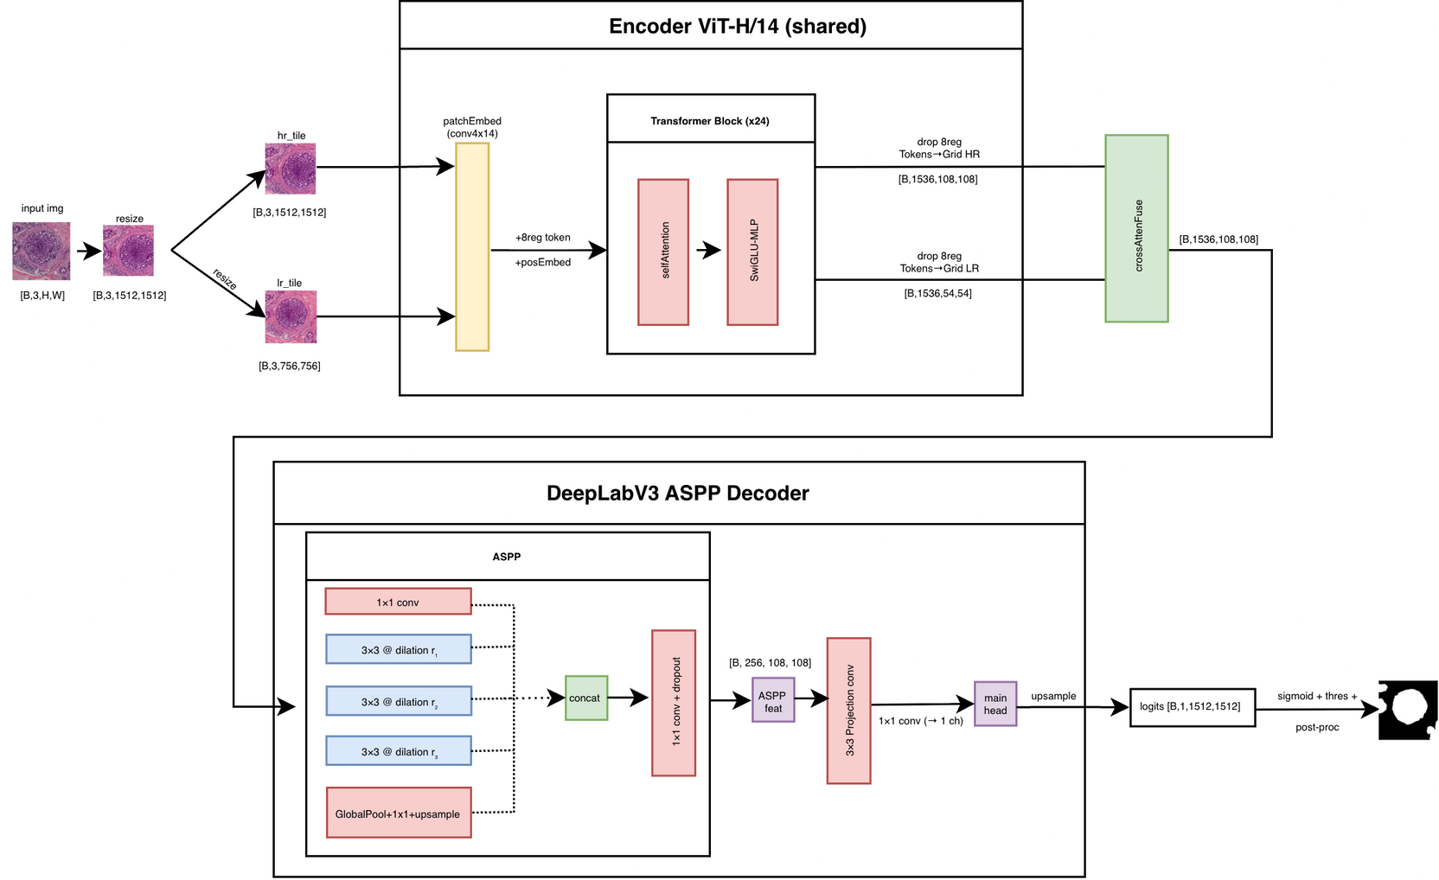
Introduction
Methodology
Results
Critical Discussion
Conclusion
Final Model: UNI-2h + DeepLabV3-Style ASPP
Notes:
Slide content (bullets)
Dual-Path Fusion
Same image processed at two scales:
• High-resolution: 1512×1512 (nuclei-level detail)
• Low-resolution: 756×756 (tissue-level structure)
Histopathology requires both local (nuclei) and global (glandular architecture) context.
A single resolution struggles to capture both effectively.
Dual-resolution streams mimic the way pathologists zoom in/out during diagnosis.
Cross-attention learns how information from different scales should be merged.
Prior research shows cross-scale fusion significantly improves robustness across scanners.

Slide 16
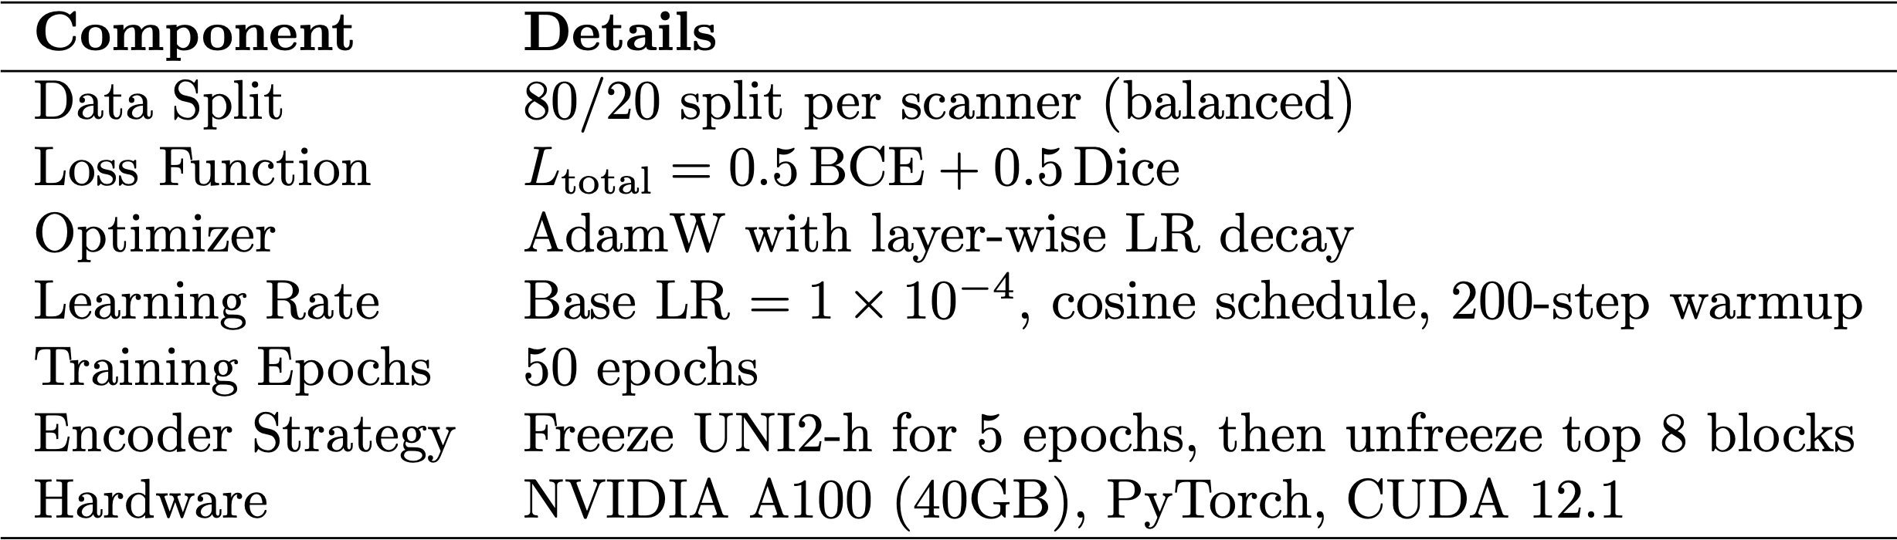
Introduction
Methodology
Results
Critical Discussion
Conclusion
Training strategy
Notes:
“Now I’ll briefly walk through the training strategy we used to ensure that all architectures were compared fairly and consistently.
We begin with the data split
The loss function is a simple but very effective combination: 0.5 Binary Cross-Entropy + 0.5 Dice loss. Binary Cross-Entropy (BCE) measures how confident the model is about each pixel being tumor or non-tumor. BCE stabilizes pixel-wise training, especially under class imbalance, while Dice focuses on region overlap and helps the model learn tumor shape and boundaries.
We use the AdamW optimizer with layer-wise learning rate decay, meaning earlier transformer layers receive smaller learning rates than later ones. This preserves the strong pretrained representations in UNI2-h, while allowing the decoder and upper layers to adapt more aggressively.
The learning rate schedule starts with a base LR of 1e-4, includes a 200-step warmup, and follows a cosine decay. Cosine scheduling helps maintain stable convergence, especially with large ViT backbones.
Training runs for 50 epochs,
For the encoder strategy, UNI2-h is frozen for the first five epochs. This allows the decoder to stabilize and prevents catastrophic overwriting of pretrained weights early in training. After that, we unfreeze the top 8 transformer blocks, enabling fine-tuning of higher-level features that are more relevant to the COSAS dataset.
Finally, all experiments were run on an NVIDIA A100 40GB GPU, using PyTorch on CUDA 12.1. This ensured consistent computational conditions across all architectures, which is important for fair comparison.”

Slide 17
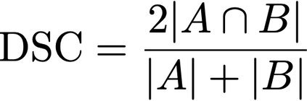
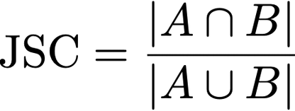
Introduction
Methodology
Results
Critical Discussion
Conclusion
Model Evaluation
Semantic segmentation evaluation metrics measure the overlap between predicted and target masks
Dice Similarity Coefficient
Intersection over Union (IoU)
Notes:
Dice measures how much the predicted tumor region overlaps the true tumor region
DICE - “Measures how similar the predicted tumor mask is to the ground truth; rewards overlap and penalizes mismatches.” - t emphasizes overall similarity and is widely used in biomedical segmentation
- ΑΘΡΟΙΣΜΑ ΜΕΓΕΘΩΝ ΣΤΟΝ ΠΑΡΟΝΟΜΑΣΤΗ
Iou - “A stricter overlap metric that compares the intersection of the prediction and ground truth relative to their union.” - is stricter because it divides by the union of the masks, so small errors affect it more
- ΕΝΩΣΗ ΜΕΓΕΘΩΝ ΣΤΟΝ ΠΑΡΟΝΟΜΑΣΤΗ

Slide 18
Introduction
Methodology
Results
Critical Discussion
Conclusion
Thresholding & Post-processing - Three-Stage Threshold Search
Stage 1 - Coarse search:
Test thresholds from 0.50–0.78, try light Gaussian smoothing (σ = 0.0 → 1.0) and mild morphological opening (0-1) / closing (1-2)
Stage 2 - Refinement:
Narrow the search around the best values; adjust filter sizes
Stage 3 - Final selection on validation set:
Pick the threshold + cleaning setup that gives highest validation Dice/Jaccard
Notes:
(General intro)
“After the model predicts a probability map, we still need to convert that into a clean binary segmentation mask. Instead of picking a random threshold like 0.5, we perform a controlled, three-stage search to find the threshold that works best across scanners. This step is important because different scanners generate different color and intensity distributions.”
Goal: Find a “good enough” threshold and general morphological strength.
Here we test a large range of values:
🔹 Thresholds: 0.50 → 0.78
Why this range?
- 0.5 is the natural decision boundary
- above 0.78 models start under-segmenting
- below ~0.50 we get too many false positives
this interval covers the “plausible” operating region
🔹 Gaussian smoothing (light blur)
🔹 Morphological opening & closing
We try:
- closing (to fill small gaps in tumor regions)
opening (to remove tiny false predictions)
Ranges are mild because the dataset is high-resolution:
openings: radius 0–1
closings: radius 1–2
At this stage, we try many combinations to see what improves the validation Dice/Jaccard.
⭐ Stage 2 — Refinement (narrow zoom-in)
Once we find combinations that perform well, we zoom into that area.
Example:
If coarse search finds:
best thresholds ≈ 0.62–0.68
best closing radius = 2
best smoothing ≈ 0.6
openings often unnecessary
Then Stage 2 uses ranges like:
thresholds 0.60–0.70 with step 0.01
smoothing 0.4–0.7
closing radius exactly 2
opening radius 0 or 1 only
This stage fine-tunes around the promising region.
⭐ Stage 3 — Final Selection
We evaluate each candidate using the validation set only.
For each threshold + morphological setup:
compute Dice
compute IoU
average the metrics across validation scanners
The combination that gives the best balanced Dice/Jaccard is chosen.
This becomes the fixed pipeline for all test images.
At this point we no longer rerun the model — we only apply transformations to saved logits, which makes it very efficient.
Final Post-processing Steps
“The final pipeline is kept intentionally simple.
We apply the chosen threshold, do a closing operation with a radius of 2 to close small cracks, optionally apply a very small opening to remove tiny speckles, remove small disconnected components, fill small holes, and optionally clear border pixels.
All of these steps improve the smoothness and accuracy of the final mask, especially at tumor boundaries.”

Slide 19
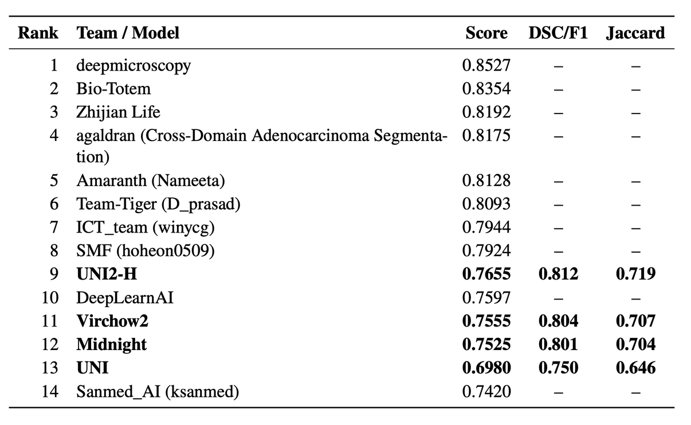
Introduction
Methodology
Results
Critical Discussion
Conclusion
Thunder Benchmark Evaluation
Evaluated: UNI2-H, UNI, Virchow2, Midnight
Still below top COSAS challenge teams
Indicates:
Foundation models capture global structure
But struggle with fine boundaries
Chosen backbone for all experiments: UNI2-H
Notes:
“To understand the baseline, we used the Thunder API to test several state-of-the-art pathology foundation models. UNI2-H, UNI, Virchow2 and Midnight represent the best transformer-based encoders trained on millions of pathology tiles.
Among them, UNI2-H performed the best, but still fell short of the top COSAS challenge teams. This was expected because Thunder evaluates pure encoders without a task-specific decoder, and segmentation requires detailed boundary reasoning.
These results showed that UNI2-H is the strongest starting point, but needs a good decoder and post-processing to achieve competitive performance. For these reasons, UNI2-H becomes our core encoder for all upcoming experiments.”

Slide 20

Introduction
Methodology
Results
Critical Discussion
Conclusion
Experiment 1: UNI2-H + DeepLabV3 (No Aux)
Added an ASPP segmentation head
Captures multi-scale context (dilations 12, 24, 36)
Early stopping at epoch 47, 11.63 GB per epoch
Final COSAS score: 0.8209
Notes:
“This was our first architecture combining UNI2-H with a DeepLabV3 decoder.
ASPP helps capture both fine nuclei-level details and broader glandular structure.
Even with minimal changes, this setup achieved a very strong score of 0.8209, already comparable to top teams in the COSAS leaderboard. It confirms that UNI2-H benefits from a powerful decoder built for segmentation.”
✔ ASPP combats scanner variation
Different scanners shift colors but not structure. ASPP focuses on shape and context, making it robust to stain intensity differences.
✔ Works well with small training sets
DeepLab is known to converge with fewer samples due to strong inductive biases.
✔ Avoids overfitting
Less parameter-heavy than UPerNet, UNet variants, or transformer decoders.
✔ Interpretable
Dilated convolutions at specific scales provide interpretable multi-scale behavior.

Slide 21
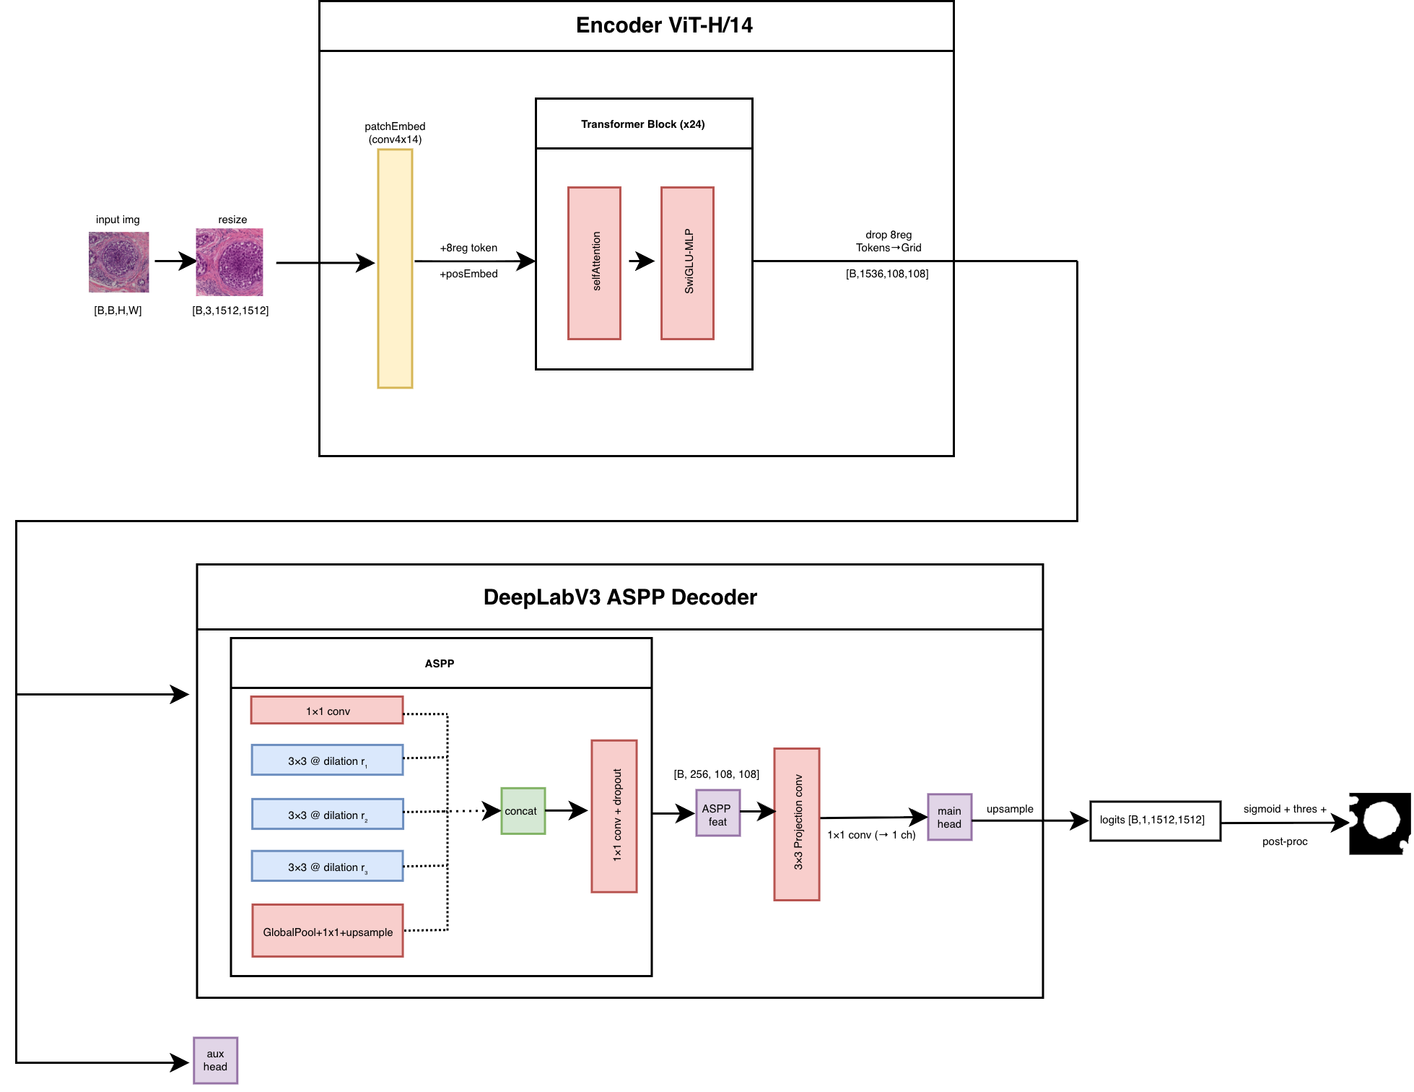
Introduction
Methodology
Results
Critical Discussion
Conclusion
Experiment 2: UNI2-H + DeepLabV3 (Auxiliary Head)
Added secondary segmentation head
Weighted auxiliary loss (λ = 0.4)
Early stopping at epoch 43, 11.64 GB per epoch
Slight improvement in training stability
But lower score: 0.8204
Notes:
Why add an auxiliary head? NO NEED FOR EXTRA
Provides extra supervision to the encoder during trainingSUPERVISION CAUSE UNI2H IS ALREADY STRONG ENOUGH.
Helps stabilize gradients in deep networks
Makes early layers learn more useful features
So attaching aux supervision to an earlier “stage” is impossible — there is no stage 3 or stage 2.
👉 That’s why your implementation attaches the AUX head to the final encoder output, which is exactly what many ViT-based segmentation papers do.
The auxiliary output is a small additional segmentation head attached to an intermediate feature layer.
It produces a second segmentation mask during training, and we add a weighted auxiliary loss (λ=0.4) to the main loss.
- NO IMPROVEMENT, likely because UNI2-h already provides stable and strong representations.

Slide 22
Introduction
Methodology
Results
Critical Discussion
Conclusion
Experiment 3: UNI2-H + Low-Resolution Fusion and DeepLabV3 Decoder
Two forward passes:
High-res path (1512×1512) → fine nuclei details
Low-res path (756×756) → tissue-level structure
Cross-attention fusion merges the two
Higher GPU use (~19.4 GB)
Best score among all models: 0.8217
Notes:
Multi-scale fusion improves domain generalization - two different kinds of visual understanding
2 LEVELS OF VISUAL INFORMATION!!!
LOW-RES-> GLOBAL STRUCTURE ISTOU
HIGH RES -> FINE NUCLEI BOUNDARIES
“This experiment introduces a dual-resolution approach to overcome a key issue in pathology segmentation: a single scale cannot capture both nuclei details and global organization.
We pass the image twice through UNI2-H: once in full resolution to preserve detail, and once in downsampled form to capture broader context.
A cross-attention block merges both representations, letting fine-grained tokens query coarse ones.
This configuration gave us the best overall COSAS score — 0.8217 — confirming that cross-scale context helps with scanner variability.
GPU memory nearly doubled, but the performance gains validated the idea.”

Slide 23
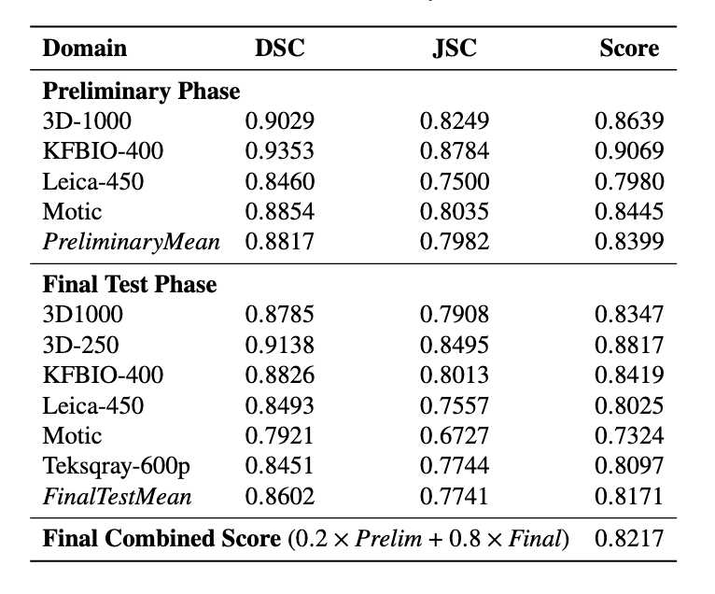
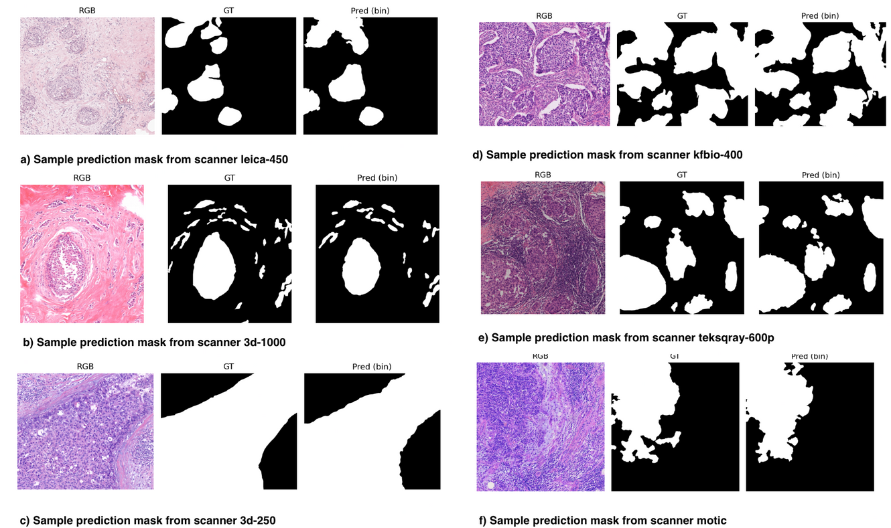
Introduction
Methodology
Results
Critical Discussion
Conclusion
Experiment 3: UNI2-H + Low-Resolution Fusion and DeepLabV3 Decoder
Notes:
“DeepLabV3 traditionally uses an auxiliary output attached to an earlier layer to stabilize gradients during training.
We tested this idea by adding an auxiliary head with a weighted combined loss.
Although training became smoother, the final score dropped slightly compared to the no-aux version. This suggests that the main UNI2-H features were already strong enough and the extra supervision did not add useful information for this dataset.”

Slide 24
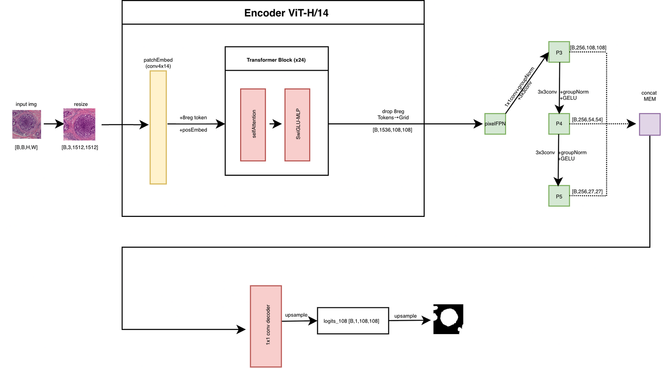
Introduction
Methodology
Results
Critical Discussion
Conclusion
Experiment 4: UNI2-H + PixelFPN + Simple 1×1 Decoder Head
Builds multi-scale features without dual forward pass
Feature pyramid levels: P3, P4, P5
Low computational cost (~11.36 GB)
Simple 1×1 conv decoder
Score: 0.8130
Notes:
SEARCHING FOR cheaper, single-pass alternative that still provides multi-scale information
PixelFPN creates three scales from the single ViT output:
P3: 108×108 (fine detail)
P4: 54×54 (medium context)
P5: 27×27 (global context)
Created by:
Strided 2×2 convolutions (downsampling)
GroupNorm + GELU at each level

Slide 25
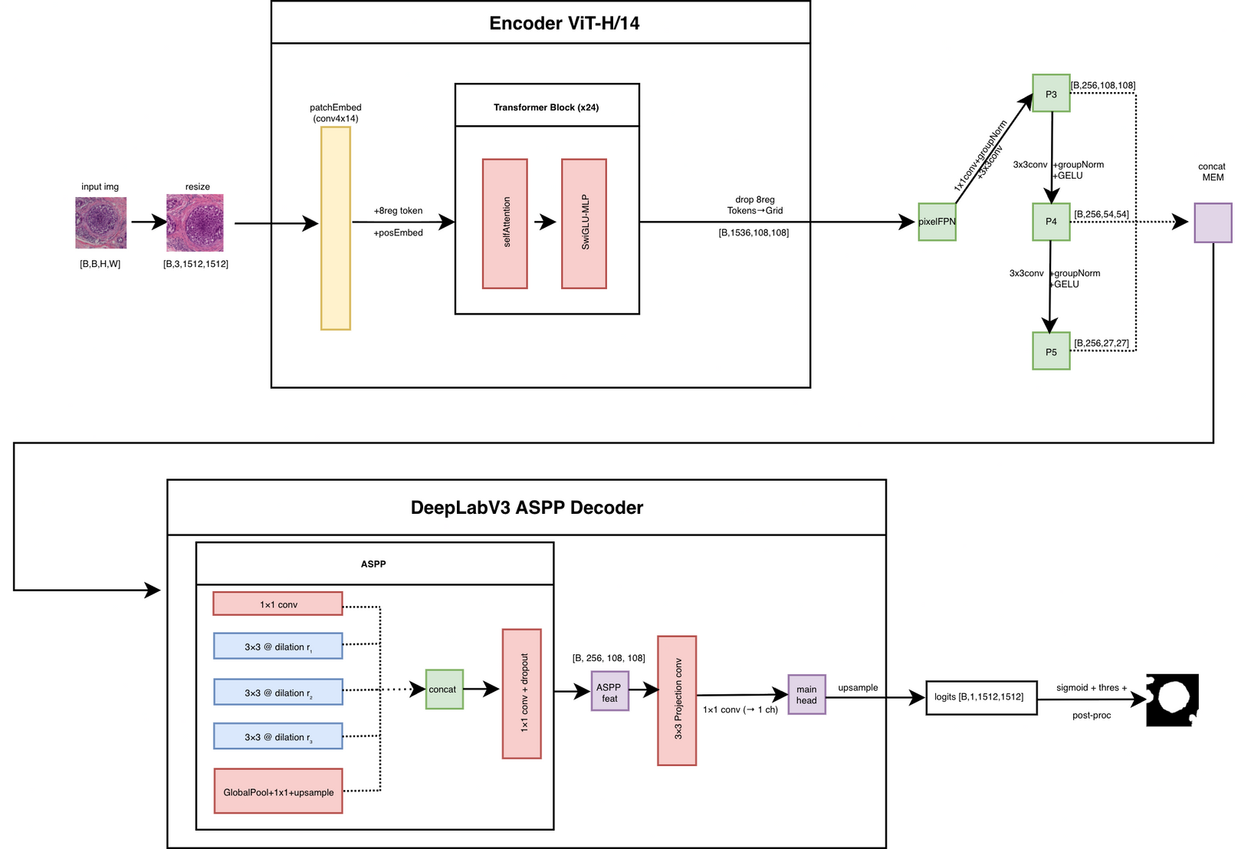
Introduction
Methodology
Results
Critical Discussion
Conclusion
Experiment 5: UNI2-H + PixelFPN + Atrous Spatial Pyramid Pooling (ASPP)
Same PixelFPN backbone, with DeepLab-style ASPP block
Slightly higher cost (~11.41 GB)
Score: 0.8129
Very similar to 1×1 head, no improvement
Notes:
“Here we check whether adding an ASPP block to the PixelFPN can recover performance losses.
The idea is that multi-dilation convolutions might give the same contextual benefits as the larger dual-resolution fusion.
Surprisingly, adding ASPP barely changed the score.
This suggests that the PixelFPN’s way of aggregating scales is already doing most of the heavy lifting, and ASPP doesn’t add much extra structure for this dataset.”

Slide 26
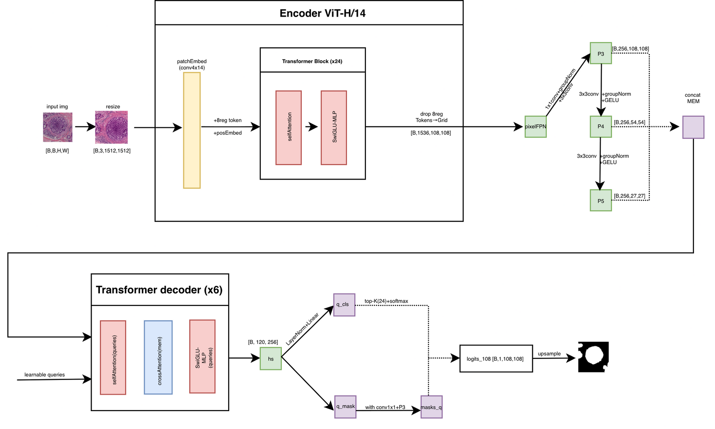
Introduction
Methodology
Results
Critical Discussion
Conclusion
Experiment 6: UNI2-H + PixelFPN + Query-Based Multi-Scale Decoder
Adds object-level reasoning (Mask2Former-style)
192 learnable queries → Top-K (64) at inference
After the decoder, each query produces:
a confidence score (“Did I find a tumor region?”)
a mask embedding (latent description of the region’s shape)
Moderate memory (15.77 GB)
Score: 0.8098
Cleaner boundaries but slightly lower metrics
Notes:
“This experiment tries a more modern, adaptive decoding strategy inspired by Mask2Former.
“Think of each query as a tiny specialist. One specializes in dense tumor clusters. Another in gland boundaries. Another in pale Leica staining. When we combine all of them, we get a robust segmentation even across scanners.
Each query produces:
a confidence score (“Did I find a tumor region?”)
a mask embedding (latent description of the region’s shape)
Only Top-K queries (64 in inference) are kept → reduces noise-> NORMALIZED WEIGHTS
Mask embeddings + P3 pixel features -> soft masks
Each query’s mask is multiplied by its weight -> MASK PROPOSAL

Slide 27
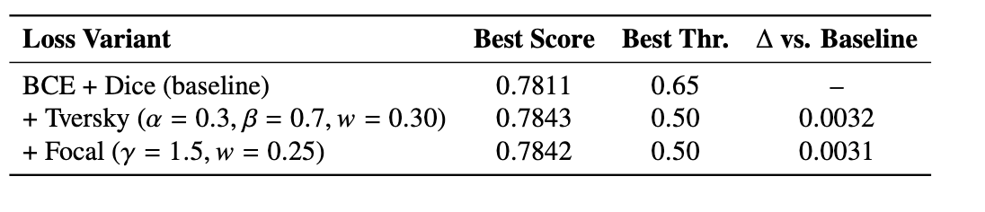
Introduction
Methodology
Results
Critical Discussion
Conclusion
Losses Experiments on best model
Notes:
“After identifying the best model, we tested several alternative losses to see if the training could become more stable or accurate.
Tversky and Focal losses only gave tiny improvements — too small to justify switching or complicating the setup.
This confirms a common trend in medical segmentation: BCE + Dice is still one of the most reliable, general-purpose formulations.”

Slide 28
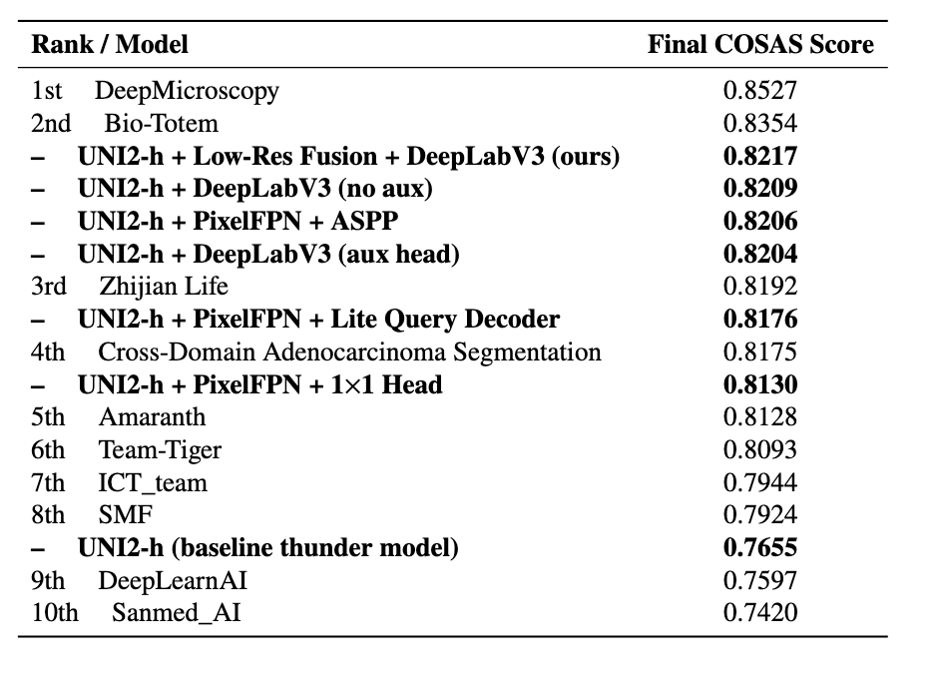
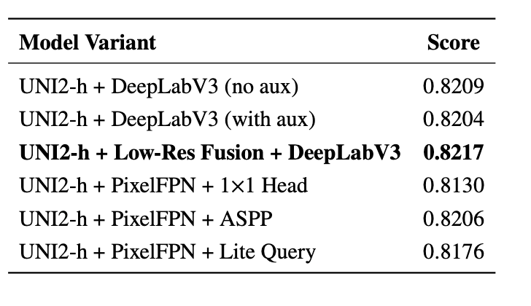
Introduction
Methodology
Results
Critical Discussion
Conclusion
Summary of results
Notes:
Best overall: Dual-Resolution Fusion + DeepLabV3
Best efficiency: PixelFPN + ASPP
Strong baseline: DeepLabV3 (no aux)
Best Performer: Dual-Resolution Fusion + DeepLabV3 (Score: 0.8217)
Runs two forward passes through UNI2-H:
High-resolution path → fine nuclei detail
Low-resolution path → global tissue structure
Cross-attention fusion allows HR tokens to request context from LR tokens
Extremely effective for pale / low-contrast scanners (Leica, Motic)
Handles ambiguous boundaries better than any other model
Shows that local + global context together is essential for robust generalization
🧱 Strong Simple Baseline: DeepLabV3 (No Auxiliary Head)
Clean, stable, and consistently strong across scanners
Auxiliary supervision did not help and slightly reduced score
Matches recent findings:
Auxiliary heads help CNN backbones,
but not ViT-based encoders like UNI2-H (already stable gradients)
A very reliable “classic” reference model

Slide 29
Introduction
Methodology
Results
Critical Discussion
Conclusion
Strengths of the Developed Approach
Fair evaluation pipeline:
Same schedule, augmentations, epochs → consistent comparisons
Powerful post-processing framework:
Multi-stage threshold search improved performance without re-training
Multi-scale reasoning as key to robustness
Strong cross-scanner performance:
Dual-Resolution Fusion + DeepLabV3 decoder → highest score (0.8217)
Notes:
“One of the biggest strengths of the thesis is the fairness of the experimental pipeline: every model was trained under identical conditions, so differences came purely from architecture.
Another strength is the multi-stage post-processing sweep, which significantly boosted results while adding interpretability.
UNI2-H proved ideal for cross-scanner tasks due to its large histology pretraining.
Finally, the dual-resolution fusion architecture showed clear benefits for scanners with difficult boundaries like Leica and Motic.”

Slide 30
Introduction
Methodology
Results
Critical Discussion
Conclusion
Limitations of the Study
Limited dataset size
180 WSIs → small for DL applications
Scanner only from one hospital
Imbalanced tumor coverage
Some scanners had much smaller tumor regions
High computational cost
Memory usage: 11-19 GB GPU depending on architecture
Post-processing based on validation set
Notes:
“Although the architectures weren't excessively heavy, GPU memory usage was still high due to 1512×1512 inputs and ViT-H/14 encoders.
Bias came from uneven scanner representation, especially in the preliminary phase, which accounts for 20% of the final score.
Static validation made experimentation faster, but post-processing might be slightly tuned to that specific distribution.
And finally, the small dataset means that random variation had more influence than ideal.”
Cached validation predictions allow fast experimentation, but tuning thresholds directly on a fixed set of probability maps can slightly overfit post-processing to that dataset

Slide 31
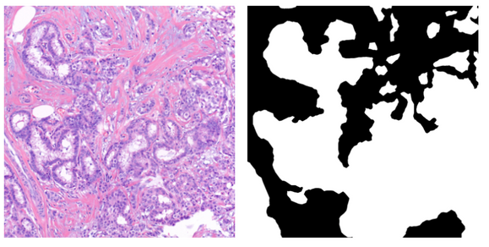
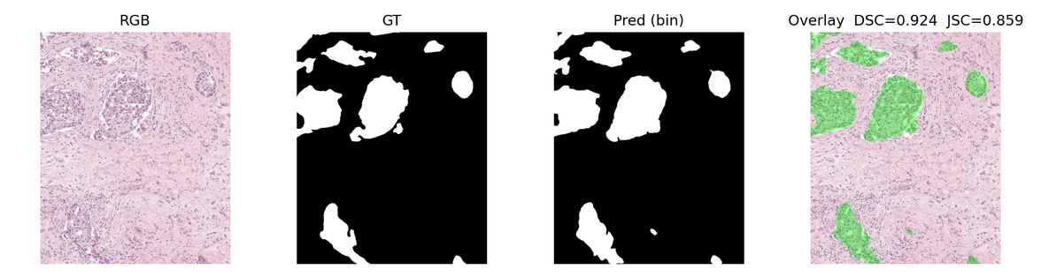
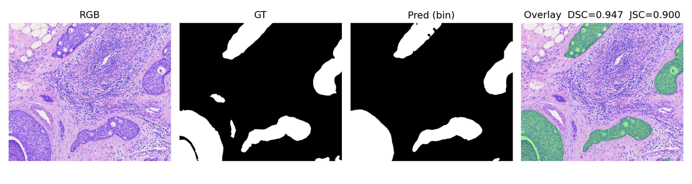
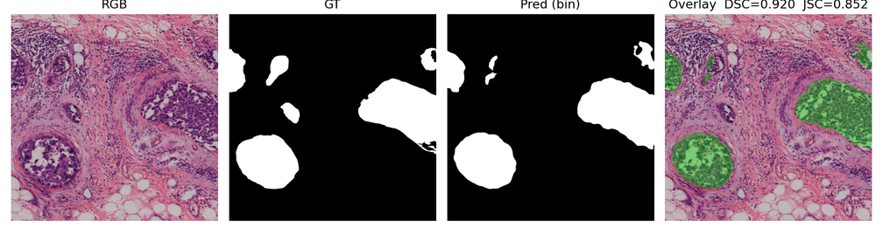
Introduction
Methodology
Results
Critical Discussion
Conclusion
Sources of Bias
Sample image and ground truth from 3d-250
Tumor coverage variation
Larger tumors in 3D-Histech / 3D-250
Smaller in Leica, Motic, Teksqray
Stain & intensity variation
Bright scanners calibrate better
Dim/pale scanners → more smoothing errors
Global augmentations
Same augmentations applied to all scanners → not domain-specific
Validation-tuned post-processing
Calibration favors dominant scanners
Sample image and ground truth from leica
Sample image and ground truth from motic
Sample image and ground truth from teksqray
Notes:
“Scanner imbalance strongly shaped performance:
- scanners with bright stains and high tumor ratio naturally gave higher Dice/Jaccard
Because color augmentations were global, the model may have been unintentionally biased toward bright domains like 3D-1000.
Also, tuning thresholds on validation data means dominant scanners influenced calibration more than rare ones.
This does not affect relative model comparison, but it may shift absolute scores.”

Slide 32
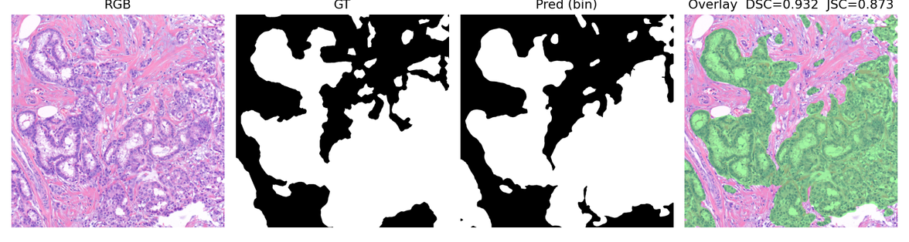
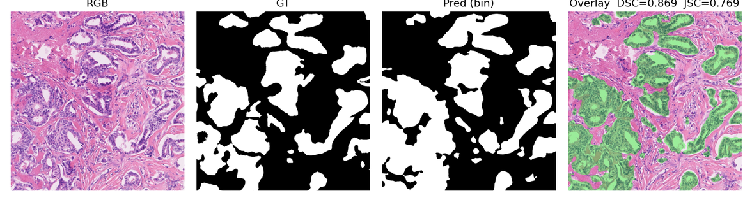
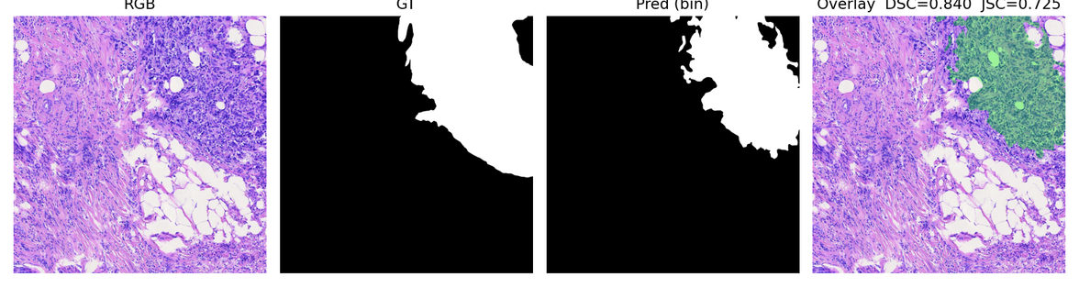
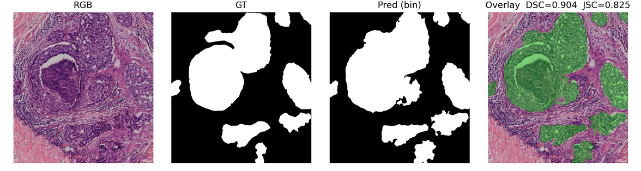
Introduction
Methodology
Results
Critical Discussion
Conclusion
Cross-Scanner Performance
Example prediction from 3d-250
Best performance:
3d-250 & 3d-1000 (bright, warm staining)
Middle performance:
KFBIO-400 (stable illumination, seen in training)
Hardest scanners:
Leica-450 & Motic (pale or dim staining, low tumor content)
Special case:
Teksqray-600p (high contrast, sharp boundaries)
Example prediction from kfbio-400
Example prediction from motic
Example prediction from teksqray
Notes:
⚖️ Mid-Performing Scanner: KFBIO-400
Medium-intensity, stable staining
Seen during training → well calibrated
Balanced tumor presence
Performance stays consistent across all architectures
DeepLab
ASPP
PixelFPN
Query decoder
Shows that when calibration is good, architecture matters less
Motic
Darker, bluish hue
Lower contrast between tumor and stroma
Hard for the model to separate regions
Tends to under-segment nuclei
🔍 Special Case: Teksqray-600p
Very high contrast, extremely sharp nuclei
Tumor boundaries are already well defined
Simpler decoders (PixelFPN + 1×1) perform better than complex ones
Reason:
Clean logits threshold perfectly
No need for heavy multi-scale reasoning
Demonstrates that high-contrast scanners reward simpler models

Slide 33
Introduction
Methodology
Results
Critical Discussion
Conclusion
Contributions and Future Work
Main Contributions
Architectural Study - Pathology Foundation Model (UNI2-h) + Deeplabv3, ASPP, PixelFPN, Transformer decoders
Cross-Scanner Generalization - robust results on unseen domains
Domain-Specific Insights - scanner color/contrast affects segmentation
Efficient Design - 11 GB VRAM
Reproducible Pipeline - unified loss, scheduler, post-processing
Future Work
Increase dataset diversity (institutions, scanners, staining)
Stain augmentation (HED jitter)
Self-supervised fine-tuning on new hospital data
Efficient inference for clinical deployment
Notes:
HED JITTER->
Hematoxylin (H) – blue/purple nuclei
Eosin (E) – pink cytoplasm
DAB (D) – brown stain in immunohistochemistry (often 0 in pure H&E)
HED jitter augmentation means:
Convert RGB → HED stain space
Randomly perturb each stain channel
Convert back to RGB

Slide 34
Introduction
Methodology
Results
Critical Discussion
Conclusion
References
[1] C. McGenity et al. “Artificial intelligence in digital pathology: a systematic review and meta-analysis of diagnostic test accuracy.” npj Digital Medicine 7 (2024).
[2] World Health Organization. “Breast Cancer: Fact Sheet.” 2022.
[3] Bo Jiang et al. “Deep learning applications in breast cancer histopathological imaging: diagnosis, treatment, and prognosis.” Breast Cancer Research 26 (2024).
[4] S. R. Duenweg et al. “Whole slide imaging (WSI) scanner differences influence optical and computed properties of digitized prostate cancer histology.” Journal of Pathology Informatics 14 (2023), p. 100321.
[5] Karin Stacke et al. “Measuring domain shift for deep learning in histopathology.” IEEE Journal of Biomedical and Health Informatics 25.2 (2020), pp. 325–336.
[6] David Tellez et al. “Quantifying the effects of data augmentation and stain color normalization in convolutional neural networks for computational pathology.” Medical Image Analysis 58 (2019), p. 101544.
[7] Chuanyun Xu et al. “Stain Normalization of Histopathological Images Based on Deep Learning: A Review.” Diagnostics 13.21 (2023), p. 3405.
[8] Kaiming He et al. “Masked Autoencoders Are Scalable Vision Learners.” CVPR (2022). arXiv:2111.06377.
[9] Maxime Oquab et al. “DINOv2: Learning Robust Visual Features without Supervision.” arXiv:2304.07193 (2023).
[10] Richard J. Chen et al. “Towards a General-Purpose Foundation Model for Computational Pathology.” Nature Medicine (2024). arXiv:2307.14324.
[11] Eric Zimmermann et al. “Virchow2: Scaling Self-Supervised Mixed Magnification Models in Pathology.” arXiv:2408.00738 (2024).
[12] Liang-Chieh Chen et al. “Rethinking Atrous Convolution for Semantic Image Segmentation.” arXiv:1706.05587 (2017).
[13] Reza Azad et al. “TransDeepLab: Convolution-Free Transformer-based DeepLab v3+ for Medical Image Segmentation.” arXiv:2208.00713 (2022).
[14] Tsung-Yi Lin et al. “Feature Pyramid Networks for Object Detection.” arXiv:1612.03144 (2017).
[15] Bowen Cheng et al. “Masked-Attention Mask Transformer for Universal Image Segmentation.” arXiv:2112.01527 (2022).
Notes:
Main Contributions
UNI2-H worked very well for cross-scanner tumor segmentation → Scores >0.81, close to top COSAS teams
Fair experiments: all models trained with the same setup → Differences came from architecture, not randomness
Scanner-by-scanner analysis → Bright scanners (3D-1000, 3D-250) perform best → Pale/dark scanners (Leica, Motic) are hardest
Good balance of accuracy + efficiency → All models fit in 11–19 GB VRAM, inference still practical
Strong post-processing pipeline → Threshold + morphology sweep improved results without retraining
Modular framework → Can extend to stain normalization, domain adaptation, or WSI-level work
Future Work
Use multi-institution, multi-scanner datasets → Better domain robustness
Add stain normalization / domain calibration → Reduce scanner differences
Move to WSI-level models → Better tissue-level understanding
Self-supervised adaptation for new hospitals → Works with unlabeled slides
Optimize model efficiency → Quantization, distillation, lighter architectures

Slide 35
Introduction
Methodology
Results
Critical Discussion
Conclusion
References
[16] Frauke Wilm et al. “Domain and Content Adaptive Convolutions for Cross-Domain Adenocarcinoma Segmentation.” arXiv:2409.09797 (2024).
[17] Huang Jiayan et al. “Domain-stratified Training for Cross-organ and Cross-scanner Adenocarcinoma Segmentation in the COSAS 2024 Challenge.” arXiv:2409.12418 (2024).
[18] Pengzhou Cai et al. “Cross-Organ and Cross-Scanner Adenocarcinoma Segmentation using Rein-to-Fine-tune Vision Foundation Models.” arXiv:2409.11752 (2024).
[19] Pierre Marza et al. “THUNDER: Tile-level Histopathology Image UNDERstanding Benchmark.” arXiv:2507.07860 (2025).
Notes:
Main Contributions
UNI2-H worked very well for cross-scanner tumor segmentation → Scores >0.81, close to top COSAS teams
Fair experiments: all models trained with the same setup → Differences came from architecture, not randomness
Scanner-by-scanner analysis → Bright scanners (3D-1000, 3D-250) perform best → Pale/dark scanners (Leica, Motic) are hardest
Good balance of accuracy + efficiency → All models fit in 11–19 GB VRAM, inference still practical
Strong post-processing pipeline → Threshold + morphology sweep improved results without retraining
Modular framework → Can extend to stain normalization, domain adaptation, or WSI-level work
Future Work
Use multi-institution, multi-scanner datasets → Better domain robustness
Add stain normalization / domain calibration → Reduce scanner differences
Move to WSI-level models → Better tissue-level understanding
Self-supervised adaptation for new hospitals → Works with unlabeled slides
Optimize model efficiency → Quantization, distillation, lighter architectures

Slide 36
Thank You

