Slide 1
Alcohol, Income and Life Expectancy
Life expectancy per country in correlation of alcohol consumption and income
Team members
Mixalis Kontis
Panagiotis Apostolou

Slide 2
What is the purpose of this presentation?
In this presentation we will analyze:
How the life expectancy of each country changes per decade
How is the income distributed each decade
Which countries consume the most/least alcohol
Make a summary if alcohol consumption and income affects
life expectancy

Slide 3
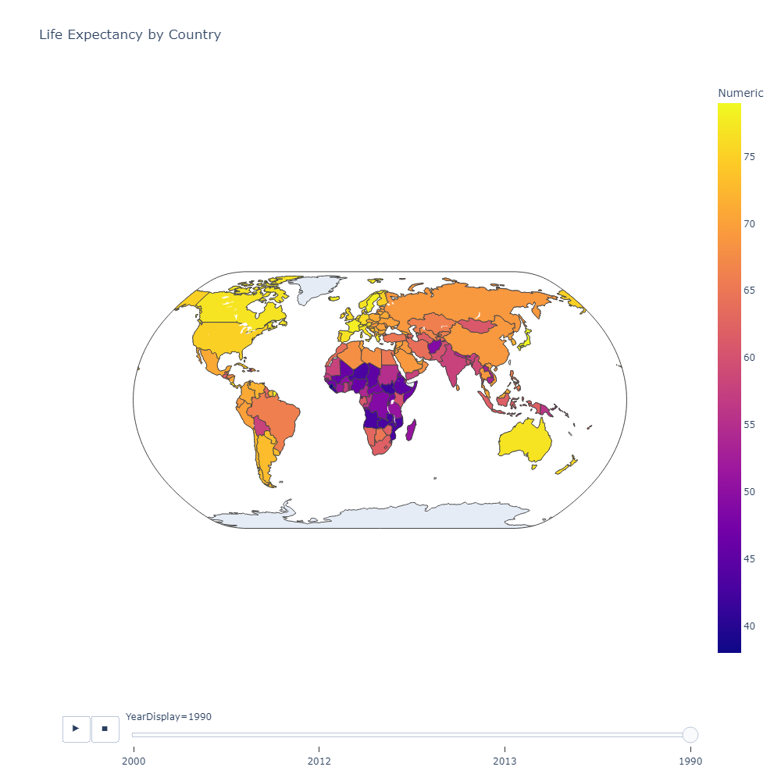
Life Expectancy Year 1990
In this slide we observe the life expectancy of each country for the year 1990

Slide 4
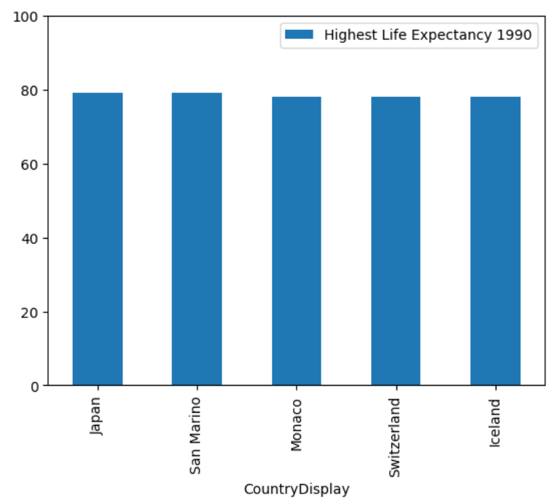
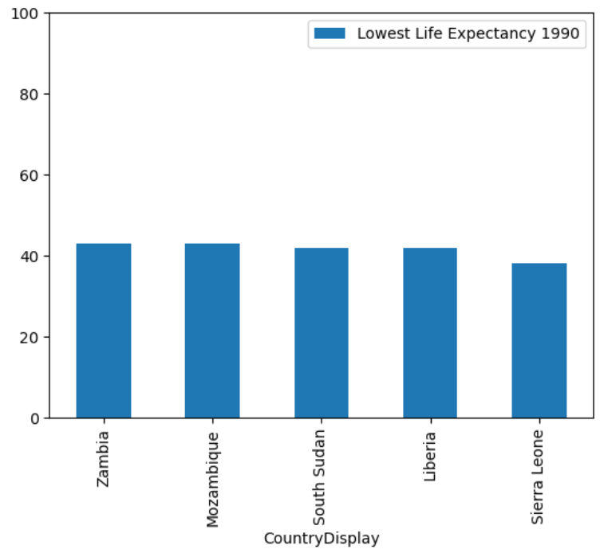
Life Expectancy of year 1990
Top 5 countries
Bottom 5 countries

Slide 5
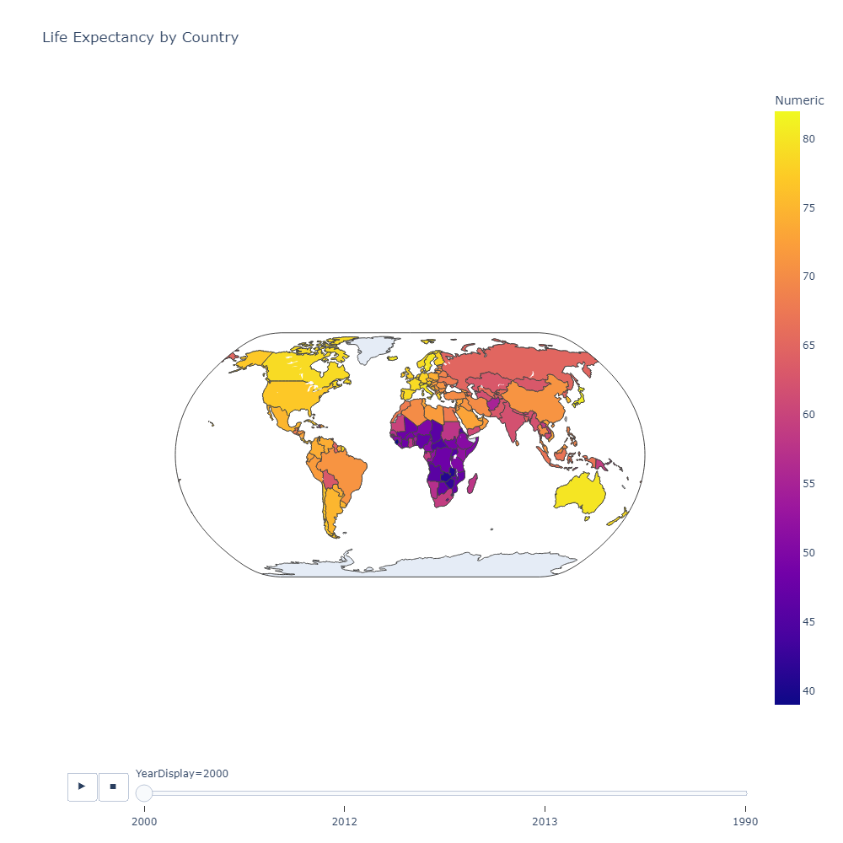
Life Expectancy Year 2000
In this slide we observe the life expectancy of each country for the year 2000

Slide 6
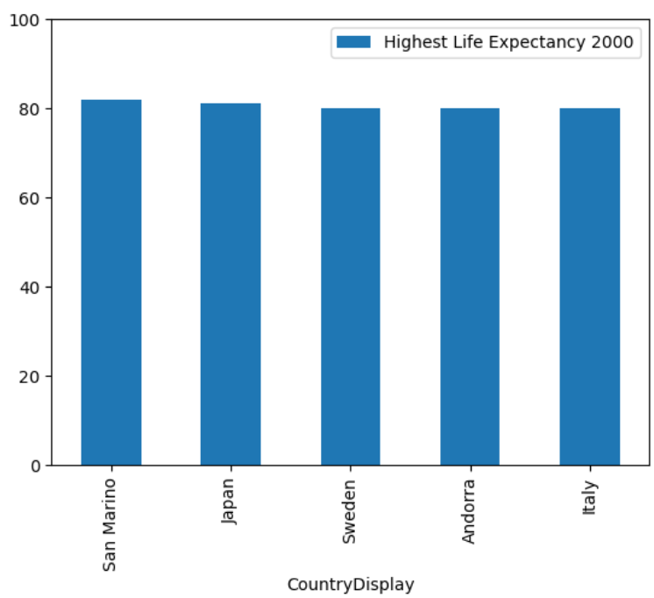
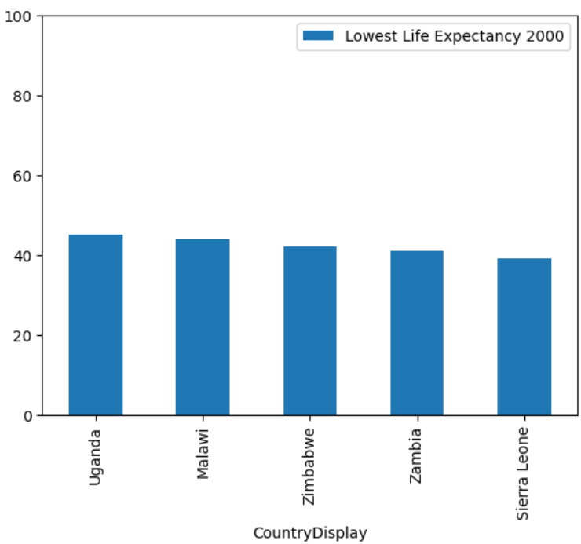
Life Expectancy of year 2000
Top 5 countries
Bottom 5 countries

Slide 7

Life Expectancy Year 2013
In this slide we observe the life expectancy of each country for the year 2013

Slide 8
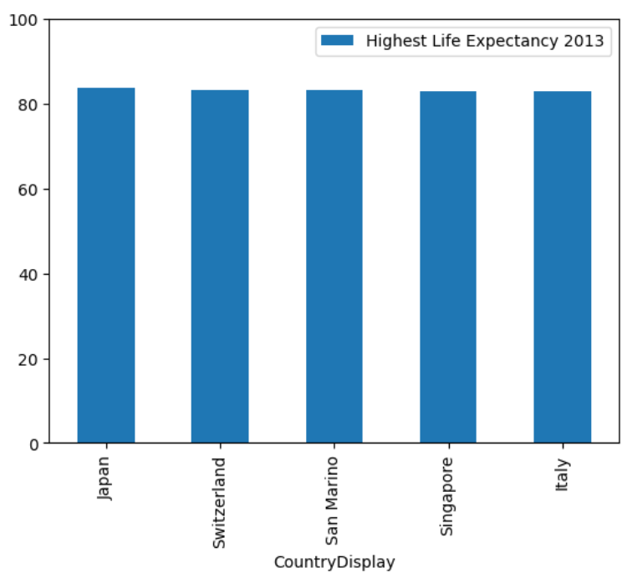
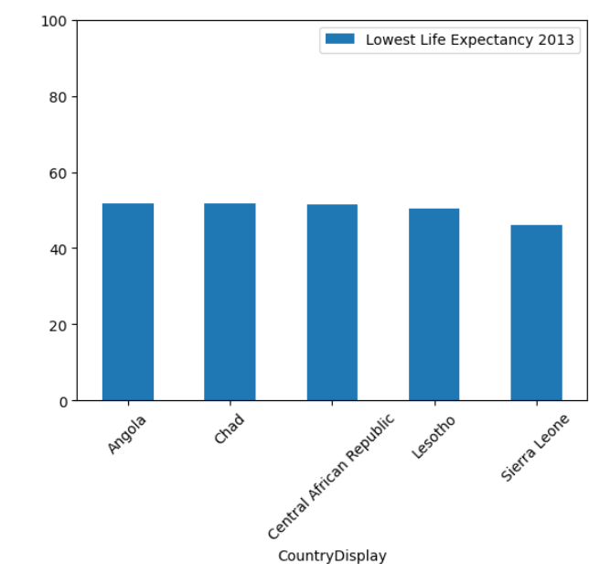
Life Expectancy of year 2013
Top 5 countries
Bottom 5 countries

Slide 9
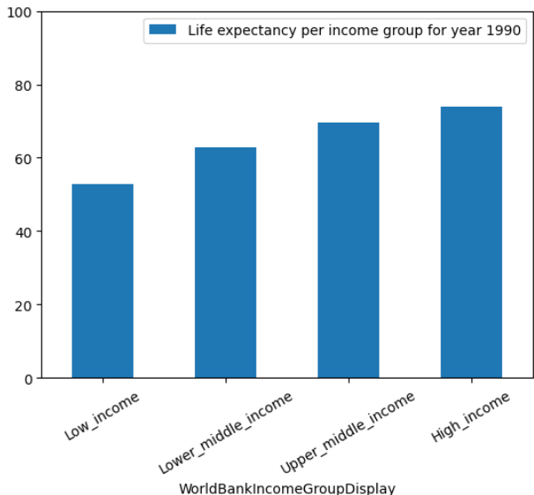
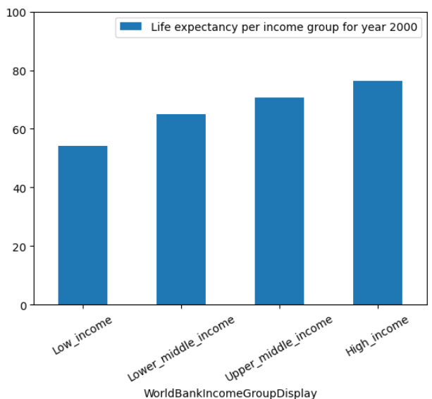
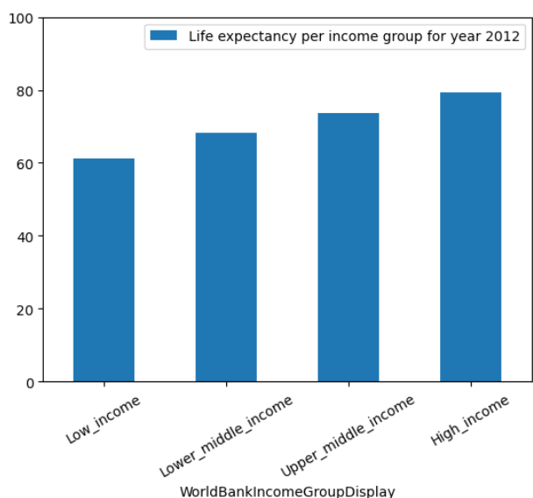
Below we can see the life expectancy according to income for 1990, 2000 and 2012 respectively

Slide 10
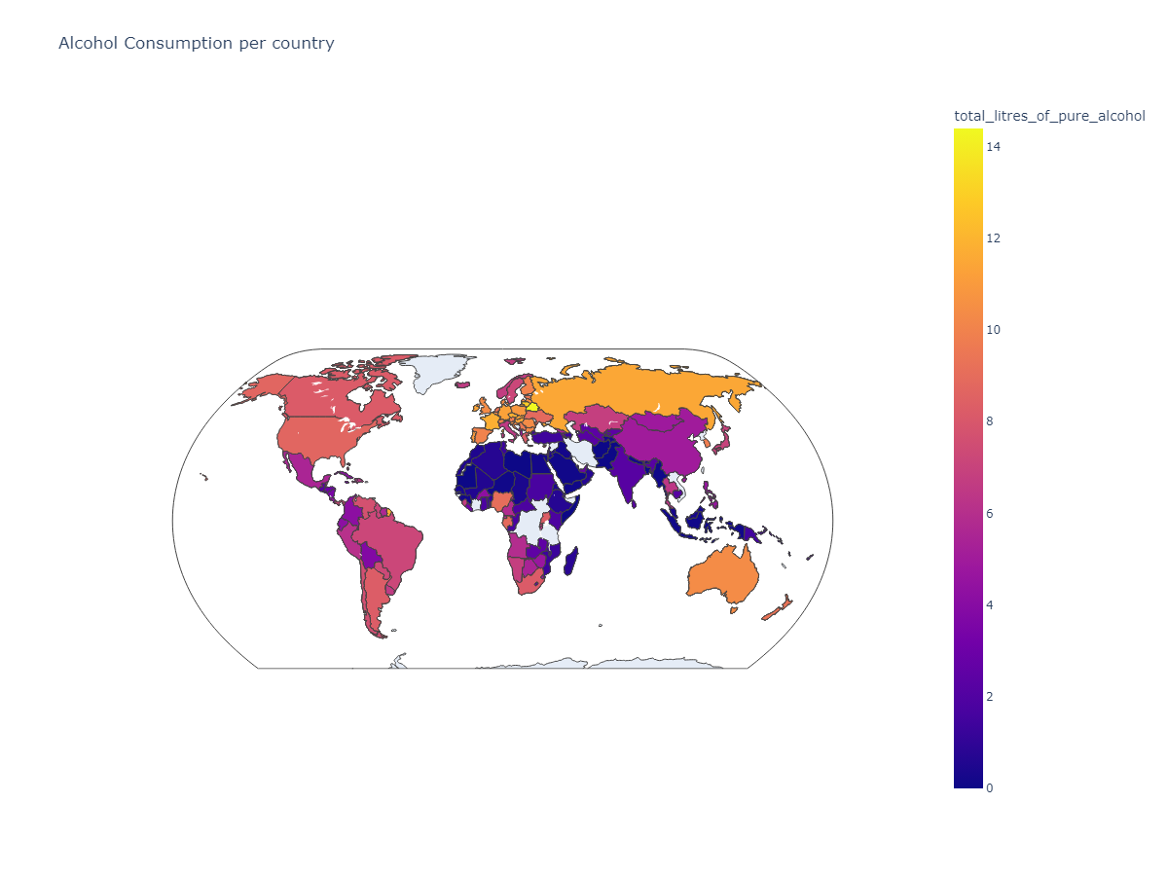
Alcohol consumption per country
In this slide we observe the alcohol consumption of each country

Slide 11
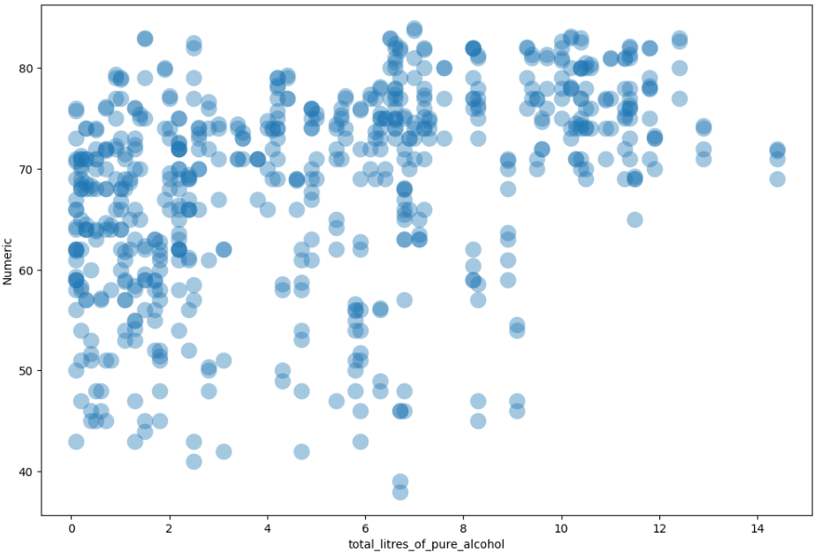
Alcohol consumption in accordance to life expectancy
Scatter plot of alcohol consumption and life expectancy

Slide 12
Summary
What we observed from the presentation:
The life expectancy for each country did not change that much from 1990 to 2013
The top 5 countries at life expectancy remained the same for the most part through the years. The same applies for the bottom 5 countries as well
The life expectancy for those with low income has increased with higher rate through the decades in comparison with those belonging at the other income groups.
From the scatter plot we come in conclusion that the amount of alcohol consumption is not the primary reason that may affect life expectancy.

