Slide 1
Sentiment Analysis - Twitter
Team 2
Rajesh
Vivek Pruthi
Jyothi Pulimamidi
Murali Korrapati

Slide 2
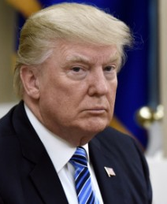
Donald J Trump - @realDonaldTrump
“CONFEFE”
“Fake News”
“great”
“America/American”
“News/media”
“Jobs”
“Today”

Slide 3
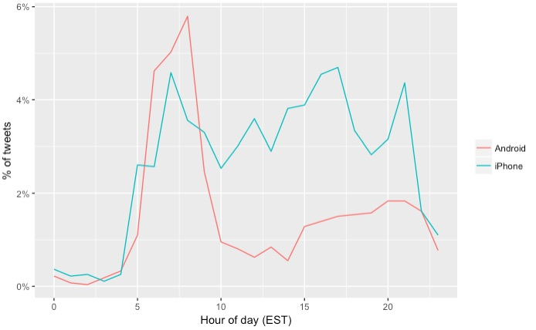
What’s going on?
Trump uses Android phone but his staff use iPhone to tweet on his behalf
He is more active with this handle than with @POTUS
He is more active in the morning hours usually

Slide 4
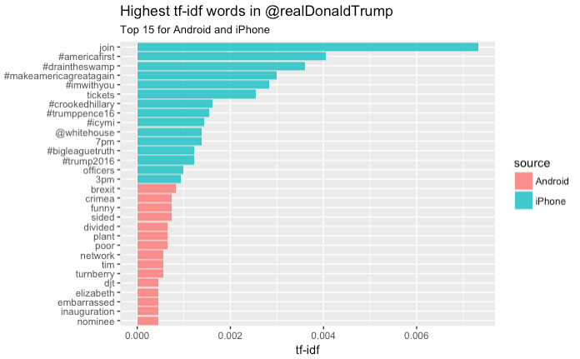
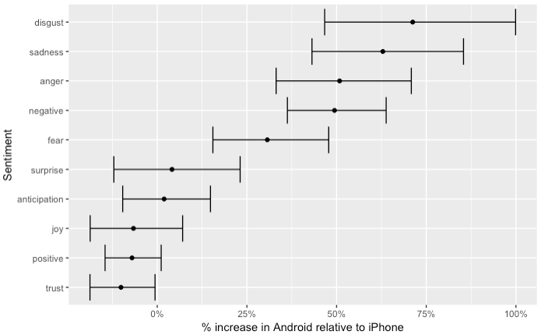
Sentiment of his tweets?

Slide 5
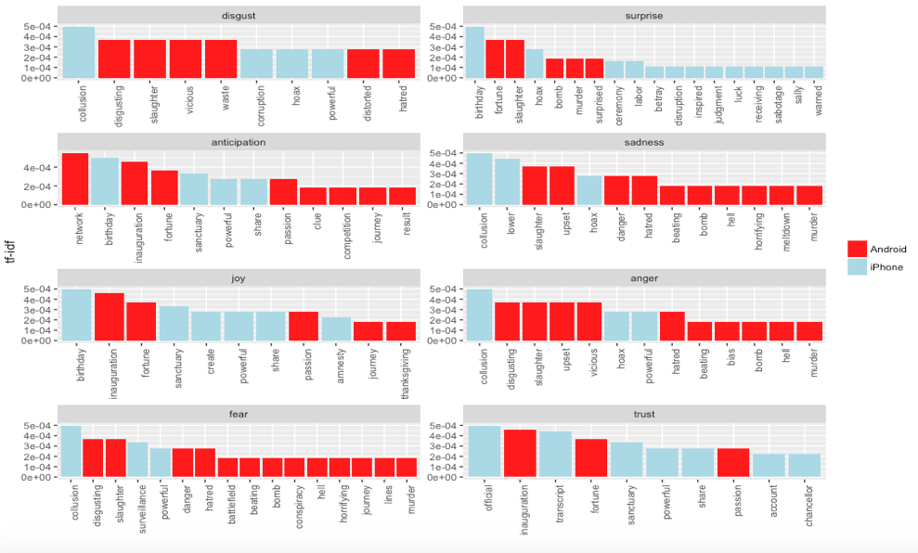
Which words he is more likely to use?

Slide 6
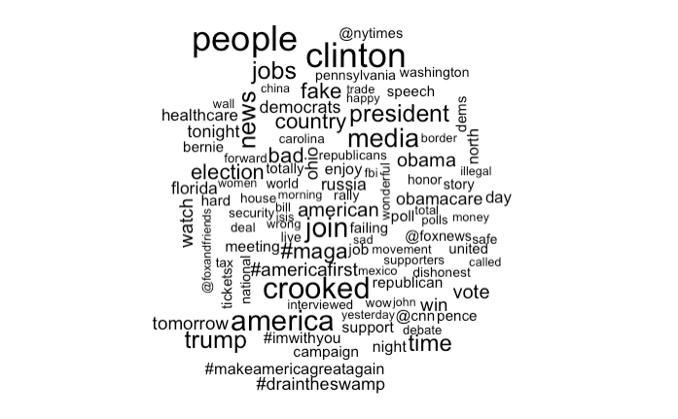
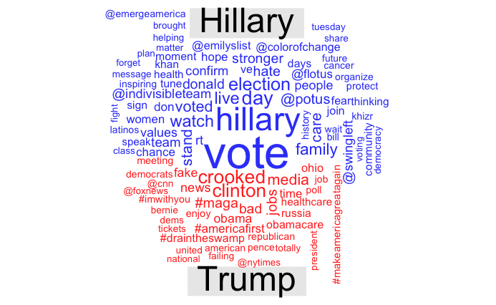
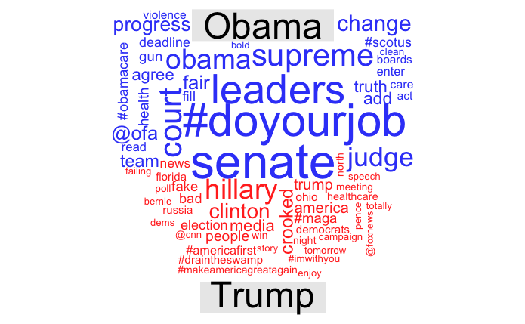
How he compares to others?

Slide 7
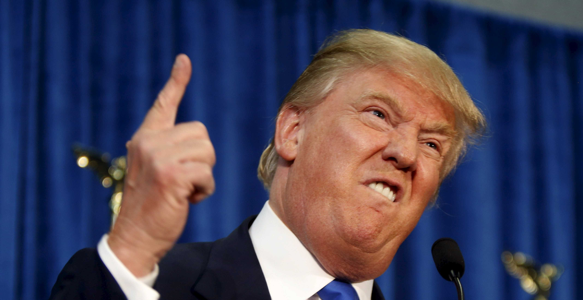
“Fake News”
Will he agree?

