Slide 1
Sentiment Analysis twitter
Technical Presentation
Rajesh
Vivek Pruthi
Jyothi Pulimamidi
Murali Korrapati

Slide 2
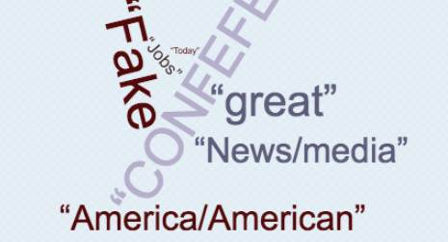
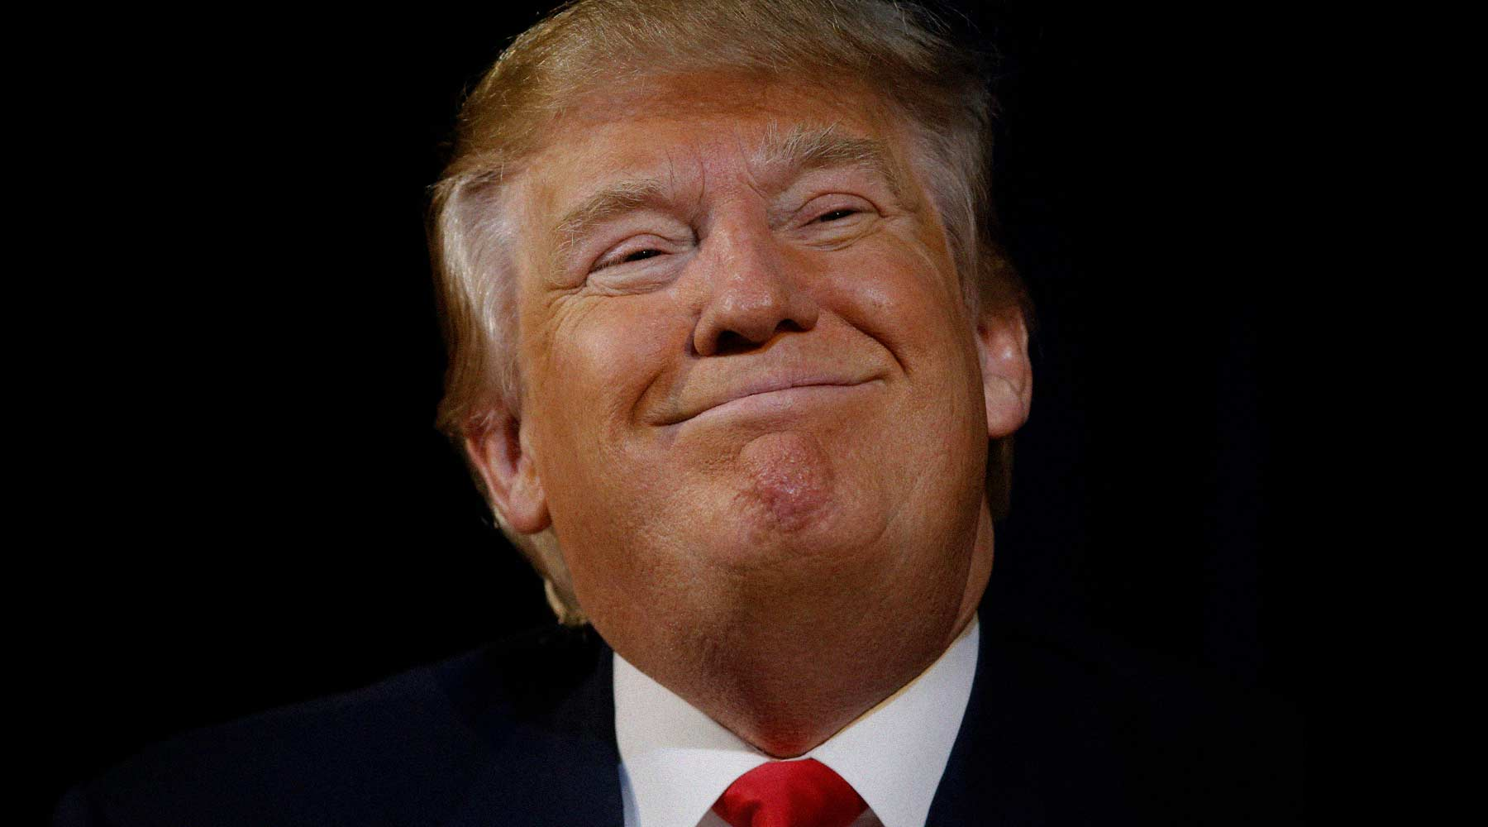
What is it?
Trump is very famous for his angry tweets
Does he tweet himself or others?
What’s the sentiment of it?
How he compares to others?

Slide 3
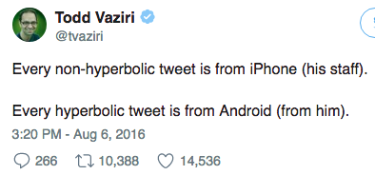
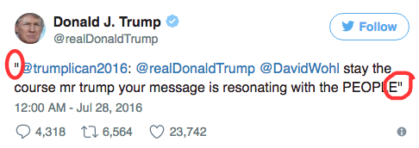
Facts
We analyzed his last 3200 tweets
He has around 35M followers
He uses Android phone to tweet
But his staff also tweets from his handle - @realDonaldTrump
He manually retweets other people’s tweets by copying and pasting them in quotes

Slide 4
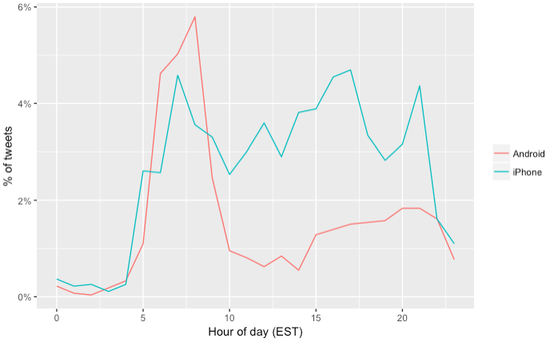
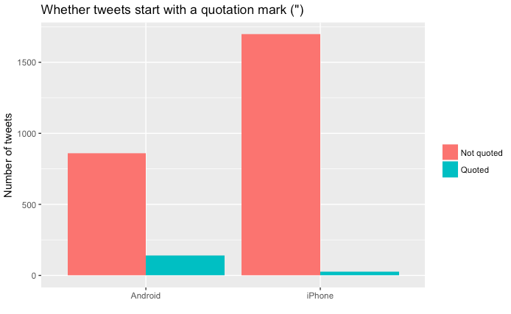
When is he active?
Quick break down of his tweets by source
He is more active in the morning time
Another way to find out if it is “real” realDonaldTrump is, looking at his manual retweets

Slide 5
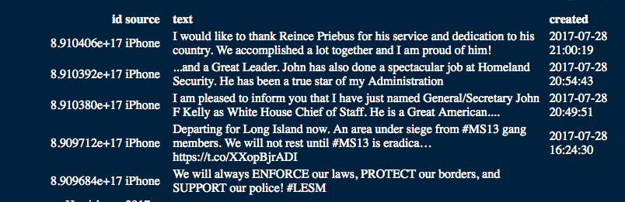
Libraries used and sample
library(tidyverse) | library(broom)
library(lubridate) | library(scales)
library(tidytext) | library(twitteR)
library(stringr) | library(wordcloud)
library(reshape2)

Slide 6
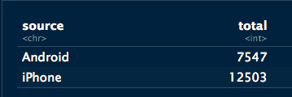
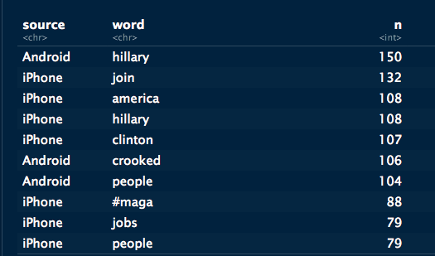
Tweets breakdown
Tweets break down by phone
Only ~37% of tweets are from “real” @realDonaldTrump
Top words used by Android(Trump) and iPhone(staff)

Slide 7

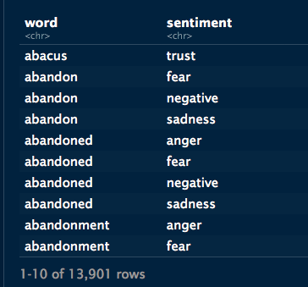
Sentiment Analysis
We used ‘nrc’ lexicon to analyze sentiment

Slide 8
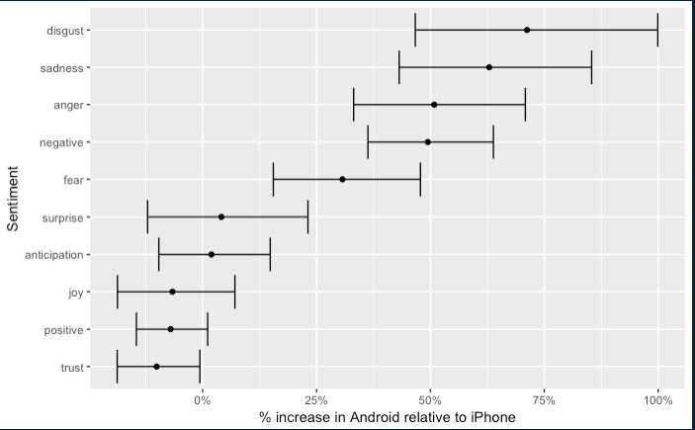
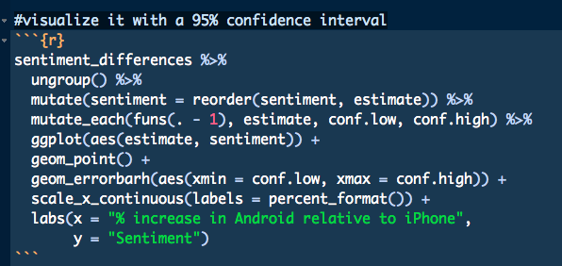
Visualizing with 95% confidence

Slide 9
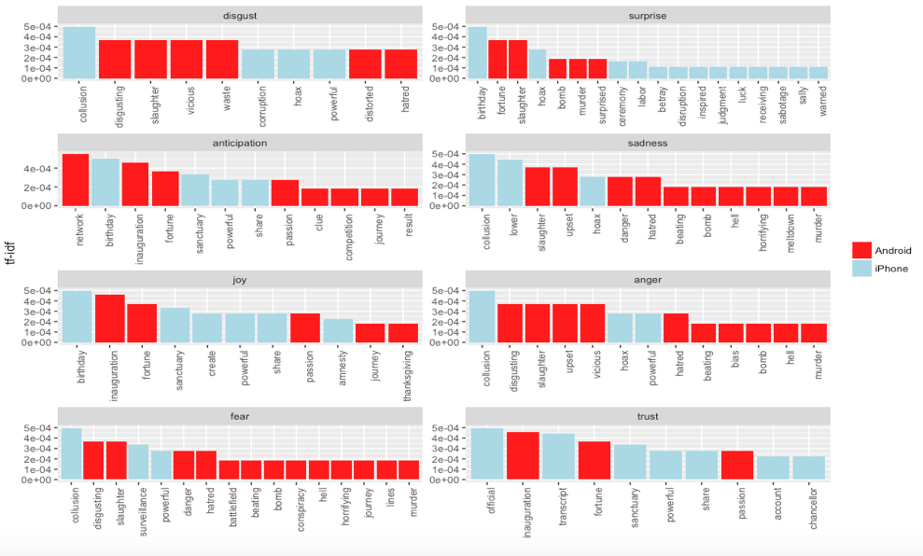
Words that contribute to –ve sentiment

Slide 10
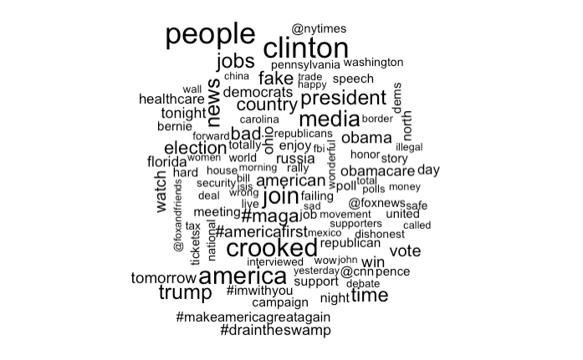
Word cloud - Trump

Slide 11
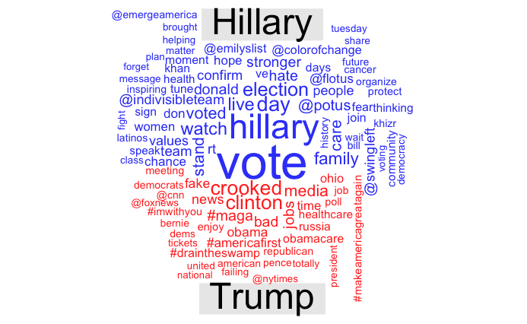
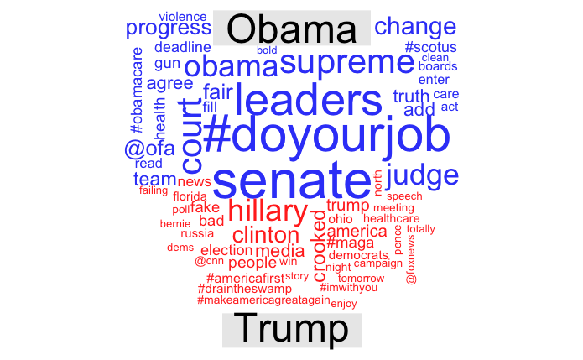
How he compares to others?

