Slide 1
Creating a dynamic asset allocation strategy based on economic regime similarity
Matt Kosik

Slide 2
Asset Allocation: the $100 Trillion Problem
What is asset allocation?
What are my choices?
How is my allocation determined?
Notes:
Industry size estimate at $100 trillion in 2020 (from PWC: https://www.pwc.com/gx/en/industries/financial-services/asset-management/publications/asset-management-2020-a-brave-new-world.html)

Slide 3
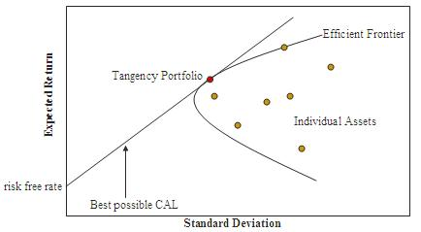
The Asset Allocation Problem
Modern Portfolio Theory
(Markowitz 1952)
Maximize Return per Risk
Mean-Variance Optimization
Max Sharpe = Tangency Portfolio

Slide 4
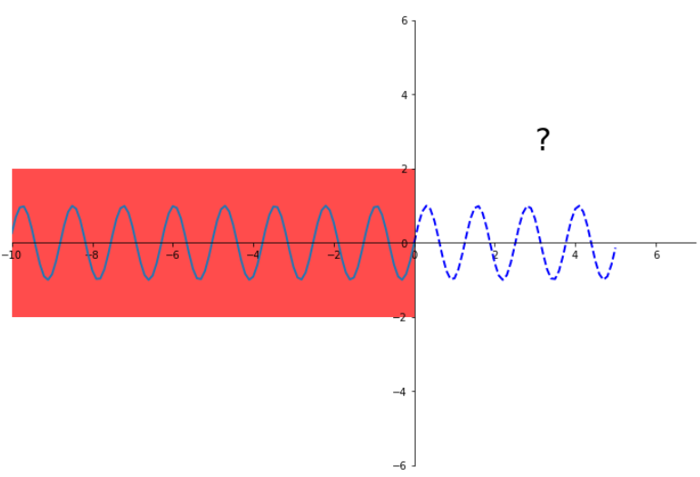
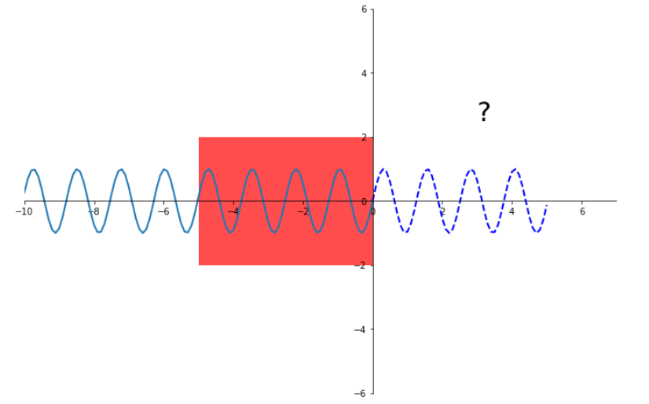
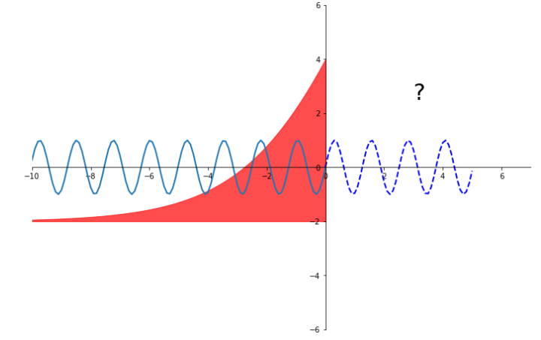
How to Estimate Future Return and Risk?
Use the past!
But how? – Currently, very arbitrary
Full History
n # of Years
Exponentially Weighted

Slide 5
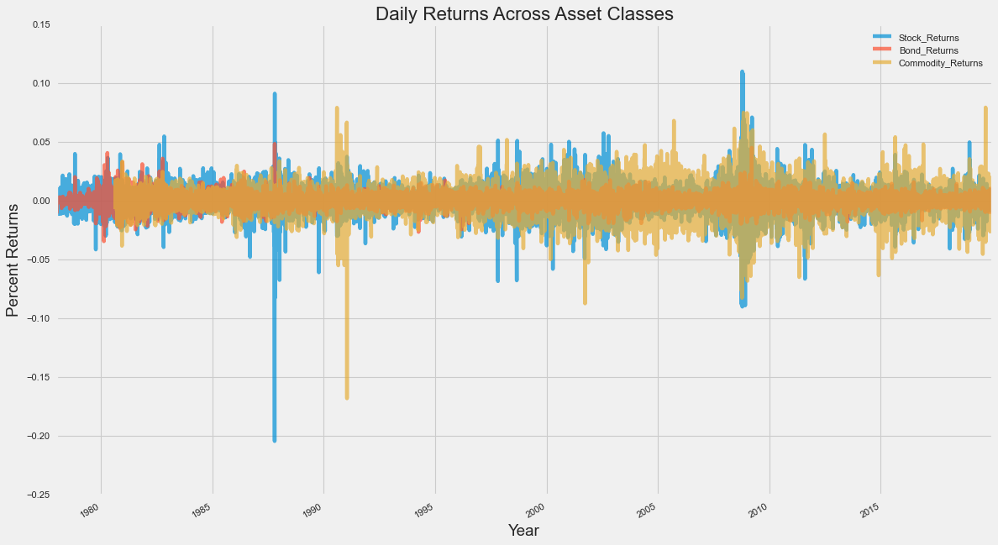
The Data – Asset Classes
Equities
S&P 500 index
Bonds
Total return 10y Treasury
Commodities
GSCI (Goldman Sachs Commodity Index)
Data via FRED, Yahoo Finance, and Koyfin.com

Slide 6
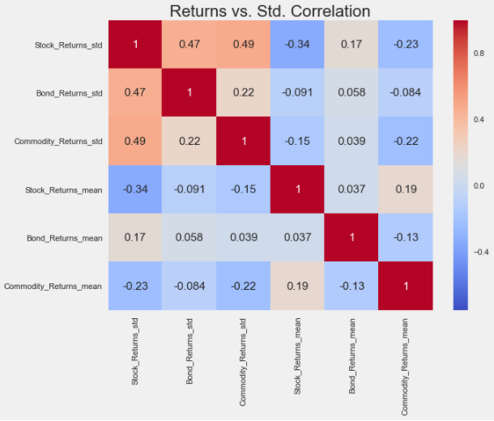
The Data – Asset Classes
Negative correlation between Return mean vs. Return std. for Equities and Commodities
Indirectly incorporate this information into model

Slide 7
The Data – Economic Variables
Labor Market
Unemployment Rate
Non Farm Payrolls
Prices
Core PCE Rate
Core CPI
U Mich. Inflation Expectations
Business
Industrial Production
ISM PMI Composite
Consumer/Housing
U Mich. Consumer Sentiment
Housing Starts
Market Rates
3 Month Yield
10y – 2y Treasury Curve
5y5y Forward Treasury Rate
Data via FRED and Quandl

Slide 8
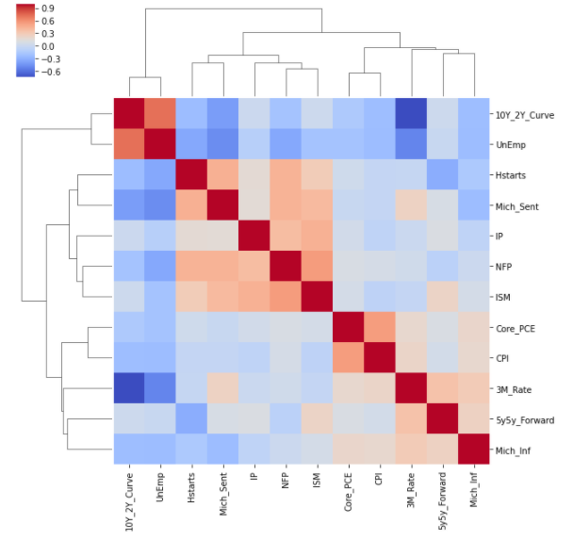
The Data – Economic Variables
12 variables: (1980-2019)
+ 3y trailing Z-Score, each
+ Change of Z-Score, each
36 features, ∼475 months
Training set = 1980-2005
Test set = 2006-2019

Slide 9
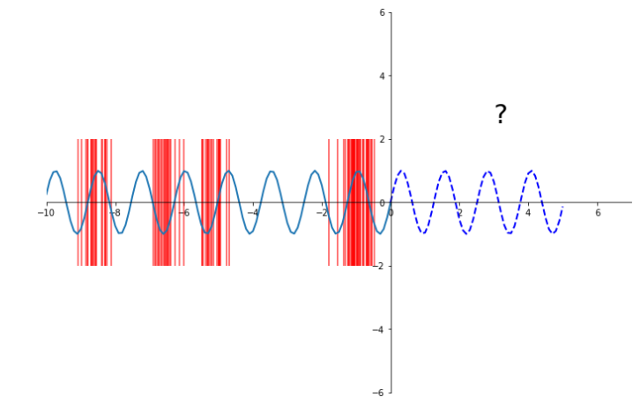
Proposed Methodology
Determine economically similar historical periods vs. today
Use only those periods to estimate future parameters
Nearest Neighbor Algorithm

Slide 10
Proposed Methodology
At the end of each month, compile all economic indicators and perform the appropriate feature transformations
Calculate similarity of the recent month to each historical month
Based on distance, group N nearest neighbor months of historical returns into subset
Calculate mean and standard deviation of daily asset returns from subset
Construct portfolio weights
5a. If recent return volatility > max volatility threshold: Minimum Variance Construction
5b. If recent returns volatility < max volatility threshold: Max Sharpe Construction

Slide 11

Additional Constraints
No short sales
No leverage
Fully invested (sum of weights =1)
Minimum weight per asset = 10%
Max Sharpe:
$$\operatorname{maximize}{\frac{μ^{T}w}{w^{T}Σw}}$$
Min Variance:
$$minimize w^{T}Σw$$

Slide 12
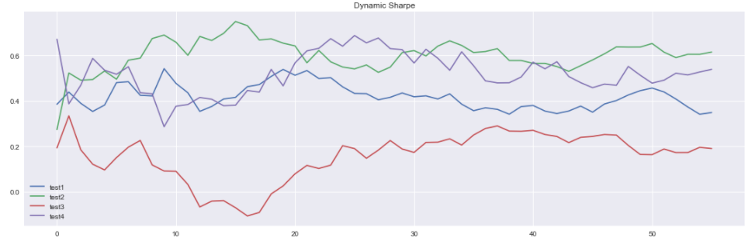
Hyperparameter Tuning
Determine N number of months to include in subset
Separate training set into training + validation
N = 36, good balance between performance and stability

Slide 13
Testing
Compare proposed Dynamic Algorithm against two competitors
Traditional Base Portfolio – 60% Equity, 30% Bonds, 10% Commodities
Static Optimal Training Portfolio
Mean-Variance Sharpe optimization over entire training set, constant weights

Slide 14
Results
Proposed Dynamic Algorithm outperforms across many measures
 | Dynamic Algo | Base Weights | Static Optimal Training Portfolio
CAGR | 5.36% | 5.57% | 3.60%
Returns | 5.43% | 6.09% | 3.71%
Std | 6.45% | 11.57% | 5.87%
Sharpe | 0.842 | 0.527 | 0.632
Max Drawdown | -13.4% | -38.6% | -16.8%
Sortino | 1.229 | 0.734 | 0.914
Calmar | 0.400 | 0.144 | 0.214

Slide 15
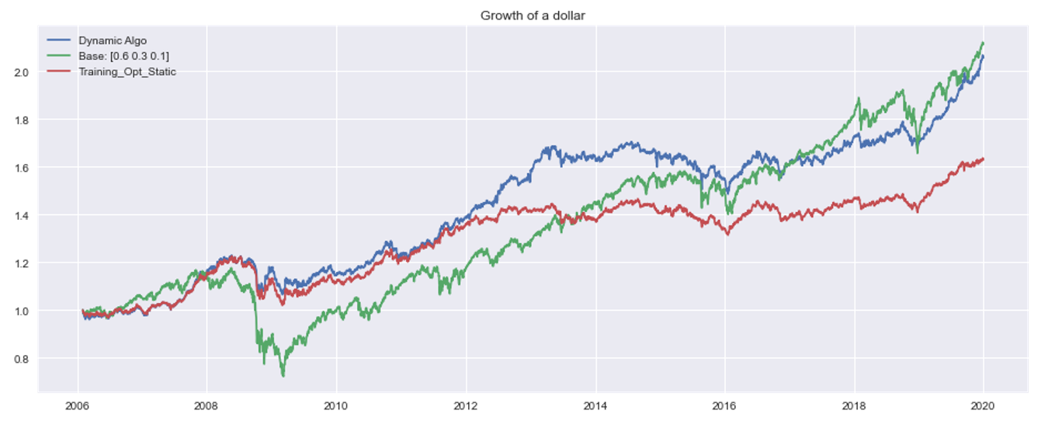
Results – Growth of a Dollar

Slide 16
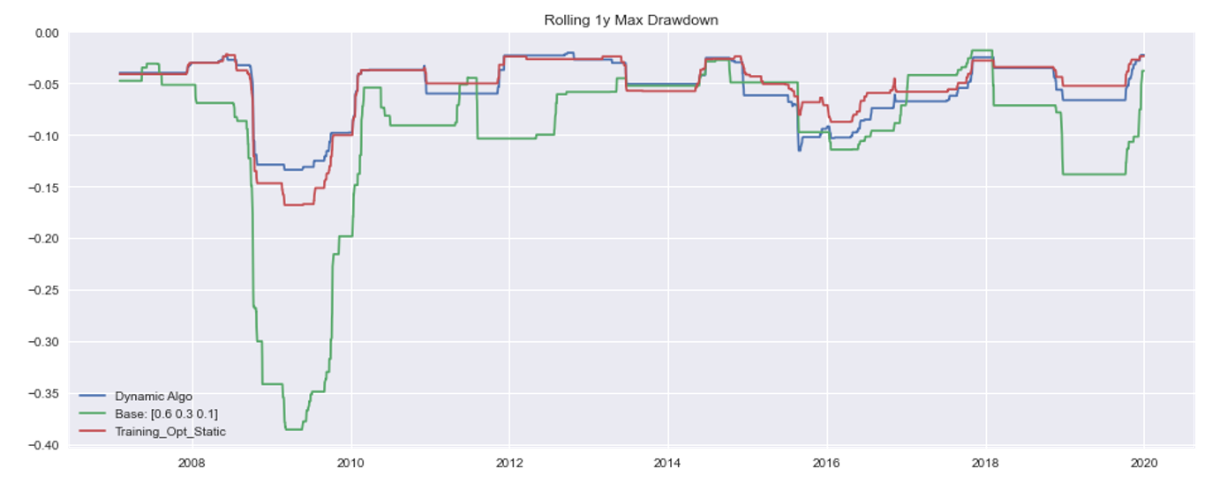
Results – Max Drawdown

Slide 17
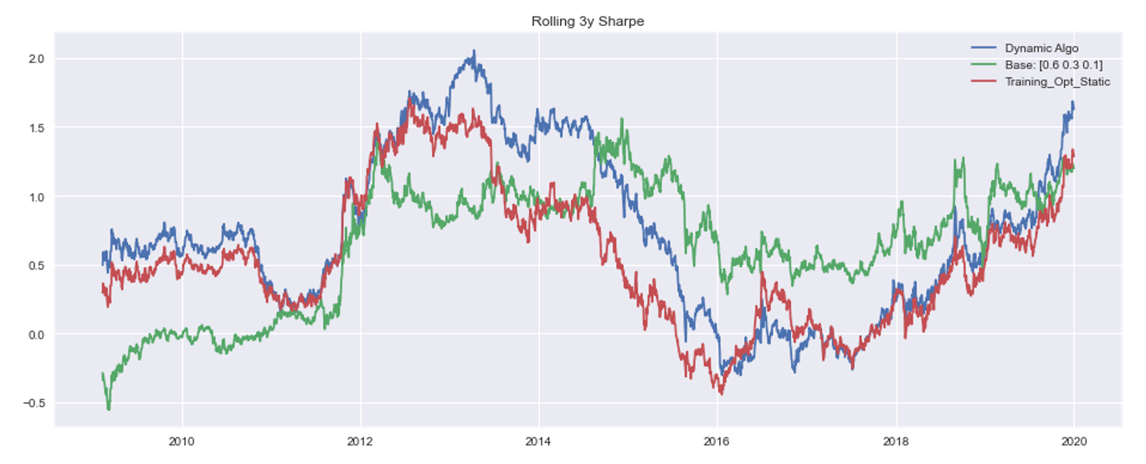
Results – Rolling Sharpe

Slide 18
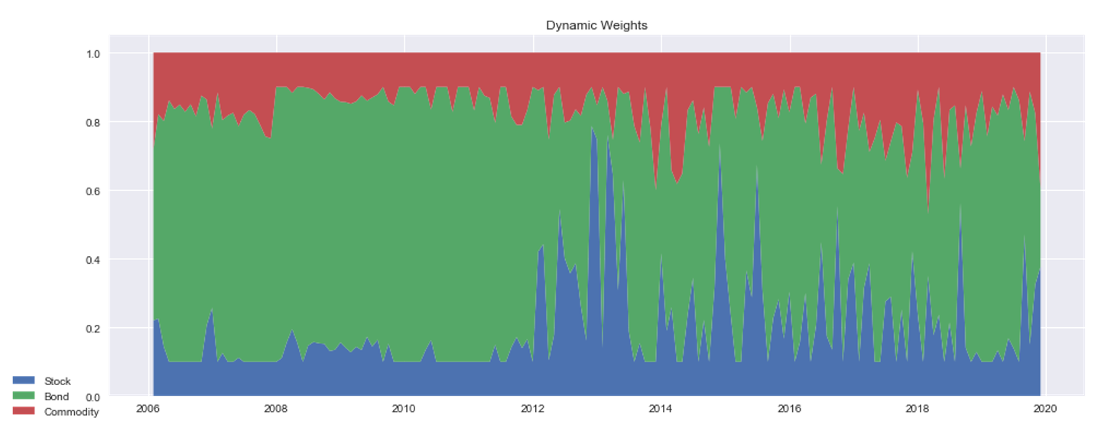
Results – Actual Weights

Slide 19
Conclusion & Extensions
Simple Dynamic Algorithm outperforms tradition portfolio
Dynamic Algorithm outperforms best possible static portfolio
Dynamic Sharpe = .842 vs. ex-post static Sharpe = .819
Future considerations:
Turnover transaction cost
Expanding training window
Bayesian approach (Black-Litterman model)
Additional estimate to take into account potential Sharpe

